Slide 1
Course 8: Intelligent Decision Support Systems
Suriya Jirasatitsin, Warapoj Meethom, Thitipoing Jamrus

Slide 2
Module 2: Software Tools for IDSS Development
The analytic hierarchy process (AHP)
R-software
RapidMiner
WEKA
Deep Learning for Smart Production

Slide 3
RapidMiner
ข้อที่ดีของซอฟต์แวร์ RapidMiner Studio X
รองรับการใช้งานไฟล์ได้หลายประเภท เช่น ไฟล์ Excel 2007
สามารถแสดงข้อมูลได้หลายรูปแบบ เช่น scatter plot 3D
สามารถแสดงผลโมเดลที่สวยงามและแก้ไขการแสดงผลให้สามารถอ่านได้ง่ายขึ้น
สามารถบันทึกไฟล์โมเดลออกเป็นไฟล์ภาพประเภทต่างๆ เช่น PNG, JPG หรือ PDF
มีวิธีการเตรียมข้อมูล (preprocess) และการวิเคราะห์ได้หลากหลายรูปแบบ
ไม่ต้องเขียนโค้ด
http://dataminingtrend.com/2014/rapidminer-studio/chapter1/

Slide 4

RapidMiner

Slide 5
Why RapidMiner
RapidMiner’s data science platform delivers lightning fast business impact for over 40,000+ organizations in every industry to drive revenue, reduce costs, and avoid risks.
https://rapidminer.com/why-rapidminer/

Slide 6
Why RapidMiner
Old Way
Slow to predict opportunities & risk
Highly specialized expertise
Opaque modeling
Legacy fragmented tools
Vendor lock-in
RapidMiner Way
Lightning fast business impact
Depth for data scientists, simplified for everyone else
Full transparency & governance for machine learning
End-to-end collaboration platform
Open source & extensible

Slide 7
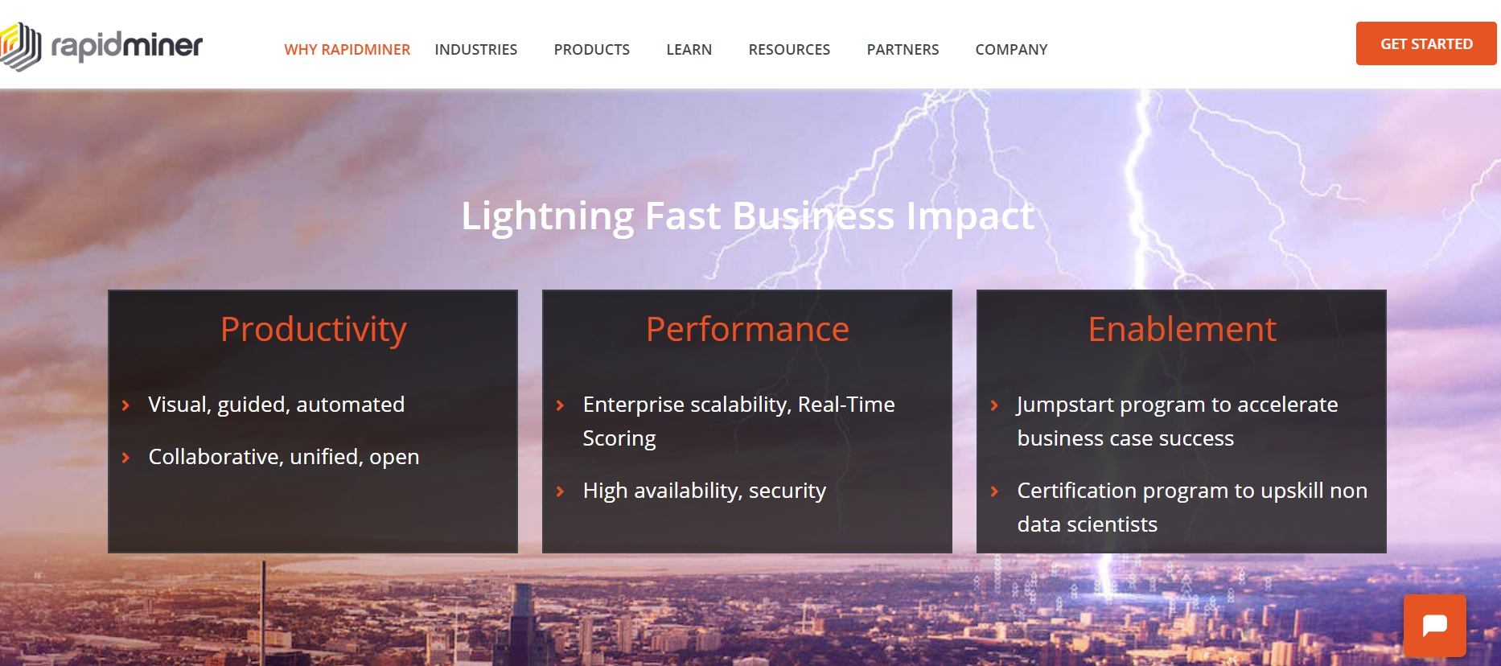
RapidMiner

Slide 8
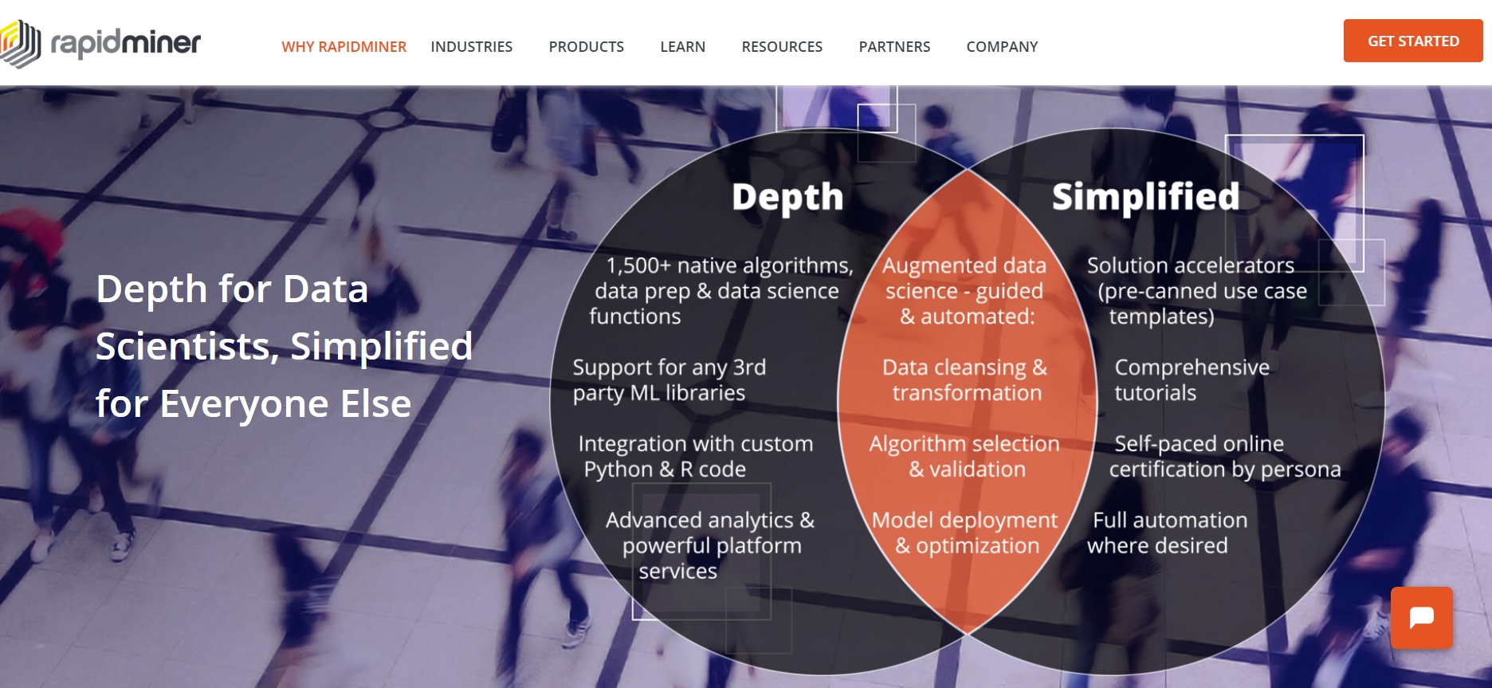
RapidMiner

Slide 9
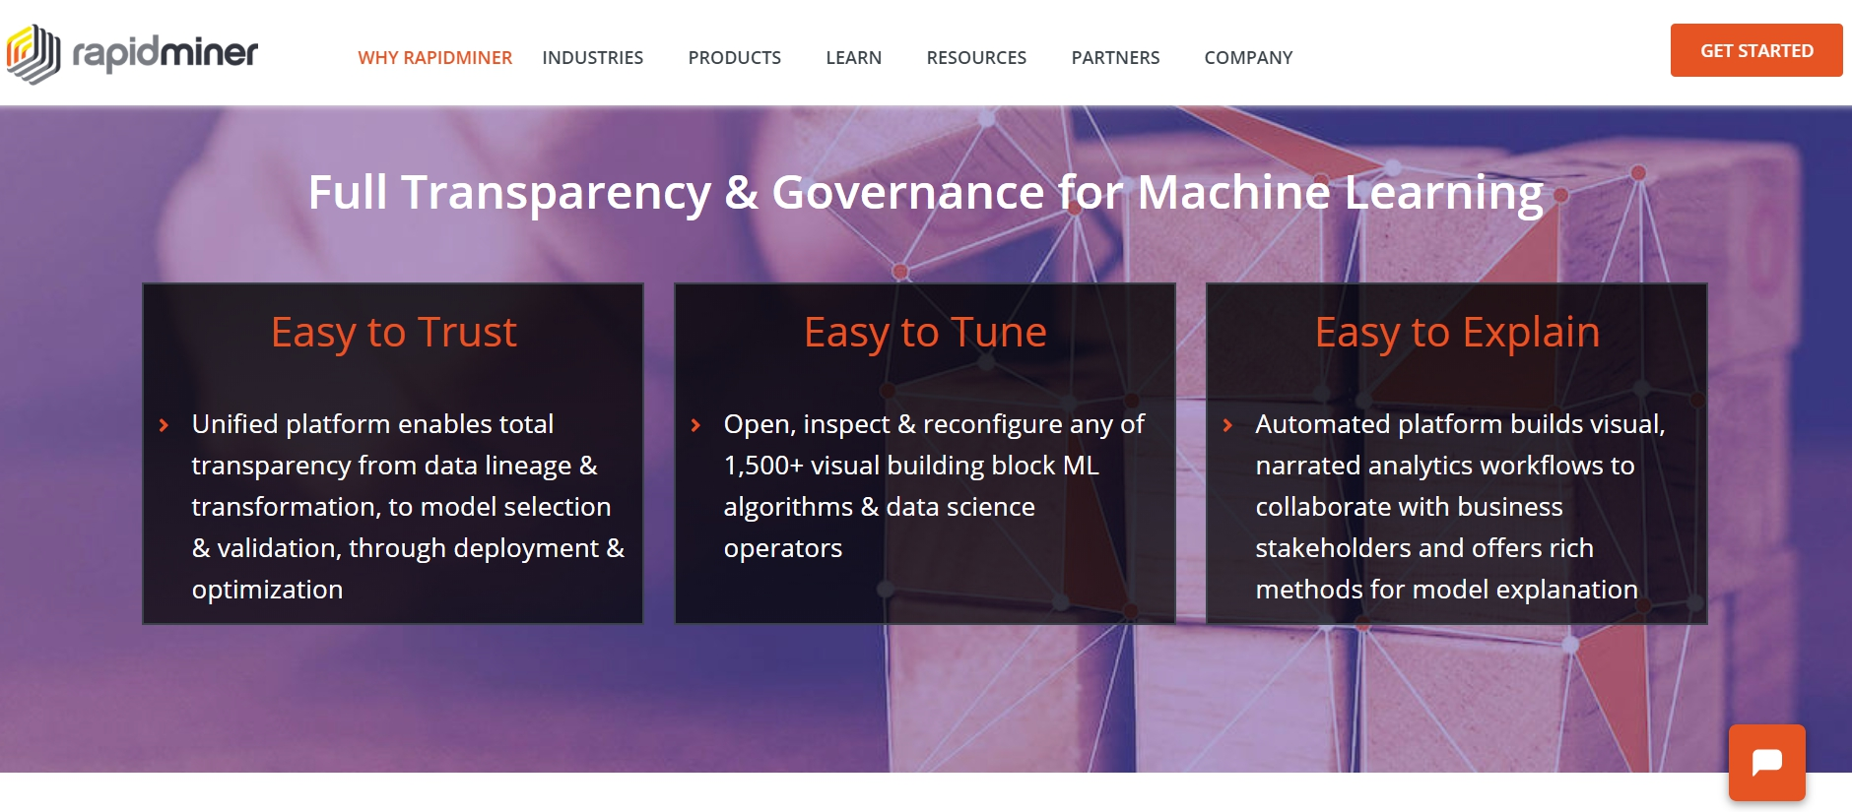
RapidMiner

Slide 10
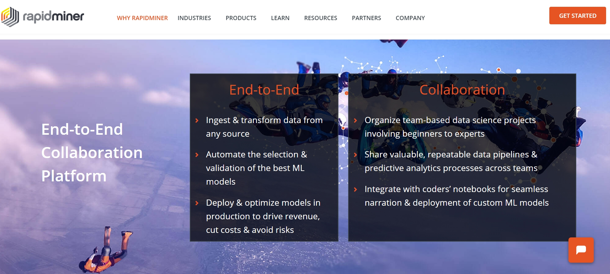
RapidMiner

Slide 11
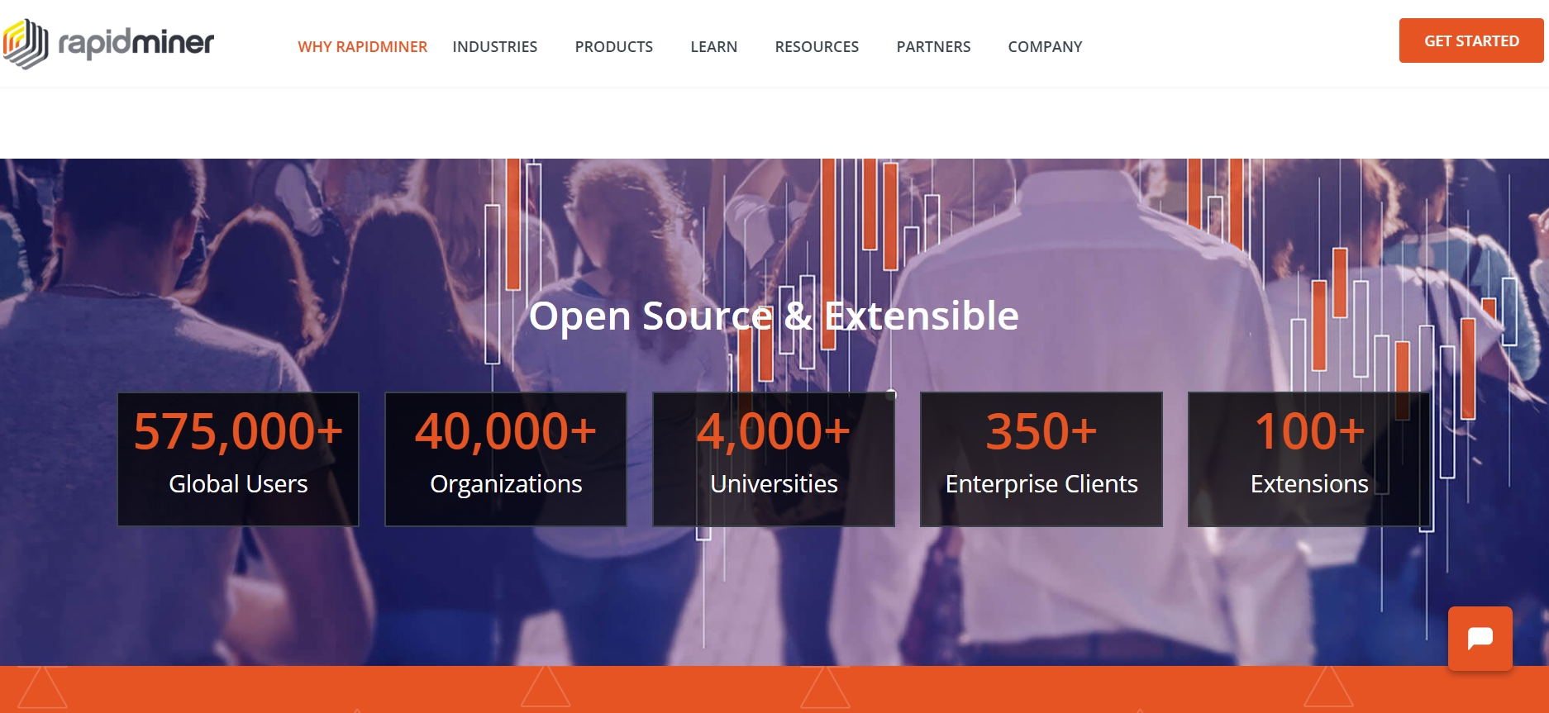
RapidMiner

Slide 12
RapidMiner Studio:
Visual workflow designer for the entire analytics team
Visual Workflow Designer
Increase productivity across the entire data science team, from analysts to experts
Speed up and automate the creation of predictive models in a drag + drop visual interface
Rich library of 1500+ algorithms and functions ensures the best model for any use case
Pre-built templates for common use cases including customer churn, predictive maintenance, fraud detection, and many more
“Wisdom of Crowds” provides proactive recommendations at every step to help beginners

Slide 13
Connect to Any Data Source
Work with all of your data, no matter where it lives
Instantly create point + click connections to databases, enterprise data warehouses, data lakes, cloud storages, business applications and social media
Easily re-use connections any time and easily share them with anyone who needs access
Connect to new sources with extensions from the RapidMiner Marketplace

Slide 14
Automated In-database Processing
Run data prep and ETL inside databases to keep your data optimized for advanced analytics
Query and retrieve data without writing complex SQL
Harness the power of highly scalable database clusters
Supports MySQL, PostgreSQL, and Google Big Query

Slide 15
Data Visualization & Exploration
Evaluate data health, completeness, and quality
Understand patterns, trends, and distributions with scatter plots, histograms, line charts, parallel coordinates, box plots, and more
Quickly find and fix common data quality problems including missing values and outliers
Explore data using robust statistical overviews and over 30 interactive visualizations

Slide 16
Data Prep & Blending
Eliminate the hassle of preparing data for predictive modeling
RapidMiner Turbo Prep offers a fully interactive point + click data prep experience
Extract, join, filter, and group data across any number of sources
Create repeatable data prep and ETL processes that can be scheduled and shared

Slide 17
Visual & Automated Machine Learning
Quickly create impactful machine learning models without writing code
RapidMiner Auto Model creates models in 5 clicks using automated machine learning
Choose from hundreds of supervised and unsupervised machine learning algorithms
Implement basic and advanced ML techniques including regression, clustering, time-series, text analytics, and deep learning
Build the model to be sensitive to constraints like costs to optimize the predictions for your desired business impact
Use both automated and manual feature engineering to optimize model accuracy

Slide 18
Model Validation
Understand the true performance of a model before deploying to production
Eliminate overfitting through a unique approach that prevents model training pre-processing data from leaking into the application of the model
Add proven techniques, like cross validation, to a model with just a single mouse click

Slide 19
Explainable Models Not Black Boxes
Create visual data science workflows that are easy to explain and easy to understand
Each step in the data prep, modeling, and validation process is documented for complete transparency
Visuals are easy to explain to others in the organization to gain buy-in for deployment
Supports the Local Interpretable Model-Agnostic Explanations (LIME) framework

Slide 20
Get More From R & Python Code
Scalable code deployment and collaboration between coders and non-coders
Deploy code-based models and code-containing models into a scalable platform
Eliminate duplicate work and ensure others re-use your work by uploading your code snippets into the RapidMiner repository for use in a simplified visual workflow designer
Make use of the vibrant Python ecosystem by building on top of specialized and cutting-edge libraries and making it available for the rest of your team using RapidMiner
Leverage data prep and ETL pipelines others have produced

Slide 21
Flexible Scoring & Model Operations
Turn predictive insights into business impact
Quickly deploy scored data to spreadsheets and data visualization tools or turn models into production web services with RapidMiner Server
RapidMiner Model Ops delivers an easy way for less advanced users to put models into production and properly manage them
Integrate with enterprise scheduling tools
Add RapidMiner Real-Time Scoring for demanding high transaction / low latency use cases

Slide 22
Automation & Process Control
Build sophisticated visual workflows and automate important tasks
Use process control operators to create workflows that repeat and loop over tasks, branch flows and access system resources
Supports a variety of scripting languages for custom integrations and automatons
Schedule processes

Slide 23
Open & Extensible
Integrate with existing applications and code
Use R and Python code and libraries to extend RapidMiner
Integrate RapidMiner with Python through the RapidMiner Python library on Github
Download new functionality provided by RapidMiner, our partners, and community through the RapidMiner Marketplace
Add new capabilities to RapidMiner through its flexible extension mechanism
RapidMiner Studio open core is available under the AGPL license
https://rapidminer.com/products/studio/

Slide 24
RapidMiner: By Industry
Automotive
CPG, Retail & e-Commerce
Communications
Energy
Financial Services
Healthcare
Insurance
Life Sciences
Manufacturing
Travel, Transport & Logistics
Utilities

Slide 25
RapidMiner: By Use Case
Churn Prevention
Customer LTV
Customer Segmentation
Demand Forecasting
Fraud Detection
Next Best Action
Price Optimization
Predictive Maintenance
Product Propensity
Quality Assurance
Risk Management
Text Mining
Up- and Cross-Selling

Slide 26
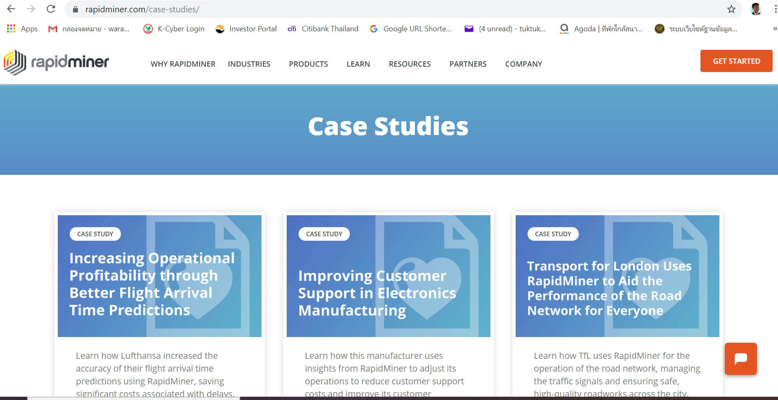
RapidMiner: Case Studies

Slide 27
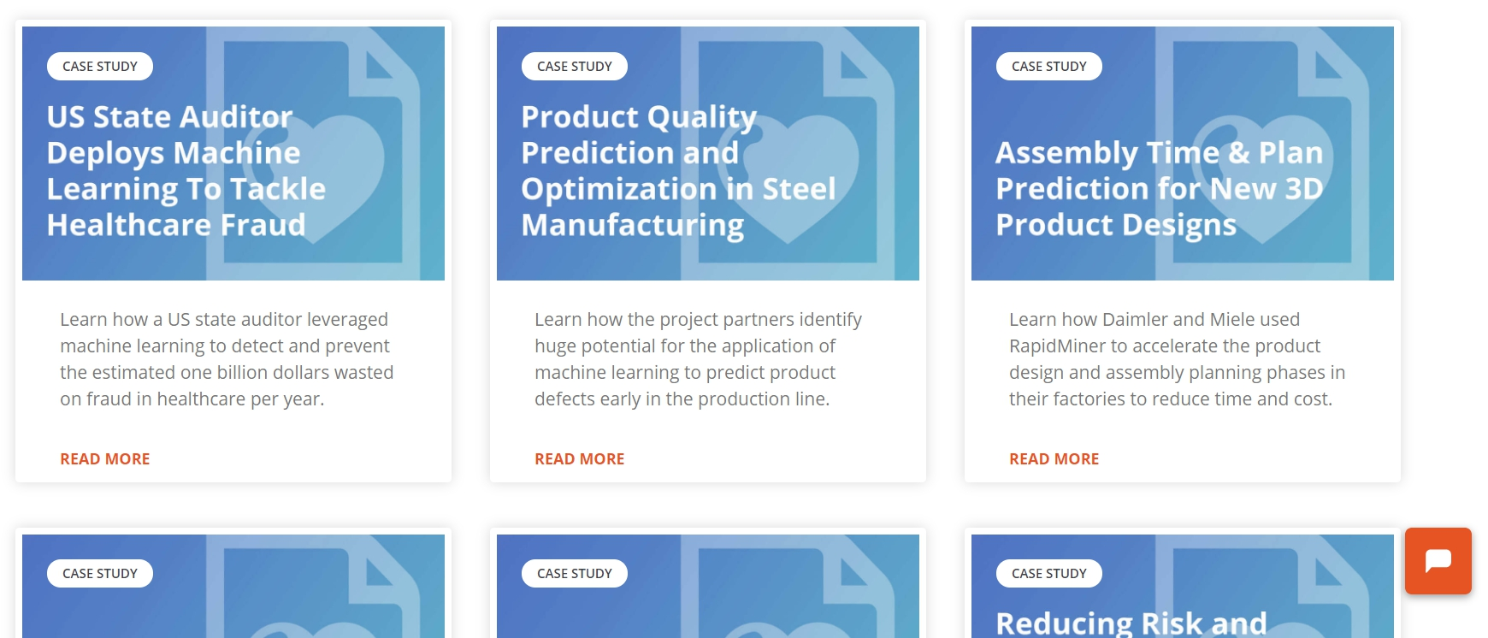
RapidMiner: Case Studies

Slide 28
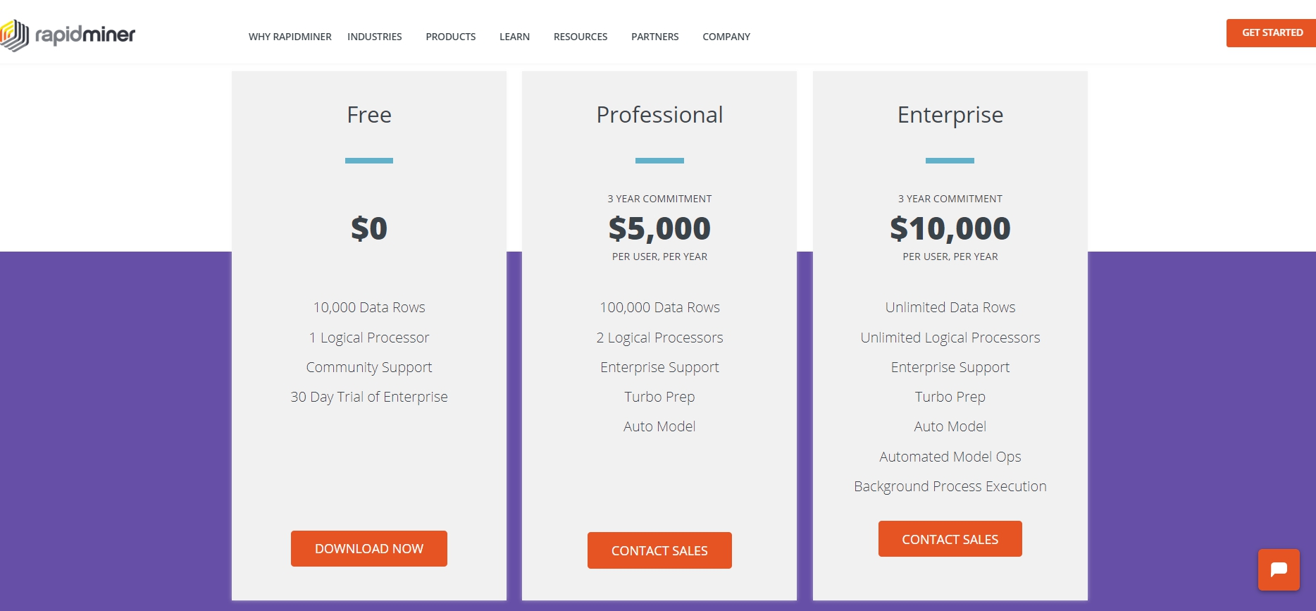
RapidMiner

Slide 29
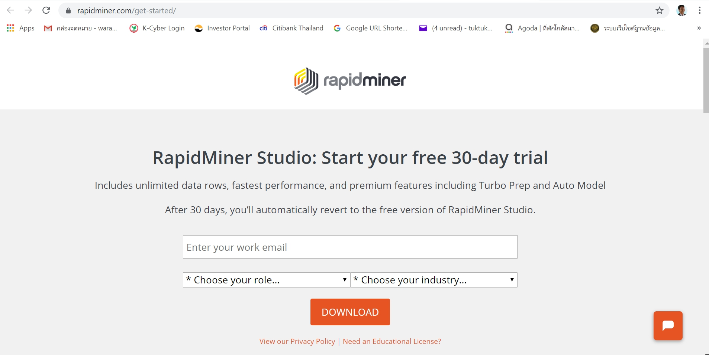
RapidMiner
download on https://rapidminer.com/get-started/

Slide 30
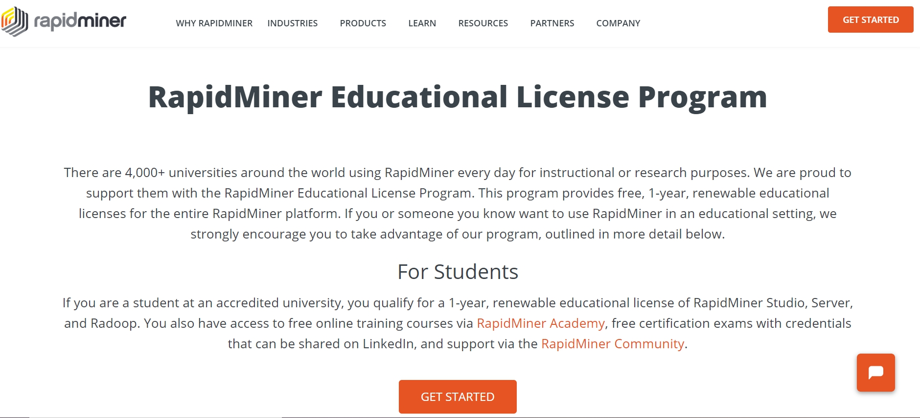
RapidMiner

Slide 31
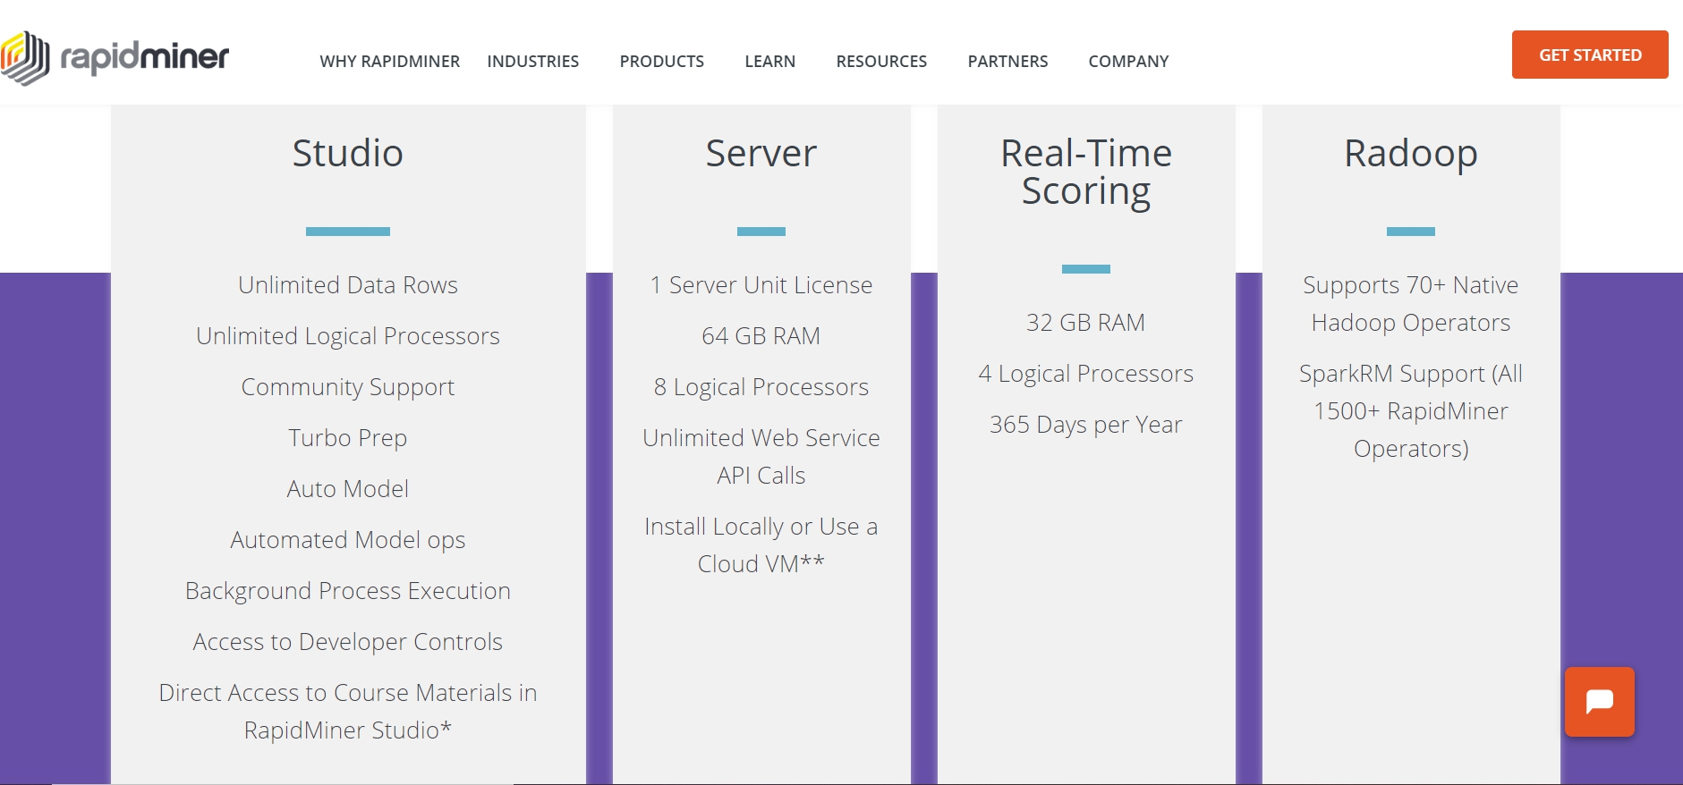
RapidMiner

Slide 32

คู่มือการใช้ Rapodminer

Slide 33
การสอนใช้ Rapidminer
https://www.youtube.com/watch?v=XJ-qHAjRRy0

Slide 34
Rapid Miner IDSS Research

