Slide 1
Course 13: Innovative Product Design and Development
Agnieszka Ociepa-Kubicka, Katarzyna Rozpondek,

Slide 2
Great Design Thinking Examples
In the Harvard Business Review article “Why Design Thinking Works,” Jeanne Liedtka reveals the results of a seven-year study she did looking at 50 business projects in a range of sectors.
What she found was this: “I have seen that…design thinking…has the potential to do for innovation exactly what TQM [total quality management] did for manufacturing: unleash people’s full creative energies, win their commitment, and radically improve processes.”
How has design thinking been applied to different industries, challenges, and business sectors? Here are examples of how it has impacted real companies and teams.
Source and more information: https://voltagecontrol.com/blog/8-great-design-thinking-examples/

Slide 3
Great Design Thinking Examples - Airbnb
Airbnb climbed out of the “trough of sorrow” with Design Thinking
Source and more information: https://voltagecontrol.com/blog/8-great-design-thinking-examples/

Slide 4
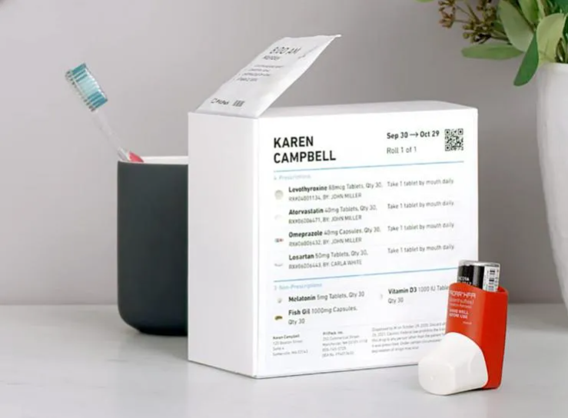
Great Design Thinking Examples - PillPack
PillPack began as a startup-in-residence at IDEO and was eventually bought by Amazon for $1 billion
Source and more information: https://voltagecontrol.com/blog/8-great-design-thinking-examples/

Slide 5
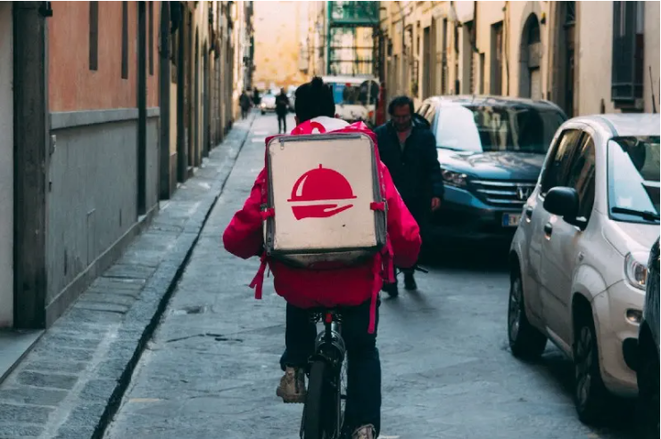
Great Design Thinking Examples - Uber Eats
The UberEATS team believes empathy for users is key to designing successful products
Source and more information: https://voltagecontrol.com/blog/8-great-design-thinking-examples/

Slide 6
Great Design Thinking Examples - Stanford Hospital
Stanford has used Design Thinking to reimagine emergency rooms and nursing units
Source and more information: https://voltagecontrol.com/blog/8-great-design-thinking-examples/

Slide 7
Great Design Thinking Examples - Bank of America
Bank of America’s Keep the Change program grew out of a Design Thinking project
Source and more information: https://voltagecontrol.com/blog/8-great-design-thinking-examples/

Slide 8
Case study Creating a product design concept based on the design thinking
Today, it is difficult to imagine running any business without ... cardboard. In the past, a lot of plastic packaging was produced, now we come back to the cardboard packaging. We transport goods in it, store documents, it is irreplaceable when we move houses, it is even suitable for making ecological furniture.
The participation of cardboard in the packaging market increases every year. It is partly due to the fashion for ecological materials, however, the financial argument proved to be the most convincing. The production of cardboard packaging is simply cheaper. After taking into account the production costs and the entire delivery process, it appears that the cardboard guarantees considerable savings for the company.

Slide 9
Description Creating a product design concept based on the design thinking
There is a factory producing packaging from corrugated cardboard.
The packaging for food and textile products.
It is a small factory employing 100 people.
For many years, no innovative solutions have been introduced.
The management would like to introduce new solutions targeted at the client's needs.
The considerations can be directed to the new service products or organizational solutions among employees so that the company will work more efficiently and will meet the expectations of various clients.

Slide 10
Task for students Creating a product design concept based on the design thinking
The division into groups - maximum 4 persons in each.
Analyzing the following stages of the design thinking method, using examplary tools, you need to solve the problem in this company with the design thinking method
How to modernize/ introduce innovative solutions in an existing small factory producing corrugated packaging.
Please create a prototype and present the solution invented in the final presentation.

Slide 11
Stage 1 - Empathy
The goal of this stage is to look at the problem through the customer's eyes. Understanding what is important to the user and how the solution will be helpful in everyday life.
Empathy is empathy in the needs of other people. Before a solution is created, you need to consider your own experience in a given area or collect the experience of others if you do not have your own.
Change of perspective and questions asked:
What does the user need?
What interests the user ?
What does the user perspective look like?
What are user possibilities?
What are user limitations?

Slide 12
Stage 1 - Empathy
EXEMPLARY TOOLS
Flip chart
Empathy map
Observation
Questionnaire
Ethnographic interviews
Sticky notes
Analysis of the environment and needs in the context of functionality
Whiteboard

Slide 13
The empathy map is a tool to better understand the client
This is the easiest way to profile a user.
The map allows to understand what users of the product feel and think and to determine their needs.
The advantage of this tool is the clear structure of the map, even for people not involved in the process of its creation.
Areas relate to product user interactions and internal feelings.
We divide a piece of paper into six areas:
What does the user see?
What does the user hear?
What does the user think and feel?
What does the user say and do?
What are the user's problems?
What are the user's needs?

Slide 14
Application of empathy map
You choose a specific user of the product (we specify his age, occupation, other basic data).
You prepare the empathy map template and personalize the user.
You go through the next questions, taking notes. The preferred order of questions is:
sees
hears
thoughts
says
problems
needs
Summary of the empathy map and considering which elements are the most important.

Slide 15
Empathy map
What does the user THINK AND FEEL?
USER
What does the user HEAR?
What does the user SEE?
What does the user SAY AND DO?
PROBLEMS
concerns, frustrations
BENEFITS
desires, needs

Slide 16
Stage 2 - Defining the problem
The purpose of this stage is to synthesize information gathered by the team during the empathy phase and determine what the specific problem is.
This is a key stage because it affects the entire direction of further work.
Applications must be documented so that they are easily accessible (white board, flip chart).
The effect of this stage is to formulate specific questions - how can we solve the problem.

Slide 17
Stage 2 - Defining the problem
EXEMPLARY TOOLS
Flip chart
Brainstorming
5-WHY method
Fishbone diagram
Sticky notes
Whiteboard

Slide 18
5-WHY method
The creator of the 5-WHY method is Sakichi Toyoda (Toyota), an element of Kaizen methodology.
This tool is widely used and popular in various organizations - universities, companies, administration, etc.
The purpose of this tool is to define the cause of the problem.
The 5-WHY method helps eliminate the appearance of a problem in the long term (if the problem has occurred, it is likely to recur).
This tool involves asking the question "why?" several times, thanks to which the essence of the problem and its solution becomes more obvious.
5-WHY covers two aspects:
Why did the problem arise?
Why was the problem not noticed?

Slide 19
Application of 5-WHY method
Collect as much information as possible about the problem. The more information you collect, the greater the chance that the cause of the problem will be identified.
The method involves asking the question "why ...?" several times (optimally 5 times) and cheating answers.
Once you've gathered enough information, you can look for people to help you determine the cause. A good solution is that they are people who have a lot of knowledge about the situation in which the problem arose.
Questions and answers should be logically linked to each other.
Then the cause of the problem should be described clearly and specifically.
This is a simple method that can be applied to any problem.

Slide 20
Stage 3 - Generating ideas
At this stage, brainstorming is carried out for each problem defined.
The key element of this stage is the application of all brainstorming principles.
After the ideas are formed, their reality should be evaluated. Can they really be implemented?
Limitations (technical, economic, legal) should be specified.
Modifying ideas so that they correspond to real and real possibilities.

Slide 21
Stage 3 - Generating ideas
Mind Mapping
EXEMPLARY TOOLS
Flip chart
6-3-5 Brainstorming
Osborn's Brainstorming Method
Six Thinking Hats
Sticky notes
Whiteboard

Slide 22
Mind mapping
Mind mapping is a tool that helps you think better, remember, solve problems creatively and take action. Triggers the creativity and flexibility that are needed to solve problems.
Each mind mapping begins with a central element that is its theme. In the center of the page we place the subject of the mind mapping .
We lead thick branches from the topic - the main slogans in the form of thick lines.
At the end of the main branches we draw another suitably thinner subbranches with more detailed slogans.
The next levels correspond to more and more details from a given issue. The further from the inside, the smaller their illustration (lines, key words, drawings, pictures).

Slide 23
Mind mapping - what is worth to remember
Spread a piece of paper horizontally.
Leave space between passwords.
Keywords be integrated with their respective branches.
Solutions should be written in capital letters so that the words are more readable.
The use of different colors is very important. This makes it easier to divide information and remember it.
Special meanings for a given color can be used, e.g. red = important information.
Use images - one image is a thousand words.
You can create additional associations in the form of arrows or dashed lines between given keywords.
Avoid creating very large maps because they will be illegible.

Slide 24
Benefits of using Mind mapping
Avoiding linear thinking, supporting multidirectional thinking.
Opening up to creative solutions.
Generating new ways of thinking.
Maps are closer to reality because it is difficult to work in the right order from the beginning.
Mind mapping allows you to get a full picture of the problem you are working on.

Slide 25
Stage 4 - Prototyping
The goal of this stage is to visually present the prototype to the user and collect feedback.
It is optimal to prototype 2-3 ideas.
This is the intermediate stage between the idea and its final implementation.
Form:
Prototype,
Model,
visualization drawing the user's path (for services),
Story,
Process scenario.
Opinion collection tools: +/- interesting method.

Slide 26
The procedure of +/- interesting method
Present the prototype to the user.
Then ask the user for feedback according to the scheme:
What do you like about this idea?
What raises your doubts?
What is interesting / interesting about this solution?

Slide 27
Stage 5 - Testing
The goal of this stage is to test the solutions developed in the recipient's environment.
At this stage, the key is to consciously choose a group of recipients who will test the solution.
You can develop guidelines on what elements the user should pay attention to when giving feedback.
After collecting the opinion, information is analyzed and possible changes introduced.
It is possible to return to earlier stages and modify them (Design Thinking is not a linear process).
The next stage of testing is the implementation of new solutions.
Feedback collection tools at this stage: +/- interesting method.

