Slide 1
Course 1. Enterprise Management in Digital Economy
TEACHING AND LEARNING MATERIALS
Tomasz Nitkiewicz (CUT)
with
Andrei Szuder (UPB), Uttapol Smutkupt (CMU), Jorge Cunha (Uminho)
Notes:
Explanation:
Comments for teachers are in the footnotes of selected slides (if needed)

Slide 2
Course 1. EMDE structure
I. Business perspective to understand the digital economy and its influence
A. How digital economy innovations and its social context impacts different types of businesses?
B. Digitalization in the context of needs, markets, channels, products and services and management and organizational set-up - identification of different way digital era changes the business
C. How the pace of changes affects the business in the digital economy: New business imperatives
D. Organizational structures and management functions of today: reshaping structures, combining resources and competences and building relations
II. Sustainable and digital: new patterns for strategies and business models
A. Strategy or business models? Different approaches to lead your business
B. Sustainable or digital: Emerging business models and its components
C. Following technical innovations with sustainable business models
D. Defining unique value proposition and designing customer relationships
E. Collaboration and competition in the age of networking
III. Strategic analysis tools and its use to capture the competitive advantage in digital economy
A. Business model canvas: capturing the key of digital business
B. Mapping the value streams: visualizing the flows and relationships
C. Decision support with strategic analysis tools: business at strategic crossroads

Slide 3
Course 1. EMDE list of workshop sessions
Impacts of digital economy innovations and social context on different types of businesses
Identification of different way digital era changes the business
New business imperatives
Reshaping structures, combining resources and competences and building relations
Different approaches to lead your business
Emerging business models and its components
Sustainable business models
Defining unique value proposition and designing customer relationships
Collaboration and competition in the age of networking
Business model canvas: capturing the key of digital business
Mapping the value streams: visualizing the flows and relationships
Decision support with strategic analysis tools: business at strategic crossroads

Slide 4
Course 1. Enterprise Management in Digital Economy
Module 3: Strategic analysis tools and its use to capture the competitive advantage in digital economy
Tomasz Nitkiewicz (CUT)
with
Andrei Szuder (UPB), Uttapol Smutkupt (CMU), Jorge Cunha (Uminho)

Slide 5
Module 1: Strategic analysis tools and its use to capture the competitive advantage in digital economy
List of topics
A. Business model canvas: capturing the key of digital business
B. Mapping the value streams: visualizing the flows and relationships
C. Decision support with strategic analysis tools: business at strategic crossroads

Slide 6
M3: Mapping the value streams Idetification of value streams
Value Streams represent the series of steps that an organization uses to implement solutions that provide a continuous flow of value to a customer. The first step is to deal with organizational structure of functional silos, which causes number of challanges:
Value delivery is inhibited by hand-offs and delays
Adopting Customer-Centricity is problematic because of organizational boundaries
Systems are designed to optimize the work in silos, not the value delivered

Slide 7
M3: Mapping the value streams Value delivery

Slide 8
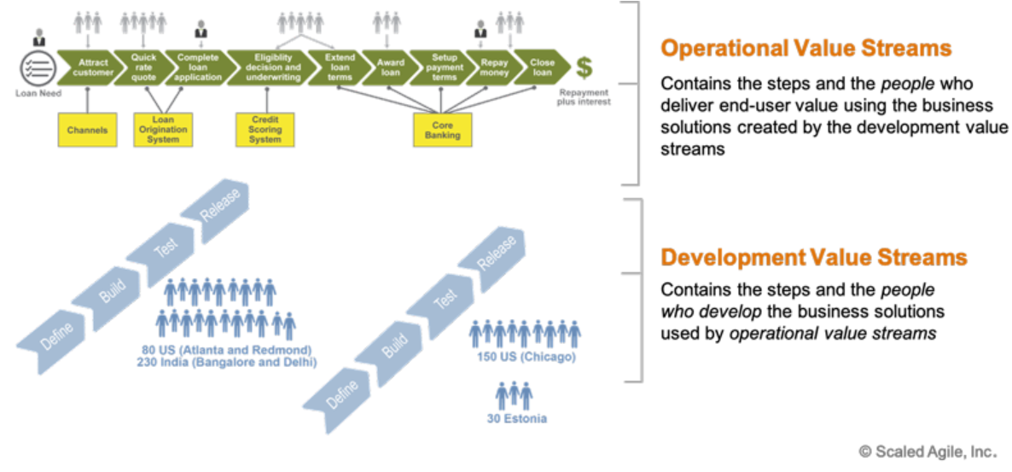
M3: Mapping the value streams Types of value streams

Slide 9
Identification of value streams
Many streams are just the products, services, or solutions that the company sells. In the larger enterprise, value flows through various applications, systems, and services—across many parts of the distributed organization—to both internal and external customers.

Slide 10
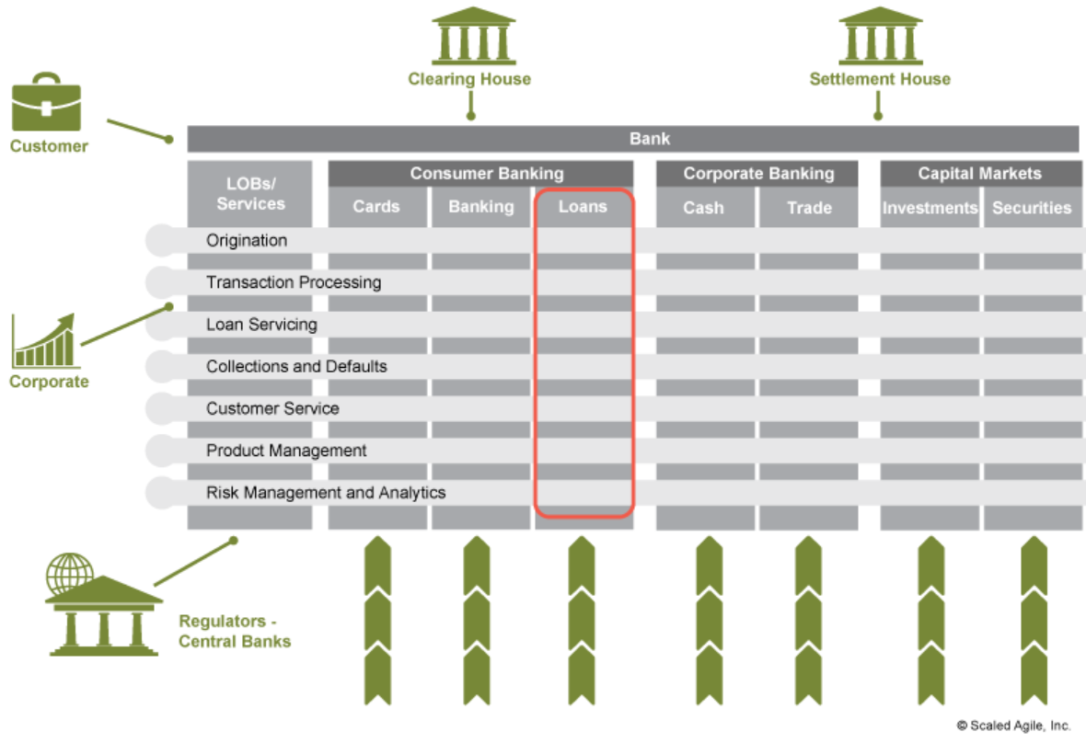
Example of operational value streams in a bank

Slide 11
M3: Mapping the value streams Example of operational value streams in a bank
The flow of value is triggered by the customer searching for and finding the bank’s loan offerings and rates, and is fulfilled when the customer repays the loan with interest. The steps and the engagement of customer and staff that performs them are marked below.

Slide 12
M3: Mapping the value streams Types of value streams
The reason to organize value streams is to accelerate the time to value (or market), by optimizing the flow of value through the system as a whole. Value stream approach offers the following benefits :
Fewer handoffs and delays, allowing the teams to work with smaller batch sizes
Enables long-lived, stable teams that focus on delivering value, instead of projects, which focus on task completion
Allows faster learning and shorter time-to-market
Contributes to higher quality and more productivity
Supports leaner development and budgeting methods

Slide 13
M3: Decision support with strategic analysis tools Support of decision-making process
Defining problem
Gathering information
Identifying alternatives
Choosing the alternative
Reviewing the results
DECISION-MAKING PROCESS
EXAMPLES OF SUPPORT TOOLS
5 WHY
Ishikawa Diagram
Pareto Analysis
Control lists
PEST
5 Forces
Brainstorming
QFD
Stakeholder analysis
Feasibility study
CBA
SWOT
Marginal analysis
Financial analysis
Life cycle assessment
Notes:
https://www.idashboards.com/blog/2019/04/10/4-tools-strategies-for-enhanced-decision-making/

Slide 14
M3: Strategic analysis tools Porter’s five forces diagram

