Slide 1
Course 1. Enterprise Management in Digital Economy
TEACHING AND LEARNING MATERIALS
Tomasz Nitkiewicz (CUT)
with
Andrei Szuder (UPB), Uttapol Smutkupt (CMU), Jorge Cunha (Uminho)
Notes:
Explanation:
Comments for teachers are in the footnotes of selected slides (if needed)

Slide 2
Course 1. EMDE structure
I. Business perspective to understand the digital economy and its influence
  A. How digital economy innovations and its social context impacts different types of businesses?
  B. Digitalization in the context of needs, markets, channels, products and services and management and organizational set-up - identification of different way digital era changes the business
  C. How the pace of changes affects the business in the digital economy: New business imperatives
  D. Organizational structures and management functions of today: reshaping structures, combining resources and competences and building relations
II. Sustainable and digital: new patterns for strategies and business models
  A. Strategy or business models? Different approaches to lead your business
  B. Sustainable or digital: Emerging business models and its components
  C. Following technical innovations with sustainable business models
  D. Defining unique value proposition and designing customer relationships
  E. Collaboration and competition in the age of networking
III. Strategic analysis tools and its use to capture the competitive advantage in digital economy
  A. Business model canvas: capturing the key of digital business
  B. Mapping the value streams: visualizing the flows and relationships
  C. Decision support with strategic analysis tools: business at strategic crossroads

Slide 3
Course 1. EMDE list of workshop sessions
Impacts of digital economy innovations and social context on different types of businesses
Identification of different way digital era changes the business
New business imperatives
Reshaping structures, combining resources and competences and building relations
Different approaches to lead your business
Emerging business models and its components
Sustainable business models
Defining unique value proposition and designing customer relationships
Collaboration and competition in the age of networking
Business model canvas: capturing the key of digital business
Mapping the value streams: visualizing the flows and relationships
Decision support with strategic analysis tools: business at strategic crossroads

Slide 4
Course 15. Enterprise Management in Digital Economy
Module 2: Sustainable and digital: new patterns for strategies and business models
Tomasz Nitkiewicz (CUT)
with
Andrei Szuder (UPB), Uttapol Smutkupt (CMU), Jorge Cunha (Uminho)

Slide 5
Module 2: Sustainable and digital: new patterns for strategies and business models
List of topics
A. Strategy or business models? Different approaches to lead your business
B. Sustainable or digital: Emerging business models and its components
C. Following technical innovations with sustainable business models
D. Defining unique value proposition and designing customer relationships
E. Collaboration and competition in the age of networking

Slide 6
Module 2: Sustainable and digital: new patterns for strategies and business models
List of workshop sessions
Different approaches to lead your business
Emerging business models and its components
Sustainable business models
Defining unique value proposition and designing customer relationships
Collaboration and competition in the age of networking

Slide 7
M2: Different challenges in digital era
Digital Ecosystems (DE)
Digital Innovation Constraints (DIC)
Digital Product Innovation (DPI)
Digital Business Model Innovation (DBMI)
Digital Knowledge Integration (DKI)
IT Transformation (ITT)
Digital Agility (DAG)
Digital Ambidexterity (DAM)
Piccinini et al., 2015

Slide 8
M2: Digital Era Challenges
Digital Ecosystems
Competing with an expanding range of new rivals and non-industry rivals and entrants (e.g., Google, Apple)
Working toward the convergence of physical infrastructures (transportation) and digital infrastructures (connectivity) and identifying new cross-industry structures
Building complementary partnerships among different ecosystem players (business and IT) to design new business models
Bridging gaps between previously separated business units and ecosystem players to create new digital value
Improving information flows and exchange between business ecosystem partners to enable a seamless customer experience

Slide 9
M2: Digital Era Challenges
Digital Innovation Constraints
Ensuring IT security in the adoption and implementation of digital technologies
Dealing with regulatory uncertainty and regional restrictions concerning digital innovation
Resolving legal/regulatory issues around automatized activities and eliminating concerns (e.g., security, safety)

Slide 10
M2: Digital Era Challenges
Digital Product Innovation
Embedding the kinds of experiences people have with digital technologies in products
Designing human-to-machine interfaces that enable a seamless consumer experience.
Embedding digital content and services into products while considering cost efficiency, but without compromising safety and security
Developing industry-wide technology standards that enable integrated customer services and a seamless experience to be provided
Achieving breakthroughs in the development and deployment of key (generative) digital technologies
Creating and capturing new value for customers from mobile sensors and real-time data streams (“big data”)

Slide 11
M2: Digital Era Challenges
Digital Business Model Innovation
Rethinking the incumbent’s role and resource composition (e.g., from automotive manufacturer to mobility services provider)
Designing new business models with valuable propositions through digital innovation
Transforming the value creation structure to achieve greater agility for digital innovation
Creating valuable new digital products and services that customers are willing to pay for, despite ongoing profitability of old model (selling cars)
Building an integrated (end-to-end) platform for mobility services and other unforeseen opportunities

Slide 12
M2: Digital Era Challenges
Digital Knowledge Integration
Understanding and catering to quickly changing consumer needs and expectations that are shaped by digital technologies
Acquiring and integrating critical know-how and patenting innovations
Attracting new talent that is able to integrate digital technology expertise with business know-how
Integrating IT know-how and creative problem solving into research and development activities

Slide 13
M2: Digital Era Challenges
IT Transformation
Designing new governance and incentive structures to exploit new digital technologies in order to innovate consumer experience
Encouraging employees to develop a digital mindset in order to increase the acceptance and use of digital technologies in everyday work and processes
Leveraging new affordances of digital technologies to improve internal communication and coordination - Rethinking the role of IT inside the organization from providing services to the business toward creating value for heterogeneous customer demands
Redesigning the relationship between IT and the business as IT becomes an integral part of the business model (new leadership roles, changed responsibilities)
Transforming legacy enterprise architecture into a modular, loosely coupled architecture that can be seamlessly connected with new digital technologies

Slide 14
M2: Digital Era Challenges
Digital Agility
-Switching to agile methodology in projects.
- Implementing a start-up mentality (e.g., fail often, fail early, trial and error) in a large organization that exhibits resistance to innovation.

Slide 15
M2: Digital Era Challenges
Digital Ambidexterity
Balancing agility—to accommodate the short lifecycle of digital technology innovation—with stability—to accommodate the long lifecycle of traditional product innovation (e.g., the car).
Aligning new, significant short-term digital technology investments with long-term strategic business planning and digital capability development in times of high uncertainty.
Balancing customized digital services that provide added value by leveraging customers’ personal data with data security and privacy.
Combining digital innovation philosophy (experimental, market learning) with manufacturing philosophy (planned, finished at time of market introduction).

Slide 16
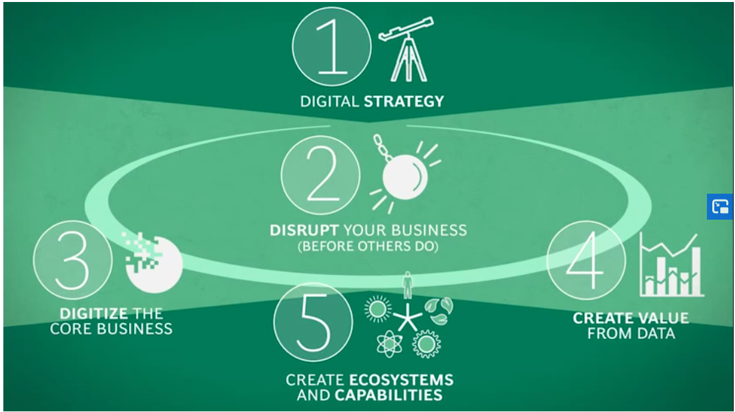
M2: New business imperatives
Business path to digital economy
(McGirr, 2019)
Notes:
https://visichain.io/digital-transformation-imperative/

Slide 17
M2: New business imperatives
Dominating business models
The Crowd Economy
The Free/Data Economy
The Smartness Economy
Closed-Loop Economies
Decentralized Autonomous Organizations (DAOs)
Multiple World Models
Transformation Economy
(McGirr, 2019)
Notes:
For explanation and examples see:
https://www.diamandis.com/blog/7-business-models-for-2020s

Slide 18
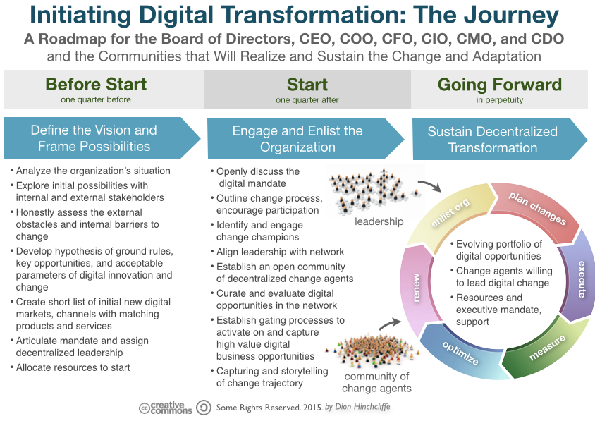
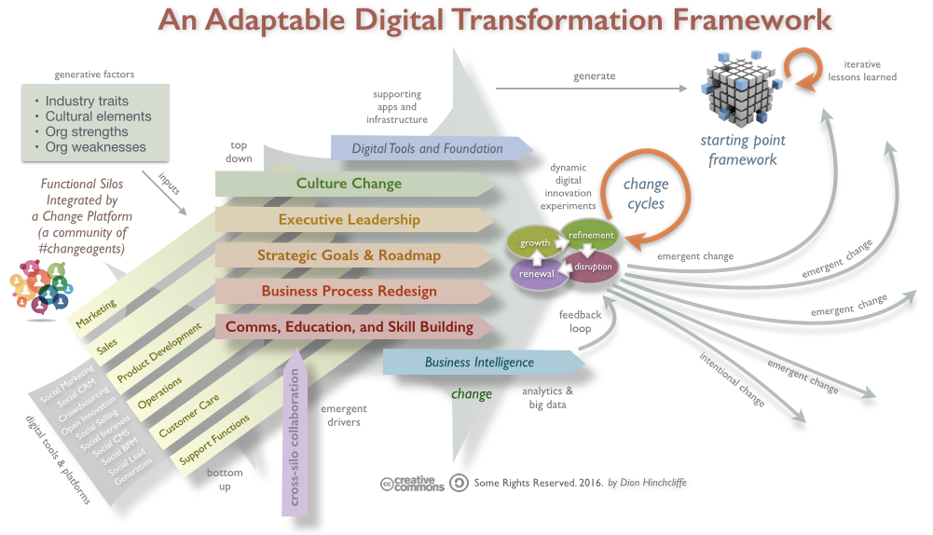
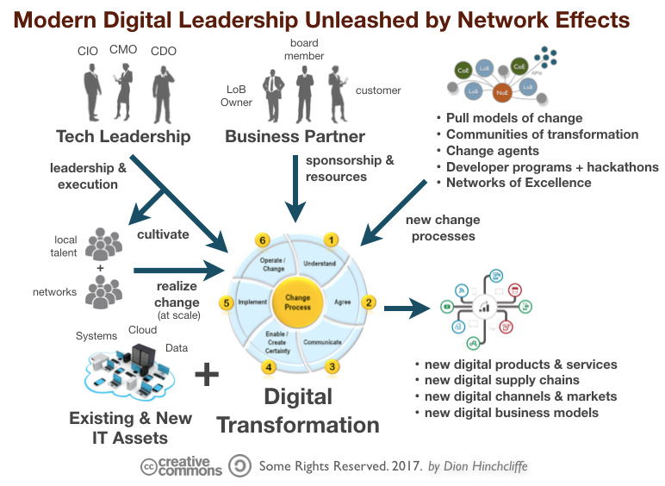
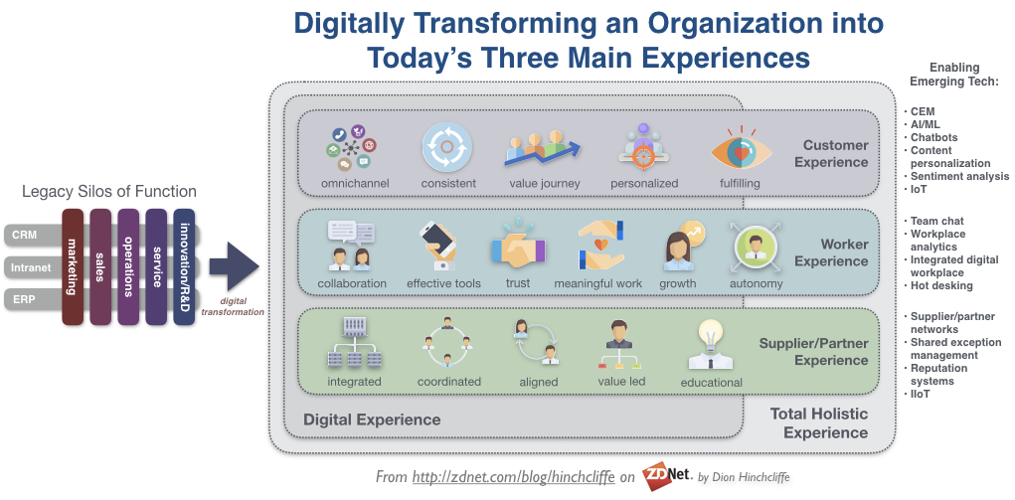
M2: New business imperatives
Digital transformation proces – different ways
(Hinchcliffe, 2018)
Notes:
https://dionhinchcliffe.com/2018/10/18/four-strategic-frameworks-for-digital-transformation/

Slide 19
Notes:
https://dionhinchcliffe.com/2018/10/18/four-strategic-frameworks-for-digital-transformation/

Slide 20
M2: New business imperatives
Digital transformation process
(Hinchcliffe, 2018)
Notes:
https://dionhinchcliffe.com/2018/10/18/four-strategic-frameworks-for-digital-transformation/

Slide 21
M2: New business imperatives
Digital transformation process
(Hinchcliffe, 2018)
Notes:
https://dionhinchcliffe.com/2018/10/18/four-strategic-frameworks-for-digital-transformation/

Slide 22
M2: New business imperatives
Digital transformation process
Notes:
https://dionhinchcliffe.com/2018/10/18/four-strategic-frameworks-for-digital-transformation/

Slide 23
M2: Emergining business models
General classification of business models innovation
Key feature | Description
cost obsession | The idea is to get rid of frills and make use of economies of scale, scope, utilization, experience and other factors for the benefit of consumers. Anything that does not create value for the consumer is stripped out.
platform | This term refers to a business model that supports two or more markets at the same time. A conventional market attracts buyers by providing a venue that supports the presence of sellers, and attracts sellers by the promise of the presence of buyers, all for a specific domain of goods or services.
global business | International growth is crucial to achieving economies of scale and attaining the mass that would enable the firm to develop and manage its production and logistics efficiently. Swift globalization is a key.
seeking excellence | These companies focus on innovation, surprise their customers with new features, and satisfy needs which weren’t even there when the product comes out.
distinctive/ adapted | drastically lowered transaction costs enable sellers to approach tiny market segments—sometimes comprising a single buyer—almost as efficiently as wide swathes of the market
Notes:
https://www.bbvaopenmind.com/en/articles/business-models-for-the-companies-of-the-future/
Technological change and its related developments allow for far-reaching innovation in business models. The companies of the future will surprise us with novel and original business models. In this new world, opportunities are on the rise. It is by definition impossible to predict what will take us by surprise or what will prove innovative. But we can to some extent cast our gaze over the businesses that are now emerging—because, as we have said, the future starts today.
One strongly rising trend in business models might be dubbed “cost obsession.” The paradigm is perhaps the low-cost airline, based on the scheme developed by Southwest Airlines in the United States—the only American airline that has never failed to turn a profit. Southwest decided to fly point-to-point using smaller, less crowded airports, and used a range of operational measures to make sure its aircraft spent more time in the air and carried more passengers on each flight. Costs came down hugely, flights could be sold more cheaply, more passengers became willing to buy—this made routes more profitable, and a virtuous circle took care of the rest. With variations, this is the business model of Ryanair in Europe, Air Asia in Asia, and any number of other carriers that operate this same model today. Cost obsession has emerged in many other industries. It is present in retail, for instance, Walmart being a prime example. The cost obsession philosophy—developed with care by Sam Walton at Walmart—has spread to an increasing number of sectors. The idea is to get rid of frills and make use of economies of scale, scope, utilization, experience and other factors for the benefit of consumers. Anything that does not create value for the consumer is stripped out.
Another business model category that is powerfully on the rise is the “platform.” This term refers to a business model that supports two or more markets at the same time. A conventional market attracts buyers by providing a venue that supports the presence of sellers, and attracts sellers by the promise of the presence of buyers, all for a specific domain of goods or services. Modern technology, however, removes barriers of time (accessible 24 hours a day) and place (accessible from almost anywhere). Platforms spring up in increasing numbers and compete with one another. One fascinating feature of inter-platform competition is that each platform seeks to achieve network externalities5 leading to a “winner takes all” outcome. Another feature is that competitors put a lot of effort into raising the costs for the weaker party to switch platforms in a bid to keep members captive. A well-known example is eBay. This platform started out auctioning second-hand goods, then grew into a third-party market where businesses of all kinds sold all sorts of products, creating a huge online bazaar.
Other examples of platforms include game consoles, operating systems, and smartphones. The key variable is the “installed base.” If a video game platform—Nintendo, say—makes big sales, it achieves a large installed base. This makes it attractive to game developers, seeking to reach a wide range of potential buyers. A continued influx of more and (one hopes) better games in turn enhances the attractiveness of the platform, further aiding the growth of the installed base. This entrenches the virtuous circle of this network externality.
A third category of business model is the “global business” that opens up to the world in a brief lapse of time. Take Mango. Unlike Zara, Mango creates its own fashions. The firm designs collections and places them on the market at affordable prices, driven by manufacturing in low-cost countries and the flexibility to produce goods that get sold rather than selling goods that get produced. From the outset, Mango focused on urban, modern, professional, relatively young women.6 So the target segment was not particularly large, and required operating in fairly big cities. International growth was crucial to achieving economies of scale and attaining the mass that would enable the firm to develop and manage its production and logistics efficiently. Swift globalization was key. An apposite supporting example is Desigual: though targeting a different segment, its strategy is analogous to Mango’s, and its inter-nationalization was even quicker.
Elsewhere, we can look at Metalquimia, a small company in Girona, Spain, which makes machinery for the meat processing industry in a highly specialized niche. Because each individual country’s market is so small, internationalization is essential. This enables Metalquimia to learn from its most demanding customers, wherever they may be based, and apply this learning to create an effective innovation process that makes the firm the spearhead of its niche, while lending it the scale for its innovation costs to pay for themselves.
The example of Metalquimia brings us to a fourth business model category which one might classify as “seeking excellence.” These companies focus on innovation, surprise their customers with new features, and satisfy needs which weren’t even there when the product comes out. The paradigm is Apple. After inventing the personal computer and almost the battle against the Wintel alliance, Apple revolutionized the world of media players with the iPod and the world of telephony with the iPhone—then it created the entirely new world of the tablet, with the iPad. In its own niche, Metalquimia has made analogous breakthroughs.
Irizar, originally a family-owned firm in the Spanish Basque Country, became a cooperative partnership within the Mondragón group, then went its own way in 2005. It makes vehicle bodywork for upmarket buses for a worldwide client base. Its highly distinctive management model is based on independently led teams and on giving everyone who works for the company an ownership stake. This approach enables Irizar to achieve an unsurpassed standard of innovative excellence in the niche market of bodywork for high-end buses.
Each of the businesses mentioned so far operates a distinct business model that supports the specific way in which it seeks to develop its capabilities. However, they all share a continuing pursuit of excellence, distinctiveness of goods and services, and an ongoing bid to innovate.
Distinctiveness of goods and services is achievable through innovation, but can also be the outcome of other factors. Some business models, for instance, are based on “speed”: adapting quickly to customer requirements, as seen in the paradigm case of Zara. Other enterprises find distinctiveness in their quality—whether intrinsic (Rolls-Royce), or linked to a highly characteristic market segment or “tribe” of buyers (Ducati). Still other firms adapt to local tastes or cater to relatively uninformed customers. The common denominator of these business models underpins a fifth category, “distinctive/adapted.” In the digital world, what’s more, distinctiveness can be taken to an extreme, where the relationship is one-on-one. This model has earned itself the name “long tail.” The concept flourishes on online sales platforms, which might take the form of a “store”—Amazon in its beginnings—or a “bazaar”—eBay. The crux is that drastically lowered transaction costs enable sellers to approach tiny market segments—sometimes comprising a single buyer—almost as efficiently as wide swathes of the market.
These five categories of business models are not exhaustive. There must be others that are unclassifiable now, and still less so in the future—innovation being unpredictable by definition. What’s more, the categories overlap. A case study illustrating one category could just as easily illustrate another. So this outline, rather than providing a taxonomy, merely points out features that make a business model “good” at creating and capturing value. These business model features set in motion virtuous circles7 and bring about a positive dynamic. The robustness of a given business model is determined by the number of positive dynamics it is capable of enlisting, so lending it the ability to survive competition with other models, both present and potential.
For further insight into these categories of business model, we can look at the virtuous circles that each of them entails. “Cost obsession” business models generate virtuous circles that gradually bring down the cost of manufacturing goods or providing services. The model might be driven by economies of scale (costs decrease as manufacturing volume increases), economies of learning (costs decrease as production accumulates), economies of capacity use (costs decrease as utilized capacity increases), or any combination of these elements and factors relating to scarce resources, such as location, techno-logy or knowledge. To generalize, all these virtuous circles lie on the supply side. We should be aware that the behavior of these costs in the tangible world, which is subject to physical limits, is not the same as in the online world, where scalability may be unlimited.
By way of contrast, the virtuous circles garnered by “platform” models arise from network externalities and the “switch” costs accepted by the customer (“lock-in”)—here, the onus lies on the demand side of the market. These powerful virtuous circles sometimes enable the “winner” to corner most of the demand; but they are fragile, being easily transformed into vicious circles when another firm grabs the “winner” spot.
“Global businesses” also depend on demand-linked virtuous circles, but usually require interaction with a key variable on the supply side. Swift internationalization captures the volume to achieve economies of scale, cover overheads, and reach innovation and brand-value milestones that would be otherwise unthinkable.
The other two business model categories also depend on supply/demand interactions. In the “seeking excellence” model, the key is innovation. Triggering a cycle of innovation is tough, because it requires you to outdo your competitors in several different ways at once to keep ahead. You need to implement best practices, secure employee commitment and attract the best talent—this is hard to keep up sustainably over time.
“Distinctive/adapted” models impose the tough challenge of maintaining a sufficient standard of distinctiveness. Speed of adaptation is the key to winning the ongoing race to be first with what the consumer wants at the given time—the best she can get at that moment, because there is no other comparable choice. There is a constant struggle against the swift “commoditization” of the product or service.
A good business model is one capable of keeping alive a virtuous circle, or a combination of them. And in the competitive setting of the twenty-first century, strength lies in developing better and more innovative business models.

Slide 24
M2: Structures for digital era
Organizational approaches towards digital transformation
Type | Objective
Special Projects Team | Define the digital transformation mission
Office of Digital Transformation | Establishing the digital priorities for enterprise
Embedded Digital Business | Implement digital transformation across enterprise
Digital Business Unit | Create a disruptive business
Notes:
https://www.cio.com/article/3515498/organisational-structures-for-digital-transformation-4-archetypes-emerge.html

Slide 25
M2: Resources for digital era
Resource management principles
Smart and sustainable
Resilience
Power of data
Lean principle
Notes:
http://hosting.fluidbook.com/open-resource-magazine-05/EN/m/index.html#/page/10

Slide 26
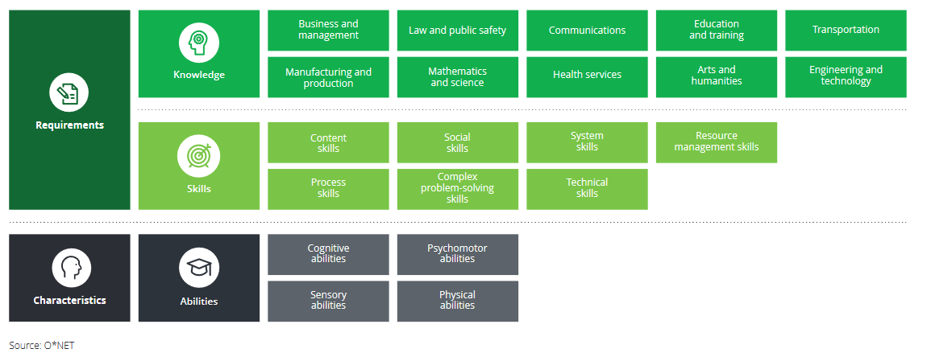
M2: Competences for digital era
Personal competencies framework
Notes:
Jim Sinur , "The Top Seven Digital Competencies for Organizations" Business Rules Journal Vol. 17, No. 4, (Apr. 2016)
URL: http://www.brcommunity.com/a2016/b856.html
The Top Seven Digital Competencies for Organizations
Summary: When you move technology from a supporting role in business to a leading player in business innovation, it requires deep competencies plus more and different skills. In this month's column Jim Sinur lists the top seven digital competencies he believes that organizations will need to possess as we progress in the digital age.
Jim Sinur VP and Research Fellow, Aragon Research Read Author Bio || Read All Articles by Jim Sinur
When you move technology from a supporting role in business to a leading player in innovation in business, it requires deep competencies plus more and different skills. I think there will be a change in what organizations will be looking for in new hires, technology professionals, business professionals, and business leaders. This is primarily motivated by organizations having to anticipate and respond to opportunities and threats from traditional and non-traditional sources.
Here are my top seven digital competencies that organizations must possess as we progress in the digital age. There are a number of new base skills & behaviors, values, and performance targets (standards & dimensions) that help build these competencies:
1 — Constituency Engagement
Customer relationships will be a big area of focus through better digital engagement designs, journey mapping, customer input, and realistic feedback loops. This is the start of digital, but better engagement needs to be expanded to include employees, partners, and value chain participants. The skills here are about listening and acting on what's best for all parties, not just the organization, and will require a much better "give and take" balance in relationships.
2 — Hyper Awareness
Organizations are no longer playing in a static world with simple business models. This puts a premium on not only being aware of traditional business contexts and simple business signals, but also on understanding emerging patterns. This requires skills in big data analytic capabilities that leverage algorithms and new/large data sources for emerging patterns of interest.
3 — Complex Problem Solving
In a fast-paced and complex world, the kinds of problems that will surface will be compound in nature and have more dimensions. This means the skills around complexity management will play a bigger role for organizations over time, as measured actions will have to be thought out over time in many arenas of impact. Organizations are ecosystems that play in and around other ecosystems, and potential interactions will need to be considered.
4 — Creative Digital Design
Knowing how to best combine digital capabilities with traditional capabilities, in not only an attractive way but also in a compelling way, is where most organizations are headed. This requires knowing the kind of user experience and man/machine interfaces that will compel an increase in business activity.
5 — Anticipatory Decision Making
Not only will organizations have to be acutely aware of what is happening in their own and neighboring contexts, they will have to be able to predict trends and new areas of impact. This includes predictive analytics, simulation, and cognitive computing capabilities. Driving organizations by looking through rear view mirrors is not the way forward, so there will be a premium on fast and future decisions.
6 — Innovative Productivity
While the traditional productivity levers will still work at times, there will be a demand to increase the new leveraging technologies such as bots and cognitive services (cogs). Resource optimization will go beyond simply creating stretch goals with punitive enforcement approaches. Resources will be considered in all the contexts they participate in at any moment in time and will be given assists that are both temporary and permanent.
7 — Operations Agility
There will be a premium on change management and technologies that respond quickly to change. This means that resources that are flexible will be desired. For people, it means that they might have to have incentives to take on risk. For software and hardware, dynamic configuration features will be a necessity. There will be pressure for rapid development through composition and configuration.
Net; Net
The digital world will be different, requiring additional competencies over and above the base competencies of an organization. This will require new skills that will be prized in the future. These skills will be shaped by the competencies that organizations need to build to survive and thrive in the digital world.

Slide 27
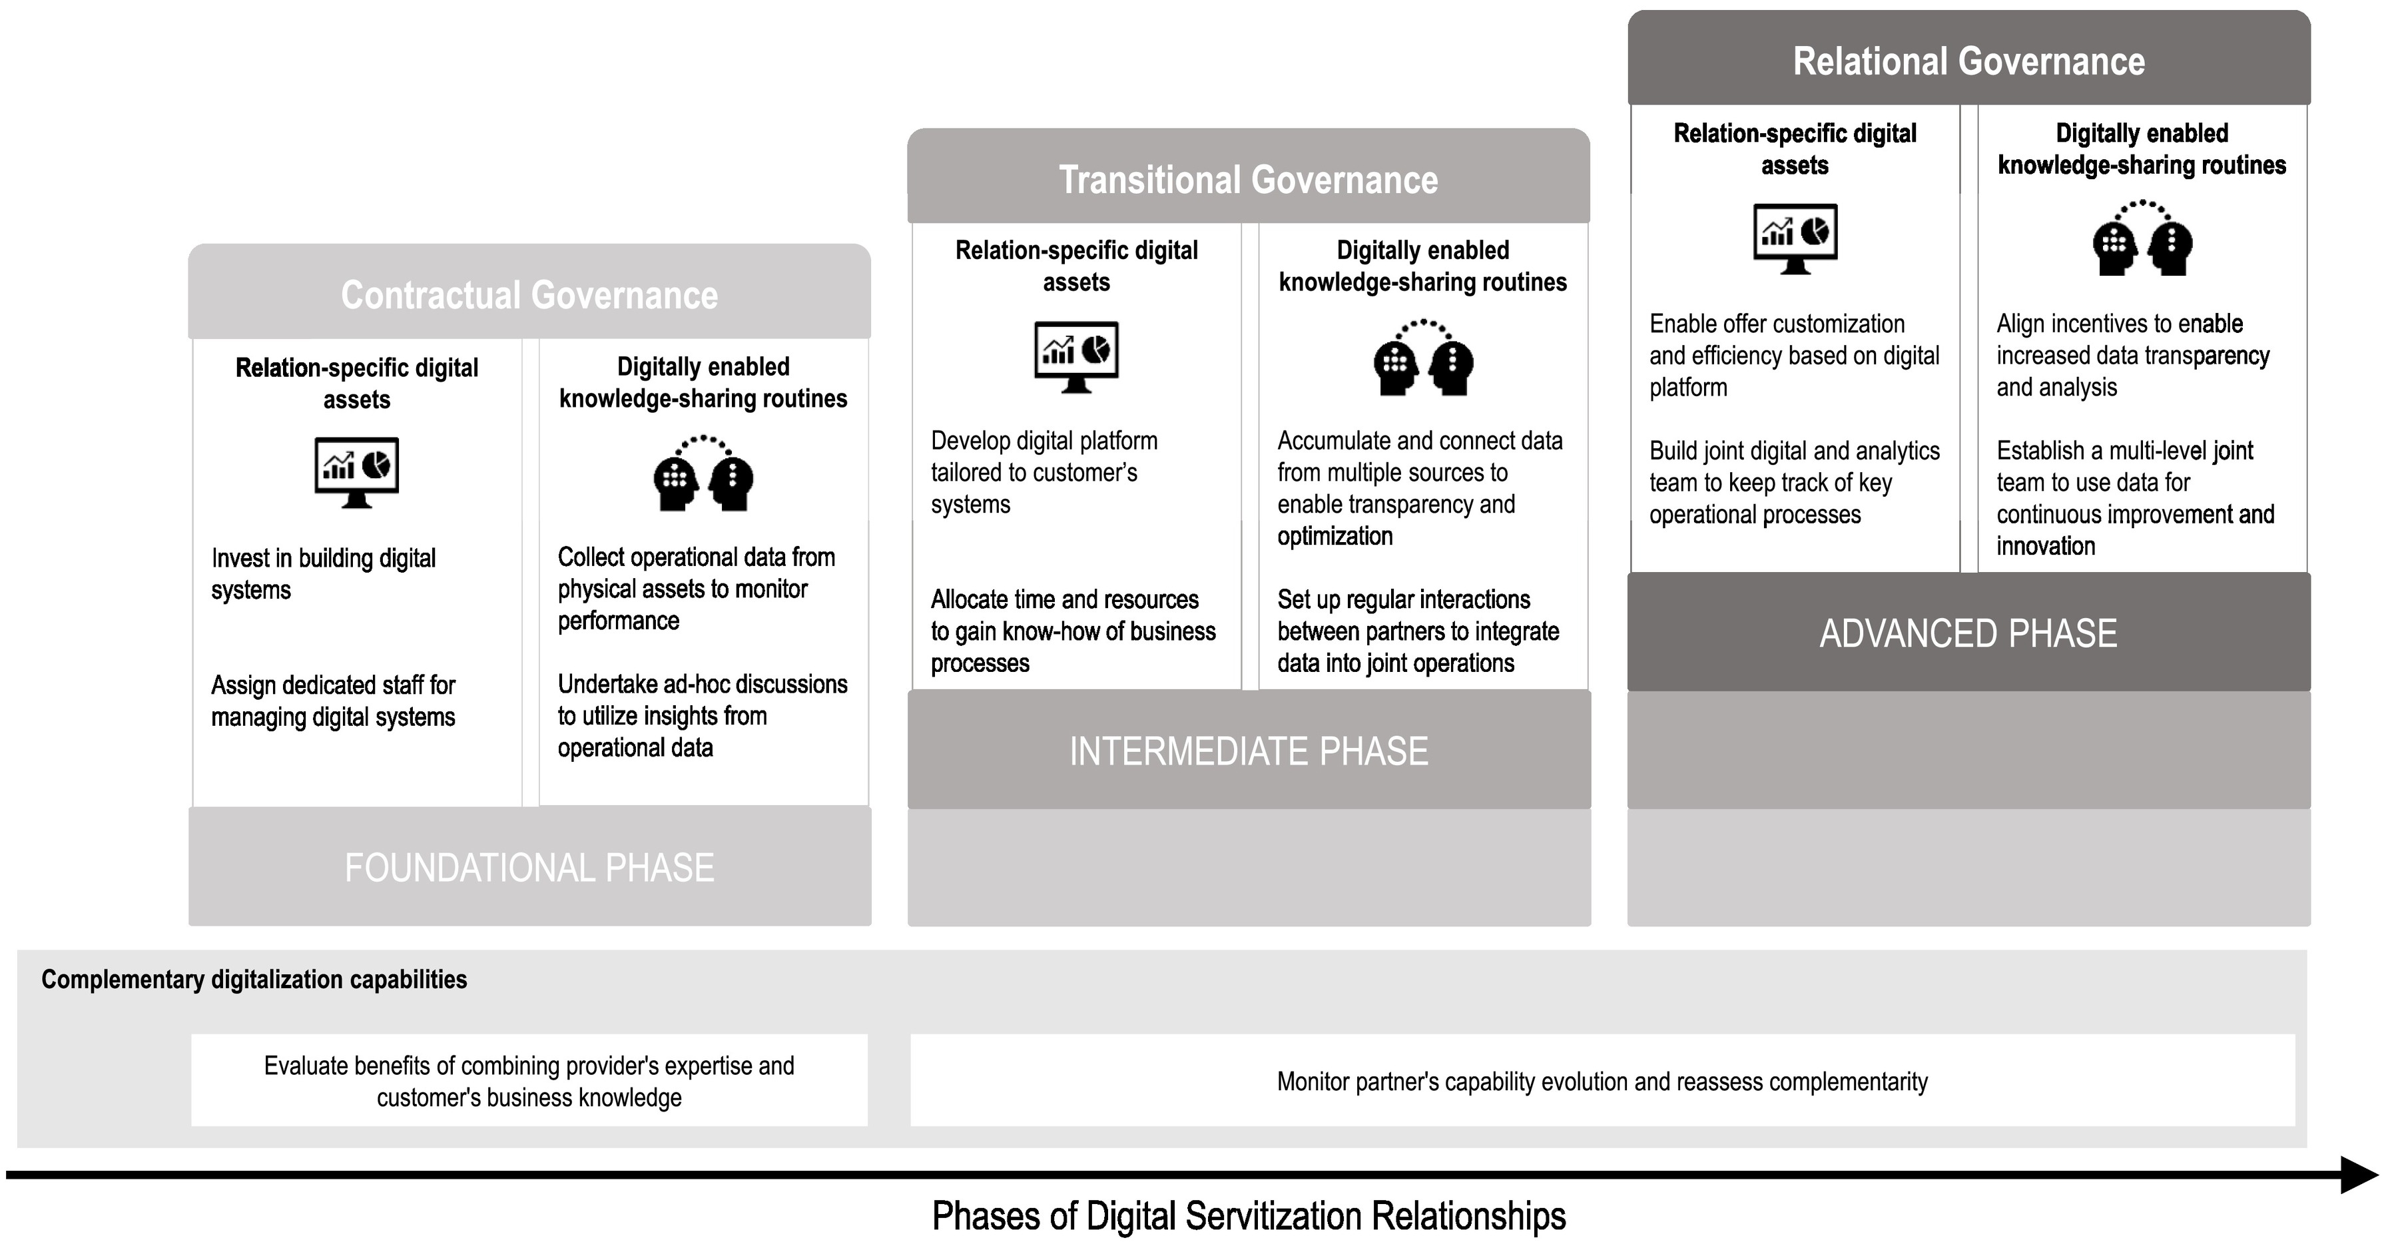
M2: Structures, resources and competences and relations for digital era
Personal competencies framework
M2: Competences for digital era
Relational transformation framework
Notes:
https://doi.org/10.1016/j.indmarman.2020.02.004

Slide 28
M2: Structures, resources and competences and relations for digital era
Digital Competencies of Organizations
Constituency Engagement
Hyper Awareness
Complex Problem Solving
Creative Digital Design
Anticipatory Decision Making
Innovative Productivity
Operations Agility
(Sinur, 2016)
Notes:
Jim Sinur , "The Top Seven Digital Competencies for Organizations" Business Rules Journal Vol. 17, No. 4, (Apr. 2016)
URL: http://www.brcommunity.com/a2016/b856.html
The Top Seven Digital Competencies for Organizations
Summary: When you move technology from a supporting role in business to a leading player in business innovation, it requires deep competencies plus more and different skills. In this month's column Jim Sinur lists the top seven digital competencies he believes that organizations will need to possess as we progress in the digital age.
Jim Sinur VP and Research Fellow, Aragon Research Read Author Bio || Read All Articles by Jim Sinur
When you move technology from a supporting role in business to a leading player in innovation in business, it requires deep competencies plus more and different skills. I think there will be a change in what organizations will be looking for in new hires, technology professionals, business professionals, and business leaders. This is primarily motivated by organizations having to anticipate and respond to opportunities and threats from traditional and non-traditional sources.
Here are my top seven digital competencies that organizations must possess as we progress in the digital age. There are a number of new base skills & behaviors, values, and performance targets (standards & dimensions) that help build these competencies:
1 — Constituency Engagement
Customer relationships will be a big area of focus through better digital engagement designs, journey mapping, customer input, and realistic feedback loops. This is the start of digital, but better engagement needs to be expanded to include employees, partners, and value chain participants. The skills here are about listening and acting on what's best for all parties, not just the organization, and will require a much better "give and take" balance in relationships.
2 — Hyper Awareness
Organizations are no longer playing in a static world with simple business models. This puts a premium on not only being aware of traditional business contexts and simple business signals, but also on understanding emerging patterns. This requires skills in big data analytic capabilities that leverage algorithms and new/large data sources for emerging patterns of interest.
3 — Complex Problem Solving
In a fast-paced and complex world, the kinds of problems that will surface will be compound in nature and have more dimensions. This means the skills around complexity management will play a bigger role for organizations over time, as measured actions will have to be thought out over time in many arenas of impact. Organizations are ecosystems that play in and around other ecosystems, and potential interactions will need to be considered.
4 — Creative Digital Design
Knowing how to best combine digital capabilities with traditional capabilities, in not only an attractive way but also in a compelling way, is where most organizations are headed. This requires knowing the kind of user experience and man/machine interfaces that will compel an increase in business activity.
5 — Anticipatory Decision Making
Not only will organizations have to be acutely aware of what is happening in their own and neighboring contexts, they will have to be able to predict trends and new areas of impact. This includes predictive analytics, simulation, and cognitive computing capabilities. Driving organizations by looking through rear view mirrors is not the way forward, so there will be a premium on fast and future decisions.
6 — Innovative Productivity
While the traditional productivity levers will still work at times, there will be a demand to increase the new leveraging technologies such as bots and cognitive services (cogs). Resource optimization will go beyond simply creating stretch goals with punitive enforcement approaches. Resources will be considered in all the contexts they participate in at any moment in time and will be given assists that are both temporary and permanent.
7 — Operations Agility
There will be a premium on change management and technologies that respond quickly to change. This means that resources that are flexible will be desired. For people, it means that they might have to have incentives to take on risk. For software and hardware, dynamic configuration features will be a necessity. There will be pressure for rapid development through composition and configuration.
Net; Net
The digital world will be different, requiring additional competencies over and above the base competencies of an organization. This will require new skills that will be prized in the future. These skills will be shaped by the competencies that organizations need to build to survive and thrive in the digital world.

Slide 29
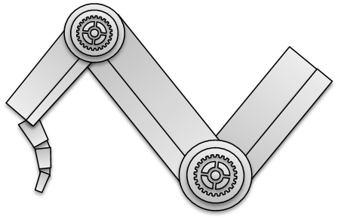




M2: Business models for digital economy

Slide 30


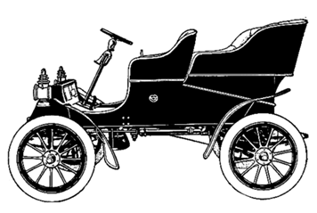
Henry Ford's slogan may be a symbol of OLD business model and a period in economic history: “Any customer can have a car painted any color that he wants so long as it is black."
The era of mass production basically continues to this day. Mass production is fueled by international trade associated with economic globalization and the unification of consumer habits.

Slide 31
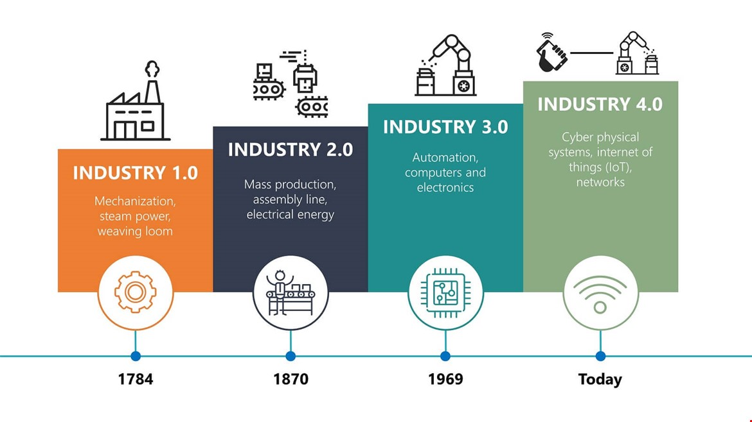
The most groundbreaking change in production systems and business is the fourth industrial revolution called Industry 4.0: a generalized term for the integration of intelligent machines, systems and manufacturing proces.

Slide 32

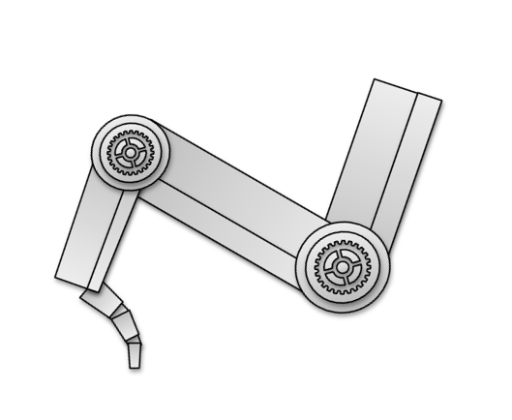

The term business model became popular in the late 90s, which, is related to the rapid erosion of prices in the IT and telecom industry.

Slide 33
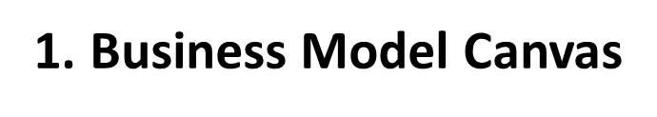

Slide 34
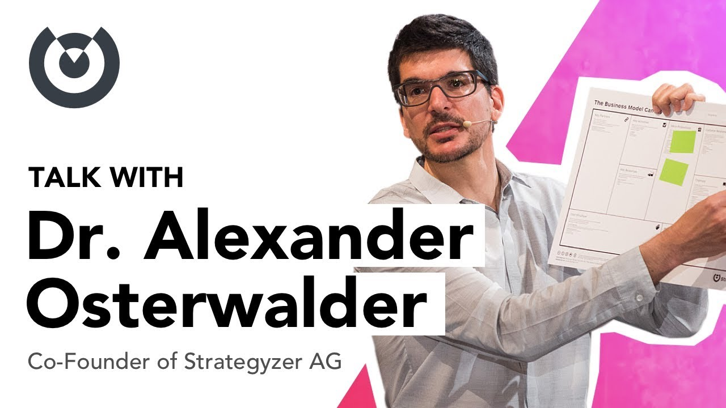
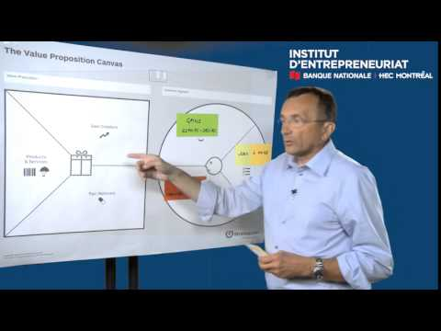
Years ago, a simple tool was developed that revolutionized the approach to the business model: -
a Business Model Canvas (BMC)

Slide 35
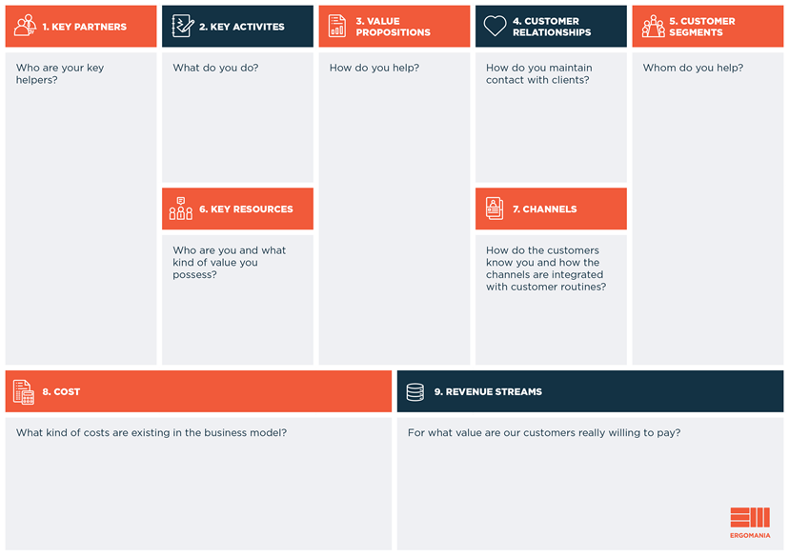

Slide 36
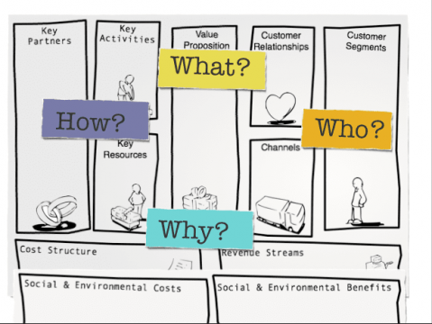
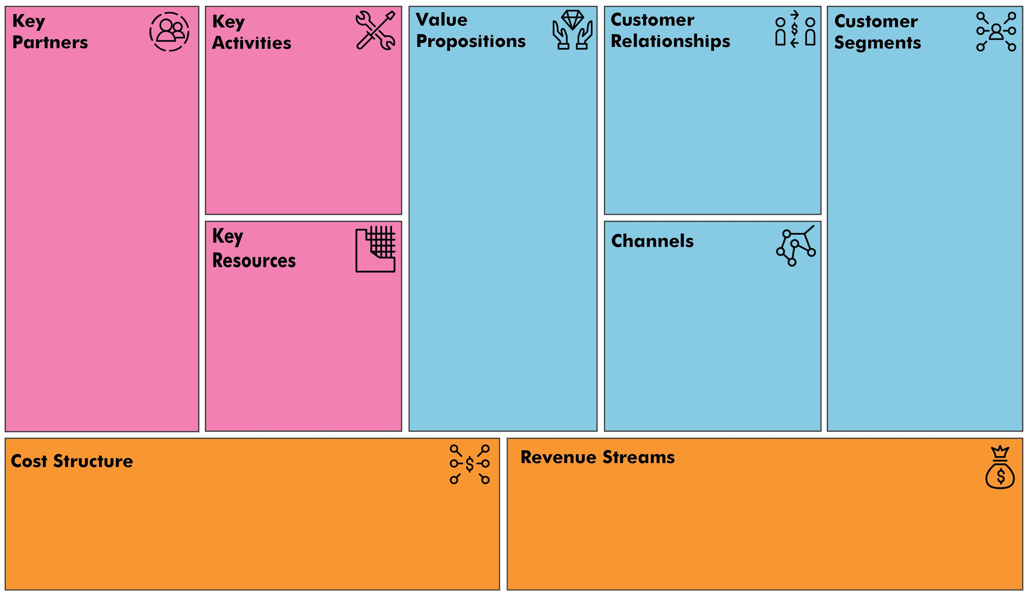

Slide 37

2. THE LEAN CANVAS

Slide 38
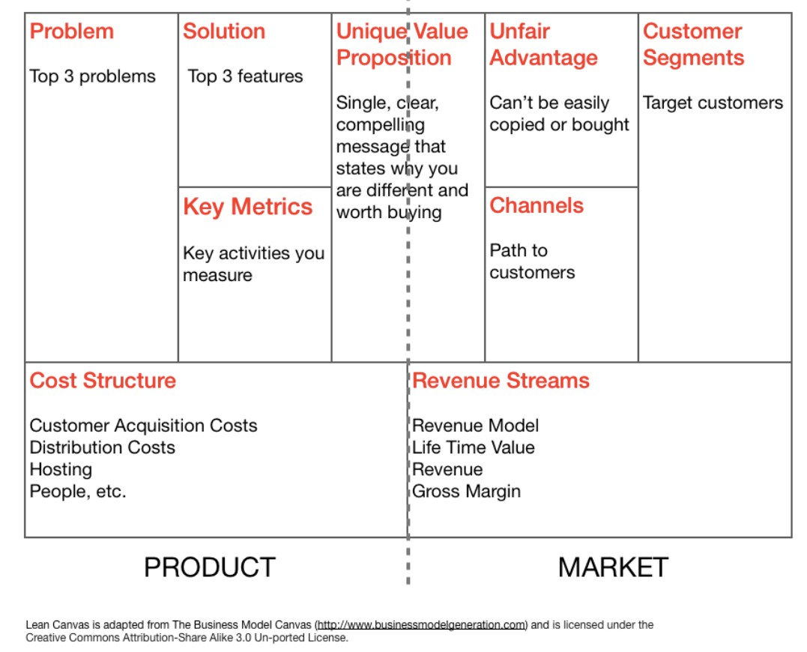
2. THE LEAN CANVAS
This model is dedicated to innovative business, such as 3D printing. Its author is Ash Maurya, who was inspired by the Business Model Canvas tool.

Slide 39
Without a problem to solve, you don’t have
a product/service to offer.
Finding a solution to the problem is the golden egg!
Key Metrics
Every business, no matter what industry or size, will have some key metrics that are used to monitor performance.
Unfair advantage can be insider information, a dream team, getting expert endorsements, existing customers etc.

Slide 40
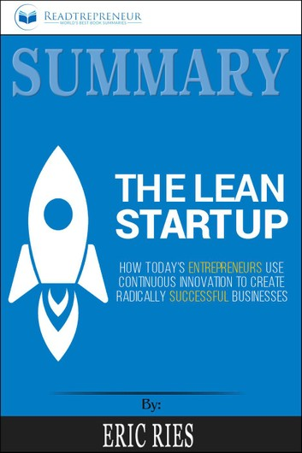
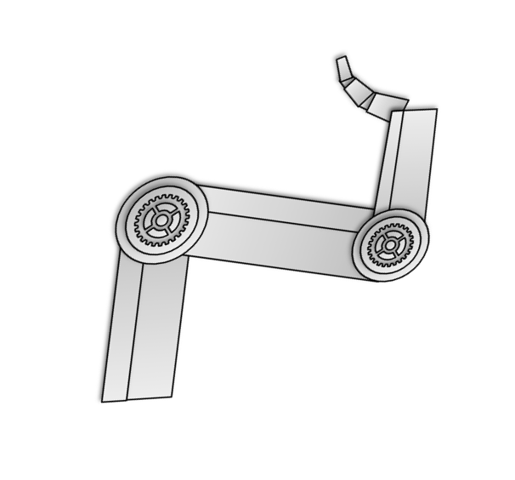
3. The Lean Startup

Slide 41
3. The Lean Startup
One of the major causes to startup failure is premature scaling. Premature scaling means that the startup starts to spend money on growth (e.g. hiring sales persons, leasing offices, expensive marketing etc.) before finding the Product and Market fit.

Slide 42
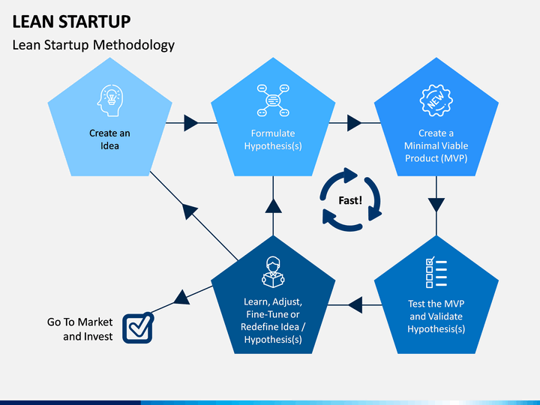

Slide 43
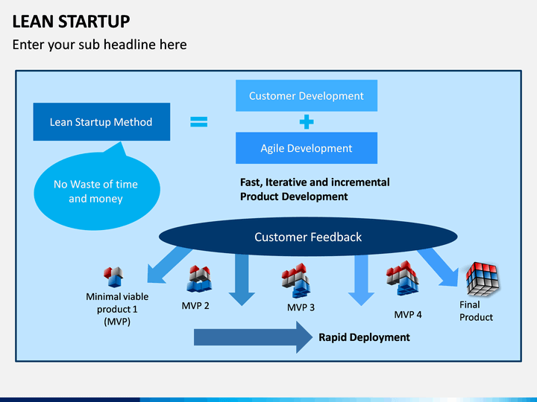

Slide 44
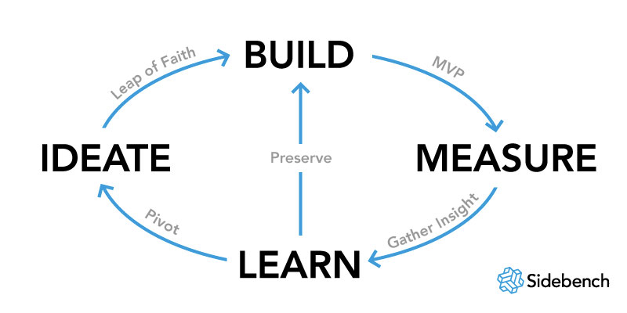
A business model of a new venture is filled with assumptions and hypotheses since little is known at start. Entrepreneurs should interact with customers as early as possible.
If the entrepreneur’s assumptions of the startup’s business model turn out to be incorrect after interaction with customers should the entrepreneur consider a major change – a pivot.
The pivot is a decision to change some or several parts of the hypotheses concerning the startup’s business model based on learning from customers.

Slide 45
Why do we need good business models for digital economy?

Slide 46

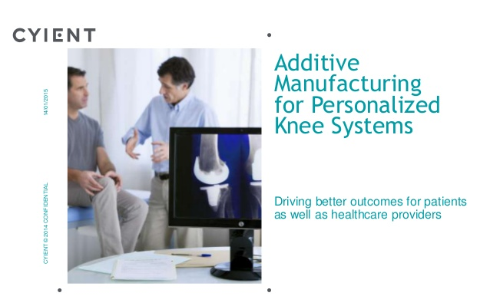
Manufacturing as a Service

