Slide 1
Cyber Physical System (CPS)
and Data Security
Module II: Digital Factory Modeling: How to formulate a virtual world
Prof.Dr.Athakorn Kengpol, KMUTNB

Slide 2
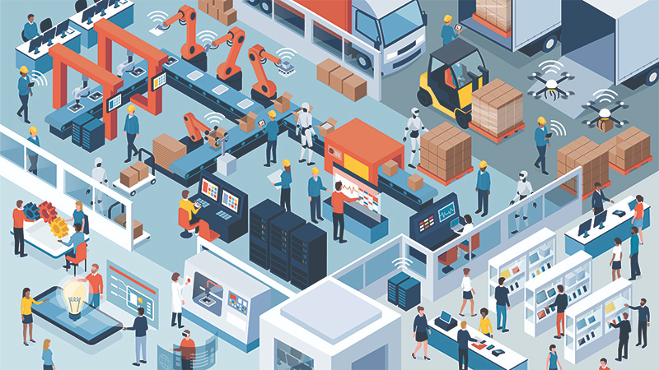
Learning Outcome
2 /53
Digital Factory
Formulate a data model representing data streamlining in a production line of an existing traditional factory using a data flow diagram

Slide 3
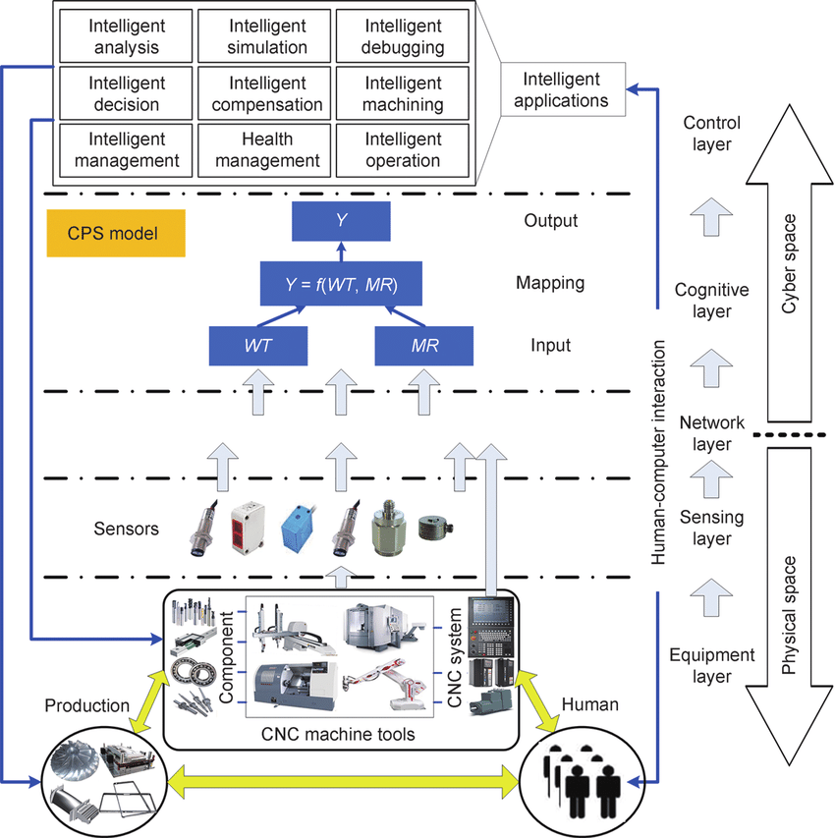
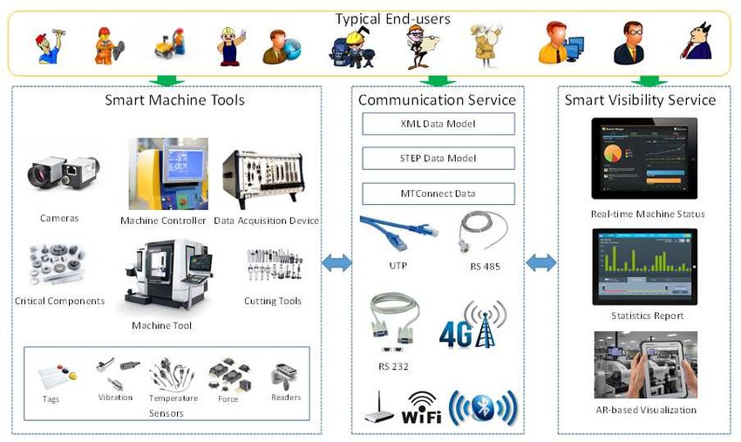
3 /53
Activities (Example)
Digital Factory
The-CPS-architecture-of-CNC-machine-tools-with-a-CPS-model
https://www.researchgate.net/figure/CPS-enabled-Smart-Machine-Tools-After-the-smart-design-CPS-enabled-smart-machine-tools_fig3_322673524
https://www.researchgate.net/figure/The-CPS-architecture-of-CNC-machine-tools-with-a-CPS-model_fig1_283117000

Slide 4
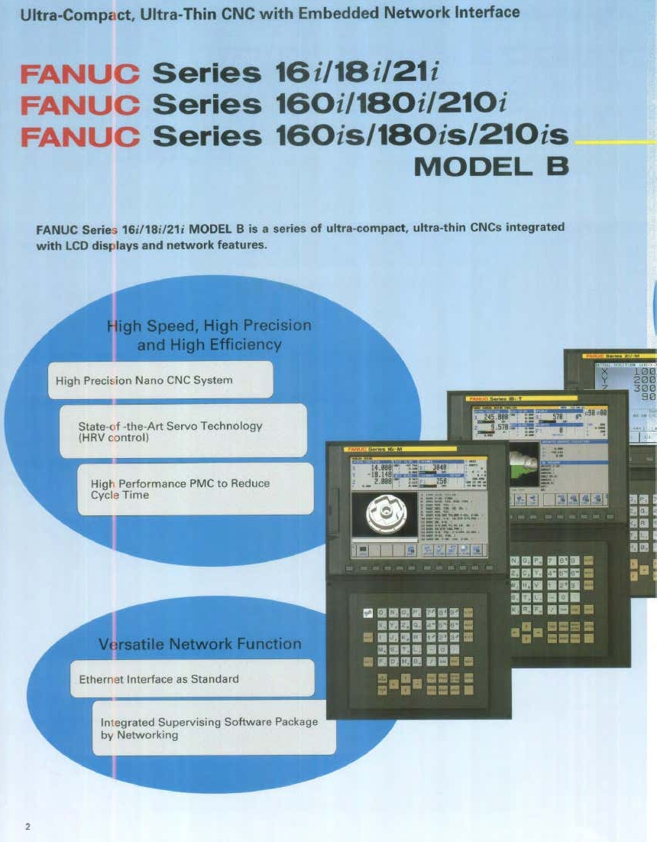
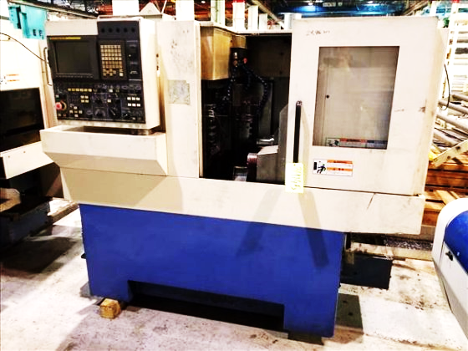
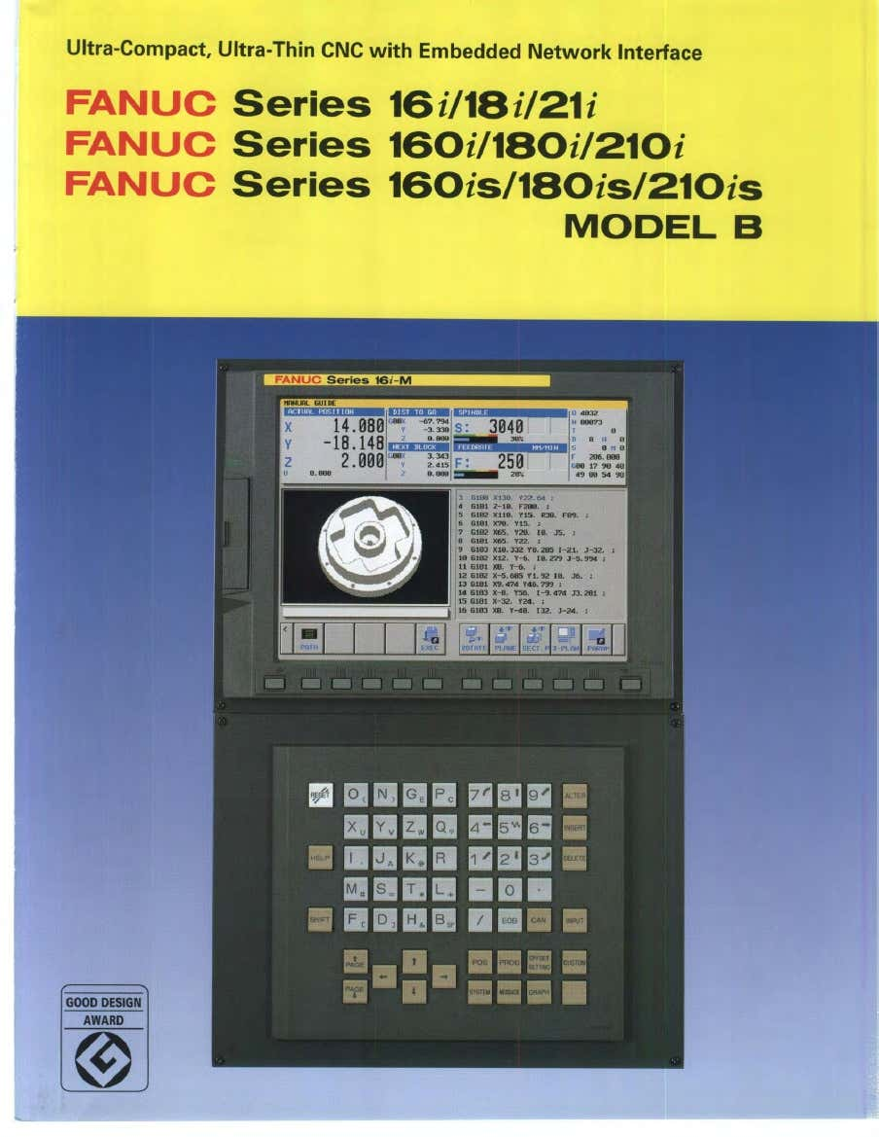
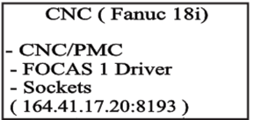
Activities (Lab sheet)
4 /53
Digital Factory
Design and development of a system for CNC turning to be in the form of Cyber-Physical Production Systems by writing architecture, data flow diagram and some available services. Streamlining process in the production line of CNC turning. Use data below:

Slide 5
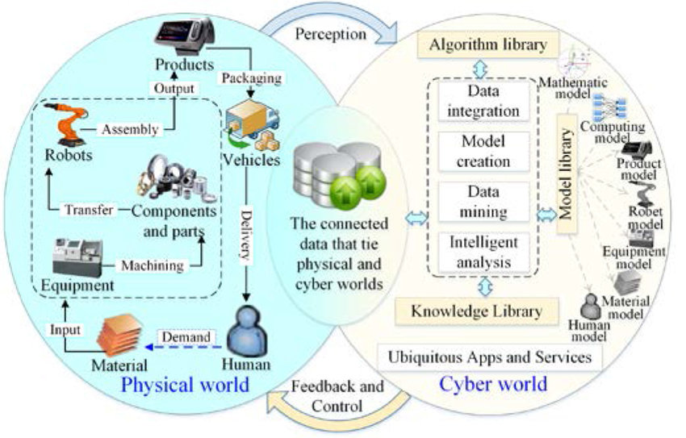
Summary
5 /53
Digital Factory
Cyber-physical systems are everywhere, from semi-autonomous vehicles to wearable devices. These types of systems blend human and compute power, and integrating mechanical systems with human physical interaction giving both a form of "super powers". Opportunities to specialize in cyber-physical systems are growing as quickly as the technology itself, from large corporations to individual makers ...
CPS is the way to streamlining process in a production line of an existing traditional factory using a data flow diagram.
https://www.researchgate.net/figure/Manufacturing-cyber-physical-integration-and-fusion-supported-by-CPS-in-SoSM_fig6_318694164

Slide 6
Learning Outcome
6 /53
Digital Factory
Formulate a data model representing data streamlining in a production line of an existing traditional factory using a data flow diagram

Slide 7
53/53
Thank you

