Slide 1
Course 12: Additive Manufacturing for Industry 4.0
Lecture 8 – Teaching material (T)
Developer: Mihaela Ulmeanu

Slide 2
8. Optimization of 3D printing process parameters
Machine preparation and settings
Design rules for 3D printing
Part quality (layer height, line width etc.)
Part shell (wall thickness, top/bottom thickness, bottom pattern initial layer etc.)
Part infill (infill density, infill pattern, infill support etc.)
Material characteristics (printing temperature, flow rate, diameter etc)
Printing speed and travel
Post-processing
Technology specific parameters

Slide 3
Machine preparation and settings
Guidance from the machine manufacturer on regular machine maintenance should always be followed, however, internal additional steps should be considered, for example: • checking the tip wipers for wear ahead of production to allow a clean tip wipe ahead of each build layer; • checking the purge chute is clear preventing a backlog during production; • checking that the build chamber is clear of debris and a new sacrificial build sheet is placed in ahead of each production run; and • ensuring that the correct material and a sufficient amount is loaded prior to pressing go on the machine.
See Laboratory 1, Workshop 1 & Workshop 2 for further guides on FDM machine preparations.

Slide 4
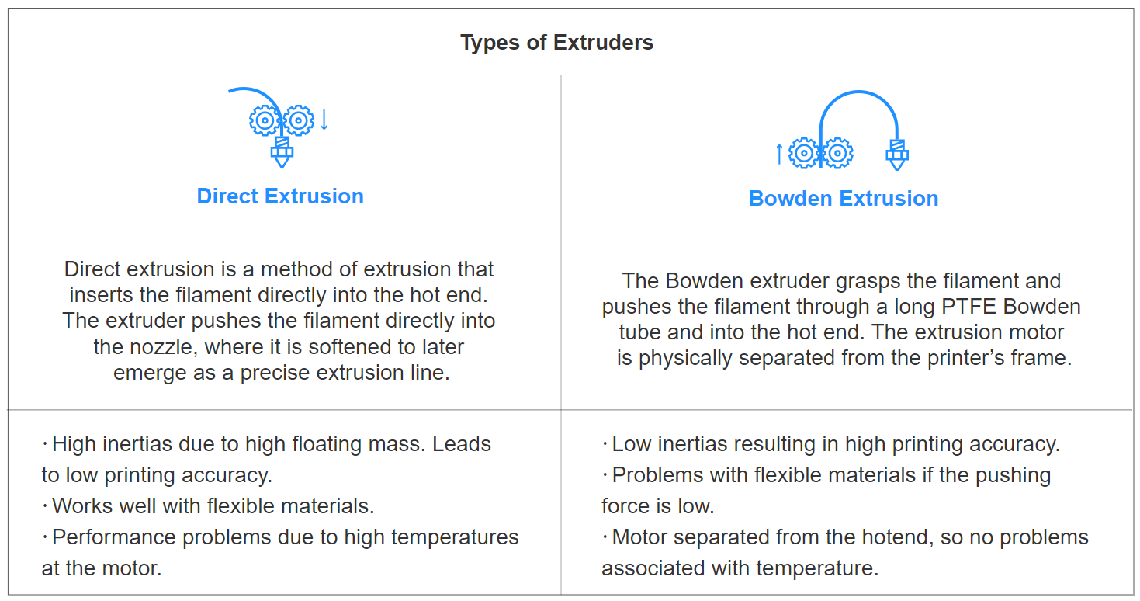
For FDM machine preparation varies on the constructive particularities of the machines
https://www.bcn3d.com/guide-on-how-to-choose-professional-desktop-3d-printer/

Slide 5
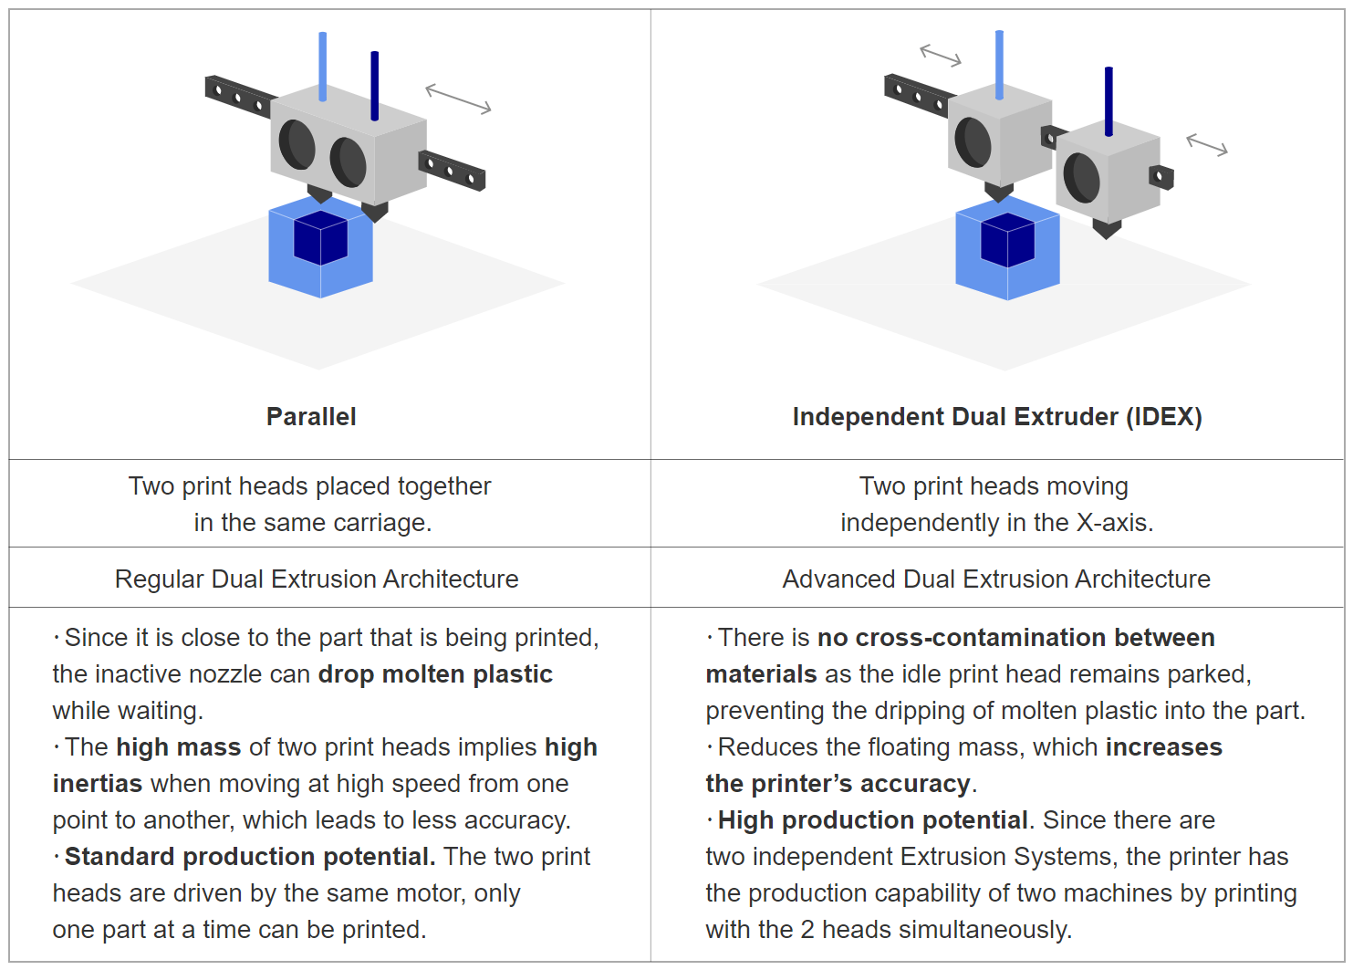
https://www.bcn3d.com/guide-on-how-to-choose-professional-desktop-3d-printer/

Slide 6
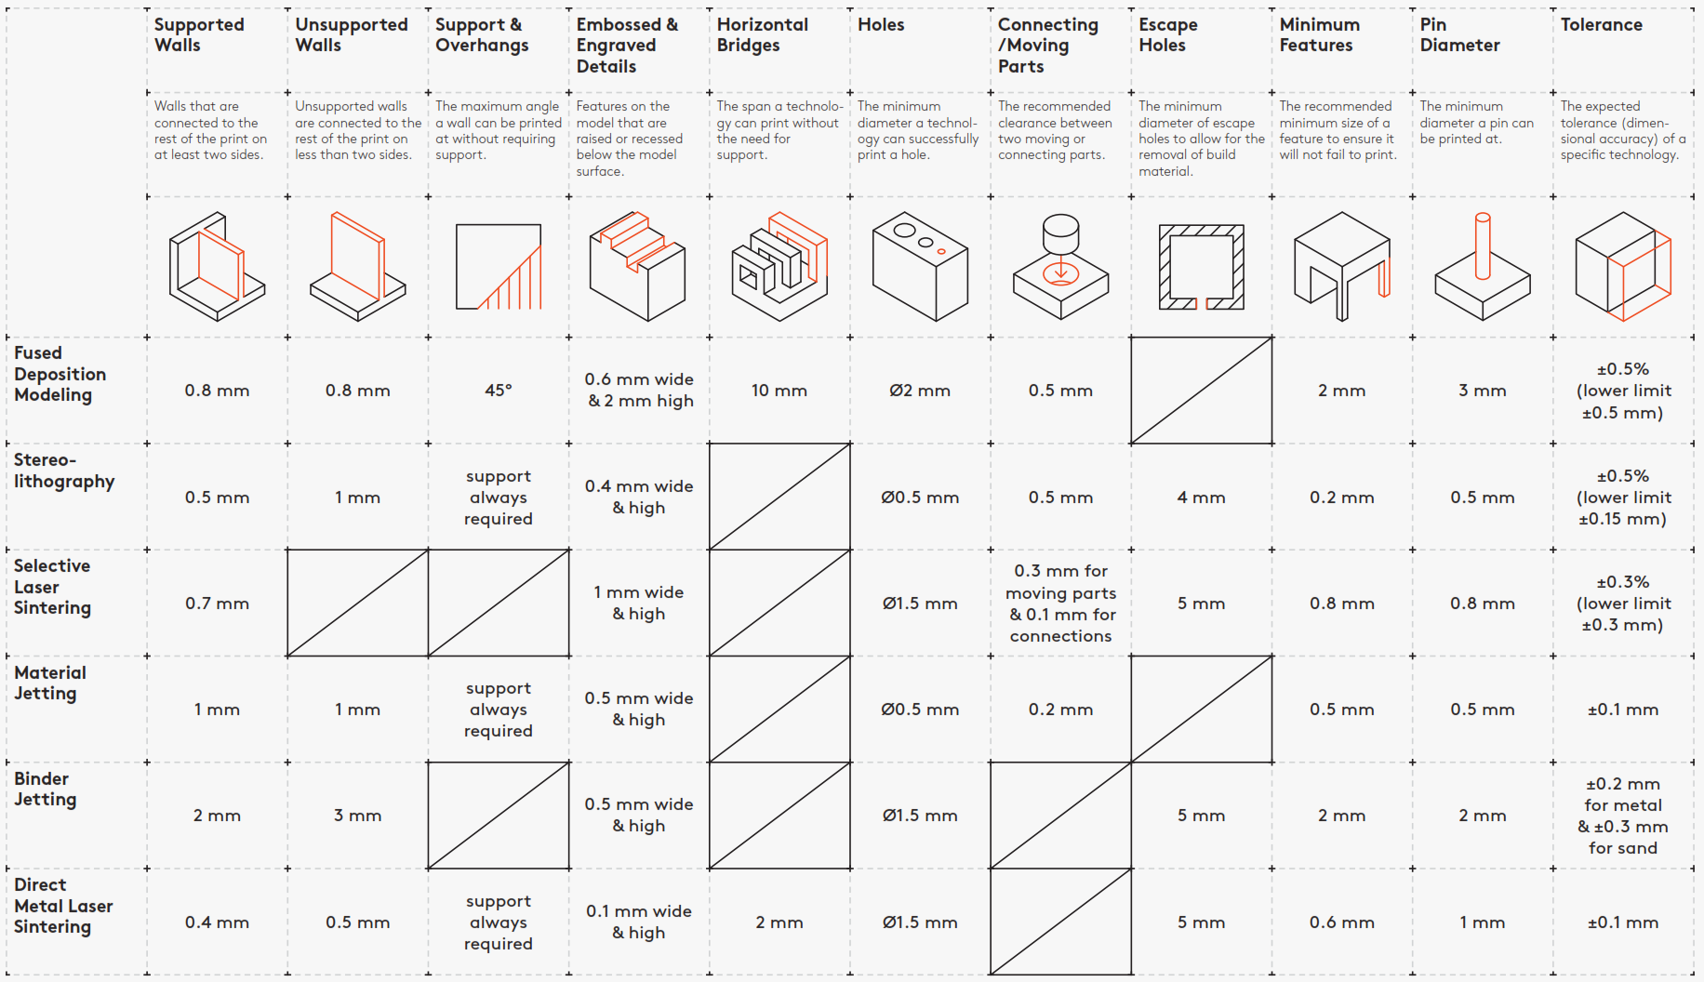
Design rules for 3D printing
https://www.3dhubs.com/knowledge-base/key-design-considerations-3d-printing/

Slide 7
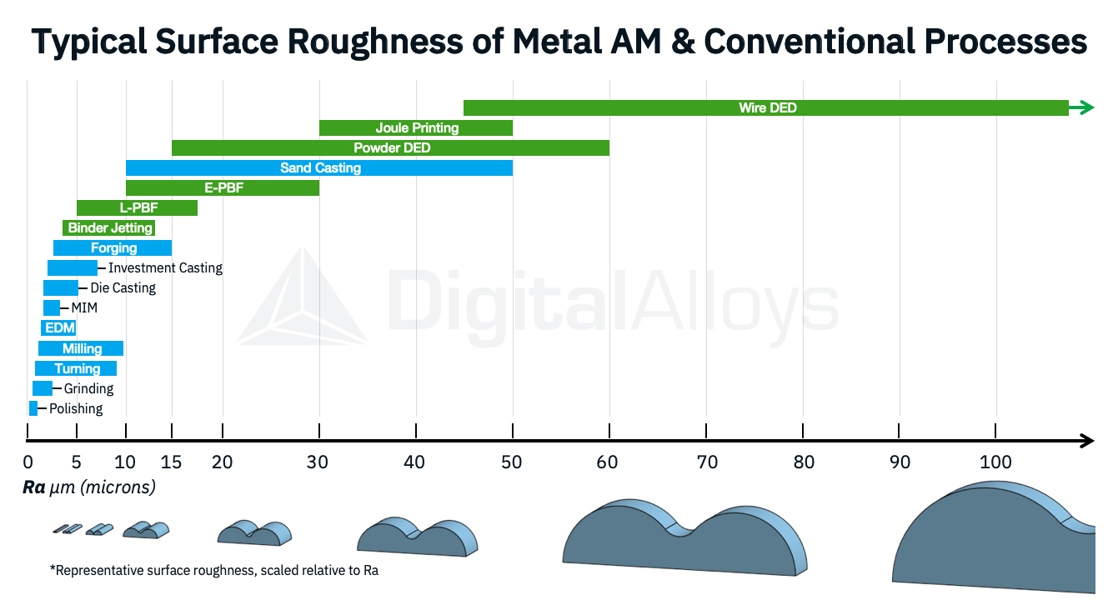
Part quality
https://www.digitalalloys.com/blog/surface-roughness/

Slide 8
The surface quality of 3D printed parts
https://3faktur.com/en/the-surface-quality-of-3d-printed-parts/

Slide 9
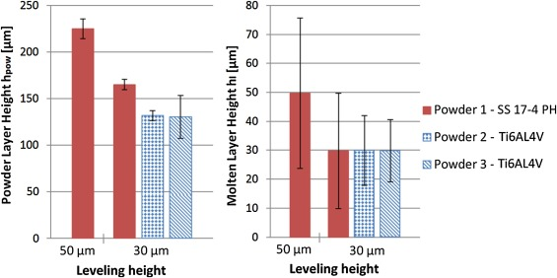
https://www.sciencedirect.com/science/article/pii/S2214860418306444

Slide 10
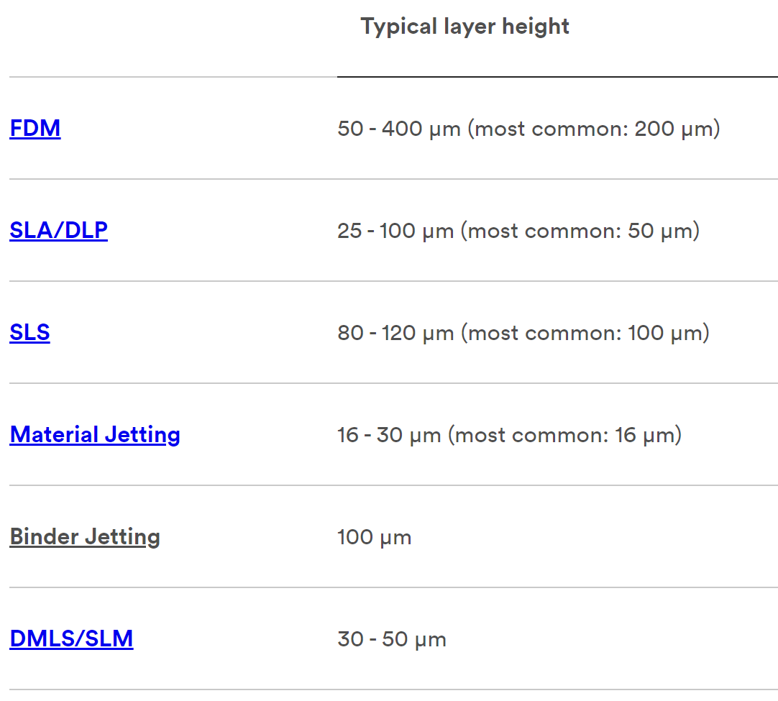
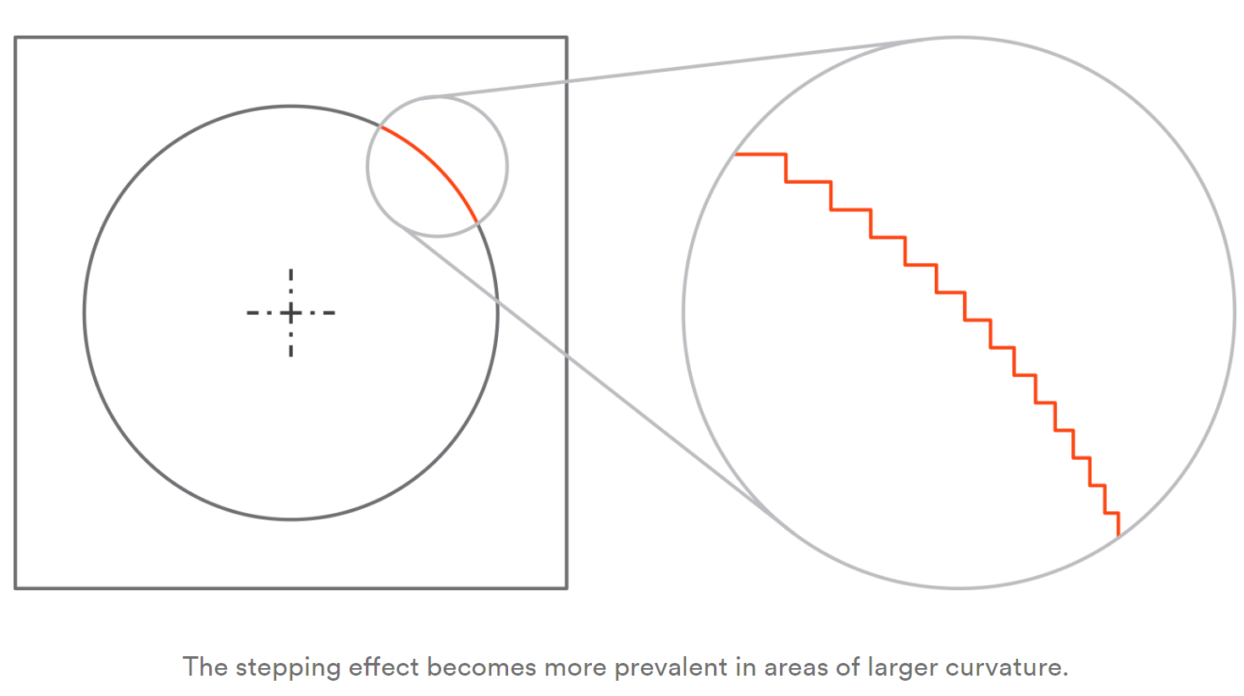
https://www.3dhubs.com/knowledge-base/impact-layer-height-3d-print/

Slide 11
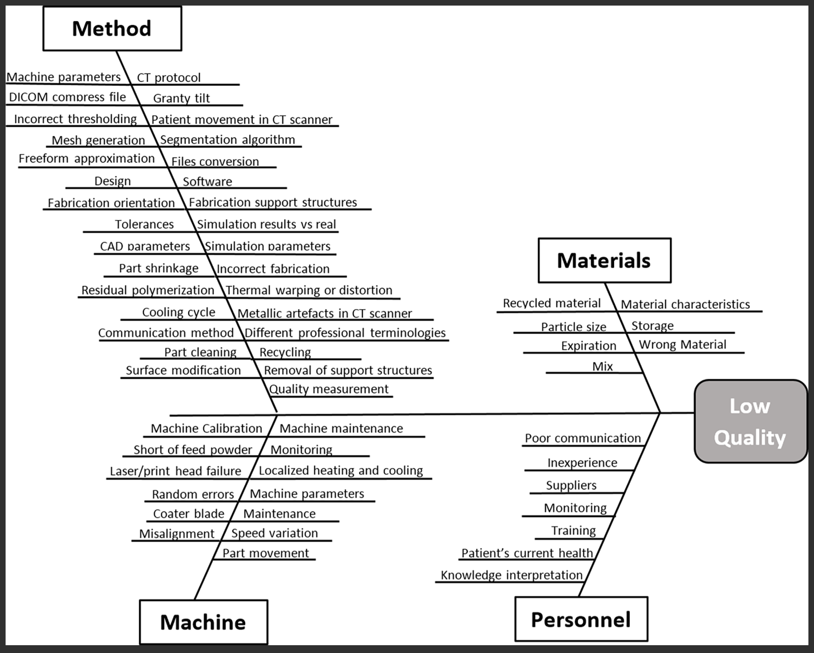
Case study: 3D printed bone prostheses and scaffolds
https://journals.plos.org/plosone/article?id=10.1371/journal.pone.0195291

Slide 12
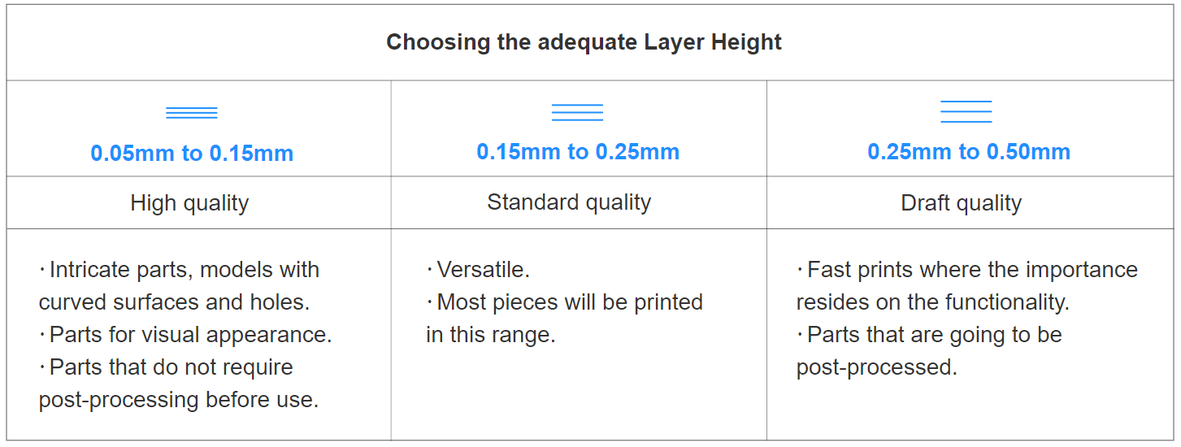
Layer height
https://www.bcn3d.com/guide-on-how-to-choose-professional-desktop-3d-printer/

Slide 13
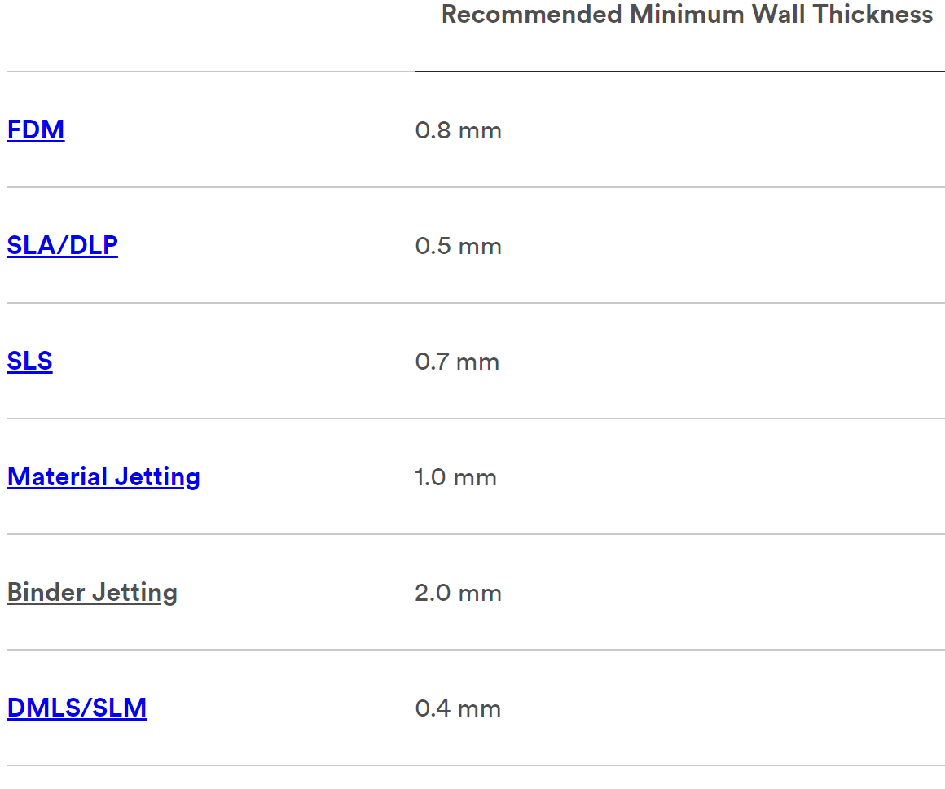
https://www.3dhubs.com/knowledge-base/3d-printing-geometry-restrictions/

Slide 14
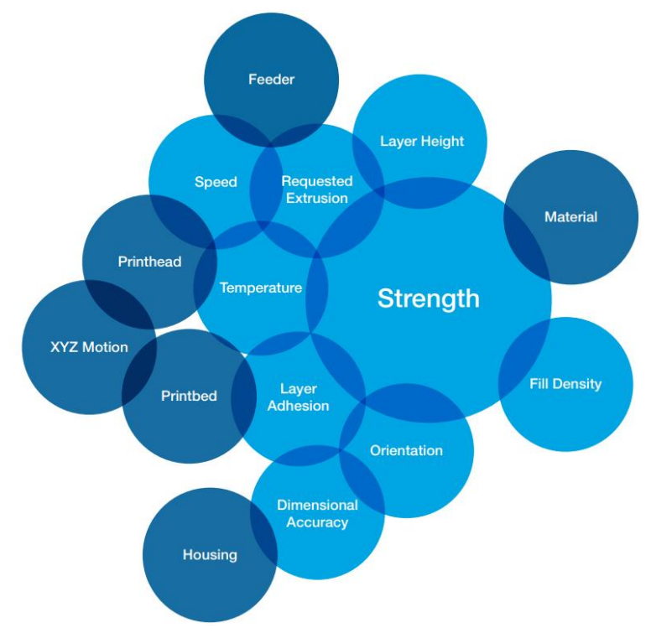
Parameters that influence on strength of FDM 3D printed material
https://www.daaam.info/Downloads/Pdfs/proceedings/proceedings_2019/074.pdf

Slide 15
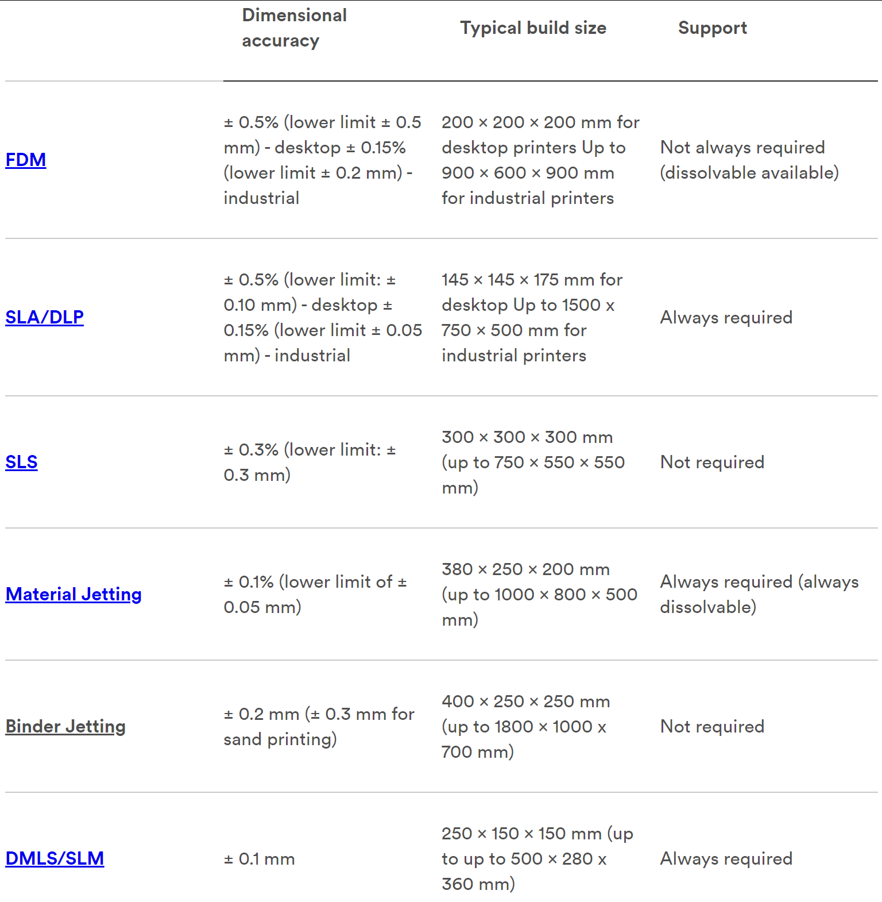
https://www.3dhubs.com/knowledge-base/selecting-right-3d-printing-process/

Slide 16
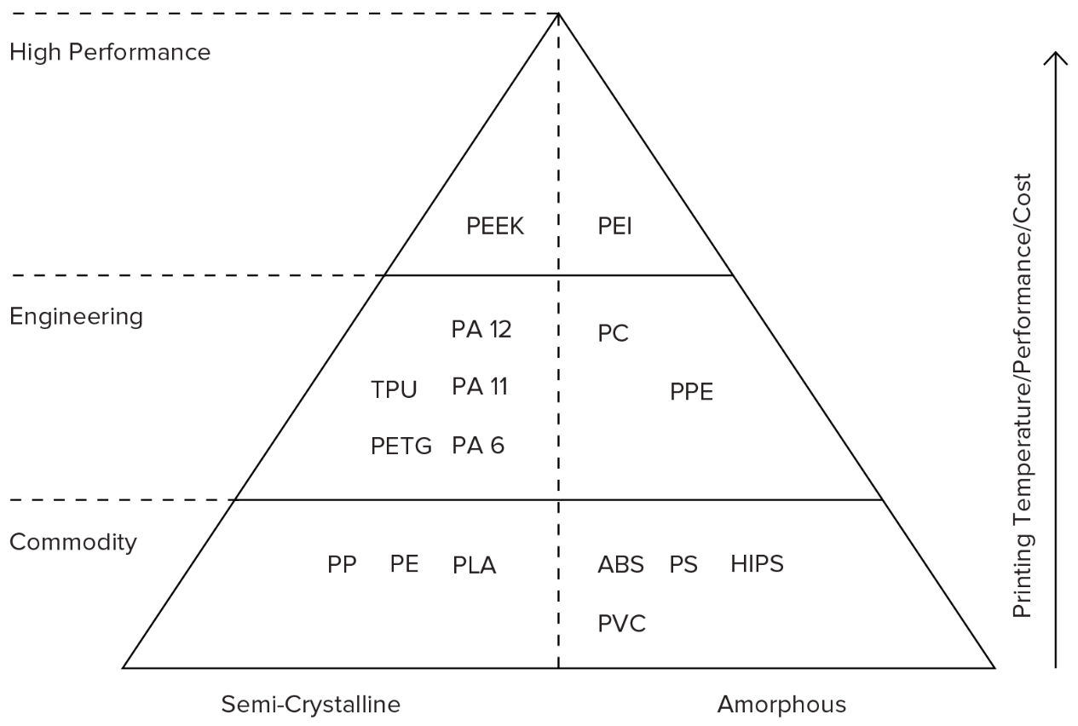
https://www.3dhubs.com/knowledge-base/selecting-right-3d-printing-process/

Slide 17
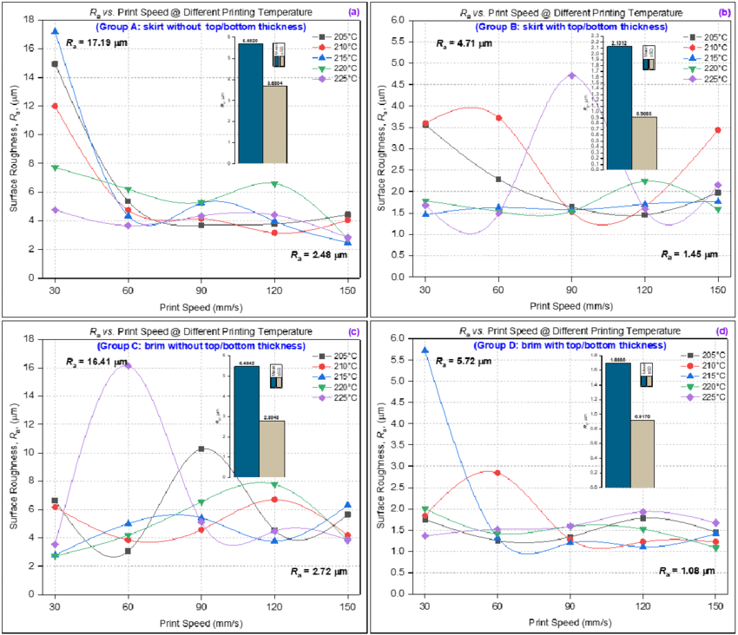
Surface roughness vs print speed at different printing temperature
https://www.researchgate.net/figure/Surface-roughness-versus-print-speed-different-printing-temperature-a-skirt-without_fig6_333133123

Slide 18
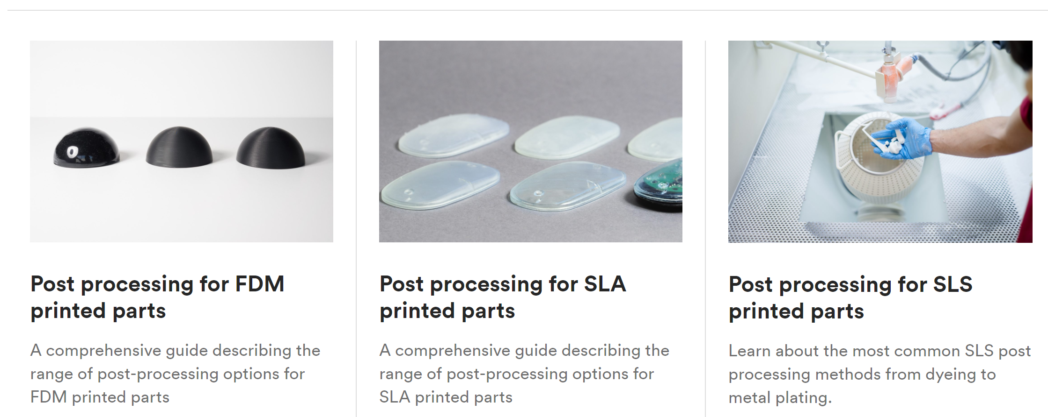
Post processing

Slide 19
https://insights.globalspec.com/article/7447/factors-to-consider-when-3d-printing-or-additive-manufacturing-metal-parts

Slide 20
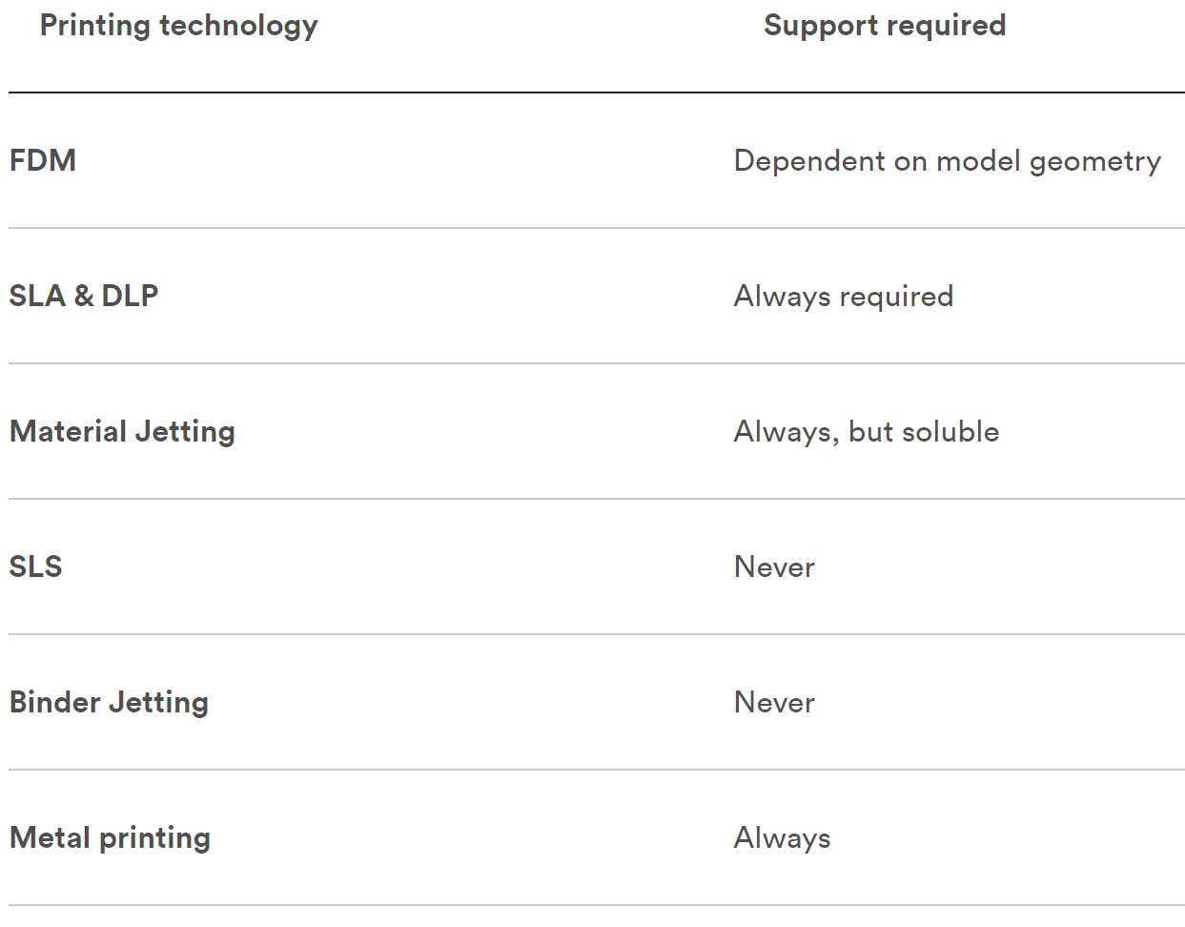
https://www.3dhubs.com/knowledge-base/supports-3d-printing-technology-overview/

Slide 21
Post-Processing Methods
Methods vary depending on AM technology, but the most common are:
Depowdering
Shot Peening
Dyeing
Spray Painting
Chemical Smoothing
Flocking
Coating
Galvanization
Physical Vapor Deposition (PVD) Coating
Chemical Vapor Deposition (CVD) Coating

