Slide 1
Course 12: Additive Manufacturing for Industry 4.0
Lecture 10 – Teaching material (T)
Developer: Mihaela Ulmeanu

Slide 2
10. Macro environment of AM
Workforce of the future
Intellectual property issues
Standards
Quality assurance
Manufacturing and Supply chain
Product design
Digital thread & Industry 4.0
European policies
Further reading:
https://www2.deloitte.com/us/en/insights/tags/additive-manufacturing.html

Slide 3
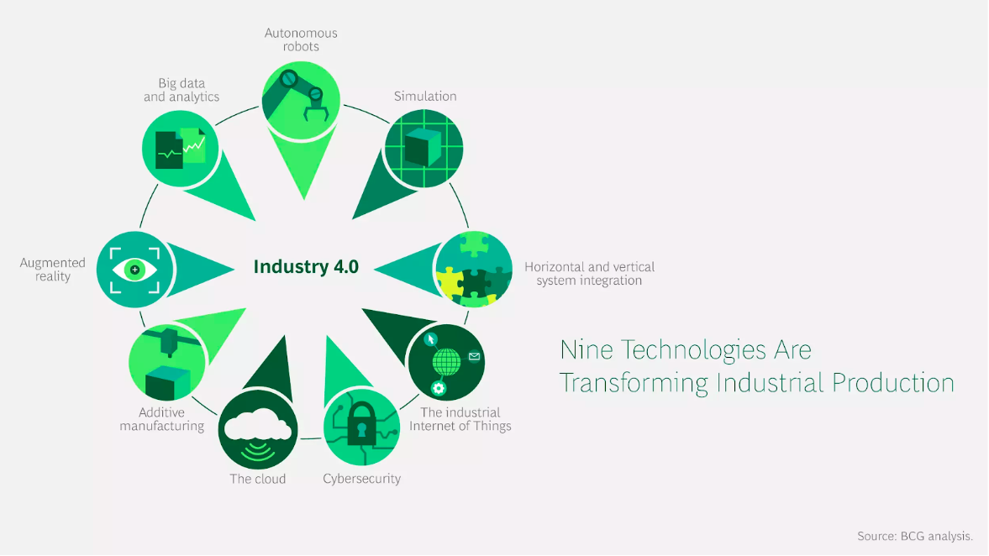

Slide 4
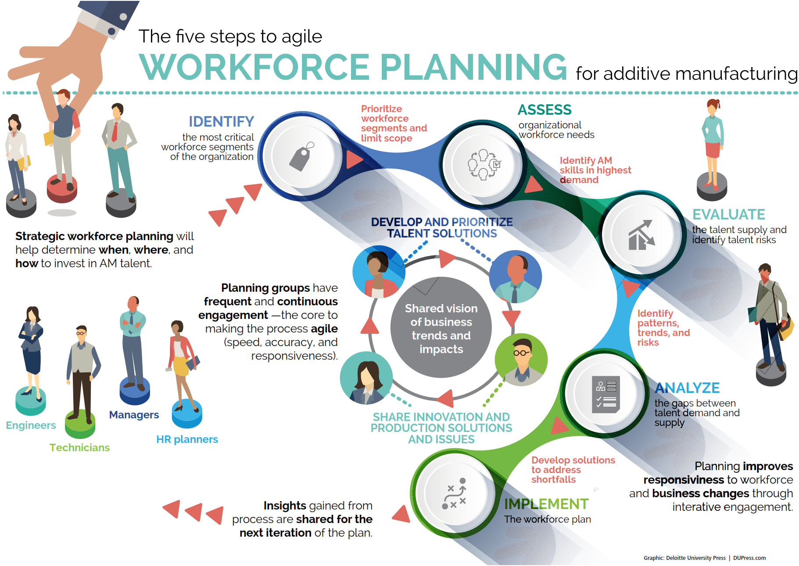
Workforce of the future
“To realize the full potential
of AM, manufacturing
organizations must focus
on developing a capable
and skilled AM workforce.”
3D opportunity for the talent gap: Additive manufacturing and the workforce of the future, A Deloitte series on additive manufacturing

Slide 5
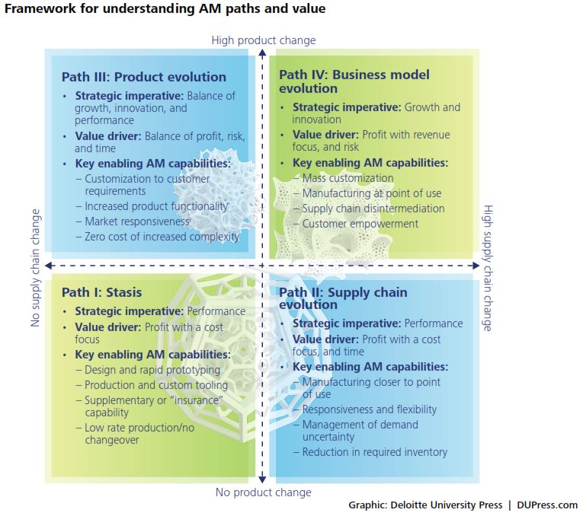
“To be sure, this soaring demand for
skilled labor is not exclusive to AM.
In fact, the talent shortages facing
AM mirror a widely recognized
skills gap across the manufacturing
industry as a whole.”
3D opportunity for the talent gap: Additive manufacturing and the workforce of the future, A Deloitte series on additive manufacturing

Slide 6
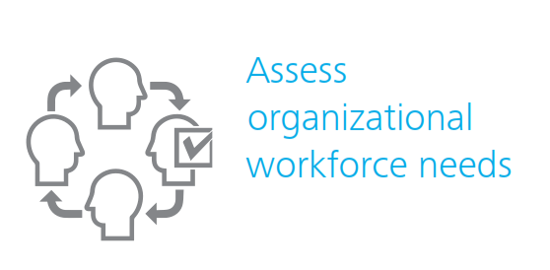
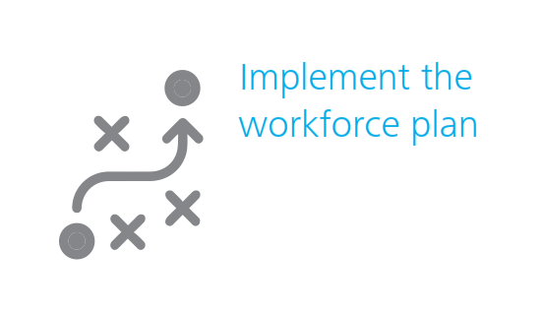
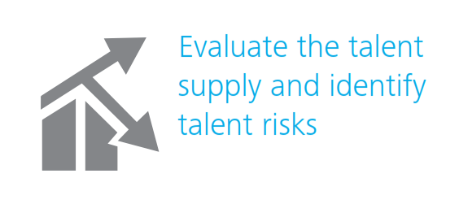
1
4
2
3
3D opportunity for the talent gap: Additive manufacturing and the workforce of the future, A Deloitte series on additive manufacturing

Slide 7
Available actions
Deliver targeted training that addresses demands identified during workforce planning.
Retain your staff by re-recruiting them.
Establish an AM innovation center.
Retain both newly acquired and legacy institutional knowledge.
Appeal to Millennials with AM’s benefits in both recruitment and retention.
Rethink the organization

Slide 8
Intellectual property issues
“Questions still exist as to whether
the customer falling victim to a
faulty print or failed part can seek
damages from the IP owner or the
printer manufacturer, or whether
the blame—and thus risk—falls on
the customer alone.”
3D opportunity for intellectual property: Additive manufacturing stakes its claim, A Deloitte series on additive manufacturing
“To reduce the IP risk associated with
running a business in the AM arena,
focusing on the economics of the interaction between the parties involved may be a healthier choice. This requires addressing IP concerns up front, in such a way that neither side is taking advantage of the other.”
3D opportunity for intellectual property: Additive manufacturing stakes its claim, A Deloitte series on additive manufacturing

Slide 9
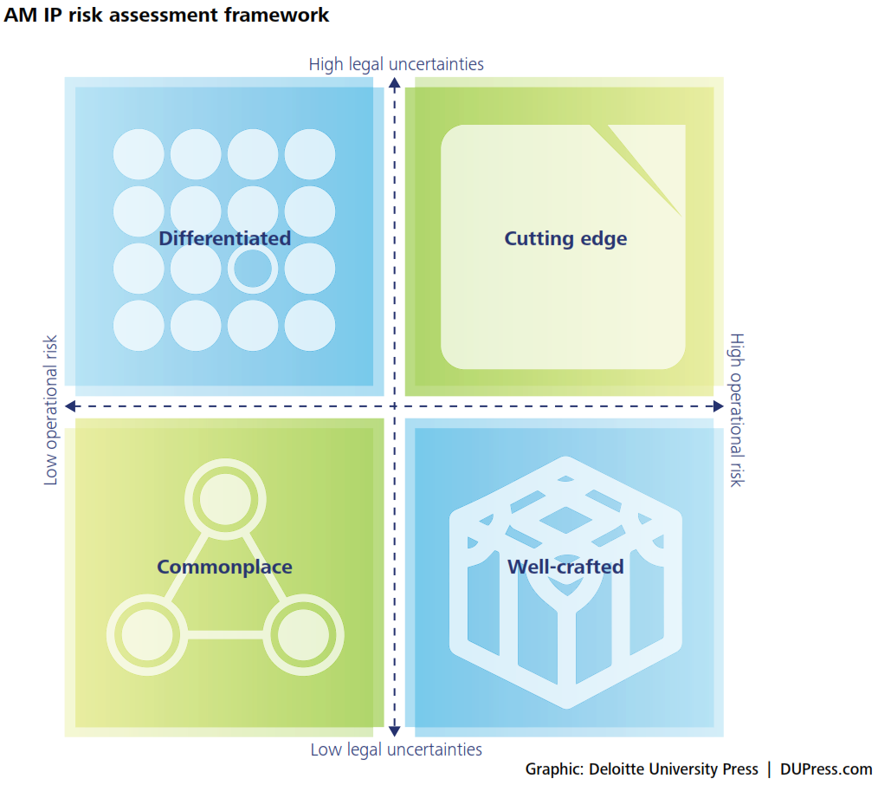
“While many IP issues as they relate to AM
currently lack strong legal precedents, businesses
should consider the importance of being
proactive in addressing these issues while
navigating the still-developing legal debate.”
3D opportunity for intellectual property: Additive manufacturing stakes its claim, A Deloitte series on additive manufacturing

Slide 10
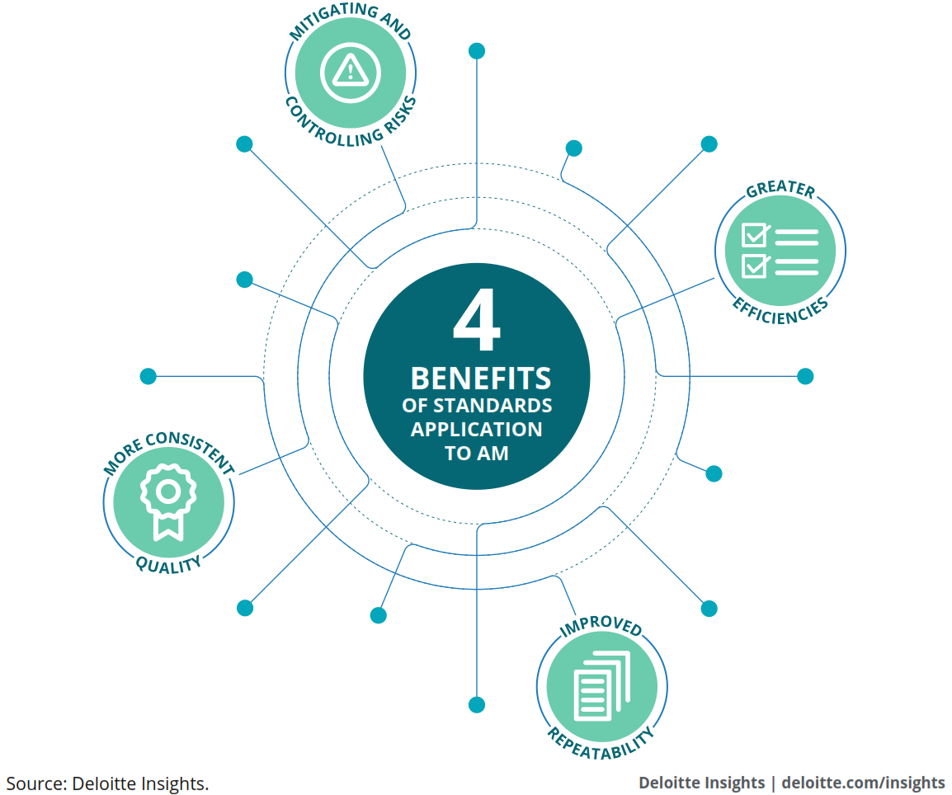
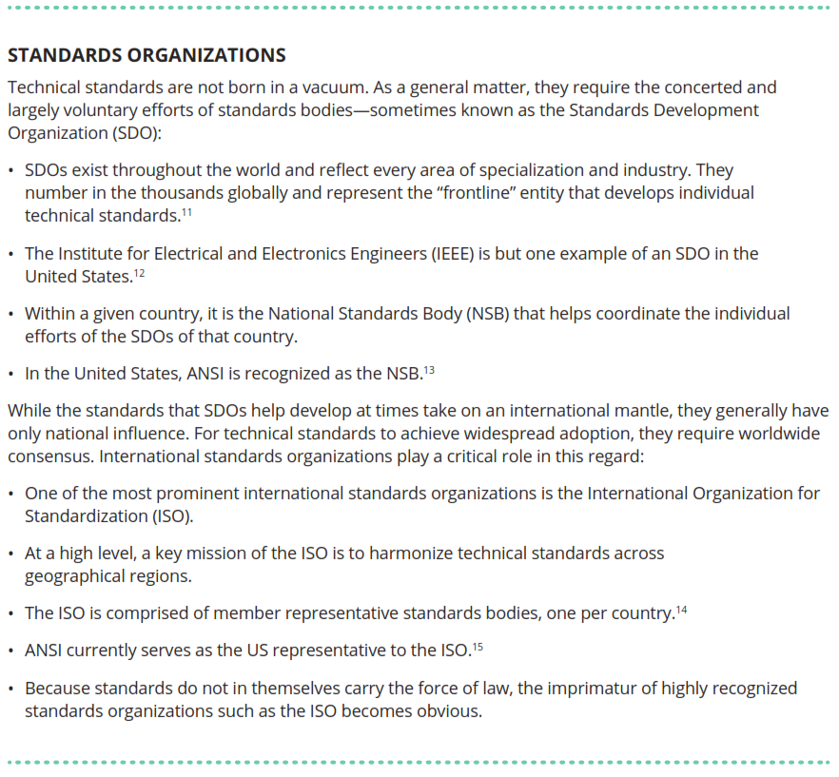
Standards
3D opportunity for standards, A Deloitte series on additive manufacturing

Slide 11
Three key areas should be considered when developing a strategy for adopting and applying AM:
1. Product or part design
2. Production and the materials used in the production of those parts
3. Data that makes up the AM process, or the “digital thread”
“Standards can be
particularly important
for emerging, highly
technical industries, such
as AM, because they
provide the foundational
element on which the
industry might be built.”
3D opportunity for standards, A Deloitte series on additive manufacturing

Slide 12
What to do in the absence of standards
Identify need
Determine variables and isolate them
Express your vision of success
Plan data collection
Run an experiment
Make observations and draw conclusions

Slide 13
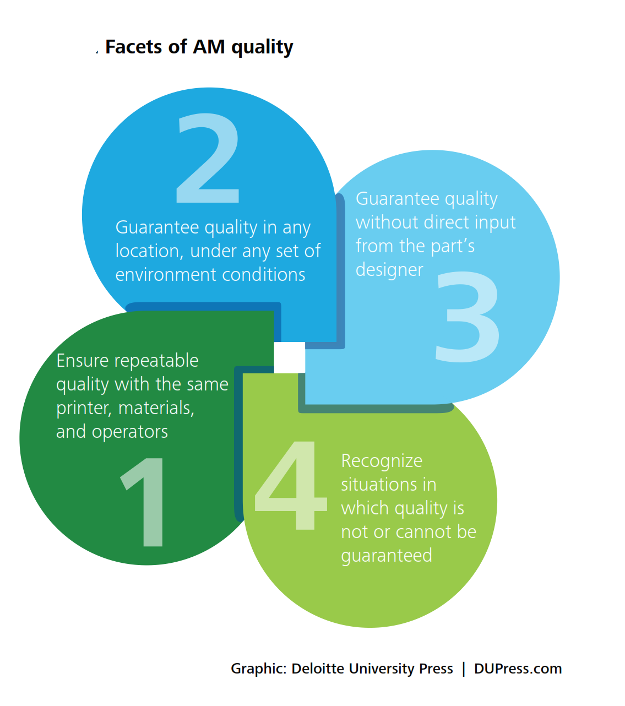
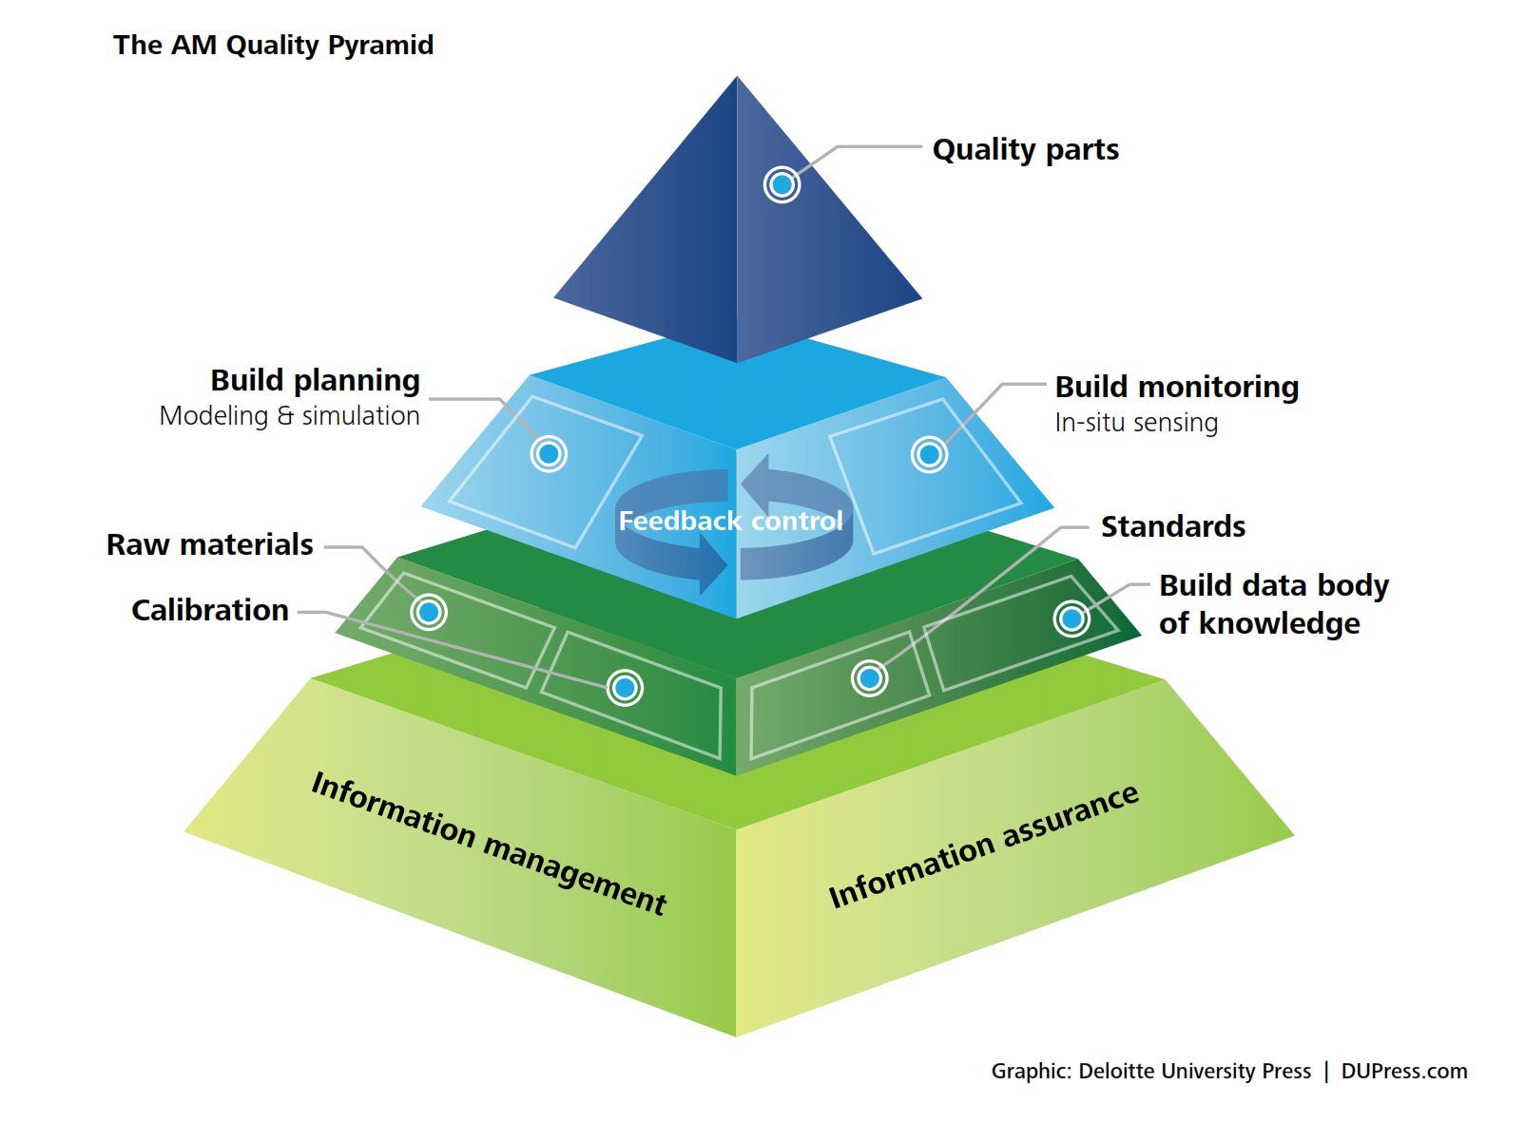
Quality assurance

Slide 14
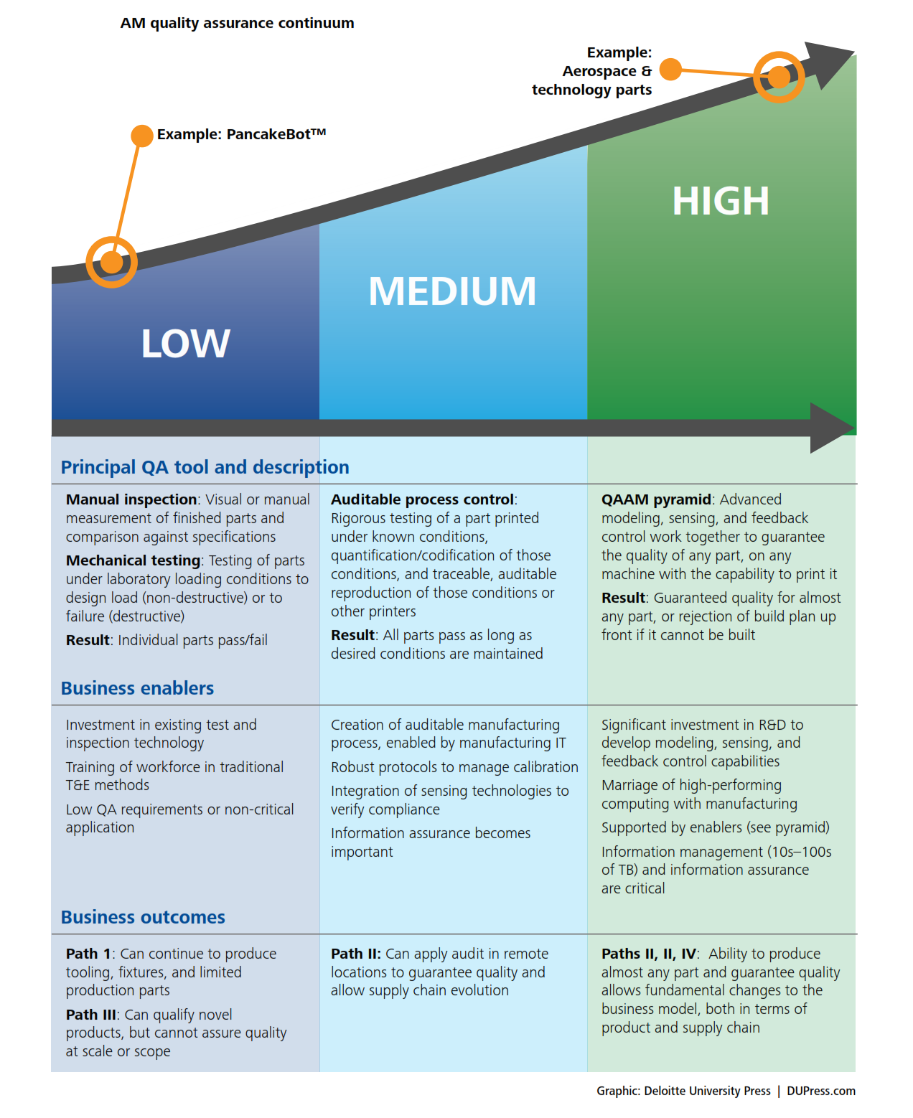
“Detailed process control of production
operations is already fairly common for quality programs; adding AM represents a new layer on what is, for many, a well-established practice.”
“Guaranteeing quality on any part anywhere also unlocks both dimensions of demonstrated AM value: product evolution and supply chain evolution.”
3D opportunity for quality assurance and parts qualification: Additive manufacturing clears the bar, A Deloitte series on additive manufacturing

Slide 15
Manufacturing and Supply chain
“The use of AM can allow
manufacturers to reduce the
amount of labor needed in
the manufacturing process,
as fewer parts/sub-assemblies mean fewer resources required
to assemble those components.”
3D opportunity for the supply chain: Additive manufacturing delivers, A Deloitte series on additive manufacturing
Reducing material inputs for leaner manufacturing
Simplifying production processes, reducing costs
Lowering risk by providing a contingency plan
Improving process flexibility, reacting faster to demand
Redesigning supply chain networks to decentralized, distributed production networks

Slide 16
“When companies
have the flexibility
to easily switch
production designs,
they can personalize
end products on a
mass scale.”
“Mass adoption of this
distributed production model
could have far-reaching effects
on the global economy.”
3D opportunity for the supply chain: Additive manufacturing delivers, A Deloitte series on additive manufacturing

Slide 17
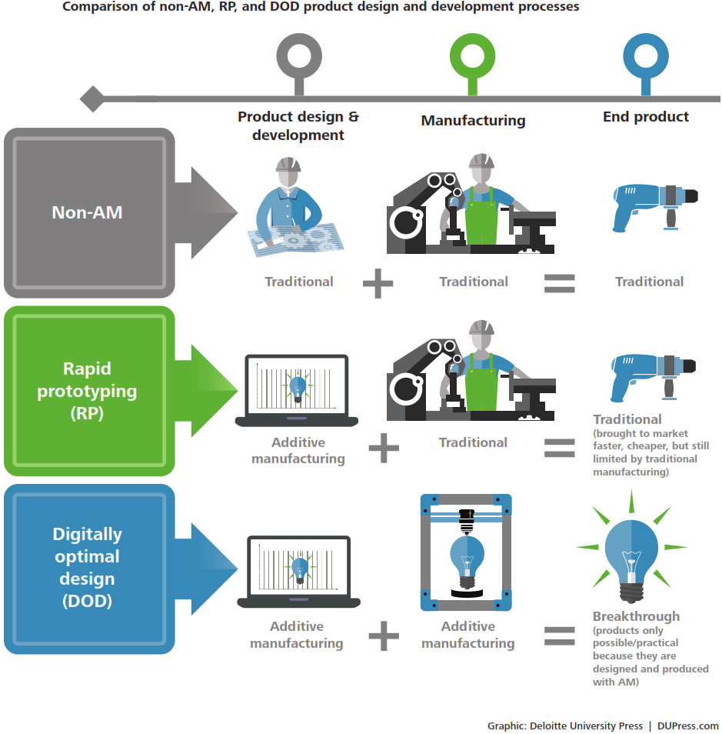
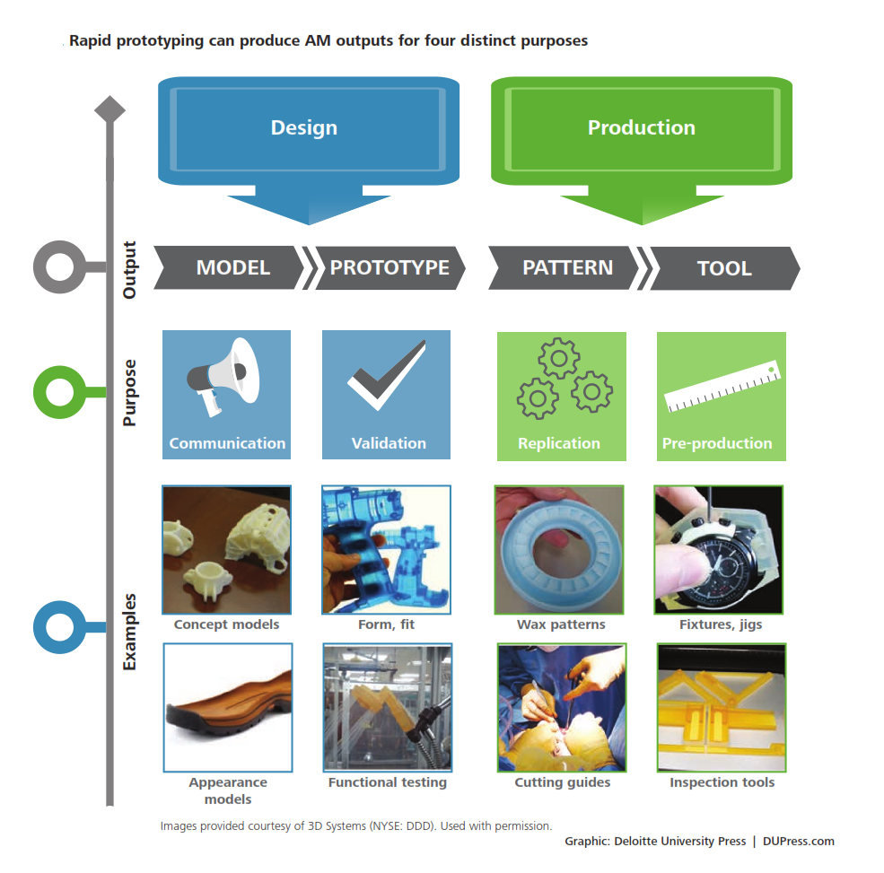
Product design

Slide 18
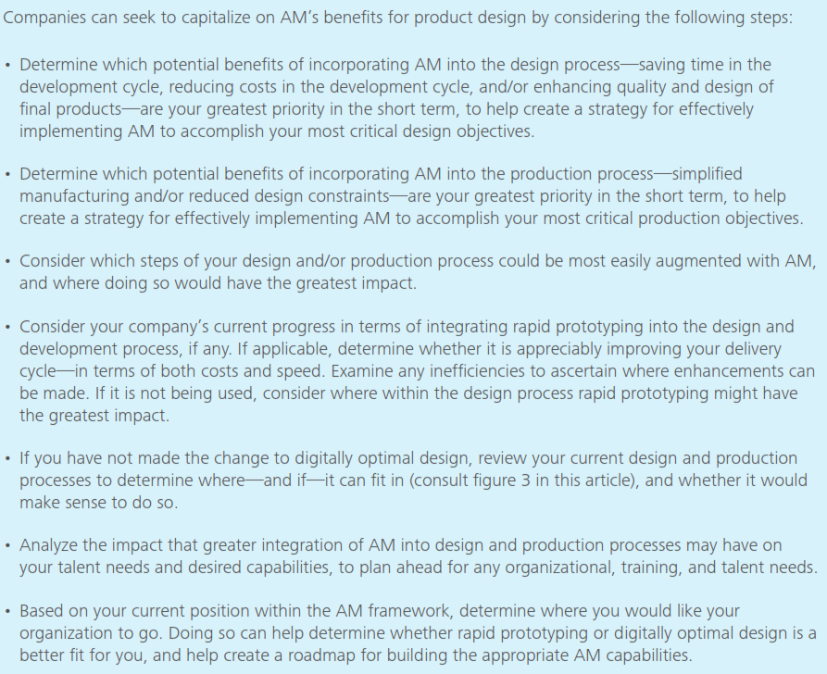
3D opportunity for product design: Additive manufacturing and the early stage, A Deloitte series on additive manufacturing

Slide 19
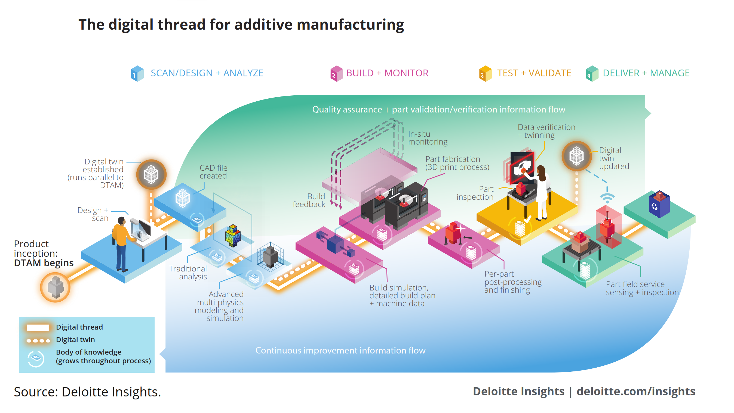
Digital thread & Industry 4.0

Slide 20
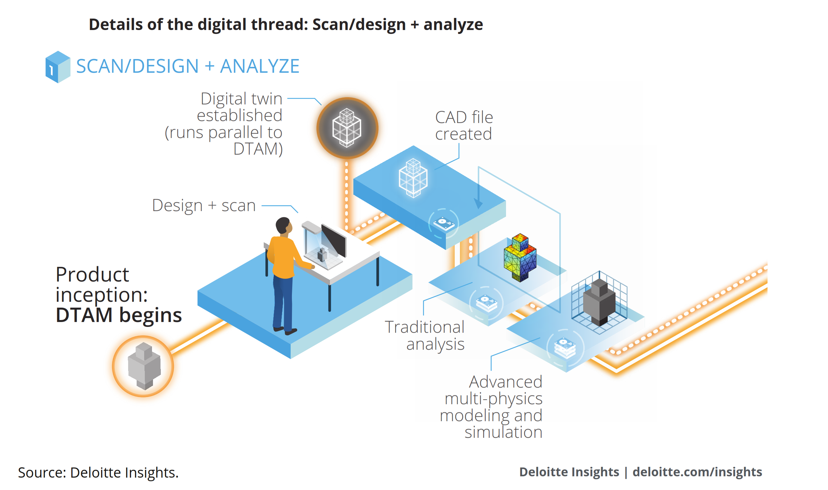

Slide 21
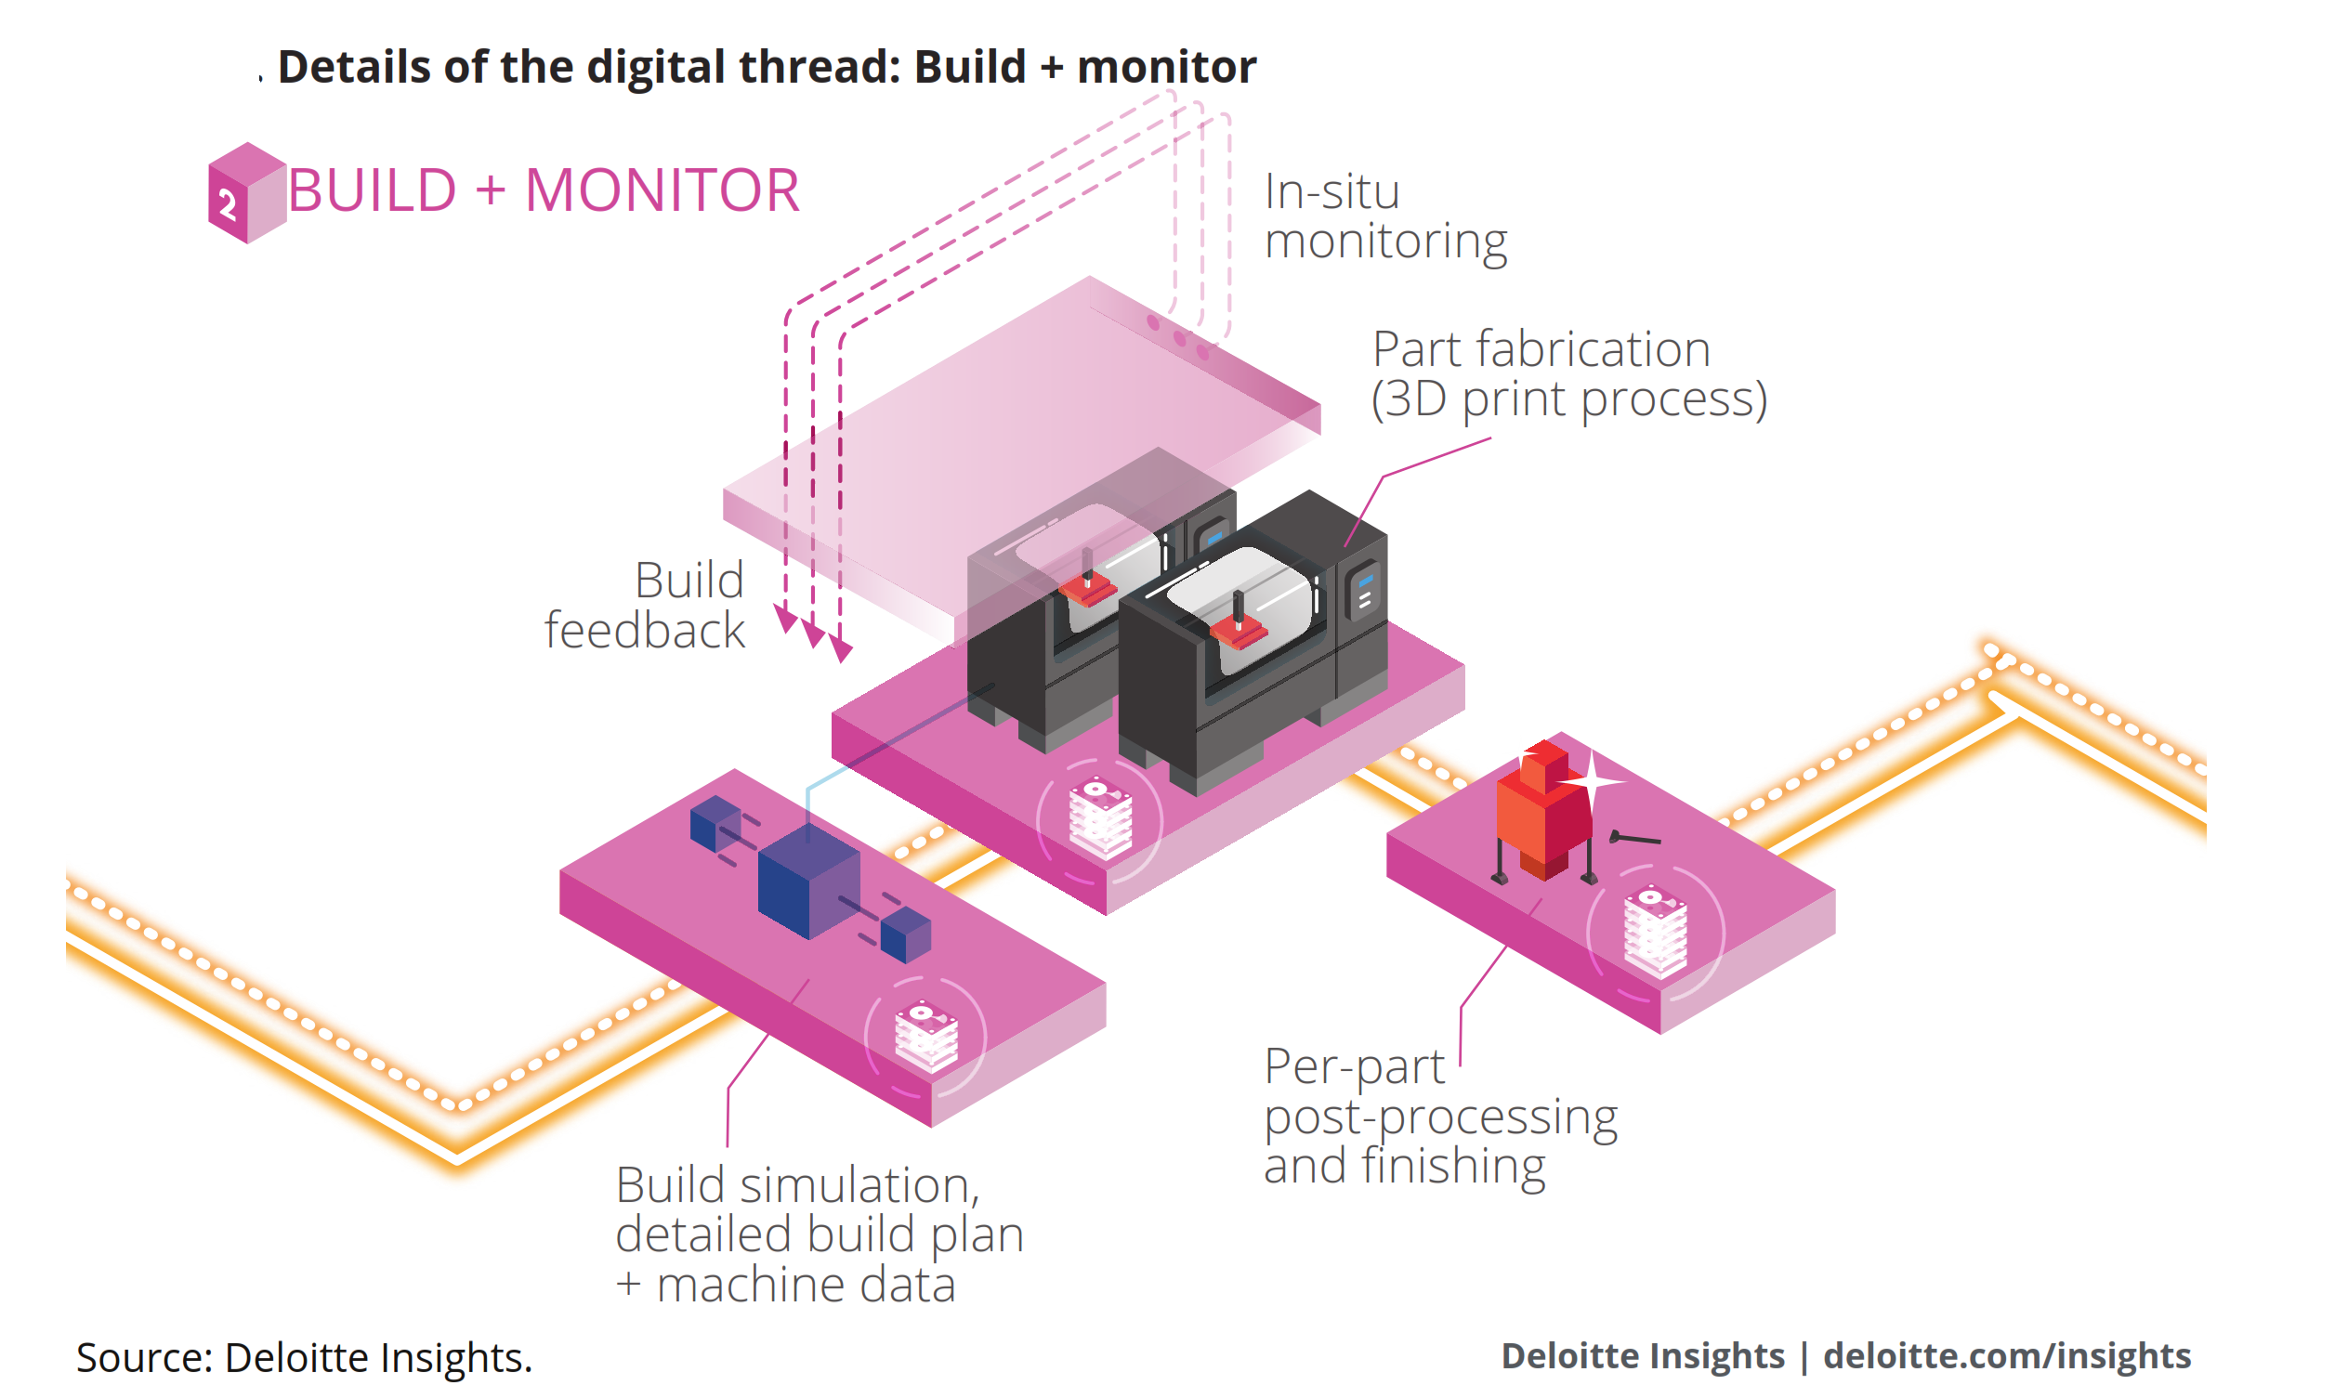

Slide 22
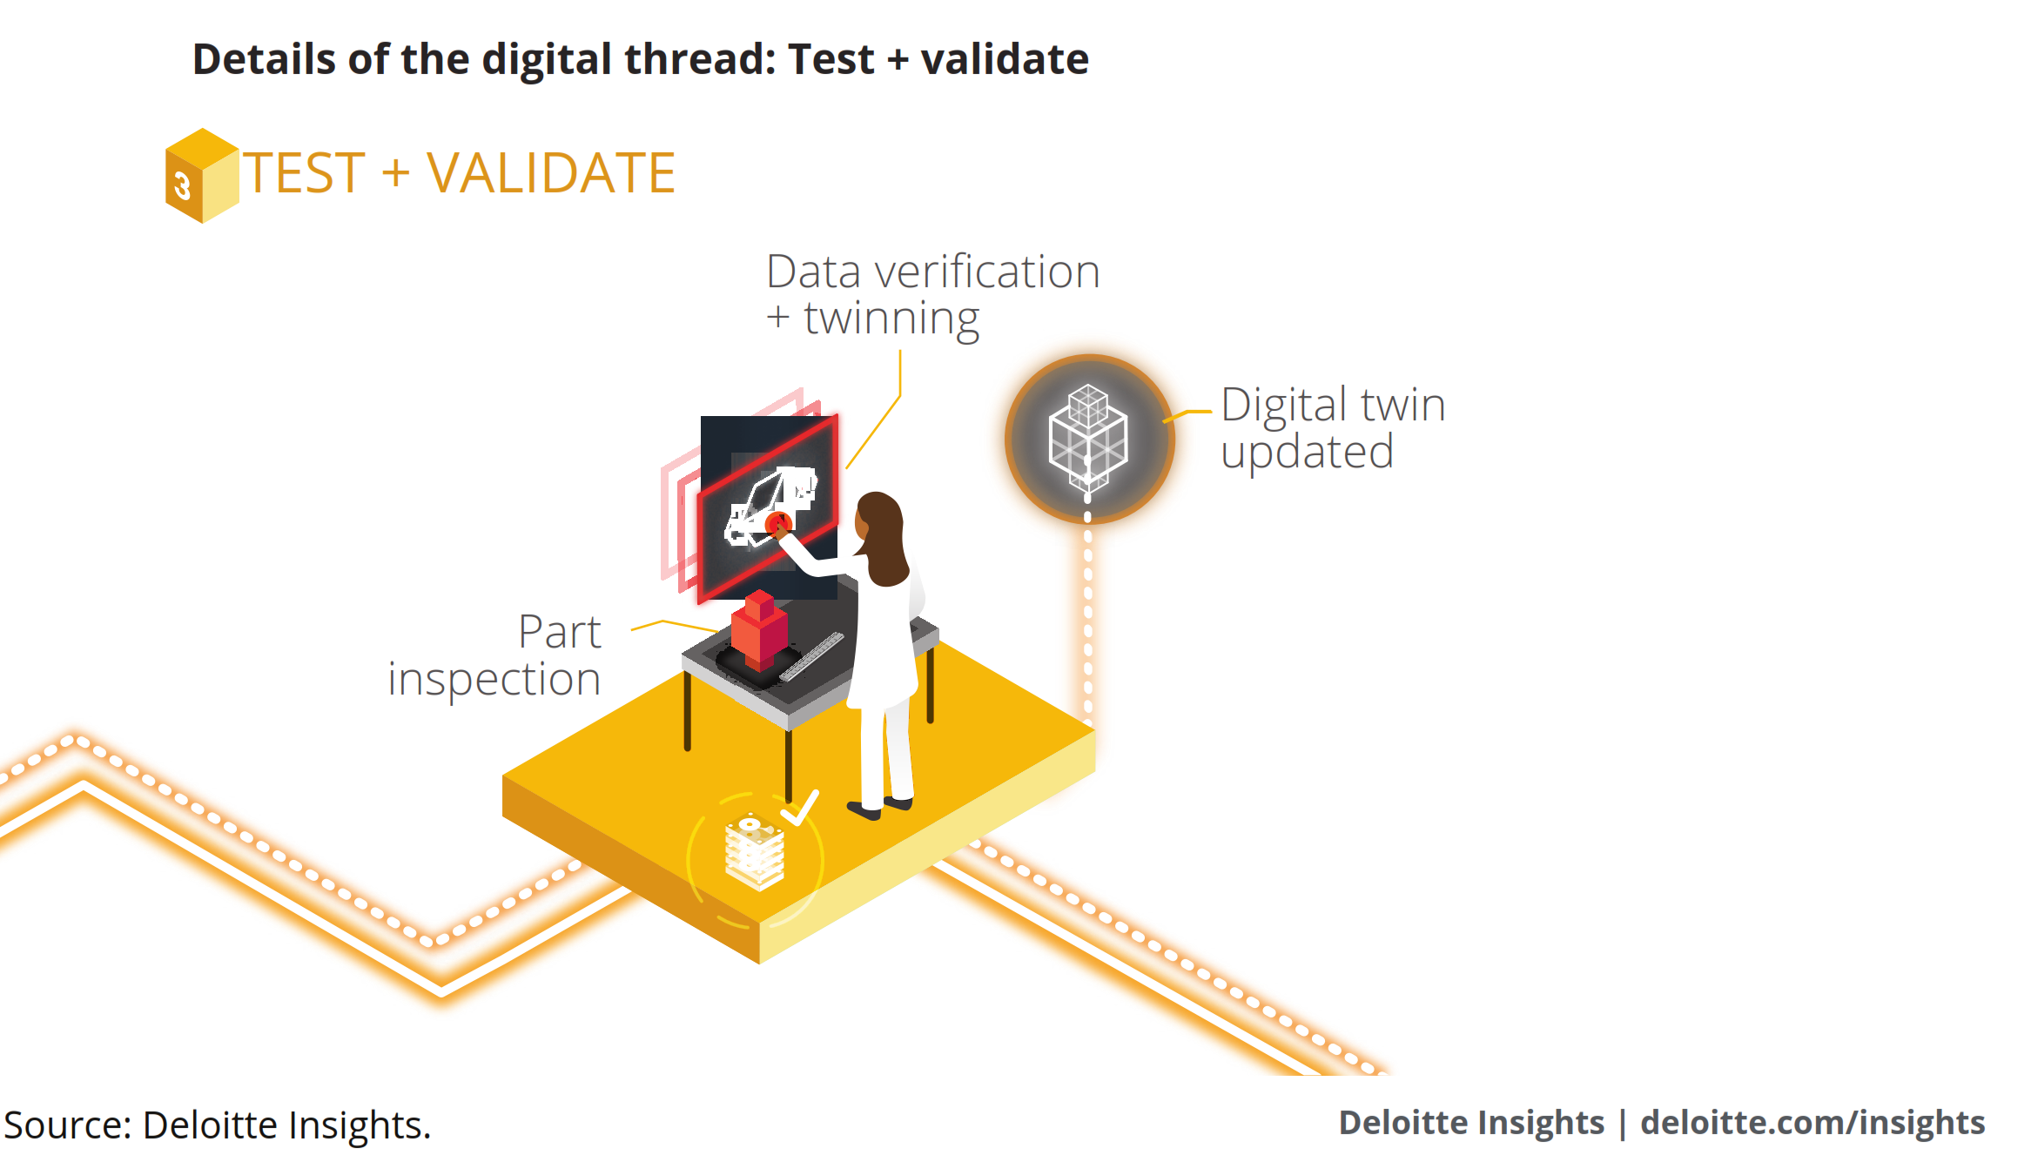

Slide 23
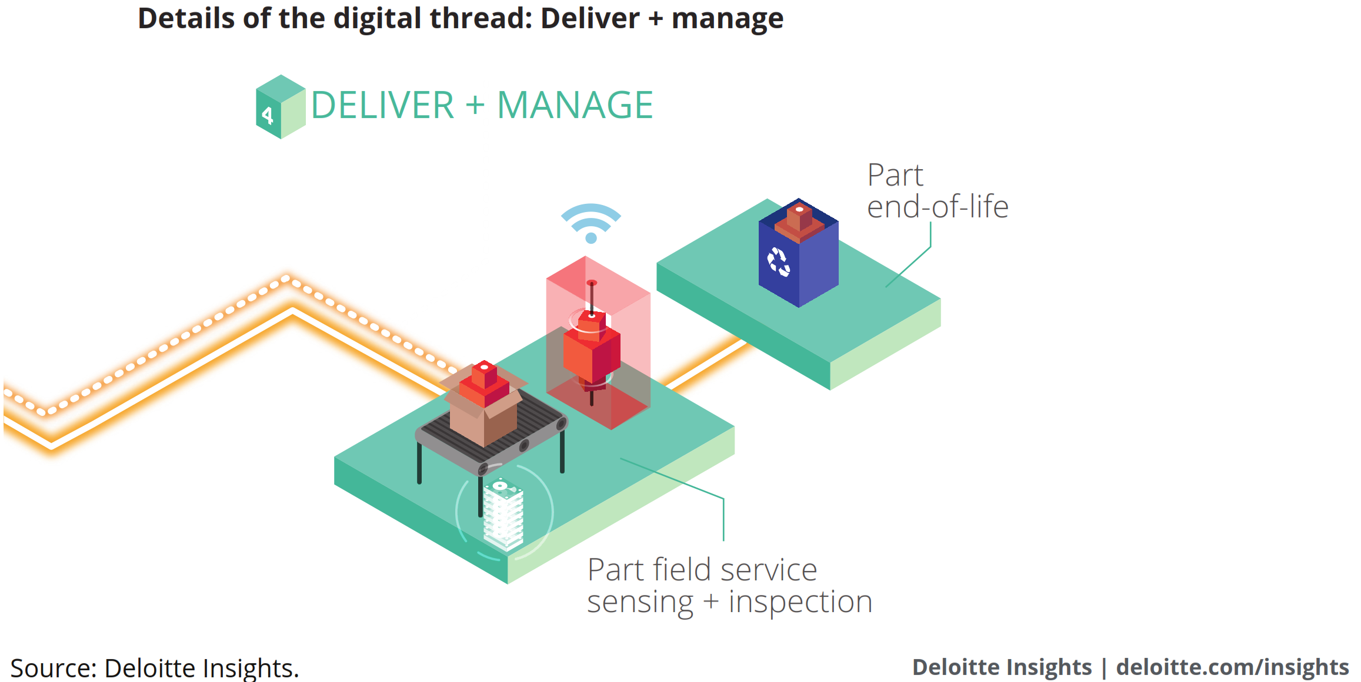

Slide 24
European policies
A number of key topics covering the economic, social and environmental agendas have been identified by the EU. These are being supported through the implementation of five large scale targets in the areas of:
Employment
Research and development
Environment
Education
Poverty and social exclusion
Further reading at:
https://www.rm-platform.com/linkdoc/AM%20SRA%20-%20February%202014.pdf
http://www.prodintec.es/attachments/article/967/1.-Lorenzo%20Valles-European%20Commission.pdf

Slide 25
You can find further readings on topics like Public safety, National Security, Constitutional Rights, Commercial Litigation Considerations Specific to 3D Printed Objects, Product Liability, 3D Printing/Component Parts/Raw Materials, Insurance Issues, Intellectual Property Issues, 3 D Printing Security Implications, Environmental Effects and Health Risks in the Workplace, here:
https://www.reedsmith.com/en/perspectives/2016/12/3d-printing-of-manufactured-goods-an-updated-analy

