Slide 1
Course 12: Additive Manufacturing for Industry 4.0
Laboratory 1 – Learning material (L)
Developer: Mihaela Ulmeanu

Slide 2
OBJECTIVES OF LABORATORY 1
Design and 3D print a master part.
Manufacture a silicone mold for rapid casting of epoxy resin.

Slide 3
Requirements
Organise into teams of 2 students.
Identify a company idea and define a brand and a logo.
3D print a set of promotional products and manufacture appropriate moulds for each of them.
The parts can be either designed, either downloaded from educational platforms.
You are required to complete all given tasks (written and practical) throughout the laboratory, including the Laboratory Worksheet (MSIE-12-L-M1S2-L01-W) provided together with your PPT presentation.

Slide 4
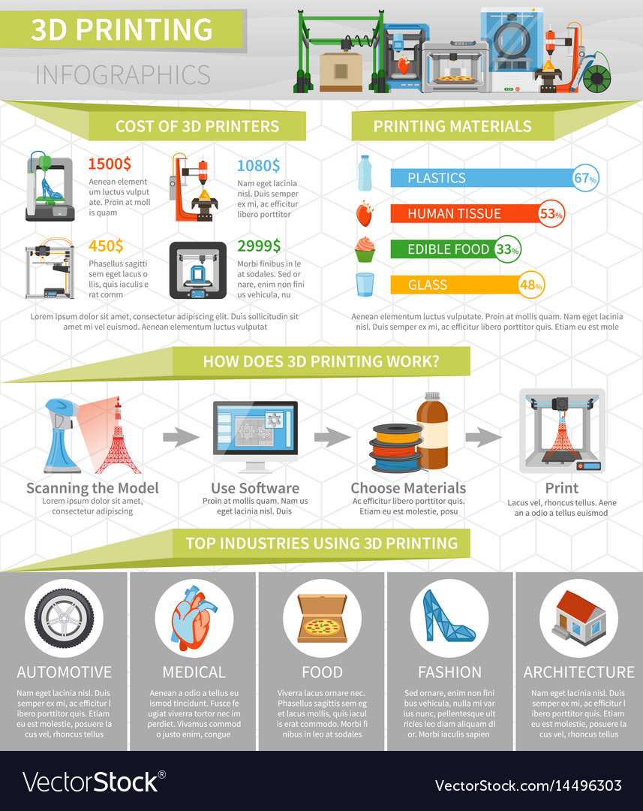
Educational platforms
http://shapeways.com
http://www.myminifactory.com
https://grabcad.com/
http://gitfab.org/
https://pinshape.com/
http://www.shapedo.com/
http://thingiverse.com
https://www.youmagine.com/
http://www.instructables.com/

Slide 5
Laboratory STAGES (1)
In order to implement the given tasks, please follow the next 13 stages:
Select the rapid tooling application (master part and mould cavity)
Make a hand drawn sketch of the master part and mould cavity, with overall dimension
Design the master part and mould cavity walls using a CAD software
Save the STL files for all designed components
Optimise the 3D printing parameters, build platform orientation and generate the final Gcode
Prepare the 3D printing equipment

Slide 6
Laboratory STAGES (2)
Start the 3D printing process
Remove parts and perform post processing
Assemble the master part and prepare the mould cavity
Prepare the bicomponent silicone
Pour the silicone inside the mould cavity, enclosing the master part
Let the silicone vulcanize, either at room temperature or set it in an oven at 120 Celsius degrees for 15 minutes
Demould and use the new mould for pouring of various liquids (preferably epoxy resins, as they have a curing period of 1 to 15 minutes).

Slide 7
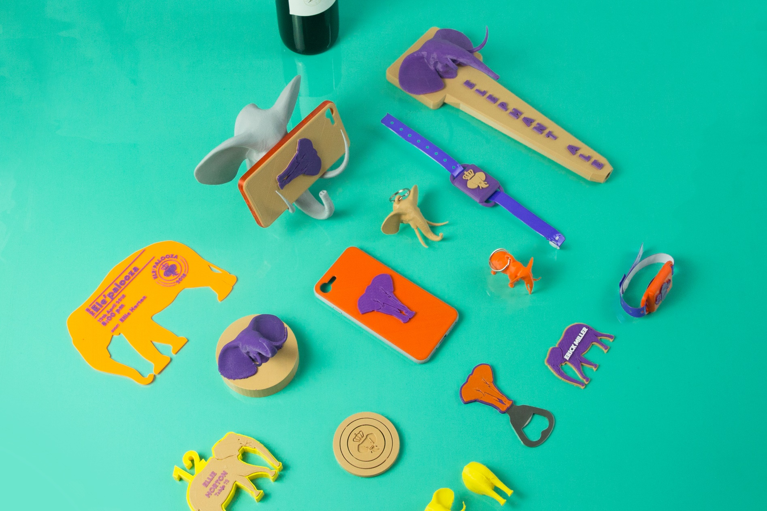
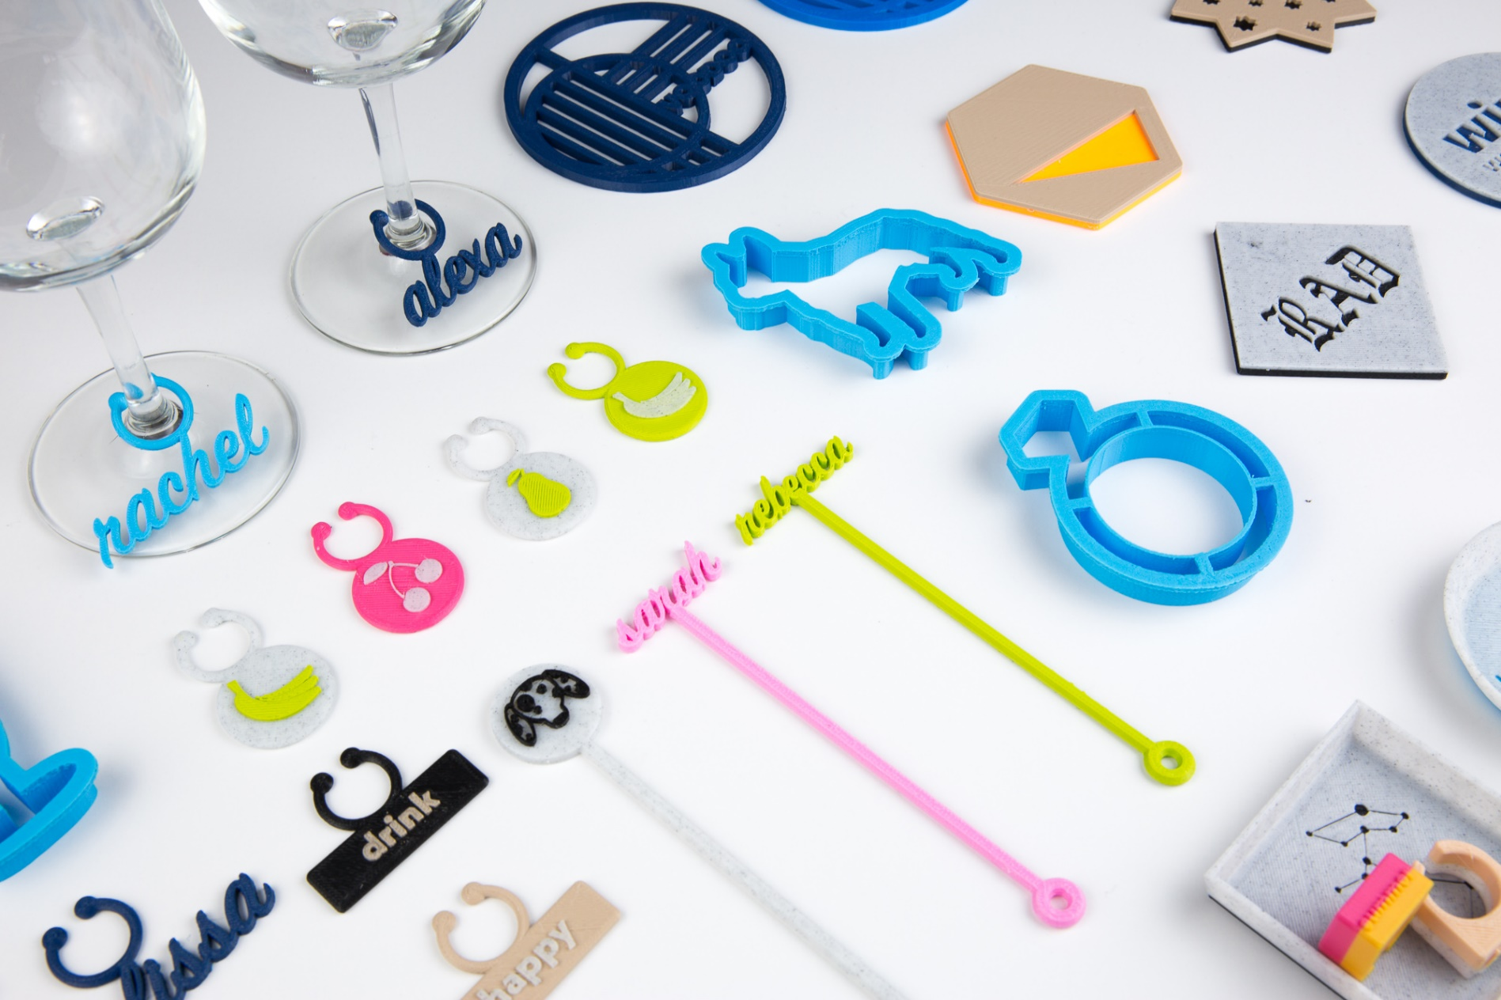
Select the rapid tooling application (master part and mould cavity)
You should select a simple (single component) master part, preferably with one flat surface for optimal positioning on the build platform.
Some examples are provided below:

Slide 8
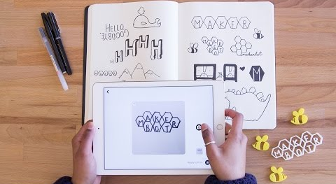
2. Make a hand drawn sketch of the master part and mould cavity, with overall dimension

Slide 9
3. Design the master part and mould cavity walls using a CAD software
This step is not mandatory, as you can use the educational platforms provided for you at the beginning of this presentation.
If you do decide to make the CAD models yourself you can use any CAD software you are proficient in.
Your assembly should be composed from at least 3 parts, as follows:
Master part – selected application
Bottom of mould cavity – Base of the recipient
Lateral walls of mould cavity – Bounding of the recipient

Slide 10
4. Save the STL files for all designed components
If you decided to use the educational platforms, you can download ready to go STL files, so you can go ahead and skip this step.
If you designed your own CAD 3D models, you must go through this process in order to generate your STL files:
File – Save As – Select STL – Options – Save
The operation is done for each of the 3 components of your assembly.

Slide 11
5. Optimise the 3D printing parameters, build platform orientation and generate the final Gcode
Make sure that you get used to the CURA software Main menus: -machine settings -materials -profiles -commands (move, scale, rotate etc) -view

Slide 12
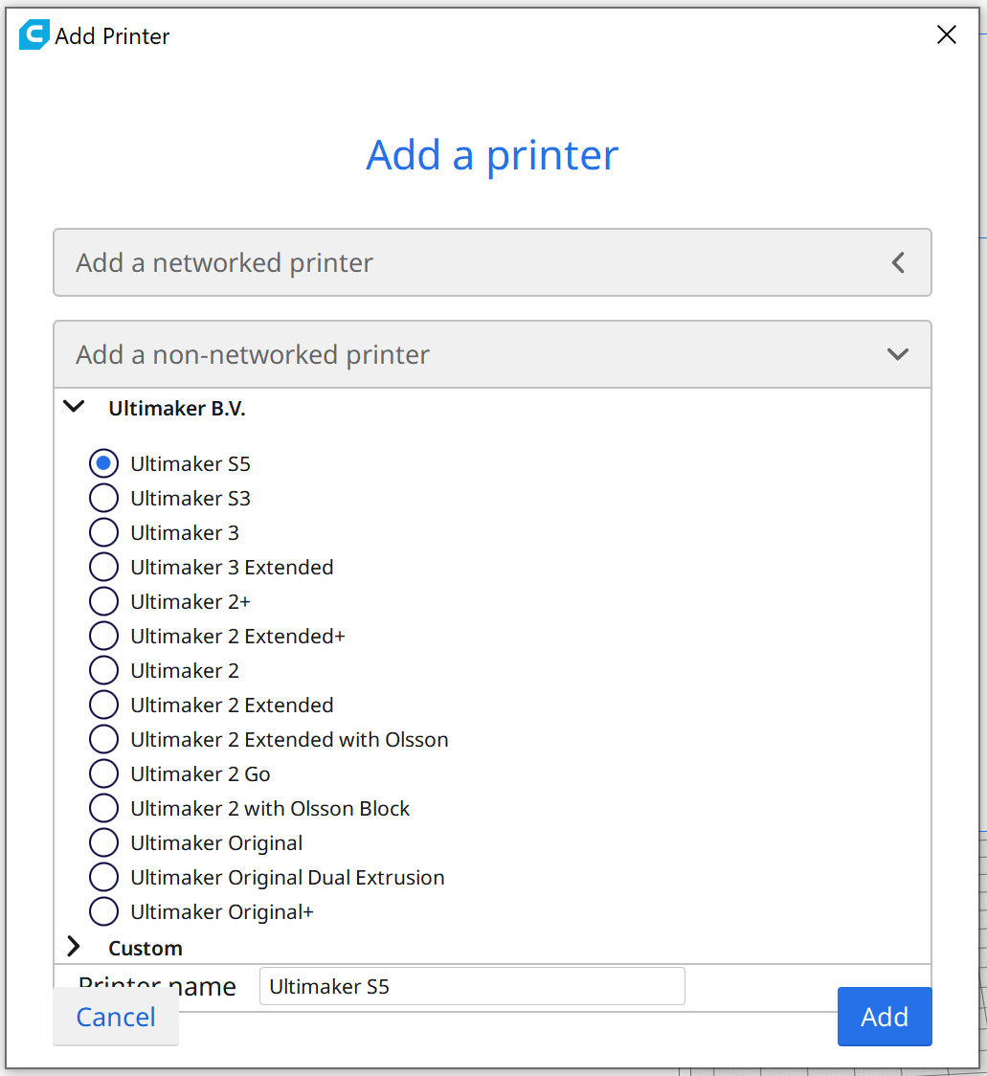
The first step is to select or define the characteristics of the 3D printer that you are using:

Slide 13
Materials and profiles
Make sure that you define the material which is loaded onto your designated 3D printer
Profile is selected depending on the desired quality and functionality of your application

Slide 14
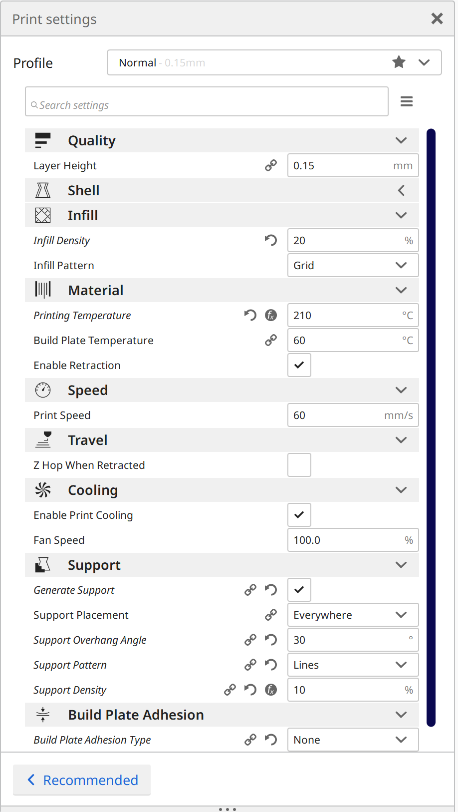
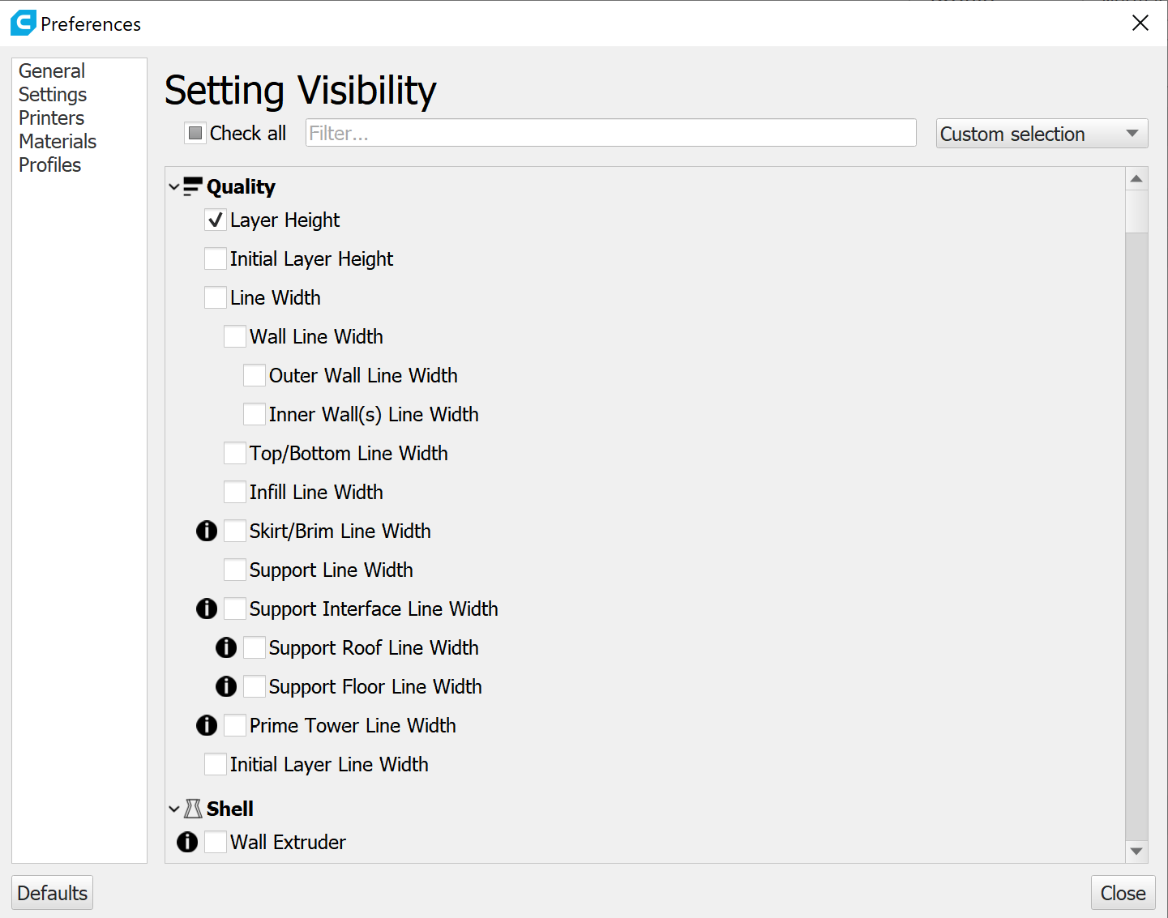
Generate G-Code: optimise 3D printing parameters

Slide 15
6. Prepare the 3D printing equipment
Depending on the available FDM equipment, you should perform the following preparation steps:
Verify that there is enough material to print the part
Verify that the machine has loaded the same material as the one you set up in Cura
Verify that the spool of filament is untangled
Check that the nozzle of the 3D printer is not blocked
Ensure that the print bed is levelled
Ensure that the print bed is clean and has no residual filament
Ensure that the travel axes are clean and unobstructed.

Slide 16
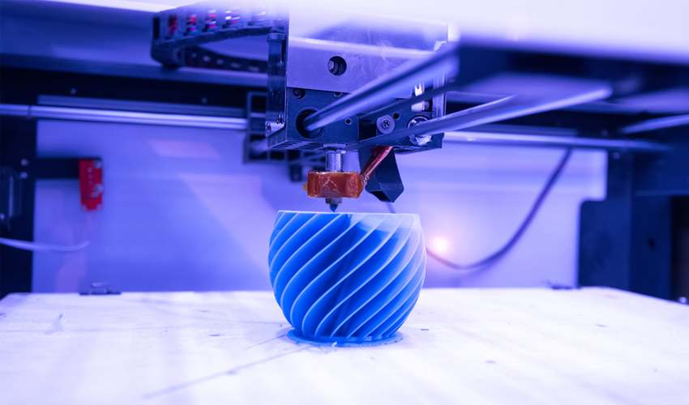
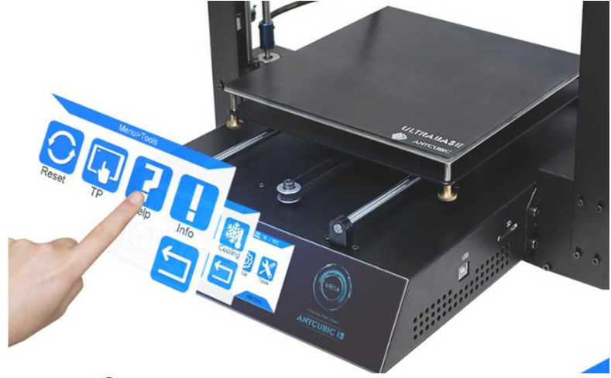
7. Start the 3D printing process

Slide 17
8. Remove parts and perform post processing
Parts should let to cool down, as they have very thin wall structures (if the parts are removed while the build platform is still hot, the general shape of the parts will come out deformed and will prevent from proper assembly)
A spatula is used to remove the parts from the build platform
Pliers are used to remove any support structures
Sanding paper is used to remove any marks from support structures or from build platform.

Slide 18
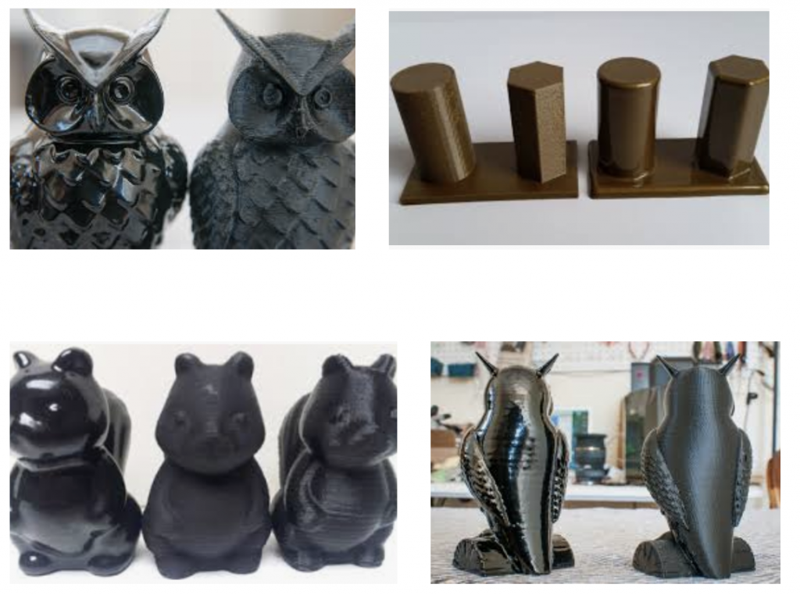
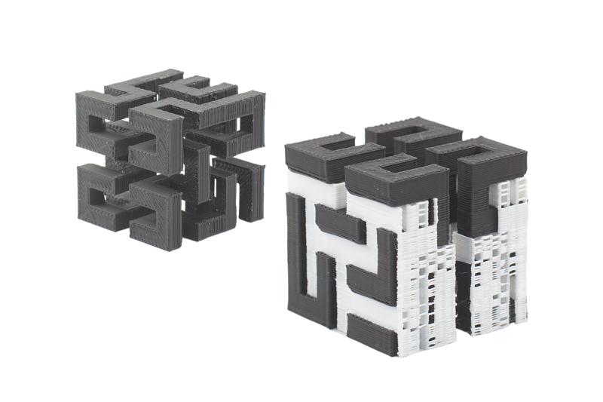
FDM Post processing

Slide 19
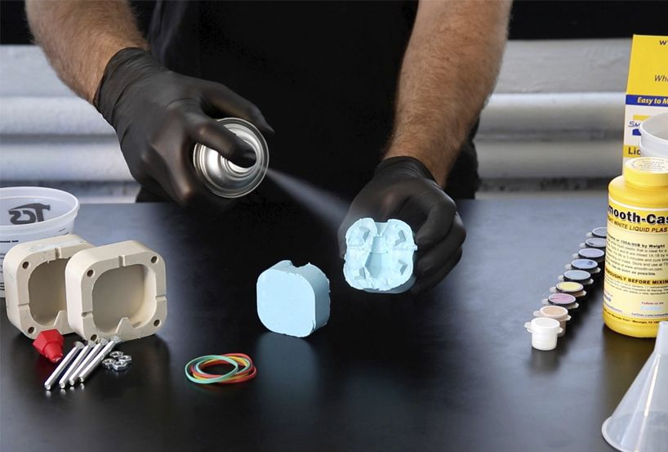
9. Assemble the master part and prepare the mould cavity

Slide 20
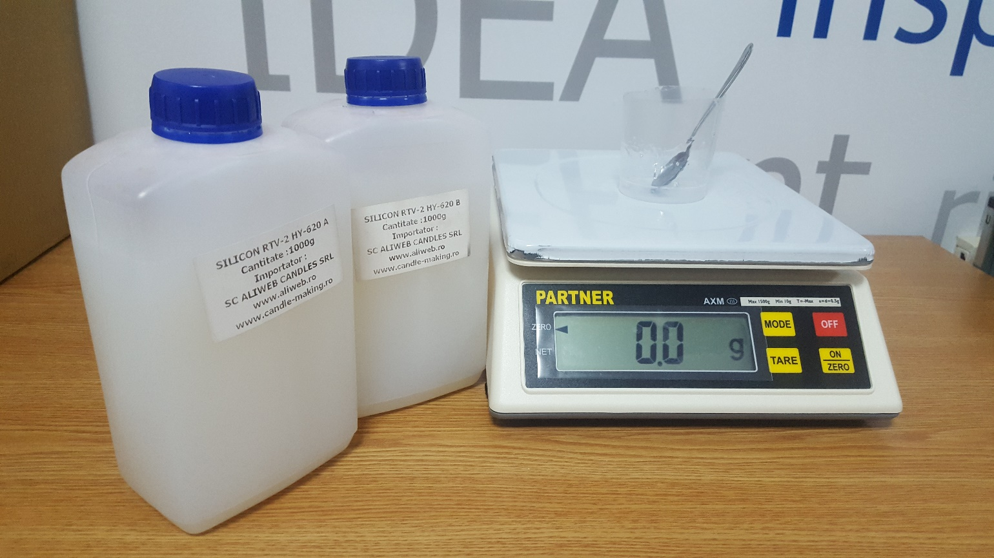
10. Prepare the bicomponent silicone
You will use:
Master pattern
Silicone bounding recipient
Bi-component silicone rubber (1:1 weight mix ratio)
Electronic scale
Plastic cup
Stir stick
Spray glue

Slide 21
11. Pour the silicone inside the mould cavity, enclosing the master part 12. Let the silicone vulcanize
Spray the master pattern with glue and let air dry for 20 min
Weigh 10g :10g of silicone base and silicone activator
Mix thoroughly the bi-component silicone
Degas the silicone mix (optional)
Pour the silicone mix in the mould recipient
Let air dry for 24 hours or use oven to vulcanize

Slide 22
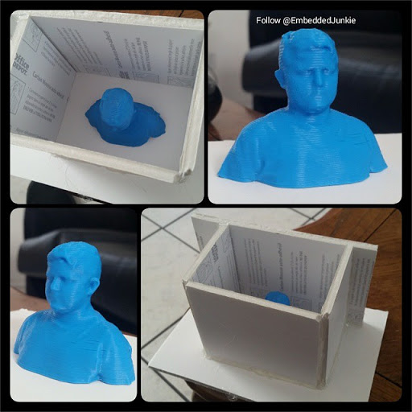
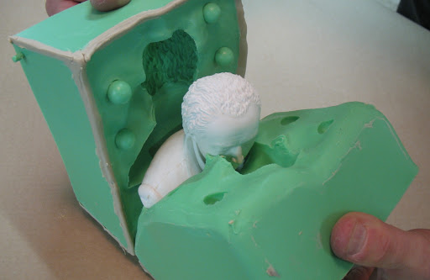
13. Demould and use the new mould for pouring of various liquids

Slide 23
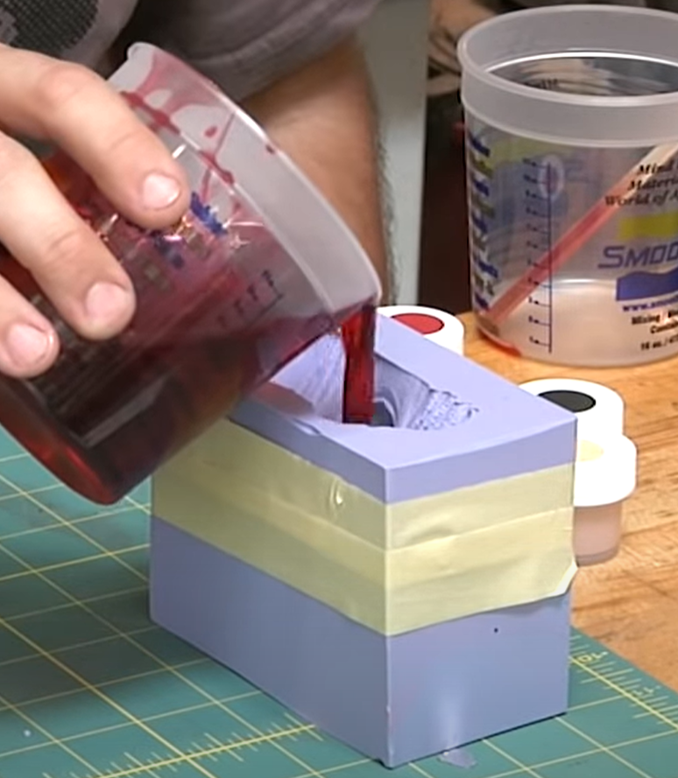
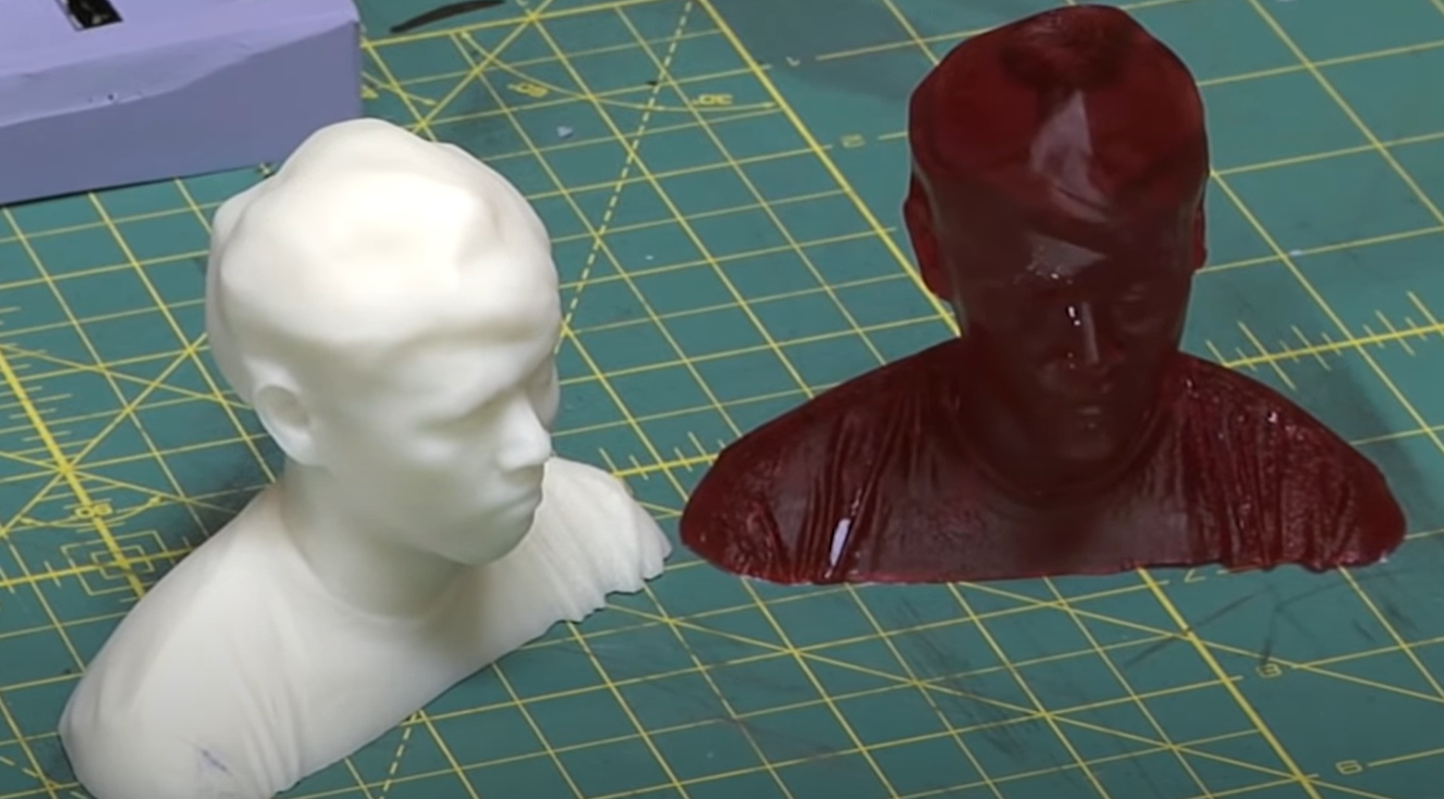
3D printed master part
Pouring of epoxy in Silicone mould
Epoxy resin replica

Slide 24
Task 01: Give three examples of applications where rapid manufactured silicone moulds are useful. Mention the benefits of using rapid manufactured silicone moulds compared to traditional manufacturing techniques.
You must use your laboratory 1 worksheet to perform this task.

