Slide 1
Advanced Optimization:
Techniques and Industrial Applications
Module 2: Heuristics and Metaheuristics

Slide 2
Teaching Material for Session 2.2:
Population-based algorithms:
GA, PSO, DE

Slide 3
Example of GA
Asymmetric traveling salesman problem: ATSP) Find the routing of this problem by GA. Total generation = 2 , Population= 4
Crossover and Mutation rate = 0.8 and 0.2 respectively.
one-point crossover and swap mutation
From/To | City 1 | City 2 | City 3 | City 4 | City 5
City 1 | 0 | 4 | 7 | 9 | 12
City 2 | 3 | 0 | 8 | 12 | 15
City 3 | 7 | 9 | 0 | 17 | 12
City 4 | 8 | 12 | 13 | 0 | 16
City 5 | 12 | 6 | 15 | 18 | 0

Slide 4
Example of GA
Step 1: Initial Solution
Step 2: Evaluation

Slide 5
Example of GA
Step 3: Crossover
Step 4: Mutation
One-Cut point crossover and crossover rate= 0.8
Swap Mutation and mutation rate = 0.2
Population | random
V₁ & V₂ | 0.3
V₃ & V₄ | 0.9
Population | random
V₁ | 0.50
V₂ | 0.31
V₃ | 0.06
V₄ | 0.18

Slide 6
Example of GA
Step 5: Evaluation
Parent
Offspring

Slide 7
Example of GA
Step 6: Selection
                Roulette wheel selection
Population | Objective function | Eval(V_{k}) | P_{k} | Q_{k}
V₁ | 56 | 0.0179 | 0.258 | 0.258
V₂ | 57 | 0.0175 | 0.254 | 0.512
V₃ | 56 | 0.0179 | 0.258 | 0.770
V₄ | 63 | 0.0159 | 0.230 | 1.000
 | F= | 0.069

Slide 8
Example of GA
Step 6: Selection (Cont.)
Random | Value (r) | Select Chromosome
1 | 0.58 | V₃
2 | 0.12 | V₁
3 | 0.96 | V₄
4 | 0.76 | V₃

Slide 9
Example of PSO
Asymmetric traveling salesman problem: ATSP) Find the routing of this problem by PSO. Total particles = 3 , weight= 0.4 and C_{p} = C_{p} = 1.
All velocity vectors are zero.
From/To | City 1 | City 2 | City 3 | City 4 | City 5
City 1 | 0 | 4 | 7 | 9 | 12
City 2 | 3 | 0 | 8 | 12 | 15
City 3 | 7 | 9 | 0 | 17 | 12
City 4 | 8 | 12 | 13 | 0 | 16
City 5 | 12 | 6 | 15 | 18 | 0

Slide 10
Example of PSO
Step 1: Encoding for particles and velocity vectors
Particle | City 1 | City 2 | City 3 | City 4 | City 5
1 | 0.2348 | 0.0154 | 0.6491 | 0.4509 | 0.7447
2 | 0.3532 | 0.0430 | 0.7317 | 0.5470 | 0.1890
3 | 0.8212 | 0.1690 | 0.6477 | 0.2963 | 0.6868
Vector | City 1 | City 2 | City 3 | City 4 | City 5
1 | 0 | 0 | 0 | 0 | 0
2 | 0 | 0 | 0 | 0 | 0
3 | 0 | 0 | 0 | 0 | 0

Slide 11
Example of PSO
Step 2: Decoding for all particles (Ranked of Value: ROV)
Particle
City
City
City
City
City
Particle
City
City
City
City
City
Particle
City
City
City
City
City

Slide 12
Example of PSO
Step 3: Evaluation
Particle 1 : Total distances = 3+9+13+12+6 = 43 Units
Particle 2 : Total distances = 15+12+9+13+9 = 58 Units
Particle 3 : Total distances = 12+13+12+12+4 = 53 Units

Slide 13
Example of PSO
Step 4: Adjust pbest and gbest
Particle 1 : Total distances = 3+9+13+12+6 = 43 Units
Position
Particle
Step 5: Adjust velocity and position

Slide 14
Example of PSO (Iteration 1)
Example for particle 2 (Iteration 1) with weight= 0.4 and C_{p} = C_{p} = 1
Position
Position

Slide 15
Example of PSO (Iteration 1)
Example for particle 2 (Iteration 1) with weight= 0.4 and C_{p} = C_{p} = 1
So, Velocity 2 = [-0.0763, -0.0104, -0.067, -0.0512, 0.1949]
Velocity 1
Velocity 2
Velocity 3

Slide 16
Example of PSO (Iteration 1)
Example for particle 2 (Iteration 1)
Position
Positi
on
Position
Positi
on
So, Position 2 = 0.2769, 0.0326, 0.6647, 0.4958, 0.3839]
Position 1
Position 2
Position 3

Slide 17
Example of PSO (Iteration 2)
Decoding for all particles (Iteration 2)
Particle
City
City
City
City
City
Particle
City
City
City
City
City
Particle
City
City
City
City
City

Slide 18
Example of PSO (Iteration 2)
Evaluation (Iteration 2)
Particle 1 : Total distances = 43 Units
Particle 2 : Total distances = 55 Units
Particle 3 : Total distances = 50 Units

Slide 19
Example of PSO (Iteration 2)
Adjust pbest and gbest
Position
Particle
Particle
Particle
Position
Particle
Adjust velocity and position
Particle
Particle
Particle

Slide 20
Example of PSO (Iteration 2)
Adjust velocity and position (Cont.)
Velocity
Particle
Particle
Particle
Position
Particle
Particle
Particle

Slide 21
Example of DE
Asymmetric traveling salesman problem: ATSP) Find the routing of this problem by DE. Vectors= 6
Weighting Factor = 2, Crossover rate = 0.8
From/To | City 1 | City 2 | City 3 | City 4 | City 5
City 1 | 0 | 4 | 7 | 9 | 12
City 2 | 3 | 0 | 8 | 12 | 15
City 3 | 7 | 9 | 0 | 17 | 12
City 4 | 8 | 12 | 13 | 0 | 16
City 5 | 12 | 6 | 15 | 18 | 0

Slide 22
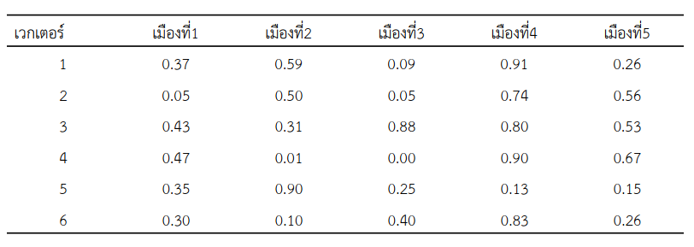
Example of DE
Step 1: Initial Solution
Vector
City
City
City
City
City

Slide 23
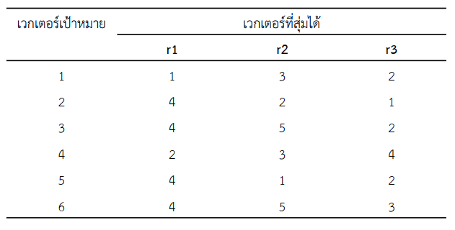
Example of DE
Step 2 : Mutation
Target
Vector
Random Vector

Slide 24
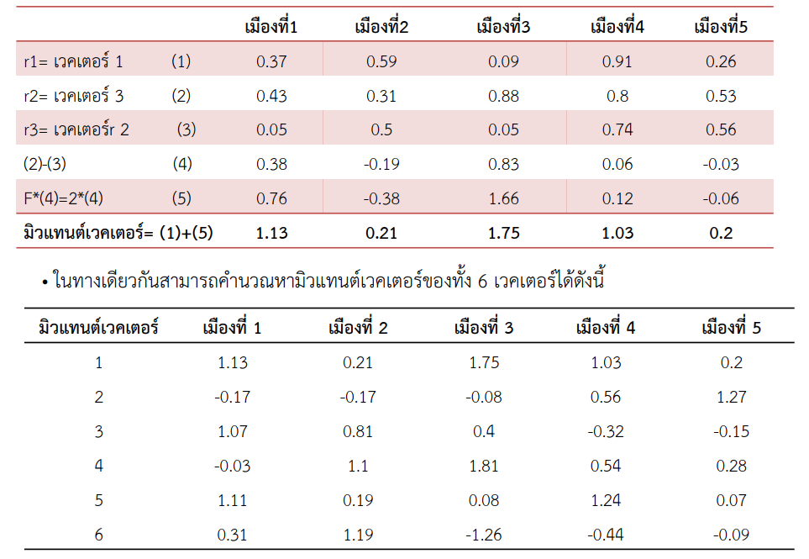

Example of DE
City
City
City
City
City
Step 2 : Mutation (Cont.)
Vector
Vector
Vector
Mutant Vector
Mutant Vector
City
City
City
City
City

Slide 25
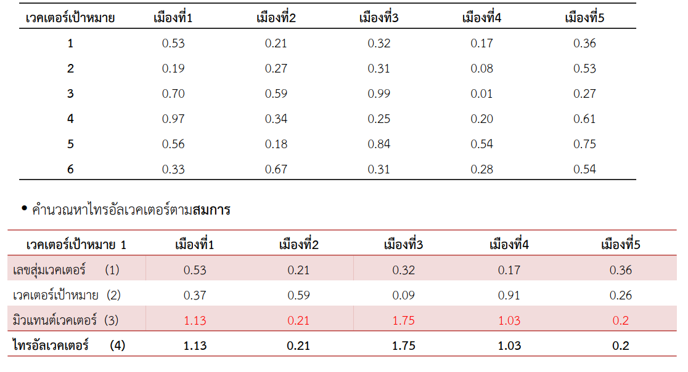

Example of DE
Step 3 : Crossover
Random
City
City
City
City
City
Calculation of Trail Vector
Trial Vector
City
City
City
City
City
Random
Target Vector
Mutant Vector
Trial Vector

Slide 26
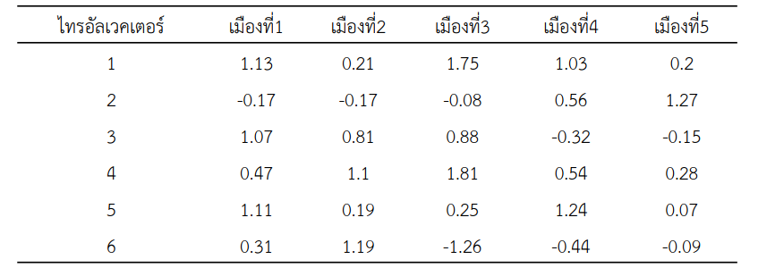
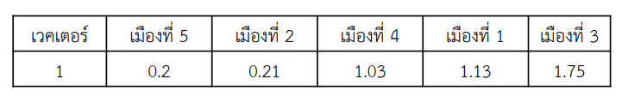
Example of DE
Step 3 : Crossover
(Cont.)
Trial Vector
City
City
City
City
City
Vector
City
City
City
City
City
Step 4 : Evaluation
Route: 5-2-4-1-3-5 = 6+12+8+7+12 = 45 Unit

Slide 27
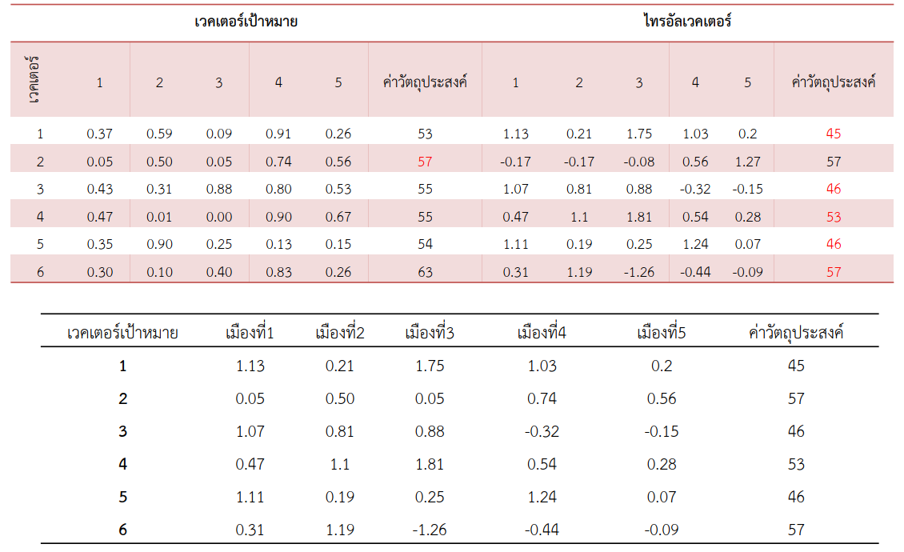
Example of DE
Step 5: Selection
Target Vector
Trial Vector
Objective
Objective
Target Vector
City
City
City
City
City
Objective

