Slide 1
Advanced Optimization:
Techniques and Industrial Applications
Module 3: Optimization and Its Applications in Industry 4 Era

Slide 2
Session 3.5:
Case Study

Slide 3
3.5 Case Study: Optimization and Its Applications in Industry 4 Era(3 hr.)
Project Objective:
1. To demonstrate students on how to apply optimization in Industry 4 Era.
2. To demonstrate students on how to develop the optimization model for solving problems in Industry 4 Era.
3. To demonstrate students on how to design an automated data-driven tool in real world optimization model.

Slide 4
Project 1: A Software and Mobile Application for Transportation in the Ice Manufacturing Industry
Problem Statement
At present, the traditional ice manufacturing industry is facing challenges. The increasing transportation cost to distribute ice and excess inventories all require a high degree of digitalization, intelligence and flexibility of direction.
The requirements mentioned above are in accordance with the requirements of the custom ice manufacturing industry. Due to the fluctuation in ice demand, in particular with peak demand for ice in the warmer seasons, storage is necessary to ensure that the ice manufacturing factory is able to deliver peak demand. Storage then allows the ice manufacturer to operate 24 hours per day.
However, storage generates high inventory costs if there is much ice product to keep. Therefore, to reduce the inventory cost, the ice manufacturing industry should manage storage to satisfy the demands as necessary.
Another major problem of the ice industry is transportation management. Since ice usually has a short shelf life, in the transportation activity, covered uninsulated vehicles are most often used, having refrigeration equipment installed in the cargo area located at the back of the vehicle (Rattanapong Kamphukaew, Sethanan, Jamrus & Wang, 2018). These vehicles are usually expensive and consume more fuel than more uncontrolled temperature vehicles.

Slide 5
Problem Statement (cont’d)
At present, ice deliveries are generally made to a fixed set of customers on a fixed route. When the demand for ice increases, delivery takes place using more vehicles.
Due to the complexities in terms of fluctuating demand and geographically dispersed customers, various types and sizes of vehicles, duration of transportation time, time windows and vehicle dimension limits on roads (vehicle accessibility of roads), the problem is modeled as the capacitated vehicle routing problem for multiple products, time windows and fuel consumption due to vehicle speed (VRPTWFS)
The problem of how to optimize fuel consumption then arises. The best schedule for the vehicles must be determined, taking into account their load and vehicle types and sizes.

Slide 6
Introduction to Mobile Application and Software
OBJ: to increase efficiency in the ice manufacturing industry logistics
To solve the problem, the software for ice transportation (IceApp) is developed as a software tool for managing the route of the vehicles for ice transportation, based on the hybridization of PSO and ALNS.
IceApp has an architecture made of software components, running on a cloud server on which is installed the Web Application, Web Service and Database Management System.
The Web Application is the program that route planners can operate through a browser such as Chrome or Safari.
The mobile application has been introduced to support transportation decision-makers, as an application for the ice manufacturing industry. The proposed mobile application for ice transportation takes advantage of the available demand data input to the IceApp software.
It offers the potential for logistics staff and route planners to achieve results for making the right decisions on ice distribution, and to maintain appropriate inventory, by improving the availability of real-time customer information.

Slide 7
Project Data
Number of product type: 1 product type
Customer data:
Generates the customers for 20 customers (QR code, location (x,y))
Therefore, student groups much prepare the customer data for 3 routes; 2 routes with 7 customers per route, and the third route contains only 6 customers.
All group will use the same customer data (totally 20 customers for 3 routes).
Distance between customers are automatically calculated based on the google distance
Generate demands, time to receive products
Factory and distribution center data:
In this model, both ice factory and distribution centers are considered. However, in this project, the product is transferred only from the factory to the customers (no distribution center is considered).
The data must be filled: capacity of the factory and distribution center, location (x,y)
In case no distribution center, the number of distribution centers must be “zero”
Vehicles data:
Vehicle used: 3 vans with capacity 2, 3, and 4 tons per vehicle
Operation time starting from 8:00-17:00
Speed used: 60 km./hr
Fuel rate: 4 km./litre

Slide 8
Group Assignment III
Each group must do the following:
Develop an algorithm to solve the problem using the “Ice App Program”.
As mentioned earlier, the “Ice App Program” was developed and installed the Web Application, Web Service, and Database Management System. The mobile application for ice transportation takes advantage of the available demand data input to the IceApp software.
To do this project, students will learn on how to apply optimization in Industry 4 Era and how to design an automated data-driven tool in real world optimization model.

Slide 9
Group Assignment III (cont’d)
Run your proposed algorithm:
Group coding the algorithm using php language can replace your algorithm to the existing one (in the IceApp software) and then run the program to get the solution.
Otherwise, students have to run the problem using your own program. However, you are not allowed to key the input to your own program manually.
Students are recommended to import the data into your program automatically. To do so, you can generate the input data files using the “Mobile Application and Software (IceApp) to run your proposed algorithm and export the output data to the “Mobile Application and Software (IceApp)” to visual the routes of each vehicle in google maps.
Discuss the results obtained

Slide 10
How to use the Mobile Application and Software (IceApp)
Step 1: Download the application with android system (Google drive: ice-tran-mobile-0.0.2.zip)
Step 2: Go to Link “http://119.59.103.118/ice-tran”
Step 3: Setup input data using the “Mobile Application and Software (IceApp)”.
Customer data:
Factory and distribution center data:
Vehicles data:
Step 4: Make the Calculation (Default of the IceApp Software: Using hybrid PSO)
Step 5: Export the input files (.xlsx) to your heuristic program
Step 6: Running your heuristic program
Step 7: Import your results to the IceApp software
Step 8: Display your results using the IceApp sofware
(Note: Details of the prof=gram instruction are in the Handout.)

Slide 11
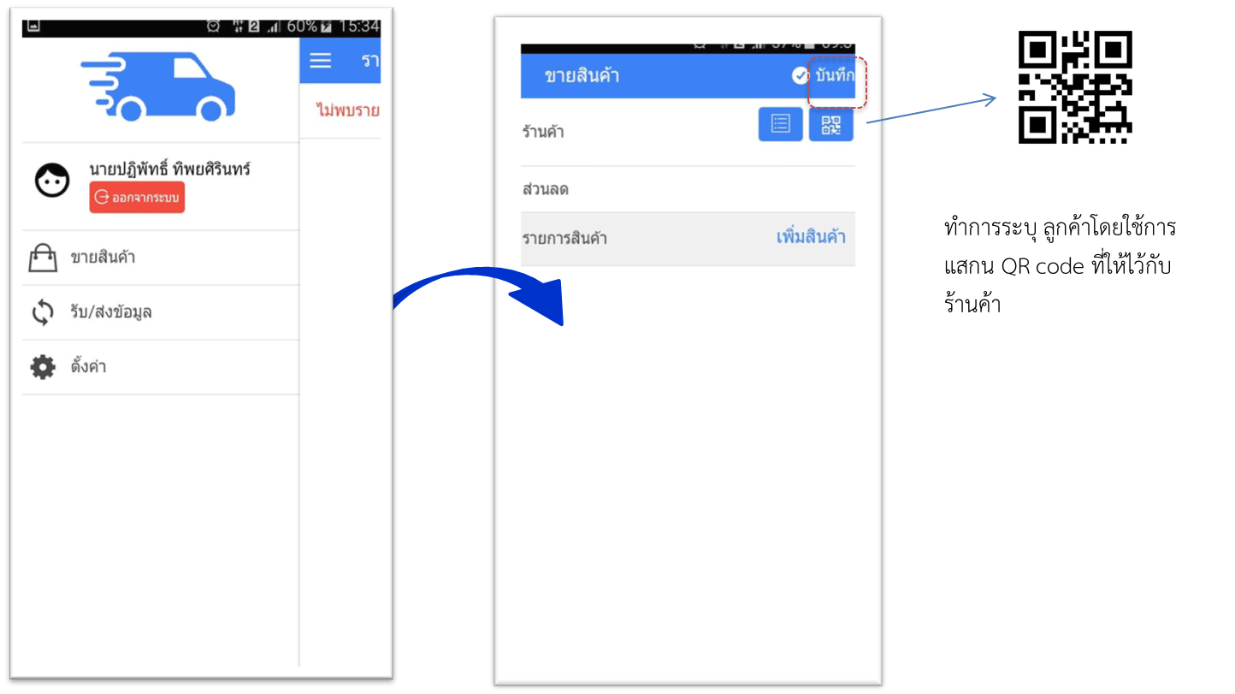
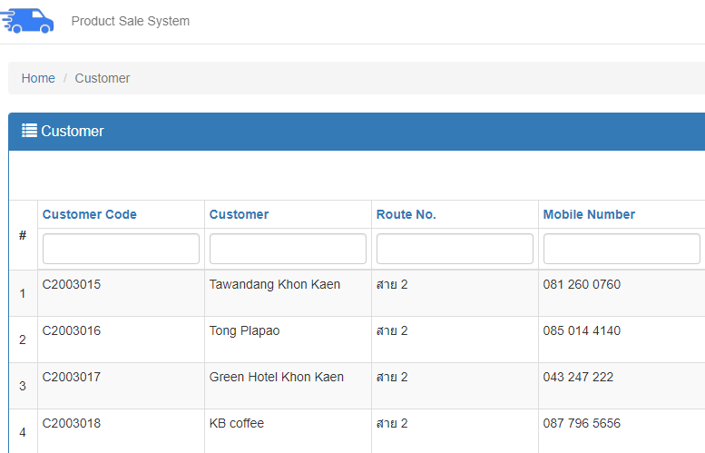
Customer data
Generates 20 customers
QR code and location (x,y))
Distance between customers are automatically calculated based on the google distance
Generates demands, time to receive products

Slide 12
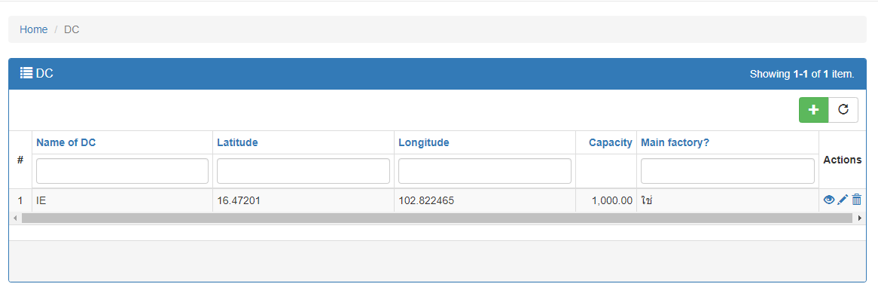
Project Data
Factory and distribution center data:
In this model, both ice factory and distribution centers are considered
The data must be filled: capacity of the factory and distribution center, location (x,y)
In case no distribution center, the number of distribution centers is zero.

Slide 13
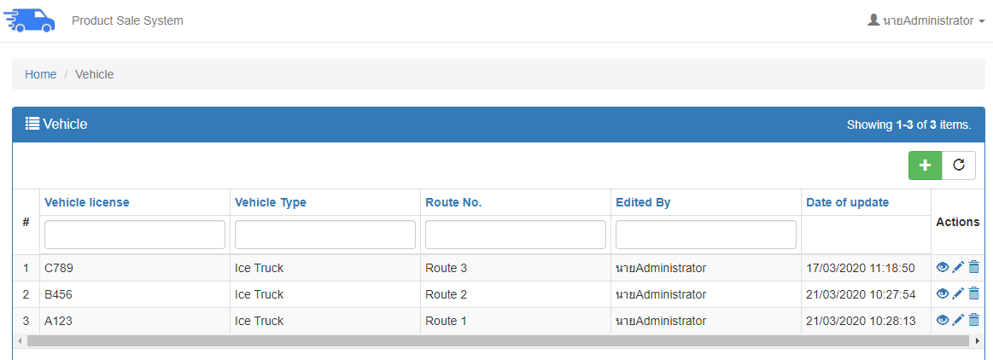
Project Data
Vehicles data:
Vehicle used: 3 vehicles with capacity 2, 3, and 4 tons
Operation time starting from 8:00-17:00
Speed used: 60 km./hr
Fuel rate: 4 km./litre

Slide 14
Examples of Results Running the IceTrans program (Students’ work)
Route 1
Route 2

