Slide 1
Advanced Optimization:
Techniques and Industrial Applications
Module 3: Optimization and Its Applications in Industry 4 Era

Slide 2
Session 3.1:
An Overview of Digital Technologies

Slide 3
Module 3: Optimization and Its Applications in Industry 4 Era
3.1 An Overview of Digital Technologies (1 hr.)
3.1.1 Digital technology concept
3.1.2 Digital technology hardware & software
3.1.3 Digital technology applications
3.2 Optimization (Opt) concept and Its Applications in Industry 4.0 Era (2 hrs.)
3.2.1 Optimization concept in Industry 4.0 era
3.2.2 Optimization applications in Industry 4.0 and mobile support
Opt in Warehouse and Inventory Management
Opt in Transportation problems
Opt in Scheduling problems
3.3 Optimization (Opt) Design in I4.0 (2 hrs.)
3.3.1 System analysis concept
3.3.2 System architecture, module and component design
3.3.3 Data input/output user interface design
3.3.4 Optimization programming, modeling, and simulation
3.3.5 Evaluating the designed system
3.4 Real-Time Optimization (2 hrs.)
3.4.1 Checking optimality conditions when input data change
3.4.2 Setting initial solution when input data change
3.5 Case Study (3 hrs.)

Slide 4
3.1 An Overview of Digital Technologies
Today is “digital business” context.
Students discuss why today is digital business.
Give some extraordinary examples
Speed and timing are importance as a competitive advantage in an increasingly real-time economy.
Why??
A large amount of data are generated by IoT devices (i.e., from mobile technologies for engaging with customers).
However, businesses don’t want data. They want visibility and dashboards to be fast and timely.
Examples??
Therefore, cybersecurity tools and data analytics are required to invest (source: PWC).
Industry 4.0 brings new opportunities to realize a smarter factory.
Challenges from Industry 4.0 (Xu et al., 2016) in terms of research aspect:
Modeling a system with IoT devices (i.e., sensors, GPS, camera, or connected devices) is generated a large amount of data.
Those data may keep arriving and changing, and so any optimization model of such a system must be efficient and dynamic.
Connection and integration among different system components creates another challenge; an integrated system has many more decision variables.

Slide 5
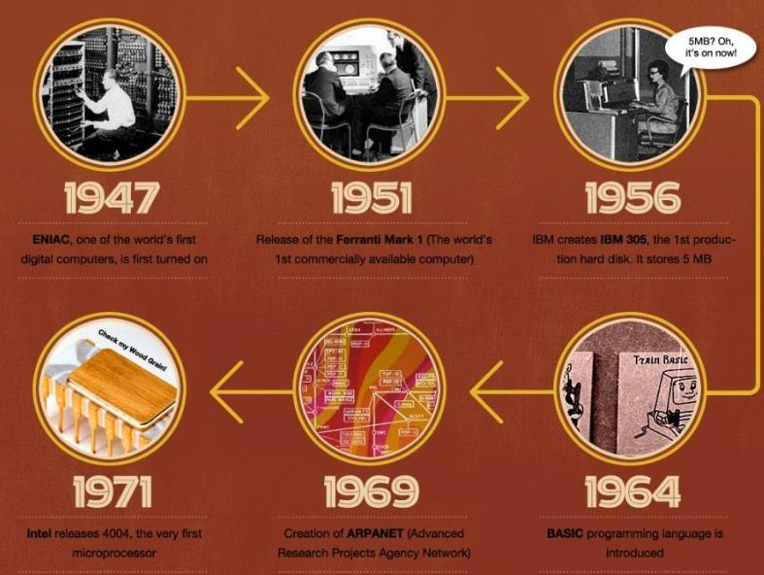
3.1.1 An Overview of Digital Technologies
1947: First digital computer
1951: First commercially available computer
1956: First production hard disk
1964: Programming language
1969: Advanced research projects agency network
1971: First microprocessor
Source: https://www.visualistan.com/2015/04/the-history-of-technology-infographic.html

Slide 6
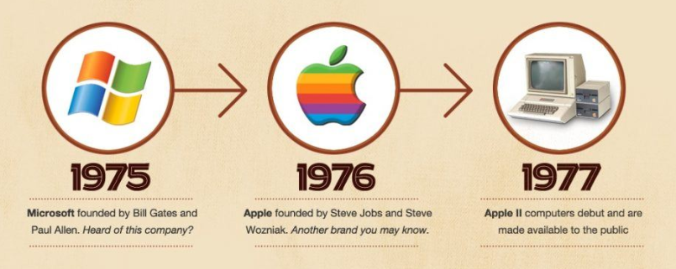
3.1.1 Digital technology history and concept
1975: Microsoft founded
1976: Apple founded
1977: Apple II computers debut
1981: Fist IBM PC
1983: The internet is born
1984-1985: Apple macintosh, computer disk
1986-1989: First laptop, Microsoft Office
Source: https://www.visualistan.com/2015/04/the-history-of-technology-infographic.html

Slide 7
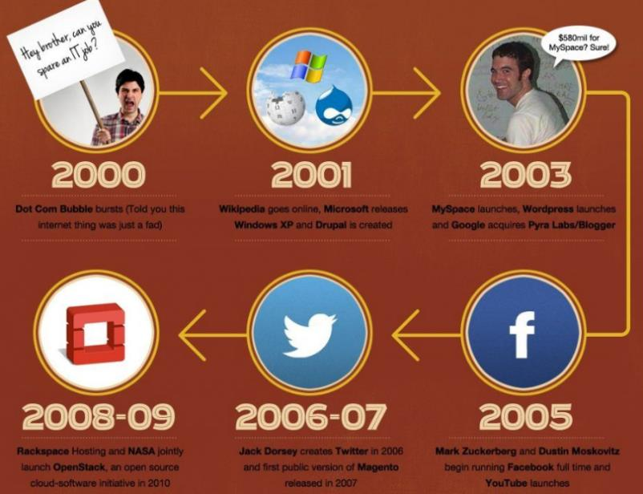
3.1.1 Digital technology history and concept
1991: Internet available for unrestricted computer use
1993: Pentium microchip
1994-1996: Amazon, Windows 95
1997-1999: Google founded, iMac, Blogger
2000: Dot Com Bubble
2001: Wikipedia online, Windows XP
2003: MySpace, Wordpress, Google
2005: Facebook, YouTube
2006-2007: Twitter
2008-2009: Open source cloud software
Source: https://www.visualistan.com/2015/04/the-history-of-technology-infographic.html

Slide 8
3.1.1 Digital technology history and concept
Responsive Web Design, HTML5
Source: https://www.visualistan.com/2015/04/the-history-of-technology-infographic.html

Slide 9
3.1.1 Digital technology concept
Digital optimization is the process of using digital technology to improve existing operating processes and business models (www.gartner.com).
Digital technologies are electronic tools, systems, devices and resources that generate, store or process data. (https://www.education.vic.gov.au/school/teachers/teachingresources/digital/Pages/teach.aspx)
The digital systems concept focuses on the components of digital systems: hardware and software (computer architecture and the operating system), and networks and the internet (wireless, mobile and wired networks and protocols). This concept is addressed in both strands.
Well known examples include social media, online games, multimedia and mobile phones.

Slide 10
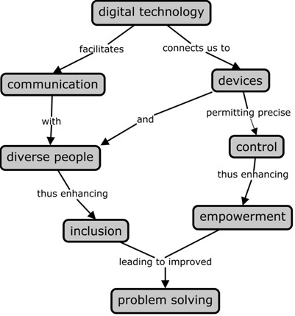
3.1.1 Digital technology concept
Digital technology facilitate communication by and with diverse people,
Enhancing inclusion and participation by more segments of society.
These technologies connect us to the material world in new ways, permitting more precise control of environment.
Jointly, these two aspects, inclusiveness on the one hand and empowerment on the other, lead to better problem solving.
Source: REVISITING THE DIGITAL DIVIDE: COLLECTIVE RESPONSIBILITES AND INDIVIDUAL RESPONSES , 2017

Slide 11
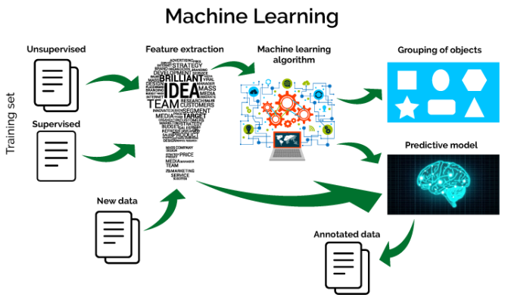
Example of the Use of Digital technology “Machine Learning”
Source: https://data-flair.training/blogs/machine-learning-tutorial/

Slide 12
3.1.2 Digital technology hardware & software
Types of Digital Technology
Search Engines
Digital Camera
Microsoft Office
3D Printing
Wearable Technologies
Virtual Currencies (Bitcoin)
Smart Home Technologies
Digital Technology Hardware
desktop computers.
laptop computers.
mobile phones.
tablet computers.
e-readers.
storage devices, such as flash drives.
input devices, such as keyboards, mice, and scanners.
output devices such as printers and speakers.

Slide 13
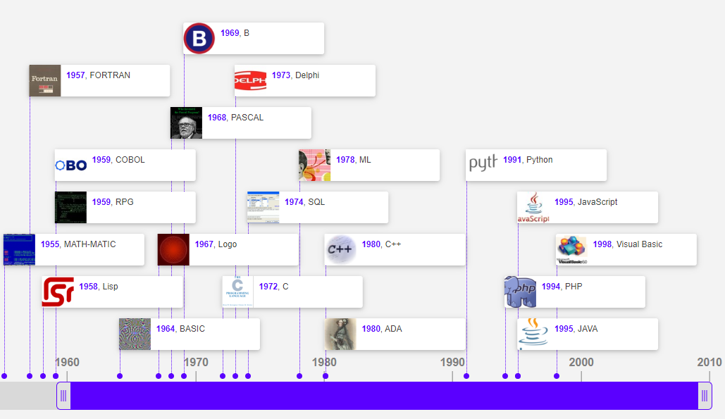
Software
Source:

Slide 14
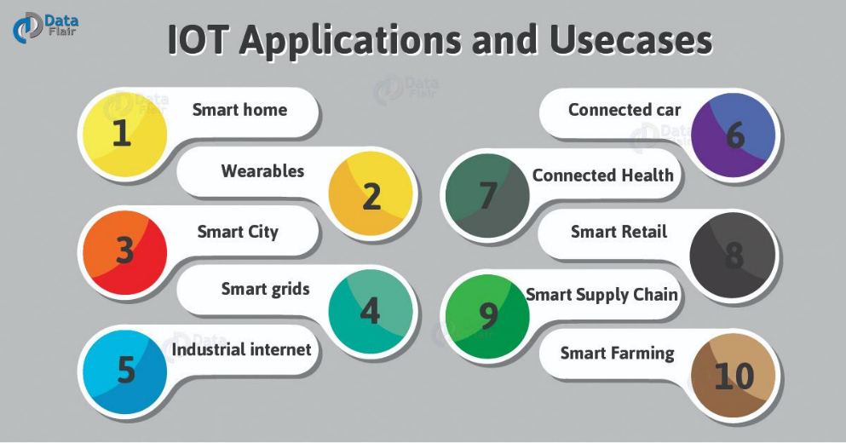
The Key Technologies of I4.0
The Internet of Things (IoT)
Cloud Computing (CC)
Big Data (BD)/Machine Learning
Simulation
Augmented Reality (AR) is technology that uses the camera of a tablet or phone to show the real world environment on the screen and then rendering digital assets on the screen combining the digital world with the physical world (Indiecad.com.au).
Additive Manufacturing (AM):
Horizontal and Vertical Systems Integration
Autonomous Robots
Cyber Security
3D Printing
Source: https://dzone.com
Source: https://arvrjourney.com/

Slide 15
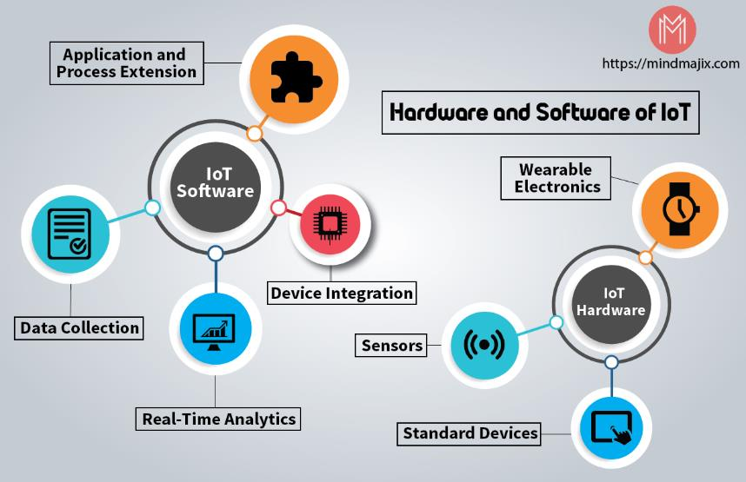
IoT hardware and Software
IoT Hardware includes a wide range of devices such as devices for routing, bridges, sensors, GPS, camera, or connected devices etc.
IoT devices manage key tasks and functions such as system activation, security, action specifications, communication, and detection of support-specific goals and actions.

Slide 16
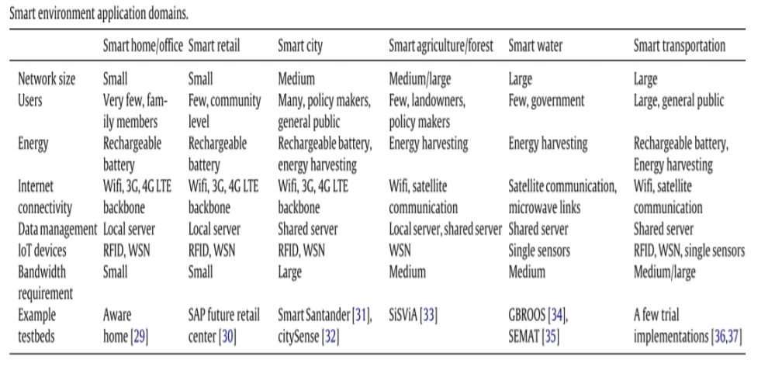
3.1.3 Digital technology applications
Source: https://www.semanticscholar.org/paper/Internet-of-Things-(IoT)%3A-A-vision%2C-architectural-Gubbi-Buyya/72c4d8b64a9959ea45677ca1955d3491ef0f1c62/figure/1

Slide 17
Assignment I (a group of 3 persons)
Find an example of the Use of Digital technology in the optimization area such as :
Scheduling
Transportation
Resource allocation
Production planning
etc
Discussion on why the industry are using it
How to apply the Digital technology and constraints

