Slide 1
Advanced Optimization:
Techniques and Industrial Applications
Module 2: Heuristics and Metaheuristics

Slide 2
Session 2.3:
Local Search Methods:
ALNS and Tabu Search

Slide 3
Heuristics and Mataheuristics
Metaheuristics: High-level strategies for guiding a search (Glover, 1986) according to feedback from the objective function, previous decisions and prior performance (Stutzle, 1998). In other words, the rules of a meta-heuristic consist of (at least) two orders, such that the overall searching behavior keeps changing while exploring the state-space.
Examples: Genetic Algorithm (GA), Particle Swarm Optimization (PSO), Adaptive Large Neighborhood Search (ALNS)

Slide 4
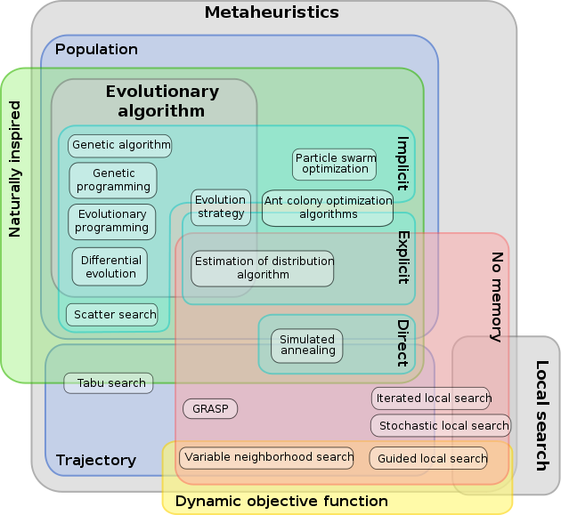
Metaheuristics Classification
Par nojhan le vendredi, 2007
Par nojhan le vendredi, 2007

Slide 5
Large Neighborhood Search (LNS)
Proposed by Shaw (1998)
LNS is a concept for efficient search developing from local search by improving searching techniques within a small to large area
The principles of LNS are based on two main processes: destroy and repair methods.
A destroy method destructs part of the current solution while a repair method rebuilds the destroyed solution

Slide 6
Large Neighborhood Search (LNS)
x : current feasible solution
x^{b} : The best solution of the search
x^{t} : a temporary solution
function d( ) : destroy method
function r( ) : repair method

Slide 7
Adaptive Large Neighborhood Search (ALNS)
Proposed by S. Ropke and D. Pisinger (2006)
Extend LNS by allowing multiple destroy and repair methods to be used within the same search
Each destroy/repair method is assigned a weight that controls how often the particular method is attempted during the search
The weights are adjusted dynamically as the search progresses so that the heuristic adapts to the instance at hand and to the state of the search

Slide 8
Adaptive Large Neighborhood Search (ALNS)
x : current feasible solution
x^{b} : The best solution of the search
$Ω^{−}$ : set of destroy method
$Ω^{+}$ : set of repair method
x^{t} : a temporary solution
function d( ) : destroy method
function r( ) : repair method
$ρ^{−}$and $ρ^{+}$ restore the weight of each destroy and repair method, respectively

Slide 9
Adaptive Large Neighborhood Search (ALNS)
What extend from LNS…
In line 2: $ρ^{−}$and $ρ^{+}$ is introduced to restore the weight of each destroy and repair method, respectively. Initially all methods have the same weight.
In line 4, the weight vectors, $ρ^{−}$and $ρ^{+}$ are used to select the destroy and repair methods using a roulette wheel principle.

Slide 10
Adaptive Large Neighborhood Search (ALNS)
The algorithm calculates the probability $Φ_{j}^{−}$ of choosing the j^{th} destroy method as follows
and the probabilities for choosing the repair methods are determined in the same way

Slide 11
Adaptive Large Neighborhood Search (ALNS)
The weights are adjusted dynamically, based on the recorded performance of each destroy and repair method. This takes place in line 12: when an iteration of the ALNS heuristic is completed, a score y for the destroy and repair method used in the iteration is computed using the formula
Where $ω_{1},ω_{2},ω_{3}, and ω_{1}$ are parameters. A highly value corresponds to a successful method.

Slide 12
Adaptive Large Neighborhood Search (ALNS)
Let a and b be the indices of the destroy and repair methods that were used in the last iteration of the algorithm, respectively. The components corresponding to the selected destroy and repair methods in the r− and r+ vectors are updated using the equations
where λ ϵ [0,1] is the decay parameter that controls how sensitive the weights are to changes in the performance of the destroy and repair methods.
Note that the weights that are not used at the current iteration remain unchanged.
The aim of the adaptive weight adjustment is to select weights that work well for the instance being solved.

Slide 13
Example Applications of LNS and ALNS
Routing problems
TSP (Traveling salesman problem)
VRP (Vehicle routing problem)
VRPTW (Vehicle routing problem with time windows)
PDPTW (Pickup and delivery problem with time windows)
Scheduling problems
Single machine scheduling
Cumulative scheduling
Job shop scheduling
Constrained project scheduling problem

Slide 14
Tabu Search
A chief way to exploit memory in tabu search is to classify a subset of the moves in a neighborhood as forbidden (or tabu).
A neighborhood is constructed to identify adjacent solutions that can be reached from current solution.
The classification depends on the history of the search, and particularly on the recency or frequency that certain move or solution components, called attributes, have participated in generating past solutions.
A tabu list records forbidden moves, which are referred to as tabu moves.
Tabu restrictions are subject to an important exception. When a tabu move has a sufficiently attractive evaluation where it would result in a solution better than any visited so far, then its tabu classification may be overridden. A condition that allows such an override to occur is called an aspiration criterion.

Slide 15
Basic Tabu Search Algorithm
Step 1: Choose an initial solution i in S. Set i* = i and k=0.
Step 2: Set k=k+1 and generate a subset V* of solution in N(i,k) such that either one of the Tabu conditions is violated or at least one of the aspiration conditions holds.
Step 3: Choose a best j in V* and set i=j.
Step 4: If f(i) < f(i*) then set i* = i.
Step 5: Update Tabu and aspiration conditions.
Step 6: If a stopping condition is met then stop. Else go to Step 2.

Slide 16
Tabu Search Algorithm (TS)

Slide 17
Tabu Search Algorithm (TS)
Tabu List: T
First in First out: FIFO
Stopping criteria
Maximum number of iterations
Maximum computation time
Number of consecutive iterations without an improvement
Objective function setting

Slide 18
Example of TS
Asymmetric traveling salesman problem: ATSP. Find the routing of this problem by TS. Tabu list = 2 , Neighborhood size = 4
Iteration = 3 and Swap move
From/To | City 1 | City 2 | City 3 | City 4 | City 5
City 1 | 0 | 4 | 7 | 9 | 12
City 2 | 3 | 0 | 8 | 12 | 15
City 3 | 7 | 9 | 0 | 17 | 12
City 4 | 8 | 12 | 13 | 0 | 16
City 5 | 12 | 6 | 15 | 18 | 0

