Slide 1
Advanced Optimization:
Techniques and Industrial Applications
Module 2: Heuristics and Metaheuristics

Slide 2
Session 2.2:
Population-based algorithms:
GA, PSO, DE

Slide 3
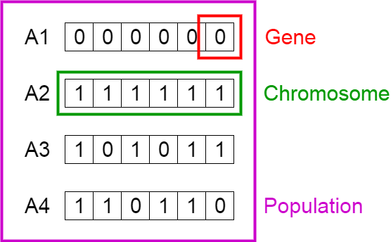
Genetic Algorithm (GA)
Chromosome
A chromosome (also sometimes called a genotype) is a set of parameters which define a proposed solution to the problem that the genetic algorithm is trying to solve. The set of all solutions is known as the population. The chromosome is often represented as a binary string, although a wide variety of other data structures are also used.
Fitness function
The fitness function determines how fit an individual is (the ability of an individual to compete with other individuals). It gives a fitness score to each individual. The probability that an individual will be selected for reproduction is based on its fitness score.

Slide 4
Simple Genetic Algorithm
1. Begin
2.
3. P(t) Initialize population
4. P(t) (Evaluate);
5. While (Not termination) ;
6. C(t) (Crossover);
7. C(t) (Mutation);
8. P(t) (Evaluate);
9. P(t+1) P(t) and C(t) (Selection);
10.
11. End while
12. End
Initial Solution
Selection
Next Population
Next Population
….
Match
Mutation
….
Crossover

Slide 5

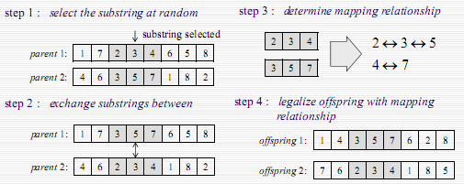
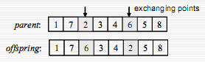
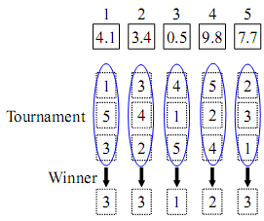
Variants of genetic algorithm
  Encoding & Decoding
  Binary-based representation
  Priority-based representation
  Random key-based representation
  Dispatching rule-based representation
  Selections
  Roulette wheel selection
  Tournament selection
  Ranking and scaling
  Crossover Operations
  One cut-point
  Two cut-point
  Partial-mapped crossover (PMX)
  Position-based crossover
  Uniform crossover
  Mutation Operations
  Flip mutation
  Swap mutation
  Insert mutation
  Neighborhood search mutation

Slide 6
Example of GA
Asymmetric traveling salesman problem: ATSP) Find the routing of this problem by GA. Total generation = 2 , Population= 4
Crossover and Mutation rate = 0.8 and 0.2 respectively.
one-point crossover and swap mutation
From/To | City 1 | City 2 | City 3 | City 4 | City 5
City 1 | 0 | 4 | 7 | 9 | 12
City 2 | 3 | 0 | 8 | 12 | 15
City 3 | 7 | 9 | 0 | 17 | 12
City 4 | 8 | 12 | 13 | 0 | 16
City 5 | 12 | 6 | 15 | 18 | 0

Slide 7
Example of GA
Step 1: Initial Solution
Step 2: Evaluation

Slide 8
Example of GA
Step 3: Crossover
Step 4: Mutation
One-Cut point crossover and crossover rate= 0.8
Swap Mutation and mutation rate = 0.2
Population | random
V₁ & V₂ | 0.3
V₃ & V₄ | 0.9
Population | random
V₁ | 0.50
V₂ | 0.31
V₃ | 0.06
V₄ | 0.18

Slide 9
Example of GA
Step 5: Evaluation
Parent
Offspring

Slide 10
Example of GA
Step 6: Selection
                Roulette wheel selection
Population | Objective function | Eval(V_{k}) | P_{k} | Q_{k}
V₁ | 56 | 0.0179 | 0.258 | 0.258
V₂ | 57 | 0.0175 | 0.254 | 0.512
V₃ | 56 | 0.0179 | 0.258 | 0.770
V₄ | 63 | 0.0159 | 0.230 | 1.000
 | F= | 0.069

Slide 11
Example of GA
Step 6: Selection (Cont.)
Random | Value (r) | Select Chromosome
1 | 0.58 | V₃
2 | 0.12 | V₁
3 | 0.96 | V₄
4 | 0.76 | V₃

Slide 12
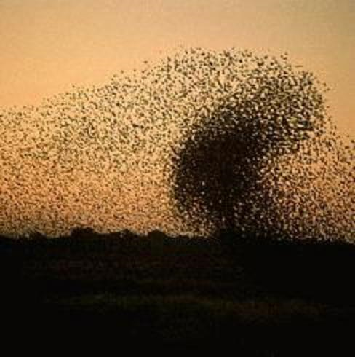
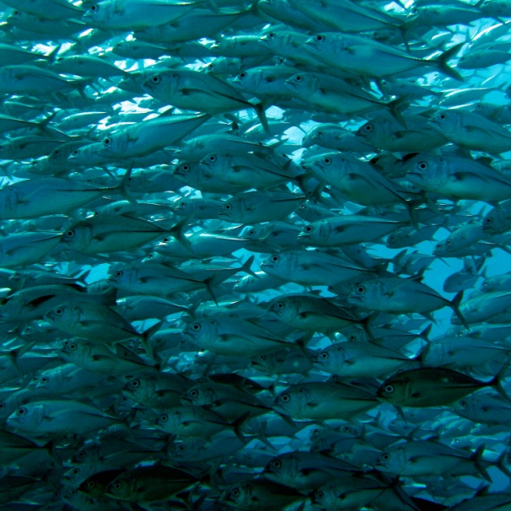
Particle Swarm Optimization (PSO)
Inspired from the nature social behavior and dynamic movements with communications of insects, birds and fish
Uses a number of agents (particles) that constitute a swarm moving around in the search space looking for the best solution
Each particle in search space adjusts its “flying” according to its own flying experience as well as the flying experience of other particles

Slide 13
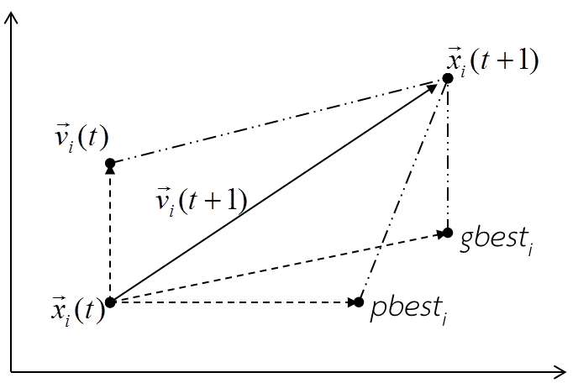
Particle Swarm Optimization (PSO)
Each particle adjusts its travelling speed dynamically corresponding to the flying experiences of itself and its colleagues
Each particle modifies its position according to:
  its current position
  its current velocity
  the distance between its current position and pbest
  the distance between its current position and gbest

Slide 14
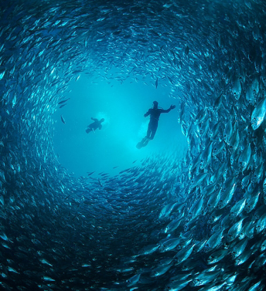
Particle Swarm Optimization (PSO)
[x*] = PSO()
P = Particle_Initialization();
For i=1 to it_max
For each particle p in P do
fp = f(p);
If fp is better than f(pBest)
pBest = p;
end
end
gBest = best p in P;
For each particle p in P do
v = v + c1*rand*(pBest – p) + c2*rand*(gBest – p);
p = p + v;
end
end

Slide 15
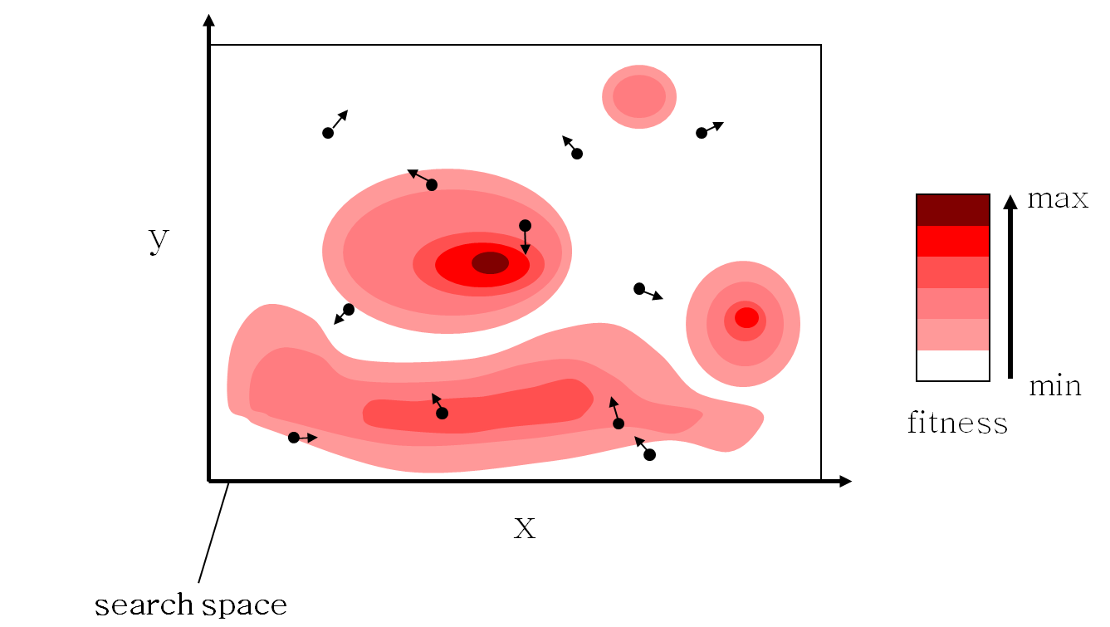
Particle Swarm Optimization (PSO)

Slide 16
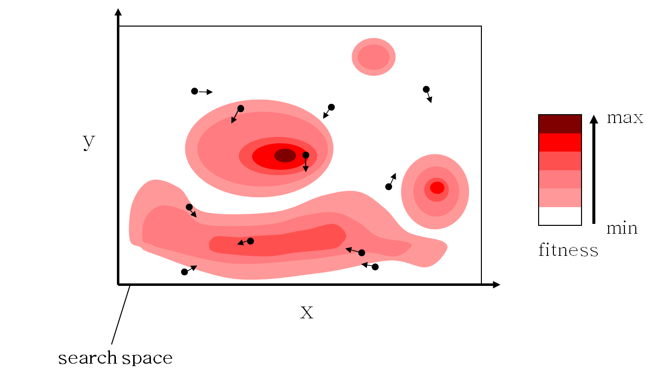
Particle Swarm Optimization (PSO)

Slide 17
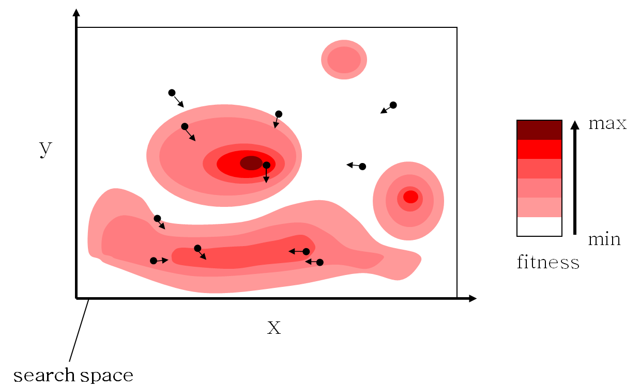
Particle Swarm Optimization (PSO)

Slide 18

Particle Swarm Optimization (PSO)

Slide 19

Particle Swarm Optimization (PSO)

Slide 20
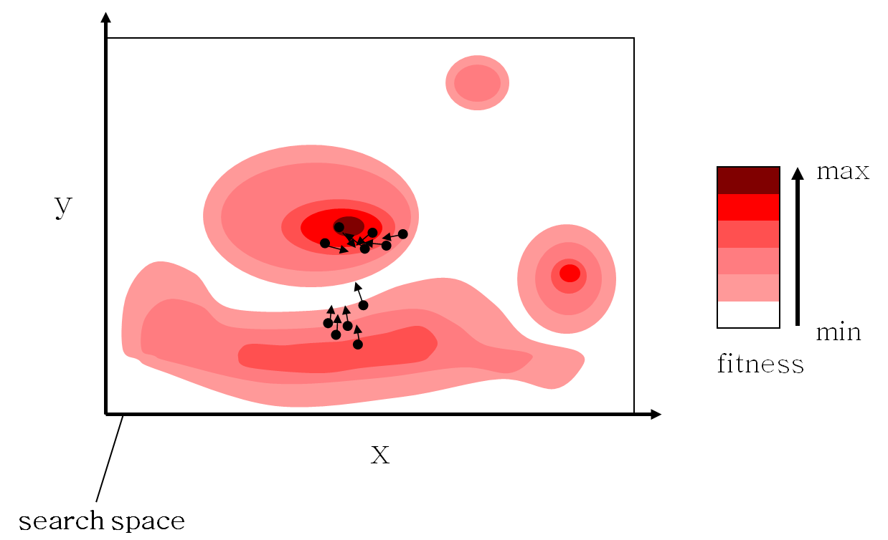
Particle Swarm Optimization (PSO)

Slide 21
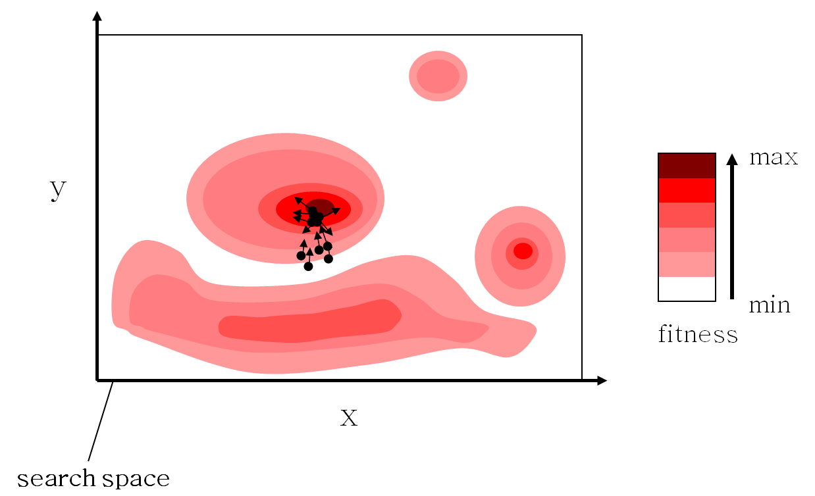
Particle Swarm Optimization (PSO)

Slide 22

Particle Swarm Optimization (PSO)

Slide 23
Particle Swarm Optimization (PSO)
$${\vec{v}}_{i}(t+1)=w{\vec{v}}_{i}(t)+c_{p}r_{1}({\vec{x}}_{pbest_{i}}−{\vec{x}}_{i}(t))+c_{g}r_{2}({\vec{x}}_{gbest_{i}}−{\vec{x}}_{i}(t))$$
  C_{p} is the importance of personal best value
  C_{g} is the importance of neighborhood best value

Slide 24
Example of PSO
Asymmetric traveling salesman problem: ATSP) Find the routing of this problem by PSO. Total particles = 3 , weight= 0.4 and C_{p} = C_{p} = 1.
All velocity vectors are zero.
From/To | City 1 | City 2 | City 3 | City 4 | City 5
City 1 | 0 | 4 | 7 | 9 | 12
City 2 | 3 | 0 | 8 | 12 | 15
City 3 | 7 | 9 | 0 | 17 | 12
City 4 | 8 | 12 | 13 | 0 | 16
City 5 | 12 | 6 | 15 | 18 | 0

Slide 25
Example of PSO
Step 1: Encoding for particles and velocity vectors
Particle | City 1 | City 2 | City 3 | City 4 | City 5
1 | 0.2348 | 0.0154 | 0.6491 | 0.4509 | 0.7447
2 | 0.3532 | 0.0430 | 0.7317 | 0.5470 | 0.1890
3 | 0.8212 | 0.1690 | 0.6477 | 0.2963 | 0.6868
Vector | City 1 | City 2 | City 3 | City 4 | City 5
1 | 0 | 0 | 0 | 0 | 0
2 | 0 | 0 | 0 | 0 | 0
3 | 0 | 0 | 0 | 0 | 0

Slide 26
Example of PSO
Step 2: Decoding for all particles (Ranked of Value: ROV)
Particle
City
City
City
City
City
Particle
City
City
City
City
City
Particle
City
City
City
City
City

Slide 27
Example of PSO
Step 3: Evaluation
Particle 1 : Total distances = 3+9+13+12+6 = 43 Units
Particle 2 : Total distances = 15+12+9+13+9 = 58 Units
Particle 3 : Total distances = 12+13+12+12+4 = 53 Units

Slide 28
Example of PSO
Step 4: Adjust pbest and gbest
Particle 1 : Total distances = 3+9+13+12+6 = 43 Units
Position
Particle
Step 5: Adjust velocity and position

Slide 29
Example of PSO (Iteration 1)
Example for particle 2 (Iteration 1) with weight= 0.4 and C_{p} = C_{p} = 1
Position
Position

Slide 30
Example of PSO (Iteration 1)
Example for particle 2 (Iteration 1) with weight= 0.4 and C_{p} = C_{p} = 1
So, Velocity 2 = [-0.0763, -0.0104, -0.067, -0.0512, 0.1949]
Velocity 1
Velocity 2
Velocity 3

Slide 31
Example of PSO (Iteration 1)
Example for particle 2 (Iteration 1)
Position
Positi
on
Position
Positi
on
So, Position 2 = 0.2769, 0.0326, 0.6647, 0.4958, 0.3839]
Position 1
Position 2
Position 3

Slide 32
Example of PSO (Iteration 2)
Decoding for all particles (Iteration 2)
Particle
City
City
City
City
City
Particle
City
City
City
City
City
Particle
City
City
City
City
City

Slide 33
Example of PSO (Iteration 2)
Evaluation (Iteration 2)
Particle 1 : Total distances = 43 Units
Particle 2 : Total distances = 55 Units
Particle 3 : Total distances = 50 Units

Slide 34
Example of PSO (Iteration 2)
Adjust pbest and gbest
Position
Particle
Particle
Particle
Position
Particle
Adjust velocity and position
Particle
Particle
Particle

Slide 35
Example of PSO (Iteration 2)
Adjust velocity and position (Cont.)
Velocity
Particle
Particle
Particle
Position
Particle
Particle
Particle

Slide 36
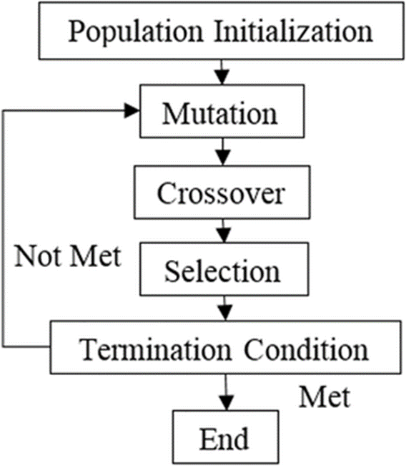
Differential Evolution : DE
  Proposed by Price and Storn in 1995
  Considered as one of the most powerful evolutionary algorithms for real number function optimization nowadays

Slide 37
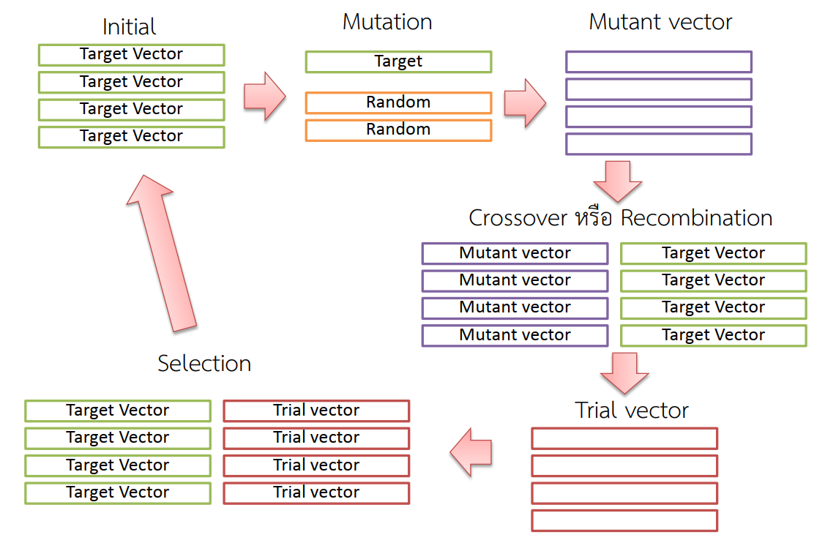
Differential Evolution : DE

Slide 38

Differential Evolution : DE
  Mutation
  X _{i,G} = Target vector
  V_{i,G+1} = Mutant vector
  X _{r1,G}, X _{r 2,G} , X _{r3,G} = Random vector
  F = Scaling factor = [0 , 2]

Slide 39

Differential Evolution : DE
  Crossover
  U _{ji,G+1} = Trial vector
  V_{ji,G+1} = Mutant vector
  X _{ji,G} = Target vector
  randb(j) = Random number = [0 , 1]
  rnbr(i) = Vector size
  CR = Crossover rate = [0 , 1]

Slide 40
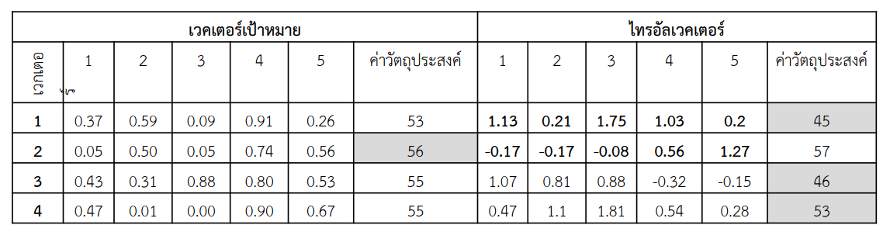
Differential Evolution : DE
  Selection
Target vector
Trial vector
Vector
Obj.
Obj.

Slide 41
Example of GA
Asymmetric traveling salesman problem: ATSP) Find the routing of this problem by DE. Vectors= 6
Weighting Factor = 2, Crossover rate = 0.8
From/To | City 1 | City 2 | City 3 | City 4 | City 5
City 1 | 0 | 4 | 7 | 9 | 12
City 2 | 3 | 0 | 8 | 12 | 15
City 3 | 7 | 9 | 0 | 17 | 12
City 4 | 8 | 12 | 13 | 0 | 16
City 5 | 12 | 6 | 15 | 18 | 0

Slide 42
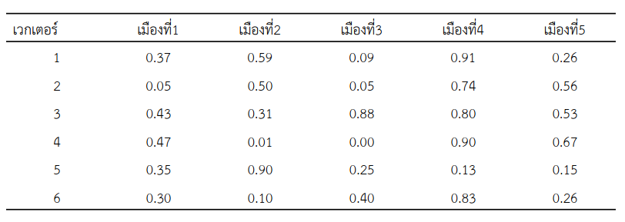
Example of DE
Step 1: Initial Solution
Vector
City
City
City
City
City

Slide 43
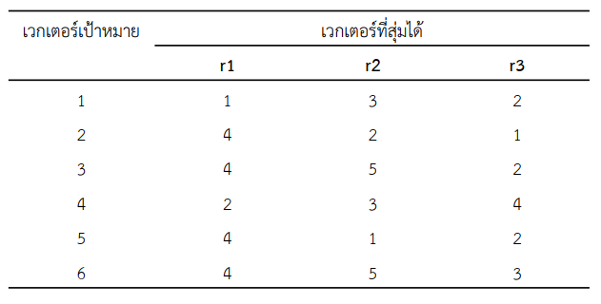
Example of DE
Step 2 : Mutation
Target
Vector
Random Vector

Slide 44
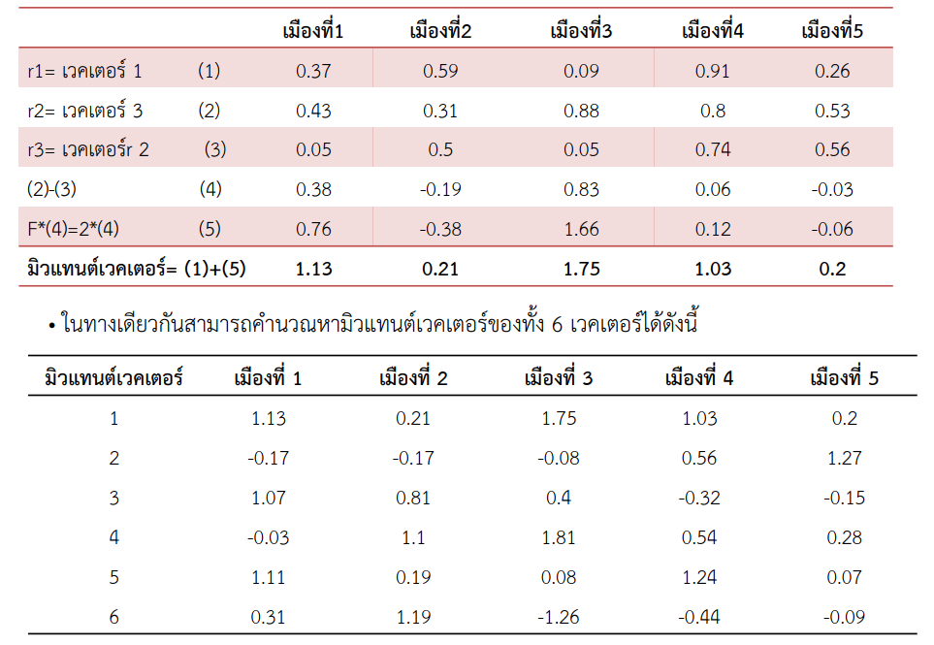
Example of DE
City
City
City
City
City
Step 2 : Mutation (Cont.)
Vector
Vector
Vector
Mutant Vector
Mutant Vector
City
City
City
City
City

Slide 45
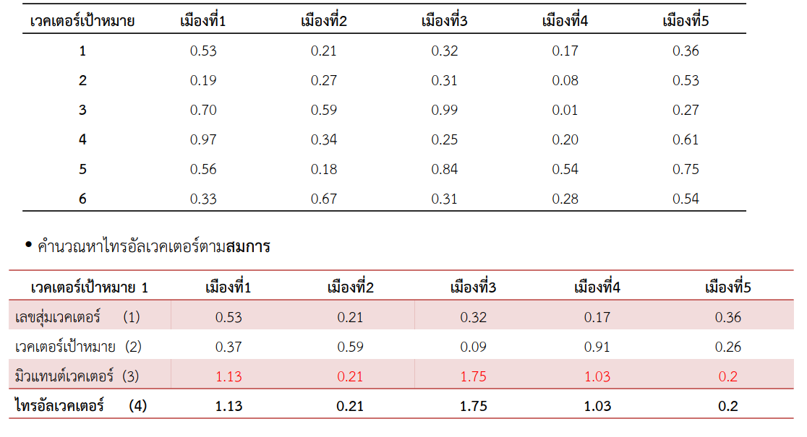
Example of DE
Step 3 : Crossover
Random
City
City
City
City
City
Calculation of Trail Vector
Trial Vector
City
City
City
City
City
Random
Target Vector
Mutant Vector
Trial Vector

Slide 46
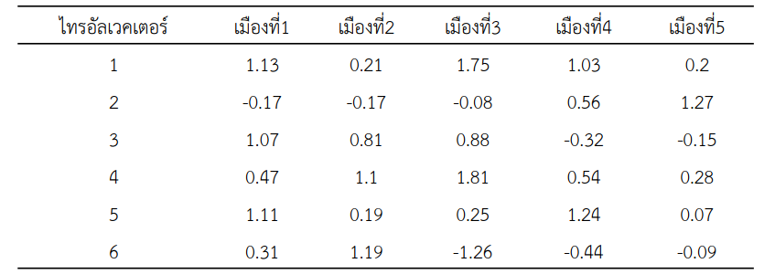
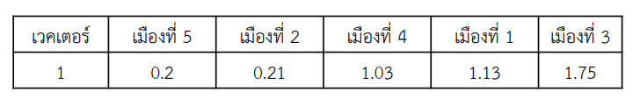
Example of DE
Step 3 : Crossover
(Cont.)
Trial Vector
City
City
City
City
City
Vector
City
City
City
City
City
Step 4 : Evaluation
Route: 5-2-4-1-3-5 = 6+12+8+7+12 = 45 Unit

Slide 47
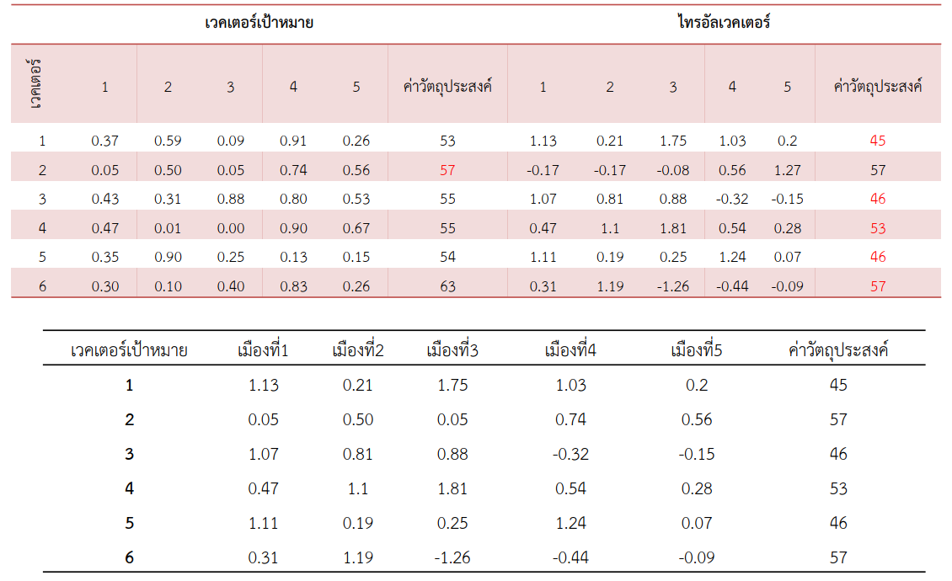
Example of DE
Step 5: Selection
Target Vector
Trial Vector
Objective
Objective
Target Vector
City
City
City
City
City
Objective

