Slide 1
Advanced Optimization:
Techniques and Industrial Applications
Module 2: Heuristics and Metaheuristics

Slide 2
Session 2.1:
Concept of Heuristics and Metaheuristics

Slide 3
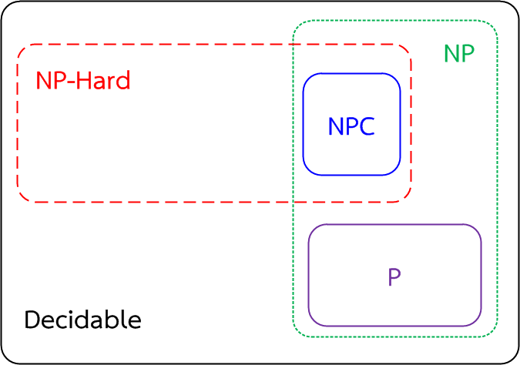
Introduction
Combinatorial optimization problem: COP
P-problems
P means polynomial time,
NP-problems
The NP stands for nondeterministic polynomial time
- Traveling salesman problem
- Knapsack problem
- Integer linear programming
NP-hard problems
NP-complete problems (NPC)

Slide 4
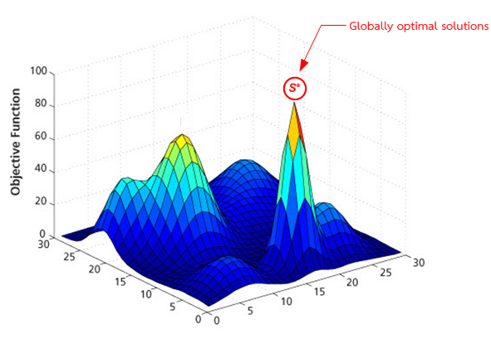
Discrete combinatorial optimization problem
Discrete optimization or combinatorial optimization
means searching for an optimal solution in a finite or countably infinite set of potential solutions. Optimality is defined with respect to some criterion function, which is to be minimized or maximized.

Slide 5
Approaches for discrete combinatorial optimization problem
Combinatorial optimization problem
Exact Method
Approximated Method
Dynamics programming
Branch and bound
Mixed integer programming
Quadratic programming
Constraint programming
Greedy Algorithm
Meta-Heuristics
Local search
Population-based search
Tabu search
Simulated annealing
Genetic Algorithm
Particle swarm optimization
Heuristics
Differential Evolution

Slide 6
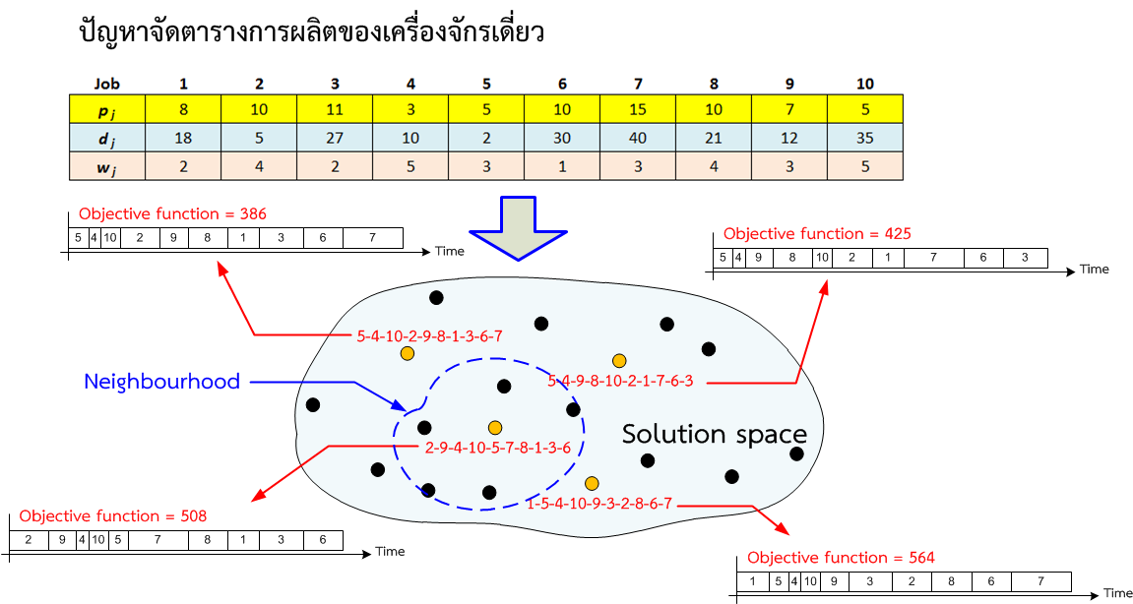
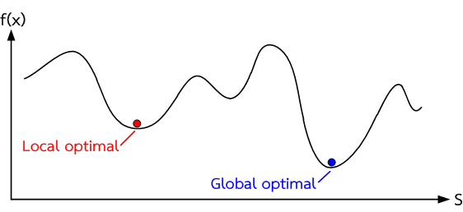
Solution space of discrete combinatorial optimization problem
Single Machine Scheduling Problem
Optimal solution ?

Slide 7
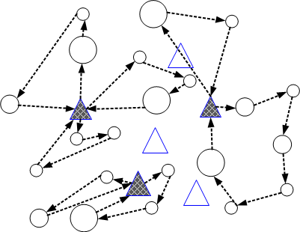
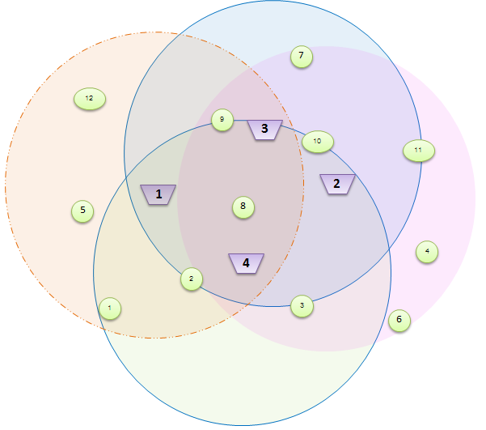
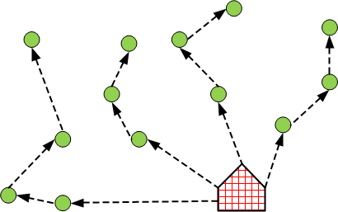
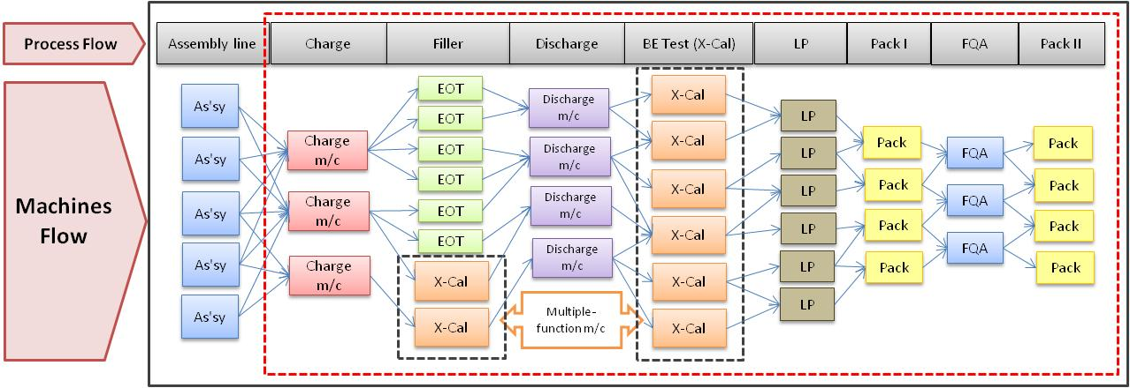
Solution space of discrete combinatorial optimization problem
Location & allocation problem: LAP
Location and routing problem: LRP
Vehicle routing problem: VRP
Production planning and scheduling

Slide 8
Heuristic approach
A heuristic technique, often called simply a heuristic, is any approach to problem solving, learning, or discovery that employs a practical method not guaranteed to be optimal or perfect, but sufficient for the immediate goals. Where finding an optimal solution is impossible or impractical, heuristic methods can be used to speed up the process of finding a satisfactory solution. Heuristics can be mental shortcuts that ease the cognitive load of making a decision.
Example: Artificial Intelligence (AI), Shortest Path Algorithms, Language recognition etc.

Slide 9
Heuristic approach
A heuristic technique, often called simply a heuristic, is any approach to problem solving, learning, or discovery that employs a practical method not guaranteed to be optimal or perfect, but sufficient for the immediate goals. Where finding an optimal solution is impossible or impractical, heuristic methods can be used to speed up the process of finding a satisfactory solution. Heuristics can be mental shortcuts that ease the cognitive load of making a decision.
Example: Artificial Intelligence (AI), Shortest Path Algorithms, Language recognition etc.

Slide 10
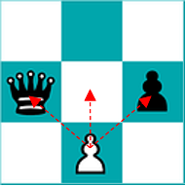
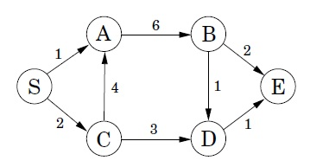
Heuristic approach
Artificial Intelligence (AI)
E.g. When a computer algorithm plays a game of Chess (e.g. Deep Blue) or a game of Go (e.g. AlphaGo), the computer cannot investigate every single move that can be played. Instead it will apply a few rules of thumb to quickly discard some moves while focusing on key moves that are more likely to lead to a victory.
Shortest Path Algorithms
Short Path Algorithms used by GPS systems and self-driving cars also use a heuristic approach to decide on the best route to go from A to Z. This is for instance the case for the A* Search algorithm which takes into consideration the distance as the crow flies between two nodes to decide which paths to explore first and hence more effectively find the shortest path between two nodes.

Slide 11
Heuristic approach
Advantage | Disadvantage
It can provide some quick and relatively inexpensive feedback to designers. | It requires knowledge and experience to apply the heuristics effectively.
You can obtain feedback early in the design process. | Trained usability experts are sometimes hard to find and can be expensive.
Assigning the correct heuristic can help suggest the best corrective measures to designers. | You should use multiple experts and aggregate their results.
You can use it together with other usability testing methodologies. | The evaluation may identify more minor issues and fewer major issues.
You can conduct usability testing to further examine potential issues

Slide 12
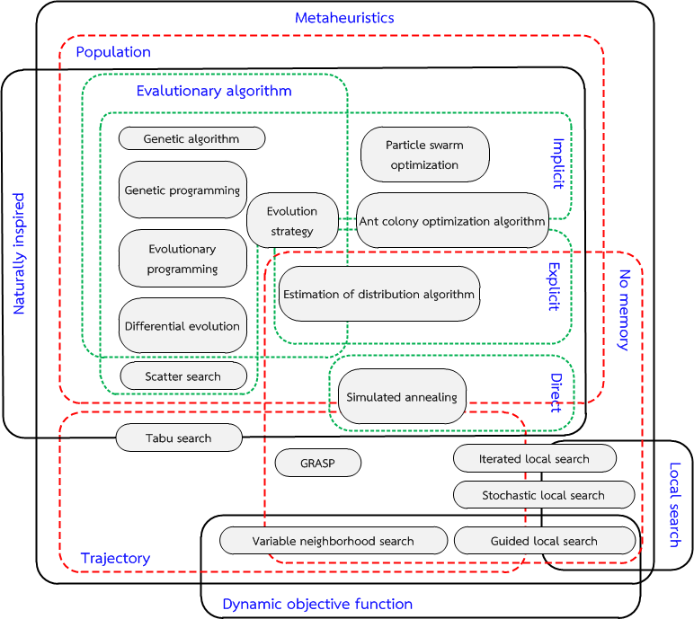
Metaheuristic approach
A metaheuristic is a higher-level procedure or heuristic designed to find, generate, or select a heuristic (partial search algorithm) that may provide a sufficiently good solution to an optimization problem, especially with incomplete or imperfect information or limited computation capacity.
Metaheuristics sample a set of solutions which is too large to be completely sampled. Metaheuristics may make few assumptions about the optimization problem being solved, and so they may be usable for a variety of problems.

Slide 13
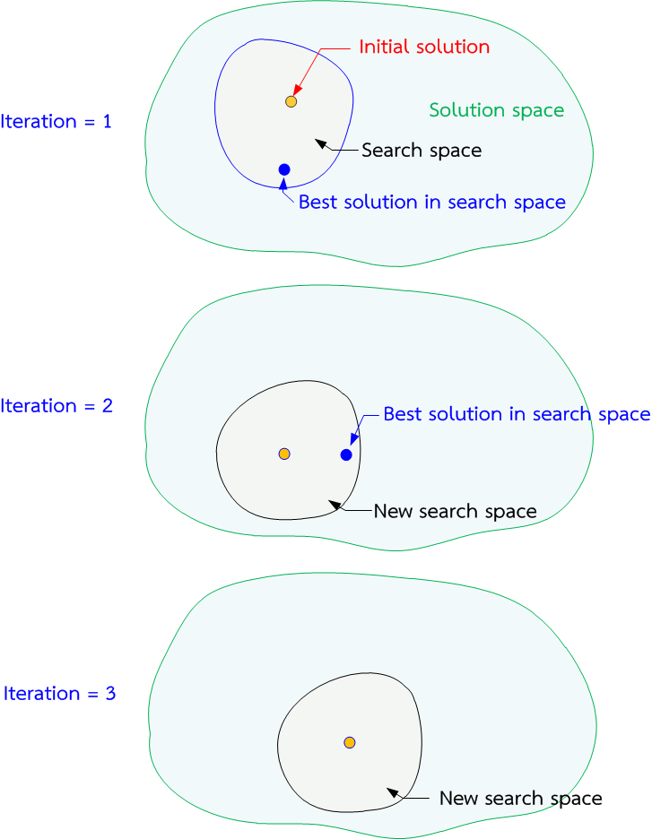
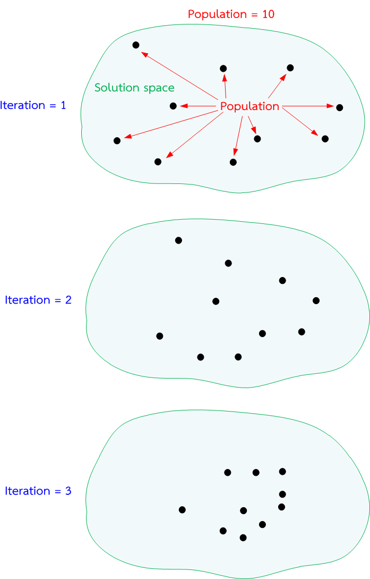
Metaheuristic approach
Local search
Population-based search

