Slide 1
Advanced Optimization:
Techniques and Industrial Applications

Slide 2
Session 1.5:
Dynamic Programming

Slide 3
Introduction
A specific type of mathematical programming in which the optimal solution of the original problem is found by solving a chain of subproblems.
In dynamic programming, the optimal solution of one subproblem will be used as input to the next subproblem. When the last subproblem is solved, the optimal solution for the entire problem is achieved, which includes the solution of the original problem.
Linkage between the stages of a DP problem is performed through recursive computations. Depending on the nature of the problem at hand, forward recursive equation or backward recursive equation will be developed for finding solution.

Slide 4

Introduction
Example 1: Shortage Path Problem
Find the shortage path from node 1 to node 9 of the network:
Define:
$f_{i}$: minimum total travel time from node i to node 9.
$t_{ij}$: travel time through the directed arc $\left(i,j\right)$.

Slide 5
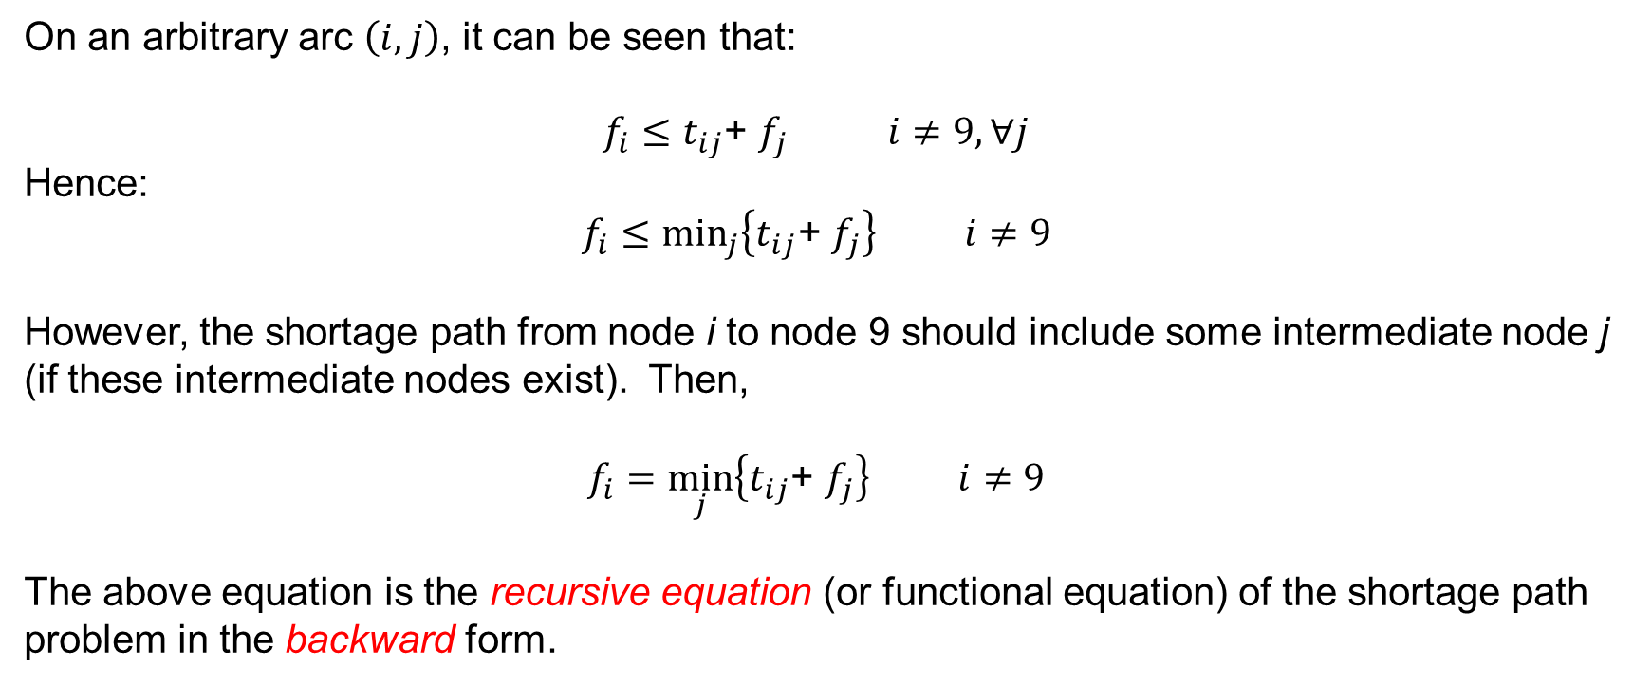
Introduction
On an arbitrary arc $\left(i,j\right)$, it can be seen that:
$f_{i}≤t_{ij}$+ $f_{j}$ $i≠9, ∀j$
Hence:
$f_{i}≤\min_{j}\left\{t_{ij}\text{+ }f_{j}\right\}$ $i≠9$
However, the shortage path from node i to node 9 should include some intermediate node j (if these intermediate nodes exist). Then,
$f_{i}=\min_{j}\left\{t_{ij}\text{+ }f_{j}\right\}$ $i≠9$
The above equation is the recursive equation (or functional equation) of the shortage path problem in the backward form.

Slide 6
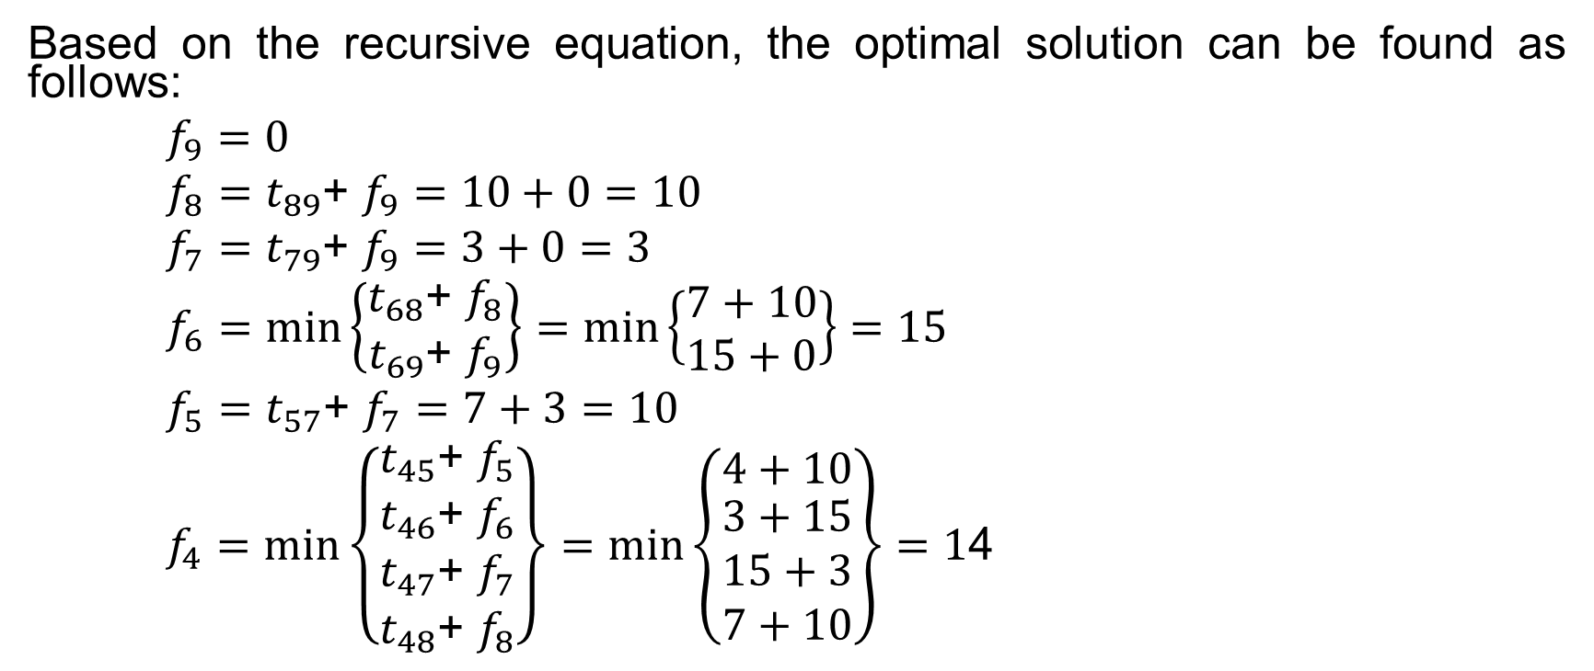
Introduction
Based on the recursive equation, the optimal solution can be found as follows:
$f_{9}=0$
$f_{8}=t_{89}\text{+ }f_{9}=10+0=10$
$f_{7}=t_{79}\text{+ }f_{9}=3+0=3$
$f_{6}=min\left\{\begin{matrix}t_{68}\text{+ }f_{8} \\ t_{69}\text{+ }f_{9}\end{matrix}\right\}=min\left\{\begin{matrix}7+10 \\ 15+0\end{matrix}\right\}=15$
$f_{5}=t_{57}\text{+ }f_{7}=7+3=10$
$f_{4}=min\left\{\begin{matrix}t_{45}\text{+ }f_{5} \\ \begin{matrix}t_{46}\text{+ }f_{6} \\ t_{47}\text{+ }f_{7} \\ t_{48}\text{+ }f_{8}\end{matrix}\end{matrix}\right\}=min\left\{\begin{matrix}4+10 \\ \begin{matrix}3+15 \\ 15+3 \\ 7+10\end{matrix}\end{matrix}\right\}=1$4

Slide 7
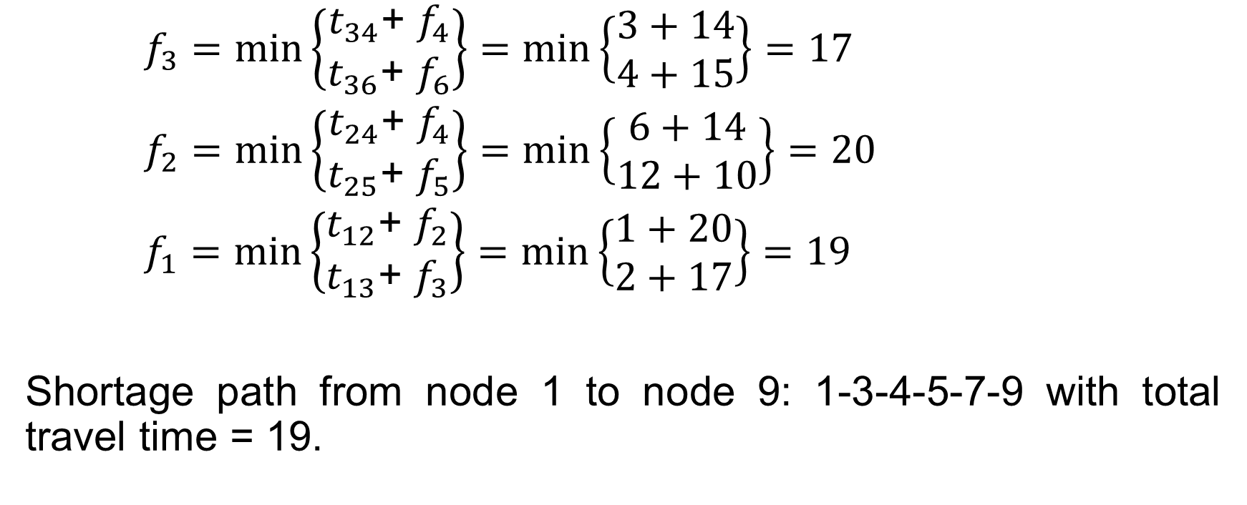
Introduction
$f_{3}=min\left\{\begin{matrix}t_{34}\text{+ }f_{4} \\ t_{36}\text{+ }f_{6}\end{matrix}\right\}=min\left\{\begin{matrix}3+14 \\ 4+15\end{matrix}\right\}=17$
$f_{2}=min\left\{\begin{matrix}t_{24}\text{+ }f_{4} \\ t_{25}\text{+ }f_{5}\end{matrix}\right\}=min\left\{\begin{matrix}6+14 \\ 12+10\end{matrix}\right\}=20$
$f_{1}=min\left\{\begin{matrix}t_{12}\text{+ }f_{2} \\ t_{13}\text{+ }f_{3}\end{matrix}\right\}=min\left\{\begin{matrix}1+20 \\ 2+17\end{matrix}\right\}=19$
Shortage path from node 1 to node 9: 1-3-4-5-7-9 with total travel time = 19.

Slide 8
Introduction
It is noted that each subproblem is associated with a network’s node and when the shortage path from node 1 to node 9 is determined, we also know the shortage paths from every nodes of the network to node 9.

Slide 9
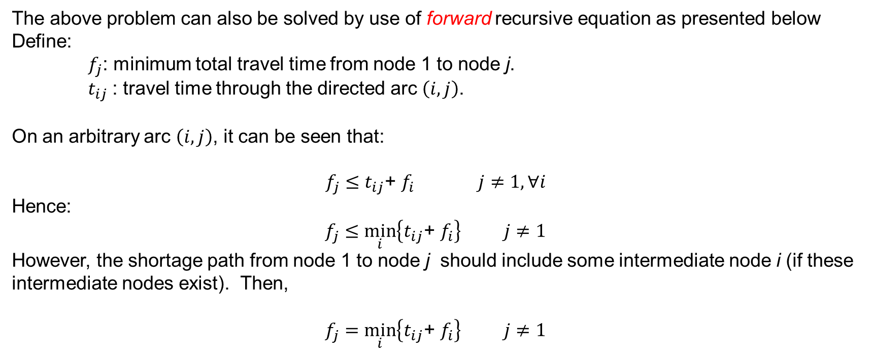
Introduction
The above problem can also be solved by use of forward recursive equation as presented below
Define:
$f_{j}$: minimum total travel time from node 1 to node j.
$t_{ij}$: travel time through the directed arc $\left(i,j\right)$.
On an arbitrary arc $\left(i,j\right)$, it can be seen that:
$f_{j}≤t_{ij}$+ $f_{i}$ $j≠1, ∀i$
Hence:
$f_{j}≤\min_{i}\left\{t_{ij}\text{+ }f_{i}\right\}$ $j≠1$
However, the shortage path from node 1 to node j should include some intermediate node i (if these intermediate nodes exist). Then,
$f_{j}=\min_{i}\left\{t_{ij}\text{+ }f_{i}\right\}$ $j≠1$

Slide 10
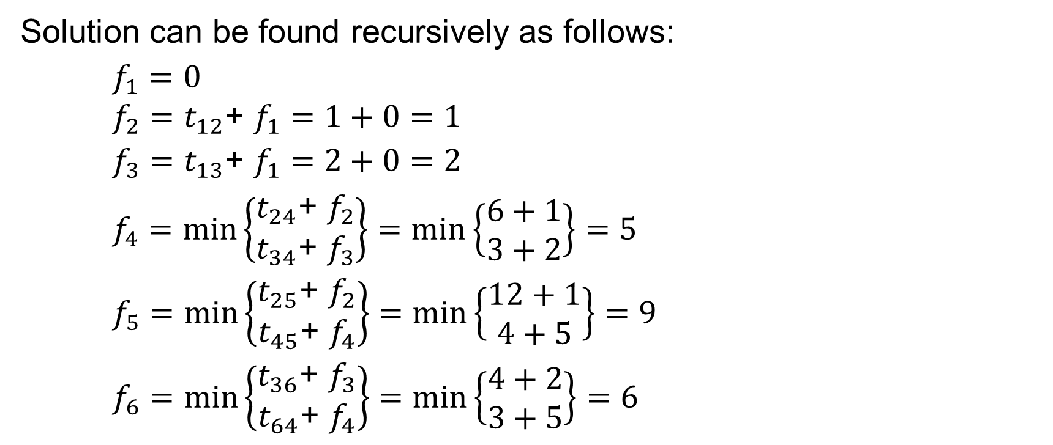
Introduction
Solution can be found recursively as follows:
$f_{1}=0$
$f_{2}=t_{12}\text{+ }f_{1}=1+0=1$
$f_{3}=t_{13}\text{+ }f_{1}=2+0=2$
$f_{4}=min\left\{\begin{matrix}t_{24}\text{+ }f_{2} \\ t_{34}\text{+ }f_{3}\end{matrix}\right\}=min\left\{\begin{matrix}6+1 \\ 3+2\end{matrix}\right\}=5$
$f_{5}=min\left\{\begin{matrix}t_{25}\text{+ }f_{2} \\ t_{45}\text{+ }f_{4}\end{matrix}\right\}=min\left\{\begin{matrix}12+1 \\ 4+5\end{matrix}\right\}=9$
$f_{6}=min\left\{\begin{matrix}t_{36}\text{+ }f_{3} \\ t_{64}\text{+ }f_{4}\end{matrix}\right\}=min\left\{\begin{matrix}4+2 \\ 3+5\end{matrix}\right\}=6$

Slide 11
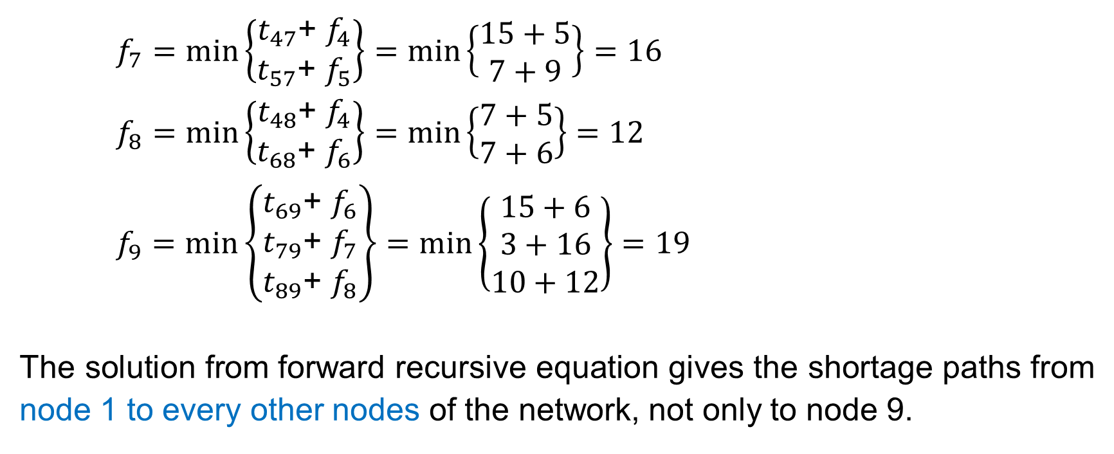
Introduction
$f_{7}=min\left\{\begin{matrix}t_{47}\text{+ }f_{4} \\ t_{57}\text{+ }f_{5}\end{matrix}\right\}=min\left\{\begin{matrix}15+5 \\ 7+9\end{matrix}\right\}=16$
$f_{8}=min\left\{\begin{matrix}t_{48}\text{+ }f_{4} \\ t_{68}\text{+ }f_{6}\end{matrix}\right\}=min\left\{\begin{matrix}7+5 \\ 7+6\end{matrix}\right\}=12$
$f_{9}=min\left\{\begin{matrix}t_{69}\text{+ }f_{6} \\ t_{79}\text{+ }f_{7} \\ t_{89}\text{+ }f_{8}\end{matrix}\right\}=min\left\{\begin{matrix}15+6 \\ 3+16 \\ 10+12\end{matrix}\right\}=19$
The solution from forward recursive equation gives the shortage paths from node 1 to every other nodes of the network, not only to node 9.

Slide 12
Introduction
Note:
Not all DP programs can be solved by both forward and backward recursive techniques. The use of backward recursion or forward recursion depends on the specific structure of the problem under consideration.

Slide 13
Introduction
Bellman’s Principle of Optimality
An optimal policy has the property that whatever the initial state and the initial decision are, the remaining decisions must constitute an optimal policy with regard to the state resulting from the first decision
The basic DP approach can be illustrated by the following diagram:

Slide 14
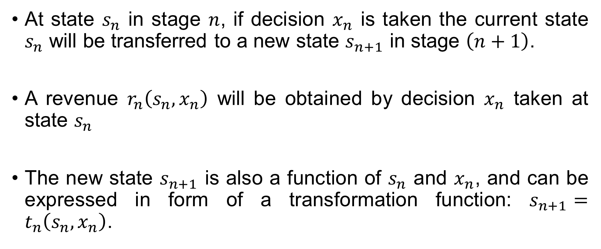
Introduction
Bellman’s Principle of Optimality
At state $s_{n}$ in stage $n$, if decision $x_{n}$ is taken the current state $s_{n}$ will be transferred to a new state $s_{n+1}$ in stage $\left(n+1\right)$.
A revenue $r_{n}\left(s_{n}, x_{n}\right)$ will be obtained by decision $x_{n}$ taken at state $s_{n}$
The new state $s_{n+1}$ is also a function of $s_{n}$ and $x_{n}$, and can be expressed in form of a transformation function: $s_{n+1}=t_{n}\left(s_{n}, x_{n}\right)$.

Slide 15
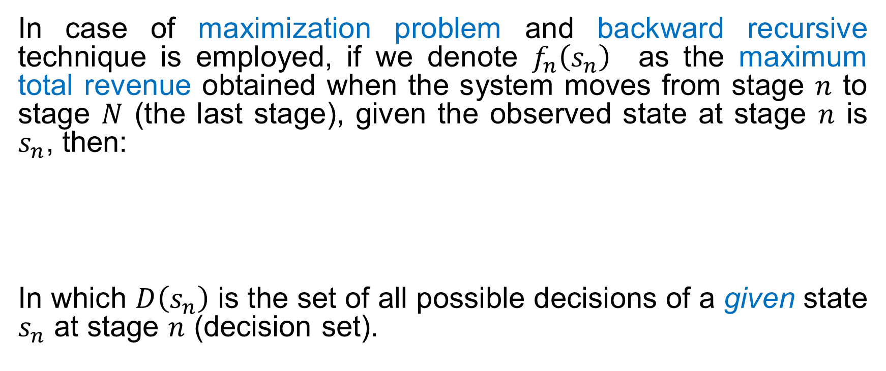
Introduction
Bellman’s Principle of Optimality
In case of maximization problem and backward recursive technique is employed, if we denote $f_{n}\left(s_{n}\right)$ as the maximum total revenue obtained when the system moves from stage $n$ to stage $N$ (the last stage), given the observed state at stage $n$ is $s_{n}$, then:
In which $D\left(s_{n}\right)$ is the set of all possible decisions of a given state $s_{n}$ at stage $n$ (decision set).

Slide 16
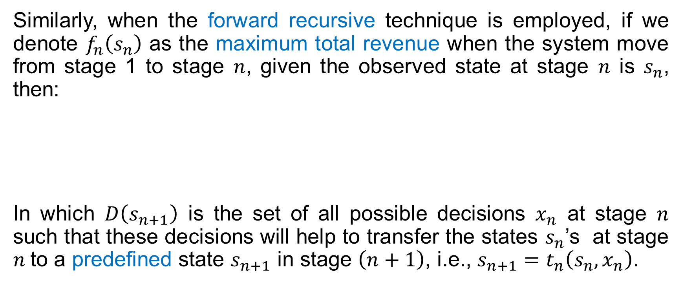
Introduction
Bellman’s Principle of Optimality
Similarly, when the forward recursive technique is employed, if we denote $f_{n}\left(s_{n}\right)$ as the maximum total revenue when the system move from stage 1 to stage $n$, given the observed state at stage $n$ is $s_{n}$, then:
In which $D\left(s_{n+1}\right)$ is the set of all possible decisions $x_{n}$ at stage $n$ such that these decisions will help to transfer the states $s_{n}$’s at stage $n$to a predefined state $s_{n+1}$ in stage $\left(n+1\right)$, i.e., $s_{n+1}=t_{n}\left(s_{n}, x_{n}\right)$.

Slide 17
Introduction
Bellman’s Principle of Optimality
The Bellman’ optimality principle can help to establish recursive equations when the structure of the problem can be arranged in stages.

Slide 18
Introduction
Bellman’s Principle of Optimality
Example 2: Find the shortage path from node 1 to node 10 of the network

Slide 19

Introduction
Bellman’s Principle of Optimality
Applying backward recursive approach, the solution can be found as follows:
Stage 4:
In stage 4, the state $s_{4}$ can be node 8 or node 9, and the only decision (i.e., $x_{4}$) that can be taken is go to node 10.

Slide 20
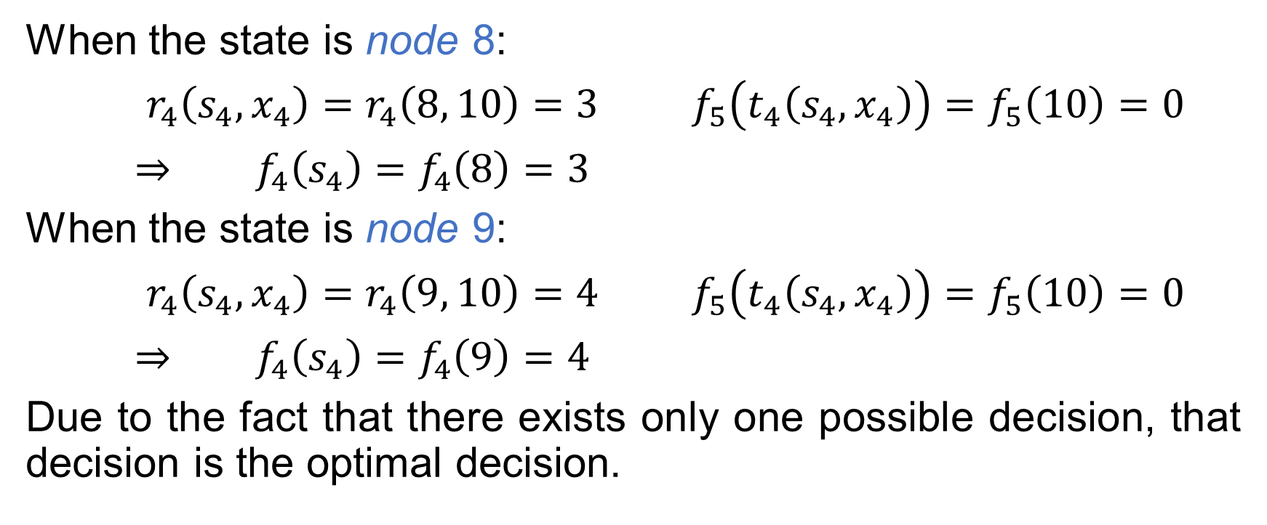
Introduction
Bellman’s Principle of Optimality
When the state is node 8:
$r_{4}\left(s_{4}, x_{4}\right)=r_{4}\left(8, 10\right)=3$ $f_{5}\left(t_{4}\left(s_{4}, x_{4}\right)\right)=f_{5}\left(10\right)=0$
$⇒$ $f_{4}\left(s_{4}\right)=f_{4}\left(8\right)=3$
When the state is node 9:
$r_{4}\left(s_{4}, x_{4}\right)=r_{4}\left(9, 10\right)=4$ $f_{5}\left(t_{4}\left(s_{4}, x_{4}\right)\right)=f_{5}\left(10\right)=0$
$⇒$ $f_{4}\left(s_{4}\right)=f_{4}\left(9\right)=4$
Due to the fact that there exists only one possible decision, that decision is the optimal decision.

Slide 21

Introduction
Bellman’s Principle of Optimality
Stage 3:
In this stage, the state $s_{3}$ can be node 5, node 6 or node 7. The decision $x_{3}$ can be go to node 8 or go to node 9.

Slide 22
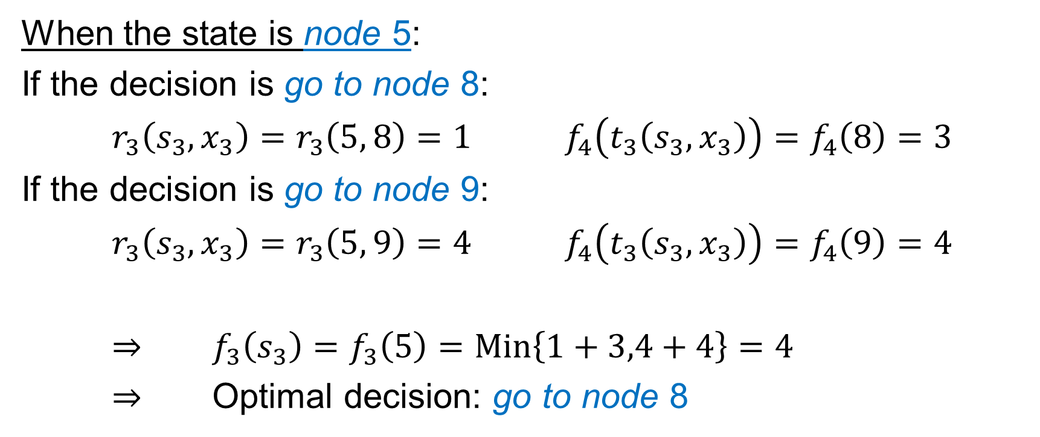
Introduction
Bellman’s Principle of Optimality
When the state is node 5:
If the decision is go to node 8:
$r_{3}\left(s_{3}, x_{3}\right)=r_{3}\left(5, 8\right)=1$ $f_{4}\left(t_{3}\left(s_{3}, x_{3}\right)\right)=f_{4}\left(8\right)=3$
If the decision is go to node 9:
$r_{3}\left(s_{3}, x_{3}\right)=r_{3}\left(5, 9\right)=4$ $f_{4}\left(t_{3}\left(s_{3}, x_{3}\right)\right)=f_{4}\left(9\right)=4$
$⇒$ $f_{3}\left(s_{3}\right)=f_{3}\left(5\right)=Min\left\{1+3,4+4\right\}=4$
$⇒$ Optimal decision: go to node 8

Slide 23

Introduction
Bellman’s Principle of Optimality
When the state is node 6:
If the decision is go to node 8:
$r_{3}\left(s_{3}, x_{3}\right)=r_{3}\left(6, 8\right)=6$ $f_{4}\left(t_{3}\left(s_{3}, x_{3}\right)\right)=f_{4}\left(8\right)=3$
If the decision is go to node 9:
$r_{3}\left(s_{3}, x_{3}\right)=r_{3}\left(6, 9\right)=3$ $f_{4}\left(t_{3}\left(s_{3}, x_{3}\right)\right)=f_{4}\left(9\right)=4$
$⇒$ $f_{3}\left(s_{3}\right)=f_{3}\left(6\right)=Min\left\{6+3,3+4\right\}=7$
$⇒$ Optimal decision: go to node 9

Slide 24
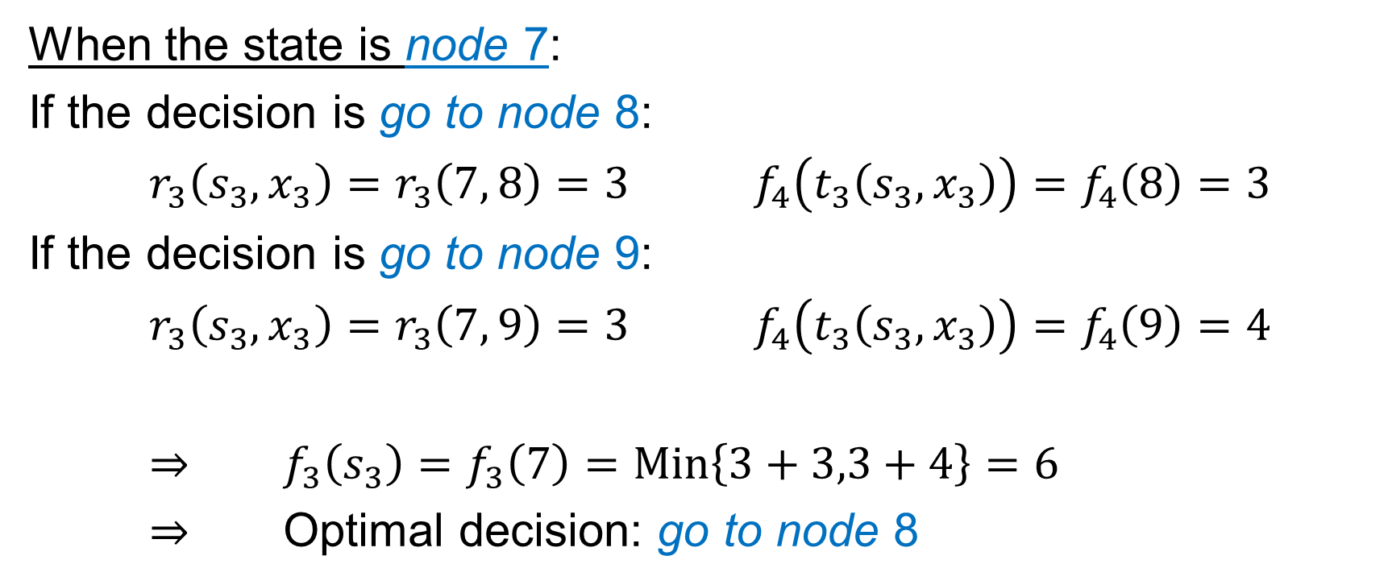
Introduction
Bellman’s Principle of Optimality
When the state is node 7:
If the decision is go to node 8:
$r_{3}\left(s_{3}, x_{3}\right)=r_{3}\left(7, 8\right)=3$ $f_{4}\left(t_{3}\left(s_{3}, x_{3}\right)\right)=f_{4}\left(8\right)=3$
If the decision is go to node 9:
$r_{3}\left(s_{3}, x_{3}\right)=r_{3}\left(7, 9\right)=3$ $f_{4}\left(t_{3}\left(s_{3}, x_{3}\right)\right)=f_{4}\left(9\right)=4$
$⇒$ $f_{3}\left(s_{3}\right)=f_{3}\left(7\right)=Min\left\{3+3,3+4\right\}=6$
$⇒$ Optimal decision: go to node 8

Slide 25

Introduction
Bellman’s Principle of Optimality
Stage 2:
In this stage, the state $s_{2}$ can be node 2, node 3 or node 4. The decision $x_{2}$ can be go to node 5, go to node 6, or go to node 7.

Slide 26
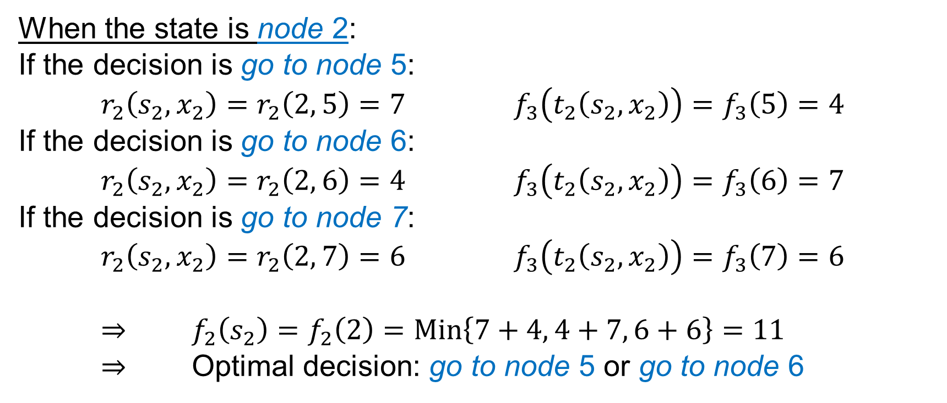
Introduction
Bellman’s Principle of Optimality
When the state is node 2:
If the decision is go to node 5:
$r_{2}\left(s_{2}, x_{2}\right)=r_{2}\left(2, 5\right)=7$ $f_{3}\left(t_{2}\left(s_{2}, x_{2}\right)\right)=f_{3}\left(5\right)=4$
If the decision is go to node 6:
$r_{2}\left(s_{2}, x_{2}\right)=r_{2}\left(2, 6\right)=4$ $f_{3}\left(t_{2}\left(s_{2}, x_{2}\right)\right)=f_{3}\left(6\right)=7$
If the decision is go to node 7:
$r_{2}\left(s_{2}, x_{2}\right)=r_{2}\left(2, 7\right)=6$ $f_{3}\left(t_{2}\left(s_{2}, x_{2}\right)\right)=f_{3}\left(7\right)=6$
$⇒$ $f_{2}\left(s_{2}\right)=f_{2}\left(2\right)=Min\left\{7+4, 4+7, 6+6\right\}=11$
$⇒$ Optimal decision: go to node 5 or go to node 6

Slide 27
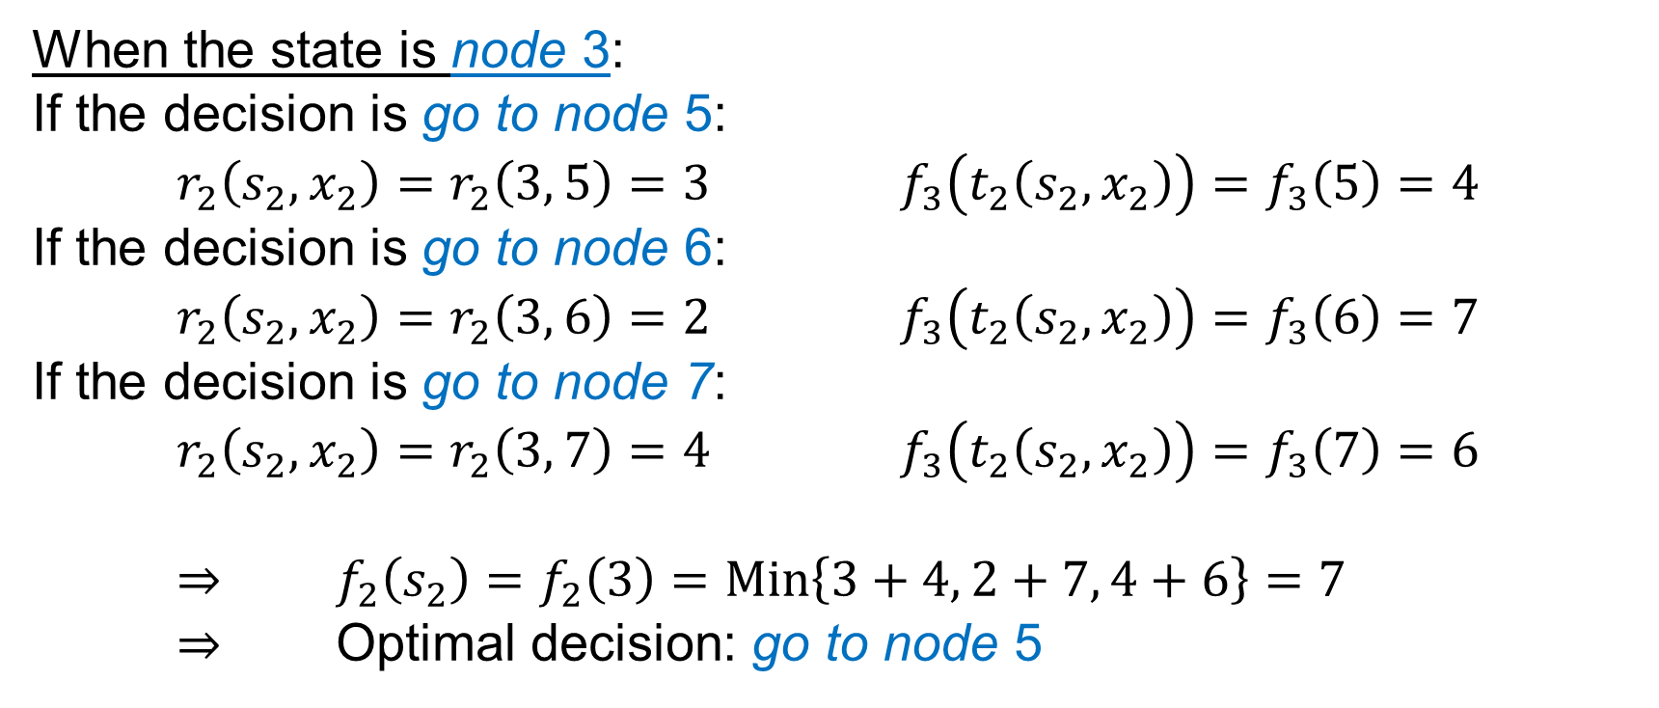
Introduction
Bellman’s Principle of Optimality
When the state is node 3:
If the decision is go to node 5:
$r_{2}\left(s_{2}, x_{2}\right)=r_{2}\left(3, 5\right)=3$ $f_{3}\left(t_{2}\left(s_{2}, x_{2}\right)\right)=f_{3}\left(5\right)=4$
If the decision is go to node 6:
$r_{2}\left(s_{2}, x_{2}\right)=r_{2}\left(3, 6\right)=2$ $f_{3}\left(t_{2}\left(s_{2}, x_{2}\right)\right)=f_{3}\left(6\right)=7$
If the decision is go to node 7:
$r_{2}\left(s_{2}, x_{2}\right)=r_{2}\left(3, 7\right)=4$ $f_{3}\left(t_{2}\left(s_{2}, x_{2}\right)\right)=f_{3}\left(7\right)=6$
$⇒$ $f_{2}\left(s_{2}\right)=f_{2}\left(3\right)=Min\left\{3+4, 2+7, 4+6\right\}=7$
$⇒$ Optimal decision: go to node 5

Slide 28
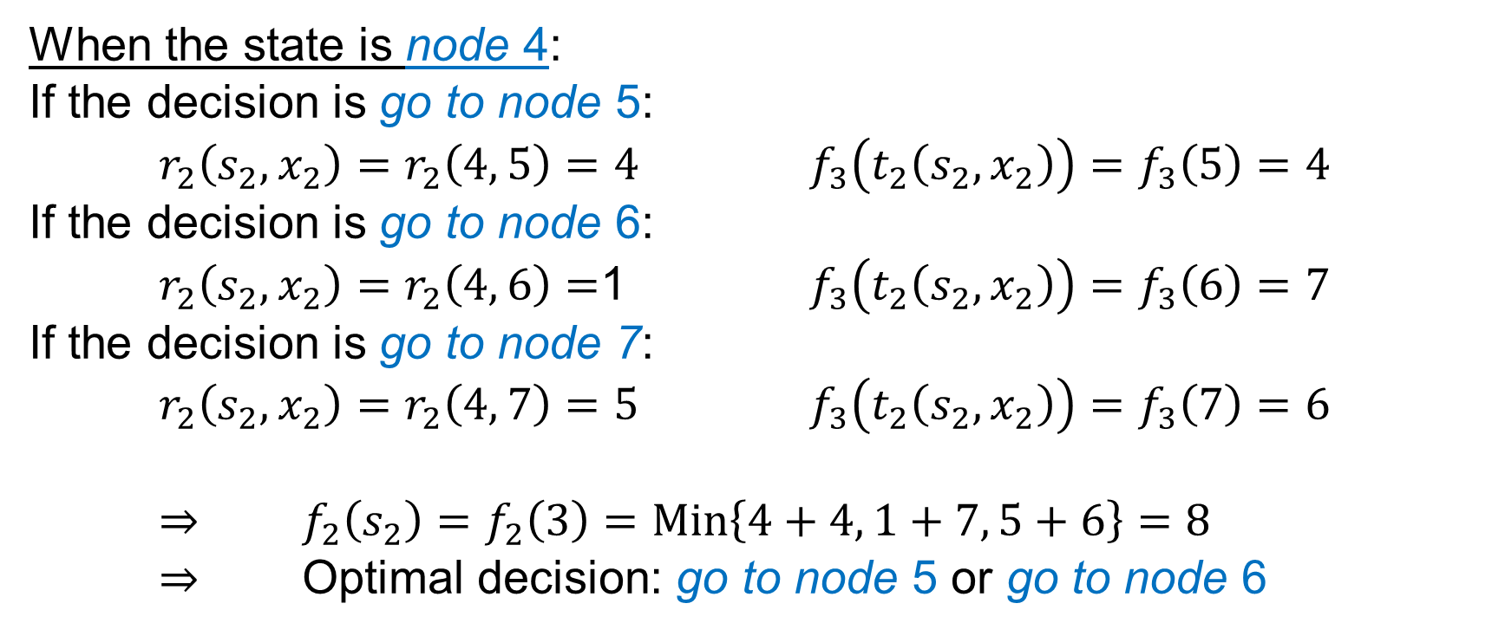
Introduction
Bellman’s Principle of Optimality
When the state is node 4:
If the decision is go to node 5:
$r_{2}\left(s_{2}, x_{2}\right)=r_{2}\left(4, 5\right)=4$ $f_{3}\left(t_{2}\left(s_{2}, x_{2}\right)\right)=f_{3}\left(5\right)=4$
If the decision is go to node 6:
$r_{2}\left(s_{2}, x_{2}\right)=r_{2}\left(4, 6\right)=$1 $f_{3}\left(t_{2}\left(s_{2}, x_{2}\right)\right)=f_{3}\left(6\right)=7$
If the decision is go to node 7:
$r_{2}\left(s_{2}, x_{2}\right)=r_{2}\left(4, 7\right)=5$ $f_{3}\left(t_{2}\left(s_{2}, x_{2}\right)\right)=f_{3}\left(7\right)=6$
$⇒$ $f_{2}\left(s_{2}\right)=f_{2}\left(3\right)=Min\left\{4+4, 1+7, 5+6\right\}=8$
$⇒$ Optimal decision: go to node 5 or go to node 6

Slide 29

Introduction
Bellman’s Principle of Optimality
Stage 1:
In this stage, the state $s_{1}$ is node 1. The decisions $x_{1}$ can be go to node 2, go to node 3, or go to node 4.

Slide 30
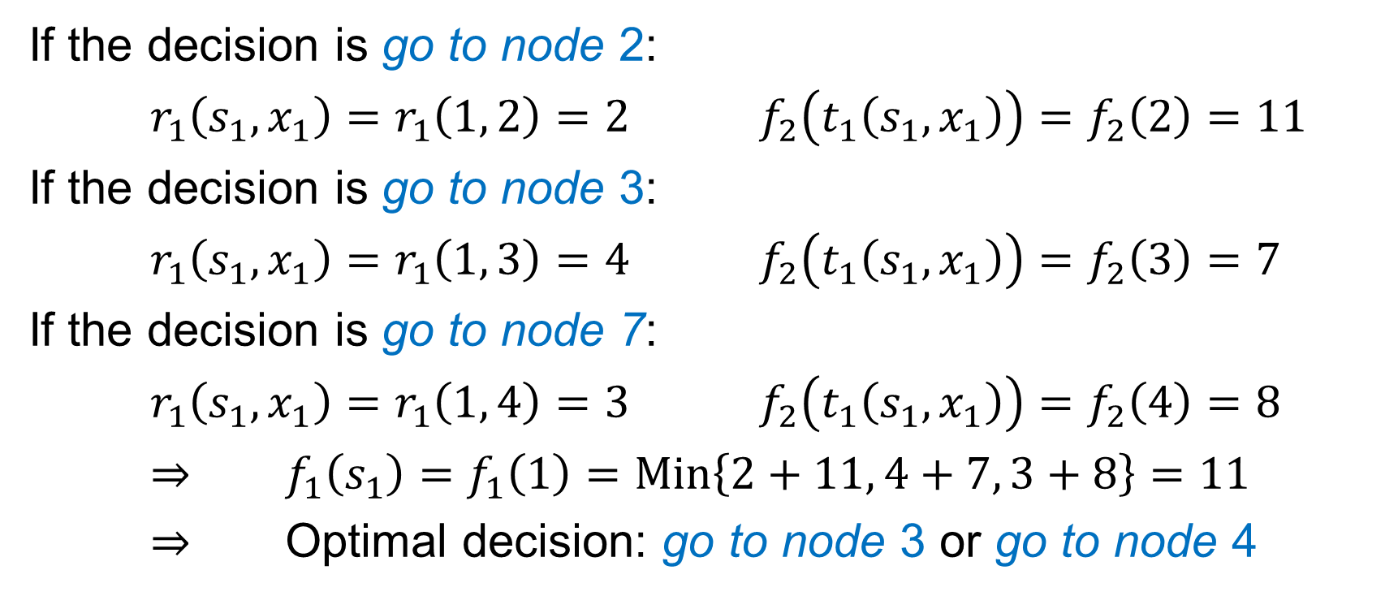
Introduction
Bellman’s Principle of Optimality
If the decision is go to node 2:
$r_{1}\left(s_{1}, x_{1}\right)=r_{1}\left(1, 2\right)=2$ $f_{2}\left(t_{1}\left(s_{1}, x_{1}\right)\right)=f_{2}\left(2\right)=11$
If the decision is go to node 3:
$r_{1}\left(s_{1}, x_{1}\right)=r_{1}\left(1, 3\right)=4$ $f_{2}\left(t_{1}\left(s_{1}, x_{1}\right)\right)=f_{2}\left(3\right)=7$
If the decision is go to node 7:
$r_{1}\left(s_{1}, x_{1}\right)=r_{1}\left(1, 4\right)=3$ $f_{2}\left(t_{1}\left(s_{1}, x_{1}\right)\right)=f_{2}\left(4\right)=8$
$⇒$ $f_{1}\left(s_{1}\right)=f_{1}\left(1\right)=Min\left\{2+11, 4+7, 3+8\right\}=11$
$⇒$ Optimal decision: go to node 3 or go to node 4

Slide 31
Introduction
Bellman’s Principle of Optimality
The optimal solution has been found. There exist three shortage paths from node 1 to node 10:
1-3-5-8-10, 1-4-5-8-10, 1-4-6-9-10

Slide 32
Introduction
Bellman’s Principle of Optimality
Example 3:
Five medical teams will be dispatched to 3 regions to help improve medical care. The performance is measured by the expected additional person-years of life. The estimated performance measures are given in the table:
No. of Teams | Additional person-years life (in 1000 units)
 | Region 1 | Region 2 | Region 3
0 1 2 3 4 5 | 0 45 70 90 105 120 | 0 20 45 75 110 150 | 0 50 70 80 100 130

Slide 33
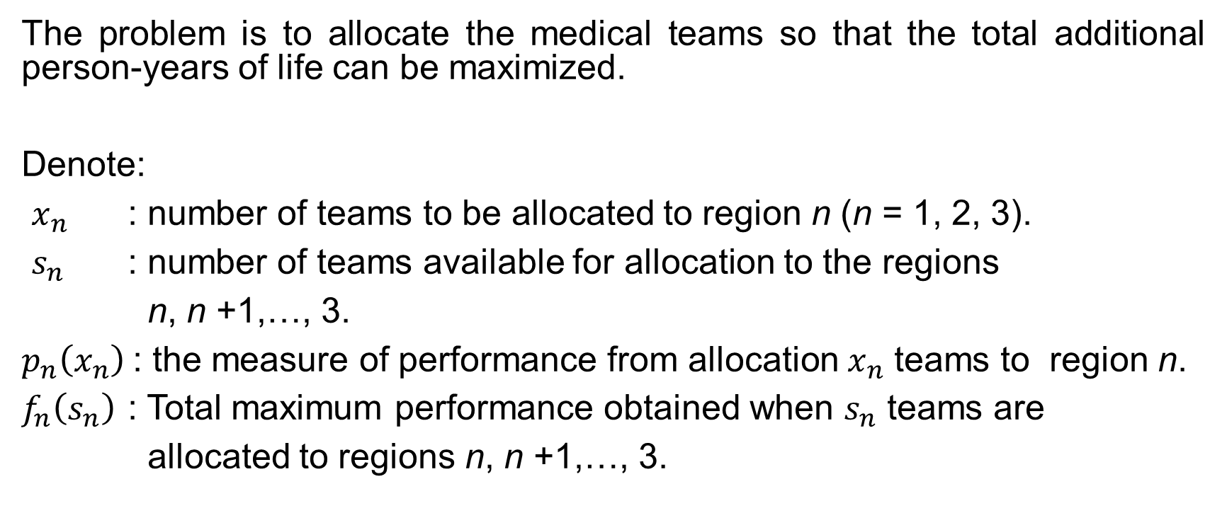
Introduction
Bellman’s Principle of Optimality
The problem is to allocate the medical teams so that the total additional person-years of life can be maximized.
Denote:
$x_{n}$ : number of teams to be allocated to region n (n = 1, 2, 3).
$s_{n}$ : number of teams available for allocation to the regions
n, n +1,…, 3.
$p_{n}\left(x_{n}\right)$: the measure of performance from allocation $x_{n}$ teams to region n.
$f_{n}\left(s_{n}\right)$ : Total maximum performance obtained when $s_{n}$ teams are
allocated to regions n, n +1,…, 3.

Slide 34
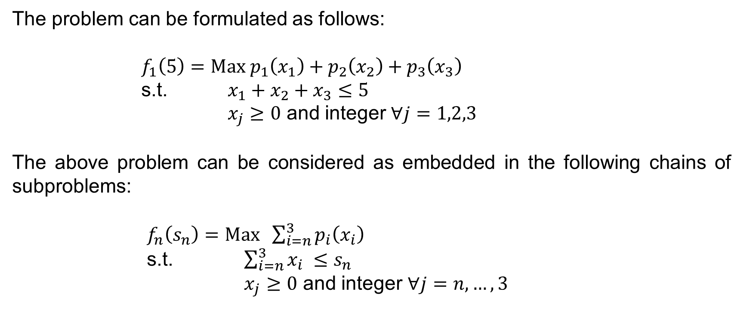
Introduction
Bellman’s Principle of Optimality
The problem can be formulated as follows:
$f_{1}\left(5\right)=Max p_{1}\left(x_{1}\right)+p_{2}\left(x_{2}\right)+p_{3}\left(x_{3}\right)$
s.t. $x_{1}+x_{2}+x_{3}≤5$
$x_{j}≥0$ and integer $∀j=1,2,3$
The above problem can be considered as embedded in the following chains of subproblems:
$f_{n}\left(s_{n}\right)=Max \sum_{i=n}^{3}{p_{i}\left(x_{i}\right)}$
s.t. $\sum_{i=n}^{3}{x_{i}} ≤$ $s_{n}$
$x_{j}≥0$ and integer $∀j=n,…,3$

Slide 35

Introduction
Bellman’s Principle of Optimality
The backward recursive equation can be developed as:
Noting that $f_{4}\left(s_{4}\right)=0$, the solution can be obtained as follows:

Slide 36

Introduction
Bellman’s Principle of Optimality
$$n=3$$

Slide 37

Introduction
Bellman’s Principle of Optimality
$$n=2$$

Slide 38

Introduction
Bellman’s Principle of Optimality
$$n=1$$
(*: no need to determine those values)
Optimal solution: $x_{1}^{∗}=1,x_{2}^{∗}=3,x_{3}^{∗}=1$; optimal objective function 170.

Slide 39
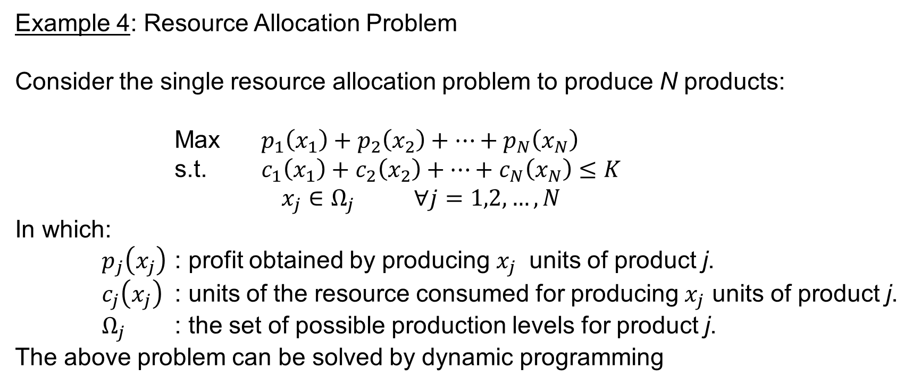
Introduction
Bellman’s Principle of Optimality
Example 4: Resource Allocation Problem
Consider the single resource allocation problem to produce N products:
Max $p_{1}\left(x_{1}\right)+p_{2}\left(x_{2}\right)+…+p_{N}\left(x_{N}\right)$
s.t. $c_{1}\left(x_{1}\right)+c_{2}\left(x_{2}\right)+…+c_{N}\left(x_{N}\right)≤K$
$x_{j}∈Ω_{j}$ $∀j=1,2,…,N$
In which:
$p_{j}\left(x_{j}\right)$ : profit obtained by producing $x_{j}$ units of product j.
$c_{j}\left(x_{j}\right)$ : units of the resource consumed for producing $x_{j}$ units of product j.
$Ω_{j}$ : the set of possible production levels for product j.
The above problem can be solved by dynamic programming

Slide 40
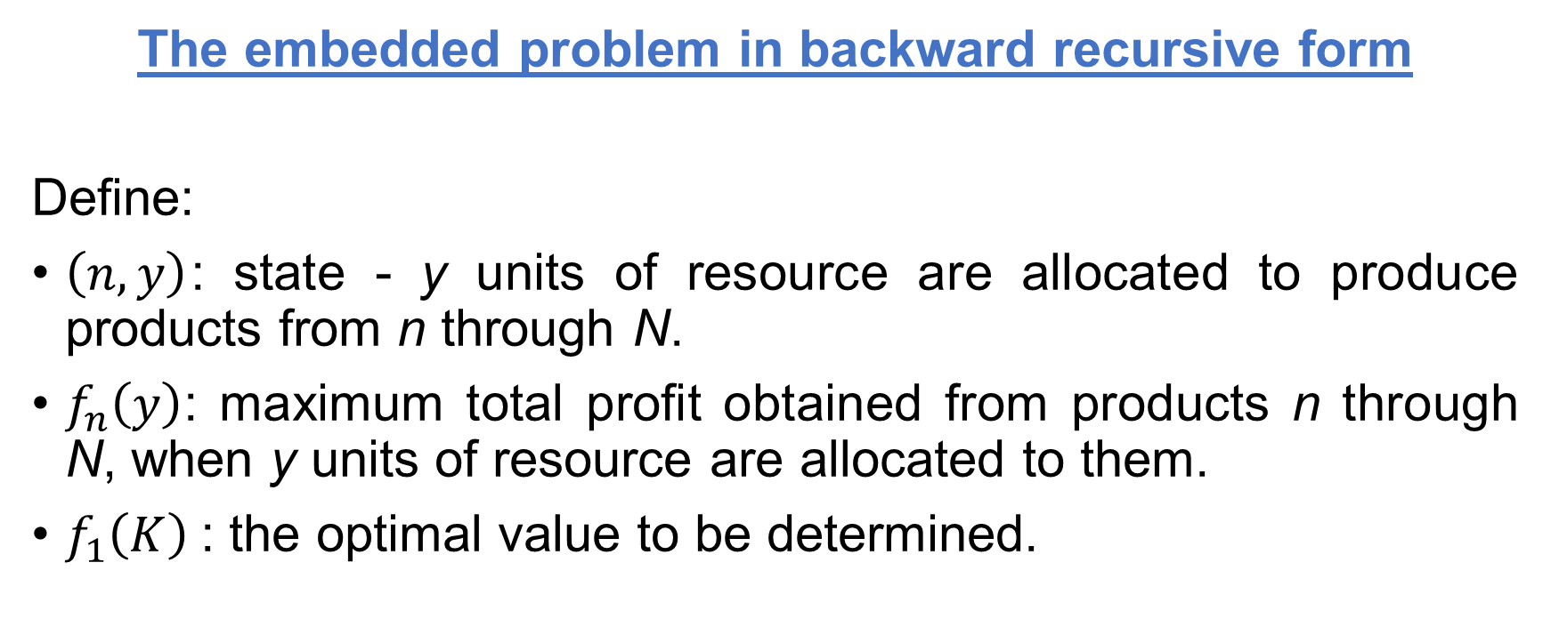
Introduction
Bellman’s Principle of Optimality
The embedded problem in backward recursive form
Define:
$\left(n,y\right)$: state - y units of resource are allocated to produce products from n through N.
$f_{n}\left(y\right)$: maximum total profit obtained from products n through N, when y units of resource are allocated to them.
$f_{1}\left(K\right)$: the optimal value to be determined.

Slide 41
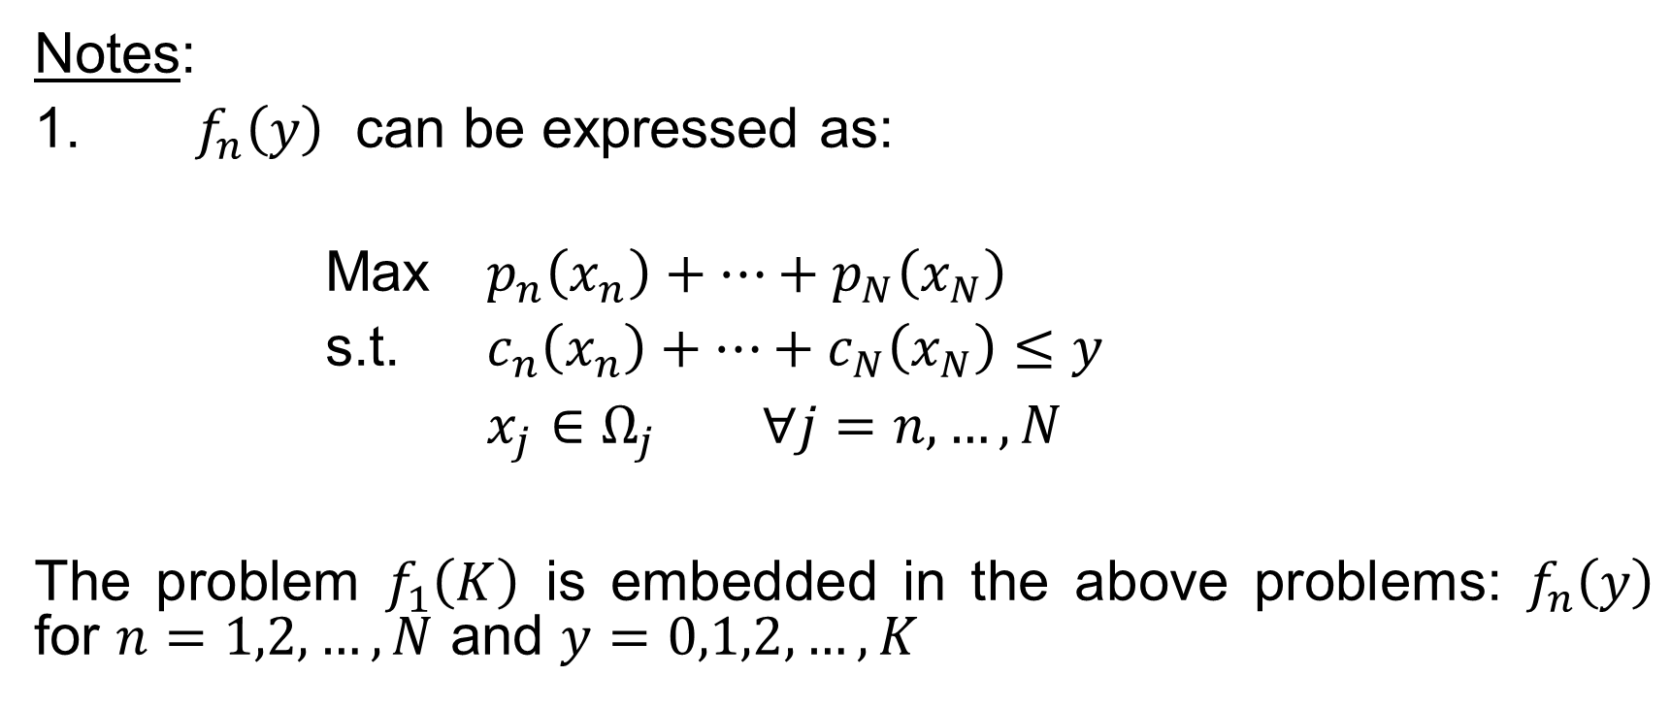
Introduction
Bellman’s Principle of Optimality
Notes:
1. $f_{n}\left(y\right)$ can be expressed as:
Max $p_{n}\left(x_{n}\right)+…+p_{N}\left(x_{N}\right)$
s.t. $c_{n}\left(x_{n}\right)+…+c_{N}\left(x_{N}\right)≤y$
$x_{j}∈Ω_{j}$ $∀j=n,…,N$
The problem $f_{1}\left(K\right)$ is embedded in the above problems: $f_{n}\left(y\right)$ for $n=1,2,…,N$ and $y=0,1,2,…,K$

Slide 42

Introduction
Bellman’s Principle of Optimality
2. Boundary conditions:
Max $f_{N}\left(y\right)=Max p_{N}\left(x_{N}\right)$
s.t. $c_{N}\left(x_{N}\right)≤y$
$x_{N}∈Ω_{N}$

Slide 43
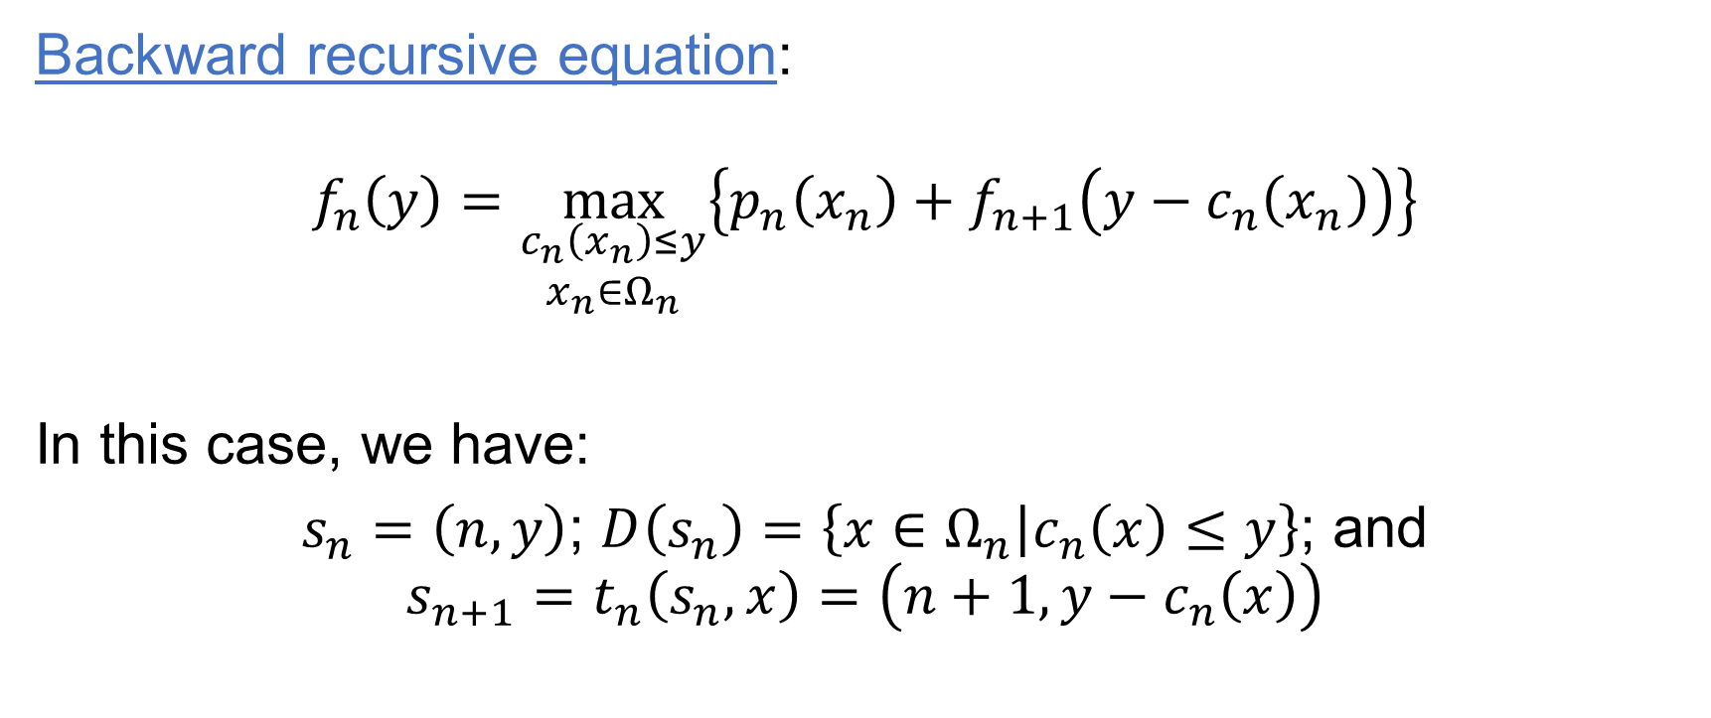
Introduction
Bellman’s Principle of Optimality
Backward recursive equation:
$$f_{n}\left(y\right)=\max_{\begin{aligned}c_{n}\left(x_{n}\right)≤y \\ x_{n}∈Ω_{n}\end{aligned}}\left\{p_{n}\left(x_{n}\right)+f_{n+1}\left(y−c_{n}\left(x_{n}\right)\right)\right\}$$
In this case, we have:
$s_{n}=\left(n,y\right)$; $D\left(s_{n}\right)=\left\{x∈Ω_{n} | c_{n}\left(x\right)≤y\right\}$; and
$${s_{n+1}=t}_{n}\left(s_{n},x\right)=\left(n+1,y−c_{n}\left(x\right)\right)$$

Slide 44
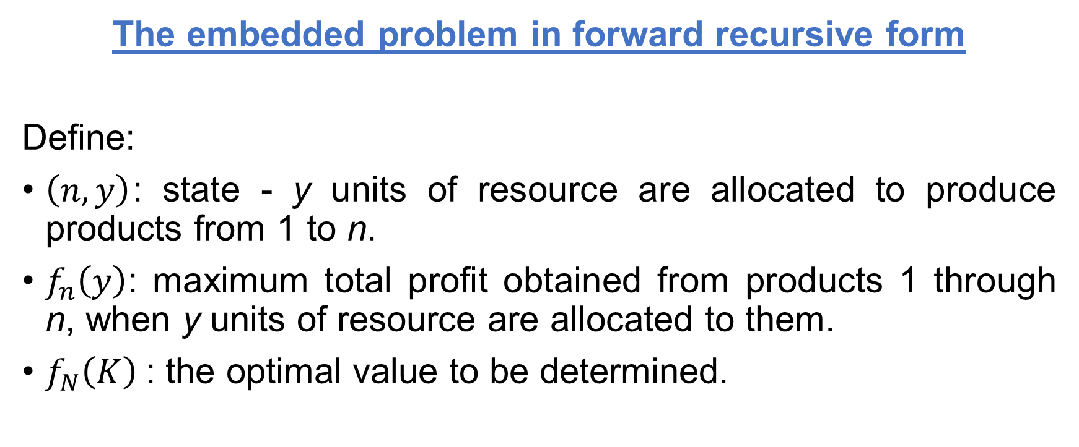
Introduction
Bellman’s Principle of Optimality
The embedded problem in forward recursive form
Define:
$\left(n,y\right)$: state - y units of resource are allocated to produce products from 1 to n.
$f_{n}\left(y\right)$: maximum total profit obtained from products 1 through n, when y units of resource are allocated to them.
$f_{N}\left(K\right)$: the optimal value to be determined.

Slide 45
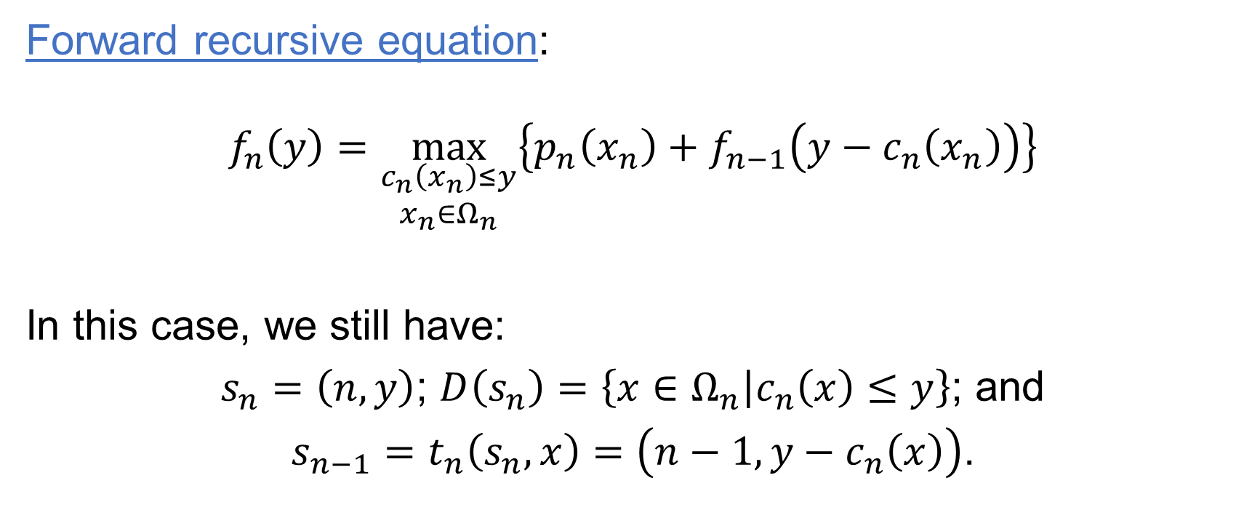
Introduction
Bellman’s Principle of Optimality
Forward recursive equation:
$$f_{n}\left(y\right)=\max_{\begin{aligned}c_{n}\left(x_{n}\right)≤y \\ x_{n}∈Ω_{n}\end{aligned}}\left\{p_{n}\left(x_{n}\right)+f_{n−1}\left(y−c_{n}\left(x_{n}\right)\right)\right\}$$
In this case, we still have:
$s_{n}=\left(n,y\right)$; $D\left(s_{n}\right)=\left\{x∈Ω_{n} | c_{n}\left(x\right)≤y\right\}$; and
${s_{n−1}=t}_{n}\left(s_{n},x\right)=\left(n−1,y−c_{n}\left(x\right)\right)$.

