Slide 1
Advanced Optimization:
Techniques and Industrial Applications

Slide 2
Session 1.4:
Non-linear Optimization

Slide 3
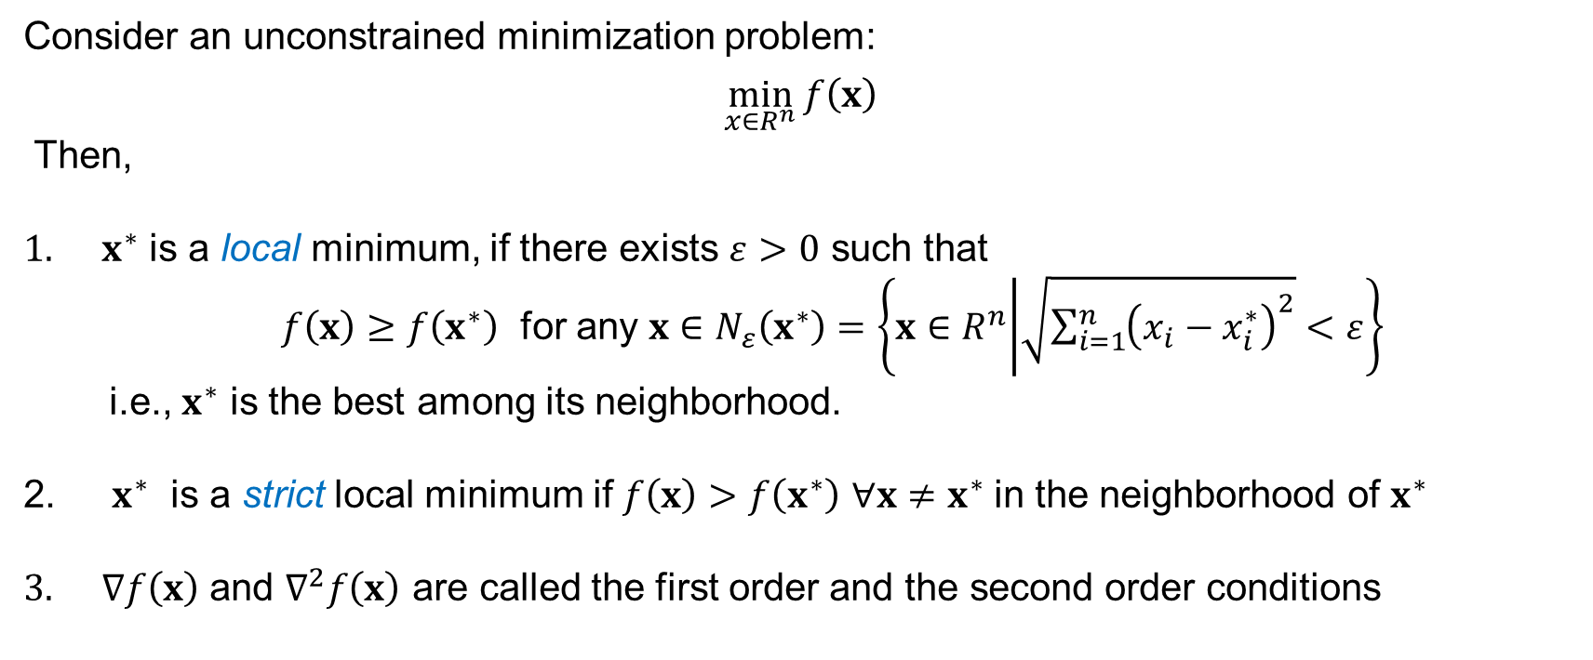
Optimality Conditions for Unconstrained Optimization
Consider an unconstrained minimization problem:
$$\min_{x∈R^{n}}{f\left(x\right)}$$
Then,
$x^{∗}$ is a local minimum, if there exists $ε>0$ such that
$f\left(x\right)≥f\left(x^{∗}\right)$ for any $x∈N_{ε}\left(x^{∗}\right)=\left\{x∈R^{n} | \sqrt{\sum_{i=1}^{n}{{\left(x_{i}−x_{i}^{∗}\right)}^{2}}}<ε\right\}$
i.e., $x^{∗}$ is the best among its neighborhood.
$x^{∗}$ is a strict local minimum if $f\left(x\right)>f\left(x^{∗}\right)$ $∀x≠x^{∗}$ in the neighborhood of $x^{∗}$
$∇f\left(x\right)$ and $∇^{2}f\left(x\right)$ are called the first order and the second order conditions

Slide 4
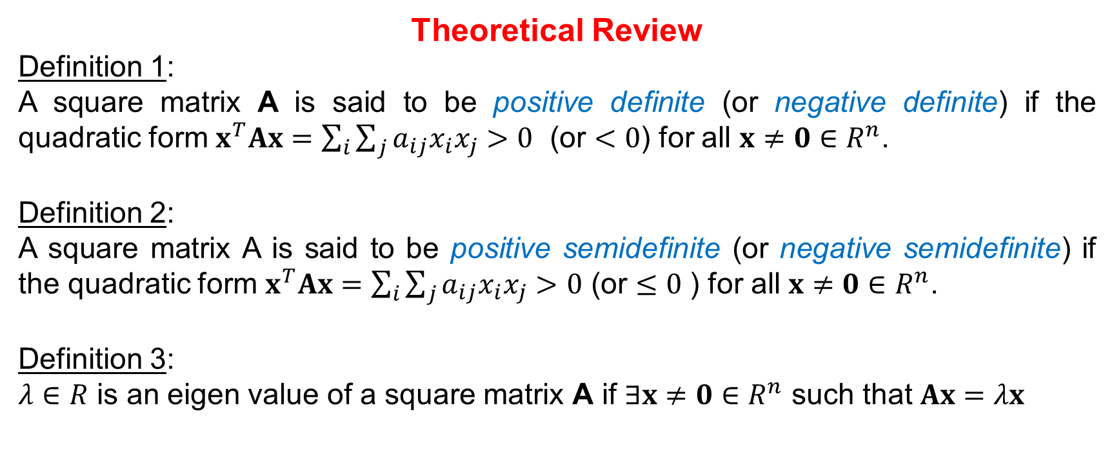
Optimality Conditions for Unconstrained Optimization
Theoretical Review
Definition 1:
A square matrix A is said to be positive definite (or negative definite) if the quadratic form $x^{T}Ax=\sum_{i}{\sum_{j}{a_{ij}x_{i}x_{j}}}>0$ (or $<0$) for all $x≠0∈R^{n}$.
Definition 2:
A square matrix A is said to be positive semidefinite (or negative semidefinite) if the quadratic form $x^{T}Ax=\sum_{i}{\sum_{j}{a_{ij}x_{i}x_{j}}}>0$ (or $≤0$ ) for all $x≠0∈R^{n}$.
Definition 3:
$λ∈R$ is an eigen value of a square matrix A if $∃x≠0∈R^{n}$ such that $Ax=λx$

Slide 5
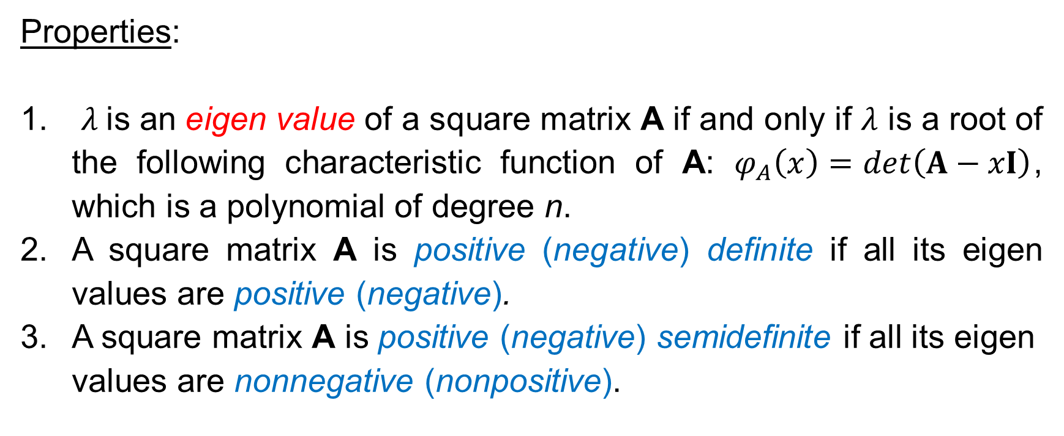
Optimality Conditions for Unconstrained Optimization
Properties:
$λ$is an eigen value of a square matrix A if and only if $λ$ is a root of the following characteristic function of A: $φ_{A}\left(x\right)=det\left(A−xI\right)$, which is a polynomial of degree n.
A square matrix A is positive (negative) definite if all its eigen values are positive (negative).
A square matrix A is positive (negative) semidefinite if all its eigen values are nonnegative (nonpositive).

Slide 6
Optimality Conditions for Unconstrained Optimization
Consider square matrix
Define:

Slide 7
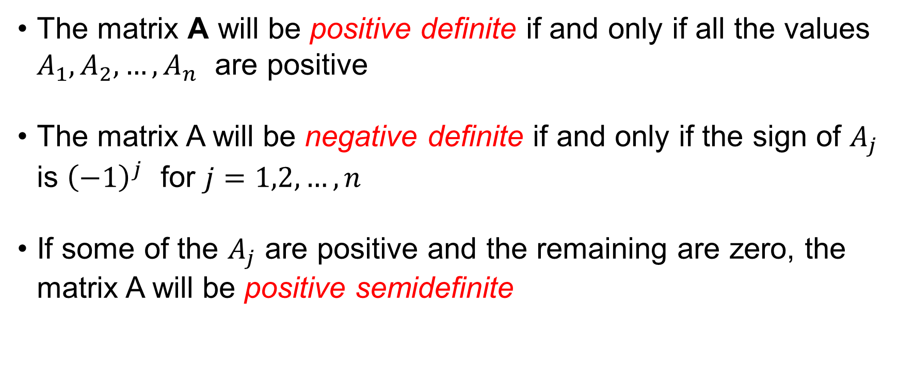
Optimality Conditions for Unconstrained Optimization
The matrix A will be positive definite if and only if all the values $A_{1},A_{2},…,A_{n}$ are positive
The matrix A will be negative definite if and only if the sign of $A_{j}$ is ${\left(−1\right)}^{j}$ for $j=1,2,…,n$
If some of the $A_{j}$ are positive and the remaining are zero, the matrix A will be positive semidefinite

Slide 8
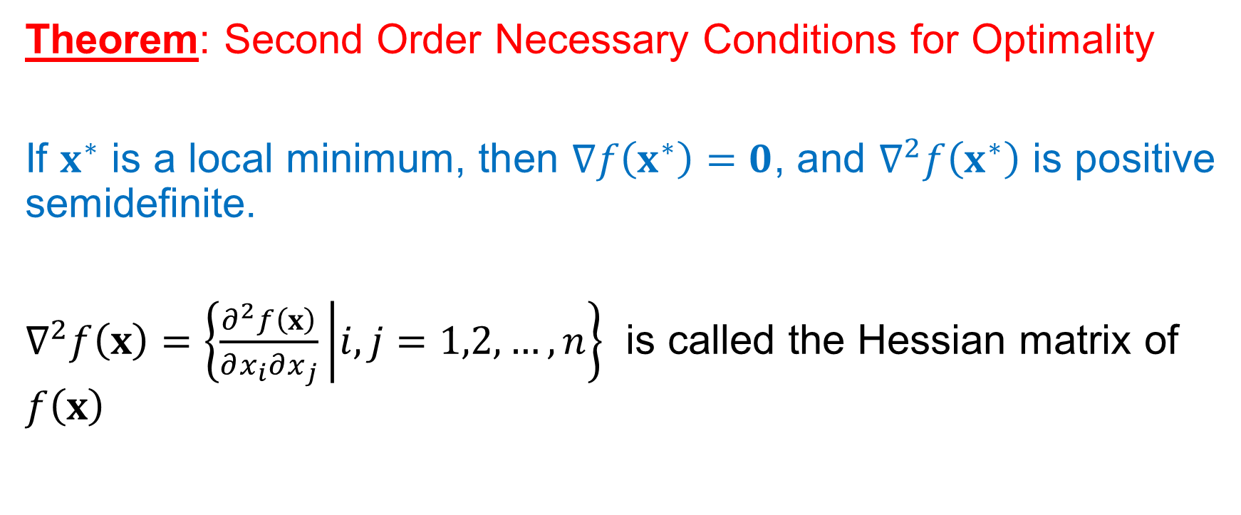
Optimality Conditions for Unconstrained Optimization
Theorem: Second Order Necessary Conditions for Optimality
If $x^{∗}$ is a local minimum, then $∇f\left(x^{∗}\right)=0$, and $∇^{2}f\left(x^{∗}\right)$ is positive semidefinite.
$∇^{2}f\left(x\right)=\left\{\frac{∂^{2}f\left(x\right)}{∂x_{i}∂x_{j}} | i,j=1,2,…,n\right\}$ is called the Hessian matrix of $f\left(x\right)$

Slide 9

Optimality Conditions for Unconstrained Optimization
Proof:
We have: $f\left(x^{∗}+dx\right)−f\left(x^{∗}\right)≥0$.
1. By using Taylor’s series expansion:
Note that $dx$ might be positive ($>0$ ) or negative ($<0$ ). Hence, (*) holds true if and only if ${∇f\left(x^{∗}\right)}^{T}dx=0$ or equivalently, $∇f\left(x^{∗}\right)=0$.

Slide 10

Optimality Conditions for Unconstrained Optimization
2. We also have:
Hence, ${{\left(dx\right)}^{T}∇}^{2}f\left(x^{∗}\right)dx≥0$ $⇒$ $∇^{2}f\left(x^{∗}\right)$ is positive semidefinite.

Slide 11
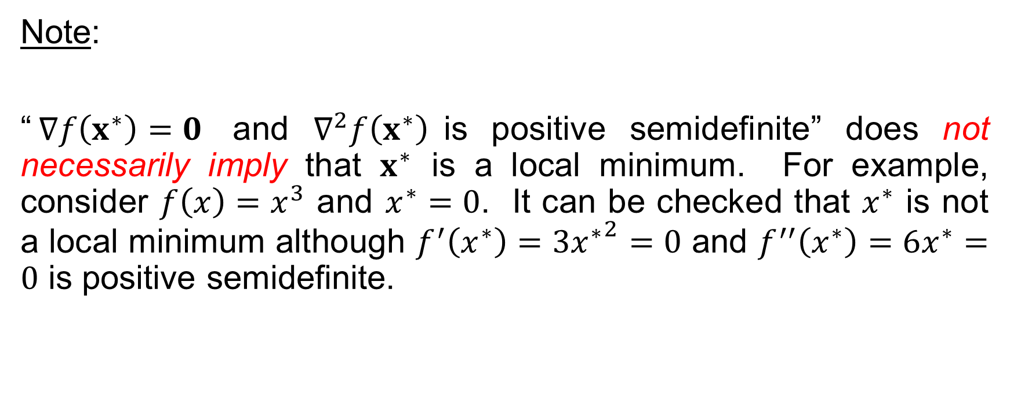
Optimality Conditions for Unconstrained Optimization
Note:
“$∇f\left(x^{∗}\right)=0$ and $∇^{2}f\left(x^{∗}\right)$is positive semidefinite” does not necessarily imply that $x^{∗}$ is a local minimum. For example, consider $f\left(x\right)=x^{3}$ and $x^{∗}=0$. It can be checked that $x^{∗}$ is not a local minimum although $f^{′}\left(x^{∗}\right)=3{x^{∗}}^{2}=0$ and $f^{′′}\left(x^{∗}\right)=6x^{∗}=0$ is positive semidefinite.

Slide 12
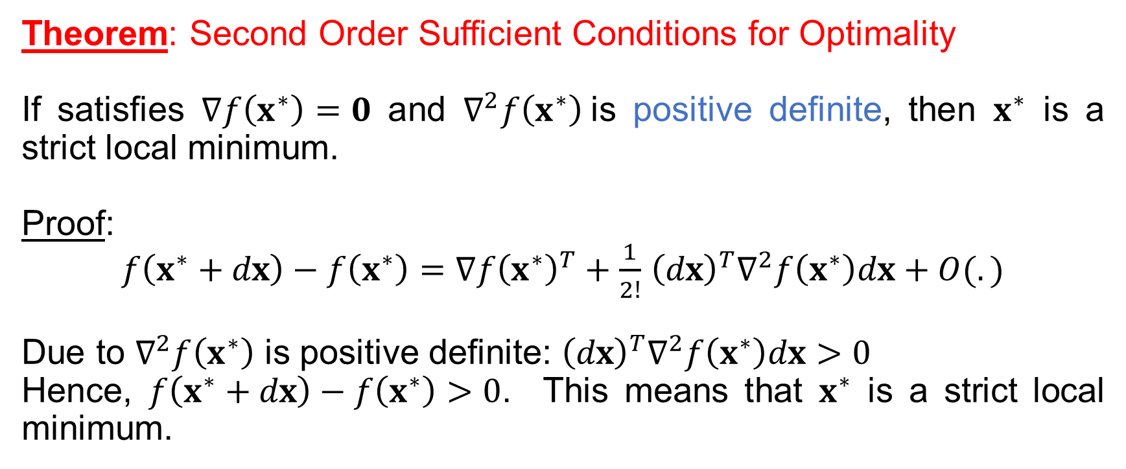
Optimality Conditions for Unconstrained Optimization
Theorem: Second Order Sufficient Conditions for Optimality
If satisfies $∇f\left(x^{∗}\right)=0$ and $∇^{2}f\left(x^{∗}\right)$is positive definite, then $x^{∗}$ is a strict local minimum.
Proof:
$f\left(x^{∗}+dx\right)−f\left(x^{∗}\right)={∇f\left(x^{∗}\right)}^{T}+\frac{1}{2!}$ ${{\left(dx\right)}^{T}∇}^{2}f\left(x^{∗}\right)dx+O(.)$
Due to $∇^{2}f\left(x^{∗}\right)$ is positive definite: ${{\left(dx\right)}^{T}∇}^{2}f\left(x^{∗}\right)dx>0$
Hence, $f\left(x^{∗}+dx\right)−f\left(x^{∗}\right)>0$. This means that $x^{∗}$ is a strict local minimum.

Slide 13
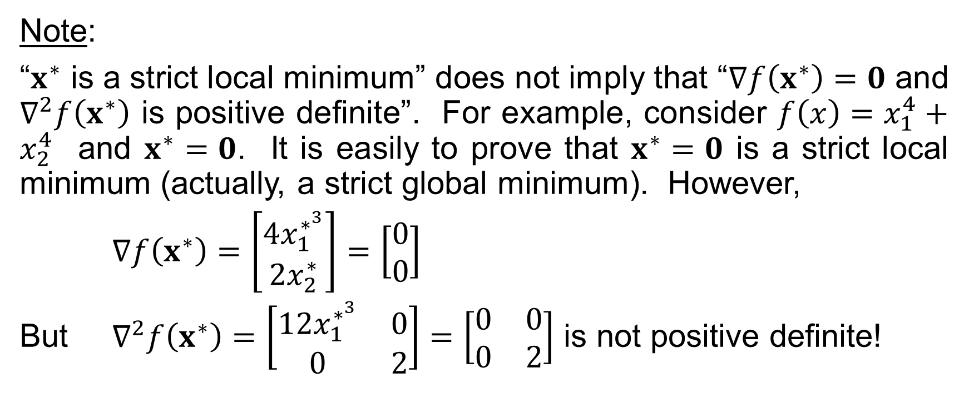
Optimality Conditions for Unconstrained Optimization
Note:
“$x^{∗}$ is a strict local minimum” does not imply that “$∇f\left(x^{∗}\right)=0$ and $∇^{2}f\left(x^{∗}\right)$ is positive definite”. For example, consider $f\left(x\right)=x_{1}^{4}+x_{2}^{4}$ and $x^{∗}=0$. It is easily to prove that $x^{∗}=0$ is a strict local minimum (actually, a strict global minimum). However,
$∇f\left(x^{∗}\right)=\left[\begin{matrix}{4x}_{1}^{∗^{3}} \\ {2x}_{2}^{∗}\end{matrix}\right]=\left[\begin{matrix}0 \\ 0\end{matrix}\right]$
But $∇^{2}f\left(x^{∗}\right)=\left[\begin{matrix}{12x}_{1}^{∗^{3}} & 0 \\ 0 & 2\end{matrix}\right]=\left[\begin{matrix}0 & 0 \\ 0 & 2\end{matrix}\right]$ is not positive definite!

Slide 14
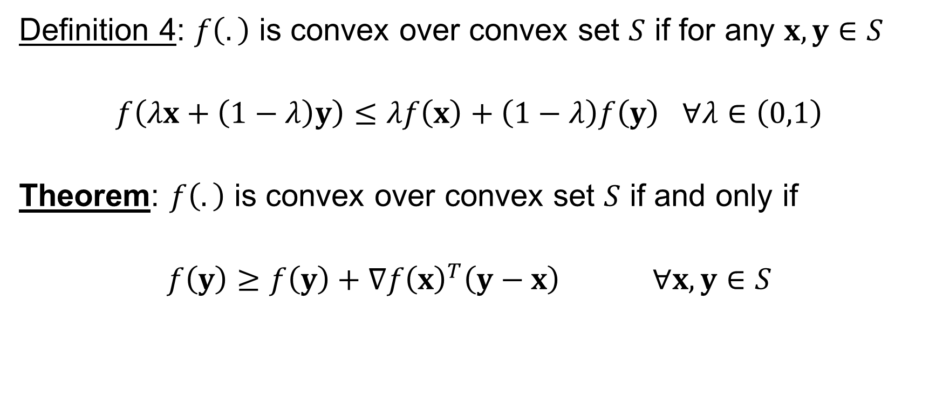
Optimality Conditions for Unconstrained Optimization
Convex Function and Global Optimality
Definition 4: $f\left(.\right)$ is convex over convex set $S$ if for any $x,y∈S$
$f\left(λx+\left(1−λ\right)y\right)≤λf\left(x\right)+\left(1−λ\right)f\left(y\right)$ $∀λ∈\left(0,1\right)$
Theorem: $f\left(.\right)$ is convex over convex set $S$ if and only if
$f\left(y\right)≥f\left(y\right)+{∇f\left(x\right)}^{T}\left(y−x\right)$ $∀x,y∈S$

Slide 15
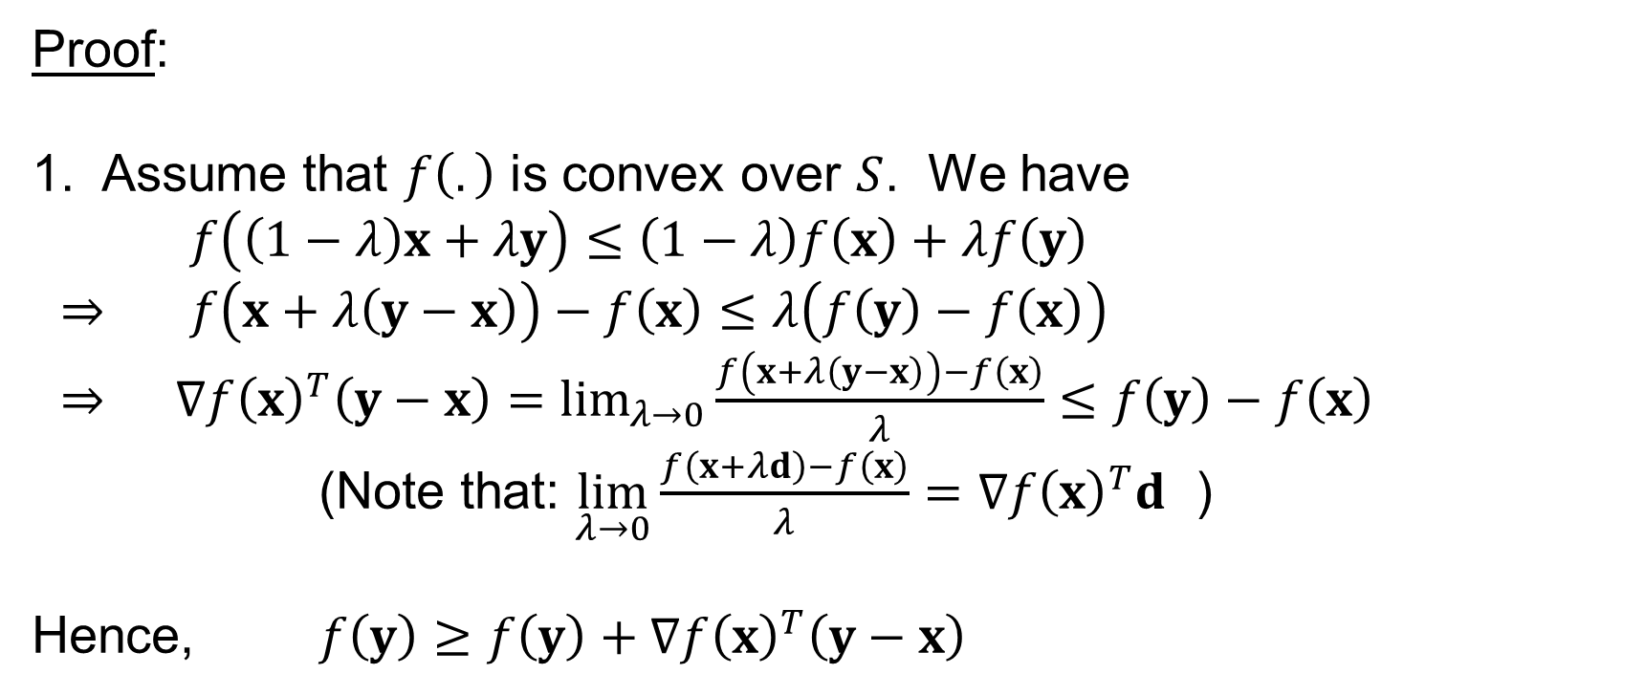
Optimality Conditions for Unconstrained Optimization
Convex Function and Global Optimality
Proof:
1. Assume that $f\left(.\right)$ is convex over $S$. We have
$f\left(\left(1−λ\right)x+λy\right)≤\left(1−λ\right)f\left(x\right)+λf\left(y\right)$
$⇒$ $f\left(x+λ\left(y−x\right)\right)−f\left(x\right)≤λ\left(f\left(y\right)−f\left(x\right)\right)$
$⇒$ ${∇f\left(x\right)}^{T}\left(y−x\right)=\lim_{λ→0}{\frac{f\left(x+λ\left(y−x\right)\right)−f\left(x\right)}{λ}}≤f\left(y\right)−f\left(x\right)$
(Note that: $\lim_{λ→0}{\frac{f\left(x+λd\right)−f\left(x\right)}{λ}={∇f\left(x\right)}^{T}d}$ )
Hence, $f\left(y\right)≥f\left(y\right)+{∇f\left(x\right)}^{T}\left(y−x\right)$

Slide 16
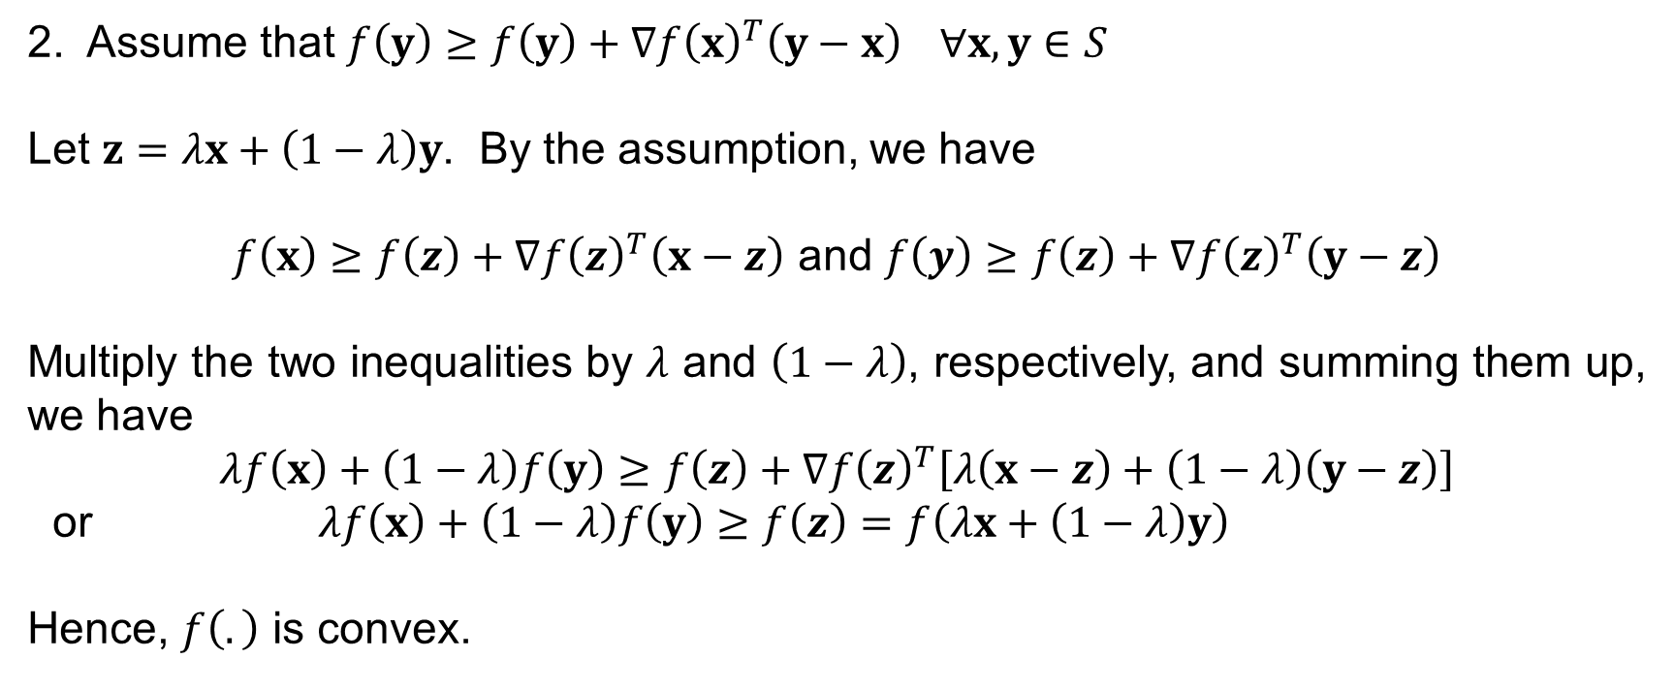
Optimality Conditions for Unconstrained Optimization
Convex Function and Global Optimality
2. Assume that $f\left(y\right)≥f\left(y\right)+{∇f\left(x\right)}^{T}\left(y−x\right)$ $∀x,y∈S$
Let $z=λx+\left(1−λ\right)y$. By the assumption, we have
$f\left(x\right)≥f\left(z\right)+{∇f\left(z\right)}^{T}\left(x−z\right)$ and $f\left(y\right)≥f\left(z\right)+{∇f\left(z\right)}^{T}\left(y−z\right)$
Multiply the two inequalities by $λ$ and $\left(1−λ\right)$, respectively, and summing them up, we have
$$λf\left(x\right)+\left(1−λ\right)f\left(y\right)≥f\left(z\right)+{∇f\left(z\right)}^{T}\left[λ\left(x−z\right)+\left(1−λ\right)\left(y−z\right)\right]$$
or $λf\left(x\right)+\left(1−λ\right)f\left(y\right)≥f\left(z\right)=f\left(λx+\left(1−λ\right)y\right)$
Hence, $f\left(.\right)$ is convex.

Slide 17
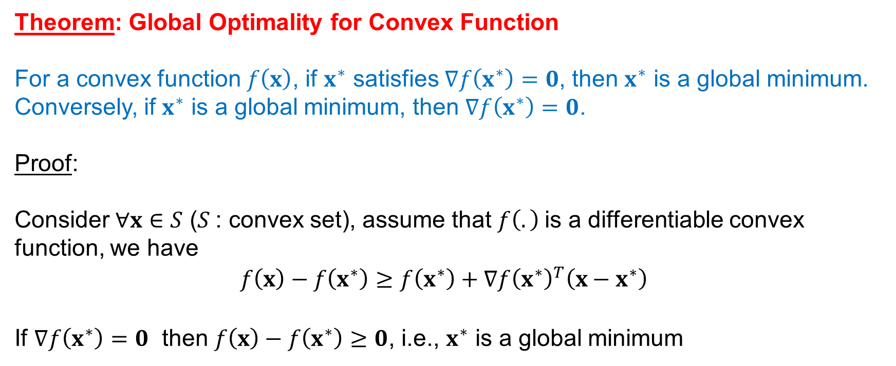
Optimality Conditions for Unconstrained Optimization
Convex Function and Global Optimality
Theorem: Global Optimality for Convex Function
For a convex function $f\left(x\right)$, if $x^{∗}$ satisfies $∇f\left(x^{∗}\right)=0$, then $x^{∗}$ is a global minimum. Conversely, if $x^{∗}$ is a global minimum, then $∇f\left(x^{∗}\right)=0$.
Proof:
Consider $∀x∈S$ ($S$: convex set), assume that $f\left(.\right)$is a differentiable convex function, we have
$$f\left(x\right)−f\left(x^{∗}\right)≥f\left(x^{∗}\right)+{∇f\left(x^{∗}\right)}^{T}\left(x−x^{∗}\right)$$
If $∇f\left(x^{∗}\right)=0$ then $f\left(x\right)−f\left(x^{∗}\right)≥0$, i.e., $x^{∗}$ is a global minimum

Slide 18
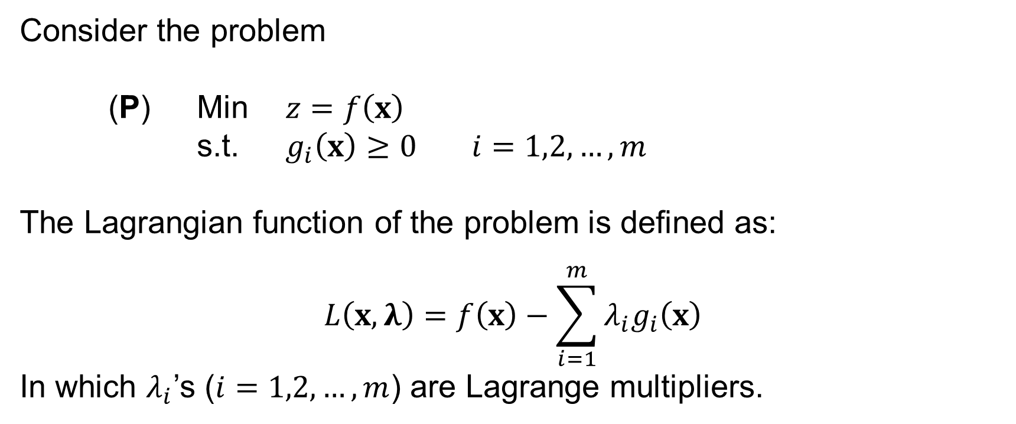
Optimality Conditions for Constrained Optimization
Consider the problem
(P) Min $z=f\left(x\right)$
s.t. $g_{i}\left(x\right)≥0$ $i=1,2,…,m$
The Lagrangian function of the problem is defined as:
$$L\left(x,λ\right)=f\left(x\right)−\sum_{i=1}^{m}{λ_{i}g_{i}\left(x\right)}$$
In which $λ_{i}$’s ($i=1,2,…,m$) are Lagrange multipliers.

Slide 19
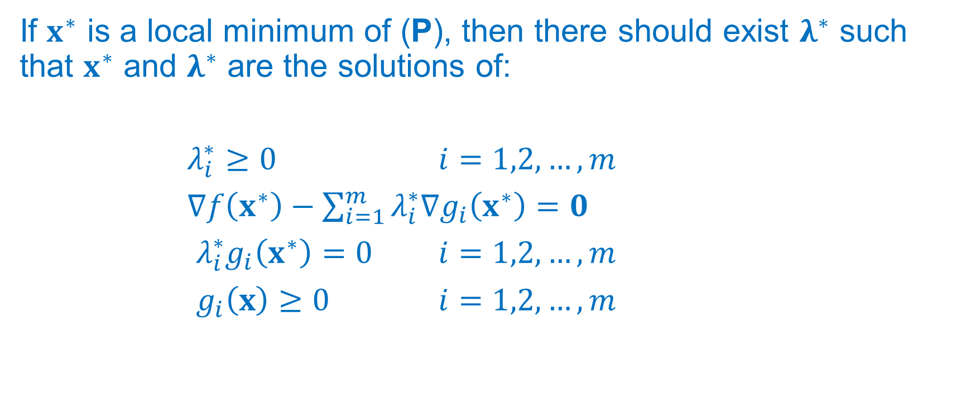
Optimality Conditions for Constrained Optimization
The Karush-Kuhn-Tucker (KKT) Necessary Condition
If $x^{∗}$ is a local minimum of (P), then there should exist $λ^{∗}$ such that $x^{∗}$ and $λ^{∗}$ are the solutions of:
$λ_{i}^{∗}≥0$ $i=1,2,…,m$
$∇f\left(x^{∗}\right)−\sum_{i=1}^{m}{λ_{i}^{∗}∇g_{i}\left(x^{∗}\right)}=0$
$λ_{i}^{∗}g_{i}\left(x^{∗}\right)=0$ $i=1,2,…,m$
$g_{i}\left(x\right)≥0$ $i=1,2,…,m$

Slide 20
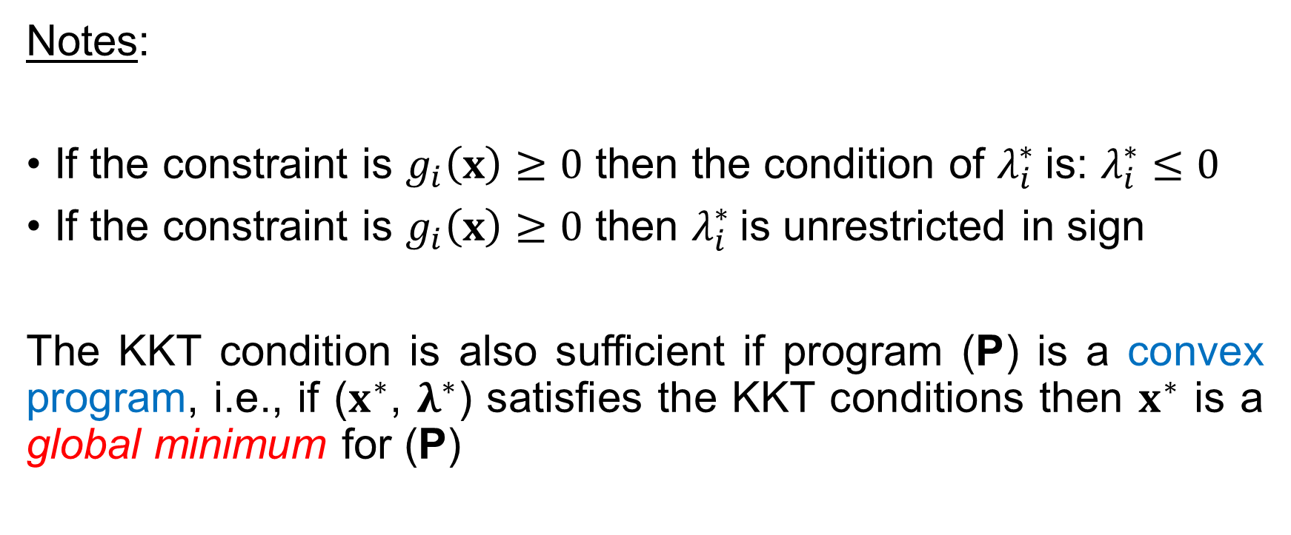
Optimality Conditions for Constrained Optimization
The Karush-Kuhn-Tucker (KKT) Necessary Condition
Notes:
If the constraint is $g_{i}\left(x\right)≥0$ then the condition of $λ_{i}^{∗}$is: $λ_{i}^{∗}≤0$
If the constraint is $g_{i}\left(x\right)≥0$ then $λ_{i}^{∗}$is unrestricted in sign
The KKT condition is also sufficient if program (P) is a convex program, i.e., if ($x^{∗}$, $λ^{∗}$) satisfies the KKT conditions then $x^{∗}$ is a global minimum for (P)

Slide 21
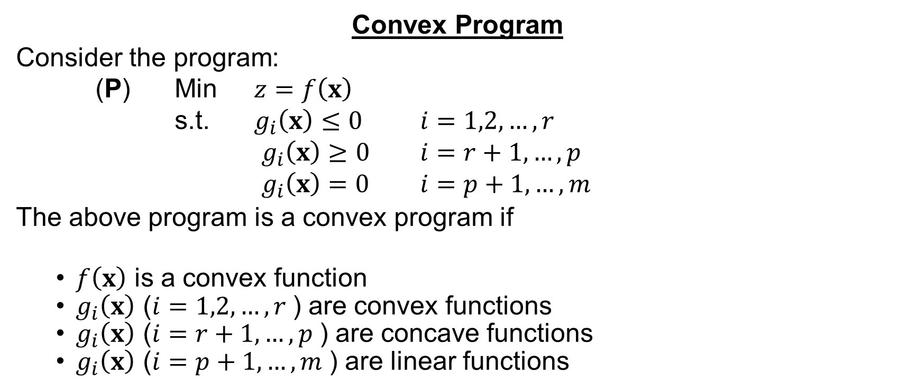
Optimality Conditions for Constrained Optimization
Convex Program
Consider the program:
(P) Min $z=f\left(x\right)$
s.t. $g_{i}\left(x\right)≤0$ $i=1,2,…,r$
$g_{i}\left(x\right)≥0$ $i=r+1,…,p$
$g_{i}\left(x\right)=0$ $i=p+1,…,m$
The above program is a convex program if
  $f\left(x\right)$ is a convex function
  $g_{i}\left(x\right)$ ($i=1,2,…,r$) are convex functions
  $g_{i}\left(x\right)$ ($i=r+1,…,p$) are concave functions
  $g_{i}\left(x\right)$ ($i=p+1,…,m$) are linear functions

Slide 22
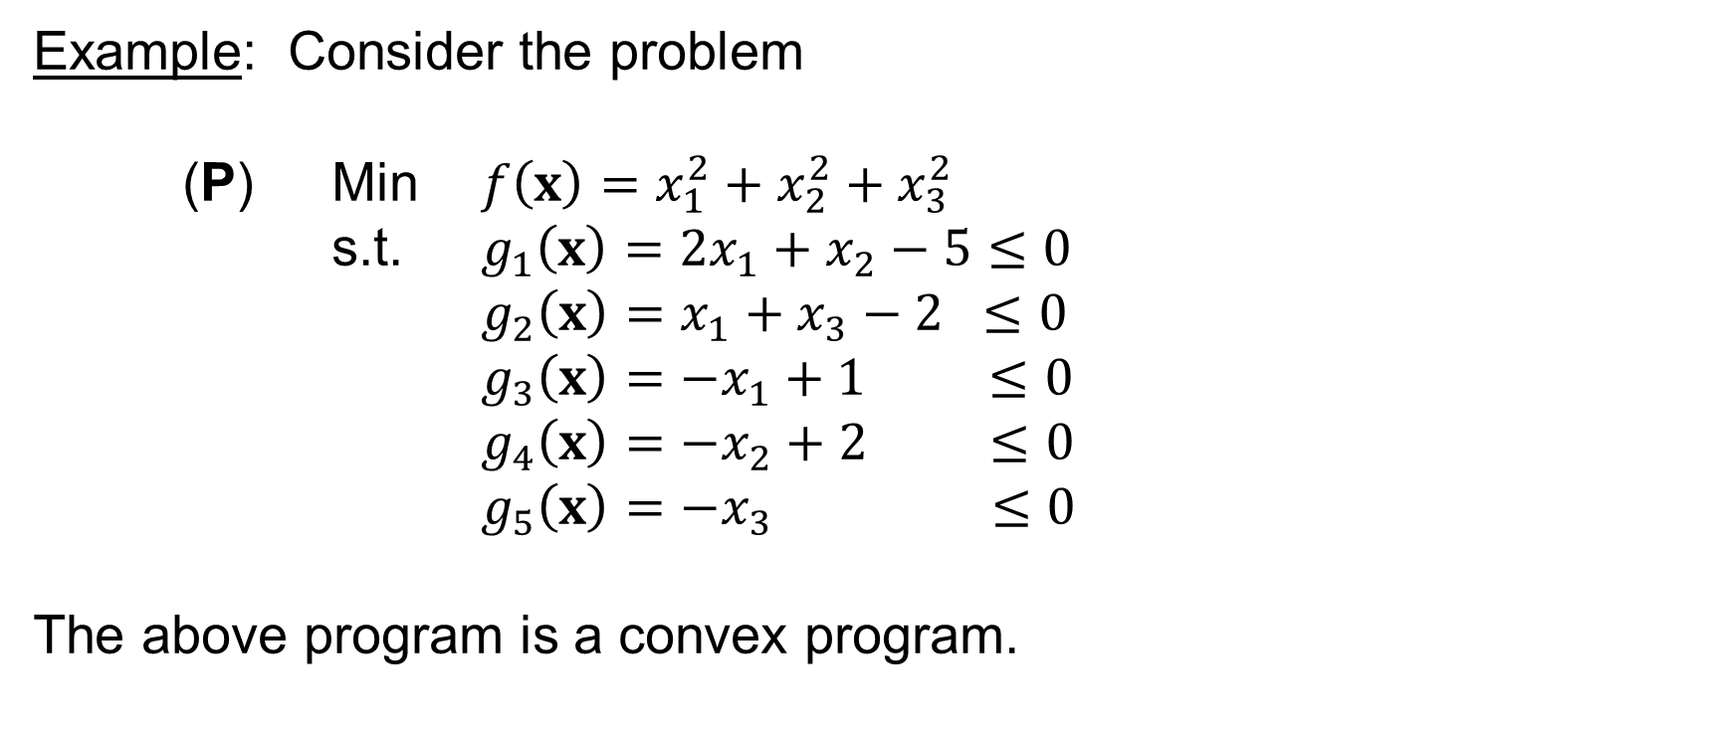
Optimality Conditions for Constrained Optimization
Example: Consider the problem
(P) Min $f\left(x\right)=x_{1}^{2}+x_{2}^{2}+x_{3}^{2}$
s.t. $g_{1}\left(x\right)=2x_{1}+x_{2}−5≤0$
$g_{2}\left(x\right)=x_{1}+x_{3}−2 ≤0$
$g_{3}\left(x\right)=−x_{1}+1 ≤0$
$g_{4}\left(x\right)=−x_{2}+2 ≤0$
$g_{5}\left(x\right)=−x_{3} ≤0$
The above program is a convex program.

Slide 23

Optimality Conditions for Constrained Optimization
The KKT conditions are given as:
The solution (global minimum) is: $x_{1}=1,x_{2}=2$, $x_{3}=0$ ($λ_{1}=λ_{2}=λ_{5}=0$, $λ_{3}=−2$, $λ_{4}=−4$)

