Slide 1
Advanced Optimization:
Techniques and Industrial Applications

Slide 2
Session 1.3:
Integer/Mixed Integer Programming & Combinatorial Optimization

Slide 3
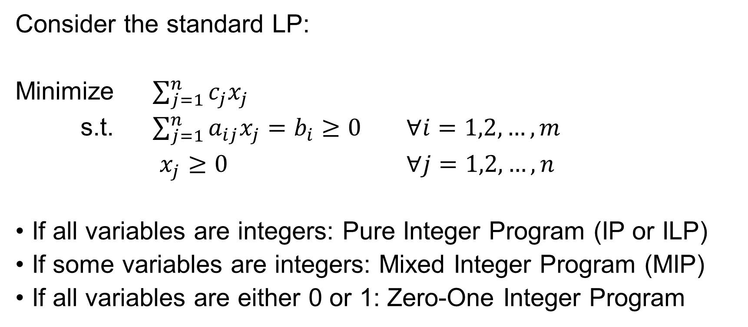
Introduction
Consider the standard LP:
Minimize $\sum_{j=1}^{n}{c_{j}x_{j}}$
s.t. $\sum_{j=1}^{n}{a_{ij}x_{j}=b_{i}≥0}$ $∀i=1,2,…, m$
$x_{j}≥0$ $∀j=1,2,…, n$
If all variables are integers: Pure Integer Program (IP or ILP)
If some variables are integers: Mixed Integer Program (MIP)
If all variables are either 0 or 1: Zero-One Integer Program

Slide 4
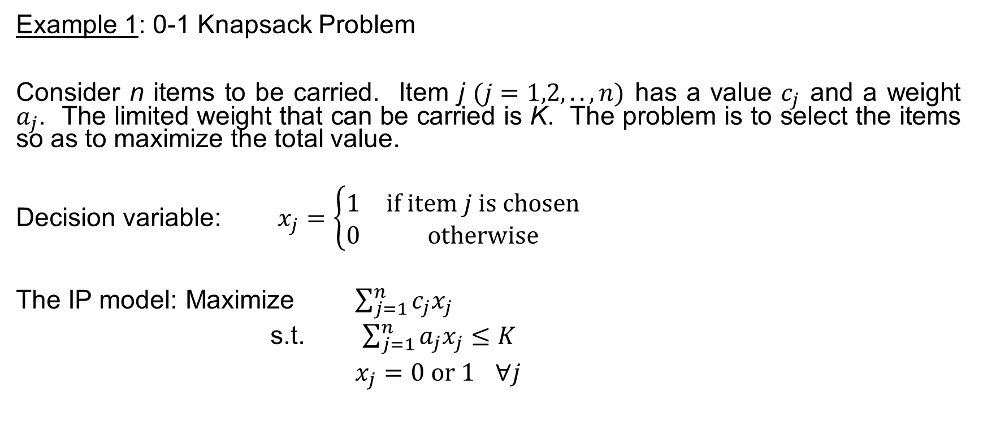
Introduction
Example 1: 0-1 Knapsack Problem
Consider n items to be carried. Item j $(j=1,2,..,n)$ has a value $c_{j}$ and a weight $a_{j}$. The limited weight that can be carried is K. The problem is to select the items so as to maximize the total value.
Decision variable: $x_{j}=\left\{\begin{matrix}1 & if item j is chosen \\ 0 & otherwise\end{matrix}\right.$
The IP model: Maximize $\sum_{j=1}^{n}{c_{j}x_{j}}$
s.t. $\sum_{j=1}^{n}{a_{j}x_{j}≤K}$
$x_{j}=0 or 1$ $∀j$

Slide 5
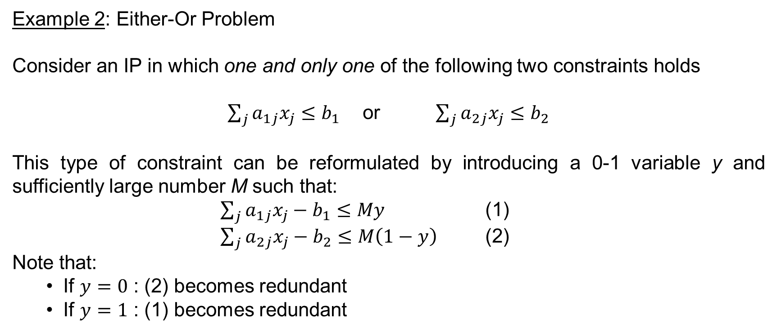
Introduction
Example 2: Either-Or Problem
Consider an IP in which one and only one of the following two constraints holds
$\sum_{j}{a_{1j}x_{j}}≤b_{1}$ or $\sum_{j}{a_{2j}x_{j}}≤b_{2}$
This type of constraint can be reformulated by introducing a 0-1 variable y and sufficiently large number M such that:
$\sum_{j}{a_{1j}x_{j}}−b_{1}≤My$ (1)
$\sum_{j}{a_{2j}x_{j}}−b_{2}≤M\left(1−y\right)$ (2)
Note that:
  If $y=0$ : (2) becomes redundant
  If $y=1$ : (1) becomes redundant

Slide 6
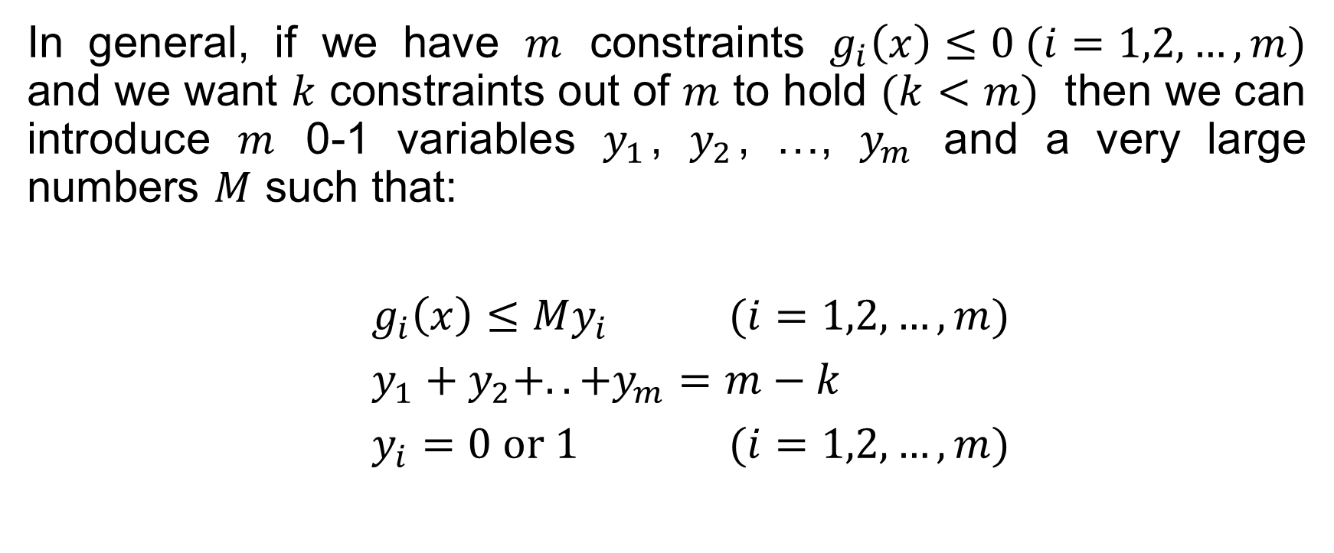
Introduction
In general, if we have $m$ constraints $g_{i}\left(x\right)≤0 (i=1,2,…,m)$ and we want $k$ constraints out of $m$ to hold $(k<m)$ then we can introduce $m$ 0-1 variables $y_{1}$, $y_{2}$, …, $y_{m}$ and a very large numbers $M$ such that:
$g_{i}\left(x\right)≤My_{i}$ $(i=1,2,…,m)$
$y_{1}+y_{2}+..+y_{m}=m−k$
$y_{i}=0 or 1$ $(i=1,2,…,m)$

Slide 7
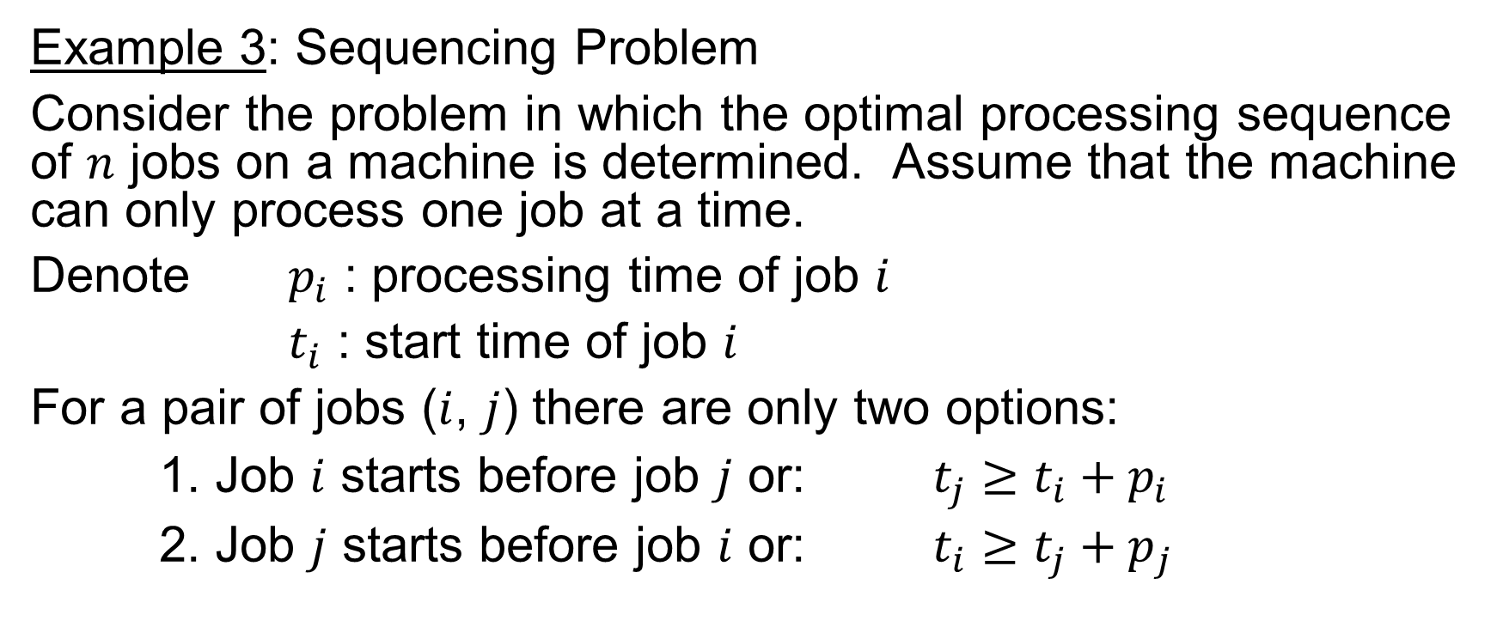
Introduction
Example 3: Sequencing Problem
Consider the problem in which the optimal processing sequence of $n$ jobs on a machine is determined. Assume that the machine can only process one job at a time.
Denote $p_{i}$ : processing time of job $i$
$t_{i}$ : start time of job $i$
For a pair of jobs ($i$, $j$) there are only two options:
1. Job $i$ starts before job $j$ or: $t_{j}≥t_{i}+p_{i}$
2. Job $j$ starts before job $i$ or: $t_{i}≥t_{j}+p_{j}$

Slide 8
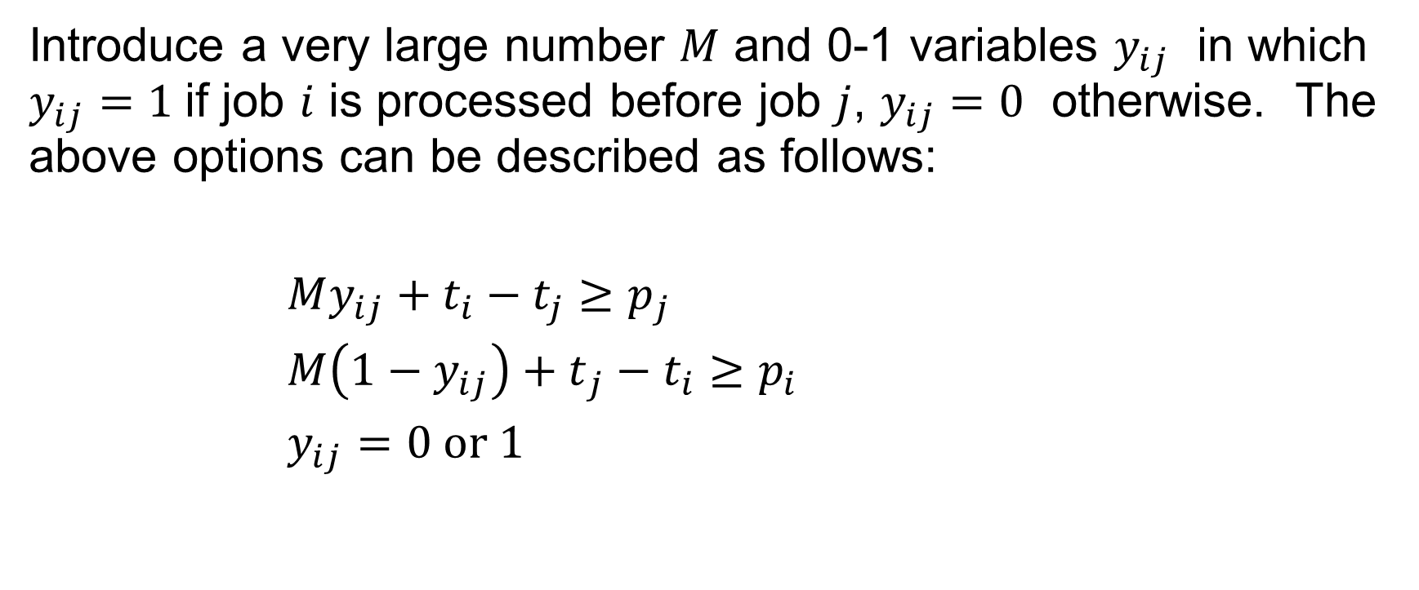
Introduction
Introduce a very large number $M$ and 0-1 variables $y_{ij}$ in which $y_{ij}=1$if job $i$ is processed before job $j$, $y_{ij}=0$ otherwise. The above options can be described as follows:
${My_{ij}+t}_{i}−t_{j}≥p_{j}$
${M\left(1−y_{ij}\right)+t}_{j}−t_{i}≥p_{i}$
$y_{ij}=0 or 1$

Slide 9
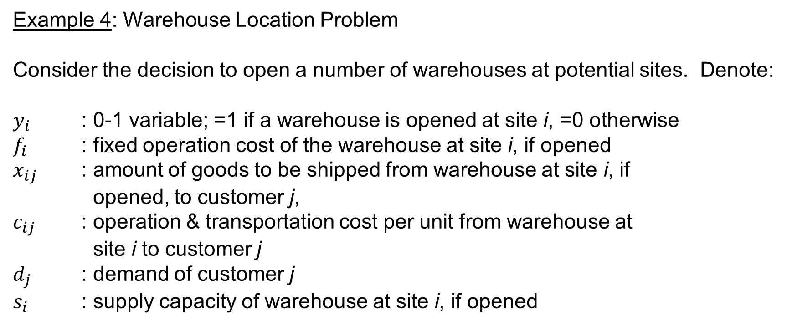
Introduction
Example 4: Warehouse Location Problem
Consider the decision to open a number of warehouses at potential sites. Denote:
$y_{i}$ : 0-1 variable; =1 if a warehouse is opened at site i, =0 otherwise
$f_{i}$ : fixed operation cost of the warehouse at site i, if opened
$x_{ij}$ : amount of goods to be shipped from warehouse at site i, if
opened, to customer j,
$c_{ij}$ : operation & transportation cost per unit from warehouse at
site i to customer j
$d_{j}$ : demand of customer j
$s_{i}$ : supply capacity of warehouse at site i, if opened

Slide 10
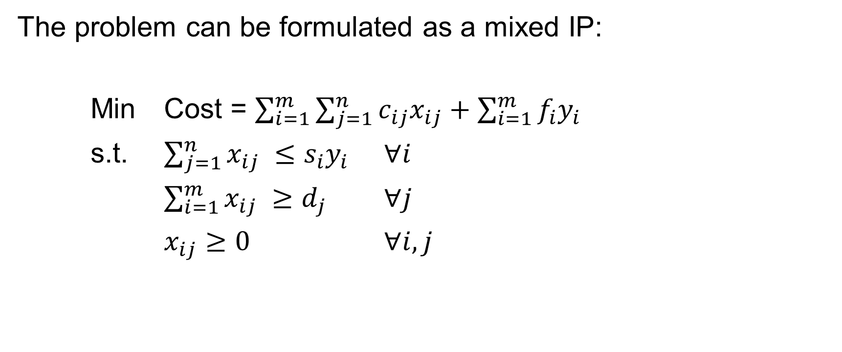
Introduction
The problem can be formulated as a mixed IP:
Min Cost = $\sum_{i=1}^{m}{\sum_{j=1}^{n}{c_{ij}x_{ij}}}+\sum_{i=1}^{m}{f_{i}y_{i}}$
s.t. $\sum_{j=1}^{n}{x_{ij}} ≤s_{i}y_{i}$ $∀i$
$\sum_{i=1}^{m}{x_{ij}} ≥d_{j}$ $∀j$
$x_{ij}≥0$ $∀i,j$

Slide 11
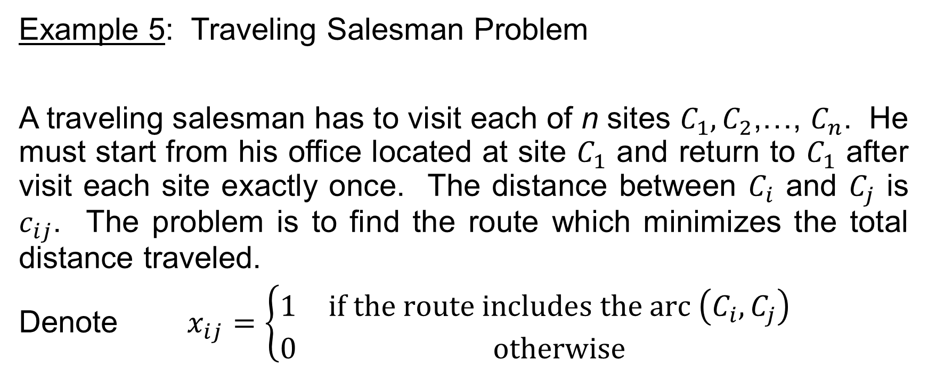
Introduction
Example 5: Traveling Salesman Problem
A traveling salesman has to visit each of n sites $C_{1},C_{2}$,…, $C_{n}$. He must start from his office located at site $C_{1}$ and return to $C_{1}$ after visit each site exactly once. The distance between $C_{i}$ and $C_{j}$ is $c_{ij}$. The problem is to find the route which minimizes the total distance traveled.
Denote $x_{ij}=\left\{\begin{matrix}1 & if the route includes the arc \left(C_{i},C_{j}\right) \\ 0 & otherwise\end{matrix}\right.$

Slide 12
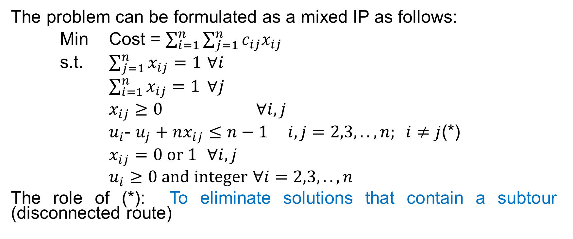
Introduction
The problem can be formulated as a mixed IP as follows:
Min Cost = $\sum_{i=1}^{n}{\sum_{j=1}^{n}{c_{ij}x_{ij}}}$
s.t. $\sum_{j=1}^{n}{x_{ij}}=1$ $∀i$
$\sum_{i=1}^{n}{x_{ij}}=1$ $∀j$
$x_{ij}≥0$ $∀i,j$
$u_{i}$- $u_{j}+nx_{ij}≤n−1$ $i,j=2,3,..,n; i≠j$(*)
$x_{ij}=0 or 1$ $∀i,j$
$u_{i}≥0 and integer$ $∀i=2,3,..,n$
The role of (*): To eliminate solutions that contain a subtour (disconnected route)

Slide 13
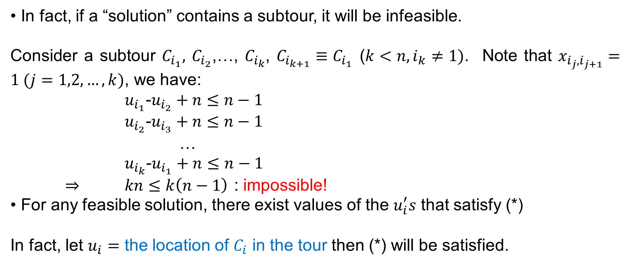
Introduction
• In fact, if a “solution” contains a subtour, it will be infeasible.
Consider a subtour $C_{i_{1}},$ $C_{i_{2}}$,…, $C_{i_{k}}$, $C_{i_{k+1}}≡C_{i_{1}}$ ($k<n, i_{k}≠1)$. Note that $x_{i_{j},i_{j+1}}=1 (j=1,2,…,k)$, we have:
$u_{i_{1}}$-$u_{i_{2}}+n≤n−1$
$u_{i_{2}}$-$u_{i_{3}}+n≤n−1$
…
$u_{i_{k}}$-$u_{i_{1}}+n≤n−1$
$⇒$ $kn≤k\left(n−1\right)$ : impossible!
• For any feasible solution, there exist values of the $u_{i}^{′}s$ that satisfy (*)
In fact, let $u_{i}=$ the location of $C_{i}$ in the tour then (*) will be satisfied.

Slide 14
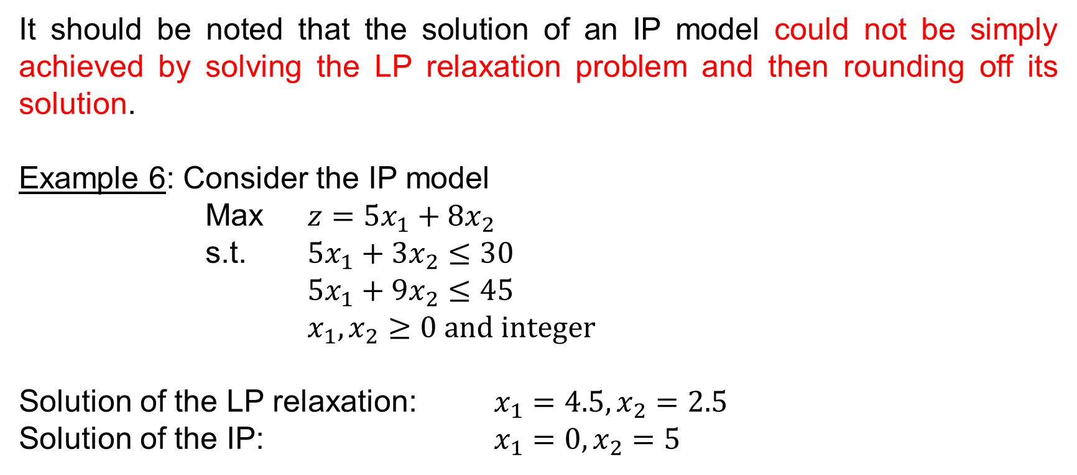
Solution Approach
It should be noted that the solution of an IP model could not be simply achieved by solving the LP relaxation problem and then rounding off its solution.
Example 6: Consider the IP model
Max $z=5x_{1}+8x_{2}$
s.t. $5x_{1}+3x_{2}≤30$
$5x_{1}+9x_{2}≤45$
$x_{1},x_{2}≥0 and integer$
Solution of the LP relaxation: $x_{1}=4.5,x_{2}=2.5$
Solution of the IP: $x_{1}=0,x_{2}=5$

Slide 15
Solution Approach
CUTTING PLANE ALGORITHM
Applied for “Pure Integer Programs”
Consider the optimal simplex tableau
of the LP relaxation of a pure IP model:

Slide 16
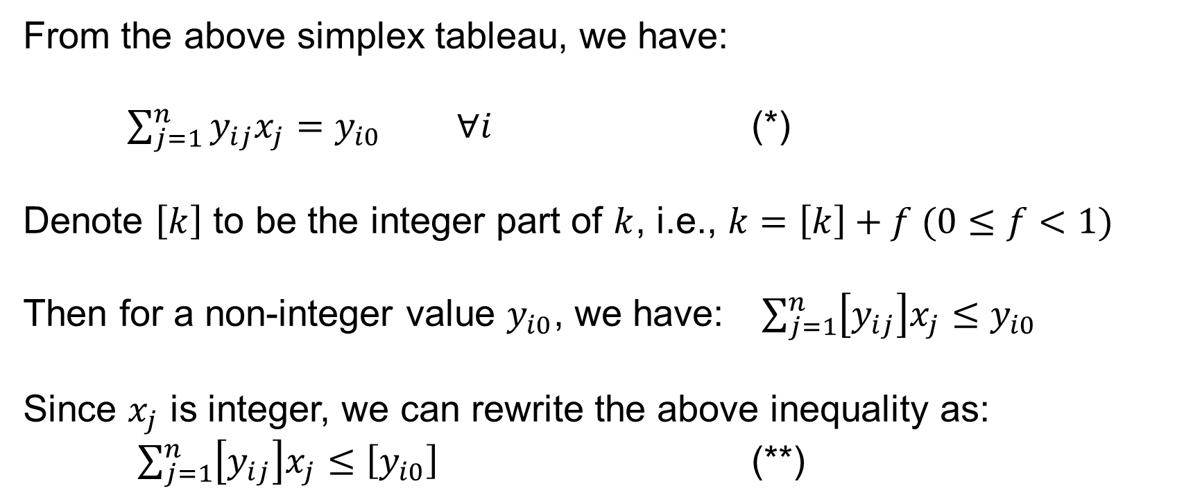
Solution Approach
CUTTING PLANE ALGORITHM
From the above simplex tableau, we have:
$\sum_{j=1}^{n}{y_{ij}x_{j}}=y_{i0} ∀i$ (*)
Denote $\left[k\right]$ to be the integer part of $k$, i.e., $k=\left[k\right]+f (0≤f<1)$
Then for a non-integer value $y_{i0}$, we have: $\sum_{j=1}^{n}{\left[y_{ij}\right]x_{j}}≤y_{i0}$
Since $x_{j}$ is integer, we can rewrite the above inequality as:
$\sum_{j=1}^{n}{\left[y_{ij}\right]x_{j}}≤\left[y_{i0}\right]$ (**)

Slide 17
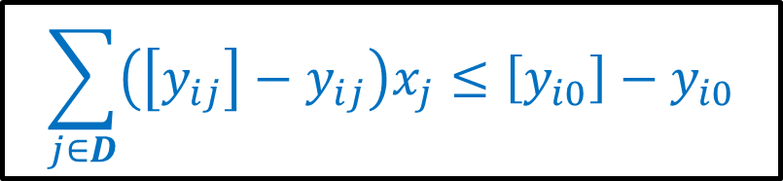
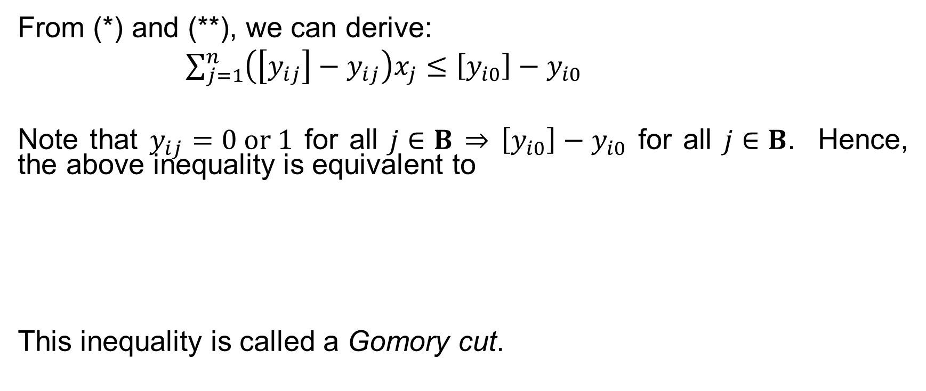
Solution Approach
CUTTING PLANE ALGORITHM
From (*) and (**), we can derive:
$\sum_{j=1}^{n}{\left(\left[y_{ij}\right]−y_{ij}\right)x_{j}}≤\left[y_{i0}\right]−y_{i0}$
Note that $y_{ij}=0 or 1$ for all $j∈B$ $⇒$ $\left[y_{i0}\right]−y_{i0}$ for all $j∈B$. Hence, the above inequality is equivalent to
This inequality is called a Gomory cut.
$$\sum_{j∈D}{\left(\left[y_{ij}\right]−y_{ij}\right)x_{j}}≤\left[y_{i0}\right]−y_{i0}$$

Slide 18
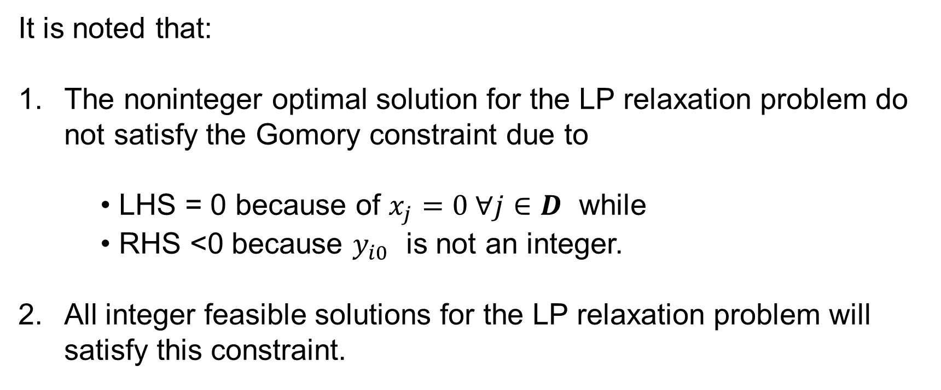
Solution Approach
CUTTING PLANE ALGORITHM
It is noted that:
The noninteger optimal solution for the LP relaxation problem do not satisfy the Gomory constraint due to
• LHS = 0 because of $x_{j}=0 ∀j∈D$ while
• RHS <0 because $y_{i0}$ is not an integer.
All integer feasible solutions for the LP relaxation problem will satisfy this constraint.

Slide 19
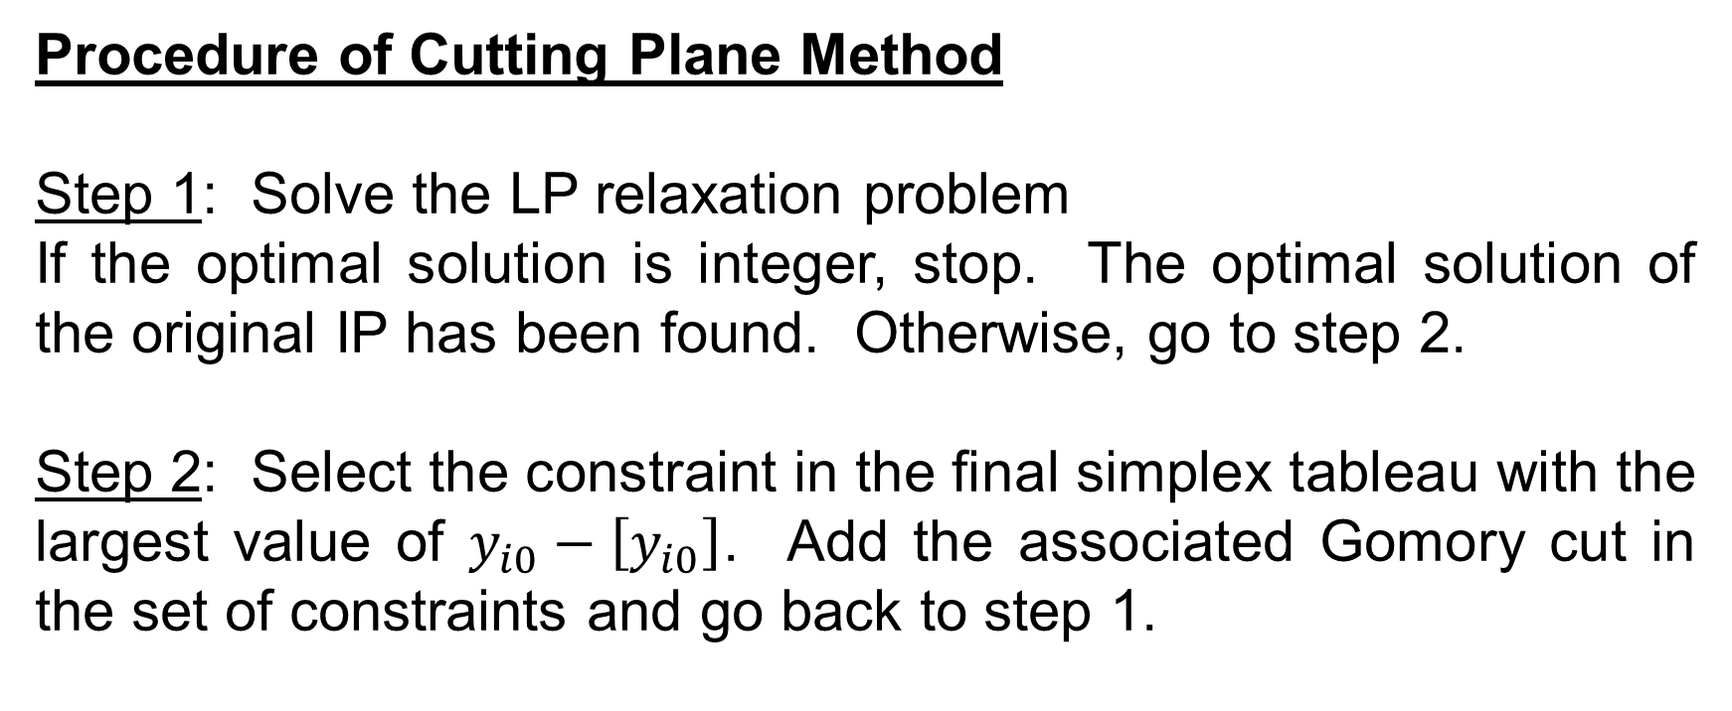
Solution Approach
CUTTING PLANE ALGORITHM
Procedure of Cutting Plane Method
Step 1: Solve the LP relaxation problem
If the optimal solution is integer, stop. The optimal solution of the original IP has been found. Otherwise, go to step 2.
Step 2: Select the constraint in the final simplex tableau with the largest value of $y_{i0}−\left[y_{i0}\right]$. Add the associated Gomory cut in the set of constraints and go back to step 1.

Slide 20

Solution Approach
CUTTING PLANE ALGORITHM
Example 7: Consider the IP program:
Max $z=−5x_{1}−6x_{2}$
s.t. $10x_{1}+3x_{2}≤$52
$2x_{1}+3x_{2} ≤$18
$x_{1},x_{2}≥0 and integer$

Slide 21
Solution Approach
CUTTING PLANE ALGORITHM
Optimal simplex tableau of the LP relaxation problem:

Slide 22
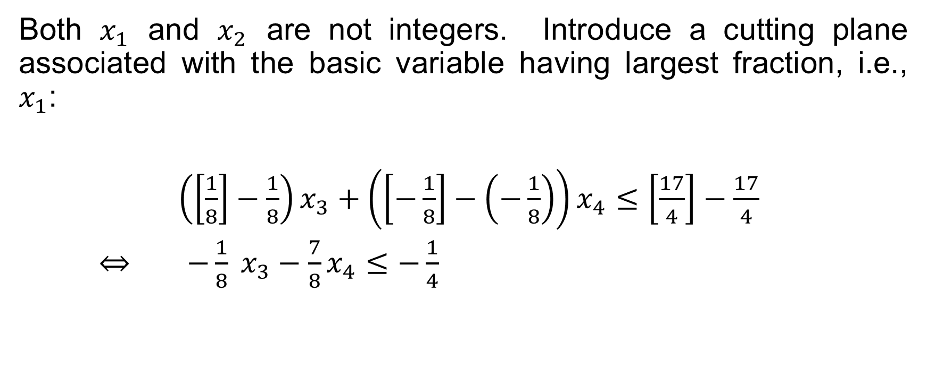
Solution Approach
CUTTING PLANE ALGORITHM
Both $x_{1}$ and $x_{2}$ are not integers. Introduce a cutting plane associated with the basic variable having largest fraction, i.e., $x_{1}$:
$\left(\left[\frac{1}{8}\right]−\frac{1}{8}\right)x_{3}+\left(\left[−\frac{1}{8}\right]−\left(−\frac{1}{8}\right)\right)x_{4}≤\left[\frac{17}{4}\right]−\frac{17}{4}$
$⇔$ $−\frac{1}{8} x_{3}−\frac{7}{8}x_{4}≤−\frac{1}{4}$

Slide 23
Solution Approach
CUTTING PLANE ALGORITHM
The updated simplex tableau:

Slide 24
Solution Approach
CUTTING PLANE ALGORITHM
Applying the dual simplex method we obtain:

Slide 25
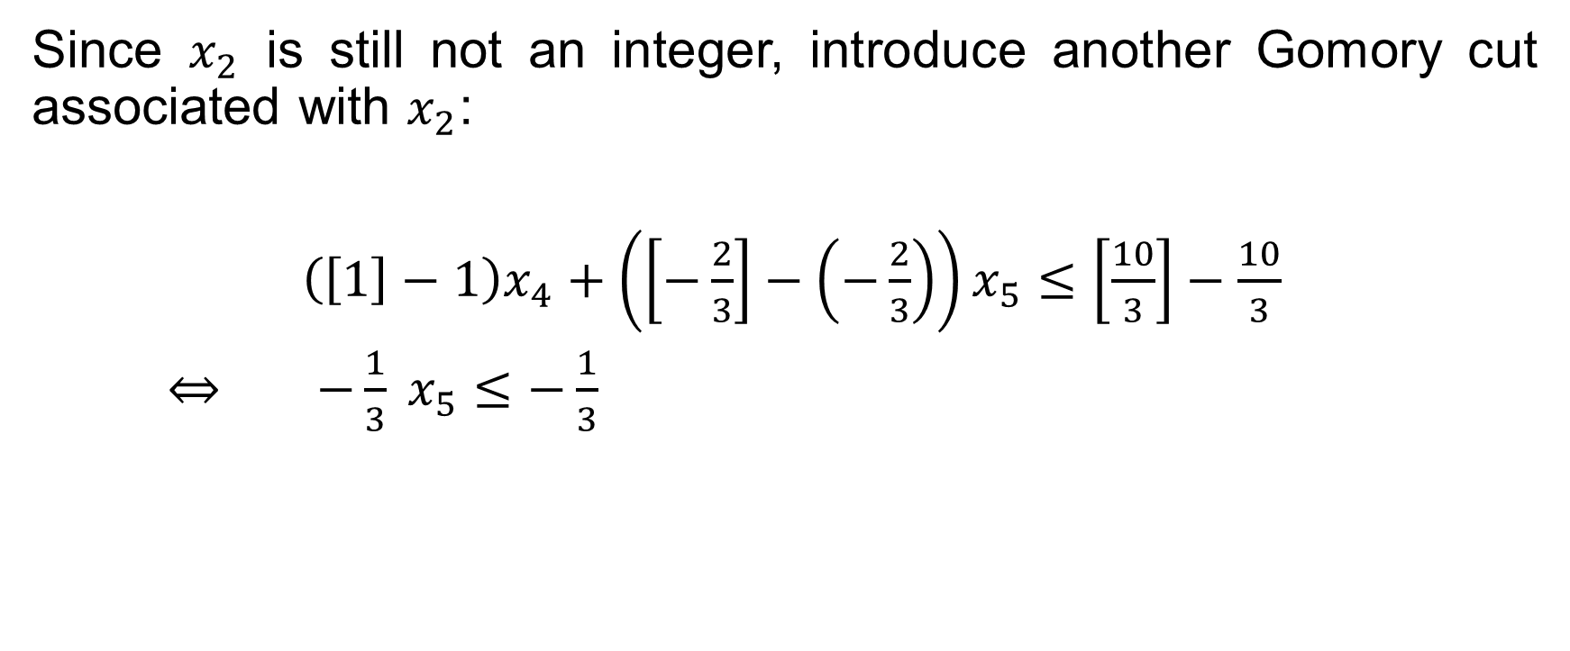
Solution Approach
CUTTING PLANE ALGORITHM
Since $x_{2}$ is still not an integer, introduce another Gomory cut associated with $x_{2}$:
$\left(\left[1\right]−1\right)x_{4}+\left(\left[−\frac{2}{3}\right]−\left(−\frac{2}{3}\right)\right)x_{5}≤\left[\frac{10}{3}\right]−\frac{10}{3}$
$⇔$ $−\frac{1}{3} x_{5}≤−\frac{1}{3}$

Slide 26
Solution Approach
CUTTING PLANE ALGORITHM
The updated simplex tableau:

Slide 27
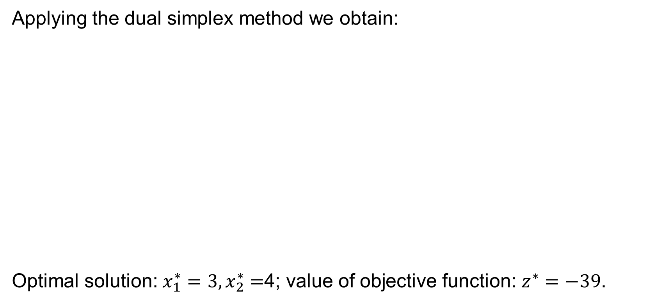
Solution Approach
CUTTING PLANE ALGORITHM
Applying the dual simplex method we obtain:
Optimal solution: $x_{1}^{∗}=3,x_{2}^{∗}=$4; value of objective function: $z^{∗}=−39$.

Slide 28
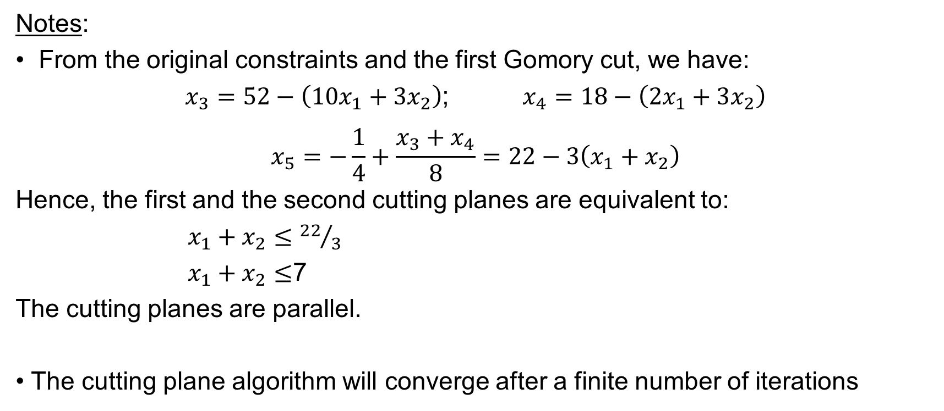
Solution Approach
CUTTING PLANE ALGORITHM
Notes:
• From the original constraints and the first Gomory cut, we have:
$x_{3}=52−\left(10x_{1}+3x_{2}\right)$; $x_{4}=18−\left(2x_{1}+3x_{2}\right)$
$$x_{5}=−\frac{1}{4}+\frac{x_{3}+x_{4}}{8}=22−3\left(x_{1}+x_{2}\right)$$
Hence, the first and the second cutting planes are equivalent to:
$x_{1}+x_{2}≤{22}/3$
$x_{1}+x_{2}≤$7
The cutting planes are parallel.
• The cutting plane algorithm will converge after a finite number of iterations

Slide 29
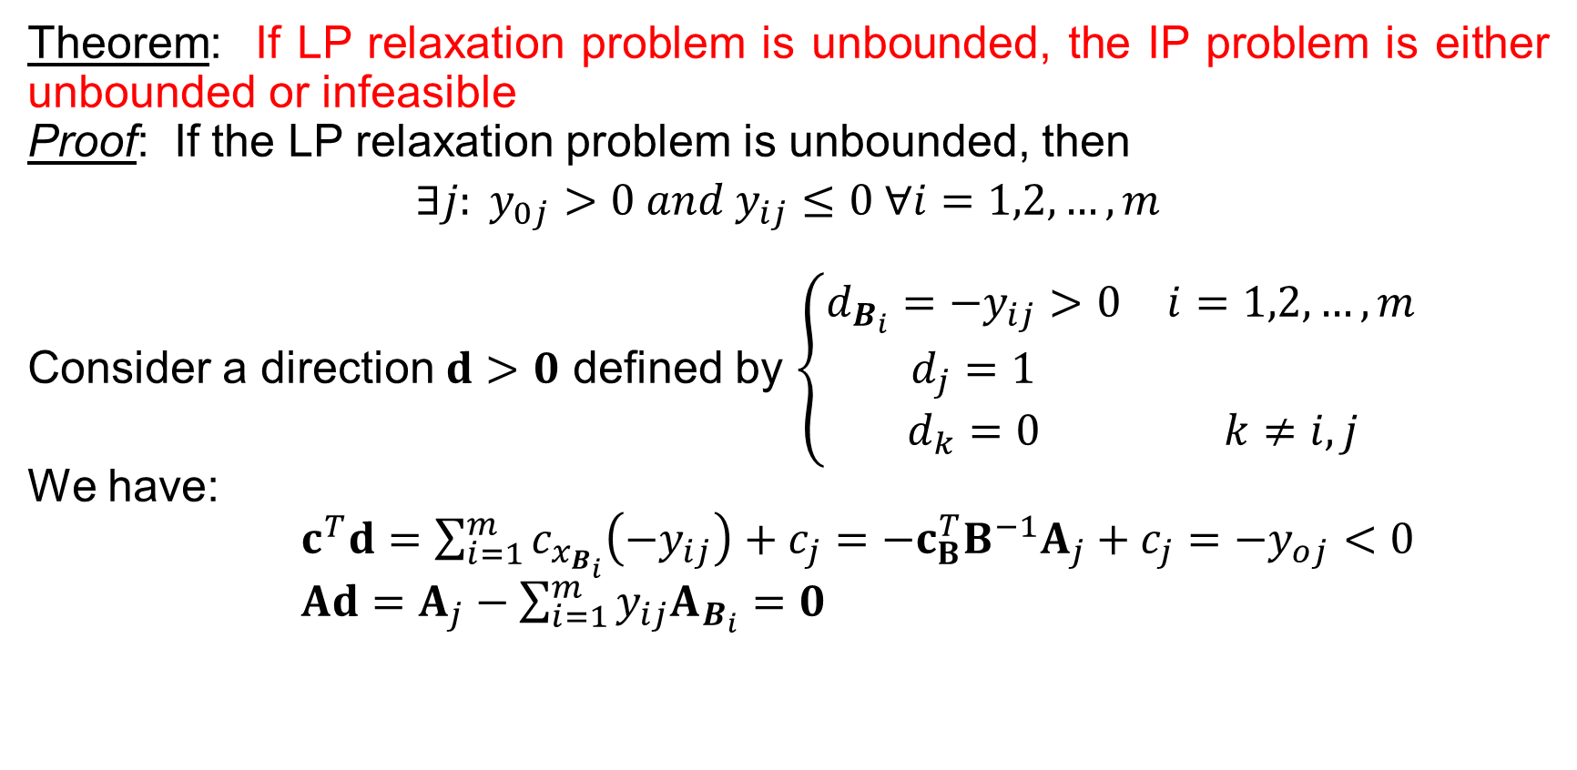
Solution Approach
CUTTING PLANE ALGORITHM
Theorem: If LP relaxation problem is unbounded, the IP problem is either unbounded or infeasible
Proof: If the LP relaxation problem is unbounded, then
$$∃j: y_{0j}>0 and y_{ij}≤0 ∀i=1,2,…,m$$
Consider a direction $d>0$ defined by $\left\{\begin{matrix}d_{B_{i}}=−y_{ij}>0 & i=1,2,…,m \\ d_{j}=1 & \\ d_{k}=0 & k≠i,j\end{matrix}\right.$
We have:
$c^{T}d=\sum_{i=1}^{m}{c_{x_{B_{i}}}\left(−y_{ij}\right)}+c_{j}=−{c_{B}^{T}B}^{−1}A_{j}+c_{j}=−y_{oj}<0$
$Ad=A_{j}−\sum_{i=1}^{m}{y_{ij}A_{B_{i}}}=0$

Slide 30
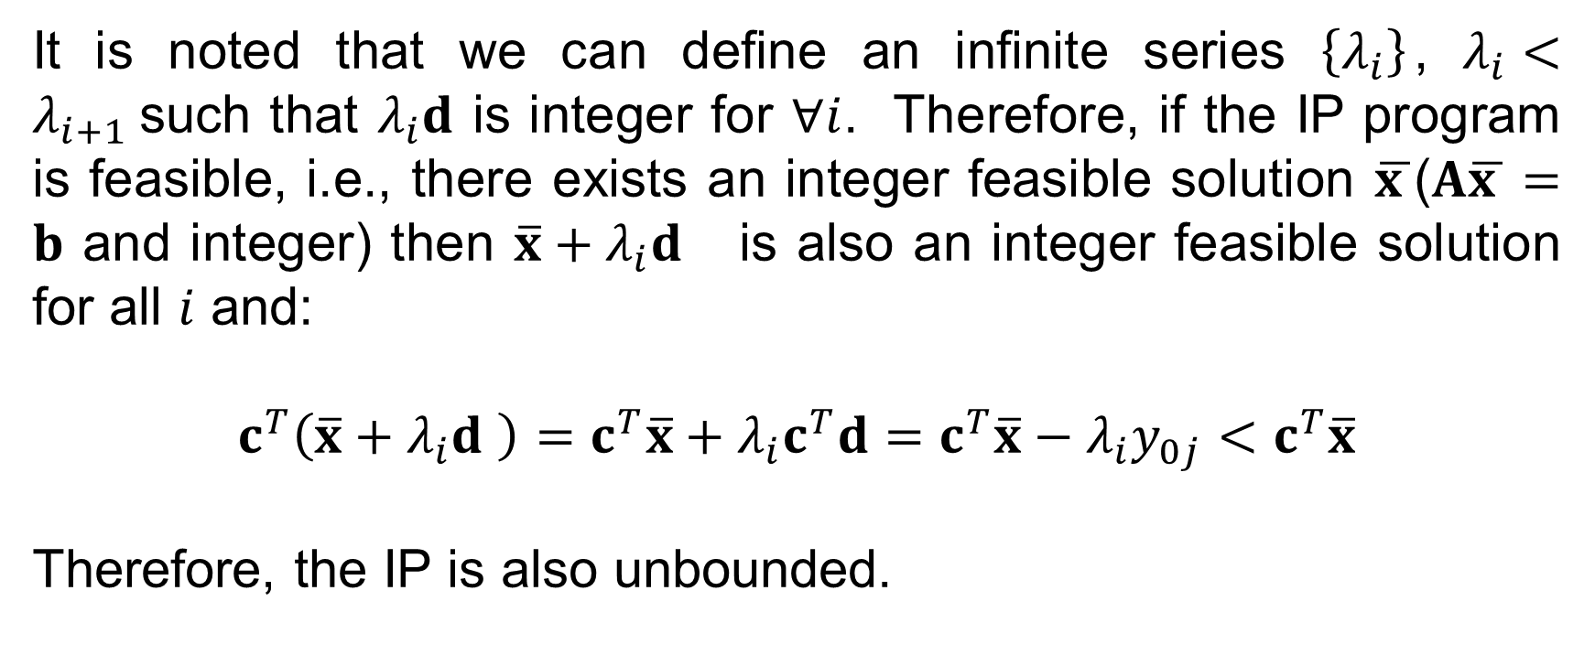
Solution Approach
CUTTING PLANE ALGORITHM
It is noted that we can define an infinite series $\left\{λ_{i}\right\}$, $λ_{i}<λ_{i+1}$such that $λ_{i}d$ is integer for $∀i$. Therefore, if the IP program is feasible, i.e., there exists an integer feasible solution $\overline{x }$($A\overline{x }=b$ and integer) then $\overline{x}+λ_{i}d$ is also an integer feasible solution for all $i$ and:
$c^{T}\left(\overline{x}+λ_{i}d \right)=c^{T}\overline{x}+λ_{i}c^{T}d=c^{T}\overline{x}−λ_{i}y_{0j}<$ $c^{T}\overline{x}$
Therefore, the IP is also unbounded.

Slide 31
Solution Approach
BRANCH AND BOUND ALGORITHM
The branch and bound algorithm can be applied for both pure IP and mixed IP programs. However, in many practical applications, the algorithm is developed based on the specific structure of the IP problem under consideration

Slide 32
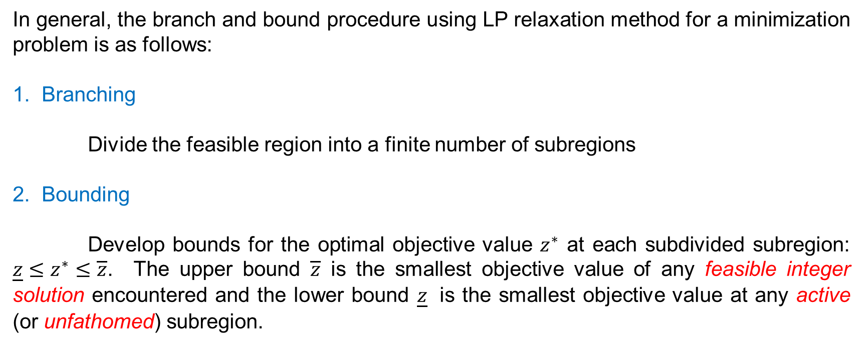
Solution Approach
BRANCH AND BOUND ALGORITHM
In general, the branch and bound procedure using LP relaxation method for a minimization problem is as follows:
1. Branching
Divide the feasible region into a finite number of subregions
2. Bounding
Develop bounds for the optimal objective value $z^{∗}$ at each subdivided subregion: ${\underline{z}≤z}^{∗}≤\overline{z}$. The upper bound $\overline{z}$ is the smallest objective value of any feasible integer solution encountered and the lower bound $\underline{z}$ is the smallest objective value at any active (or unfathomed) subregion.

Slide 33
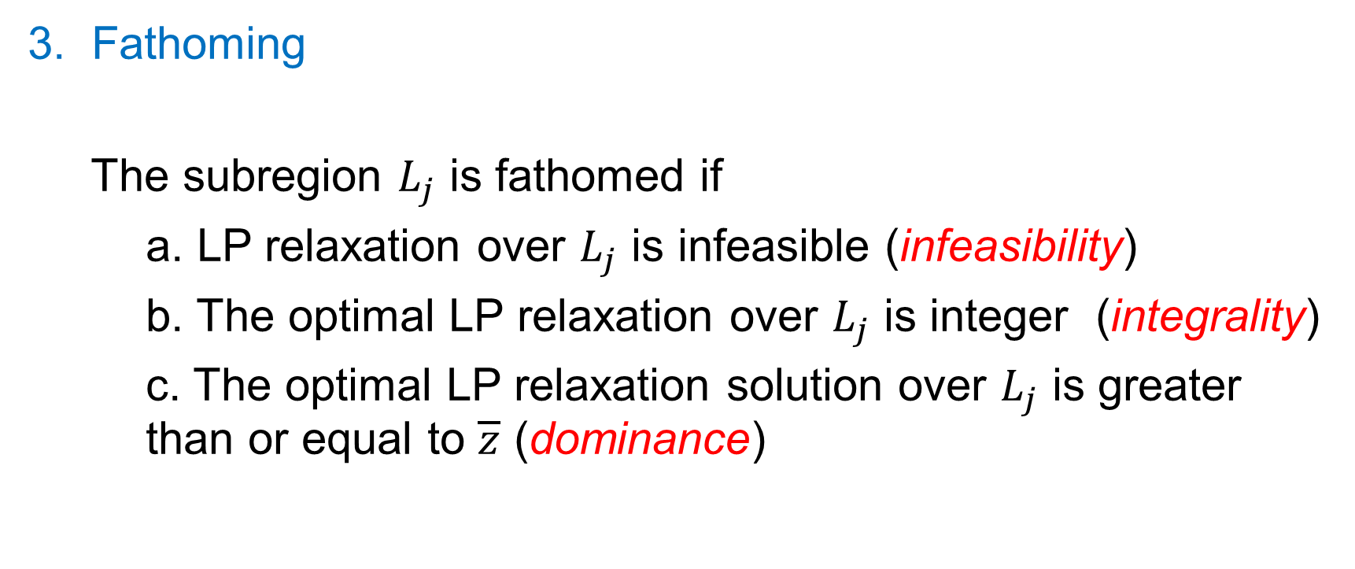
Solution Approach
BRANCH AND BOUND ALGORITHM
3. Fathoming
The subregion $L_{j}$ is fathomed if
a. LP relaxation over $L_{j}$ is infeasible (infeasibility)
b. The optimal LP relaxation over $L_{j}$ is integer (integrality)
c. The optimal LP relaxation solution over $L_{j}$ is greater than or equal to $\overline{z}$ (dominance)

Slide 34
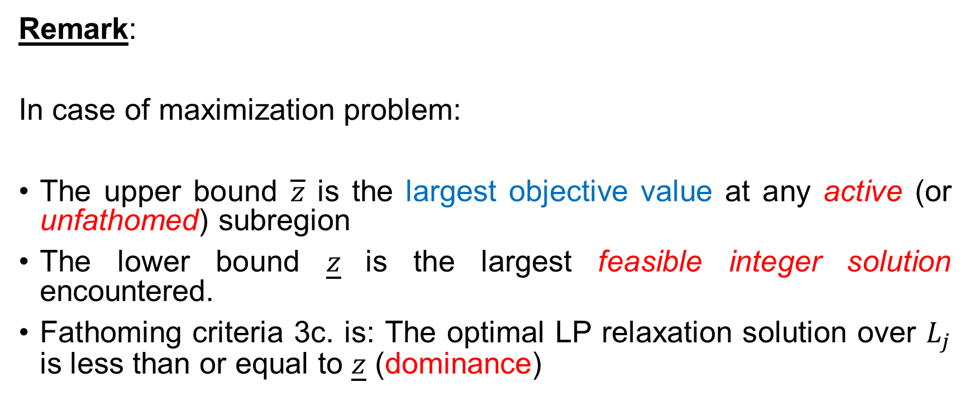
Solution Approach
BRANCH AND BOUND ALGORITHM
Remark:
In case of maximization problem:
The upper bound $\overline{z}$ is the largest objective value at any active (or unfathomed) subregion
The lower bound $\underline{z}$is the largest feasible integer solution encountered.
Fathoming criteria 3c. is: The optimal LP relaxation solution over $L_{j}$ is less than or equal to $\underline{z}$ (dominance)

Slide 35
Solution Approach
BRANCH AND BOUND ALGORITHM
Branching procedure:
1. Depth-first search or LIFO
If the current node is not fathomed, the next node considered is one of its two sons. We can:
  Arbitrarily select the left son or the right son
  Select the son that has the smaller lower bound (for minimization problem) or the larger upper bound (for maximization problem)
When a node is fathomed, go back toward the root until we find the first node that has a son that has not yet been considered

Slide 36
Solution Approach
BRANCH AND BOUND ALGORITHM
2. Breadth-first search
All the nodes at a given level are considered before any nodes at the next lower level. Note that the level of a node in the enumeration tree is the number of arcs in the unique path between it and the root.
3. Best lower bound
When a node has been fathomed, select the next node from all active nodes that has the smallest lower bound (for minimization problem) or the largest upper bound (for minimization problem)

Slide 37
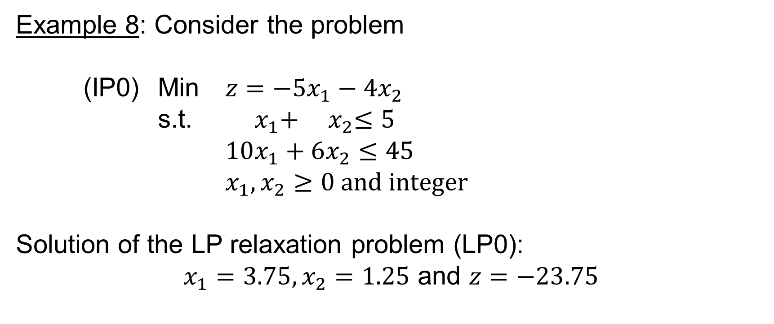
Solution Approach
BRANCH AND BOUND ALGORITHM
Example 8: Consider the problem
(IP0) Min $z=−5x_{1}−4x_{2}$
s.t. $x_{1}+{ x}_{2}≤5$
$10x_{1}+6x_{2}≤45$
$x_{1},x_{2}≥0 and integer$
Solution of the LP relaxation problem (LP0):
$x_{1}=3.75, x_{2}=1.25$ and $z=−23.75$

Slide 38
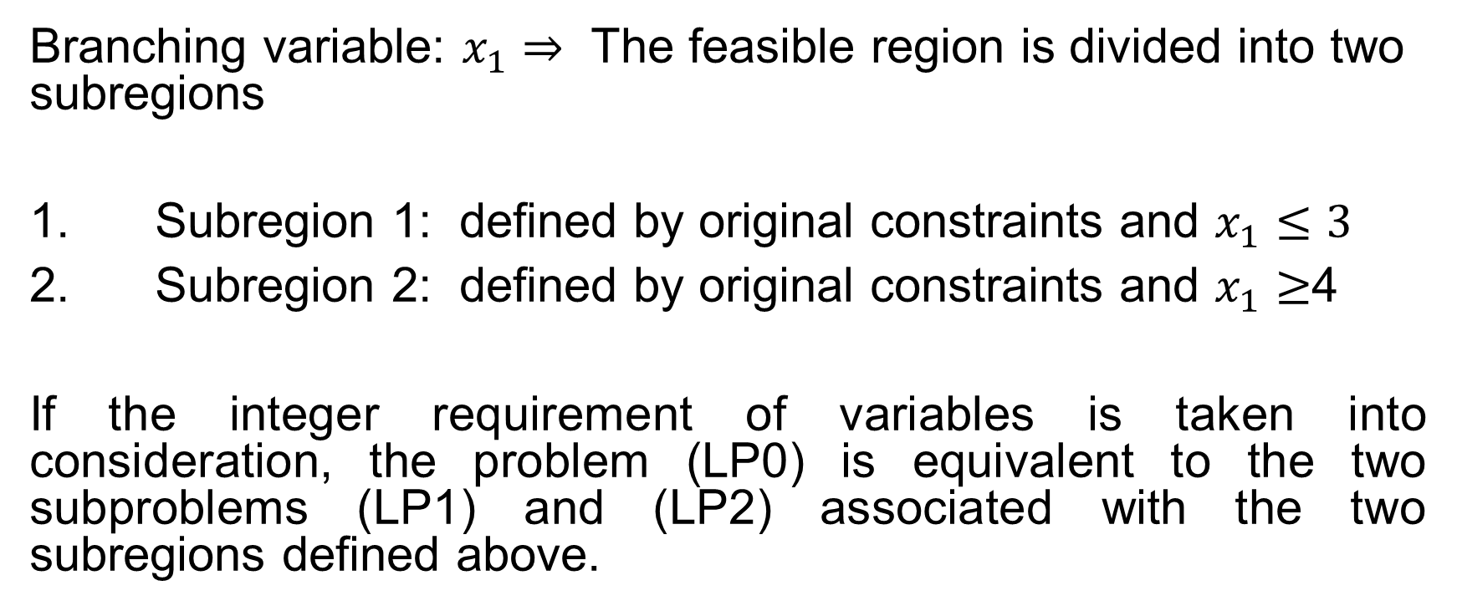
Solution Approach
BRANCH AND BOUND ALGORITHM
Branching variable: $x_{1}$ $⇒$ The feasible region is divided into two subregions
1. Subregion 1: defined by original constraints and $x_{1}≤3$
2. Subregion 2: defined by original constraints and $x_{1}≥$4
If the integer requirement of variables is taken into consideration, the problem (LP0) is equivalent to the two subproblems (LP1) and (LP2) associated with the two subregions defined above.

Slide 39
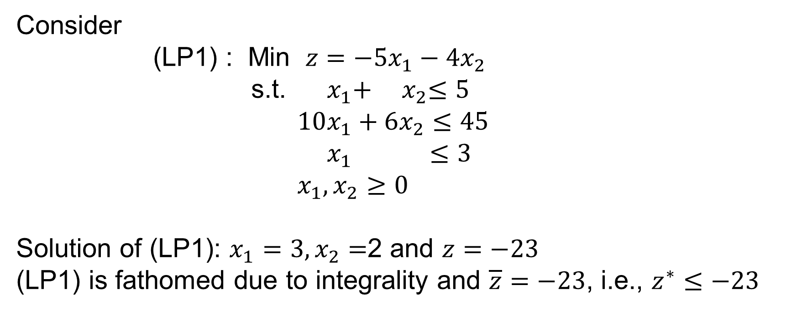
Solution Approach
BRANCH AND BOUND ALGORITHM
Consider
(LP1) : Min $z=−5x_{1}−4x_{2}$
s.t. $x_{1}+{ x}_{2}≤5$
$10x_{1}+6x_{2}≤45$
$x_{1} ≤3$
$x_{1},x_{2}≥0$
Solution of (LP1): $x_{1}=3, x_{2}=$2 and $z=−23$
(LP1) is fathomed due to integrality and $\overline{z}=−23$, i.e., $z^{∗}≤−23$

Slide 40
Solution Approach
BRANCH AND BOUND ALGORITHM
The next step should be to consider (LP2). However, due to the fact that all coefficients of the objective function are integers and that the optimal objective value of (LP0) is -23.75, there exists no subproblem of (LP0) that can give a better solution than -23. Therefore, there is no need to consider (LP2).
Solution of (LP1) is then the optimal solution of the original (IP0) problem

Slide 41
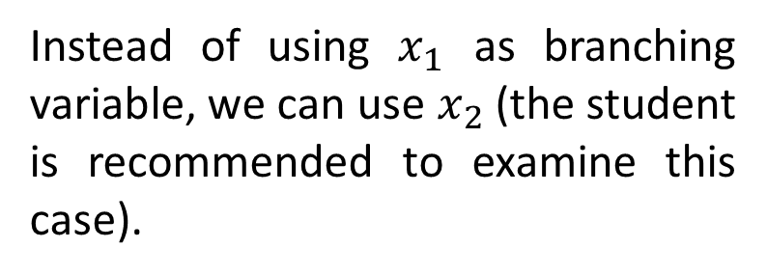
Solution Approach
BRANCH AND BOUND ALGORITHM
If (LP2) is examined before (LP1): using depth-first search technique, the solution can be determined as follows:
Instead of using $x_{1}$ as branching variable, we can use $x_{2}$ (the student is recommended to examine this case).
Note: There is no general guidance for the selection of branching variable

Slide 42
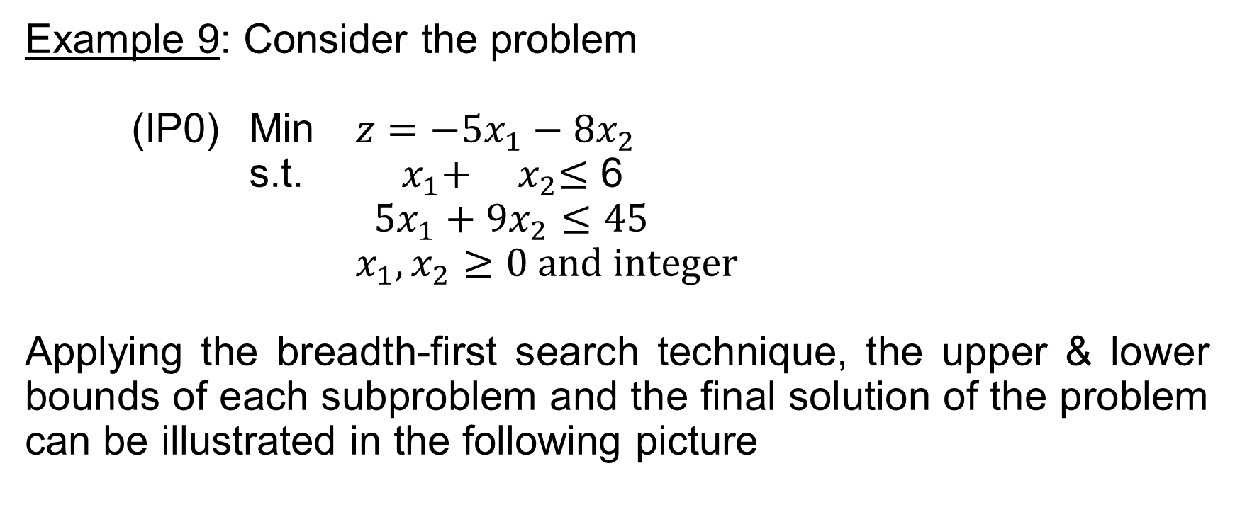
Solution Approach
BRANCH AND BOUND ALGORITHM
Example 9: Consider the problem
(IP0) Min $z=−5x_{1}−8x_{2}$
s.t. $x_{1}+{ x}_{2}≤$ 6
$5x_{1}+9x_{2}≤45$
$x_{1},x_{2}≥0 and integer$
Applying the breadth-first search technique, the upper & lower bounds of each subproblem and the final solution of the problem can be illustrated in the following picture

Slide 43
Solution Approach
BRANCH AND BOUND ALGORITHM

Slide 44
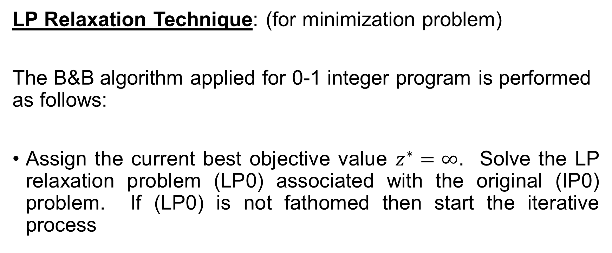
Solution Approach
BRANCH AND BOUND ALGORITHM FOR 0-1 IP
LP Relaxation Technique: (for minimization problem)
The B&B algorithm applied for 0-1 integer program is performed as follows:
Assign the current best objective value $z^{∗}=∞$. Solve the LP relaxation problem (LP0) associated with the original (IP0) problem. If (LP0) is not fathomed then start the iterative process

Slide 45
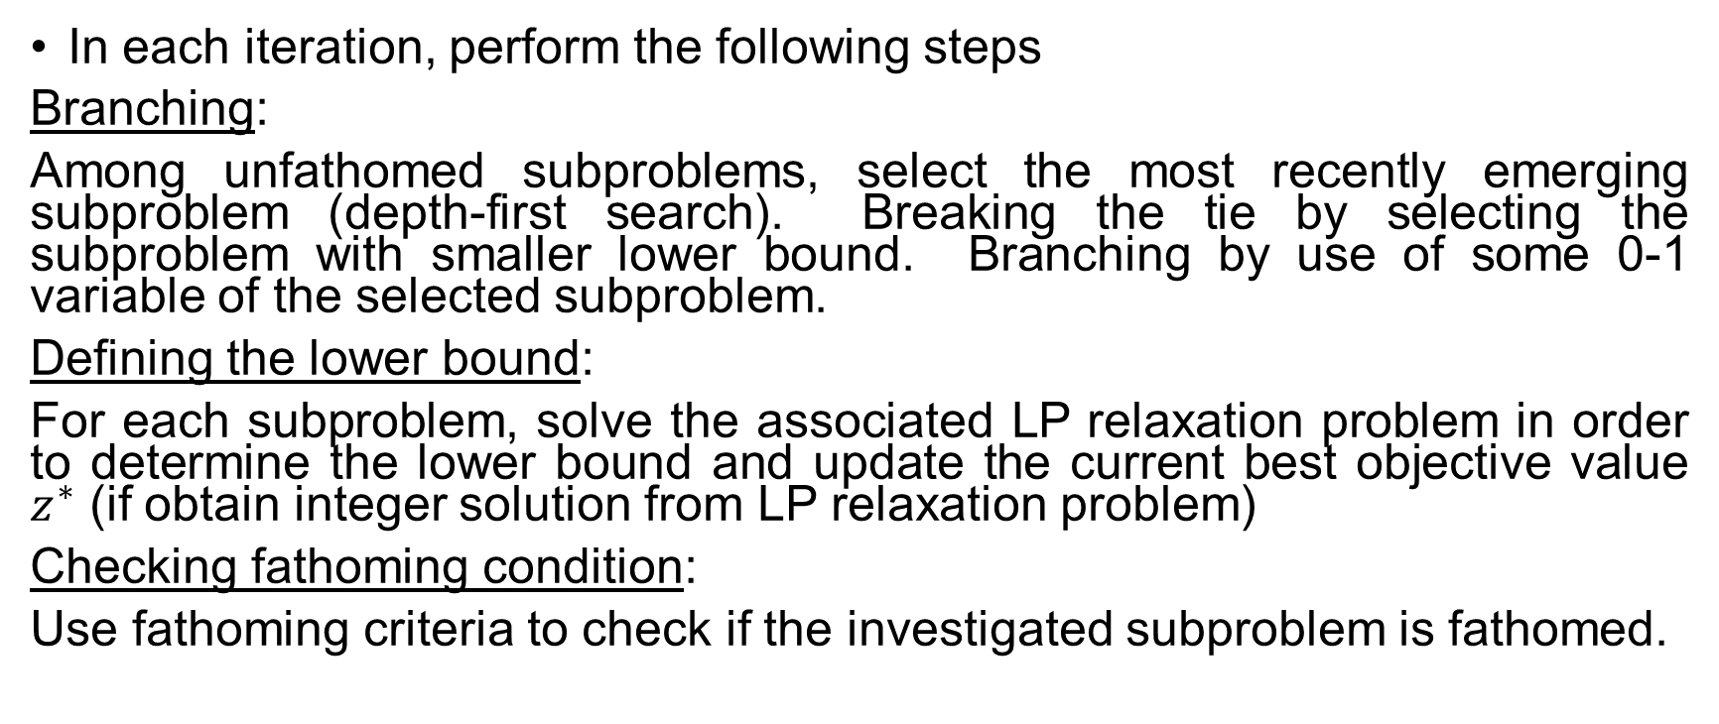
Solution Approach
BRANCH AND BOUND ALGORITHM FOR 0-1 IP
In each iteration, perform the following steps
Branching:
Among unfathomed subproblems, select the most recently emerging subproblem (depth-first search). Breaking the tie by selecting the subproblem with smaller lower bound. Branching by use of some 0-1 variable of the selected subproblem.
Defining the lower bound:
For each subproblem, solve the associated LP relaxation problem in order to determine the lower bound and update the current best objective value $z^{∗}$ (if obtain integer solution from LP relaxation problem)
Checking fathoming condition:
Use fathoming criteria to check if the investigated subproblem is fathomed.

Slide 46
Solution Approach
BRANCH AND BOUND ALGORITHM FOR 0-1 IP
The above procedure is performed until all subproblems are fathomed. The current best objective value is the optimal objective value.

Slide 47
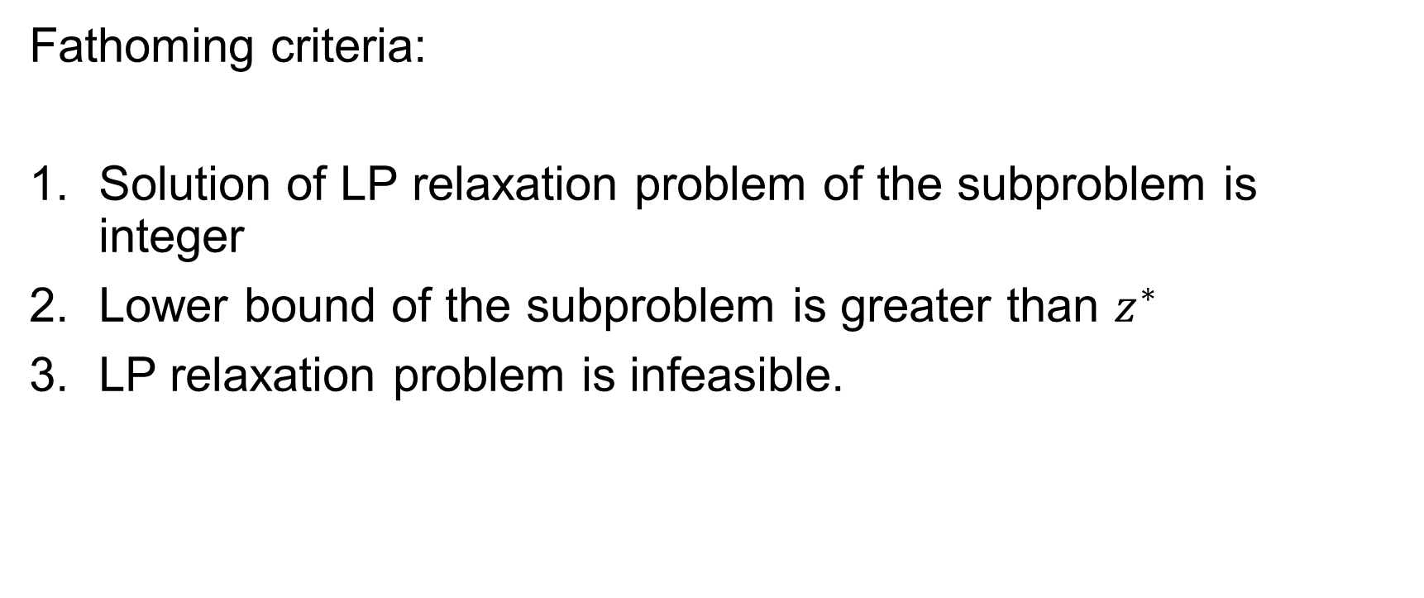
Solution Approach
BRANCH AND BOUND ALGORITHM FOR 0-1 IP
Fathoming criteria:
Solution of LP relaxation problem of the subproblem is integer
Lower bound of the subproblem is greater than $z^{∗}$
LP relaxation problem is infeasible.

Slide 48
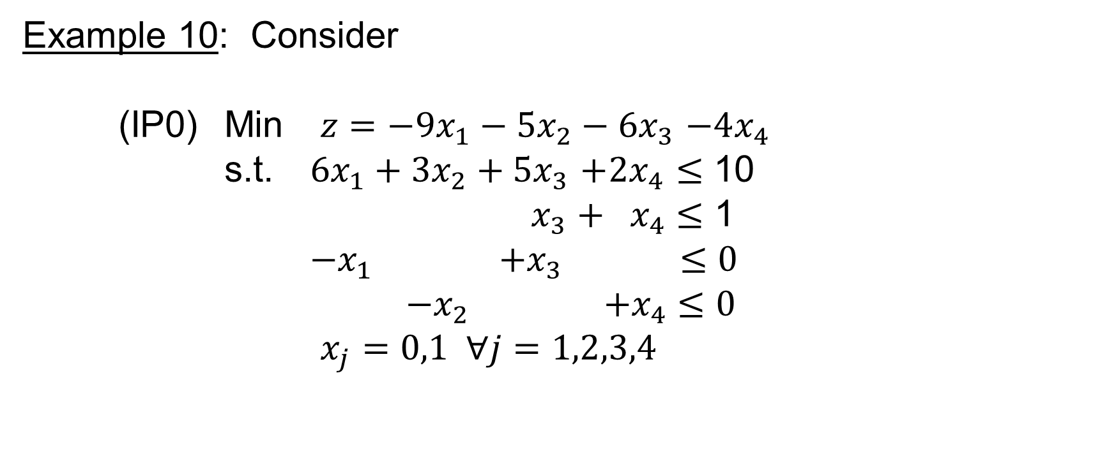
Solution Approach
BRANCH AND BOUND ALGORITHM FOR 0-1 IP
Example 10: Consider
(IP0) Min $z=−9x_{1}−5x_{2}−6x_{3}$ $−4x_{4}$
s.t. $6x_{1}+3x_{2}+5x_{3}$ $+2x_{4}≤$ 10
${ x}_{3}$ $+{ x}_{4}$ $≤$ 1
${−x}_{1}$ $+x_{3}$ $≤0$
${−x}_{2}$ $+x_{4}$ $≤0$
$x_{j}=0,1 ∀j=1,2,3,4$

Slide 49
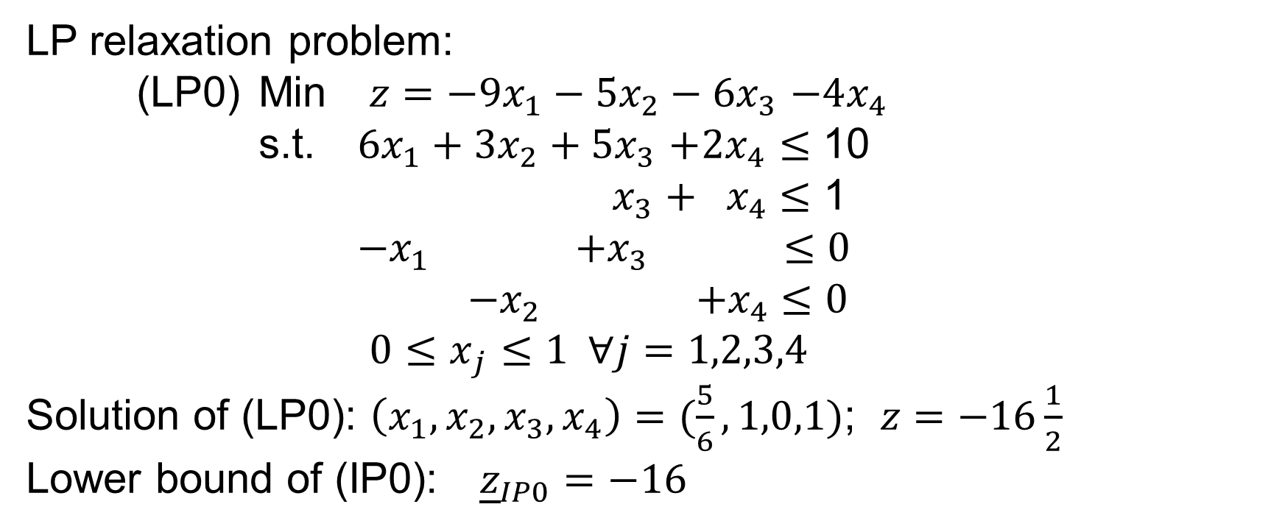
Solution Approach
BRANCH AND BOUND ALGORITHM FOR 0-1 IP
LP relaxation problem:
(LP0) Min $z=−9x_{1}−5x_{2}−6x_{3}$ $−4x_{4}$
s.t. $6x_{1}+3x_{2}+5x_{3}$ $+2x_{4}≤$ 10
${ x}_{3}$ $+{ x}_{4}$ $≤$ 1
${−x}_{1}$ $+x_{3}$ $≤0$
${−x}_{2}$ $+x_{4}$ $≤0$
${0≤x}_{j}≤1 ∀j=1,2,3,4$
Solution of (LP0): $\left(x_{1},x_{2},x_{3},x_{4}\right)=(\frac{5}{6},1,0,1)$; $z=−16\frac{1}{2}$
Lower bound of (IP0): ${\underline{z}}_{IP0}=−16$

Slide 50

Solution Approach
BRANCH AND BOUND ALGORITHM FOR 0-1 IP
Iteration 1: Branching variable $x_{1}$. The two subproblems:

Slide 51
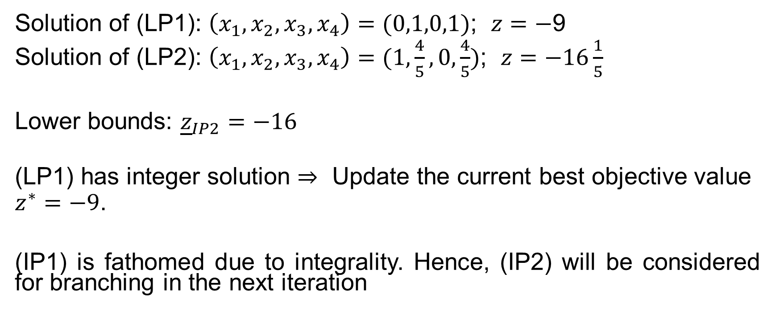
Solution Approach
BRANCH AND BOUND ALGORITHM FOR 0-1 IP
Solution of (LP1): $\left(x_{1},x_{2},x_{3},x_{4}\right)=(0,1,0,1)$; $z=−$9
Solution of (LP2): $\left(x_{1},x_{2},x_{3},x_{4}\right)=(1,\frac{4}{5},0,\frac{4}{5})$; $z=−16\frac{1}{5}$
Lower bounds: ${\underline{z}}_{IP2}=−16$
(LP1) has integer solution $⇒$ Update the current best objective value $z^{∗}=−9$.
(IP1) is fathomed due to integrality. Hence, (IP2) will be considered for branching in the next iteration

Slide 52

Solution Approach
BRANCH AND BOUND ALGORITHM FOR 0-1 IP
Iteration 2: Branching subproblem (IP2) based on $x_{2}$

Slide 53
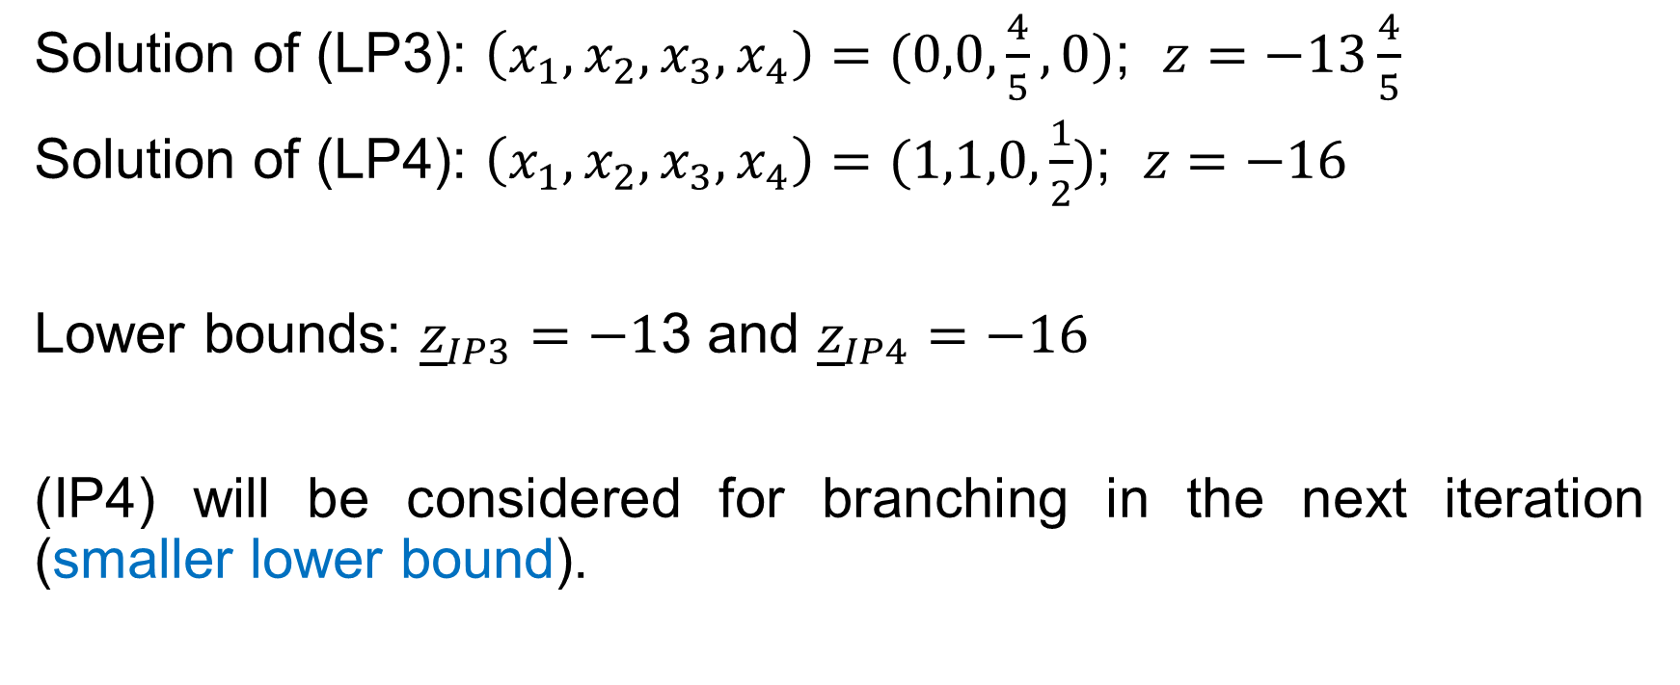
Solution Approach
BRANCH AND BOUND ALGORITHM FOR 0-1 IP
Solution of (LP3): $\left(x_{1},x_{2},x_{3},x_{4}\right)=(0,0,\frac{4}{5},0)$; $z=−13\frac{4}{5}$
Solution of (LP4): $\left(x_{1},x_{2},x_{3},x_{4}\right)=(1,1,0,\frac{1}{2})$; $z=−16$
Lower bounds: ${\underline{z}}_{IP3}=−1$3 and ${\underline{z}}_{IP4}=−16$
(IP4) will be considered for branching in the next iteration (smaller lower bound).

Slide 54

Solution Approach
BRANCH AND BOUND ALGORITHM FOR 0-1 IP
Iteration 3: Branching subproblem (IP4) based on $x_{3}$

Slide 55
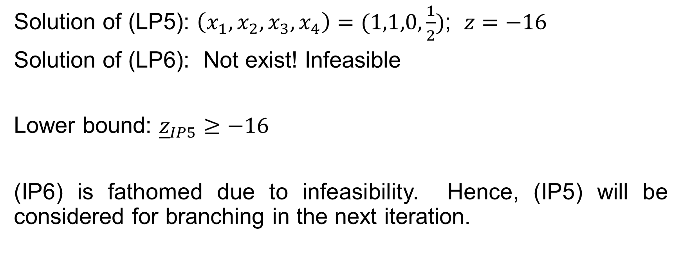
Solution Approach
BRANCH AND BOUND ALGORITHM FOR 0-1 IP
Solution of (LP5): $\left(x_{1},x_{2},x_{3},x_{4}\right)=(1,1,0,\frac{1}{2})$; $z=−16$
Solution of (LP6): Not exist! Infeasible
Lower bound: ${\underline{z}}_{IP5}≥−16$
(IP6) is fathomed due to infeasibility. Hence, (IP5) will be considered for branching in the next iteration.

Slide 56
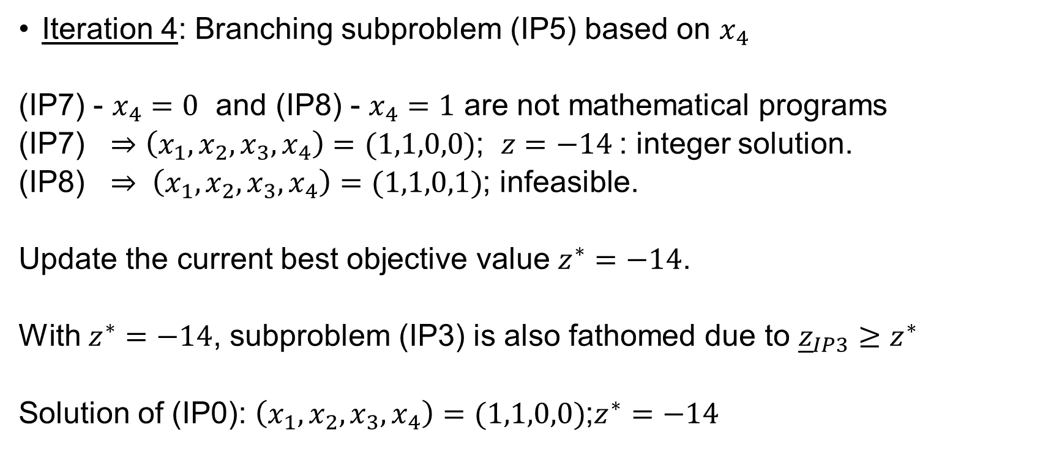
Solution Approach
BRANCH AND BOUND ALGORITHM FOR 0-1 IP
Iteration 4: Branching subproblem (IP5) based on $x_{4}$
(IP7) - $x_{4}=0$ and (IP8) - $x_{4}=1$ are not mathematical programs
(IP7) $⇒$ $\left(x_{1},x_{2},x_{3},x_{4}\right)=(1,1,0,0)$; $z=−14$: integer solution.
(IP8) $⇒ \left(x_{1},x_{2},x_{3},x_{4}\right)=(1,1,0,1)$; infeasible.
Update the current best objective value $z^{∗}=−14$.
With $z^{∗}=−14$, subproblem (IP3) is also fathomed due to ${\underline{z}}_{IP3}≥z^{∗}$
Solution of (IP0): $\left(x_{1},x_{2},x_{3},x_{4}\right)=(1,1,0,0)$;$z^{∗}=−14$

Slide 57
Solution Approach
BRANCH AND BOUND ALGORITHM FOR 0-1 IP
The solution procedure can be summarized in the following graph:

Slide 58
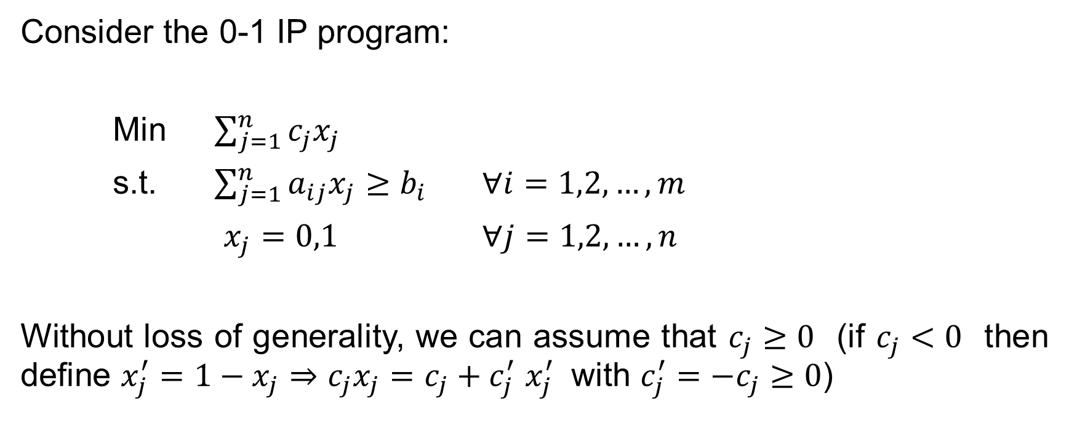
Solution Approach
IMPLICIT ENUMERATION METHOD FOR 0-1 IP
Consider the 0-1 IP program:
Min $\sum_{j=1}^{n}{c_{j}x_{j}}$
s.t. $\sum_{j=1}^{n}{a_{ij}x_{j}≥b_{i}}$ $∀i=1,2,…, m$
$x_{j}=0,1$ $∀j=1,2,…, n$
Without loss of generality, we can assume that $c_{j}≥0$ (if $c_{j}<0$ then define $x_{j}^{′}=1−x_{j}$ $⇒$ $c_{j}x_{j}=c_{j}+c_{j}^{′}$ $x_{j}^{′}$ with $c_{j}^{′}=−c_{j}≥0$)

Slide 59
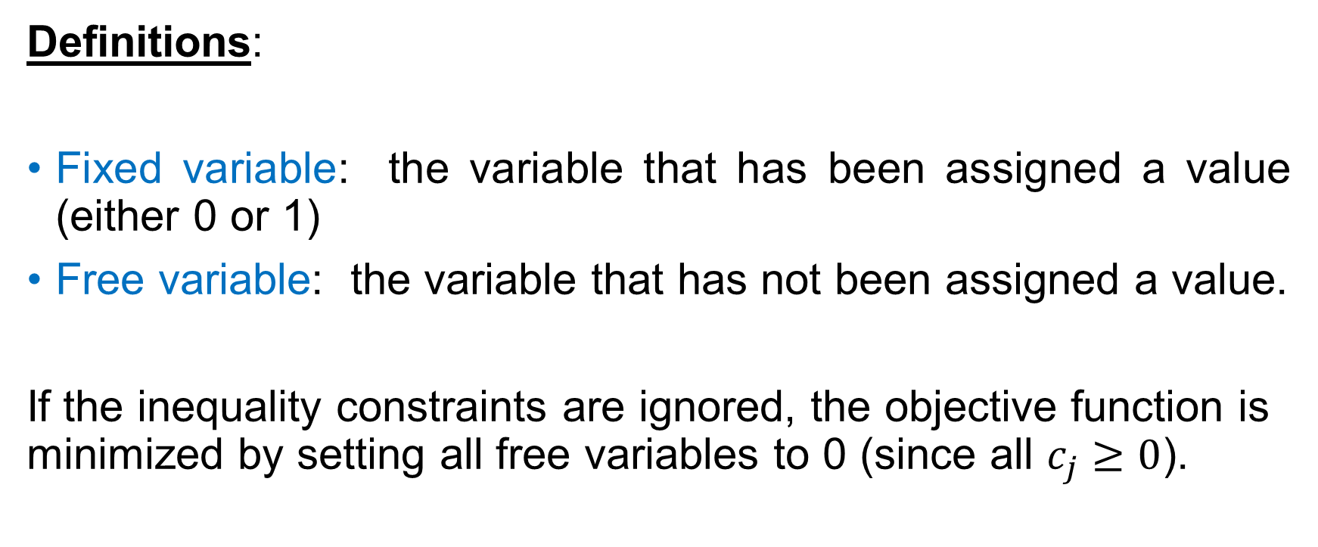
Solution Approach
IMPLICIT ENUMERATION METHOD FOR 0-1 IP
Definitions:
Fixed variable: the variable that has been assigned a value (either 0 or 1)
Free variable: the variable that has not been assigned a value.
If the inequality constraints are ignored, the objective function is minimized by setting all free variables to 0 (since all $c_{j}≥0$).

Slide 60
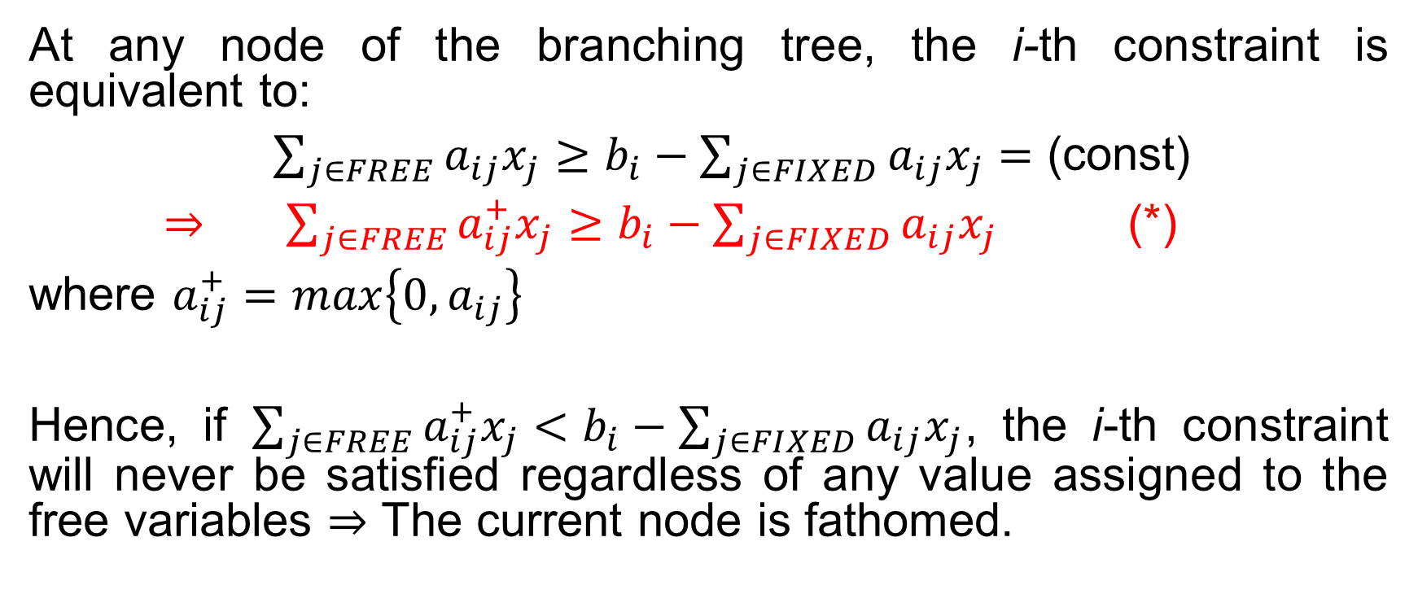
Solution Approach
IMPLICIT ENUMERATION METHOD FOR 0-1 IP
At any node of the branching tree, the i-th constraint is equivalent to:
$\sum_{j∈FREE}{a_{ij}x_{j}}≥b_{i}−\sum_{j∈FIXED}{a_{ij}x_{j}}=$ (const)
$⇒$ $\sum_{j∈FREE}{a_{ij}^{+}x_{j}}≥b_{i}−\sum_{j∈FIXED}{a_{ij}x_{j}}$ (*)
where $a_{ij}^{+}=max\left\{0, a_{ij}\right\}$
Hence, if $\sum_{j∈FREE}{a_{ij}^{+}x_{j}}<b_{i}−\sum_{j∈FIXED}{a_{ij}x_{j}}$, the i-th constraint will never be satisfied regardless of any value assigned to the free variables $⇒$ The current node is fathomed.

Slide 61
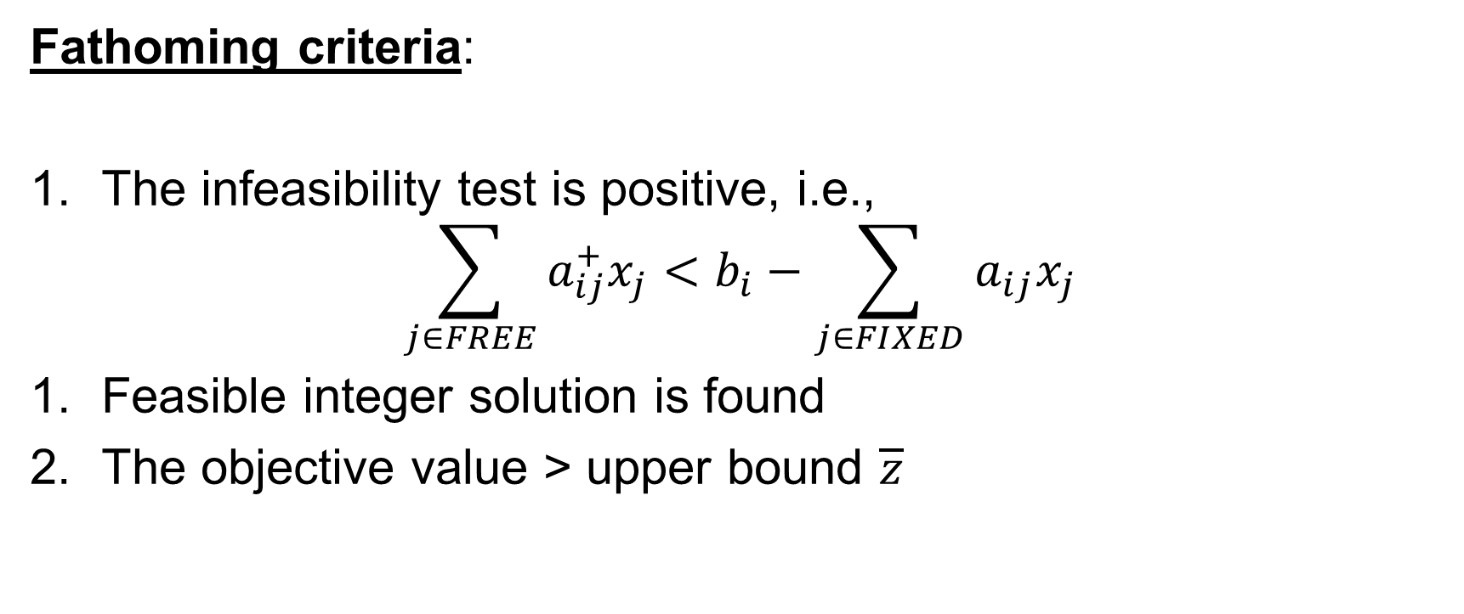
Solution Approach
IMPLICIT ENUMERATION METHOD FOR 0-1 IP
Fathoming criteria:
The infeasibility test is positive, i.e.,
$$\sum_{j∈FREE}{a_{ij}^{+}x_{j}}<b_{i}−\sum_{j∈FIXED}{a_{ij}x_{j}}$$
Feasible integer solution is found
The objective value > upper bound $\overline{z}$

Slide 62
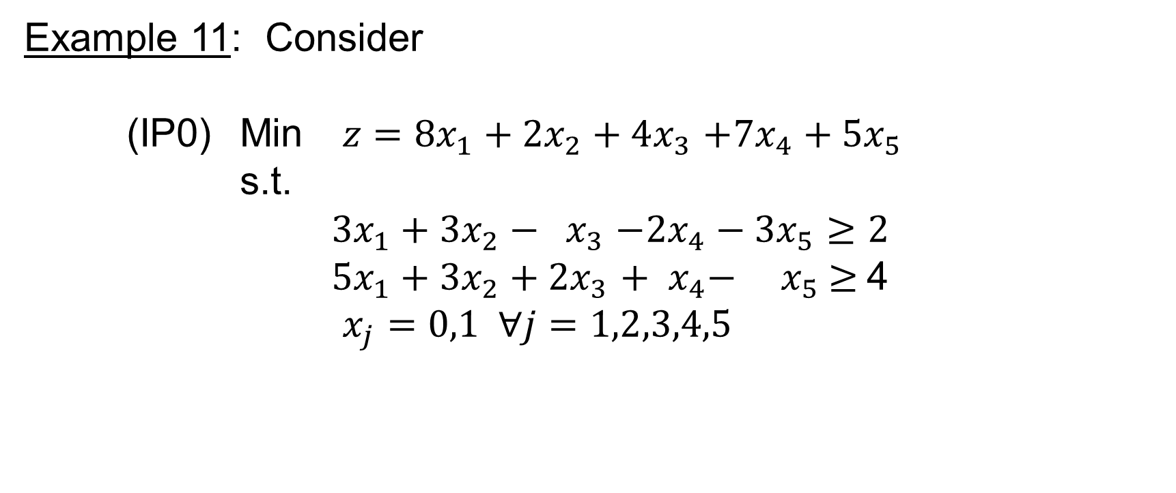
Solution Approach
IMPLICIT ENUMERATION METHOD FOR 0-1 IP
Example 11: Consider
(IP0) Min $z=8x_{1}+2x_{2}+4x_{3}$ $+7x_{4}+5x_{5}$
s.t.
$3x_{1}+3x_{2}−{ x}_{3}$ $−2x_{4}−3x_{5}≥2$
$5x_{1}+3x_{2}+2x_{3}$ $+ x_{4}−{ x}_{5} ≥$4
$x_{j}=0,1 ∀j=1,2,3,4,5$

Slide 63
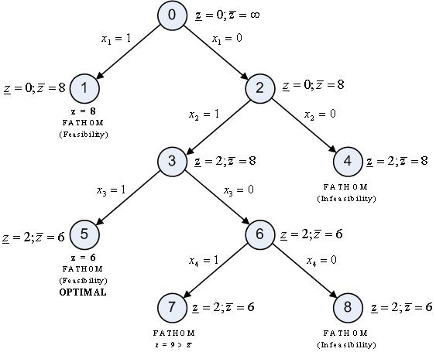
Solution Approach
IMPLICIT ENUMERATION METHOD FOR 0-1 IP
Solution Diagram:

Slide 64

Solution Approach
IMPLICIT ENUMERATION METHOD FOR 0-1 IP
Node 0: No fixed variables
If we set all variables equal zero then $z=0$ but the constraints are not satisfied. Hence, $\underline{z}=0$ and $\overline{z}=∞$
Node 1: $x_{1}=1$
Minimum value = 8 by setting $x_{2}=x_{3}=x_{4}=x_{5}=0$. Both constraints are satisfied $⇒$ Node 1 is fathomed. Update $\overline{z}=8$.
Node 2: $x_{1}=$0
Minimum value = 0 by setting $x_{2}=x_{3}=x_{4}=x_{5}=0$. Both constraints are not satisfied.
Checking (*): $3≥2 \& 6≥4$ - Both constraints satisfy (*) $⇒$ Further branching
Node 3: $x_{1}=$0, $x_{2}=1$
Minimum value = 2 by setting $x_{3}=x_{4}=x_{5}=0$. Constraint 2 is not satisfied. Update $\underline{z}=$2.
Checking (*): $3≥$1 - Constraint 2 satisfies (*) $⇒$ Further branching

Slide 65

Solution Approach
IMPLICIT ENUMERATION METHOD FOR 0-1 IP
Node 4: $x_{1}=$0, $x_{2}=$0
Minimum value = 0 by setting $x_{3}=x_{4}=x_{5}=0$. Both constraints are not satisfied.
Checking (*): $0≥2 \& 3≥4$ - Both constraints do not satisfy (*) $⇒$ Node 4 is fathomed. (In fact, if any constraint does not satisfy (*) then the node is fathomed)
Node 5: $x_{1}=$0, $x_{2}=$1, $x_{3}=1$
Minimum value = 6 by setting $x_{4}=x_{5}=0$. Both constraints are satisfied $⇒$ Node 5 is fathomed. Update $\overline{z}=6$.
Node 6: $x_{1}=$0, $x_{2}=$1, $x_{3}=0$
Minimum value = 2 by setting $x_{4}=x_{5}=0$. Constraint 2 is not satisfied.
Checking (*): $1≥1$ - Constraint 2 satisfies (*) $⇒$ Further branching..

Slide 66

Solution Approach
IMPLICIT ENUMERATION METHOD FOR 0-1 IP
Node 7: $x_{1}=$0, $x_{2}=$1, $x_{3}=0$, $x_{4}=$1
Minimum value = 9 by setting $x_{5}=0$. Node 7 is fathomed because $z=9>\overline{z}=6$ .
Node 8: $x_{1}=$0, $x_{2}=$1, $x_{3}=0$, $x_{4}=$1
Minimum value = 2 by setting $x_{5}=0$. Constraint 2 is not satisfied.
Checking (*): $1≥1$ - Constraint 2 does not satisfy (*) $⇒$ Node 8 is fathomed.
Optimal solution: $x_{1}=$0, $x_{2}=$1, $x_{3}=$1, $x_{4}=$0, $x_{5}=$0 and $z^{∗}=6$

Slide 67
Combinatorial Optimization
Combinatorial analysis is the study of the arrangement, grouping, or selection of discrete objects, usually finite in number.
In Operations Research, combinatorial optimization aims at searching for the best element among a finite set of elements
Integer programming together with combinatorial optimization are considered as “discrete optimization”

Slide 68
Combinatorial Optimization
Common problems involving combinatorial optimization:
  Knapsack Problem
  Travelling Salesman Problem
  Assignment Problem
  Transportation Problem
  Vehicle Routing Problem
  Shortage Path Problem
  Maximum Flow Problem
  Minimum Spanning Tree Problem
  Set Covering Problem
  Cutting Stock Problem
  etc

Slide 69
Combinatorial Optimization
In this section, solution techniques for a few network flow problems will be discussed. It should be noted that these techniques are efficient only for problems with small dimensionality
Most of the combinatorial problems are difficult to solve. In many practical applications, metaheuristic algorithms (e.g., GA, ACO, SA, PSO,…) should be used to help find good solution for combinatorial optimization problems

Slide 70

Transportation Problem
Find the least-cost transportation plan from a set of supply nodes with supply capacities $s_{i}$ ($i=1,2,…,m$) to a set of demand nodes with required demand quantities $d_{j}$ ($j=1,2,…,n$)
Minimize Z = $\sum_{i=1}^{m}{\sum_{j=1}^{n}{c_{ij}x_{ij}}}$
s.t. $\sum_{j=1}^{n}{x_{ij}}≤s_{i}$ ($i=1,2,…,m$)
$\sum_{i=1}^{m}{x_{ij}}≥d_{j}$ ($j=1,2,…,n$)
$x_{ij}≥0$ $∀i,j$
Where: $x_{ij}$ - the amount to be transported from supply node i to demand node j
$c_{ij}$ - unit transportation cost form supply node i to demand node j

Slide 71

Transportation Problem
Feasibility condition:
$\sum_{i=1}^{m}{s_{i}} ≥\sum_{j=1}^{n}{d_{j}}$
The balanced transportation model:
$\sum_{i=1}^{m}{s_{i}}=\sum_{j=1}^{n}{d_{j}}$

Slide 72

Transportation Problem
If the demand exceeds the supply, a dummy supply node with a capacity$\sum_{j=1}^{n}{d_{j}}−\sum_{i=1}^{m}{s_{i}}$ is added to balance the transportation model. The unit transportation cost from the dummy supply node to any demand node is zero
If the supply exceeds the demand, a dummy demand node with a required demand quantity $\sum_{i=1}^{m}{s_{i}} −\sum_{j=1}^{n}{d_{j}}$is added to balance the transportation model. The unit transportation cost from any supply node to the dummy demand node is zero.
The balanced transportation problem always has optimal solution.

Slide 73
Transportation Problem
Example 12:
Note that there exists a redundant constraint!
Supply | Demand
 | 1 | 2 | 3 | 4
1 | 5 | 7 | 9 | 6
2 | 6 | 7 | 10 | 5
3 | 7 | 6 | 8 | 1

Slide 74
Transportation Problem
Transportation tableau:

Slide 75
Transportation Problem
Transportation Algorithm
The transportation algorithm follows the exact steps of the simplex method:
Step 1: Determine a starting basic feasible solution and go to step 2
Step 2: Use the optimality condition to determine the entering variable from among all nonbasic variables. If the optimality condition is satisfied, stop. Otherwise, go to step 3
Step 3: Use the feasibility condition to determine the leaving variable from among all basic variables and find the new basic variable. Return to step 2
However, with the specific structure of the transportation model, the computations will be organized in a more convenient form

Slide 76
Transportation Problem
Determine the Starting Solution
THE NORTHWEST-CORNER METHOD
Start at the northwest-corner cell (route) of the tableau
Allocate as much as possible from a supply node (a row) to the demand nodes with the priority order from left to right until the supply capacity of the current supply node is exhausted. Start with a new supply node (a new row)
Allocate as much as possible to a demand node (a column) from the supply nodes with the priority order from top to bottom until the demand of the current demand node is satisfied. Start with a new demand node (a new column)

Slide 77
Transportation Problem
Determine the Starting Solution
Example 13: Consider the problem in Ex.12

Slide 78
Transportation Problem
Determine the Starting Solution
THE LEAST-COST METHOD
Assigning as much as possible to the cell with the smallest unit transportation cost (break ties arbitrarily).
Discard the satisfied row or column and adjust the amounts of supply and demand. Redetermine the cell with smallest unit transportation cost.
Repeat until all demand nodes are satisfied (all supply nodes are exhausted)

Slide 79
Transportation Problem
Determine the Starting Solution
Example 14: Consider the problem in Ex.12

Slide 80
Transportation Problem
Determine the Starting Solution
Note: We have a better starting solution

Slide 81
Transportation Problem
Determine the Starting Solution
THE VOGEL APPROXIMATION METHOD (VAM)
VAM is an improved version of the least-cost method in order to produce a better starting solution
For each row/column, determine a penalty measure by subtracting the smallest unit cost element in the row/column from the next smallest unit cost element in the same row/column
Identify the row or column with the largest penalty (break ties arbitrarily or select the row/column such that the allocated amount can be maximized). Allocate as much as possible to the cell with the least unit transportation cost in the selected row or column
Discard the satisfied row or column.
Go to step 1

Slide 82
Transportation Problem
Determine the Starting Solution
Example 15: Consider the problem in Ex.12

Slide 83
Transportation Problem
Determine the Starting Solution

Slide 84
Transportation Problem
Determine the Starting Solution

Slide 85
Transportation Problem
Determine the Starting Solution

Slide 86
Transportation Problem
Determine the Starting Solution
Total transportation cost of this starting solution:

Slide 87

Transportation Problem
Finding Optimal Solution
In this section, the methods to find optimal solution for non-degenerate transportation problems will be discussed. It is noted that a transportation problem is non-degenerate if there are exactly $(m+n−1)$ cells assigned positive values in any iteration.

Slide 88

Transportation Problem
Finding Optimal Solution
The Stepping-Stone Method
Find the starting solution. At each iteration, perform the following steps:
1. Compute the improvement indices $I_{ij}$ for all empty cells $\left(i,j\right)$ in the tableau:
For each empty cell $\left(i,j\right)$, draw a closed path which is comprised of horizontal and vertical segments connecting that cell with other non-empty cells.
Alternatively assign the plus/minus signs for the vertices of the path, starting with plus sign at the current cell.
The improvement index $I_{ij}$ of cell $\left(i,j\right)$ is defined as the algebraic sum of unit transportation costs on the path.

Slide 89

Transportation Problem
Finding Optimal Solution
2. If all improvement indices are nonnegative, the current solution is optimal. Otherwise, the empty cell with the most negative value of $I_{ij}$ will be selected for improvement by reallocating the assigned value for all cells on the path as follows:
Determine the minimum assigned value among all cells with minus sign: $x_{ij}^{min}$
The value of the cells with minus sign will be subtracted by an amount $x_{ij}^{min}$.
The value of the cells with plus sign will be added an amount $x_{ij}^{min}$.
3. Construct the new transportation tableau and return to step 1.

Slide 90

Transportation Problem
Finding Optimal Solution
Notes:
There exists a unique path for each empty cell.
Compared to the simplex method, the cells assigned positive values are basic variable while the empty cells are nonbasic variable. The improvement index $I_{ij}$ associated with the empty cell $\left(i,j\right)$ is the reduced cost associated with that cell.
After each iteration, there will be one nonempty cell become empty. There is no need to investigate this new empty cell in the next iteration.

Slide 91
Transportation Problem
Finding Optimal Solution
Example 16:
Empty cells: (1,3), (1,4), (2,1), (3,1), (3,2), (3,3)

Slide 92

Transportation Problem
Finding Optimal Solution
Iteration 1: Consider cell (1,3): (Why?)
$I_{13}=+9−10+7−7=−1:$ Not optimal; $x_{min}=min\left(20,80\right)=20$ (Note that: $I_{14}=1,I_{21}=1,$ $I_{31}=6,$ $I_{32}=3,I_{33}=$2). Hence, $x_{12}=0,x_{13}=20,$ $x_{22}=60,$ $x_{23}=60$

Slide 93

Transportation Problem
Finding Optimal Solution
Iteration 2:
Cell (1,4): $I_{14}=+6−5+10−9=+2$ $⇒$ Cell (1,4) satisfies the optimality condition

Slide 94

Transportation Problem
Finding Optimal Solution
Cell (2,1): $I_{21}=+6−5+9−10=$0 $⇒$ Cell (2,1) satisfies the optimality condition

Slide 95

Transportation Problem
Finding Optimal Solution
Cell (3,1): $I_{31}=+7−5+9−10+5−1=$5 $⇒$ Cell (3,1) satisfies the optimality condition

Slide 96

Transportation Problem
Finding Optimal Solution
Cell (3,2): $I_{32}=+6−7+5−1=$ 3 $⇒$ Cell (3,2) satisfies the optimality condition

Slide 97

Transportation Problem
Finding Optimal Solution
Cell (3,3): $I_{33}=+8−10+5−1=$ 2 $⇒$ Cell (3,3) satisfies the optimality condition
We have optimal solution!

Slide 98

Transportation Problem
Finding Optimal Solution
The Modified Distribution Method (MODI) - The Method of Multipliers
In this method, the improvement indices are computed based on the dual variables of the transportation problem. The principle of this method is as follows:
Denote $u_{i} \left(i=1,2,…,m\right)$, $v_{j} \left(j=1,2,…,n\right)$: dual variables associated with supply node i and demand node j . We have:
1. $I_{ij}=c_{ij}−\left(u_{i}+v_{j}\right)=0$ at nonempty cells.
2. $I_{ij}=c_{ij}−\left(u_{i}+v_{j}\right)≠0$ at empty cells.
From the set of equations developed from the values of nonempty cells, we can determine all values of $u_{i} \left(i=1,2,…,m\right)$ and $v_{j} \left(j=1,2,…,n\right)$

Slide 99
Transportation Problem
Finding Optimal Solution
Example 17:

Slide 100

Transportation Problem
Finding Optimal Solution
$⇒$ $I_{13}=18,I_{14}=−2,$ $I_{21}=−5,$ $I_{31}=−15,I_{32}=9,I_{33}=9$ ($Z=1420$)
$⇒$ The first iteration: Select cell (3,1)

Slide 101
Transportation Problem
Finding Optimal Solution
This tableau is optimal!

Slide 102

Transportation Problem
Finding Optimal Solution
Degeneracy
If degeneracy occurs at starting tableau $⇒$ Assign 0 to an empty cell and deal with this cell as a nonempty one.
If degeneracy occurs at an iteration (when there are two nonempty cells associated with the minimum value on the path) $⇒$ Assign to one of them and deal with this cell as a nonempty one (usually select the cell with smaller unit transportation cost).

Slide 103
Transportation Problem
Finding Optimal Solution
Example 18:

Slide 104
Transportation Problem
Finding Optimal Solution
After iteration 1 (pivot at cell (3,1)):

Slide 105
Transportation Problem
Finding Optimal Solution
After iteration 2 (pivot at cell (2,3)):
Assign 0 to cell (3,3)!

Slide 106
Transportation Problem
Finding Optimal Solution
Multiple Solutions
The transportation problem will has multiple solutions if the improvement index of an empty cell equals to 0 at the optimal tableau
Reason: Pivoting at that empty cell will result in a new solution with the same (optimal) objective function.

Slide 107
Assignment Problem
A specific type of LP that aims at assigning a set of n jobs to a set of n machines/workers/employees.
Objective: minimize the total cost or total time
Assignment problem can be considered as a balanced transportation problem in which all supplies and demands are equal to 1. However, the methods developed for balanced transportations problems are very inefficient in this case because the problem is highly degenerate.

Slide 108

Assignment Problem
Denote $c_{ij}$: cost of assigning job j to machine i
Decision variables
$x_{ij}=\left\{\begin{matrix}1 & if job j is assigned to machine i \\ 0 & otherwise\end{matrix}\right.$
Problem:
Minimize Z = $\sum_{i=1}^{n}{\sum_{j=1}^{n}{c_{ij}x_{ij}}}$
s.t. $\sum_{i=1}^{n}{x_{ij}}=1$ $∀j$
$\sum_{j=1}^{n}{x_{ij}}=1$ $∀i$
$x_{ij}=0 or 1$ $∀i,j$

Slide 109
Assignment Problem
The Hungarian Method
Determine the cost matrix of the assignment problem
Step 1: Determine the reduced cost matrix of the problem
Find the minimum element in each row of the cost matrix; subtract this minimum cost from each cost in the same row of the cost matrix
Find the minimum element in each column of the new matrix; subtract this minimum cost from each cost in the same column of the matrix

Slide 110
Assignment Problem
The Hungarian Method
Step 2:
Draw the minimum number of lines (horizontal or vertical) that are needed to cover all the zeros in the reduced cost matrix. If n lines are drawn, stop: the optimal solution is found and determined from the covered zeros. Otherwise, go to step 3.
Note: The optimal solution is defined from a set of independent zeros in the final matrix, which is the set of zeros such that there is no horizontal or vertical line that covers more than one of them.
Step 3:
Find the smallest uncovered element in the reduced cost matrix. Subtract this value from each uncovered element and add this value to each element that is covered by two lines. Return to step 2

Slide 111
Assignment Problem
The Hungarian Method
Example 19:

Slide 112
Assignment Problem
The Hungarian Method
Reduced cost matrix:

Slide 113
Assignment Problem
The Hungarian Method

Slide 114
Assignment Problem
The Hungarian Method
(Minimum number of lines: 3 < 5)

Slide 115
Assignment Problem
The Hungarian Method
(Minimum number of lines: 4 < 5)

Slide 116
Assignment Problem
The Hungarian Method
Optimal Solution

Slide 117

Assignment Problem
The Hungarian Method
There are multiple solutions:
  $x_{12}=x_{21}=$ $x_{35}= x_{44}= x_{53}=1$
  $x_{14}=x_{22}=$ $x_{35}= x_{41}= x_{53}=1$
  $x_{14}=x_{21}=$ $x_{35}= x_{42}= x_{53}=1$
  $x_{14}=x_{21}=$ $x_{35}= x_{43}= x_{52}=1$
Optimal objective value = 5

Slide 118
Maximum Flow Problem
Consider the following network’s problem: Transport the maximum amount of flow from a starting point (the source node) to a terminal point (the sink node)
The network with directed arcs will be considered first and expansion to networks with undirected arcs will then be investigated.

Slide 119

Maximum Flow Problem
Network with Directed Arcs
Consider the network with $m$ nodes and $n$ arcs. The capacity of arc $\left(i,j\right)$ is $c_{ij}$ ($i,j=1,2,..,m$)
Decision variables: $x_{ij}$ - flow through arc $\left(i,j\right)$
Denote $f$ : total flow from source node 1 to sink node $m$
The problem can be formulated as an LP:
Max $f$
s.t. $\sum_{j=1}^{m}{x_{ij}}−\sum_{k=1}^{m}{x_{ki}}=\left\{\begin{matrix}f & if & i=1 \\ 0 & if & i=2,3,…,m−1 \\ −f & if & i=m\end{matrix}\right.$
$x_{ij}≤c_{ij}$ $∀(i,j)$
$x_{ij}≥0$ $∀(i,j)$

Slide 120
Maximum Flow Problem
Network with Directed Arcs
Example 20:

Slide 121

Maximum Flow Problem
Network with Directed Arcs
Ford-Fulkerson’s Labeling Algorithm
Can be applied when $c_{ij}$’s are integers or rational numbers
General Principle: An unlabeled node j will be labeled based on a labeled node i which is connected to j by arc $\left(i,j\right)$. The label of node j will have the form $\left[i±,v_{j}\right]$, in which:
$v_{j}$ : the amount of flow changed between i and j.
$i+$ : if the flow from i to j increases by an amount $v_{j}$.
$i−$ : if the flow from i to j decreases by an amount $v_{j}$.

Slide 122

Maximum Flow Problem
Network with Directed Arcs
Step 1:
Find a starting feasible solution for the problem (for instance, $x_{ij}=0$ $∀(i,j)$).
Assign label $\left[−,∞\right]$ to node 1 (the source node): this means that the source node has unlimited supply capacity.

Slide 123

Maximum Flow Problem
Network with Directed Arcs
Step 2: Successively assign label for unlabeled nodes as follows
Select a labeled node – At the beginning, only node 1 is labeled node.
Consider an unlabeled node j that is directly connected to i:
If $x_{ij}≤c_{ij}$: assign the label $\left[i+,v_{j}\right]$ to node j, in which $v_{j}=Min\left\{v_{i},c_{ij}−x_{ij}\right\}$. Meaning: the maximum increase of amount of flow from i to j is the smaller value between the amount of flow that can be transported from i and the remaining capacity of arc $\left(i,j\right)$.
If $x_{ji}>0$: assign the label $\left[i−,v_{j}\right]$ to node j, in which $v_{j}=Min\left\{v_{i},x_{ji}\right\}$. Meaning: take back to node j a portion of the amount of flow that has been transported to i.
This step is repeated until:
Node m has been labeled $⇒$ A breakthrough path exists between the source node and the sink node. Then, go to step 3. Or,
Cannot find a breakthrough path. Then, go to step 4.

Slide 124

Maximum Flow Problem
Network with Directed Arcs
Step 3:
The breakthrough path defined in step 3 is a flow augmenting path. The labeling procedure has assigned a label $\left[i+,v_{m}\right]$ to node $m$. Revise the starting feasible solution to get a better feasible solution as follows:
  $x_{ij}^{′}=x_{ij}+v_{m}$ if $\left(i,j\right)$ is on the flow augmenting path and node j has the label $\left[i+,v_{j}\right]$
  $x_{ji}^{′}=x_{ji}−v_{m}$ if $\left(i,j\right)$ is on the flow augmenting path and node j has the label $\left[i−,v_{j}\right]$
Remove all labels and return to step 2.

Slide 125

Maximum Flow Problem
Network with Directed Arcs
Step 4:
Optimal solution is achieved. The maximum flow can be determined from the sum of all labels $v_{m}$’s received in step 3 (only if the starting solution is $x_{ij}=0$ $∀(i,j)$).
Notes:
The purpose of step 2 is to find a breakthrough path that connects the source node and the sink node. Therefore, it is not necessary to determine the labels of all nodes. The target should be finding a path such that the augmented flow is as large as possible
$⇒$ Rule of thumb: starting from a labeled node, select an unlabeled node j such that the assigned label $v_{j}$ to that node is largest.

Slide 126

Maximum Flow Problem
Network with Directed Arcs
In each iteration (step 2), each node has a unique label.
Other ways to determine maximum flow
  Total algebraic flows at the source node.
  Total algebraic flows at the sink node.
  When the breakthrough path does not exist (the last iteration), the network’s nodes can be divided into two sets: Set $X$ includes the source node and set $\overline{X}$ includes the sink node. The arcs that connect $X$ and $\overline{X}$ is called a cut set. Total transport capacity of the cut set $c\left(X,\overline{X}\right)$is the maximum amount of flow that can be transported from the source node to the sink node.

Slide 127
Maximum Flow Problem
Network with Directed Arcs
Example 21:

Slide 128

Maximum Flow Problem
Network with Directed Arcs
Iteration 1: starting feasible solution: zeros for all arcs
Node 1: $\left[−,∞\right]$ Node 2: $\left[1+,9\right]$ Node 4: $\left[2+,4\right]$ Node 6: $\left[4+,4\right]$
Breakthrough path: 1-2-4-6.
New feasible solution: $x_{12}=x_{24}=x_{46}=4$, other variables = 0
Iteration 2:
Node 1: $\left[−,∞\right]$ Node 3: $\left[1+,8\right]$ Node 5: $\left[3+,5\right]$ Node 6: $\left[5+,5\right]$
Breakthrough path: 1-3-5-6.
New feasible solution: $x_{12}=x_{24}=x_{46}=4$, $x_{13}=x_{35}=x_{56}=$5, other variables = 0

Slide 129

Maximum Flow Problem
Network with Directed Arcs
Iteration 3:
Node 1: $\left[−,∞\right]$ Node 2: $\left[1+,5\right]$ Node 5: $\left[2+,4\right]$ Node 6: $\left[5+,1\right]$
Breakthrough path: 1-2-5-6.
New feasible solution: $x_{12}=$5, $x_{24}=x_{46}=4$, $x_{13}=x_{35}=$5, $x_{56}=6$, $x_{25}=1$, other variables = 0
Iteration 4:
Node 1: $\left[−,∞\right]$ Node 3: $\left[1+,3\right]$ Node 6: $\left[3+,2\right]$
Breakthrough path: 1-3-6.
New feasible solution: $x_{12}=$5, $x_{24}=x_{46}=4$, $x_{13}=$7, $x_{35}=$5, $x_{56}=6$, $x_{36}=$2, $x_{25}=1$, $x_{32}=$0

Slide 130

Maximum Flow Problem
Network with Directed Arcs
Iteration 5:
Node 1: $\left[−,∞\right]$ Node 2: $\left[1+,4\right]$ Node 5: $\left[2+,3\right]$ Node 3: $\left[1+,1\right]$
The breakthrough path does not exist: $X=\left\{1,2,3,5\right\}$ $\overline{X}=\left\{4,6\right\}$
The current solution is optimal. The maximum flow from node 1 to node 6 can be determined as follows:
$\sum{v_{m}}=4+5+1+2=12$ or $x_{46}+x_{36}+x_{56}=4+2+6=12$
or $x_{12}+x_{13}=5+7=12$ or $c\left(X,\overline{X}\right)=c_{24}+c_{36}+c_{56}=4+2+6=12$

Slide 131
Maximum Flow Problem
Network with Directed Arcs
Example 22:

Slide 132

Maximum Flow Problem
Network with Directed Arcs
Iteration 1: starting feasible solution: zeros for all arcs
Node 1: $\left[−,∞\right]$ Node 3: $\left[1+,10\right]$ Node 2: $\left[3+,9\right]$ Node 4: $\left[2+,5\right]$ Node 6: $\left[4+,5\right]$
Breakthrough path: 1-3-2-4-6.
New feasible solution: $x_{13}=x_{32}=x_{24}=x_{46}=5$, other variables = 0
Iteration 2:
Node 1: $\left[−,∞\right]$ Node 2: $\left[1+,7\right]$ Node 5: $\left[2+,1\right]$ Node 6: $\left[5+,1\right]$
Breakthrough path: 1-2-5-6.
New feasible solution: $x_{13}=x_{32}=x_{24}=x_{46}=5$, $x_{12}=x_{25}=x_{56}=1$, other variables = 0

Slide 133

Maximum Flow Problem
Network with Directed Arcs
Iteration 3:
Node 1: $\left[−,∞\right]$ Node 3: $\left[1+,5\right]$ Node 6: $\left[3+,5\right]$
Breakthrough path: 1-3-6.
New feasible solution: $x_{13}=10$, $x_{32}=x_{24}=x_{46}=5$, $x_{12}=x_{25}=x_{56}=1$, $x_{36}=5$ , other variables = 0.
Iteration 4:
Node 1: $\left[−,∞\right]$ Node 2: $\left[1+,6\right]$ Node 3*: $\left[2−,5\right]$ Node 5: $\left[3+,3\right]$ Node 6: $\left[5+,3\right]$
Breakthrough path: 1-2-3-5-6.
New feasible solution: $x_{13}=10$, $x_{32}=2$, $x_{24}=x_{46}=5$, $x_{12}=4$, $x_{25}=1$, $x_{56}=4$ $x_{36}=5$, $x_{35}=3$

Slide 134

Maximum Flow Problem
Network with Directed Arcs
Iteration 5:
Node 1: $\left[−,∞\right]$ Node 2: $\left[1+,3\right]$ Node 3*: $\left[2−,2\right]$ Node 6: $\left[3+,1\right]$
Breakthrough path: 1-2-3-6.
New feasible solution: $x_{13}=10$, $x_{32}=1$, $x_{24}=x_{46}=5$, $x_{12}=5$, $x_{25}=1$, $x_{56}=4$ $x_{36}=6$, $x_{35}=3$
Iteration 6:
Node 1: $\left[−,∞\right]$ Node 2: $\left[1+,2\right]$ Node 3*: $\left[2−,1\right]$
The breakthrough path does not exist: $X=\left\{1,2,3\right\}$ $\overline{X}=\left\{4,5,6\right\}$
The current solution is optimal.
The maximum flow: $c\left(X,\overline{X}\right)=c_{24}+c_{25}+c_{35}+c_{36}=5+1+3+6=15$

Slide 135
Maximum Flow Problem
Network with Directed Arcs
Note:
For problem with multiple source nodes with limited supply capacity and multiple sink nodes with limited demand, an artificial source node and an artificial sink node will be introduced and the Ford-Fulkerson’s algorithm can be applied to find optimal solution. It is also noted the maximum flow problem is a transportation problem in which the objective is to maximize the amount of goods transported from supply nodes to demand nodes.

Slide 136
Maximum Flow Problem
Network with Undirected Arcs
Ford-Fulkerson’s algorithm can be applied. However, it is noted that there exist 2 variables for an undirected arc
Example 23:

Slide 137

Maximum Flow Problem
Network with Undirected Arcs
Iteration 1: starting feasible solution: zeros for all arcs
Node 1: $\left[−,∞\right]$ Node 3: $\left[1+,30\right]$ Node 5: $\left[3+,20\right]$
Breakthrough path: 1-3-5.
New feasible solution: $x_{13}=x_{35}=20$, other variables = 0.
Iteration 2:
Node 1: $\left[−,∞\right]$ Node 2: $\left[1+,20\right]$ Node 3: $\left[2+,20\right]$ Node 4: $\left[3+,10\right]$
Node 5: $\left[4+,10\right]$
Breakthrough path: 1-2-3-4-5.
New feasible solution: $x_{12}=x_{23}=x_{34}=x_{45}=10$, $x_{13}=x_{35}=20$, other variables = 0.

Slide 138

Maximum Flow Problem
Network with Undirected Arcs
Iteration 3:
Node 1: $\left[−,∞\right]$ Node 4: $\left[1+,10\right]$ Node 5: $\left[4+,10\right]$
Breakthrough path: 1-4-5.
New feasible solution: $x_{14}=10, x_{12}=x_{23}=x_{34}=10$, $x_{45}=20$, $x_{13}=x_{35}=20$, other variables = 0.
Iteration 4:
Node 1: $\left[−,∞\right]$ Node 2: $\left[1+,10\right]$ Node 5: $\left[2+,10\right]$
Breakthrough path: 1-4-5.
New feasible solution: $x_{14}=10,x_{12}=20, x_{23}= x_{34}=10$, $x_{45}=20$, $x_{13}=x_{35}=20$, $x_{25}=10$, $x_{43}=0$.

Slide 139

Maximum Flow Problem
Network with Undirected Arcs
Iteration 5:
Node 1: $\left[−,∞\right]$ Node 3: $\left[1+,10\right]$ Node 2*: $\left[3−,10\right]$ Node 5: $\left[2+,10\right]$
Breakthrough path: 1-3-2-5.
New feasible solution: $x_{14}=10,x_{12}=20, x_{23}=0, x_{34}=10$, $x_{45}=20$, $x_{13}=30, x_{35}=20$, $x_{25}=20$, $x_{43}=0$.
Iteration 6:
Node 1: $\left[−,∞\right]$
The breakthrough path does not exist: $X=\left\{1\right\}$ $\overline{X}=\left\{2,3,4,5\right\}$
The current solution is optimal.
Maximum flow: $c\left(X,\overline{X}\right)=c_{12}+c_{13}+c_{14}=20+30+10=60$

Slide 140

Shortage Path Problem
Consider a network with m nodes and n directed arcs and a cost $c_{ij}$ is associated with each arc $\left(i,j\right)$. The shortage path problem is to find the shortage (least costly) path from node 1 to node m.
The problem can be formulated as an LP as follows:
Min $\sum_{i=1}^{m}{\sum_{j=1}^{m}{{c_{ij}x}_{ij}}}$
s.t. $\sum_{j}{x_{ij}}−\sum_{k}{x_{ki}}=\left\{\begin{matrix}1 & if & i=1 \\ 0 & if & i=2,3,…,m−1 \\ −1 & if & i=m\end{matrix}\right.$
$x_{ij}=0 or 1$ $∀(i,j)$
In which: $x_{ij}=0$: $\left(i,j\right)$ is not included in the path,
$x_{ij}=1$: $\left(i,j\right)$ is included in the path.

Slide 141

Shortage Path Problem
Dijkstra’s Labeling Algorithm
Step 1:
Assign label $L_{i}=\left[−,v_{i}\right]$ for network’s nodes, starting with $v_{1}=0$, $v_{2}=v_{3}=…=v_{m}=∞$.
Step 2:
If $v_{j}≤v_{i}+c_{ij}$ $∀(i,j)$ $⇒$ The current solution is optimal.
If there exist an arc $(p,q)$ such that $v_{q}≤v_{p}+c_{pq}$ $⇒$ reassign the label of node $q$: $L_{q}=\left[p,v_{q}=v_{p}+c_{pq}\right]$. Return to check 2.1

Slide 142
Shortage Path Problem
Dijkstra’s Labeling Algorithm
Example 24:
Find the shortage path from 1 to 4 for the following network

Slide 143

Shortage Path Problem
Dijkstra’s Labeling Algorithm
Iteration 1: $v_{1}=0$, $v_{2}=v_{3}=v_{4}=∞$
Iteration 2: ${∞=v}_{3}>v_{1}+c_{13}=−1$ $⇒$ $v_{3}=−1$, $L_{3}=\left[1,−1\right]$
Iteration 3: ${∞=v}_{2}>v_{1}+c_{12}=2$ $⇒$ $v_{2}=2$, $L_{2}=\left[1,2\right]$
Iteration 4: ${−1=v}_{3}>v_{2}+c_{23}=−2$ $⇒$ $v_{3}=−$2, $L_{3}=\left[2,−2\right]$
Iteration 5: ${∞=v}_{4}>v_{2}+c_{24}=6$ $⇒$ $v_{4}=6$, $L_{4}=\left[2,6\right]$: (redundant step!)
Iteration 6: ${6=v}_{4}>v_{3}+c_{34}=−$8 $⇒$ $v_{4}=−8$, $L_{4}=\left[3,−8\right]$
The current solution is optimal: $v_{j}≤v_{i}+c_{ij}$ $∀(i,j)$.
The shortest path: 1-2-3-4. Minimum “cost” $v_{4}=−8$.

Slide 144

Shortage Path Problem
Labeling Algorithm with Nonnegative Costs
Let $N=\left\{1,2,3,…,m\right\}$ be the set of network’s nodes.
Step 1: Set $v_{1}=0$ and $X=\left\{1\right\}$.
Step 2: Set $\overline{X}=N−X$, $\left(X, \overline{X}\right)=\left\{\left(i,j\right) | i∈X, j∈\overline{X}\right\}$.
Select $\left(i,j\right)∈\left(X, \overline{X}\right)$ such that:
$$v_{p}+c_{pq}=\min_{\left(i,j\right)∈\left(X, \overline{X}\right)}\left\{v_{i}+c_{ij}\right\}$$
Assign ${v_{q}=v}_{p}+c_{pq}$ and adjust $X=X∪\left\{1\right\}$.
Repeat step 2 exactly $\left(m−1\right)$ times to get the optimal solution.

Slide 145
Shortage Path Problem
Labeling Algorithm with Nonnegative Costs
Example 24:
Consider the shortage path problem from node 1 to node 5 for the following network

Slide 146

Shortage Path Problem
Labeling Algorithm with Nonnegative Costs
Iteration 1: $v_{1}=0$, $X=\left\{1\right\}$, $\overline{X}=\left\{2,3,4,5\right\}$
$⇒$ $\left(X, \overline{X}\right)=\left\{\left(1,2\right),\left(1,3\right),\left(1,4\right)\right\}$: $v_{1}+c_{12}=2$; $v_{1}+c_{13}=2$; $v_{1}+c_{14}=3$
Select $\left(p,q\right)=\left(1,2\right)$.
Iteration 2: $v_{2}=2$, $X=\left\{1,2\right\}$, $\overline{X}=\left\{3,4,5\right\}$
$⇒$ $\left(X, \overline{X}\right)=\left\{\left(1,3\right),\left(1,4\right),\left(2,5\right)\right\}$: $v_{1}+c_{13}=2$; $v_{1}+c_{14}=3$; $v_{2}+c_{25}=7$
Select $\left(p,q\right)=\left(1,3\right)$.
Iteration 3: $v_{3}=$2, $X=\left\{1,2,3\right\}$, $\overline{X}=\left\{4,5\right\}$
$⇒$ $\left(X, \overline{X}\right)=\left\{\left(1,4\right),\left(2,5\right),\left(3,5\right)\right\}$: $v_{1}+c_{14}=3$; $v_{2}+c_{25}=7$; $v_{3}+c_{35}=7$
Select $\left(p,q\right)=\left(1,4\right)$.

Slide 147

Shortage Path Problem
Labeling Algorithm with Nonnegative Costs
Iteration 4: $v_{4}=3$, $X=\left\{1,2,3,4\right\}$, $\overline{X}=\left\{5\right\}$
$⇒$ $\left(X, \overline{X}\right)=\left\{\left(2,5\right),\left(3,5\right),\left(4,5\right)\right\}$: $v_{2}+c_{25}=7$; $v_{3}+c_{35}=7$; $v_{4}+c_{45}=3$
Select $\left(p,q\right)=\left(4,5\right)$.
Iteration 5: $v_{5}=3$, $X=\left\{1,2,3,4,5\right\}$, $\overline{X}=\left\{∅\right\}$
The shortage path: 1-4-5. Minimum “cost”: $v_{5}=3$

Slide 148
Shortage Path Problem
Labeling Algorithm with Nonnegative Costs
Note:
In some cases, we have to deal with the longest path problem (the case of profit instead of cost)
To find the solution for the longest path problem, change the sign of all “profits” on arcs and apply the labeling algorithms for the shortage path problem.

