Slide 1
Advanced Optimization:
Techniques and Industrial Applications

Slide 2
Session 1.2:
Linear Programming

Slide 3
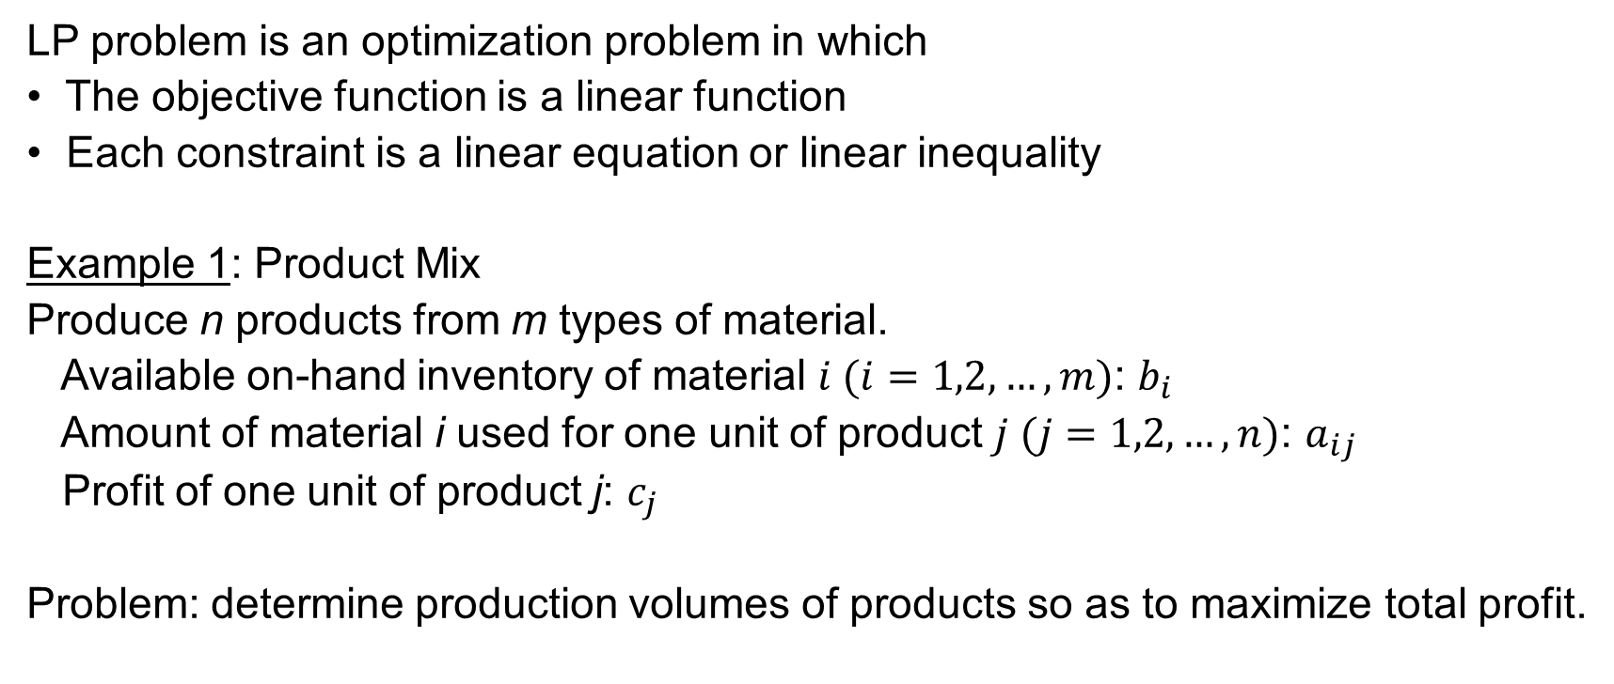
Introduction
LP problem is an optimization problem in which
• The objective function is a linear function
• Each constraint is a linear equation or linear inequality
Example 1: Product Mix
Produce n products from m types of material.
Available on-hand inventory of material $i (i=1,2,…,m)$: $b_{i}$
Amount of material i used for one unit of product $j (j=1,2,…,n)$: $a_{ij}$
Profit of one unit of product j: $c_{j}$
Problem: determine production volumes of products so as to maximize total profit.

Slide 4
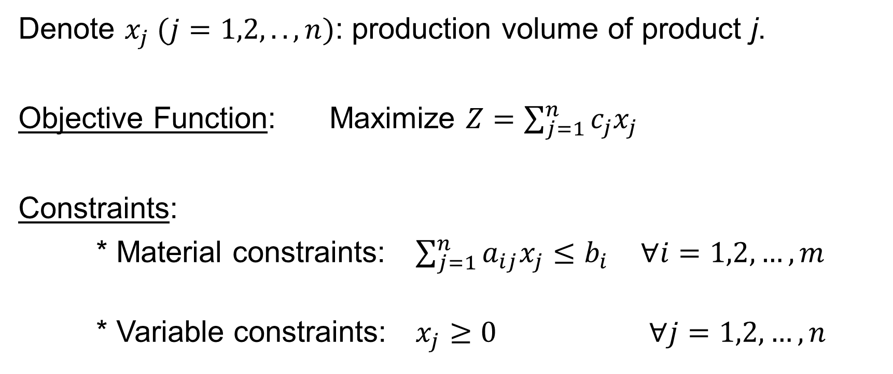
Introduction
Denote $x_{j} (j=1,2,..,n)$: production volume of product j.
Objective Function: Maximize $Z=\sum_{j=1}^{n}{c_{j}x_{j}}$
Constraints:
* Material constraints: $\sum_{j=1}^{n}{a_{ij}x_{j}≤b_{i}}$ $∀i=1,2,…, m$
* Variable constraints: $x_{j}≥0$ $∀j=1,2,…, n$

Slide 5
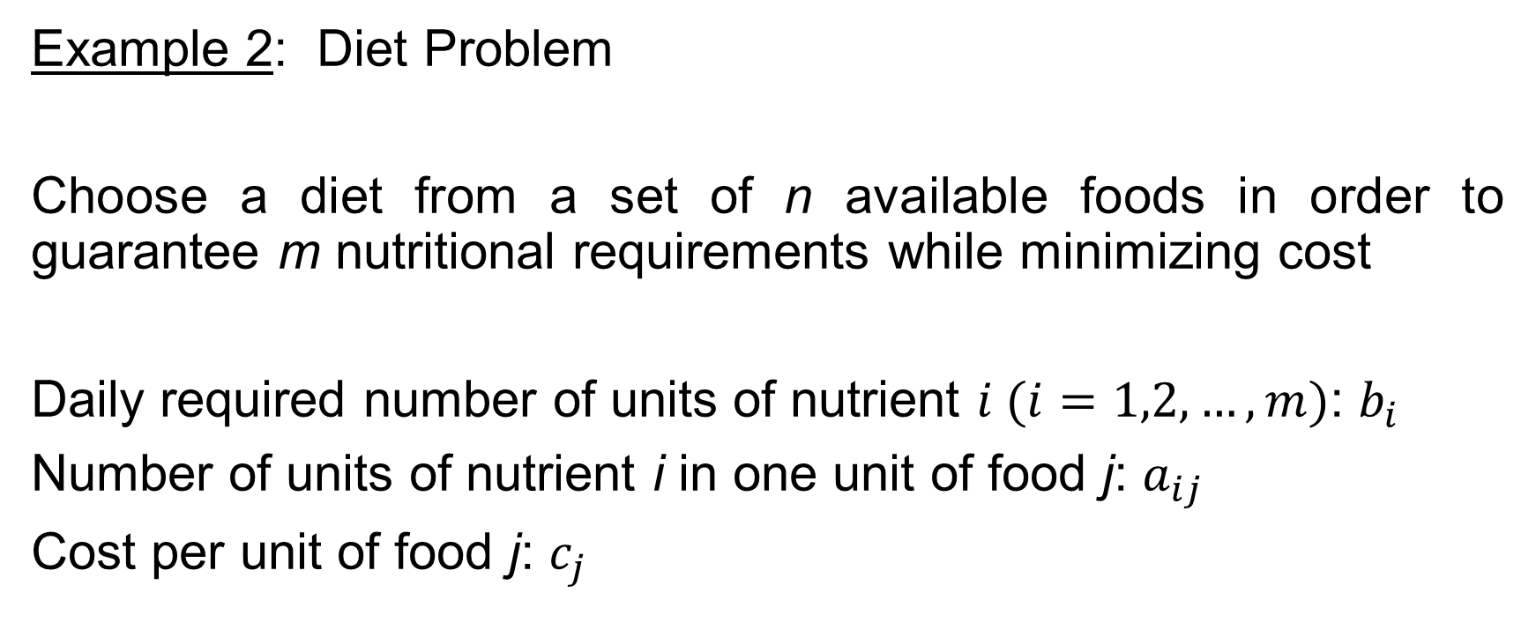
Introduction
Example 2: Diet Problem
Choose a diet from a set of n available foods in order to guarantee m nutritional requirements while minimizing cost
Daily required number of units of nutrient $i (i=1,2,…,m)$: $b_{i}$
Number of units of nutrient i in one unit of food j: $a_{ij}$
Cost per unit of food j: $c_{j}$

Slide 6
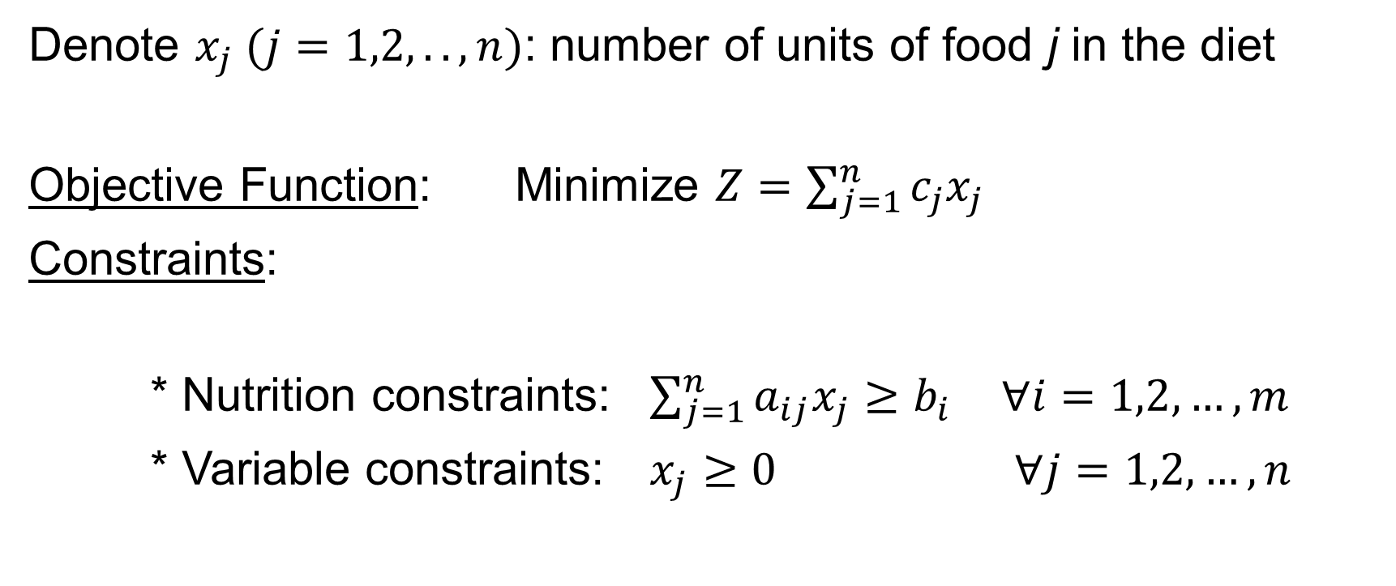
Introduction
Denote $x_{j} (j=1,2,..,n)$: number of units of food j in the diet
Objective Function: Minimize $Z=\sum_{j=1}^{n}{c_{j}x_{j}}$
Constraints:
* Nutrition constraints: $\sum_{j=1}^{n}{a_{ij}x_{j}≥b_{i}}$ $∀i=1,2,…, m$
* Variable constraints: $x_{j}≥0$ $∀j=1,2,…, n$

Slide 7
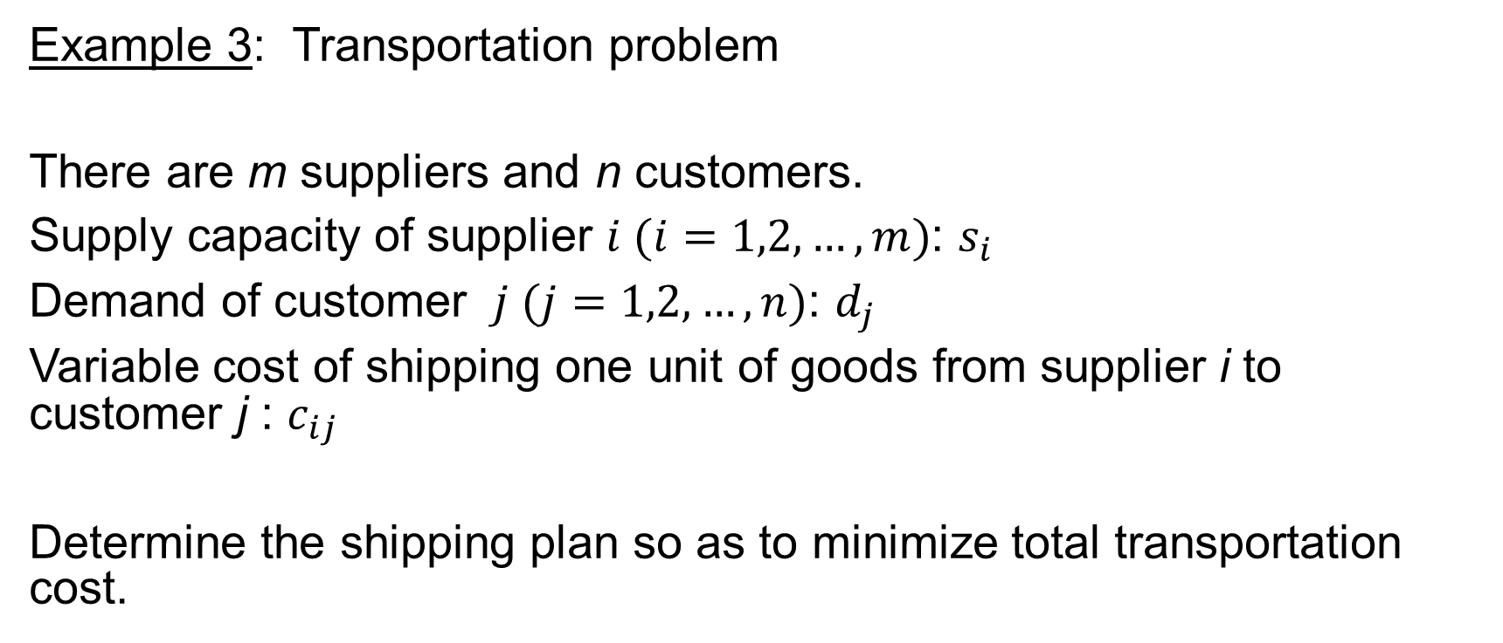
Introduction
Example 3: Transportation problem
There are m suppliers and n customers.
Supply capacity of supplier $i (i=1,2,…,m)$: $s_{i}$
Demand of customer $j (j=1,2,…,n)$: $d_{j}$
Variable cost of shipping one unit of goods from supplier i to customer j : $c_{ij}$
Determine the shipping plan so as to minimize total transportation cost.

Slide 8
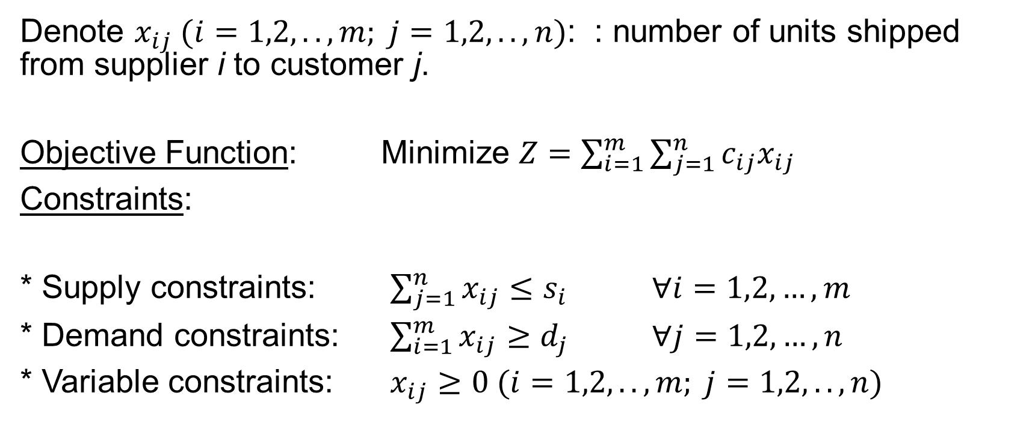
Introduction
Denote $x_{ij} (i=1,2,..,m; j=1,2,..,n)$: : number of units shipped from supplier i to customer j.
Objective Function: Minimize $Z=\sum_{i=1}^{m}{\sum_{j=1}^{n}{c_{ij}x_{ij}}}$
Constraints:
* Supply constraints: $\sum_{j=1}^{n}{x_{ij}≤s_{i}}$ $∀i=1,2,…, m$
* Demand constraints: $\sum_{i=1}^{m}{x_{ij}≥d_{j}}$ $∀j=1,2,…, n$
* Variable constraints: $x_{ij}≥0 (i=1,2,..,m; j=1,2,..,n)$

Slide 9
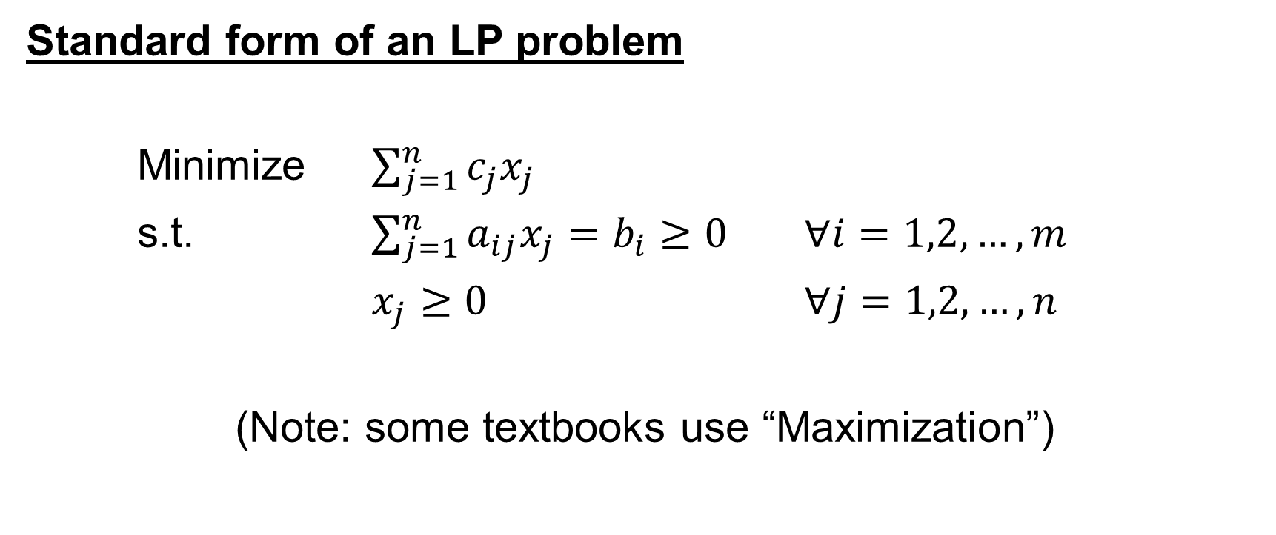
Background Concepts
Standard form of an LP problem
Minimize $\sum_{j=1}^{n}{c_{j}x_{j}}$
s.t. $\sum_{j=1}^{n}{a_{ij}x_{j}=b_{i}≥0}$ $∀i=1,2,…, m$
$x_{j}≥0$ $∀j=1,2,…, n$
(Note: some textbooks use “Maximization”)

Slide 10
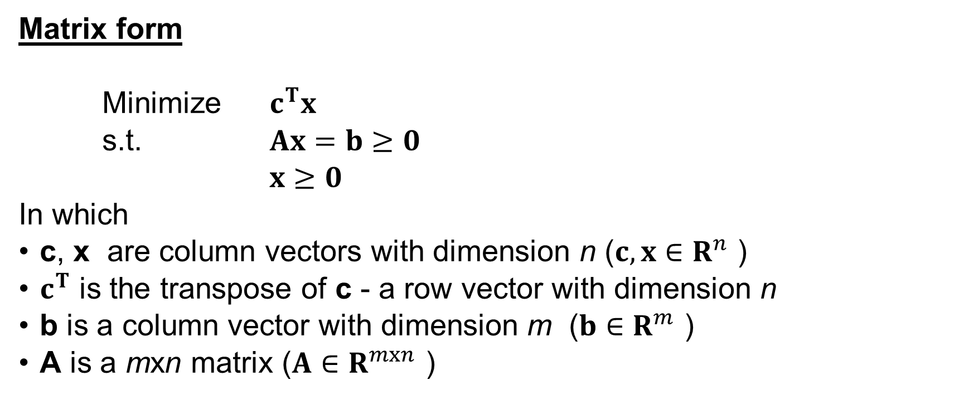
Background Concepts
Matrix form
Minimize $c^{T}x$
s.t. $Ax=b≥0$
$x≥0$
In which
c, x are column vectors with dimension n ($c,x∈R^{n}$ )
$c^{T}$ is the transpose of c - a row vector with dimension n
b is a column vector with dimension m ($b∈R^{m}$ )
A is a mxn matrix ($A∈R^{mxn}$ )

Slide 11
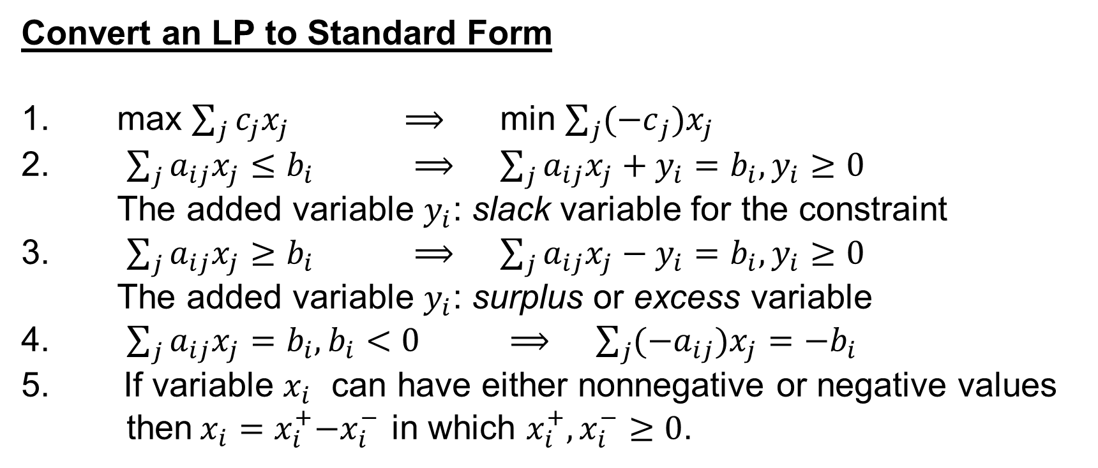
Background Concepts
Convert an LP to Standard Form
1. max $\sum_{j}{c_{j}x_{j}}$ $⟹$ min $\sum_{j}{{(−c}_{j})x_{j}}$
2. $\sum_{j}{a_{ij}x_{j}≤b_{i}}$ $⟹$ $\sum_{j}{a_{ij}x_{j}+y_{i}=b_{i},y_{i}≥0}$
The added variable $y_{i}$: slack variable for the constraint
3. $\sum_{j}{a_{ij}x_{j}≥b_{i}}$ $⟹$ $\sum_{j}{a_{ij}x_{j}−y_{i}=b_{i},y_{i}≥0}$
The added variable $y_{i}$: surplus or excess variable
4. $\sum_{j}{a_{ij}x_{j}=b_{i},b_{i}<0}$ $⟹$ $\sum_{j}{{(−a}_{ij})x_{j}={−b}_{i}}$
If variable $x_{i}$ can have either nonnegative or negative values
then${ x_{i}=x}_{i}^{+}−x_{i}^{−}$ in which $x_{i}^{+},x_{i}^{−}≥0$.

Slide 12
Background Concepts
Example 4:
Consider the following LP:

Slide 13
Background Concepts
The standard form:

Slide 14
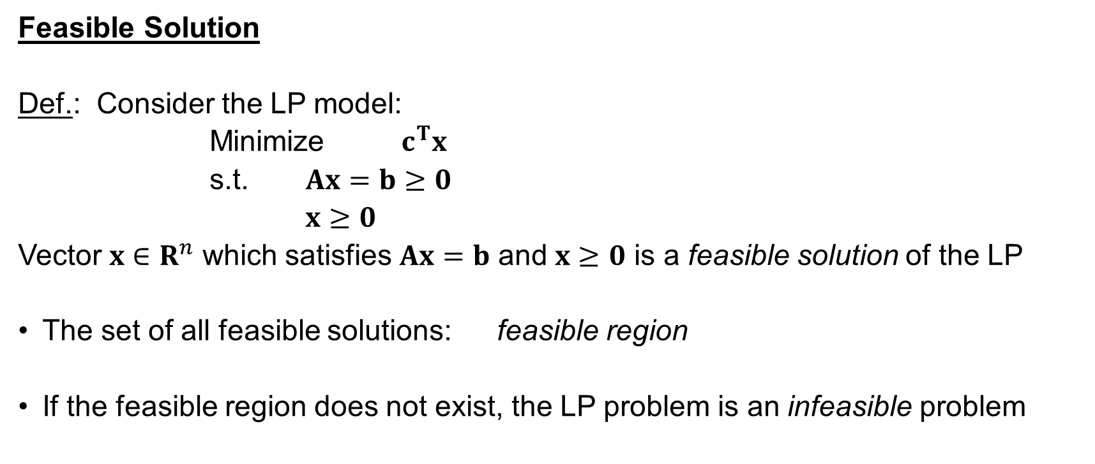
Background Concepts
Feasible Solution
Def.: Consider the LP model:
Minimize $c^{T}x$
s.t. $Ax=b≥0$
$x≥0$
Vector $x∈R^{n}$ which satisfies $Ax=b$ and $x≥0$ is a feasible solution of the LP
The set of all feasible solutions: feasible region
If the feasible region does not exist, the LP problem is an infeasible problem

Slide 15
Background Concepts
Example 5:
Feasible region of the model: crossed area in the figure

Slide 16
Background Concepts
Convex Set
Def. A set of points S is a convex set if the line segment connecting any pair of point in S is wholly contained in S
Convex Convex Nonconvex

Slide 17
Background Concepts
Extreme Point
Def. For any convex set, a point P in S is an extreme point if it does not lie on any line segment connecting two distinct points in the set
In the above figures, the extreme points are any point in the circumference of the circle (first figure) and A, B, C, D (second figure)
Note that
• The feasible region of an LP problem is a convex set
• The optimal solution of an LP problem is one of the extreme points of the feasible region

Slide 18
Background Concepts
Basic and Nonbasic Variables
Consider an LP in standard form

Slide 19
Background Concepts
Define:

Slide 20
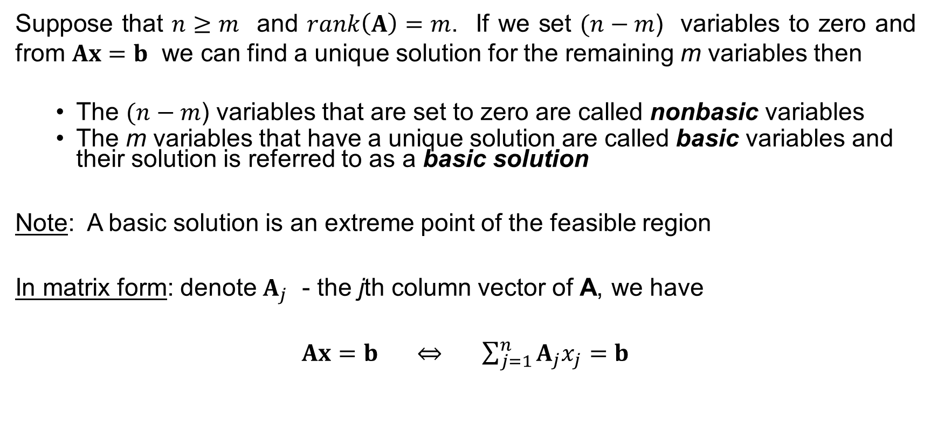
Background Concepts
Suppose that $n≥m$ and $rank\left(A\right)=m$. If we set $(n−m$) variables to zero and from $Ax=b$ we can find a unique solution for the remaining m variables then
  The $(n−m$) variables that are set to zero are called nonbasic variables
  The m variables that have a unique solution are called basic variables and their solution is referred to as a basic solution
Note: A basic solution is an extreme point of the feasible region
In matrix form: denote $A_{j}$ - the jth column vector of A, we have
$Ax=b$ $⇔ \sum_{j=1}^{n}{A_{j}x_{j}}=b$

Slide 21
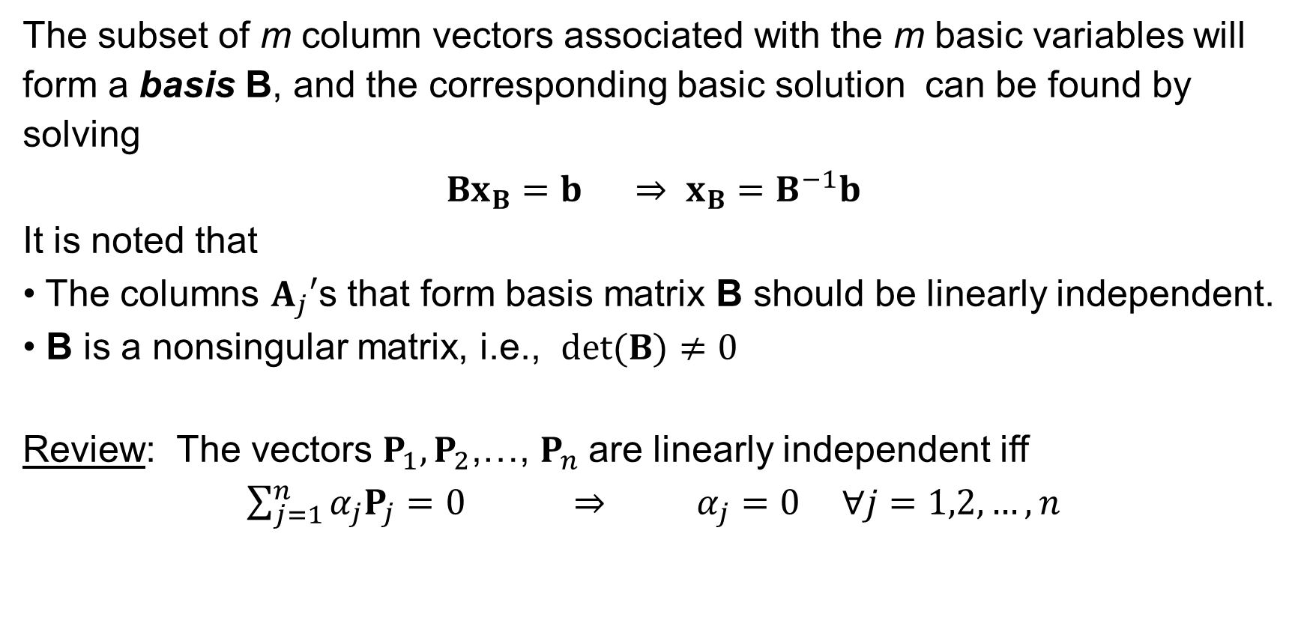
Background Concepts
The subset of m column vectors associated with the m basic variables will form a basis B, and the corresponding basic solution can be found by solving
$Bx_{B}=b$ $⇒ x_{B}=B^{−1}b$
It is noted that
• The columns $A_{j}′$s that form basis matrix B should be linearly independent.
• B is a nonsingular matrix, i.e., $det⁡(B)≠0$
Review: The vectors $P_{1},P_{2}$,…, $P_{n}$are linearly independent iff
$\sum_{j=1}^{n}{α_{j}P_{j}}=0$ $⇒$ $α_{j}=0 ∀j=1,2,…,n$

Slide 22
Simplex Method
Simplex tableau
Consider the following LP and its equivalent standard form

Slide 23
Simplex Method
The initial simplex tableau:

Slide 24
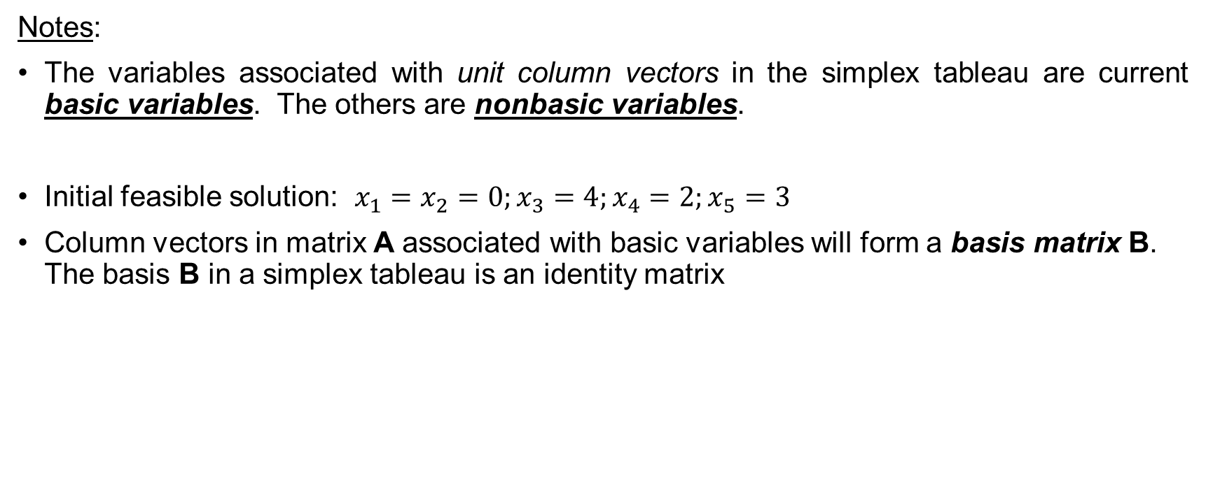
Simplex Method
Notes:
The variables associated with unit column vectors in the simplex tableau are current basic variables. The others are nonbasic variables.
Initial feasible solution: $x_{1}=x_{2}=0;x_{3}=4;x_{4}=2;x_{5}=3$
Column vectors in matrix A associated with basic variables will form a basis matrix B. The basis B in a simplex tableau is an identity matrix

Slide 25
Simplex Method
In general, a simplex tableau has the following form:

Slide 26
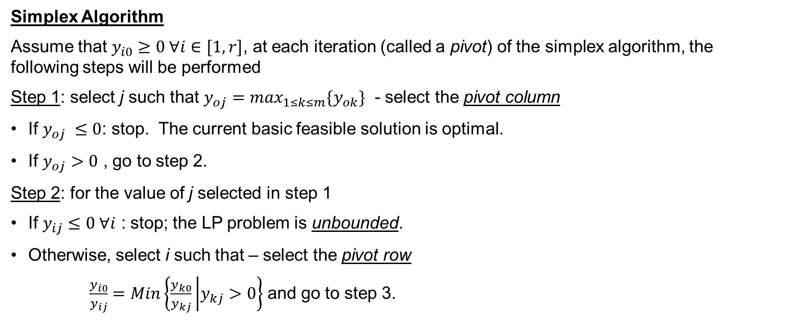
Simplex Method
Simplex Algorithm
Assume that $y_{i0}≥0 ∀i∈[1,r]$, at each iteration (called a pivot) of the simplex algorithm, the following steps will be performed
Step 1: select j such that $y_{oj}=\max_{1≤k≤m}\{y_{ok}\}$ - select the pivot column
If $y_{oj} ≤0$: stop. The current basic feasible solution is optimal.
If $y_{oj}>0$ , go to step 2.
Step 2: for the value of j selected in step 1
If $y_{ij}≤0 ∀i$ : stop; the LP problem is unbounded.
Otherwise, select i such that – select the pivot row
$\frac{y_{i0}}{y_{ij}}=Min\left\{\frac{y_{k0}}{y_{kj}} | y_{kj}>0\right\}$ and go to step 3.

Slide 27
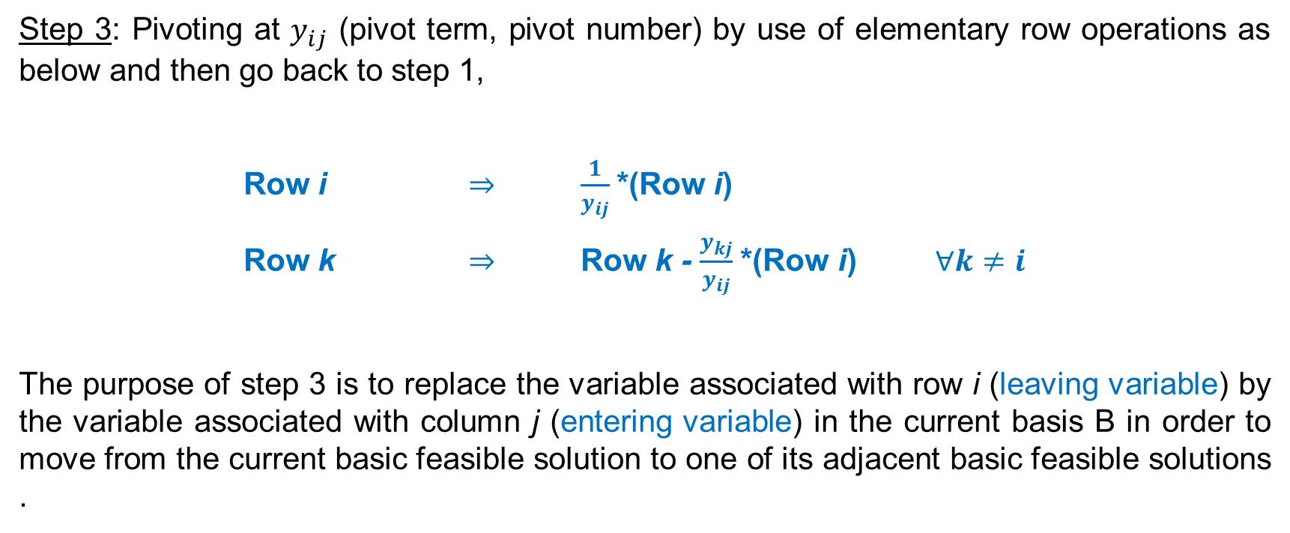
Simplex Method
Step 3: Pivoting at $y_{ij}$ (pivot term, pivot number) by use of elementary row operations as below and then go back to step 1,
Row i $⇒$ $\frac{1}{y_{ij}}$*(Row i)
Row k $⇒$ Row k - $\frac{y_{kj}}{y_{ij}}$*(Row i) $∀k≠i$
The purpose of step 3 is to replace the variable associated with row i (leaving variable) by the variable associated with column j (entering variable) in the current basis B in order to move from the current basic feasible solution to one of its adjacent basic feasible solutions .

Slide 28
Simplex Method
Example 7:

Slide 29
Simplex Method
The initial simplex tableau:

Slide 30
Simplex Method
Step 1:

Slide 31

Simplex Method
Step 2:
Optimal solution: $x_{1}^{∗}=3/2$, $x_{2}^{∗}=1/2$, $Z^{∗}=−7/2$

Slide 32
Simplex Method
Notes:
A constraint is binding if its LHS and RHS are equal at the optimal solution. Otherwise, the constraint is nonbinding.
In the above example, constraint 1 is nonbinding while constraints 2&3 are binding

Slide 33
Simplex Method

Slide 34
Simplex Method

Slide 35

Simplex Method
Step 1:
The problem is unbounded! Reason:
$Z=−6−5x_{2}+2x_{4}$
$x_{3}=5+2x_{2}−x_{4}$ $⇒$ Z can approach $−∞$
$x_{1}=3+3x_{2}−x_{4}$

Slide 36
Determine Initial Basic Solution
In some LP problems, after adding slack variables we still do not have an identity matrix to serve as an initial basis matrix (ill-behaved LPs). In these cases, an artificial starting solution should be determined so that the simplex algorithm can be applied.
There are two methods: The two-phase method
The BigM method

Slide 37
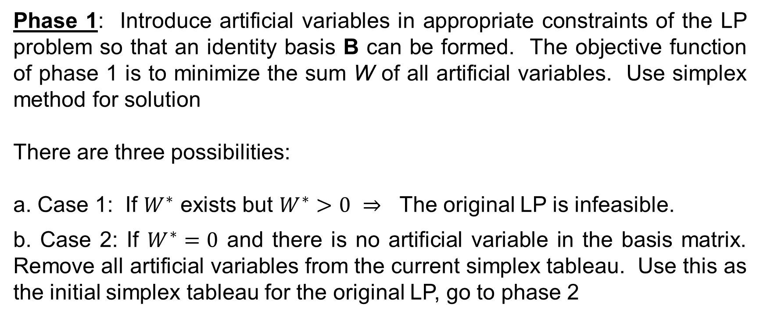
The Two-Phase Method
Phase 1: Introduce artificial variables in appropriate constraints of the LP problem so that an identity basis B can be formed. The objective function of phase 1 is to minimize the sum W of all artificial variables. Use simplex method for solution
There are three possibilities:
a. Case 1: If $W^{∗}$ exists but $W^{∗}>0$ $⇒$ The original LP is infeasible.
b. Case 2: If $W^{∗}=0$ and there is no artificial variable in the basis matrix. Remove all artificial variables from the current simplex tableau. Use this as the initial simplex tableau for the original LP, go to phase 2

Slide 38
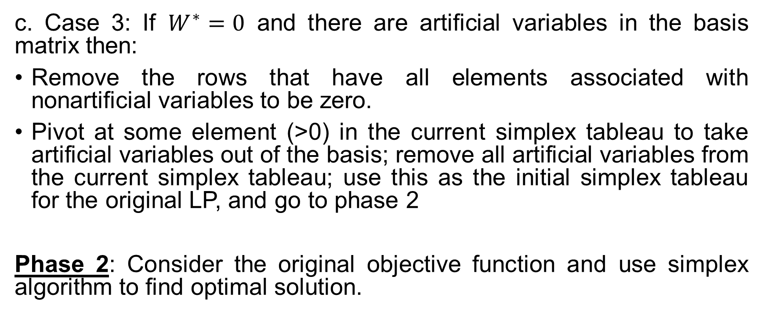
The Two-Phase Method
c. Case 3: If $W^{∗}=0$ and there are artificial variables in the basis matrix then:
Remove the rows that have all elements associated with nonartificial variables to be zero.
Pivot at some element (>0) in the current simplex tableau to take artificial variables out of the basis; remove all artificial variables from the current simplex tableau; use this as the initial simplex tableau for the original LP, and go to phase 2
Phase 2: Consider the original objective function and use simplex algorithm to find optimal solution.

Slide 39
The Two-Phase Method
Example 8:

Slide 40

The Two-Phase Method
Phase 1: Min $W=x_{5}$
s.t.
This table is not a simplex tableau because the coefficients associated with the basic variables in row 0 are not zeros! So, Row operation should be conducted on row 0 to form the starting simplex tableau as follows

Slide 41
The Two-Phase Method
Starting Simplex Tableau:

Slide 42

The Two-Phase Method
Iteration 1: Pivot term: 1*; $x_{2}$ -entering variable; $x_{3}$ -leaving variable.
Optimal solution has been found. However, $W^{∗}=6≠0$. The original LP is infeasible.

Slide 43
The Two-Phase Method

Slide 44

The Two-Phase Method
Phase 1: Min $W=x_{4}+x_{5}$
s.t.

Slide 45
The Two-Phase Method
Starting Simplex Tableau:

Slide 46

The Two-Phase Method
Iteration 1: Pivot term: 3*; $x_{1}$ -entering variable; $x_{5}$ -leaving variable.

Slide 47

The Two-Phase Method
Iteration 2: Pivot term: 4/3*; $x_{3}$ -entering variable; $x_{4}$ -leaving variable.

Slide 48

The Two-Phase Method
Phase 2:
$⇒$ Starting simplex tableau of phase 2:

Slide 49

The Two-Phase Method
Iteration 1: Pivot term: 5/4*; $x_{2}$ -entering variable; $x_{1}$ -leaving variable.
Optimal solution has been founded!

Slide 50
The Two-Phase Method

Slide 51

The Two-Phase Method
Phase 1: Min $W=x_{5}+x_{6}+x_{7}$
s.t.

Slide 52
The Two-Phase Method
Starting simplex tableau:

Slide 53
The Two-Phase Method
Iteration 1: Pivot term: 1* (or 2*)

Slide 54
The Two-Phase Method
Iteration 2: Pivot term: 1*

Slide 55
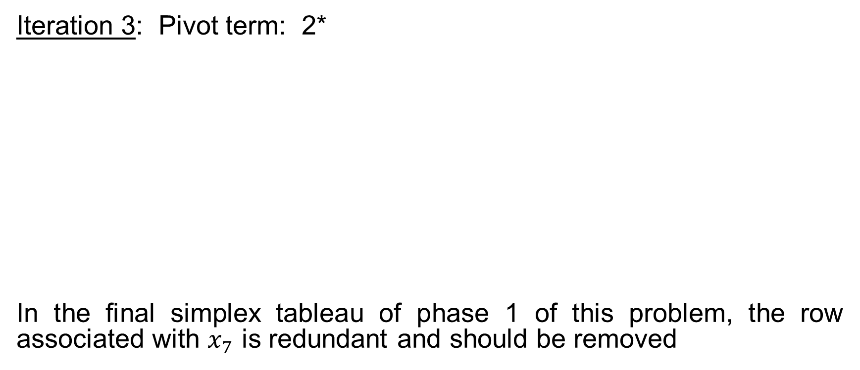
The Two-Phase Method
Iteration 3: Pivot term: 2*
In the final simplex tableau of phase 1 of this problem, the row associated with $x_{7}$ is redundant and should be removed

Slide 56
The Two-Phase Method
Phase 2: The starting simplex tableau is developed as follows:
Optimal solution found!

Slide 57
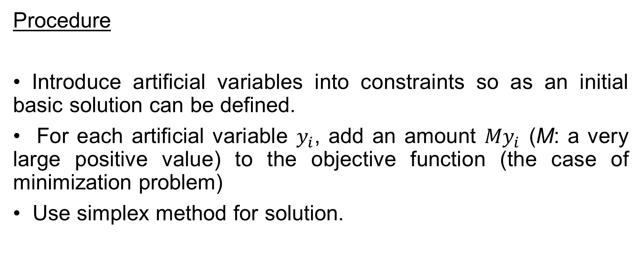
The BigM Method
Procedure
• Introduce artificial variables into constraints so as an initial basic solution can be defined.
• For each artificial variable $y_{i}$, add an amount ${My}_{i}$ (M: a very large positive value) to the objective function (the case of minimization problem)
• Use simplex method for solution.

Slide 58
The BigM Method
Example 9:

Slide 59
The BigM Method

Slide 60
The BigM Method
Starting simplex tableau:

Slide 61
The BigM Method
Note: Another type of simplex tableau for BigM method:

Slide 62

The BigM Method
Iteration 1: Pivot term: 1*; $x_{2}$ -entering variable; $x_{3}$ -leaving variable.

Slide 63

The BigM Method
Or
The simplex tableau is optimal. But the artificial variable $x_{5}>0$ $⇒$ The original LP is infeasible.

Slide 64
The BigM Method

Slide 65
The BigM Method
Starting simplex tableau:

Slide 66
The BigM Method
Iteration 1: Pivot term: 3*; $x_{1}$ -entering variable; $x_{5}$ -leaving variable.

Slide 67
The BigM Method
Iteration 2: Pivot term: 4/3*; $x_{3}$ -entering variable; $x_{4}$ -leaving variable.

Slide 68

The BigM Method
Iteration 3: Pivot term: 5/4*; $x_{2}$ -entering variable; $x_{1}$ -leaving variable.
Optimal Solution: $x_{1}^{∗}=0,x_{2}^{∗}=2/5,$ $x_{3}^{∗}=9/5,$with Z* = 11/5.

Slide 69
The BigM Method

Slide 70
The BigM Method

Slide 71
The BigM Method
Starting simplex tableau:

Slide 72
The BigM Method
Iteration 1: Pivot term: 1* (or 2*)

Slide 73
The BigM Method
Iteration 2: Pivot term: 1*

Slide 74
The BigM Method
Iteration 3: Pivot term: 2*

Slide 75

The BigM Method
Optimal Solution: $x_{1}^{∗}=2,x_{2}^{∗}=2,$ $x_{3}^{∗}=2,$with Z* = -4.
Note that the information $x_{7}=$0 in the final simplex tableau is redundant (This must be satisfied!)

Slide 76
Special Case in Simplex Method Application
There are four special cases:
  Degeneracy
  Alternative optima
  Unbounded solutions
  Infeasible solutions

Slide 77
Special Case in Simplex Method Application
Degeneracy
When the model has at least one redundant constraint, a tie may occur when checking feasibility condition (Step 2) in the application of simplex method.
The tie can be broken arbitrarily and this will lead to the fact that at least one basic variable will be zero in the next iteration. This new solution is said to be degenerate

Slide 78
Special Case in Simplex Method Application
Degeneracy
Example 10:

Slide 79
Special Case in Simplex Method Application
Degeneracy
Starting simplex tableau:

Slide 80

Special Case in Simplex Method Application
Degeneracy
If $x_{2}$ enters and $x_{3}$ leaves the basic solution, then

Slide 81

Special Case in Simplex Method Application
Degeneracy
Next $x_{1}$ enters and $x_{4}$ leaves the basic solution, then
Optimal solution! (but the value of objective function does not change)

Slide 82
Special Case in Simplex Method Application
Alternative Optima
When the objective function is parallel to a binding constraint, the objective function will assume the same optimal value, called alternative optima, at more than one solution point. In this situation, there is an infinity of such solutions

Slide 83
Special Case in Simplex Method Application
Alternative Optima
Example 11:

Slide 84
Special Case in Simplex Method Application
Alternative Optima

Slide 85

Special Case in Simplex Method Application
Alternative Optima
The optimal solution is reached. However, it is noted that the coefficient associated with nonbasic variable $x_{1}$ on row 0 is zero. Hence, $x_{1}$ can enter the basic solution without changing the optimal value of z.

Slide 86
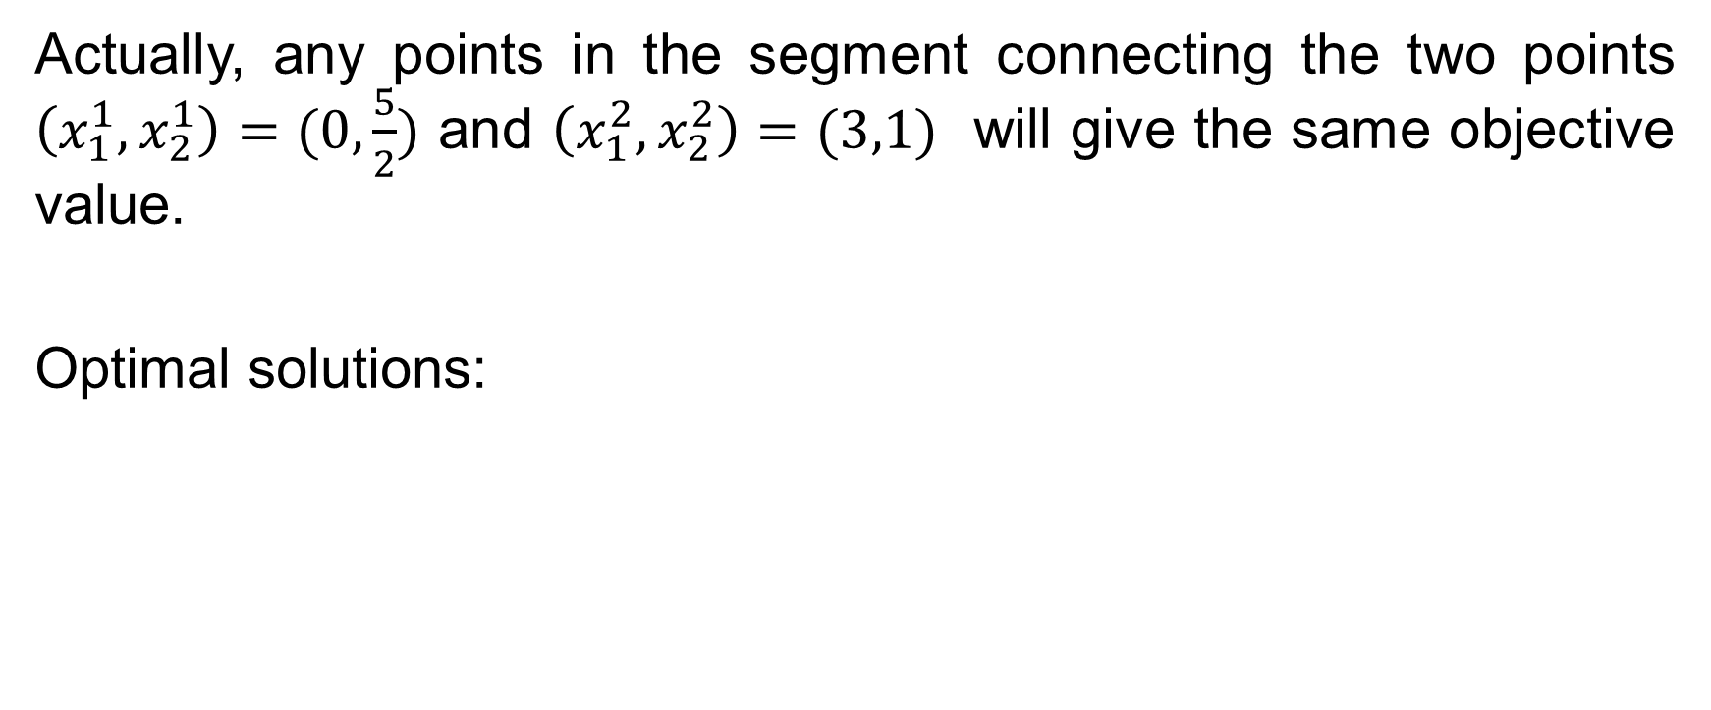
Special Case in Simplex Method Application
Alternative Optima
Actually, any points in the segment connecting the two points $\left(x_{1}^{1},x_{2}^{1}\right)=(0,\frac{5}{2})$ and $\left(x_{1}^{2},x_{2}^{2}\right)=(3,1)$ will give the same objective value.
Optimal solutions:

Slide 87
Special Case in Simplex Method Application
Unbounded Solution
When an LP model is poorly constructed (lack of some necessary constraints), the objective value may increase (in case of maximization) or decrease (in case of minimization) indefinitely

Slide 88
Special Case in Simplex Method Application
Unbounded Solution
Example 12:

Slide 89
Special Case in Simplex Method Application
Unbounded Solution

Slide 90

Special Case in Simplex Method Application
Unbounded Solution
In the last simplex tableau: $Z=−50−x_{3}+3/2x_{4}$

Slide 91
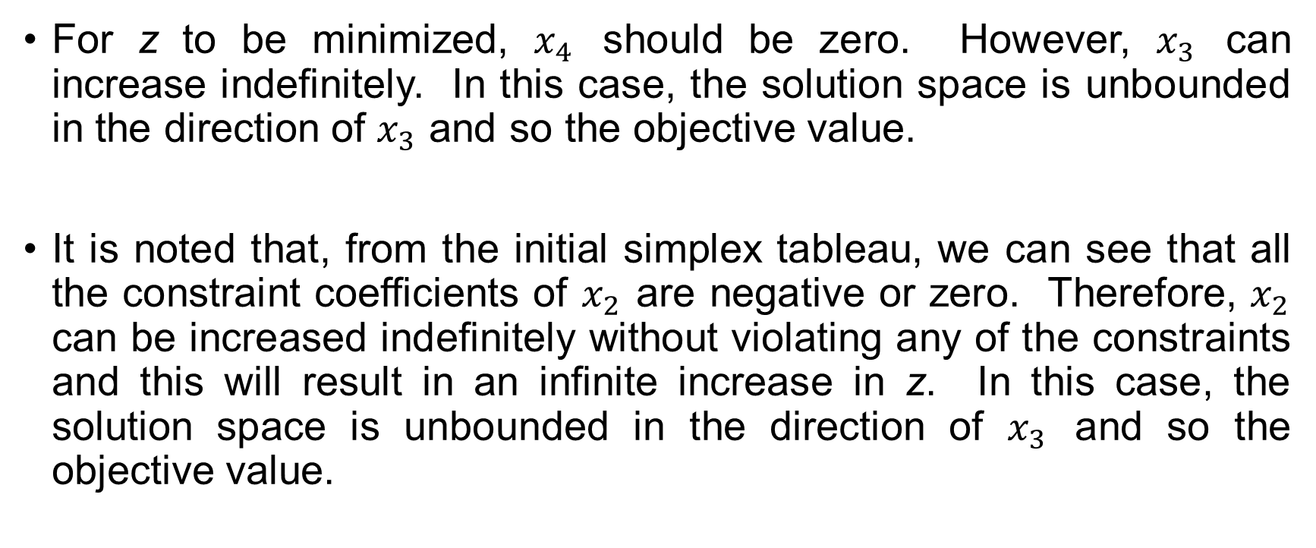
Special Case in Simplex Method Application
Unbounded Solution
For z to be minimized, $x_{4}$ should be zero. However, $x_{3}$ can increase indefinitely. In this case, the solution space is unbounded in the direction of $x_{3}$ and so the objective value.
It is noted that, from the initial simplex tableau, we can see that all the constraint coefficients of $x_{2}$ are negative or zero. Therefore, $x_{2}$ can be increased indefinitely without violating any of the constraints and this will result in an infinite increase in z. In this case, the solution space is unbounded in the direction of $x_{3}$ and so the objective value.

Slide 92
Special Case in Simplex Method Application
Unbounded Solution
How to recognize unboundedness? If at any iteration:
All constraint coefficients of any nonbasic variable are zero or negative (unbounded solution space)
The corresponding objective coefficient of that variable is also positive (unbounded objective value)

Slide 93
Special Case in Simplex Method Application
Infeasible Solution
This is the case of LP models with inconsistent constraints (incorrectly formulated LPs)
See Example 8.1 or 9.1 discussed before for an illustration.

Slide 94
Revised Simplex Method
Weaknesses of (Primal) Simple Method:
The initial basic solution comes only from the slack variables. So, it we don’t have enough slack variables, some artificial variables should be introduced and then two-phase or BigM method should be applied. The increase in total number of variables will require more computational effort.
It is not flexible. We cannot select an arbitrary combination of variables to serve as a basic solution at the beginning. This flexibility is sometimes quite important if we already knew a near-optimal solution.

Slide 95
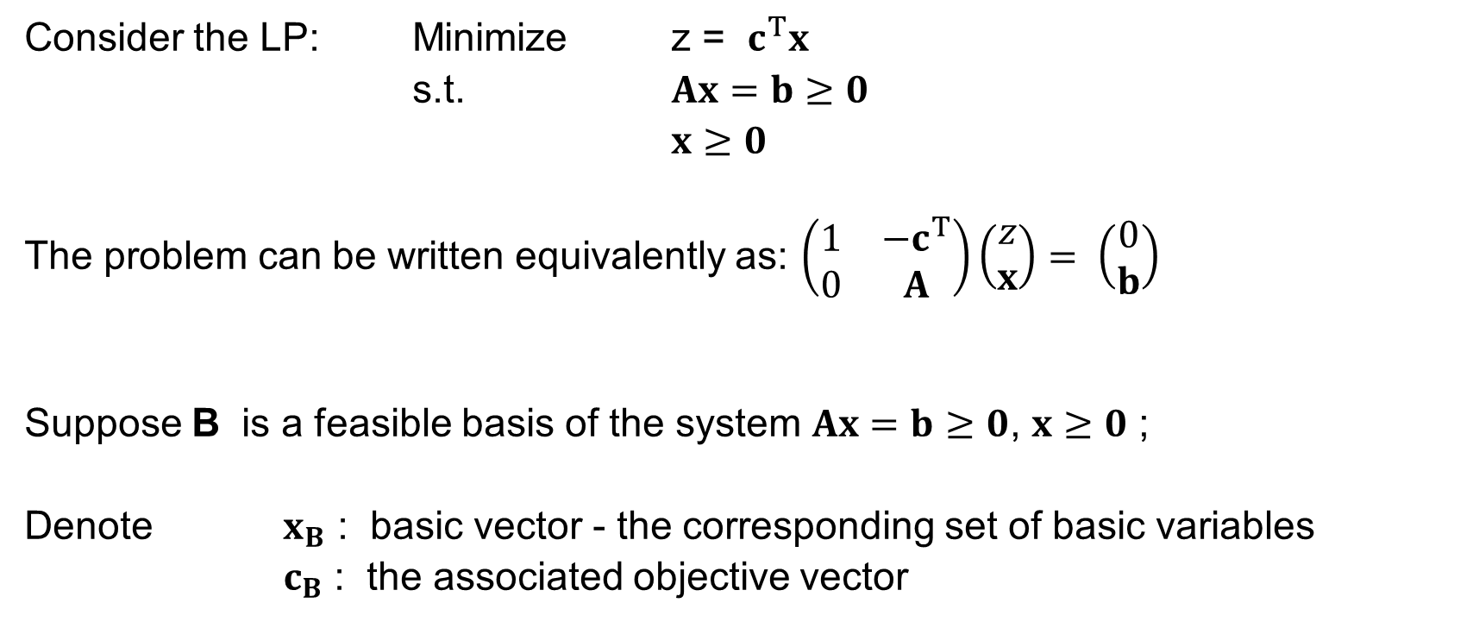
Revised Simplex Method
SIMPLEX TABLE IN MATRIX FORM
Consider the LP: Minimize z = $c^{T}x$
s.t. $Ax=b≥0$
$x≥0$
The problem can be written equivalently as: $\left(\begin{matrix}1 & −c^{T} \\ 0 & A\end{matrix}\right)\left(\begin{matrix}z \\ x\end{matrix}\right)= \left(\begin{matrix}0 \\ b\end{matrix}\right)$
Suppose B is a feasible basis of the system $Ax=b≥0$, $x≥0$ ;
Denote $x_{B}$ : basic vector - the corresponding set of basic variables
$c_{B}$ : the associated objective vector

Slide 96
Revised Simplex Method
SIMPLEX TABLE IN MATRIX FORM
The corresponding feasible basic solution as well as the associated objective value can be determined as:
The general simplex tableau can be derived based on the following equation:
Or equivalently,

Slide 97
Revised Simplex Method
SIMPLEX TABLE IN MATRIX FORM
Simplex tableau in matrix form:

Slide 98

Revised Simplex Method
SIMPLEX TABLE IN MATRIX FORM
In details, the simplex tableau column associated with variable $x_{j}$ can be represented as follows:
Note that if $x_{j}$ is a basic variable then: $c_{B}^{T}B^{−1}A_{j}−c_{j}=0$

Slide 99
Revised Simplex Method
SIMPLEX TABLE IN MATRIX FORM
Example 13:

Slide 100

Revised Simplex Method
SIMPLEX TABLE IN MATRIX FORM
Consider the simplex tableau associated with the basis $B=\left(A_{1},A_{2}\right)$
We have:
Hence,

Slide 101
Revised Simplex Method
SIMPLEX TABLE IN MATRIX FORM

Slide 102
Revised Simplex Method
SIMPLEX TABLE IN MATRIX FORM
The corresponding simplex tableau (without introducing any artificial variable !):

Slide 103
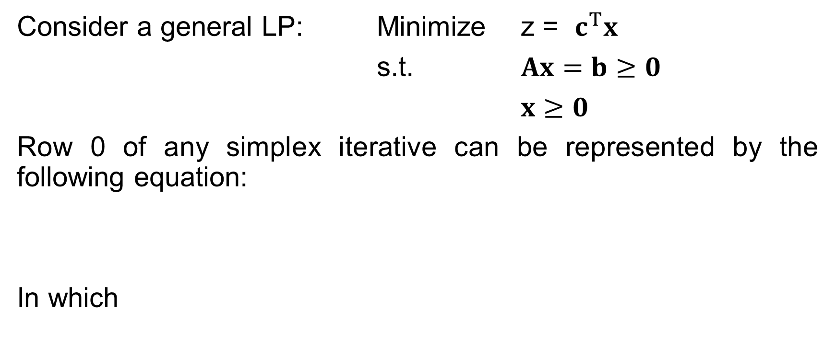
Revised Simplex Method
OPTIMALITY CONDITION
Consider a general LP: Minimize z = $c^{T}x$
s.t. $Ax=b≥0$
$x≥0$
Row 0 of any simplex iterative can be represented by the following equation:
In which

Slide 104
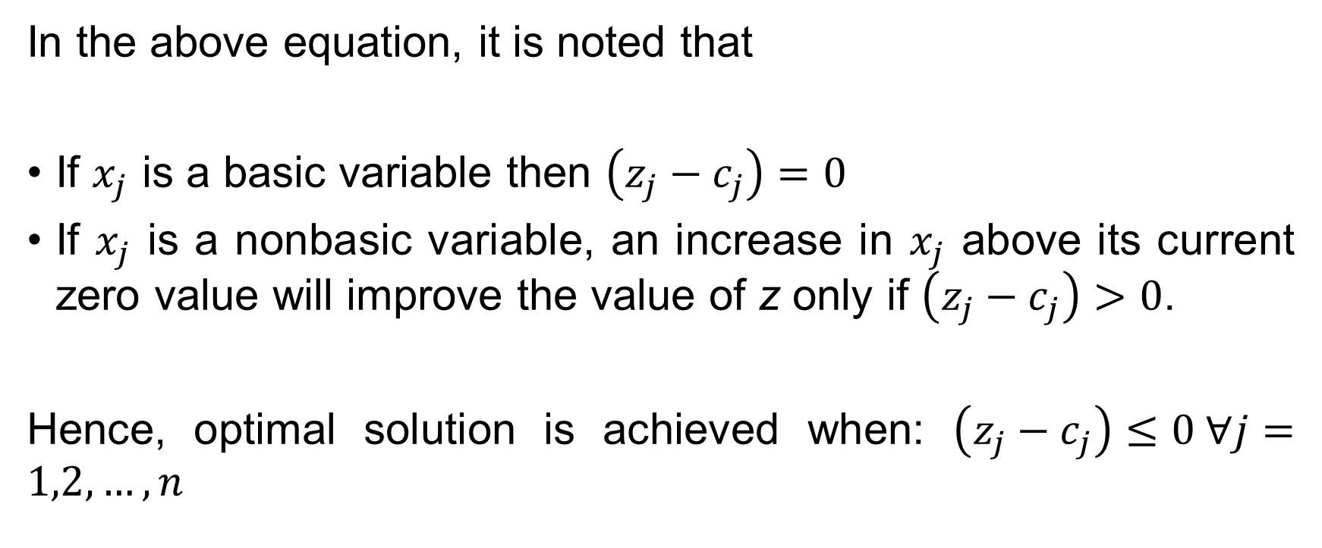
Revised Simplex Method
OPTIMALITY CONDITION
In the above equation, it is noted that
If $x_{j}$ is a basic variable then $\left(z_{j}−c_{j}\right)=0$
If $x_{j}$ is a nonbasic variable, an increase in $x_{j}$ above its current zero value will improve the value of z only if $\left(z_{j}−c_{j}\right)>0$.
Hence, optimal solution is achieved when: $\left(z_{j}−c_{j}\right)≤0 ∀j=1,2,…,n$

Slide 105
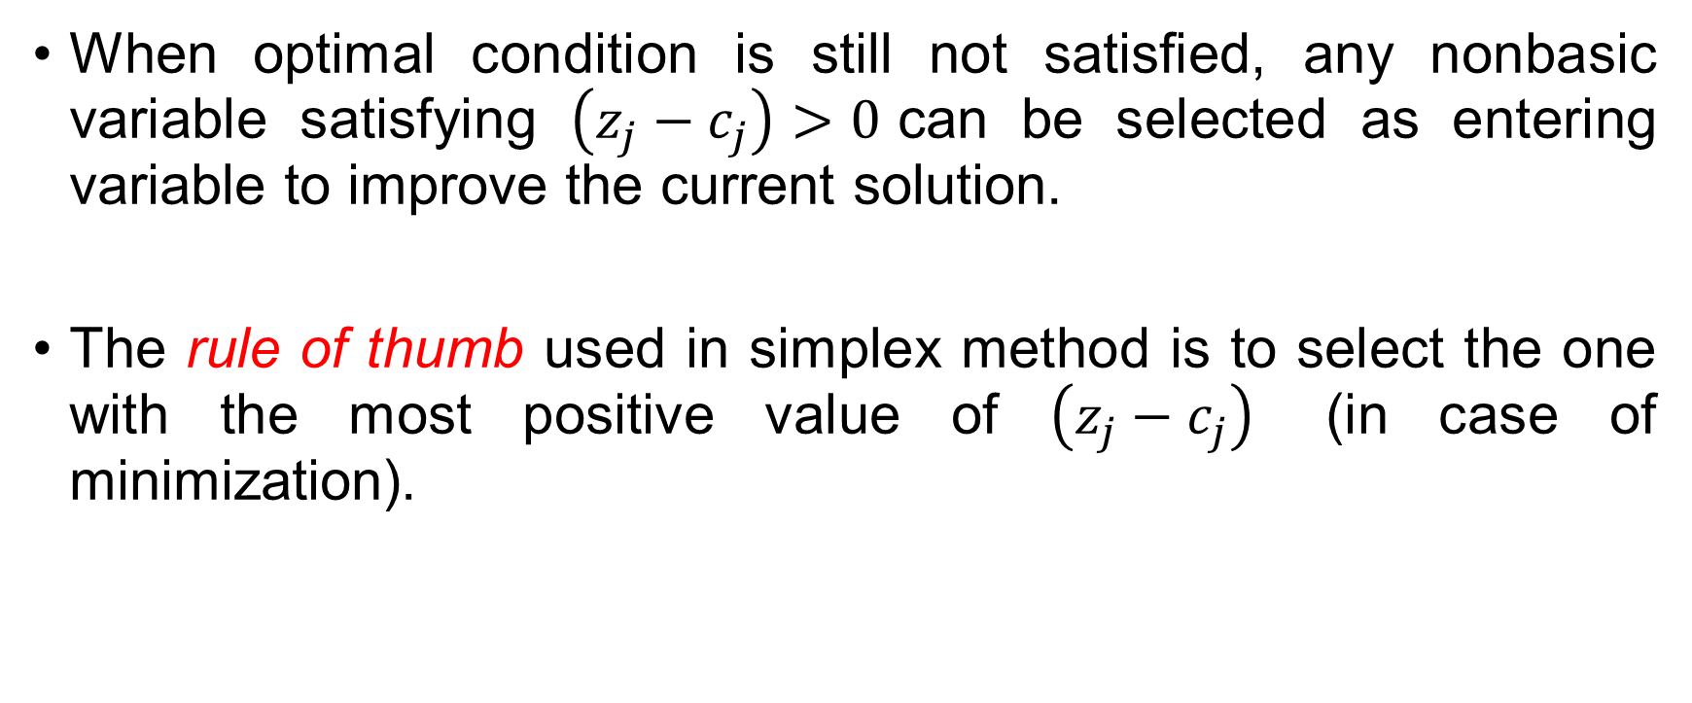
Revised Simplex Method
OPTIMALITY CONDITION
When optimal condition is still not satisfied, any nonbasic variable satisfying $\left(z_{j}−c_{j}\right)>0$can be selected as entering variable to improve the current solution.
The rule of thumb used in simplex method is to select the one with the most positive value of $\left(z_{j}−c_{j}\right)$ (in case of minimization).

Slide 106
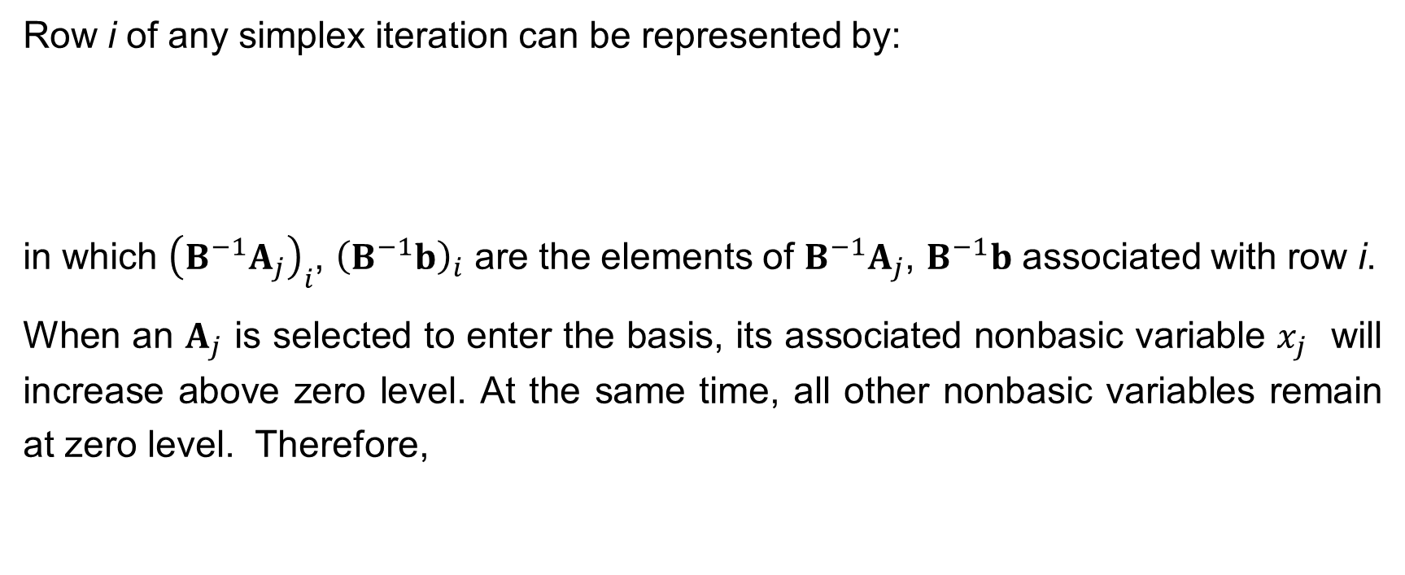
Revised Simplex Method
FEASIBILITY CONDITION
Row i of any simplex iteration can be represented by:
in which ${\left(B^{−1}A_{j}\right)}_{i}$, ${\left(B^{−1}b\right)}_{i}$ are the elements of $B^{−1}A_{j}$, $B^{−1}b$ associated with row i.
When an $A_{j}$ is selected to enter the basis, its associated nonbasic variable $x_{j}$ will increase above zero level. At the same time, all other nonbasic variables remain at zero level. Therefore,

Slide 107
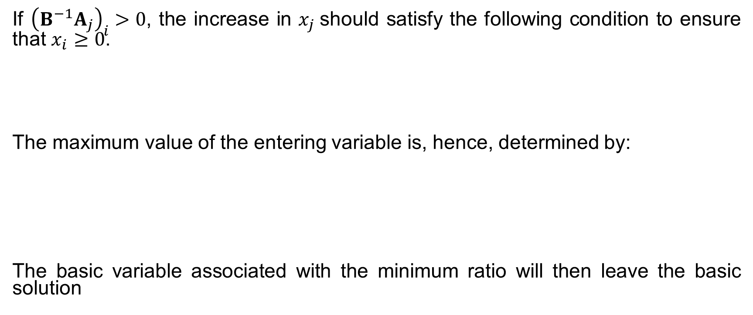
Revised Simplex Method
FEASIBILITY CONDITION
If ${\left(B^{−1}A_{j}\right)}_{i}>0$, the increase in $x_{j}$should satisfy the following condition to ensure that $x_{i}≥0$.
The maximum value of the entering variable is, hence, determined by:
The basic variable associated with the minimum ratio will then leave the basic solution

Slide 108
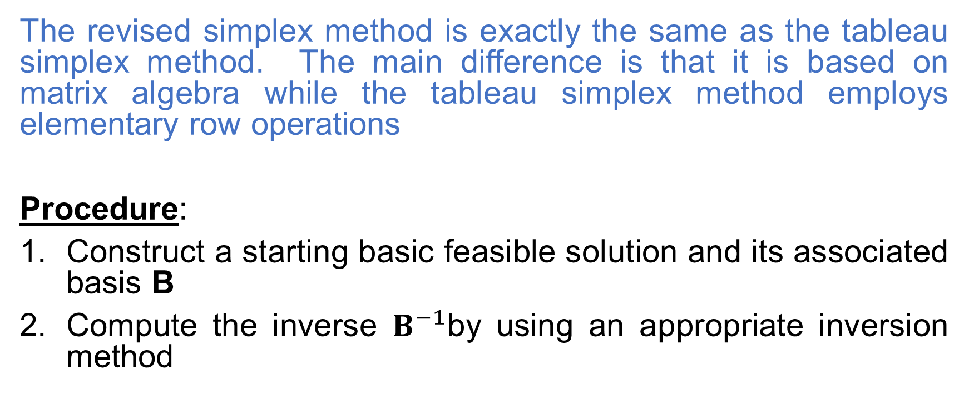
Revised Simplex Method
The revised simplex method is exactly the same as the tableau simplex method. The main difference is that it is based on matrix algebra while the tableau simplex method employs elementary row operations
Procedure:
Construct a starting basic feasible solution and its associated basis B
Compute the inverse $B^{−1}$by using an appropriate inversion method

Slide 109
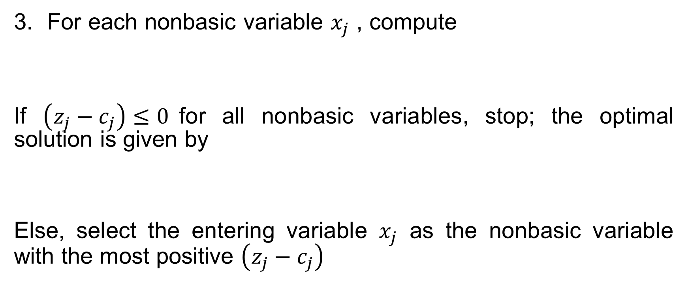
Revised Simplex Method
For each nonbasic variable $x_{j}$ , compute
If $\left(z_{j}−c_{j}\right)≤0$for all nonbasic variables, stop; the optimal solution is given by
Else, select the entering variable $x_{j}$ as the nonbasic variable with the most positive $\left(z_{j}−c_{j}\right)$

Slide 110
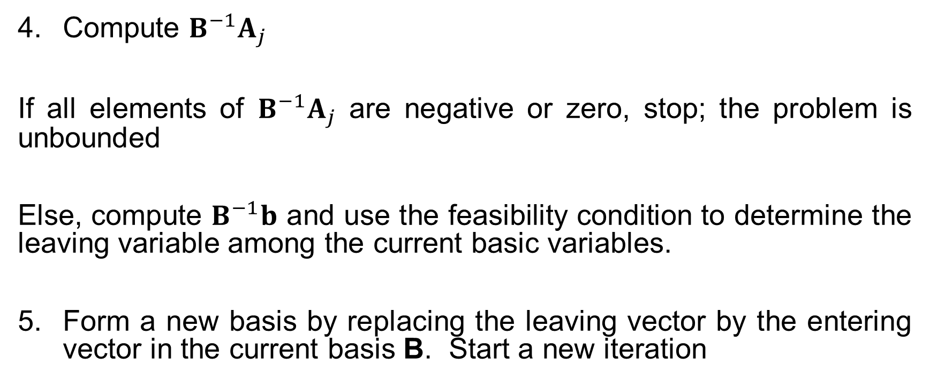
Revised Simplex Method
Compute $B^{−1}A_{j}$
If all elements of $B^{−1}A_{j}$ are negative or zero, stop; the problem is unbounded
Else, compute $B^{−1}b$ and use the feasibility condition to determine the leaving variable among the current basic variables.
Form a new basis by replacing the leaving vector by the entering vector in the current basis B. Start a new iteration

Slide 111
Revised Simplex Method
Example 14:

Slide 112

Revised Simplex Method
Iteration 0:
Thus:
Check for optimality:
$⇒$ $x_{1}$ is the entering variable

Slide 113

Revised Simplex Method
Check feasibility condition:
Hence,
$⇒$ $x_{3}$ is the leaving variable

Slide 114
Revised Simplex Method
Iteration 1:
Thus

Slide 115

Revised Simplex Method
Check for optimality:
$⇒$ $x_{2}$ is the entering variable
Check feasibility condition:
Hence,
$⇒$ $x_{4}$ is the leaving variable

Slide 116
Revised Simplex Method
Iteration 2:
Thus

Slide 117

Revised Simplex Method
Check for optimality:
$⇒$ $x_{B_{2}}$ is optimal. Optimal solution: $x_{1}=2,x_{2}=1.5, z=−21$
Note: Methods of determining the inverse of matrix: Adjoint Matrix Method, Gauss-Jordan Method, Use of Product Form of the Inverse (see textbook of Taha), LU Decomposition.

Slide 118

The Dual of a Linear Program
Example 15: Consider the diet problem which is considered by a dieter
Choose a diet from a set of n available foods in order to guarantee m nutritional requirements while minimizing cost
  Daily required number of units of nutrient i: $b_{i} (i=1,2,…,m)$
  Number of units of nutrient i in one unit of food j $(j=1,2,…,n)$: $a_{ij}$
  Cost per unit of food j : $c_{j} (j=1,2,…,n)$
  Number of units of food j in the diet: $x_{j} (j=1,2,…,n)$

Slide 119
The Dual of a Linear Program
The Primal Problem:

Slide 120

The Dual of a Linear Program
Consider a druggist who sells m types of pill in which pill i contains one unit of nutrient i $(i=1,2,…,m)$. In order to convince the dieter to use his pills to supply the daily nutrient requirement, instead of using various foods, the prices of the pills $u_{1},u_{2},$…, $u_{m}$ should be attractive in such a way that the cost of a combination of m pills that provide exactly the same amount of nutrients as a unit of food j is less expensive than the cost of a unit of food j.
If the dieter concerns about the minimum requirement of m nutrients, he will buy exactly $b_{i}$ units of pill i.

Slide 121
The Dual of a Linear Program
The problem of the druggist is to maximize his sales. This problem can be formulated as an LP problem as follows:
(P) is the primal problem and (D) is the dual problem of (P).

Slide 122

The Dual of a Linear Program
Example 16: Consider the Product Mix Problem
Company A want to produces n products from m types of material. The problem is to determine production volumes of products so as to maximize total profit
  Available on-hand inventory of material i : $b_{i} (i=1,2,…,m)$
  Amount of material used for one unit of product j $(j=1,2,…,n)$: $a_{ij}$
  Profit of one unit of product j : $c_{j} (j=1,2,…,n)$
  Production volume of product j: ${ x}_{j} (j=1,2,…,n)$

Slide 123
The Primal Problem:

Slide 124

The Dual of a Linear Program
Suppose that company B wants to purchase all company A’ resources. This request will be attractive to company A if
The offered unit price of material i from company B is higher than the unit purchase price of material i an amount, says, $u_{i}$ for each i.
The profit comes from selling the raw materials needed to produce one unit of product j to company B should be higher than the profit gained from producing one unit of product j.

Slide 125
The Dual of a Linear Program
The problem of company B is then to minimize the additional cost of purchasing while satisfying the above constraints:

Slide 126
The Dual of a Linear Program
In matrix form:

Slide 127

The Dual of a Linear Program
Remarks:
1. The dual of the dual problem is the primal problem itself
Proof:
(D) is equivalent to: $−Min {\left(−b\right)}^{T}u$
s.t. ${\left(−A\right)}^{T}u ≥−c$ ; $u≥$0
and the dual is: $−Max {\left(−c\right)}^{T}x$
s.t. $−Ax ≤−b$ ; x $≥$0
which is equivalent to (P).

Slide 128
The Dual of a Linear Program
2. The dual of the standard form LP:
Proof:
(P)

Slide 129

The Dual of a Linear Program
Hence,
(D)
(in which $u=v−w$)

Slide 130
The Dual of a Linear Program
3. In general, the conversion between the Primal and Dual can be summarized as follows:

Slide 131
The Dual of a Linear Program
Example 17:
Primal Problem Dual Problem

Slide 132

Dual Theorem
Consider the primal and dual problems in the form (standard!):
We says that
$\overline{x}$ is a primal feasible solution if $A\overline{x}≥b$ and $\overline{x}≥0$
$\overline{u}$is a dual feasible solution if $A^{T}\overline{u}≤c$ and $\overline{u}≥0$

Slide 133

Dual Theorem
Weak Duality Theorem
If $\overline{x}$ is a primal feasible solution and $\overline{u}$ is a dual feasible solution then
$$c^{T}\overline{x}≥b^{T}\overline{u}$$
Proof: $c^{T}\overline{x} ≥{\left(A^{T}\overline{u}\right)}^{T}\overline{x}$ since $A^{T}\overline{u}≤c$ ,$\overline{x}≥0$
$={\overline{u}}^{T}A\overline{x}$
$≥{\overline{u}}^{T}b$ since $A\overline{x} ≥b$ ,$\overline{u}≥0$
$={\left({\overline{u}}^{T}b\right)}^{T}=b^{T}\overline{u}$

Slide 134

Dual Theorem
Weak Duality Theorem
Corollaries:
If $\overline{x}$ is a primal feasible solution and $\overline{u}$ is a dual feasible solution such that $c^{T}\overline{x}=b^{T}\overline{u}$ then $\overline{x}$ is an optimal solution of (P) and $\overline{u}$ is an optimal solution of (D) with the same optimal objective value: $c^{T}\overline{x}=b^{T}\overline{u}$
If (P) (or (D)) is unbounded then (D) (or (P)) is infeasible

Slide 135

Dual Theorem
Strong Duality Theorem
If both the primal and the dual problems are feasible, then both have optimal solutions $\overline{x}$ and $\overline{u}$ that satisfy $c^{T}\overline{x}=b^{T}\overline{u}$
Proof:
1. If (P) (or (D)) is feasible but does not have optimal solution then (P) (or (D)) is unbounded. Hence, (D) (or (P)) is infeasible! So, (P) (or (D)) should have optimal solution.

Slide 136

Dual Theorem
Strong Duality Theorem
2. (P) is equivalent to: Min $c^{T}x$
s.t. $Ax−y=b$ and $x,y≥0$
Suppose $\overline{x}$ is the optimal solution of (P) and the optimal simplex tableau is:
In which

Slide 137

Dual Theorem
Strong Duality Theorem
Note that the coefficient of the column associated with $y$ is:

Slide 138

Dual Theorem
Strong Duality Theorem
Let $\overline{u}={\left({\overline{c}}_{B}^{T}B^{−1}\right)}^{T}$ , we have:
${\overline{c}}_{B}^{T}B^{−1}A−c^{T}≤0$ and $−{\overline{c}}_{B}^{T}B^{−1}≤0$ (due to optimality of (P))
$⟹$ $A^{T}\overline{u} ≤c$ and $\overline{u} ≥0$
$⟹$ $\overline{u}$ is a feasible solution of (D) that satisfies $b^{T}\overline{u}=c^{T}\overline{x}$
From the weak duality theorem, it can be concluded that $\overline{u}$ is an optimal solution of (D).

Slide 139

Dual Theorem
Complementary Slackness Condition
If $x$ and $u$ are primal and dual feasible solutions then $x$ and $u$ are both optimal if and only if
$u^{T}\left(Ax−b\right)=0$ and ${\left(A^{T}u−c\right)}^{T}x=0$
i.e.,
and

Slide 140

Dual Theorem
Complementary Slackness Condition
Proof:
If $x$ and $u$ are both feasible, we have:
$Ax−b≥0$ $⟹$ $u^{T}\left(Ax−b\right)≥0$ $⟹$ $u^{T}Ax≥u^{T}b$
$A^{T}u−c≤0$ $⟹$ ${\left(A^{T}u−c\right)}^{T}x≤0$ $⟹$ $u^{T}Ax≤c^{T}x$
If $x$ and $u$ are both optimal, we have: $u^{T}b=c^{T}x$, and hence, $u^{T}\left(Ax−b\right)=0$and ${\left(A^{T}u−c\right)}^{T}x=0$
If $u^{T}\left(Ax−b\right)=0$and ${\left(A^{T}u−c\right)}^{T}x=0$: $u^{T}Ax=u^{T}b$ and $u^{T}Ax=c^{T}x$ . Therefore, $x$ and $u$ are both optimal solutions of (P) and (D).

Slide 141
Relationship between Primal – Dual Solution
Consider an iterative of the simplex method applied on a standard LP with the current basis B and the associated simplex table:

Slide 142

Relationship between Primal – Dual Solution
At each step of the simplex algorithm, we keep $B^{−1}b≥0$ , and thus the basic solution $x=\left[\begin{matrix}x_{B} \\ 0\end{matrix}\right]=\left[\begin{matrix}B^{−1}b \\ 0\end{matrix}\right]≥0$: always feasible.
Let $u={\left(c_{B}^{T}B^{−1}\right)}^{T}$ then $u$ is dual feasible if and only if $A^{T}u ≤c$, i.e., $c_{B}^{T}B^{−1}A−c^{T}≤0$. This is the optimality condition of the primal problem.
The primal optimality condition is actually
the dual feasibility condition

Slide 143

Relationship between Primal – Dual Solution
Hence, at any intermediate stage of the simplex method, we have:
(i) A primal basic feasible solution $x=\left[\begin{matrix}B^{−1}b \\ 0\end{matrix}\right]$ and
(ii) A dual infeasible solution $u={\left(c_{B}^{T}B^{−1}\right)}^{T}$
and Primal Obj. Value $=c^{T}x$ $={c_{B}^{T}B^{−1}b=u}^{T}b=$ Dual Obj. Value.
At the final simplex tableau, the dual solution become dual feasible.

Slide 144

Relationship between Primal – Dual Solution
At optimal solutions $x$ and $u$, the optimal objective value is ${z^{∗}=c}^{T}x$ $=b^{T}u=$ ${\overline{c}}_{B}^{T}B^{−1}b$. If $b_{i}$ increases one unit, the optimal objective value will change and $\frac{dz^{∗}}{db_{i}}={\left({\overline{c}}_{B}^{T}B^{−1}\right)}_{i}={\overline{u}}_{i}$ . So, ${\overline{u}}_{i}$ is the rate of change of the optimal objective value $z^{∗}$with respect to the change of right-hand side value $b_{i}$ .
If constraint i is for a kind of resource,
${\overline{u}}_{i}$ is called the shadow price of that resource

Slide 145

Dual Simplex Method
In some LP problems, it is easy to find an initial simplex tableau which satisfies optimality conditions (or dual feasibility conditions) but does not satisfy feasibility conditions (or dual optimality conditions). For example,
Minimize $c^{T}x$
s.t. $Ax≥b$
$x≥0$
By introduce the surplus variables $y$, an initial infeasible simplex tableau can be derived

Slide 146

Dual Simplex Method
The initial basic solution $\left[\begin{matrix}x \\ y\end{matrix}\right]=\left[\begin{matrix}0 \\ −b\end{matrix}\right]$is infeasible but the optimality condition $\left[\begin{matrix}−c^{T} & 0\end{matrix}\right]≤0$ can be satisfied.

Slide 147

Dual Simplex Method
In this case, if the simplex method introduced before is employed (primal simplex method), some artificial variables have to be introduced and it becomes more complicated to find the optimal solution (two-phase or Big M methods should be applied)
Starting with an optimal but infeasible simplex tableau, i.e., $y_{0i}≤0, ∀i∈\left[1,m\right]$, the dual simplex method can be applied to find optimal solution.

Slide 148

Dual Simplex Method
PROCEDURE
Step 1: If $y_{j0}≥0, ∀i∈\left[1,r\right]$ : stop, an optimal solution has been found. Otherwise, select $i$ such that $y_{i0}=\min_{1≤k≤r}\left\{y_{k0}\right\}<0$.
Step 2: With the selected $i$, if $y_{ij}≥0, ∀j∈\left[1,m\right]$: stop, the primal problem is infeasible. Otherwise, select $j$ such that
$\frac{y_{0j}}{y_{ij}}=\min_{k}\left\{\frac{y_{0k}}{y_{ik}} | y_{ik}<0\right\}$ and go to step 3.
Step 3: Pivot at $y_{ij}$ and go back to step 1.

Slide 149
Dual Simplex Method
Example 18:
Introduce surplus variables:

Slide 150
Dual Simplex Method
Initial infeasible simplex tableau:

Slide 151

Dual Simplex Method
Iteration 1:
Min{-5,-6} = -6
Min{-3/-2, -4/-2, -5/-1} = 3/2
$⇒$ Pivot term -2*, $x_{1}$ - entering variable; $x_{5}$ - leaving variable.

Slide 152


Dual Simplex Method
Iteration 2:
The only negative RHS value: -2
Min{-1/-1, (-7/2)/(-5/2), (-3/2)/(-1/2)} = 1/1
$⇒$ Pivot term -1*, -entering variable; -leaving variable.
Optimal Solution:
$x_{1}^{∗}=1,x_{2}^{∗}=2,$ $x_{3}^{∗}=0$
Objective Value = 11

Slide 153
Dual Simplex Method
Note 1: A simplex table of the dual simplex algorithm for a given basis B has the form:

Slide 154

Dual Simplex Method
If $y_{i0}<0$ and $y_{ij}≥0, ∀j=1,2,…,m$ then the primal problem is infeasible and hence, the dual problem is unbounded.
Proof: Since all $x_{j}≥0$ $⇒$ $x_{B_{i}}=y_{i0}−\sum_{k∈D}{y_{ik}x_{k}}<0$: the primal problem is infeasible

Slide 155

Dual Simplex Method
Note 2: In each iteration of the dual simplex method, primal optimality condition (dual feasibility condition) is always satisfied and the objective value does not decrease.
Proof: when pivoting at $y_{ij}$, the new objective value $z^{′}$ can be expressed as:
$$z^{′}=y_{00}−y_{0j}\frac{y_{i0}}{y_{ij}}=y_{00}−y_{0j}x_{j}$$
Due to $y_{0j}<0$ and $x_{j}≥0$: $z^{′}=y_{00}−y_{0j}x_{j}≥y_{00}$

Slide 156

Dual Simplex Method
Furthermore, the new value of $y_{0k}$, denoted by $y_{ok}^{′}$ can be expressed as: $y_{ok}^{′}=y_{0k}−{\frac{y_{ik}}{y_{ij}}y}_{0j}$. Hence,
If $y_{ik}>0$: $−{\frac{y_{ik}}{y_{ij}}y}_{0j}<0$ $⇒$ $y_{ok}^{′}≤y_{0k}≤0$
If $y_{ik}<0$: $y_{ok}^{′}=y_{ik}\left(\frac{y_{0k}}{y_{ik}}−\frac{y_{0j}}{y_{ij}}\right)≤0$
due to $\frac{y_{0j}}{y_{ij}}=\min_{k}\left\{\frac{y_{0k}}{y_{ik}} | y_{ik}<0\right\}$

Slide 157
Dual Simplex Method
Note 3: The dual simplex method is just simply the simplex method applied to the dual problem by using the primal simplex tableau.
Note 4: The optimal solution of the dual problem (if it exists) can be determined from the shadow prices of the primal problem.

Slide 158
Dual Simplex Method
Example 19:

Slide 159

Dual Simplex Method
The optimal simplex tableau of this LP (see example 7):
Optimal solution: $x_{1}^{∗}=3/2$, $x_{2}^{∗}=1/2$, $Z^{∗}=−7/2$

Slide 160
Dual Simplex Method
The dual problem:

Slide 161

Dual Simplex Method
Denote $U_{1}=−u_{1},U_{2}=−u_{2},U_{3}=−u_{3}$, we have

Slide 162
Dual Simplex Method
Introduce slack variables:

Slide 163
Dual Simplex Method
Apply dual simplex method - the initial simplex tableau is

Slide 164

Dual Simplex Method
Iteration 1: Min{-2,-1} = -2; Min{-4/-1, -2/-1, -3/-2} = -3/-2
$⇒$ Pivot term -2*, $U_{3}$ -entering variable; $U_{3}$ -leaving variable.

Slide 165

Dual Simplex Method
Iteration 2: Min{-(5/2)/-(8/3), -(1/2)/-1} = -(1/2)/-1
$⇒$ Pivot term -1*, $U_{2}$ -entering variable; $U_{5}$ -leaving variable.
Optimal solution: $u_{1}^{∗}=$0, $u_{2}^{∗}=−1/2$, $Z^{∗}=−7/2$

Slide 166

Important Parameters in the Simplex Tableau
Shadow Price (Dual Price)
Consider the product mix problem: Produce n products from m types of material.
Available on-hand inventory of material $i (i=1,2,…,m)$: $b_{i}$
Amount of material i used for one unit of product $j (j=1,2,…,n)$: $a_{ij}$
Profit of one unit of product j: $c_{j}^{′}$
Problem: determine production volumes of products so as to maximize total profit.

Slide 167

Important Parameters in the Simplex Tableau
Shadow Price (Dual Price)
Denote $x_{j} (j=1,2,..,n)$: production volume of product j.
Objective Function: Maximize Profit $Z^{′}=\sum_{j=1}^{n}{{c_{j}^{′}x}_{j}}$
or Minimize “Cost” $Z=\sum_{j=1}^{n}{{c_{j}x}_{j}}$with ${c_{j}=−c}_{j}^{′}$
Constraints:
* Material constraints: $\sum_{j=1}^{n}{a_{ij}x_{j}≤b_{i}}$ $∀i=1,2,…, m$
* Variable constraints: $x_{j}≥0$ $∀j=1,2,…, n$

Slide 168

Important Parameters in the Simplex Tableau
Shadow Price (Dual Price)
It is noted that, slack variables $x_{k}(k=1,2,…, m)$will be introduced to convert the problem into standard form. The optimal simplex tableau of the standard form problem can be expressed as:
$e_{k}$ is the unit column vector associated with $x_{k}$ in the matrix A.

Slide 169

Important Parameters in the Simplex Tableau
Shadow Price (Dual Price)
It should be noted that ${c_{B}^{T}B}^{−1}e_{k}={\left({c_{B}^{T}B}^{−1}\right)}_{k}$
The optimal objective value: ${{Z^{∗}=c}_{B}^{T}B}^{−1}b=\sum_{k=1}^{m}{{\left({c_{B}^{T}B}^{−1}\right)}_{k}b_{k}}$
Hence:
$\frac{∂z^{∗}}{∂b_{k}}={\left({c_{B}^{T}B}^{−1}\right)}_{k}=$ the z-value of $x_{k}$ at optimal solution
${\left({c_{B}^{T}B}^{−1}\right)}_{k}$ is called the shadow price of material $k (k=1,2,…, m)$. So, if the amount of material $k$ increases (decreases) “one” unit, the optimal objective value will increase (decrease) ${\left({c_{B}^{T}B}^{−1}\right)}_{k}$unit provided that the optimality condition is still satisfied.

Slide 170
Important Parameters in the Simplex Tableau
Shadow Price (Dual Price)
Example 20: Produce two products A, B from three types of material 1,2, and 3.
1kg of product A requires: 1kg material 1, 1kg material 2 and 2kg material 3. Unit profit of A: 200 mil./ton
1kg of product B requires: 8/3kg material 1, 1kg material 2. Unit profit of B: 100 mil./ton
Available amount of materials 1,2, and 3: 4, 2, and 3 tons.

Slide 171
Important Parameters in the Simplex Tableau
Shadow Price (Dual Price)
The LP program:
Monetary unit used in objective function: 100 millions.

Slide 172

Important Parameters in the Simplex Tableau
Shadow Price (Dual Price)
The optimal simplex tableau:
Optimal solution: $x_{1}^{∗}=3/2$, $x_{2}^{∗}=1/2$, $Z^{∗}=−7/2$

Slide 173
Important Parameters in the Simplex Tableau
Shadow Price (Dual Price)
From the optimal simplex tableau, it can be concluded that
Changing the amount of material 1 will not help increase the benefit
Increasing the amount of material 2 by 1 unit (1 ton) will help reduce the “cost” by 1 unit (100 millions), or equivalently, increase the profit by 1 unit (100 millions).
Increasing the amount of material 3 by 1 unit (1 ton) will help reduce the “cost” by 1/2 unit (50 millions), or equivalently, increase the profit by 1/2 unit (50 millions).
Note that the above analysis holds true only if the optimality condition is still satisfied when changing RHS parameters.

Slide 174
Important Parameters in the Simplex Tableau
Reduced Cost
Consider the problem in example 20 and one of its simplex tableau during the solution process (not the optimal one!):

Slide 175

Important Parameters in the Simplex Tableau
Reduced Cost
The value ${{c_{j}−c}_{B}^{T}B}^{−1}A_{j}$ (which is the z-value with opposite sign) is called the reduced cost of producing product j.
For instances, in the above simplex tableau:
• Reduced costs associated with $x_{1}$, $x_{3}$, $x_{4}$ are 0.
• Reduced cost associated with $x_{2}$ is -1.
• Reduced cost associated with $x_{5}$ is 1.

Slide 176

Important Parameters in the Simplex Tableau
Reduced Cost
Meaning of reduced cost:
Consider $x_{2}$, we have:
This vector expresses the linear combination of basic variables which is equivalent to $x_{2}$. That is $x_{2}$ $⇔$ ${\frac{8}{3}x}_{3}+x_{4}+{0x}_{1}$.

Slide 177

Important Parameters in the Simplex Tableau
Reduced Cost
In order to understand the equivalence; let assume that in addition to the production of the two products A, and B, we produce also C,D, and E with the following information:
1kg of product C requires: 1kg material 1. Unit profit of C: 0
1kg of product D requires: 1kg material 2. Unit profit of D: 0
1kg of product E requires: 1kg material 3. Unit profit of E: 0
The LP model with these new added products will not change and $x_{3}$, $x_{4}$, $x_{5}$represent production volumes of C,D, and E, respectively.

Slide 178

Important Parameters in the Simplex Tableau
Reduced Cost
The material consumptions of each unit of the products can be expressed by column vectors of the constraint matrix A:
It can be easily seen that the amount of each type of materials used to produce one kg of product B is exactly the same as the total amount of each type of materials used to produce 8/3kg of product C + 1kg of product D + 0kg of product A. The expression $x_{2}$ $⇔$ ${\frac{8}{3}x}_{3}+x_{4}+{0x}_{1}$ is used to illustrate the above relationship.

Slide 179

Important Parameters in the Simplex Tableau
Reduced Cost
• ${c_{B}^{T}B}^{−1}A_{2}=\left[\begin{matrix}0 & 0 & −2\end{matrix}\right]\left[\begin{matrix}8/3 \\ 1 \\ 0\end{matrix}\right]=0$: This value is the “cost” to produce the combination of (8/3kg of product C + 1kg of product D + 0kg of product A), which consume the same amount of materials as of 1kg of product B.
• Thus, $c_{2}−{c_{B}^{T}B}^{−1}A_{2}=−1$ is the reduction in total “cost” if 1kg of B is produced instead of the combination (8/3kg of product C + 1kg of product D + 0kg of product A).

Slide 180

Important Parameters in the Simplex Tableau
Reduced Cost
So, if $c_{2}−{c_{B}^{T}B}^{−1}A_{2}<0$ (the z-value >0) as in this case, it will be better to produce B than its equivalent combination of (C,D,A) $⇒$ $x_{2}$ should enter the basic solution to help reduce the objective value.
The above analysis of reduced cost also explains for the optimality condition in the primal simplex method discussed before.

