Slide 1
Module 3: Automated Quality Report System
Quality System Transformation

Slide 2
What will you learn from this content?
01
Quality system transformation
02
The contents of project development

Slide 3
QMS Digitization
Digital transformation offers opportunity to transform manual quality management operations into digital form.
Tasks of quality management
Collection and analysis data on products, processes and management systems
Monitoring and managing processes
Decision-making based on actual data
Scaling requirements of the quality system to evolving processes, risks identification and analysis
Etc.
Notes:
Margarita A. Menshikova, Yana V. Piunova, Maria N. Makhova, Digital Transformation in the Quality Management System, 2019 International Conference "Quality Management, Transport and Information Security, Information Technologies" (IT&QM&IS), 23-27 Sept. 2019

Slide 4
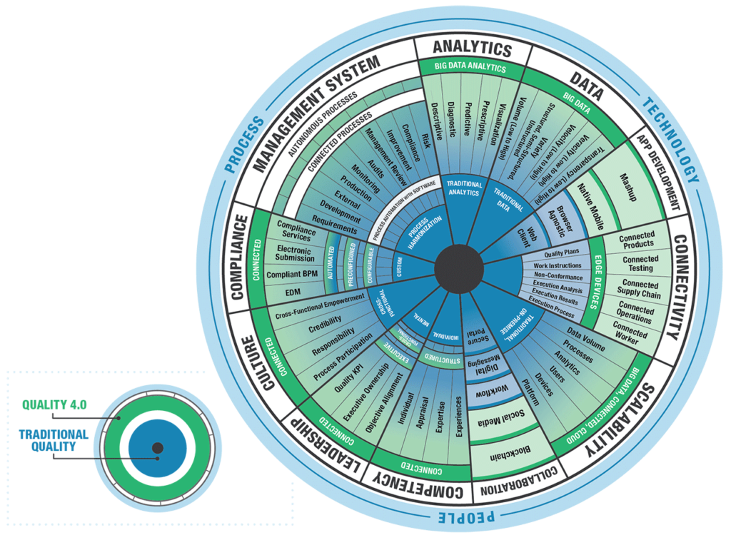
QMS Digitization
Quality 4.0
Data
Analytics
Connectivity
Collaboration
App Development
Scalability
Management Systems
Compliance
Culture
Leadership
Competency
Traditional Quality System
Planning
Coordination
Organization
Control
Quality Assurance
Notes:
Margarita A. Menshikova, Yana V. Piunova, Maria N. Makhova, Digital Transformation in the Quality Management System, 2019 International Conference "Quality Management, Transport and Information Security, Information Technologies" (IT&QM&IS), 23-27 Sept. 2019

Slide 5
Stages of the QMS Digitization
1. Registration and analysis of data
To measure and record everything that could affect the quality of a product
Internet of Things and various types of door sensors are used for the new data sources
The big data systems are used to analyze huge, complex and rapidly growing data sets from several sources
2. Demonstration of compliance with the requirements
To confirm the objectivity of the obtained evidence of compliance with regulatory provisions in many processes of an organization
Blockchain technology is used to have a secure, decentralized and totally objective system to indicate compliance with the requirements
Forgery or swapping of certificates is excluded
Notes:
Margarita A. Menshikova, Yana V. Piunova, Maria N. Makhova, Digital Transformation in the Quality Management System, 2019 International Conference "Quality Management, Transport and Information Security, Information Technologies" (IT&QM&IS), 23-27 Sept. 2019

Slide 6
Stages of the QMS Digitization
3. Monitoring and control
Deep learning and neural networks, it became possible to use artificial intelligence for this purpose.
A trained neural network detects trends and changes in processes much more efficiently and faster than a human or automated systems based on statistical data processing
4. Decision-making in ambiguous situations
Algorithms are set up in processes maps or operating procedures
Digital transformation allows solving this problem through the use of predictive analytics.
Notes:
Margarita A. Menshikova, Yana V. Piunova, Maria N. Makhova, Digital Transformation in the Quality Management System, 2019 International Conference "Quality Management, Transport and Information Security, Information Technologies" (IT&QM&IS), 23-27 Sept. 2019

Slide 7
Stages of the QMS Digitization
Notes:
Margarita A. Menshikova, Yana V. Piunova, Maria N. Makhova, Digital Transformation in the Quality Management System, 2019 International Conference "Quality Management, Transport and Information Security, Information Technologies" (IT&QM&IS), 23-27 Sept. 2019

Slide 8
Stages of the QMS Digitization
The main functions of the QMS that need to be automated
Electronic documentation management (organization of QMS documentary)
Automation of monitoring and measure processes (external and internal audits)
Statistical control of product quality (automation of record maintaining, maintaining product quality statistical data)
Customer satisfaction monitoring
Notes:
Margarita A. Menshikova, Yana V. Piunova, Maria N. Makhova, Digital Transformation in the Quality Management System, 2019 International Conference "Quality Management, Transport and Information Security, Information Technologies" (IT&QM&IS), 23-27 Sept. 2019

Slide 9
Portal Pillars – Quality 4.0
A company can start by implementing QMS portal based on 2 modules:
Documents Controller System (DCS) – a digital tool in charge to assure model of documented information. This is a web-based solution, workflow based developed to control documents proposals, checking, approvals
Online Risks Controller (ORC) – a digital tool which control documentation of risks, opportunities and preventive actions in a workflow environment
Both DCS and ORC will be modified according each company internal process
Notes:
Omnium, Quality Systems Digital Transformation, https://omnium.ro/quality-systems-digital-transformation/

Slide 10
Portal Pillars – Quality 4.0
Notes:
Omnium, Quality Systems Digital Transformation, https://omnium.ro/quality-systems-digital-transformation/

Slide 11
QMS Considerations
1. Critical Processes – determining which quality processes to automate
Document control to securely manage creation, revision, and distribution of controlled documents
Corrective action to create a closed-loop workflow to fix problems quickly and effectively
Employee training to ensure team members have the required skills, knowledge, and abilities
Change management to assess the potential impact and reduce risk of changes to people, processes, or equipment
Risk assessment tools including failure mode and effects analysis (FMEA) to standardize how you handle risks in Total Product Life Cycle development process
Reporting analytics to spot quality trends and proactively ensure compliance with customer, regulatory, and standard requirements
Notes:
Tony Parise, Digital Transformation: Seven Considerations for Your QMS, https://www.mpo-mag.com/issues/2019-04-01/view_columns/digital-transformation-seven-considerations-for-your-qms/

Slide 12
QMS Considerations
2. Flexibility - Look for software flexible enough to adapt to internal processes.
If forced to change processes to accommodate the software’s limitations, you won’t be able to achieve the process efficiency required for true digital transformation
Operational excellence demands continuous process refinement and improvement
Without flexibility, information is stuck where it doesn’t belong or other concessions are made as you shoehorn new product introduction needs into the QMS’ limitations
With a flexible QMS, historical data can create new categories for reporting to increase visibility, mitigate risk, make better decisions, and reduce use of the “other” category
A flexible QMS also allows seamlessly handling changes in activity by location
Notes:
Tony Parise, Digital Transformation: Seven Considerations for Your QMS, https://www.mpo-mag.com/issues/2019-04-01/view_columns/digital-transformation-seven-considerations-for-your-qms/

Slide 13
QMS Considerations
3. Integration - interoperable with other systems
Able to push and pull data from systems such as enterprise resource planning (ERP); laboratory information management system (LIMS); manufacturing execution system (MES); learning management system (LMS); production equipment; distributed control system (DCS); energy management system and battery management system (BMS); product lifecycle management (PLM) software; and supply chain management system
A connected factory where systems communicate, improving visibility and efficiency so you’re not manually jumping between systems
Unlock significant advances in machine learning, artificial intelligence, and IoT
Smart sensors and equipment are capable of generating huge volumes of data
Notes:
Tony Parise, Digital Transformation: Seven Considerations for Your QMS, https://www.mpo-mag.com/issues/2019-04-01/view_columns/digital-transformation-seven-considerations-for-your-qms/

Slide 14
QMS Considerations
4. Digital Transformation Capabilities - to considering current and future capabilities around mobile tools, IoT, and advanced analytics
A QMS that allows you to make any application’s process mobile is key to design processes around the organization’s unique needs and business benefits
The ability to access the QMS via mobile devices
5. Vendor Considerations - whether prospective vendors can ensure successful implementation
Focus on experience they have in industry
The vendor’s investment in developing and improving the software
Customer references
Notes:
Tony Parise, Digital Transformation: Seven Considerations for Your QMS, https://www.mpo-mag.com/issues/2019-04-01/view_columns/digital-transformation-seven-considerations-for-your-qms/

Slide 15
Case Study
Zimmer – worldwide leader in musculoskeletal health
Provides orthopedic reconstructive, spinal and trauma devices, biologics, dental implants and related surgical products.
Operates in more than 24 countries around the world and sells products in more than 100 countries
9,500 employees worldwide
Problems
Multiple Quality Systems across the company
Several failed attempts to create a global Quality System
Local QMS ownership and reporting
Outdated IT systems
Notes:
Manfred Walder, A Quality System Transformation, Zimmer Holding INC.

Slide 16
Case Study
The Management Support
Building Management Support by Senior Vice President of Quality/Regulatory/Clinical
Global QMS system requested and fully supported by CEO
Single owner and supported by global Quality VP team (reporting to SVP)
Building on proven industry success
Global Culture initiative supports openness to change
The Gage for QMS Development
Compliant – Get it done in the prescribed way
Effective – Get it done right the first time
Efficient – Get it done without waste
Notes:
Manfred Walder, A Quality System Transformation, Zimmer Holding INC.

Slide 17
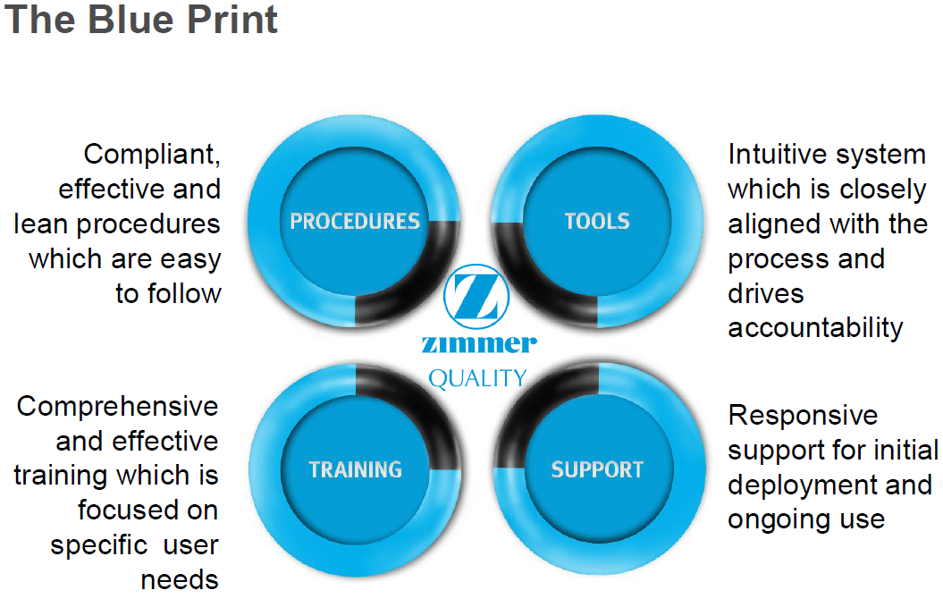
Case Study
Notes:
Manfred Walder, A Quality System Transformation, Zimmer Holding INC.

Slide 18
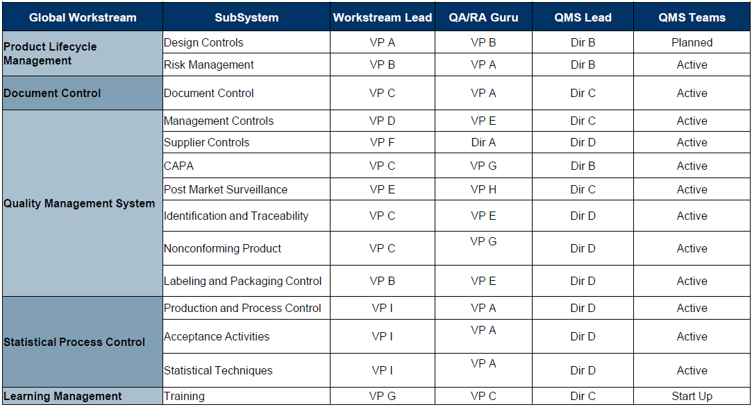
Case Study
Notes:
Manfred Walder, A Quality System Transformation, Zimmer Holding INC.

