Slide 1
Module 3: Automated Quality Report System
Strategic Quality Improvement under I4.0

Slide 2
What will you learn from this content?
01
The strategy of quality improvement (QI)
The quality improvement initiative
02
QI strategy from the automated quality report system
03

Slide 3
Quality management in the era of Industry 4.0
Economic aspects
The basic role that quality plays in the economic performance of companies
New performance measures and metrics for peer-driven target settings and customer expectations
Sophistication in quality standard, practices and methods to gain sustainable competitive advantage
Decision models
Decision models related to contemporary quality management
Costs of poor quality decision models with customer expectations and credibility
Notes:
Quality management in the 21st century enterprises: Research pathway towards Industry 4.0 International Journal of Production Economics 207 (2019) 125–129

Slide 4
Quality management in the era of Industry 4.0
Business models
Contemporary lean techniques and economical influences in manufacturing and services
Outsourcing/offshoring quality challenges in logistics and supply chain operations
Continuous improvement strategies and models that results in minimal viable change and pivoting
Emerging philosophies and business tactics that looks beyond total quality management and six sigma
Role of product innovation, design (R&D) and gross root autonomy in quality management
Notes:
Quality management in the 21st century enterprises: Research pathway towards Industry 4.0 International Journal of Production Economics 207 (2019) 125–129

Slide 5
Quality management in the era of Industry 4.0
Human aspects
Capturing message credibility and supplier involvement aspects in qualify function deployment
Leadership emphasis and process flexibility in achieving economical sustainability
Business models and tactics for peer involvement of employees within enterprises
Business models that studies quality management influence in a multi-cultural environment
Technological aspects
Role of technology, automation and IT/IS in quality management
Notes:
Quality management in the 21st century enterprises: Research pathway towards Industry 4.0 International Journal of Production Economics 207 (2019) 125–129

Slide 6
Quality-improvement methods
Customers define the functional requirements of products, while manufacturers need to respond appropriately and provide the market with products that customers will accept
Customer requirements or trends in the market change quickly; therefore, manufacturers are forced to reorganize internal processes and quickly respond to the changing needs of the market
Notes:
Radej, B., Drnovšek, J., Begeš, G. An overview and evaluation of quality‐improvement methods from the manufacturing and supply‐chain perspective, Advances in Production Engineering & Management, Volume 12 | Number 4 | December 2017 | pp 388–400

Slide 7
Quality-improvement methods
To achieve stability in the relationship, companies should choose suppliers based on their quality and reliability, encourage their participation in the design of products and try to improve the suppliers’ awareness of the importance of quality.
Notes:
Radej, B., Drnovšek, J., Begeš, G. An overview and evaluation of quality‐improvement methods from the manufacturing and supply‐chain perspective, Advances in Production Engineering & Management, Volume 12 | Number 4 | December 2017 | pp 388–400

Slide 8
Quality-improvement methods
To improve the level of manufacturing quality
Collect all the necessary information about the cost of poor quality and display it in a transparent manner
Define effective measures to improve each individual cost and determine the people responsible and the dates of implementation
Regularly and promptly communicate information about the cost of poor quality and improvement actions to the employees
Modify processes to prevent the detected problems from repeating and continuously analyse the situation of low‐quality costs and implement improvement measures
Motivate employees in the company so that they, on their own initiative, contribute to the implementation of preventive measures in the company processes
Notes:
Radej, B., Drnovšek, J., Begeš, G. An overview and evaluation of quality‐improvement methods from the manufacturing and supply‐chain perspective, Advances in Production Engineering & Management, Volume 12 | Number 4 | December 2017 | pp 388–400

Slide 9
Quality-improvement methods
Taguchi’s iceberg
Notes:
Radej, B., Drnovšek, J., Begeš, G. An overview and evaluation of quality‐improvement methods from the manufacturing and supply‐chain perspective, Advances in Production Engineering & Management, Volume 12 | Number 4 | December 2017 | pp 388–400

Slide 10
Quality-improvement methods
Supply Chain network
Manufacturing Company
Customer
Internal
Quality
Check
External
Quality
Check
Internal
Quality
Check
A general manufacturing model
Notes:
Radej, B., Drnovšek, J., Begeš, G. An overview and evaluation of quality‐improvement methods from the manufacturing and supply‐chain perspective, Advances in Production Engineering & Management, Volume 12 | Number 4 | December 2017 | pp 388–400

Slide 11
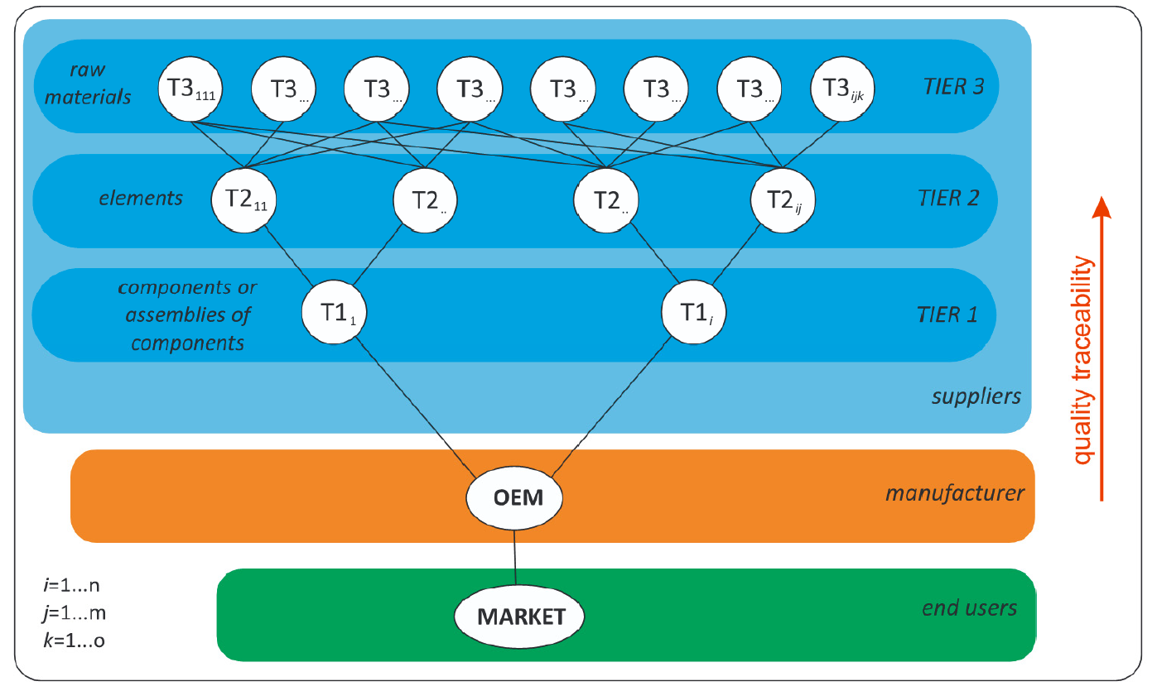
Quality-improvement methods
An example of a supply chain
Notes:
Radej, B., Drnovšek, J., Begeš, G. An overview and evaluation of quality‐improvement methods from the manufacturing and supply‐chain perspective, Advances in Production Engineering & Management, Volume 12 | Number 4 | December 2017 | pp 388–400

Slide 12
Quality-improvement methods
Quality Tools
Cause-and-effect diagram
Flow chart
Control table
Control chart
Histogram
Pareto analysis
Scatter plot
Quality-assurance methods
Quality function deployment (QFD)
Statistical process control (SPC)
Failure modes and effect analysis (FMEA)
Plan-Do-Check-Act (PDCA)
Poka-Yoke
5 S
Notes:
Radej, B., Drnovšek, J., Begeš, G. An overview and evaluation of quality‐improvement methods from the manufacturing and supply‐chain perspective, Advances in Production Engineering & Management, Volume 12 | Number 4 | December 2017 | pp 388–400

Slide 13
Quality-improvement methods
Optimizing the internal processes
FMEA
PDCA
Poka-Yoke
Optimizing product quality
QFD
Cause-and-Effect diagrams
Notes:
Radej, B., Drnovšek, J., Begeš, G. An overview and evaluation of quality‐improvement methods from the manufacturing and supply‐chain perspective, Advances in Production Engineering & Management, Volume 12 | Number 4 | December 2017 | pp 388–400

Slide 14
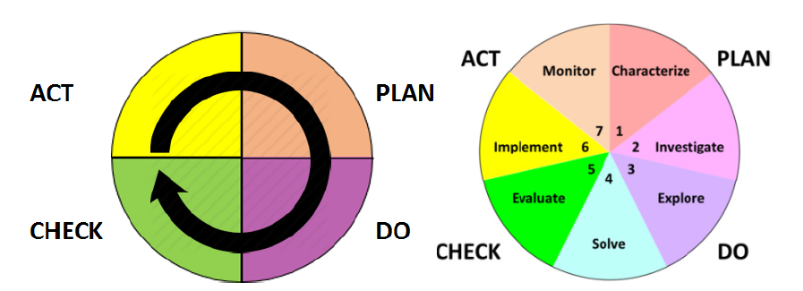
Quality-improvement methods
Improved PDCA method in manufacturing process
Notes:
Radej, B., Drnovšek, J., Begeš, G. An overview and evaluation of quality‐improvement methods from the manufacturing and supply‐chain perspective, Advances in Production Engineering & Management, Volume 12 | Number 4 | December 2017 | pp 388–400

Slide 15
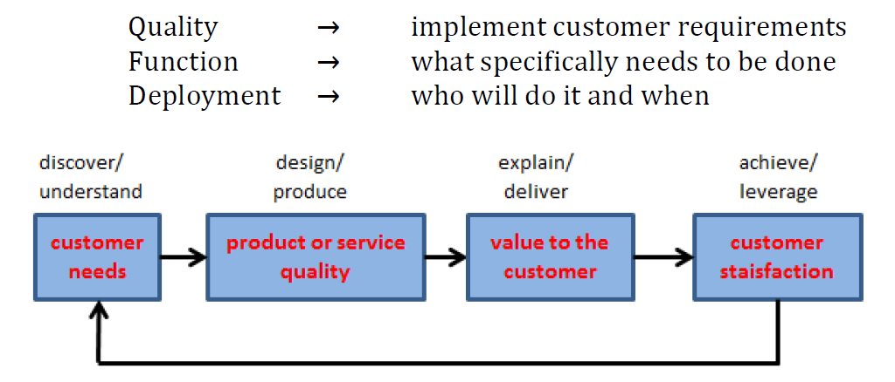
Quality-improvement methods
QFD method in manufacturing processes
Notes:
Radej, B., Drnovšek, J., Begeš, G. An overview and evaluation of quality‐improvement methods from the manufacturing and supply‐chain perspective, Advances in Production Engineering & Management, Volume 12 | Number 4 | December 2017 | pp 388–400

Slide 16
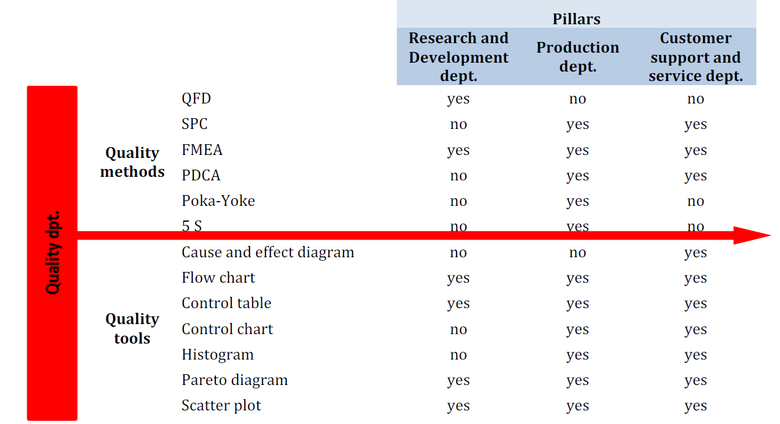
Quality-improvement methods
The prime responsibility and initiatives for a particular pillar in terms of quality deployment.
Notes:
Radej, B., Drnovšek, J., Begeš, G. An overview and evaluation of quality‐improvement methods from the manufacturing and supply‐chain perspective, Advances in Production Engineering & Management, Volume 12 | Number 4 | December 2017 | pp 388–400

Slide 17
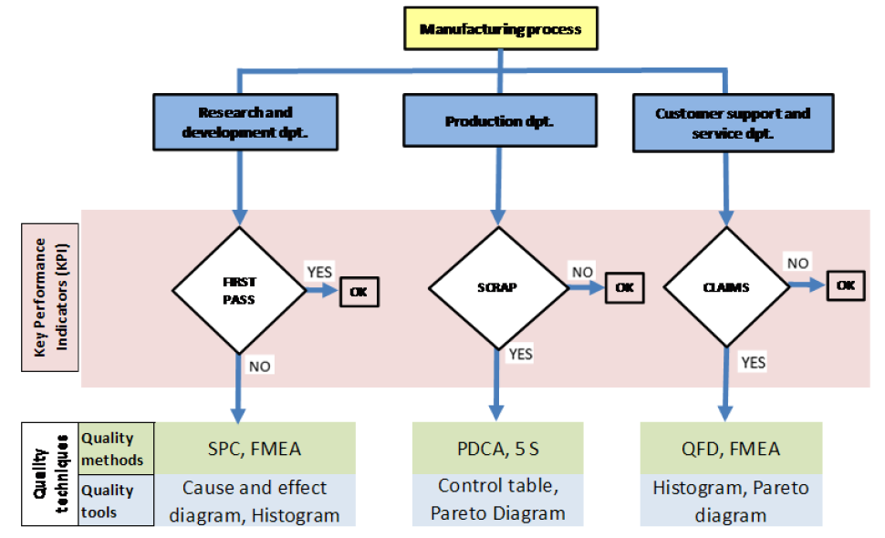
Quality-improvement methods
Application Techniques of quality methods and tools
Notes:
Radej, B., Drnovšek, J., Begeš, G. An overview and evaluation of quality‐improvement methods from the manufacturing and supply‐chain perspective, Advances in Production Engineering & Management, Volume 12 | Number 4 | December 2017 | pp 388–400

Slide 18
Quality-improvement methods
Application Techniques of quality methods and tools
Notes:
Radej, B., Drnovšek, J., Begeš, G. An overview and evaluation of quality‐improvement methods from the manufacturing and supply‐chain perspective, Advances in Production Engineering & Management, Volume 12 | Number 4 | December 2017 | pp 388–400

Slide 19
Strategy for quality systems automation
Mission statement for automation
Automatically to acquire, manage and provide quality information in the enterprise such that correct, timely information is available for decision support and reporting purposes at all levels
To form a nexus which will facilitate integration of quality information with the other sub-systems of the business, in a move towards computer-integrated manufacturing (CIM)
Notes:
J.D.T. Tannock, 1992, Automating Quality Systems – a guide to the design and implementation of automated quality systems in manufacturing, Chapman & Hall

Slide 20
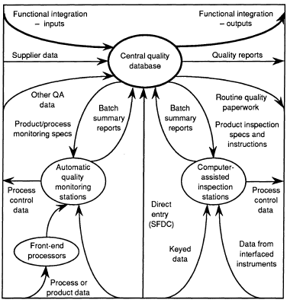
Strategy for quality systems automation
The Integrated quality System (IQS)
Consisting of quality data collection and management
Central quality database provides the generalized quality data from manufacturing
Quality data obtained by direct entry, CAI stations, or fully automatic quality monitoring
Notes:
J.D.T. Tannock, 1992, Automating Quality Systems – a guide to the design and implementation of automated quality systems in manufacturing, Chapman & Hall

Slide 21
Strategy for quality systems automation
Quality data collection strategy
Direct entry – the inspection task is a manual or visual one, and the quality information is entered via a terminal for transmission directly to the database
Computer-aided inspection(CAI) - a local computer gives instructions to a human inspector as to the inspection procedures and use of measurement equipment, and accepts product or process quality information directly from the equipment for local evaluation and recording
Automated inspection - the data collection, analysis, communications and perhaps process control elements of the task are performed without human intervention
Notes:
J.D.T. Tannock, 1992, Automating Quality Systems – a guide to the design and implementation of automated quality systems in manufacturing, Chapman & Hall

Slide 22
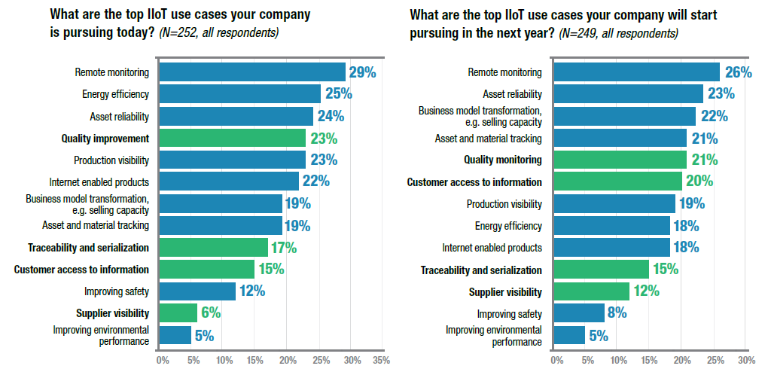
Strategy for quality systems automation
Notes:
LNS research, Quality 4.0 Impact and Strategy Handbook- Getting digitally connected to Transform Quality Management

Slide 23
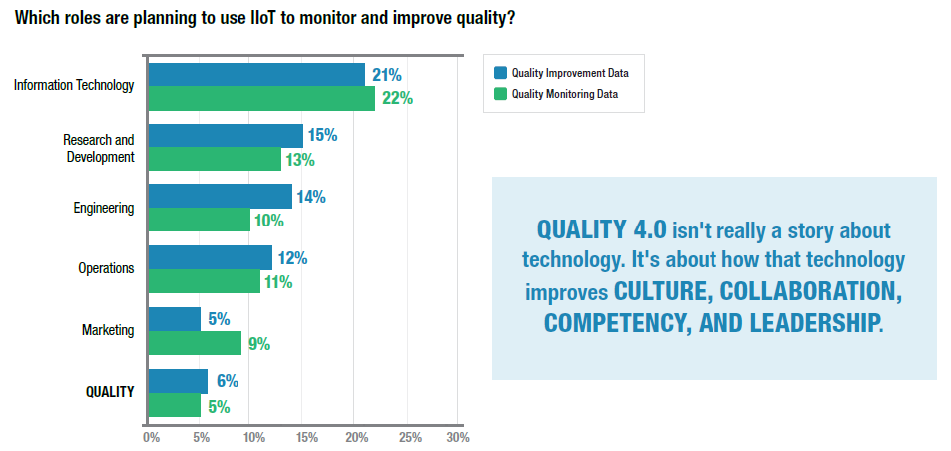
Strategy for quality systems automation
Notes:
LNS research, Quality 4.0 Impact and Strategy Handbook- Getting digitally connected to Transform Quality Management

Slide 24
A Case Study on Quality Improvement
A manufacturer of household electronic appliances
Using open-source and freely-available software : WEKA
Running on readily available hardware
Using only existing data-collection points
Provide actionable feedback
Results: Make improvements to the manufacturing operations, and to increase product quality.
Notes:
Harley Oliff, Ying Liu, 2017, Towards Industry 4.0 Utilizing Data-Mining Techniques: a Case Study on Quality Improvement, Procedia CIRP

Slide 25
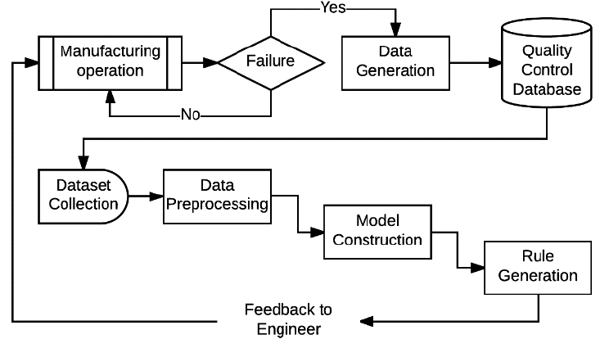
A Case Study on Quality Improvement
Notes:
Harley Oliff, Ying Liu, 2017, Towards Industry 4.0 Utilizing Data-Mining Techniques: a Case Study on Quality Improvement, Procedia CIRP

Slide 26
A Case Study on Quality Improvement
Algoritms
The PART algorithm uses a divide-and-conquer approach to build a decision tree, before ‘pruing’ the unnecessary structures within the tree
The Jrip or RIPPER algorithm
Sample
6000 instances of quality control entries
Validation
10-fold-cross-validation
Accuracy JRiP - 94.5%, PART – 96.0%
Notes:
Harley Oliff, Ying Liu, 2017, Towards Industry 4.0 Utilizing Data-Mining Techniques: a Case Study on Quality Improvement, Procedia CIRP

Slide 27
A Case Study on Quality Improvement
Notes:
Harley Oliff, Ying Liu, 2017, Towards Industry 4.0 Utilizing Data-Mining Techniques: a Case Study on Quality Improvement, Procedia CIRP

Slide 28
A Case Study on Quality Improvement
To utilize data mining to improve assembly and quality control processes
To demonstrate an effective Decision Support System and qualifies at the cognition level in the 5C’s architecture; demonstrating a level of intelligence in-line with the Industry 4.0 initiative
The final system works with archived data and has s low computational requirement by design
Notes:
Harley Oliff, Ying Liu, 2017, Towards Industry 4.0 Utilizing Data-Mining Techniques: a Case Study on Quality Improvement, Procedia CIRP

Slide 29
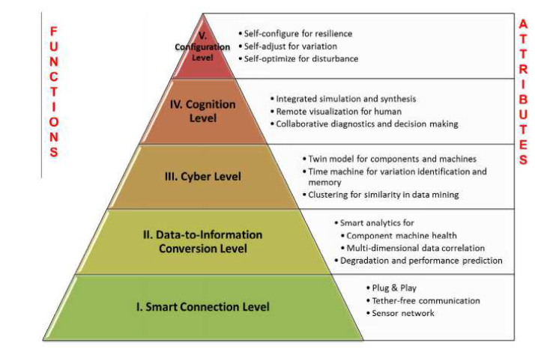
A Case Study on Quality Improvement
Notes:
Harley Oliff, Ying Liu, 2017, Towards Industry 4.0 Utilizing Data-Mining Techniques: a Case Study on Quality Improvement, Procedia CIRP

