Slide 1
Quality Control Concepts and Tools
Course 4: Quality Management for Extended Enterprise

Slide 2
Outlines
Intro to statistical process control
Basic SPC tools
Control charts

Slide 3
SPC
Statistical process control (SPC) is defined as the use of statistical techniques to control a process or production method ^{[1]}
SPC tools and procedures can help you monitor process behavior, discover issues in internal systems, and find solutions for production issues.
Statistical process control is often used interchangeably with statistical quality control (SQC), which is also
  a key continuous improvement tool
  a fundamental tool in six sigma methodology
^{[1]} https://asq.org/quality-resources/statistical-process-control

Slide 4
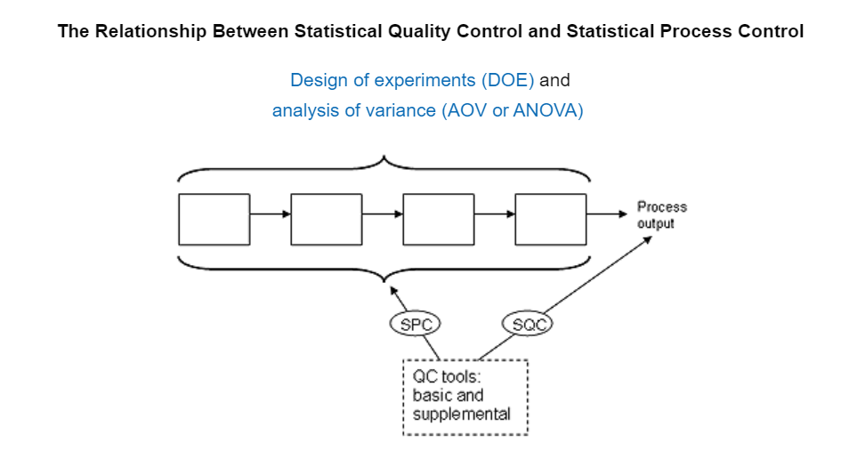
SQC vs. SPC
https://asq.org/quality-resources/statistical-process-control

Slide 5
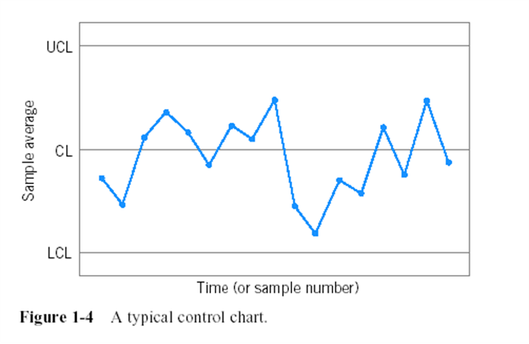
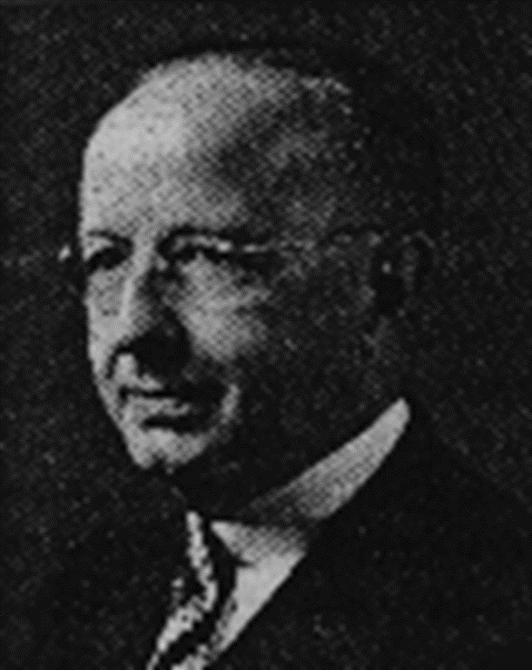
Statistical Process Control (SPC)
The first control chart was developed around 1924^{[1]} by Walter A. Shewhart as a method to improve or achieve quality control in a manufacturing process
^{[1]} Introduction to Statistical Quality Control, 6th Edition by Douglas C. Montgomery.
Walter A. Shewart (1891-1967)

Slide 6
Basic SPC Tools
Cause-and-Effect diagram
Check sheet
Control chart
Histogram
Pareto chart
Scatter diagram
Defect concentration diagram

Slide 7
An Application of SPC
Improving quality in a copper plating operation at a printed circuit board fabrication plant
The DMAIC process was used
During the define step, the team decided to focus on reducing flow time through the process
During the measures step, controller downtime was recognized as a major factor in excessive flow time

Slide 8
Cause-and-Effect Diagram

Slide 9
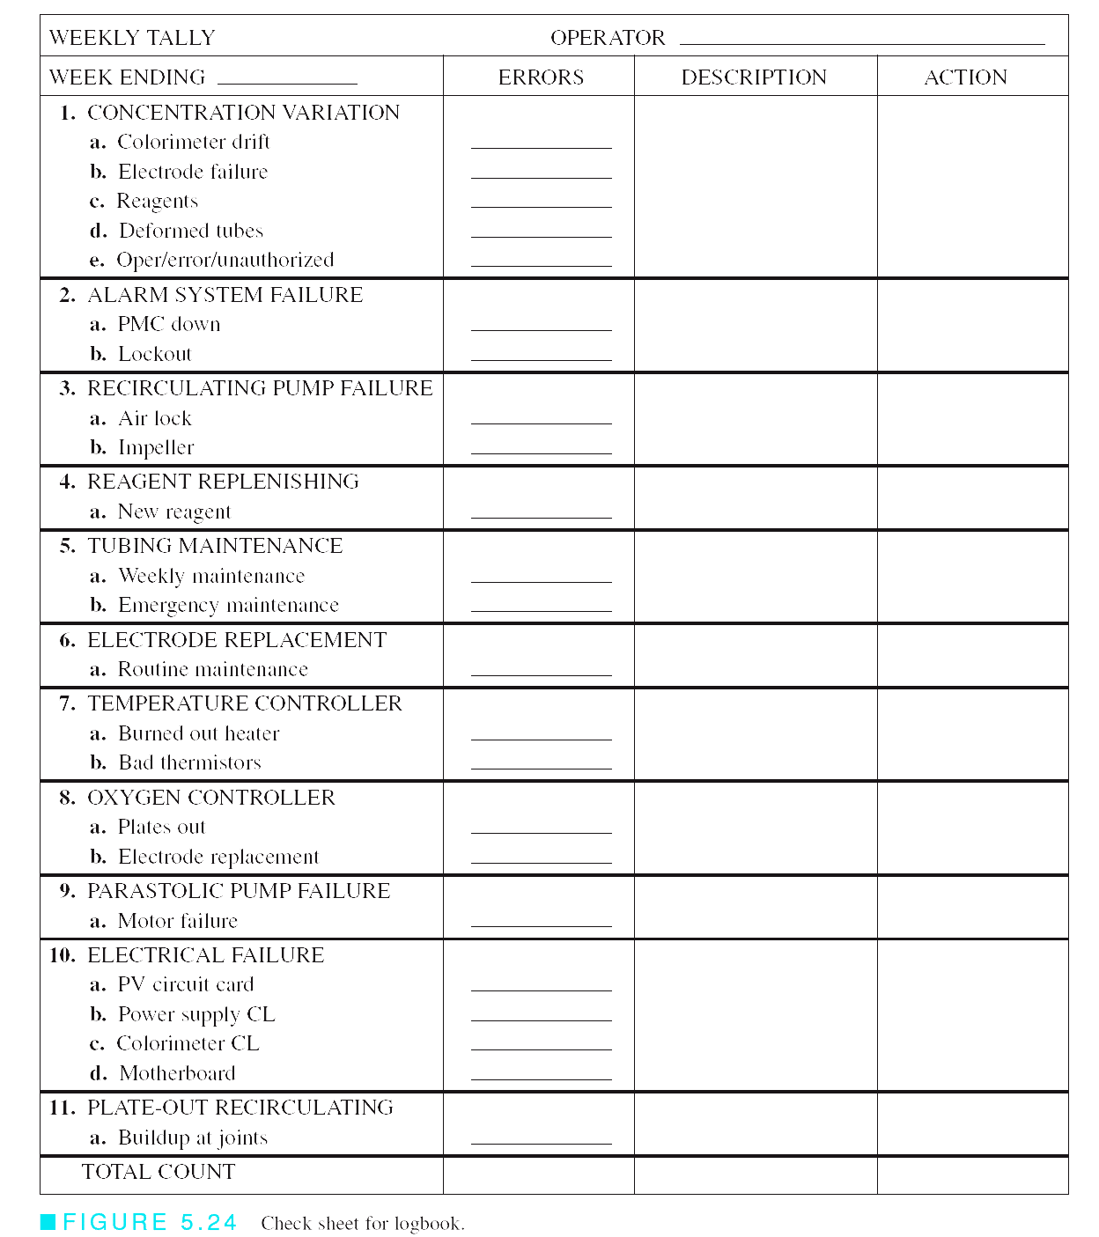
Check Sheet

Slide 10
Pareto Diagram

Slide 11
Control Chart
X chart
R chart

Slide 12
Control Chart
Course 4: Quality Management for Extended Enterprise

Slide 13
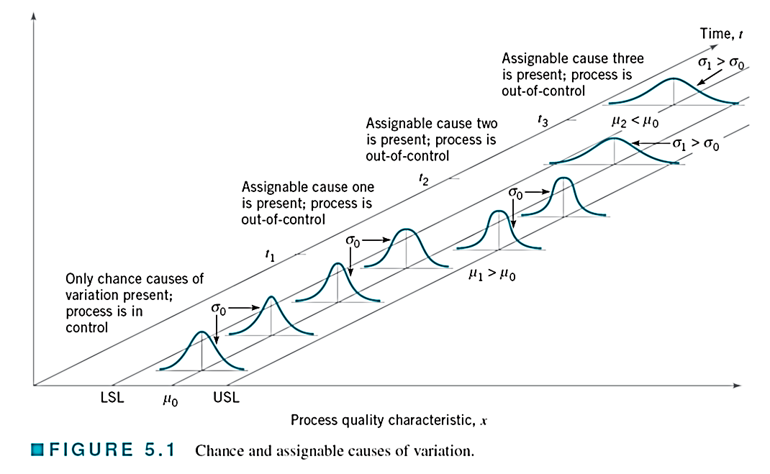
Process Center and Process Variability

Slide 14
Two Sources of Variability
1. Due to chance causes
Chance cause (Shewhart) = common cause (Juran) = white noise (GE) = background noise = Inherent cause
The chance-cause variation is inherent in a production process and inevitable
  Humidity, temperature, etc. (due to environment)
A process that is operating with only chance causes of variation (or natural variability) present is said to be in statistical control

Slide 15
Two Sources of Variability (cond.)
1. Due to assignable causes
Assignable cause (Shewhart) = special cause (Juran) = black noise = external cause
The assignable-cause variation is very critical, and so the cause must be identified
  Operator errors, defective raw materials, improperly adjusted machines, etc.
A process that is operating in presence of assignable causes of variation is said to be out of control

Slide 16
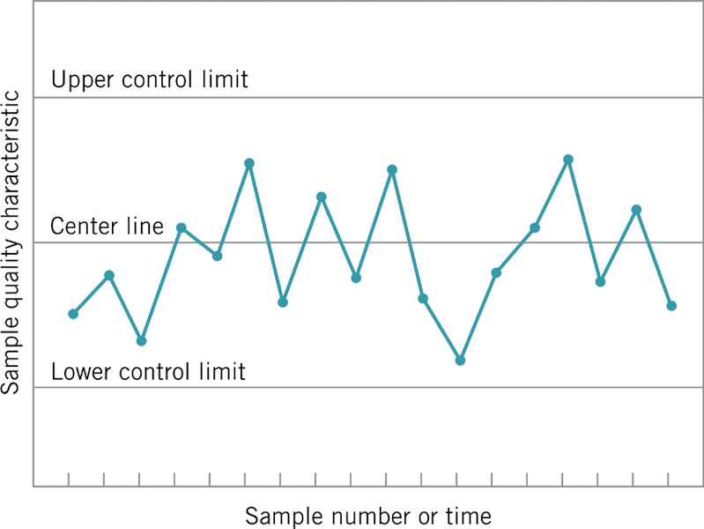
Basis of the Control Chart
A control chart contains
  A center line
  An upper control limit
  A lower control limit
Process is in control
  No action is necessary
Process is out of control
  Investigation / action are required to find / eliminate assignable causes
Close connection between control charts and hypothesis testing

Slide 17
Main Purpose of Control Charts
Quickly detect process shifts
Identify assignable causes
Take corrective actions (before many nonconforming units are manufactured)
Reduce process variability
Improve process quality
Maximize product quality
Satisfy customers
Gain market share

Slide 18
Steps of Control Charts
1. Define process parameters
2. Design Samples
3.Determine CL, UCL, and LCL
4. Plot data
5. Make judgments

Slide 19
1. Define Process Parameter
a.k.a, Quality characteristics of interest
Three types of Process Parameter
  Variables data (quantitative data)
  Attributes data (qualitative data)
  Time-oriented data
Selection of control charts (CCs)
  CCs for variables ➔ Xbar-R charts, Xbar-S charts
  CCs for attributes ➔ p-chart, c-chart, u-chart

Slide 20
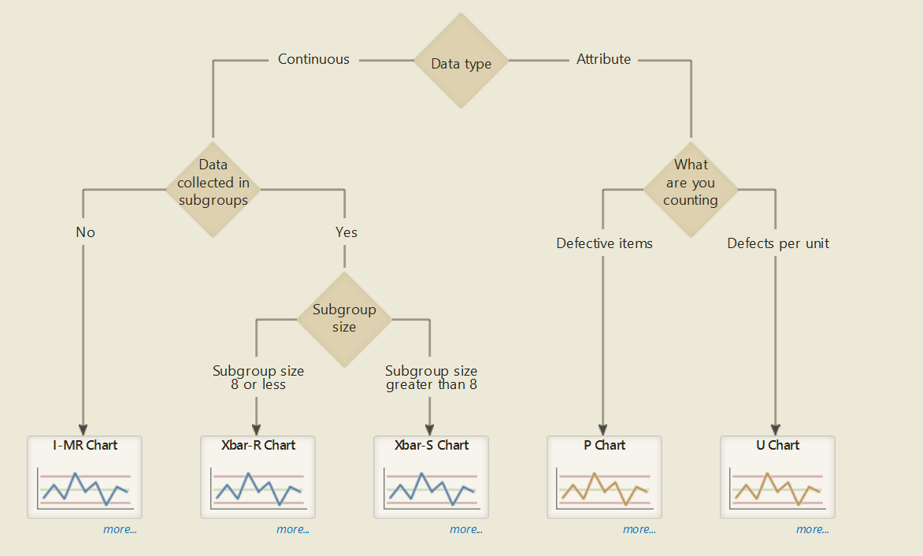
Type of Control Charts
Minitab 18®

Slide 21
2. Design Samples
With data which are not obtained from a production process in a rational manner or not subgrouped in a rational manner, a control chart will be nothing more than wallpaper!
Therefore, three decisions must be made when designing a control chart, which are
  Sampling frequency
  Selection of subgroup
  Sample size

Slide 22
i. Sampling Frequency
There are several major strategies that may be employed in sampling frequency
Use of regular intervals with grouped spacing (= clustering) or regular intervals with individual unit spacing
Use of random intervals with grouped spacing or with individual unit spacing
Use of regular interval sampling with judgment-based modification

Slide 23
ii. Selection of subgroup
When control charts are applied to production processes, time order of production is a logical basis for rational subgroups
Be careful! Although time order is preserved, it is still possible to form subgroups erroneously. If some of the observations are taken at the end of one shift and the remaining observations are taken at the start of the next shift, then any differences between shifts might not be detected

Slide 24
ii. Selection of subgroup (cond.)
Two general approaches to select subgroups
Each sample consists of units that are produced at the same time (or as closely together as possible)
  This approach is often used when the primary purpose of the control chart is to detect process shifts
Each sample consists of units of product that are representation of all units that have been produced since the last sample was taken
  This approach is often used, when the control chart is employed to make decisions about the acceptance of all units of product that have been produced since the last sample.

Slide 25
iii. Sample Size
In designing a control chart, we must specify both sample size to use and the sampling frequency. They are often treated as decision variables in the area called “economic design of control charts.” In general,
  Larger samples (= lager sample size) will make it easier to detect small shifts in the process.
  Smaller sample sizes will make it easier to detect a large shift in the process.
Tip: When determining the sample size, you must keep in mind the size of the shift that you are trying to detect.

Slide 26
Sample Size / Sampling Frequency
There are four possible cases:
Use larger sample sizes at short intervals.
Use larger sample sizes at longer intervals.
Use small sample sizes at short intervals.
Use small sample sizes at longer intervals.

Slide 27
Control Limits and Specification Limits
Control limits:
  Statistical calculation from a process
  Process limits are used for individual items
  Control limits are used with averages
  Limits = μ ± 3σ
  Define usual (common causes) & unusual (special causes)
Specification limits:
  Engineered
  Limits = target ± tolerance
  Define acceptable & unacceptable

Slide 28
Control Limits and Specification Limits (cond.)
(LCL, UCL) ≠ (LSL, USL).
Specification limits are used to identify whether or not a
component or product (i.e., n=1) is defective. If a defect is found, it needs to be reworked or scrapped.
In contrast, control limits are used to identify whether or not a process is in control by utilizing a number of random samples (usually n ≥ 3)

Slide 29
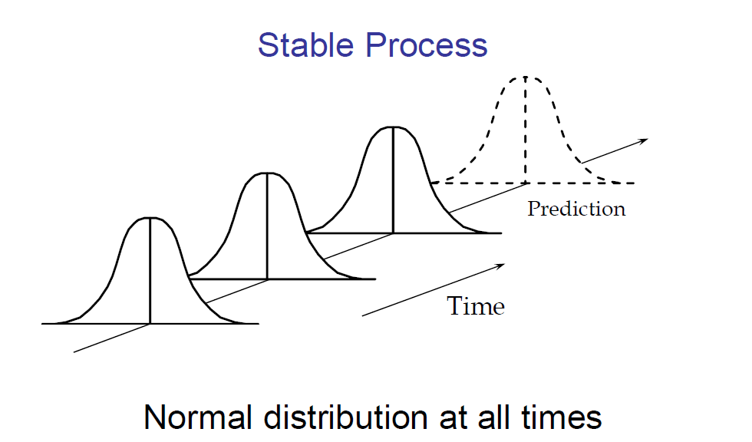
Examining Variation

Slide 30
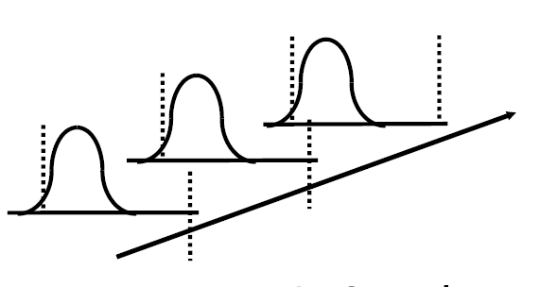
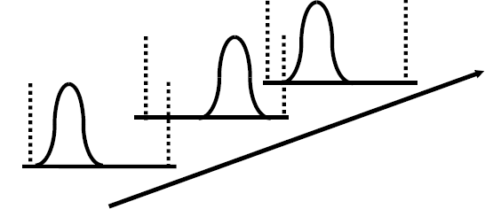

Statistically in Control vs. Technically in Control
Time
Statistically controlled process
inhibits only natural random fluctuations (common causes)
is stable
is predictable
may yield products out of specification
Technically controlled process
yields products within specification
may not be stable and so may not be predictable

Slide 31
Phase I and Phase II of Control Chart Application
Phase I is a retrospective analysis of process data to construct trial control limits
  Charts are effective at detecting large, sustained shifts in process parameters, outliers, measurement errors, data entry errors, etc.
  Facilitates identification and removal of assignable causes
In phase II, the control chart is used to monitor the process
  Process is assumed to be reasonably stable
  Emphasis is on process monitoring, not on bringing an unruly process into control

Slide 32
Control Chart Pattern
In the implementation of control charts, the process should be considered out-of-control when points fall outside the chart control limits, or when control charts present unnatural patterns ^{[1]}
Unnatural patterns in a control chart can be associated with a specific set of assignable causes provided that appropriate process knowledge is available ^{[2]}
Hence, control chart pattern (CCP) recognition is the most important supplement and enhancement to the conventional control charting ^{[3]}
[1] Montgomery DC. Introduction to Statistical Quality Control (3rd edn). Wiley: New York, 1996.
[2] Western Electric. Statistical Quality Control Handbook. Western Electric Company: New York, 1958.
[3] Guh, R. S. (2003). Integrating artificial intelligence into on‐line statistical process control. Quality and reliability engineering international, 19(1), 1-20.

Slide 33
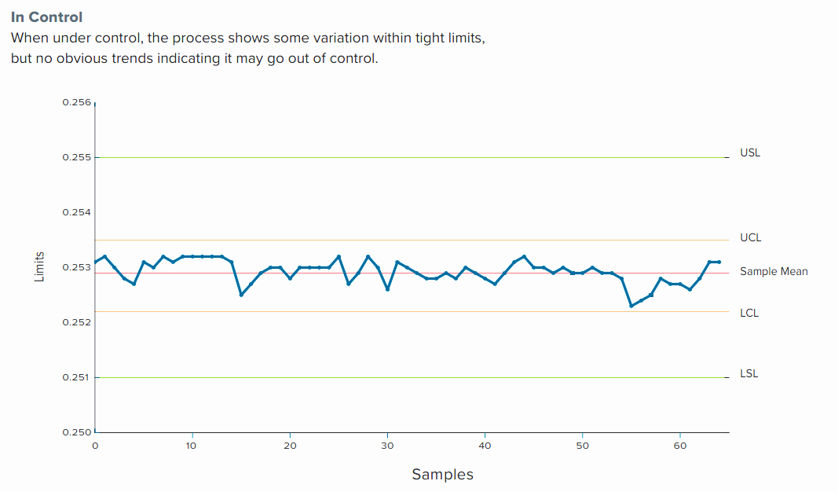
In-Control Process
[Ref] Technical Note. “PREDICTIVE STATISTICAL PROCESS CONTROL”. An update on data-driven CNC machining at L&S Machine Company.

Slide 34
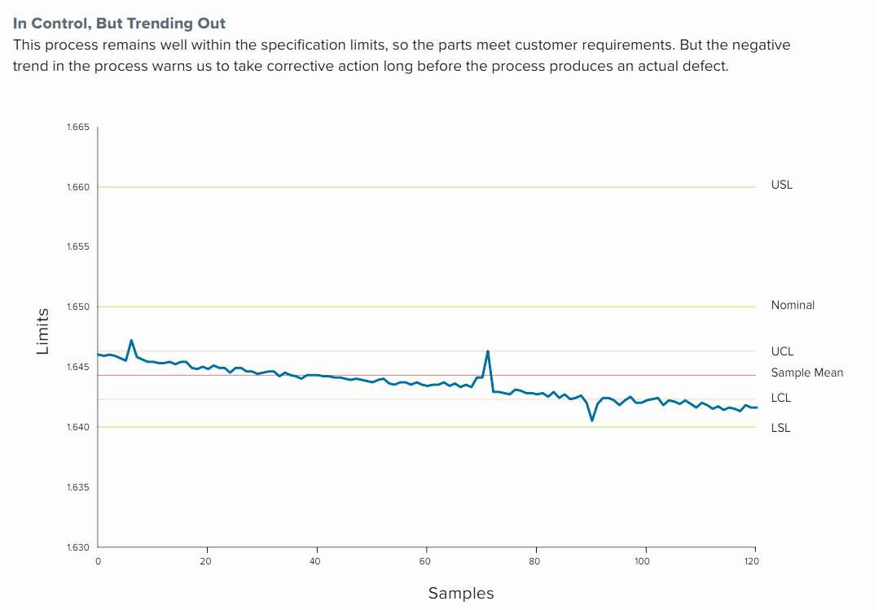
In-control, But Trending out
[Ref] Technical Note. “PREDICTIVE STATISTICAL PROCESS CONTROL”. An update on data-driven CNC machining at L&S Machine Company.

Slide 35
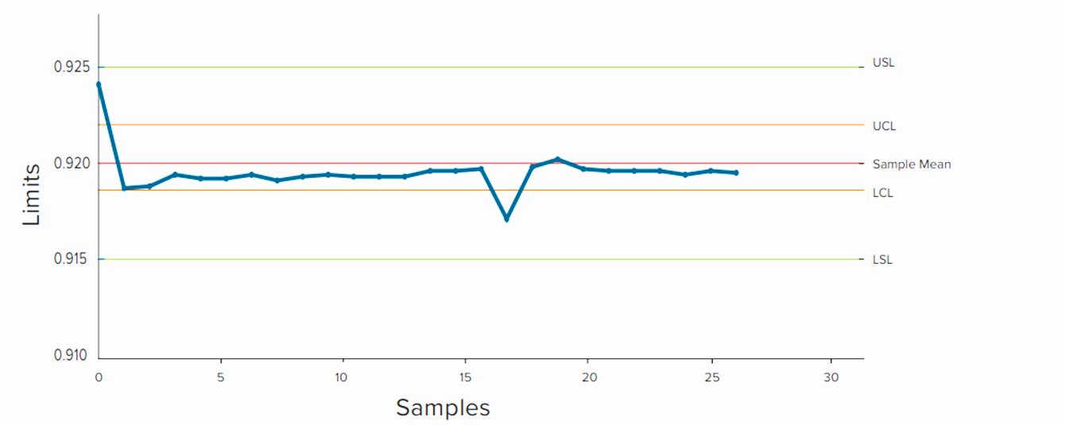
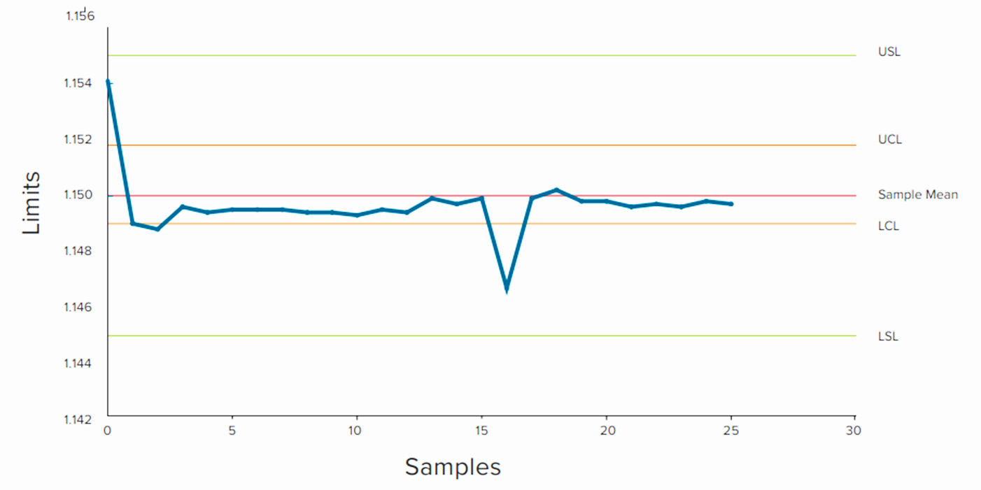
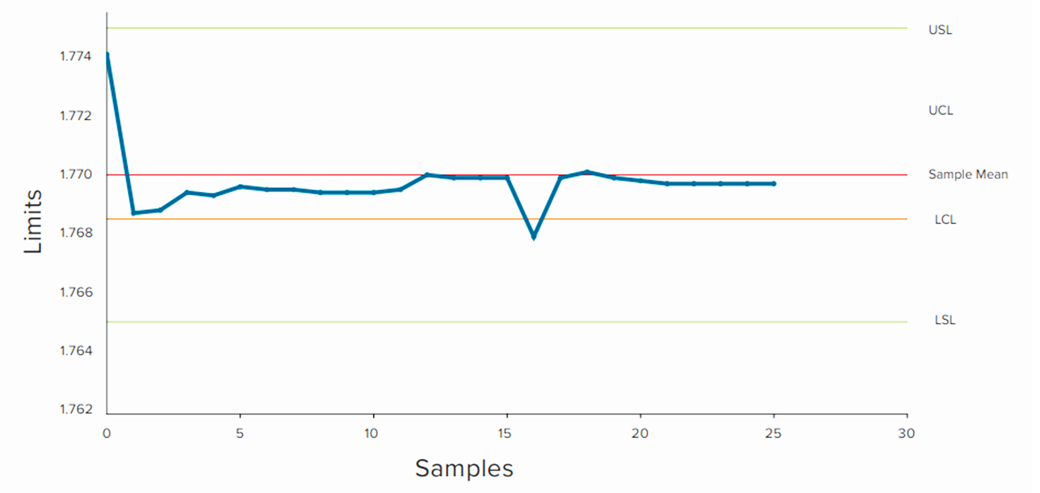
Predictive Tool Wear
Tool wear is easily identified through a careful monitoring of process control charts.
In these three samples, the same tool used on three different features on the same part shows variation at the same sample, indicating the presence of tool wear.
[Ref] Technical Note. “PREDICTIVE STATISTICAL PROCESS CONTROL”. An update on data-driven CNC machining at L&S Machine Company.

Slide 36
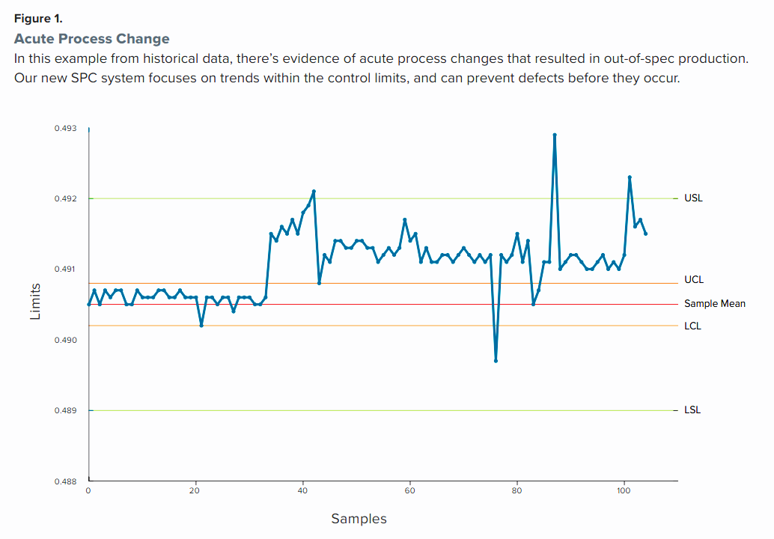
Acute Process Change
[Ref] Technical Note. “PREDICTIVE STATISTICAL PROCESS CONTROL”. An update on data-driven CNC machining at L&S Machine Company.

Slide 37
Implementation of Control Chart
Determining which process characteristics to control
Determining where the charts should be implemented in the process
Choosing the proper type of control charts
Taking actions to improve processes as the result of SPC/control chart analysis
Selecting data-collection systems and computer software

Slide 38
Summary
Histograms, probability plots, and process capability ratios summarize the performance of the process.
Control charts are very effective in
  Display the potential capability of the process
  Address the issue of statistical control
  Show systematic patterns in process output
Thus, the control chart should be regarded as the primary technique of process capability analysis.

