Slide 1
Quality Strategy for Digital Quality Management System
name

Slide 2
Module outcomes
Understand and assess customers’ needs
Define technologies in Industry 4.0 in response to customers’ needs
Transform traditional production system, organization, and quality culture to digital quality management system

Slide 3
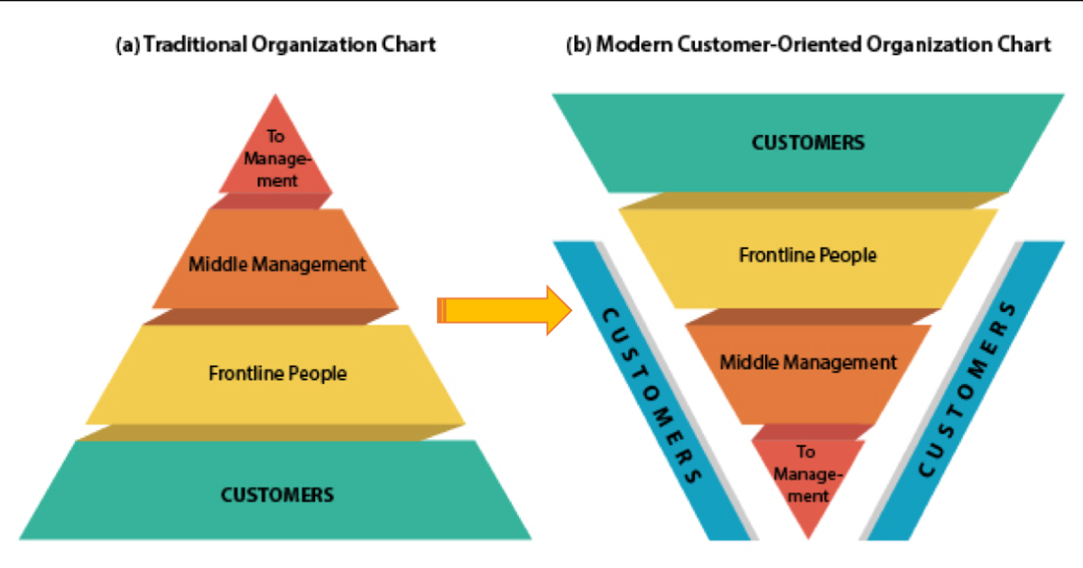
Customer-driven organizations
Customer- and market-driven enterprise is committed to providing excellent quality and competitive products and services to satisfy the needs and wants of a well-defined market segment (Edosomwan, 1993).
Short-term focus
Bottom-line financial results & quick return
Customers are irrational and a pain
Focus on error and defect detection
Product-driven
Crisis management
Long-term focus
Focus on customer satisfaction
Voice of customer is important
Focus on error and defect prevention
Customer-driven
Continuous process improvement
(from Kotler, 1991)

Slide 4
Customer-driven organizations
5 traits of customer-driven organizations
Flatten hierarchies
Adaptable processes
Effective communication
Measuring results
Rewarding employees
From “100 Of The Most Customer-Centric Companies” (https://www.forbes.com/sites/blakemorgan/2019/06/30/100-of-the-most-customer-centric-companies/#65c7b9ef63c3)

Slide 5
Customer Needs: Voice of Customer (VOC)
Voice of customer is “actual customer descriptions in their own words, for the functions and features they desire for the goods and service they need”
Approaches to collect VOC
Existing company information
Competitor benchmark
Complaints
Sales representative billing
Interviews
Surveys
Focus groups

Slide 6
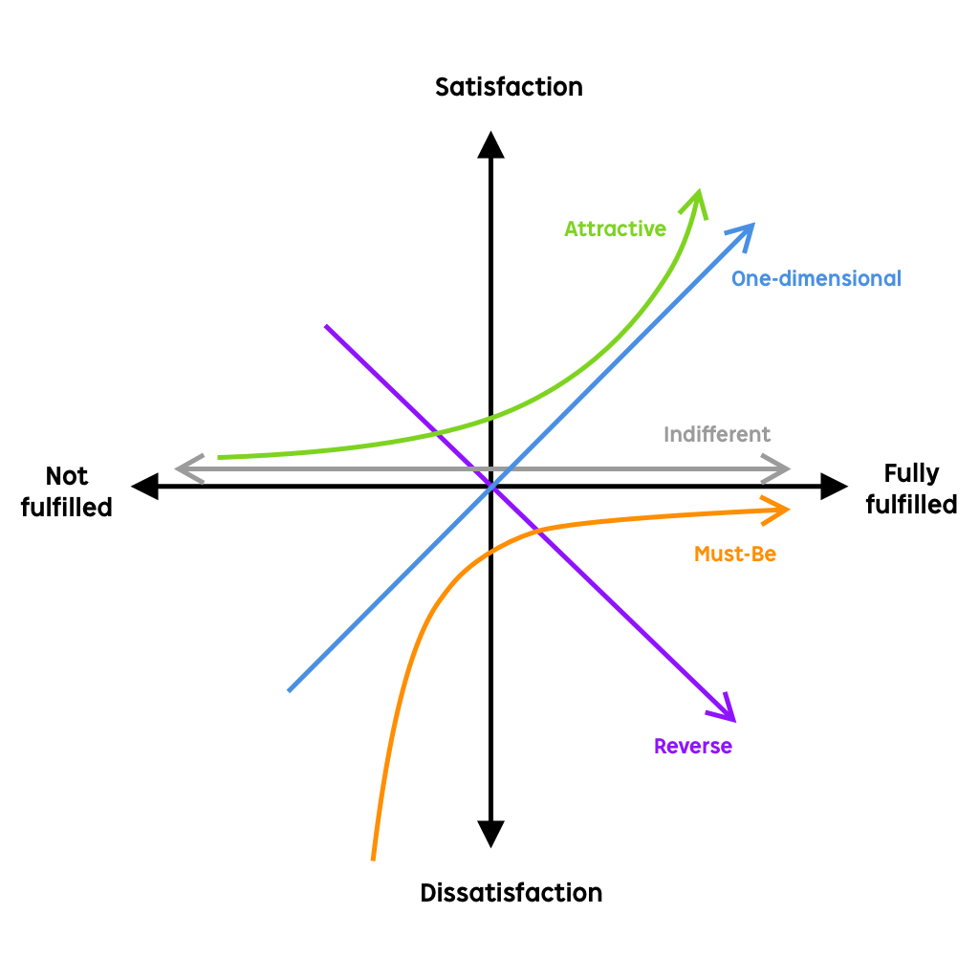
The Kano Model: Delivering Products That Will Delight
The Kano Model was developed by Dr. Noriaki Kano in 1984.
The approach to prioritizing features on a product roadmap based on the degree to which they are likely to satisfy customers.
5 categories of product features
Quality | What customers think | What we should do
Attractive | Satisfied if having this feature that is not expected | Definitely invest in this feature
Must-be | Unsatisfied if not having this feature | Cannot ignore this feature
One-dimensional | The more this feature is provided, the more satisfied | Find the threshold to invest in this feature
Indifferent | Do not care if this feature exists or not | No need to invest in this feature
Reverse | Unsatisfied if having this feature | Do not invest in this feature

Slide 7
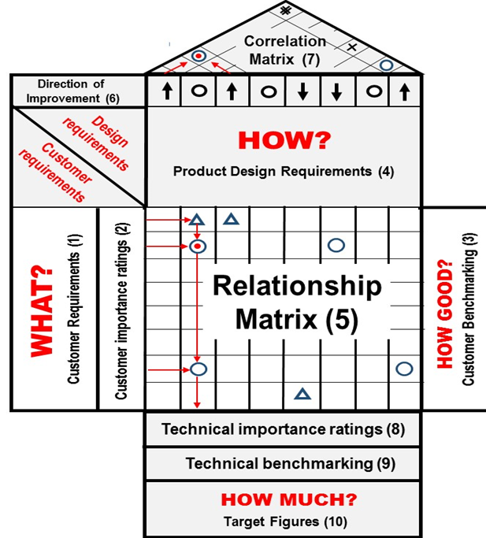
Quality Function Deployment (QFD)
Quality Function Deployment (QFD, House of Quality) is an approach to transferring customer needs and requirement into technical specification for new product and service development
Benefit of QFD
Customer driven
Reduce time
Promotes teamwork
Provides documentation

Slide 8
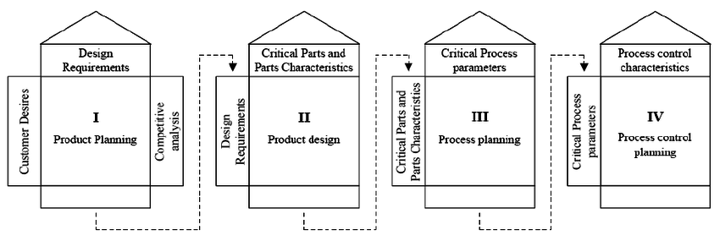
4 Phases of QFD process

Slide 9
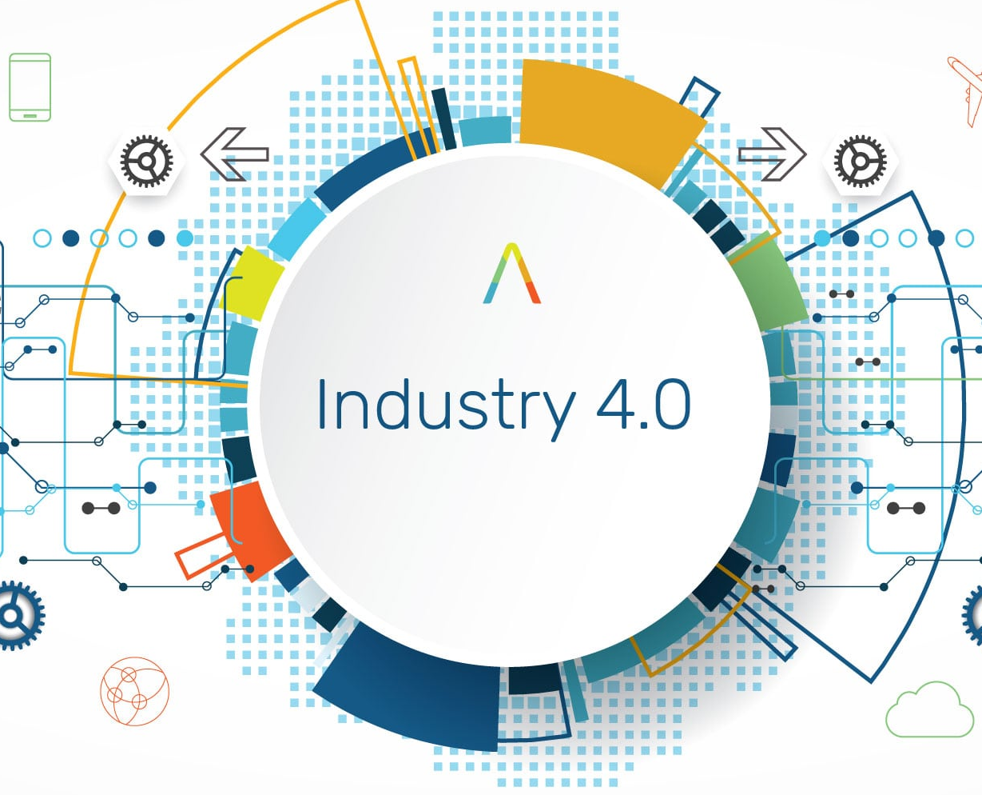
Workshop
Defining Strategy for QMS in Industry 4.0

Slide 10
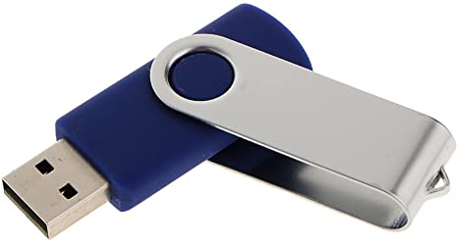
Workshop: Overview
Situation
Company A is a large manufacturer of USB flash drives for domestic and international markets. The manufacturing process is shown in the VDO below.
How's a USB Flash Drive Made? Trip to the Kingston Production Plant
Click: https://www.youtube.com/watch?v=g_6mMFmes1s

Slide 11
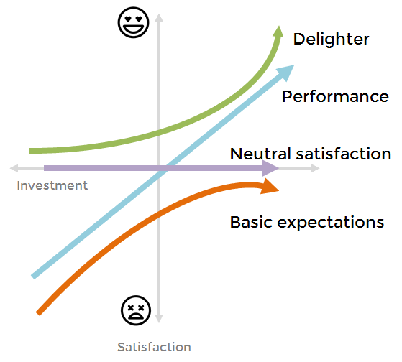
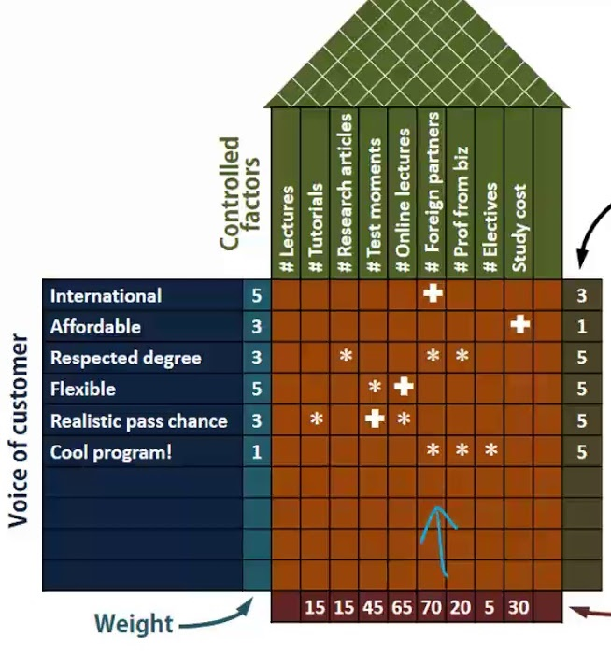
Workshop: Overview
However, with rapid technological change, CEO of Company A is facing many challenges. First, the USB flash drive might be obsolete due to the arrival of Cloud storage. Second, many competitors now can produce USB flash drive in a lower cost so that the company might lose the market share. To sustain the business, CEO has an idea of introducing new features for a USB flash drive and launch to the market soon. From the meeting with management team, CEO suggests 4 steps to define strategy to achieve his vision.
Step 1
Step 2
Step 3
Step 4
Conduct a market survey
Prioritize customers’ needs by using Kano Model
Transform needs to specification by using QFD
Define strategies for operation and quality management system

Slide 12
Workshop
Step 1: Acquisition of VOC
The marketing team develops a survey based on 15 features of new USB flash drive and then conduct launches a survey to100 participants. The survey data are presented in the working sheet (Part 1).
USB flash drive features
Fast data transfer
Durable/ long life
Portable/ compact
High capacity
Compatible with every operation system (Both hardware and software)
Quiet
Modern style/ packaging
Password encryption
Non-volatile storage
Consume less energy
Automatically upload to cloud
Indicate while transferring data
No need to eject when removed from PC
Automatically eject when finishing data transfer
Trackable if lost

Slide 13
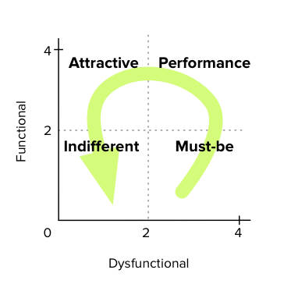
Workshop
Rule of thumb for prioritizing features
Step 2: Application of Kano Model
From the working sheet, your team needs to…
Understand how the questions are designed and how the data are collected
Apply Kano Model: computing user satisfaction score (CS) and use dissatisfaction score (DS)
Visualize CS and DS of all features, prioritize, and select them
Transform the result from Kano Model to QFD score

Slide 14
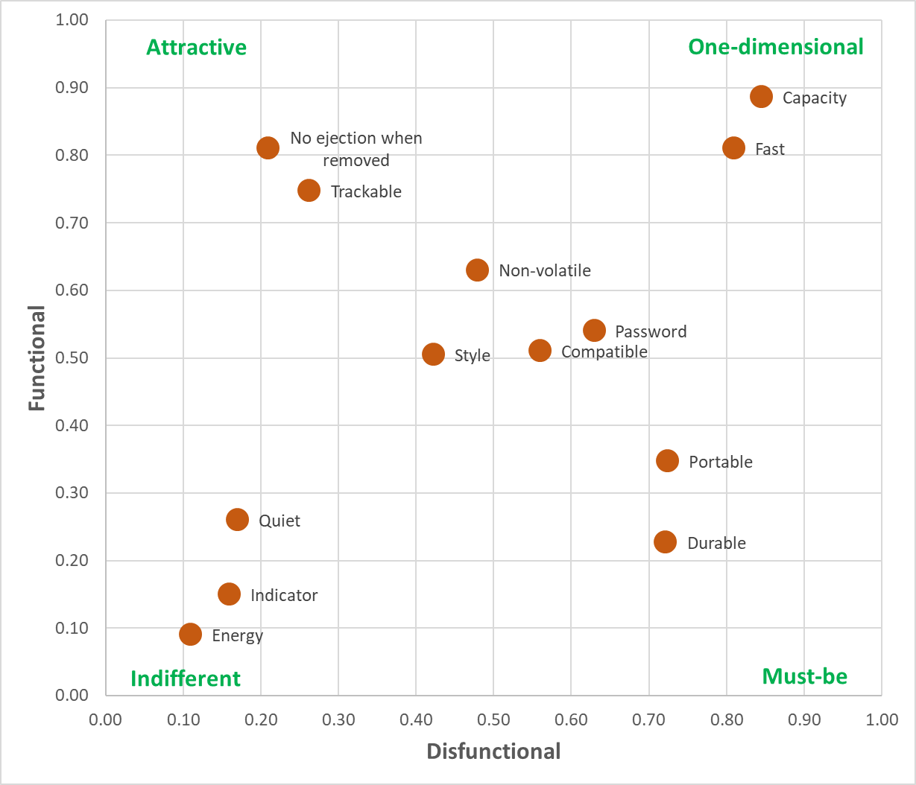
Workshop
The result should look like this…
NOTE: Feature 11 (Automatically upload to cloud) & 14 (Automatically eject when finishing data transfer) are removed due to reverse quality
Now, you need to choose which features to be developed further
Convert CS and DS to QFD score

Slide 15
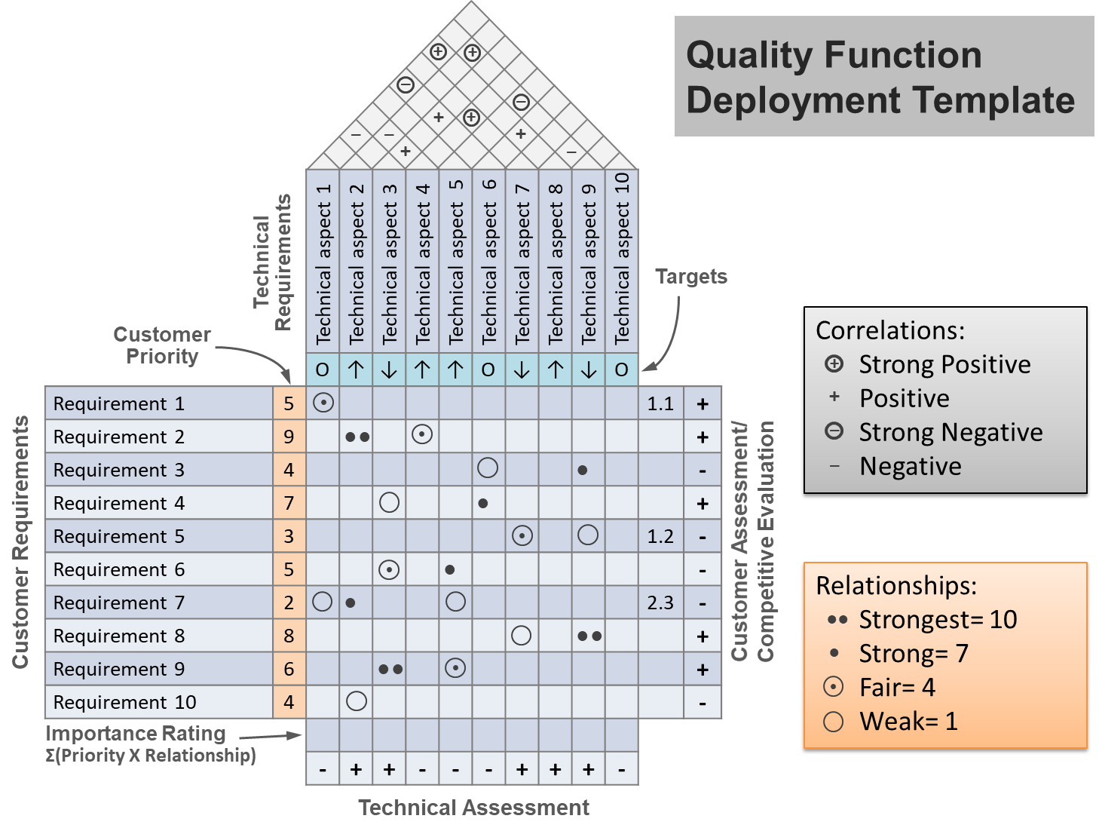
Workshop
Step 3: QFD
After converting scores from Kano Model, you should complete the QFD (only Phase 1). Follow the instruction in the worksheet (Part 2).

Slide 16
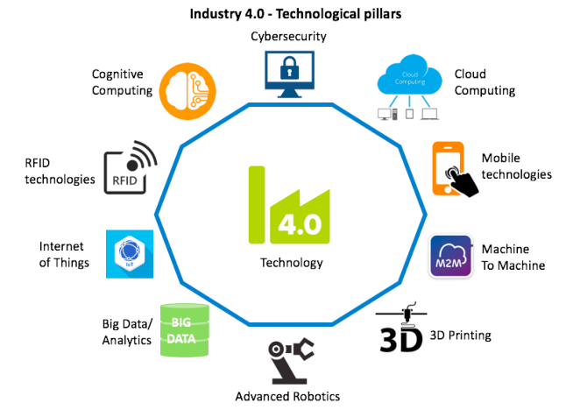
Workshop
Step 4: Defining strategies for QMS
Based on your QFD, select only important technical requirements (speciation) and one technology for Industry 4.0.
Selected technical requirements + one technology for Industry 4.0
At which production processes should be changed to satisfy technical requirements?
How can Industry 4.0 technology improve manufacturing processes?
Based on the selected technical requirements, which processes should be focused to implement new quality management?
How can Industry 4.0 technology help strengthen existing quality management system
Operational strategy
Quality management strategy

