Slide 1
Module 3: Automated Quality Report System
Real-Time Quality Control

Slide 2
What will you learn from this content?
01
Structure and components of the quality control tools and devices
02
Process management of real-time quality control

Slide 3
In-process Quality Control
Notes:
J.D.T. Tannock, 1992, Automating Quality Systems, Chapman & Hall

Slide 4
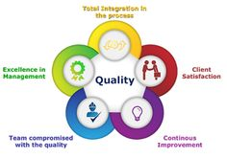
In-process Quality Control
Any effective strategy for product quality must involve the use of an appropriate mix of methods, aimed at eliminating the possibility of unsatisfactory items reaching the customer with minimum additional cost
Notes:
J.D.T. Tannock, 1992, Automating Quality Systems, Chapman & Hall

Slide 5
In-process Quality Control
For manufacturing
Process improvement – to eliminate the possibility of defective items. Eliminating all important causes of process variability.
In-process quality control – monitoring process parameters or in-process inspection of product.
Post-process quality control – to detect and filter out defective items. Sampling inspection combined with SPC methods is sufficient to control the majority of processes.
Notes:
J.D.T. Tannock, 1992, Automating Quality Systems, Chapman & Hall

Slide 6
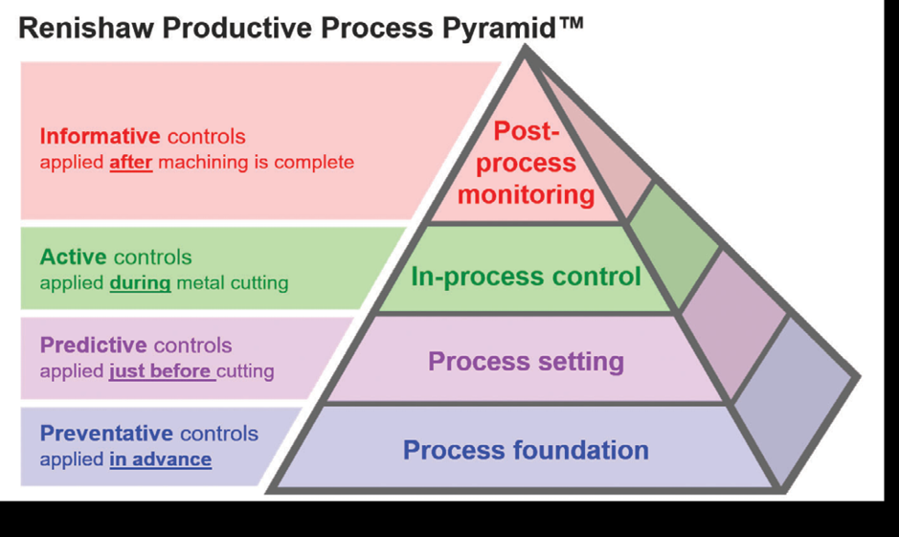
In-process Quality Control
Notes:
https://www.aerospacemanufacturinganddesign.com/article/5-questions-with-dan-skulan/

Slide 7
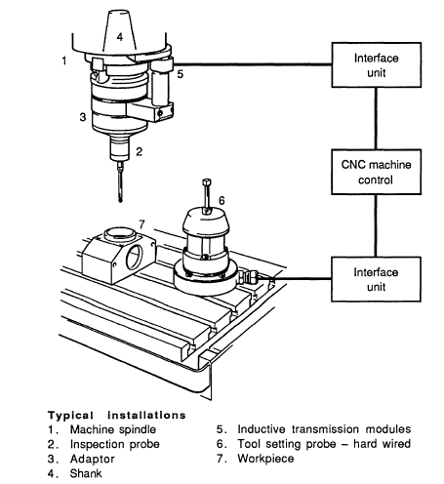
Examples of Automatic In-process Quality Control
In-cycle gauging with CNC machining
Most CNC machines incorporate ‘closed-loop’ positional feedback.
They are fitted with axis measuring scales – sensors to determine the position of the machine slides.
Use of the computer-controlled axis moves of the machine tool to position cutting tools and take cuts and move a probe which is fitted in place of a cutting tool.
Touch trigger probes are used to sense the position and size of the cutting tools
Notes:
J.D.T. Tannock, 1992, Automating Quality Systems, Chapman & Hall

Slide 8
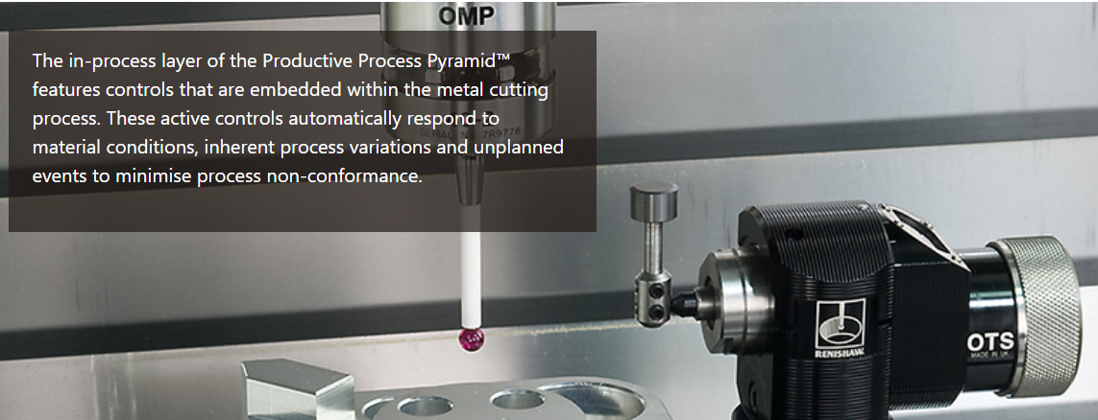
Examples of Automatic In-process Quality Control
Notes:
https://www.renishaw.com/en/in-process-control--14159

Slide 9
Examples of Automatic In-process Quality Control
Plastic injection moulding
Thermoplastic granules are heated, mixed and sheared in a screw preplasticizer until they melt, when they are injected under pressure into a cooled metal mould
Deviations from the set values (melt temperatures; injection, metering and cycle times; melt cushion; pressure integral and maximum value) can be logged, trigger an alarm, or shut down the process according to the extent by which the process tolerance has been exceeded
Software produce SPC control charts based on the process data, with automatically calculated limits which trigger action when a trend is detected
Notes:
J.D.T. Tannock, 1992, Automating Quality Systems, Chapman & Hall

Slide 10
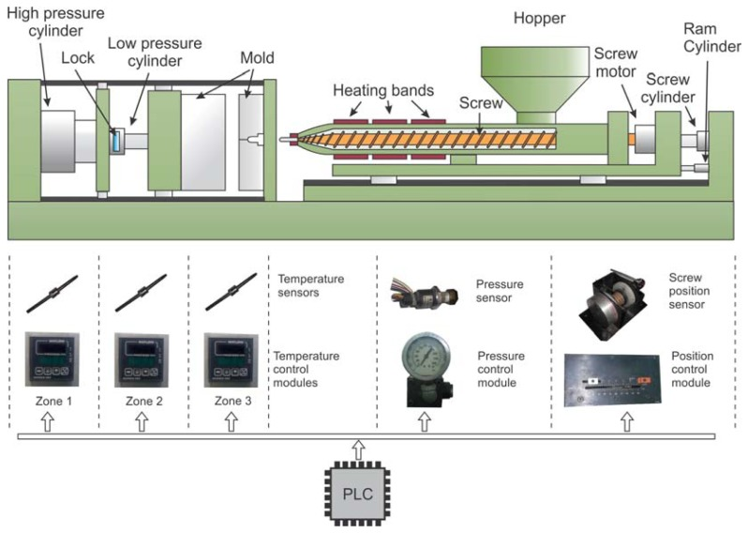
Examples of Automatic In-process Quality Control
Notes:
Benigno Muñoz-Barron, Luis Morales-Velazquez, Rene J. Romero-Troncoso, Carlos Rodriguez-Donate, Miguel Trejo-Hernandez, Juan P. Benitez-Rangel and Roque A. Osornio-Rios , FPGA-Based Multiprocessor System for Injection Molding Control, Sensors 2012, 12, 14068-14083;

Slide 11
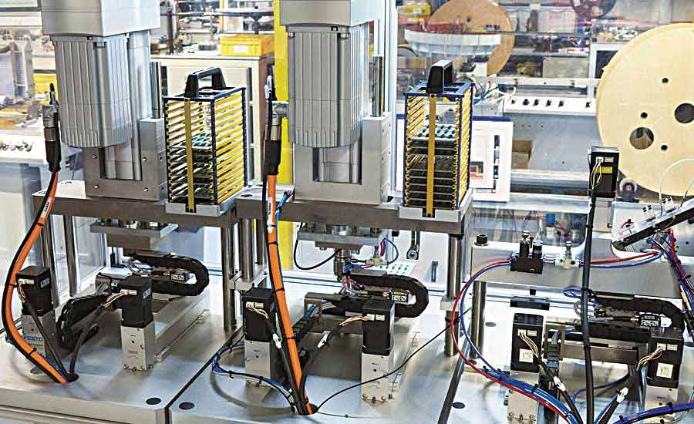
Case Study
Case#1 Assembly Process Monitoring
Monitoring the high-speed automatic assembly of electrical connectors
Moulded plastic bodies with holes into
A flexible computer-controlled manufacturing cell capable of rapid product changeover
Pins were inserted at a rate of ten per second from a bandolier
Plastic bodies were located on carriers which move along a conveyer system
Notes:
J.D.T. Tannock, 1992, Automating Quality Systems, Chapman & Hall

Slide 12
Case Study
Case#1 Assembly Process Monitoring
Quality Problems
Bent or smashed pins
Incorrect pin end position
Incorrect pin protrusion
Insufficient pin retention force
Defects
An infrequent and apparently random occurrence when there was no identifiable process or material fault
An increasing incidence of problems when wear or maladjustment in the insertion mechanism was starting to affect the process
Notes:
J.D.T. Tannock, 1992, Automating Quality Systems, Chapman & Hall

Slide 13
Case Study
Case#1 Assembly Process Monitoring
Quality Problems
Bent or smashed pins
Incorrect pin end position
Incorrect pin protrusion
Insufficient pin retention force
Defects
An infrequent and apparently random occurrence when there was no identifiable process or material fault
An increasing incidence of problems when wear or maladjustment in the insertion mechanism was starting to affect the process
Notes:
J.D.T. Tannock, 1992, Automating Quality Systems, Chapman & Hall

Slide 14
Case Study
Case#1 Assembly Process Monitoring
Solution
A process monitoring with immediate process control feedback
The assembly force was chosen as the only accessible process parameter
A front-end processor allow communications with the assembly machine controller
Notes:
J.D.T. Tannock, 1992, Automating Quality Systems, Chapman & Hall

Slide 15
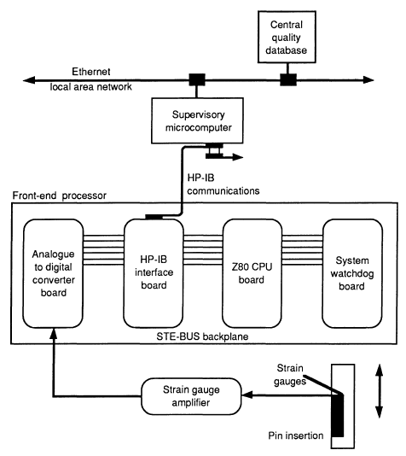
Case Study
Assembly force front-end processor
Notes:
J.D.T. Tannock, 1992, Automating Quality Systems, Chapman & Hall

Slide 16
Case Study
Case #02: Web based cloud solution for support of quality management 4.0 in the concept of industry 4.0
Objective: Implementation of ICT systems, especially web-based applications, clouds and open source tools for improvement of the quality management
Industry 4.0 pilar: Big data and analytics, and Cloud systems
Notes:
Miladin Stefanović, Aleksandar Đorđević, Hrvoje Puškarić, Miloš Petronijević, 2019, Web based cloud solution for support of quality management 4.0 in the concept of industry 4.0, Quality Festival 2019

Slide 17
Case Study
Notes:
Miladin Stefanović, Aleksandar Đorđević, Hrvoje Puškarić, Miloš Petronijević, 2019, Web based cloud solution for support of quality management 4.0 in the concept of industry 4.0, Quality Festival 2019

Slide 18
Case Study
Case #03 Unifying Real-time Visibility Across 26 Factories (Nestle Waters)
System: InfinityQS
Nestlé Waters meets consumer needs by keeping its wide variety of products flowing through strong distribution channels. The company has emerged as a substantial player in the bottled water market. That leadership position is strengthened by the company’s continuous improvement efforts—starting with a major initiative to improve quality and operational visibility across its production facilities
Notes:
InfinityQS, Keeping Success Flowing

Slide 19
Case Study
Case #02: Unifying Real-time Visibility Across 26 Factories (Nestle Waters)
Before implementation:
Nestlé Waters had been using a cumbersome paper-based system to collect and analyze data. When issues arose that required immediate attention, the company’s quality engineers had to disrupt operators on the production line to retrieve the necessary data.
Notes:
InfinityQS, Keeping Success Flowing

Slide 20
Case Study
Case #03: Unifying Real-time Visibility Across 26 Factories (Nestle Waters)
Implementation:
The Nestlé Waters IT team leveraged InfinityQS Professional Services. These expert services are provided by teams of skilled, certified quality engineers, industrial statisticians, and Six Sigma Black Belts, all with extensive manufacturing experience. They spread the implementation across 16 Retail sites, as well as eight Home and Office sites, and integrated them with corporate headquarters.
Notes:
InfinityQS, Keeping Success Flowing

Slide 21
Case Study
Case #02: Unifying Real-time Visibility Across 26 Factories (Nestle Waters)
Implementation:
Nestlé Waters now has real-time visibility over production processes—both within individual sites and at the corporate level across dozens of factories. By tracking trends in quality data, they are able to make more accurate and timely decisions about process improvements.
It is ultimately easier for the operator. Even with the minimal computer skills many of the operators had in the beginning, the overwhelming consensus is that they prefer using InfinityQS over a paper system.
Notes:
InfinityQS, Keeping Success Flowing

Slide 22
Case Study
Notes:
InfinityQS, Keeping Success Flowing

Slide 23
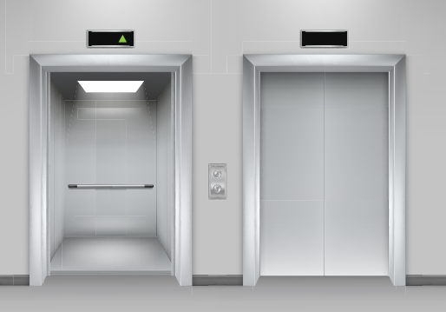
Case Study
Case #04: How an Elevator Manufacturer Uses Real-Time SPC Data for Process Improvement
Problem: - The tendency to produce out-of-spec elevator wall panels.
- Job site construction delays (2-7 days)
- Wasted installation crew time
- Cost money
Notes:
InfifityQS, Elevating Quality to the Top Floor

Slide 24
Case Study
Case #03: How an Elevator Manufacturer Uses Real-Time SPC Data for Process Improvement
Solution: Implementing ProFicient system at their primary elevator panel manufacturing site to identify when and where panel processes. Prompting shop-floor operators to take immediate correction action.
“Once we put InfinityQS controls in place, we were able to prevent non-conforming material from leaving the factory.”
Notes:
InfifityQS, Elevating Quality to the Top Floor

Slide 25
Case Study
Notes:
InfifityQS, Elevating Quality to the Top Floor

