Slide 1
Module 3: Automated Quality Report System
Automated Quality Report Concept

Slide 2
What will you learn from this content?
01
Concept of the automated quality report
Automated quality report the coherences with Key Risk Indicators
02
KPI generated from the digital quality management structure
03

Slide 3
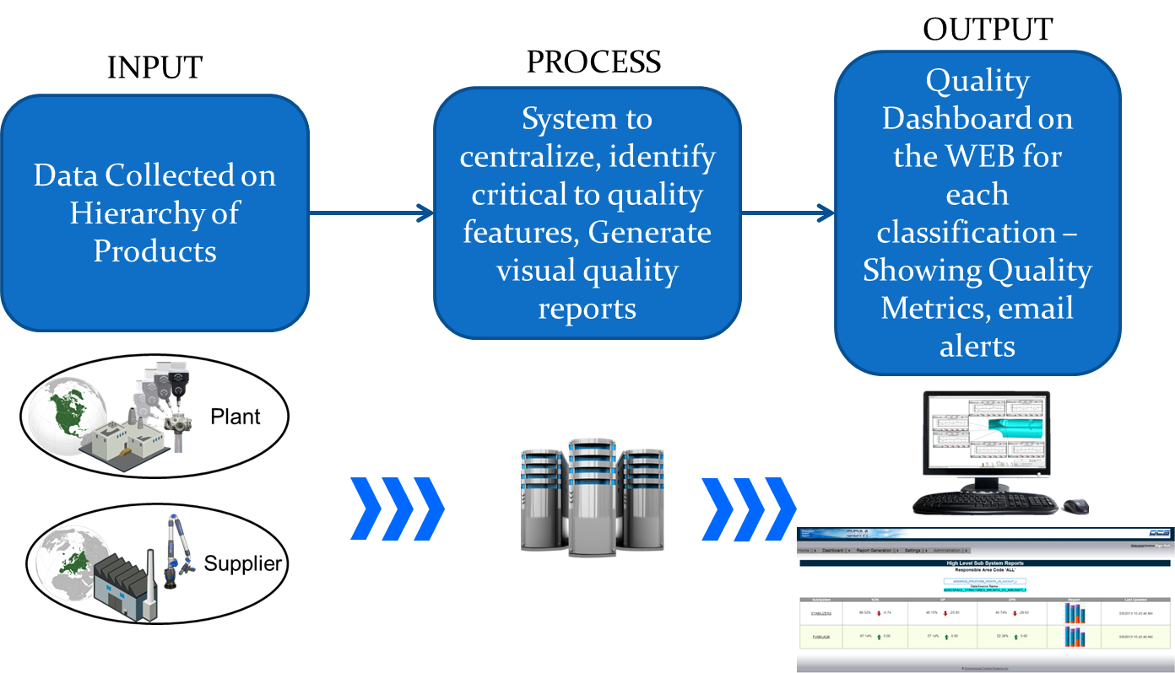
Quality Data Management (QDM)
https://www.3dcs.com/automated-spc-systems-qdm/system-overview

Slide 4
QDM Overview
In manufacturing, quality data management systems consist of
Product inspection specifications
Inspection sheets for inspection and test results
Summaries of product quality information
Customer complaints files
Calibration files for inspection equipment
Receiving goods inspection records
History file of suppliers
Non-conformance (scrap, rework and concession) records
Notes:
Reference: Automating Quality Systems: A guide to the design and implementation of automated quality systems in manufacturing, J.D.T. Tannock

Slide 5
QDM Overview
Mostly the data are manual paper-based systems. The problems within the manual process are
Inefficiencies that include time spent manually collecting and reformatting data from external applications.
The high probability of making mistakes during manual entry, because data must be reformatted over several steps until they are ready to be integrated into the final document.
Notes:
Reference: Automation of Quality Reports in the Aerospace Industry RICARDO EITO-BRUN AND ANTONIO AMESCUA-SECO IEEE TRANSACTIONS ON PROFESSIONAL COMMUNICATION, VOL. 00, NO. 00, JUNE 2018

Slide 6
QDM Overview
The automatic generation of quality reports using outputs generated by different tools ensures the quality of the data used as an input
Data are automatically collected from the tools where originally generated and recorded, with no manual intervention, thus ensuring data accuracy, objectivity, believability, timeliness, and completeness.
Engineers can edit and complete the reports by adding assessments, explanations, and content.
The automated formatting of the documents contributes to a consistent, homogeneous layout and presentation that makes it easier to interpret by third parties.
Notes:
Reference: Automation of Quality Reports in the Aerospace Industry RICARDO EITO-BRUN AND ANTONIO AMESCUA-SECO IEEE TRANSACTIONS ON PROFESSIONAL COMMUNICATION, VOL. 00, NO. 00, JUNE 2018

Slide 7
QDM Overview
Case Study#1: Kaiser Permanente
An American Company provides health care services and not-for-profit health plans. Its mission is to provide high-quality, affordable health care services and to improve the health of its members and the communities
(https://about.kaiserpermanente.org)
Notes:
Reference: Automated quality reporting can result in efficiencies, Kaiser Permanente, https://about.kaiserpermanente.org/our-story/health-research/news/automated-quality-reporting-through-ehrs-can-result-in-significa

Slide 8
QDM Overview
Case Study#1: Kaiser Permanente
The company uses electric health records to automate reporting of quality measures reduces reporting time required for one measure set alone by about 50 percent, according to a new study published in the journal of the American medical informatics association.
The automated quality reporting allows the company to keep up with the public reporting initiatives without adding to high overhead costs. Additionally, the automated quality reporting of quality measures enable some data become available real-time and improving an expedited manner.
Notes:
Reference: Automated quality reporting can result in efficiencies, Kaiser Permanente, https://about.kaiserpermanente.org/our-story/health-research/news/automated-quality-reporting-through-ehrs-can-result-in-significa

Slide 9
QDM Overview
Case Study#1: Kaiser Permanente
The company is widely recognized for its leadership in harnessing health IT to improve quality and care delivery. Kaiser Permanente HealthConnect® enables all of Kaiser Permanente clinicians to electronically access their patient’s Kaiser Permanente medical records and serves as a model for other care systems.
“…Many electronic health record systems require care providers to enter additional data and provide documentation that may slow down the care process…” “…The trick is to make use of the natural digital exhaust from existing clinical processes, which can also increase the credibility and accuracy of the data…” said Terhilda Garrido, vice president of Health IT transformation and Analytics, Kiser Permanente.
Notes:
Reference: Automated quality reporting can result in efficiencies, Kaiser Permanente, https://about.kaiserpermanente.org/our-story/health-research/news/automated-quality-reporting-through-ehrs-can-result-in-significa

Slide 10
Requirements for the Quality Database
There is often a gap in understanding between the potential users and the analyst.
Analyst: understands the abilities of the database software, but not the specialist knowledge of the users.
Users: cannot relate their quality systems knowledge to the potential capabilities of the software.
By working with an initial prototype, they will gain an improved understanding of the possible, on which they can base requests for changes and enhancements.

Slide 11
The functions of a quality database
Quality Specs.
Database configuration
Maintain
Quality
specifications
Quality
Specs.
Quality
Summary
tables
Batch
quality
reports
Receive
Correlate batch
data
Supplier
Quality
tables
Report
requests
Receive and
Correlate other
QA data
Incoming goods
quality report
Reject product
reports
Process quality
reports
Supplier reports
Quality reports
QA info
tables
Analyze and
generate
reports
Automated systems
Notes:
Reference: Automating Quality Systems: A guide to the design and implementation of automated quality systems in manufacturing, J.D.T. Tannock

Slide 12
Generation of quality reports
The basic manufacturing quality data supplied to the database will allow the generation of a number of reports:
Quality details of completed batches
Non-conformance details
Quality summaries for particular periods
Quality summaries for particular customers
Process capability indices
List of held batches
Notes:
Reference: Automating Quality Systems: A guide to the design and implementation of automated quality systems in manufacturing, J.D.T. Tannock

Slide 13
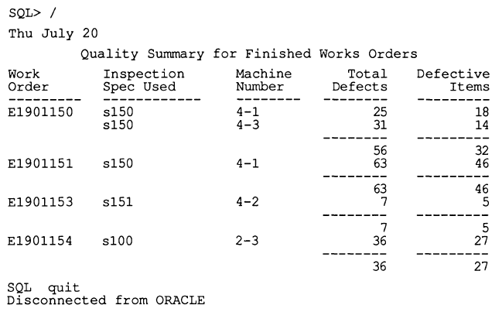
Generation of quality reports
Example of quality summary report
Notes:
Reference: Automating Quality Systems: A guide to the design and implementation of automated quality systems in manufacturing, J.D.T. Tannock

Slide 14
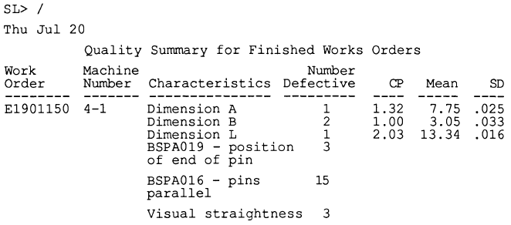
Generation of quality reports
Example of expanded quality summary report with statistics and capability information
Notes:
Reference: Automating Quality Systems: A guide to the design and implementation of automated quality systems in manufacturing, J.D.T. Tannock

Slide 15
Quality Reporting
Case Study#2: Automation of Quality Reports in the Aerospace Industry
Currently, engineers must interact with external tools to extract the data, copy it to the target document, and then reformat the data to final document’s layout. A software engineering company develops products for the European Space Agency, the National Aeronautics and Space Administration, and the Centre National d’Estudes Spatiales.
Notes:
Reference: Automation of quality reports in the aerospace industry, Ricardo Eito-Brun and Antonio Amescua-Seco, IEEE TRANSACTIONS ON PROFESSIONAL COMMUNICATION, JUNE 2018

Slide 16
Quality Reporting
Case Study#2: Automation of Quality Reports in the Aerospace Industry
the development of software involves creating documents and records that communicate information about the software specifications and design, provide written descriptions of the system behavior, and document the features and decisions.
In the aerospace sector, specific standards impose requirements on processes, activities, and documentation. The documents must include heterogeneous data.
Notes:
Reference: Automation of quality reports in the aerospace industry, Ricardo Eito-Brun and Antonio Amescua-Seco, IEEE TRANSACTIONS ON PROFESSIONAL COMMUNICATION, JUNE 2018

Slide 17
Quality Reporting
Case Study#2: Automation of Quality Reports in the Aerospace Industry
The final document must include
Traceability between requirements and design elements
Traceability between requirements and test cases
Results of tests and inspections
Compliance with coding rules
Software metrics
Problem status
Notes:
Reference: Automation of quality reports in the aerospace industry, Ricardo Eito-Brun and Antonio Amescua-Seco, IEEE TRANSACTIONS ON PROFESSIONAL COMMUNICATION, JUNE 2018

Slide 18
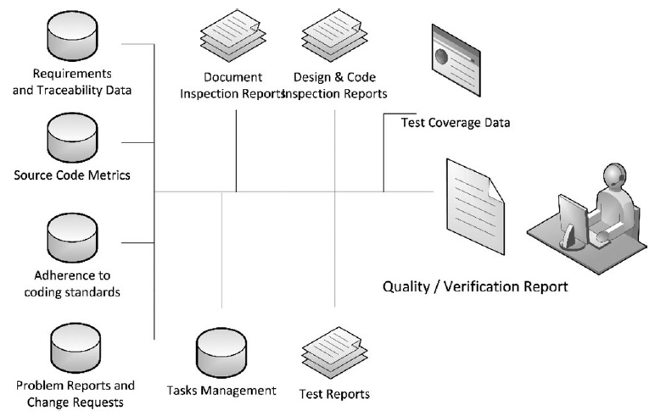
Quality Reporting
Data-management scenario: Source data for quality reports
Notes:
Reference: Automation of quality reports in the aerospace industry, Ricardo Eito-Brun and Antonio Amescua-Seco, IEEE TRANSACTIONS ON PROFESSIONAL COMMUNICATION, JUNE 2018

Slide 19
Quality Reporting
The production of quality reports is based on the following two actions
The use of XML to support data exchange, integration, and editing
The implementation of interfaces to gather data from external tools used for requirements management, testing, source-code verification, and problem and task management
Notes:
Reference: Automation of quality reports in the aerospace industry, Ricardo Eito-Brun and Antonio Amescua-Seco, IEEE TRANSACTIONS ON PROFESSIONAL COMMUNICATION, JUNE 2018

Slide 20
Quality Reporting
Report generation process
Automated extraction of source data from data provider tools
Conversion of the data into an intermediate XML format that is kept in the project repository, linked to the software version
Aggregation of the intermediate XML files to build a preliminary, draft version of the document
Editing the draft version – using an XML editor – with additional information and qualitative assessments
Notes:
Reference: Automation of quality reports in the aerospace industry, Ricardo Eito-Brun and Antonio Amescua-Seco, IEEE TRANSACTIONS ON PROFESSIONAL COMMUNICATION, JUNE 2018

Slide 21
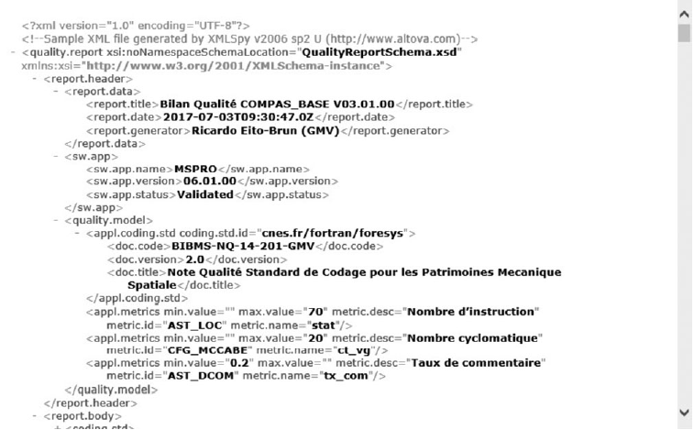
Draft XML document generated with the source data
Notes:
Reference: Automation of quality reports in the aerospace industry, Ricardo Eito-Brun and Antonio Amescua-Seco, IEEE TRANSACTIONS ON PROFESSIONAL COMMUNICATION, JUNE 2018

Slide 22
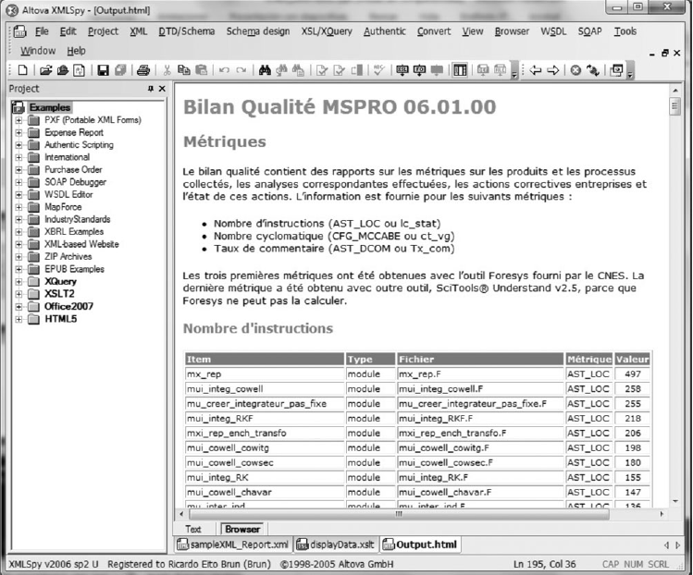
Edition of the XML document
Notes:
Reference: Automation of quality reports in the aerospace industry, Ricardo Eito-Brun and Antonio Amescua-Seco, IEEE TRANSACTIONS ON PROFESSIONAL COMMUNICATION, JUNE 2018

Slide 23
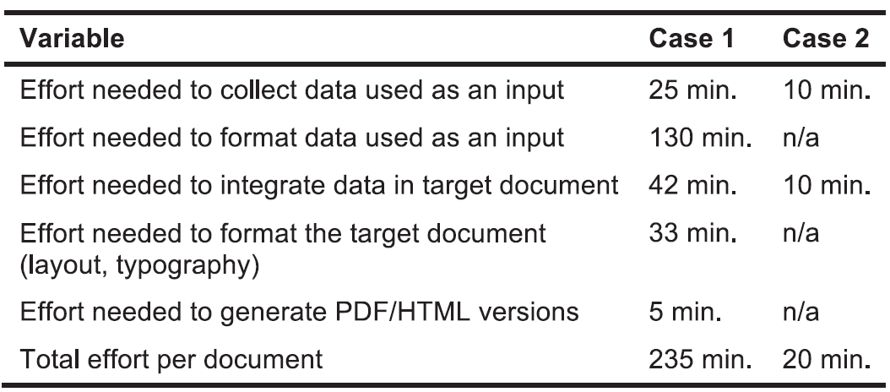
Comparison of document creation effort
Case 1: manual process
Case 2: XML
Notes:
Reference: Automation of quality reports in the aerospace industry, Ricardo Eito-Brun and Antonio Amescua-Seco, IEEE TRANSACTIONS ON PROFESSIONAL COMMUNICATION, JUNE 2018

Slide 24
Quality Reporting
Case Study#2: Automation of Quality Reports in the Aerospace Industry
This case study demonstrates that
The use of XML can speed the elaboration of technical documents and improve their quality
Technical communication staff members can apply their knowledge and experience toward the use of structured content editing and mark-up languages (XML, XSLT, etc.) to improve other content-authoring activities in engineering companies.
Notes:
Reference: Automation of quality reports in the aerospace industry, Ricardo Eito-Brun and Antonio Amescua-Seco, IEEE TRANSACTIONS ON PROFESSIONAL COMMUNICATION, JUNE 2018

Slide 25
KRI Reporting
Case Study#3: Midwestern Utility Company, Inc.
Midwestern Utilities, Inc., is a utility holding company delivering regulated electric and gas services. It had not taken a structured enterprise-wide approach to managing risks until it began a formal Enterprise Risk Management (ERM) program.
Notes:
Reference: Risk Reporting & Key Risk Indicators: A case study analysis, Stephen R. Boyd, Johannes A. Moolman, Nkemjika J. Nwosu. Poole College of Management, NC State

Slide 26
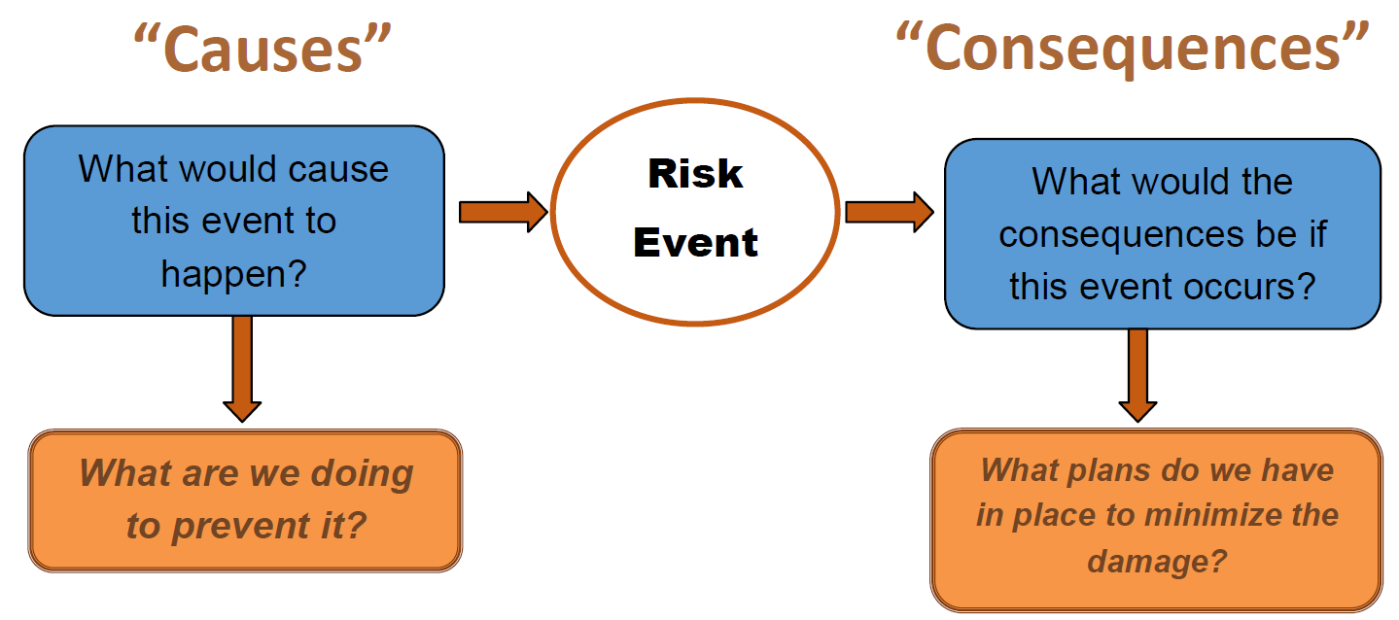
KRI Reporting
Case Study#3: Midwestern Utility Company, Inc.
Developing Key Risk Indicators
It use “Bowtie Analysis” to identify Key Risk Indictor (KRI) metric that predicting risk events.
Notes:
Reference: Risk Reporting & Key Risk Indicators: A case study analysis, Stephen R. Boyd, Johannes A. Moolman, Nkemjika J. Nwosu. Poole College of Management, NC State

Slide 27
KRI Reporting
Case Study#3: Midwestern Utility Company, Inc.
The bowtie analysis was completed through a series of workshops organized by the ERM director. Each risk owner was asked to pull together information on their risk in advance of the meeting in order to optimize time in the workshop. The risk owners worked together to decode the root causes of the identified risks by discussing what combination of events would lead to the occurrence of each risk.
Notes:
Reference: Risk Reporting & Key Risk Indicators: A case study analysis, Stephen R. Boyd, Johannes A. Moolman, Nkemjika J. Nwosu. Poole College of Management, NC State

Slide 28
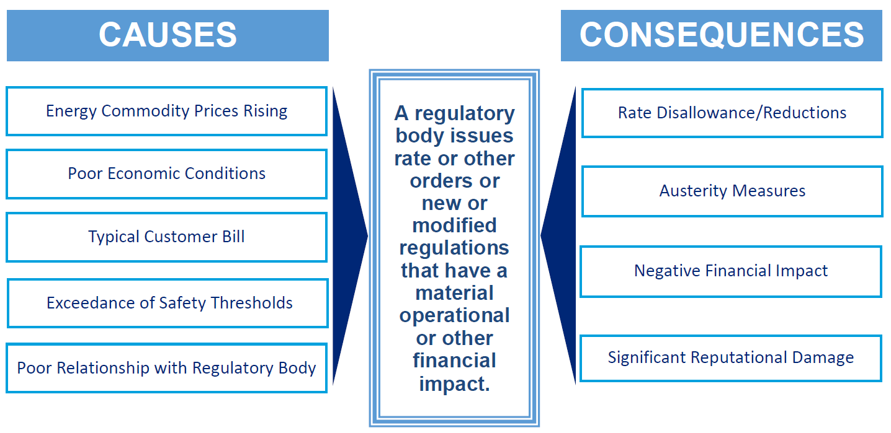
Notes:
Reference: Risk Reporting & Key Risk Indicators: A case study analysis, Stephen R. Boyd, Johannes A. Moolman, Nkemjika J. Nwosu. Poole College of Management, NC State

Slide 29
KRI Reporting
Case Study#3: Midwestern Utility Company, Inc.
The causes identified in the bowtie analysis are then evaluated to identify predictive metrics that could be used as KRIs. The ERM director then worked with the risk owners to set thresholds for each KRI. The subject matter experts determine a weight for each KRI.
Notes:
Reference: Risk Reporting & Key Risk Indicators: A case study analysis, Stephen R. Boyd, Johannes A. Moolman, Nkemjika J. Nwosu. Poole College of Management, NC State

Slide 30
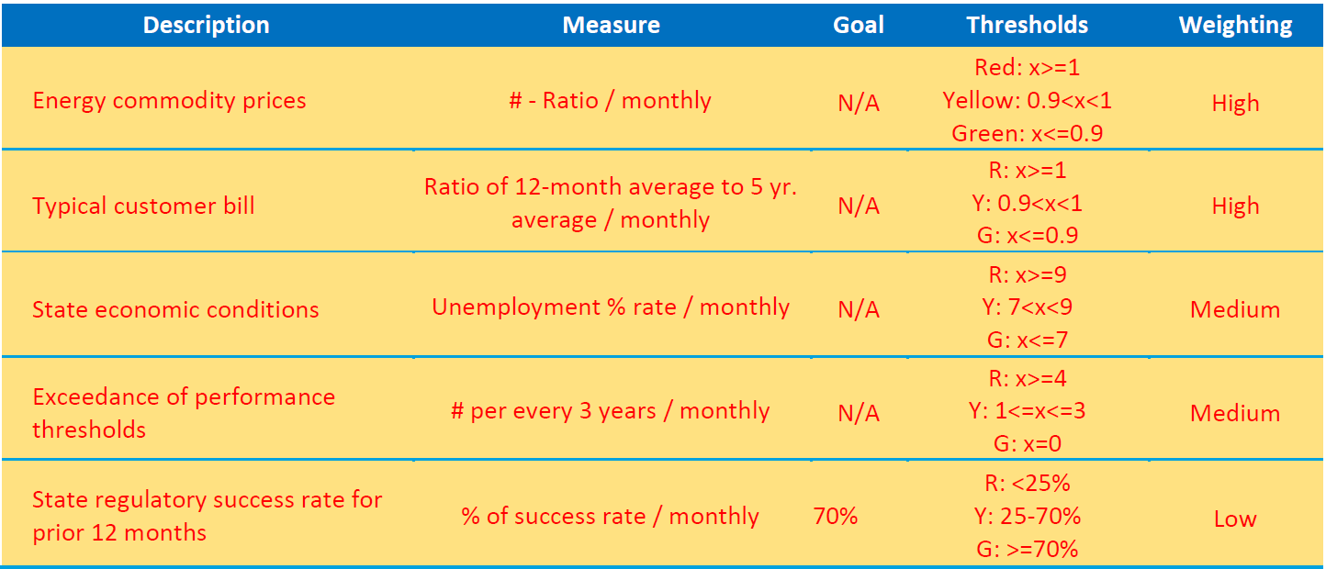
Notes:
Reference: Risk Reporting & Key Risk Indicators: A case study analysis, Stephen R. Boyd, Johannes A. Moolman, Nkemjika J. Nwosu. Poole College of Management, NC State

Slide 31
KRI Reporting
Case Study#3: Midwestern Utility Company, Inc.
Graphs of the metrics for the KRIs used for regulatory risk are shown. These KRIs are measured and monitored.
Each risk owner has the responsibility of monitoring the risks belonging to department in which he or she works.
At the end of each quarter, the ERM director works with each risk owner individually and complies a KRI summary dashboard for the risk in that risk owner’s department.
Notes:
Reference: Risk Reporting & Key Risk Indicators: A case study analysis, Stephen R. Boyd, Johannes A. Moolman, Nkemjika J. Nwosu. Poole College of Management, NC State

Slide 32
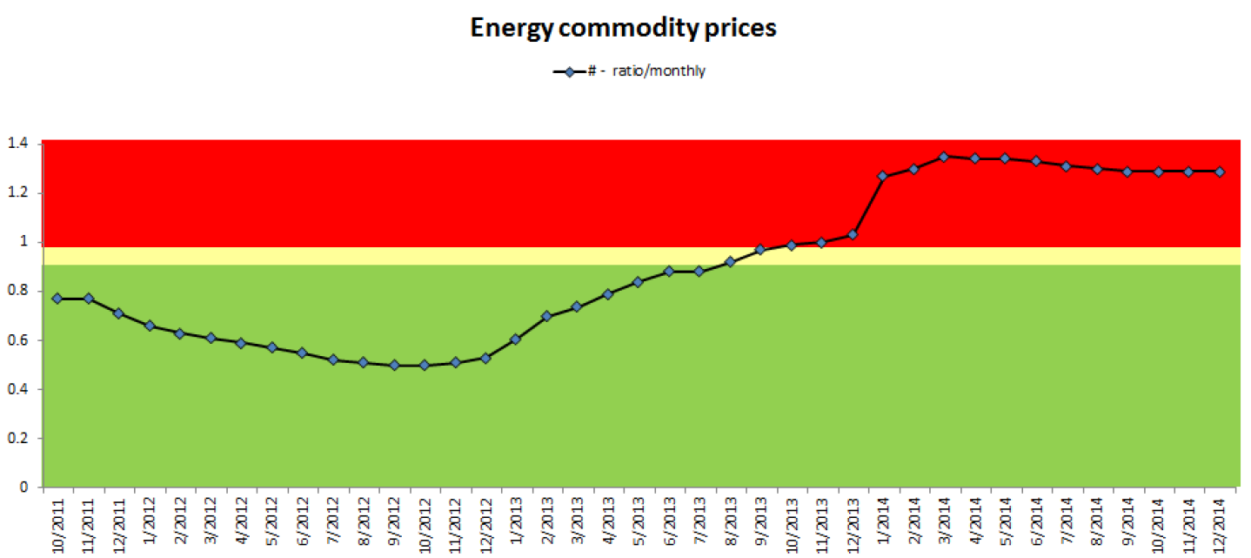
Example of KRIs graph
Notes:
Reference: Risk Reporting & Key Risk Indicators: A case study analysis, Stephen R. Boyd, Johannes A. Moolman, Nkemjika J. Nwosu. Poole College of Management, NC State

Slide 33
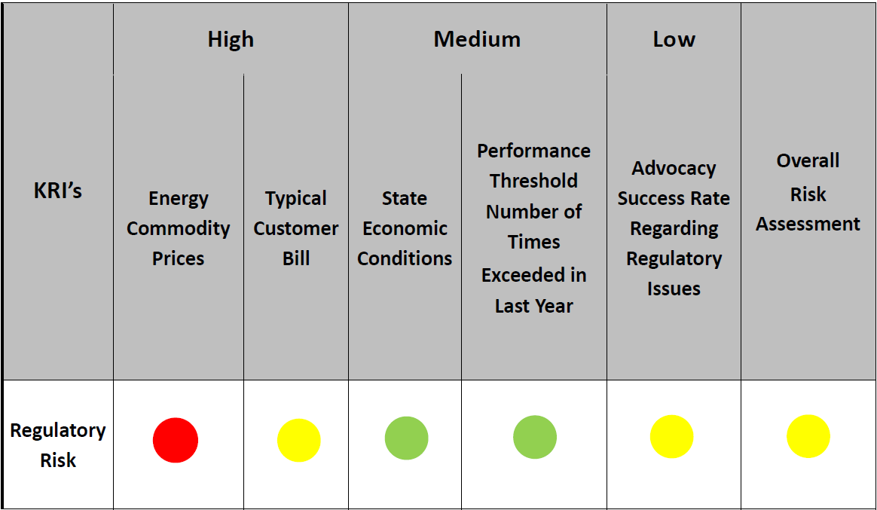
Example of the KRI summary dashboard
Notes:
Reference: Risk Reporting & Key Risk Indicators: A case study analysis, Stephen R. Boyd, Johannes A. Moolman, Nkemjika J. Nwosu. Poole College of Management, NC State

Slide 34
KRI Reporting
Case Study#3: Midwestern Utility Company, Inc.
In conclusion, the company effectively uses KRIs to monitor the 14 major corporate risks that face the organization.
Each KRI was then monitored quarterly using graphs to display those metrics in an easy to follow way.
The reporting process actively engages senior executives by providing key information on KRIs which trigger a review and may lead to potential change to current mitigation strategies.
Notes:
Reference: Risk Reporting & Key Risk Indicators: A case study analysis, Stephen R. Boyd, Johannes A. Moolman, Nkemjika J. Nwosu. Poole College of Management, NC State

Slide 35
KPI Tracking System
Case Study#4: A mature offshore oilfield
The fundamental challenges for this project are:
Multiple data sources and disconnected data systems
Manual system leading to delay in decisions
Understanding shortfalls to close the production gap
Lack of efficient KPI management system
Notes:
Reference: Bringing Excellence in Asset Management through Streamlined Automated Reporting & KPI Tracking System, SPE-182495-MS, Society of Petroleum Engineers

Slide 36
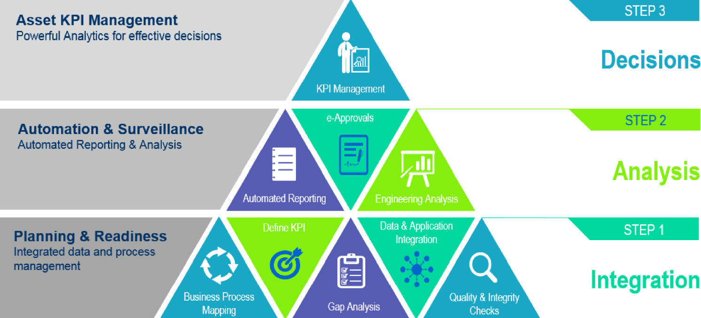
Solution Overview
Notes:
Reference: Bringing Excellence in Asset Management through Streamlined Automated Reporting & KPI Tracking System, SPE-182495-MS, Society of Petroleum Engineers

Slide 37
KPI Tracking System
Case Study#4: A mature offshore oilfield
Automated Reporting:
Production reports such as Daily Production Report (DPR), well test compliance, current production levels, field parameter comparison, monthly deferments analysis are available on the web-based report manager and accessible when the users are connected to company network.
Notes:
Reference: Bringing Excellence in Asset Management through Streamlined Automated Reporting & KPI Tracking System, SPE-182495-MS, Society of Petroleum Engineers

Slide 38
Example of reports used for further analysis and diagnostics
Notes:
Reference: Bringing Excellence in Asset Management through Streamlined Automated Reporting & KPI Tracking System, SPE-182495-MS, Society of Petroleum Engineers

Slide 39
KPI Tracking System
Case Study#4: A mature offshore oilfield
KPI Management:
KPI analytics assists users in understanding data and the underlying relationships and correlations between various data types through rich and interactive visualization.
Notes:
Reference: Bringing Excellence in Asset Management through Streamlined Automated Reporting & KPI Tracking System, SPE-182495-MS, Society of Petroleum Engineers

Slide 40
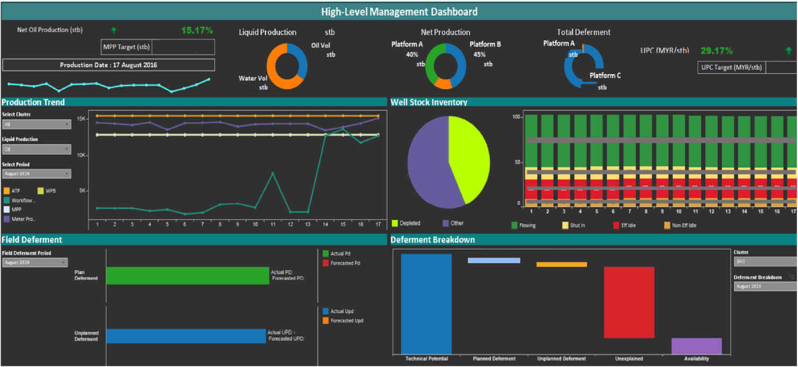
Example of KPI Analytics Screen for High Level Management
Notes:
Reference: Bringing Excellence in Asset Management through Streamlined Automated Reporting & KPI Tracking System, SPE-182495-MS, Society of Petroleum Engineers

Slide 41
KPI Tracking System
Case Study#4: A mature offshore oilfield
In conclusion, having streamlined the reporting process and the KPI management system the time spent before the implementation has reduced drastically. Engineers are spending less time in high value activities such as analysis, KPI management and analytics for decision making.
The overall cycle time has reduced from hours to minutes that results in an improved efficiency in an average of 68% of the whole process cycle.
Notes:
Reference: Bringing Excellence in Asset Management through Streamlined Automated Reporting & KPI Tracking System, SPE-182495-MS, Society of Petroleum Engineers

Slide 42
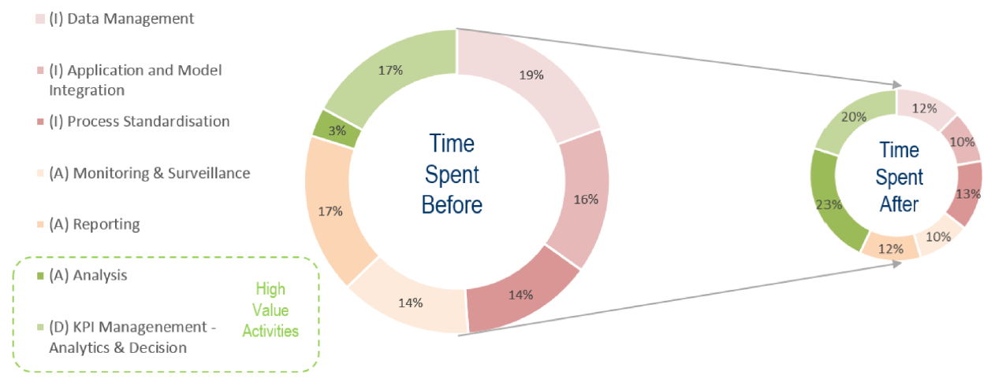
Notes:
Reference: Bringing Excellence in Asset Management through Streamlined Automated Reporting & KPI Tracking System, SPE-182495-MS, Society of Petroleum Engineers

Slide 43
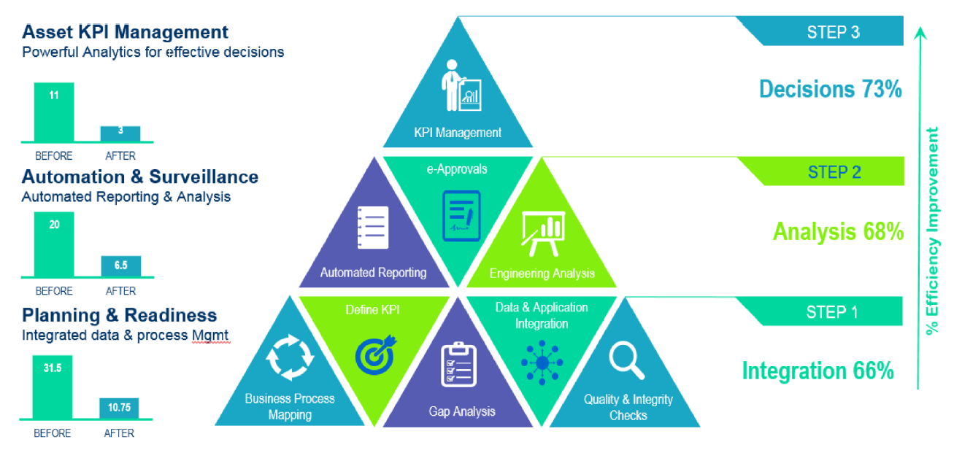
Notes:
Reference: Bringing Excellence in Asset Management through Streamlined Automated Reporting & KPI Tracking System, SPE-182495-MS, Society of Petroleum Engineers

