Slide 1
Multivariate SPC Strategy

Slide 2
Outlines
What is multivariate data?
Control chart for multivariate data
Multivariate EWMA Chart
T²-Generalized Variance Chart
[Ref] Technical Note. “PREDICTIVE STATISTICAL PROCESS CONTROL”. An update on data-driven CNC machining at L&S Machine Company.

Slide 3
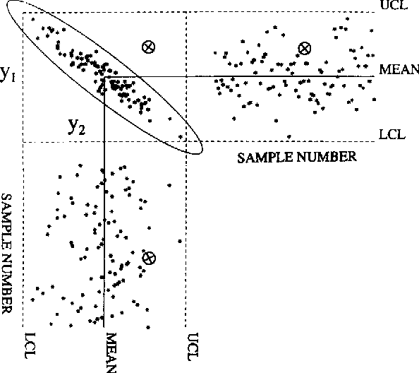
Multivariate Control Charts
Display statistics from two or more related measurement variables. A multivariate chart shows how several variables jointly influence a process or outcome. For example, you can use multivariate control charts to investigate how the tensile strength and diameter of a fiber affect the quality of fabric.
Acceptance region
Figure 1. Quality control of two variables, i.e. bivariate, illustrating the misleading nature of univariate charts.

Slide 4
Advantages of Multivariate Control Charts
Several advantages over creating multiple univariate charts:
The actual control region of the related variables is represented (elliptical for bivariate case).
You can maintain a specific Type I error.
A single control limit determines whether the process is in control
However, multivariate charts are more difficult to interpret than classic Shewhart control charts. For example, the scale on multivariate charts is unrelated to the scale of any of the variables, and out-of-control signals do not reveal which variable (or combination of variables) caused the signal.

Slide 5
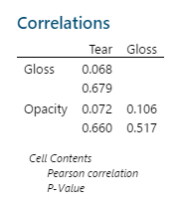
Correlations of Variables
Choose Stat > Basic Statistics > Correlation.
To determine whether you should use a univariate or multivariate chart, test a correlation of your variables.
To test correlation in Minitab
Choose Stat > Basic Statistics > Correlation
Examine the linear relationship between variables (Pearson)
Close to zero ➔ no linear relationship between the variables
The sign of the coefficient indicates the direction of the relationship
Determine whether the correlation coefficient is significant
P-value ≤ α: The correlation is statistically significant
P-value > α: The correlation is not statistically significant
Examine the monotonic relationship between variables (Spearman)
Close to zero ➔ no monotonic relationship between the variables (in the rank-ordered data)
The sign of the coefficient indicates the direction of the relationship

Slide 6
Multivariate EWMA Chart
Use Multivariate EWMA Chart to simultaneously monitor two or more related process characteristics in an exponentially weighted control chart.
In the multivariate EWMA chart, each plotted point includes weighting from all previous data, which helps you to detect small process shifts quicker than you can with other multivariate control charts.
The Multivariate EWMA chart is the multivariate counterpart to the EWMA chart.

Slide 7
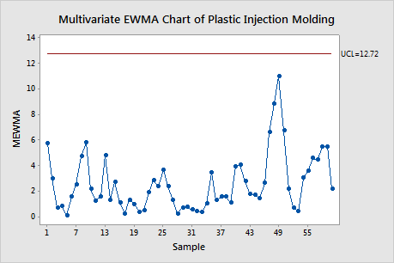
Multivariate EWMA Chart
For example, use a multivariate EWMA chart to monitor temperature and pressure in a plastic injection-molding process. Because temperature and pressure both affect the plastic strength, the engineer wants to monitor these variables at the same time.
No points are above the upper control limit, so the variability can be considered stable.
However, the points that are higher than the rest that could be investigated.

Slide 8
Example of Multivariate EWMA Chart
A production manager monitors the diameter and weight of bowls that are manufactured at a plant to ensure consistency. The manager collects three bowls per day and measures their diameters and weights.
The production manager creates a multivariate EWMA chart to simultaneously monitor the diameter and weights of bowl over time.
Open the sample data, BowlConsistency.MTW.
Choose Stat > Control Charts > Multivariate Charts > Multivariate EWMA.
In Variables, enter Weight Diameter.
In Subgroup sizes, enter Day.
Click OK.

Slide 9
Interpret the results
None of the subgroup ranges are above the control limit. This chart does not provide any evidence for lack of control. Thus, the process mean vector is in control.

Slide 10
T²-Generalized Variance Chart
Use T²-Generalized Variance Chart to simultaneously monitor whether the process location and the process variability of two or more related variables are in control.
This chart is the multivariate counterpart to the Xbar-R, Xbar-S, and I-MR charts.

Slide 11
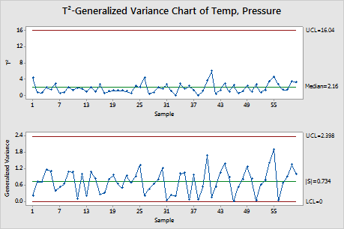
T²-generalized variance chart
For example, an engineer uses a T2-generalized variance chart to monitor temperature and pressure in a plastic injection-molding process. Because temperature and pressure both affect the plastic strength, the engineer wants to monitor these variables at the same time.
The points vary randomly around the center line and are below the upper control limit for both charts.
No trends or patterns are shown.
The process location and process variability of the plastic product strength are stable.

Slide 12
Example of T²-generalized variance chart
Open the sample data, PlasticSheets.MTW.
Choose Stat > Control Charts > Multivariate Charts > T<sup>2</sup>-Generalized Variance.
In Variables, enter Tear Gloss Opacity.
In Subgroup sizes, enter Subgroup.
Click OK.
A quality engineer wants to monitor the variability in the tear strength, glossiness, and opacity of plastic sheets that her company manufactures. She measures four sheets a day for 10 days. Previous analyses have found that these variables are correlated.
The quality engineer creates a T²-Generalized Variance chart to simultaneously monitor the mean and variation of tear strength, glossiness, and opacity of the plastic sheets over 10 days.
Open the sample data, PlasticSheets.MTW.
Choose Stat > Control Charts > Multivariate Charts > T<sup>2</sup>-Generalized Variance.
In Variables, enter Tear Gloss Opacity.
In Subgroup sizes, enter Subgroup.
Click OK.

Slide 13
Interpret the results
The quality engineer looks at the Generalized Variance chart first. If the Generalized Variance chart shows that the process variation is not in control, then the control limits on the T² chart are inaccurate.
The joint variation of the tear strength, glossiness, and opacity is above the upper control limit at point 6. The engineer should investigate why the variation is not in control and correct the issues before interpreting the T² chart.
T²-Generalized Variance Chart of Tear, ..., Opacity
Test Results for Generalized Variance Chart of Tear, ..., Opacity
TEST. One point beyond control limits.
Test Failed at points: 6
* WARNING * If graph is updated with new data, the results above may no longer
be correct.

Slide 14
References
D. C. Montgomery (2012) Introduction to Statistical Quality Control, 7th Edition by. John Wiley & Sons, Inc.
J. F., MacGregor, and T. Kourti, (1995). Statistical process control of multivariate processes. Control Engineering Practice, 3(3), 403-414.
J. H. Woodall and W.H. Sullivan (1996). "A Comparison of Multivariate Control Charts for Individual Observations," Journal of Quality Technology, 28 (4), 398-408.
R. L. Mason, N. D. Tracy, and J. C. Young. (1995). "Decomposition of T 2 for Multivariate Control Chart Interpretation," Journal of Quality Technology , 27, April, 99-108.
K M. Bodden and S E. Rigdon (1999). A Program for Approximating the In-Control ARL for the MEWMA Chart. Journal of Quality Technology, 31,January, 120−123.
Minitab® support. https://support.minitab.com/.

