Slide 1
Quality Control Concept under Digital Data Collection
Automated Quality Inspection System in Manufacturing Process

Slide 2
Outlines
Review of pre-class video assignments
What is a Vision system?
https://youtu.be/atoUpGgw2fE
What Is Image Processing?
https://youtu.be/QMLbTEQJCaI
Traditional Quality Inspection System
Automated Quality Inspection System

Slide 3
Traditional Quality Inspection System
Feedbacks for Process Improvement
Random Inspection
Samples
Frequency
Process Data
Data Analysis
SPC
Production Process
Work-in-Process
Finished goods
Sample size
Inspection resources
Paper
Excel file
Distribution
Process Capability
Control chart
Software
Excel
Minitab
Check sheet
Measurement system analysis
Data type
Quantity
Appraisal
[Ref] Technical Note. “PREDICTIVE STATISTICAL PROCESS CONTROL”. An update on data-driven CNC machining at L&S Machine Company.

Slide 4
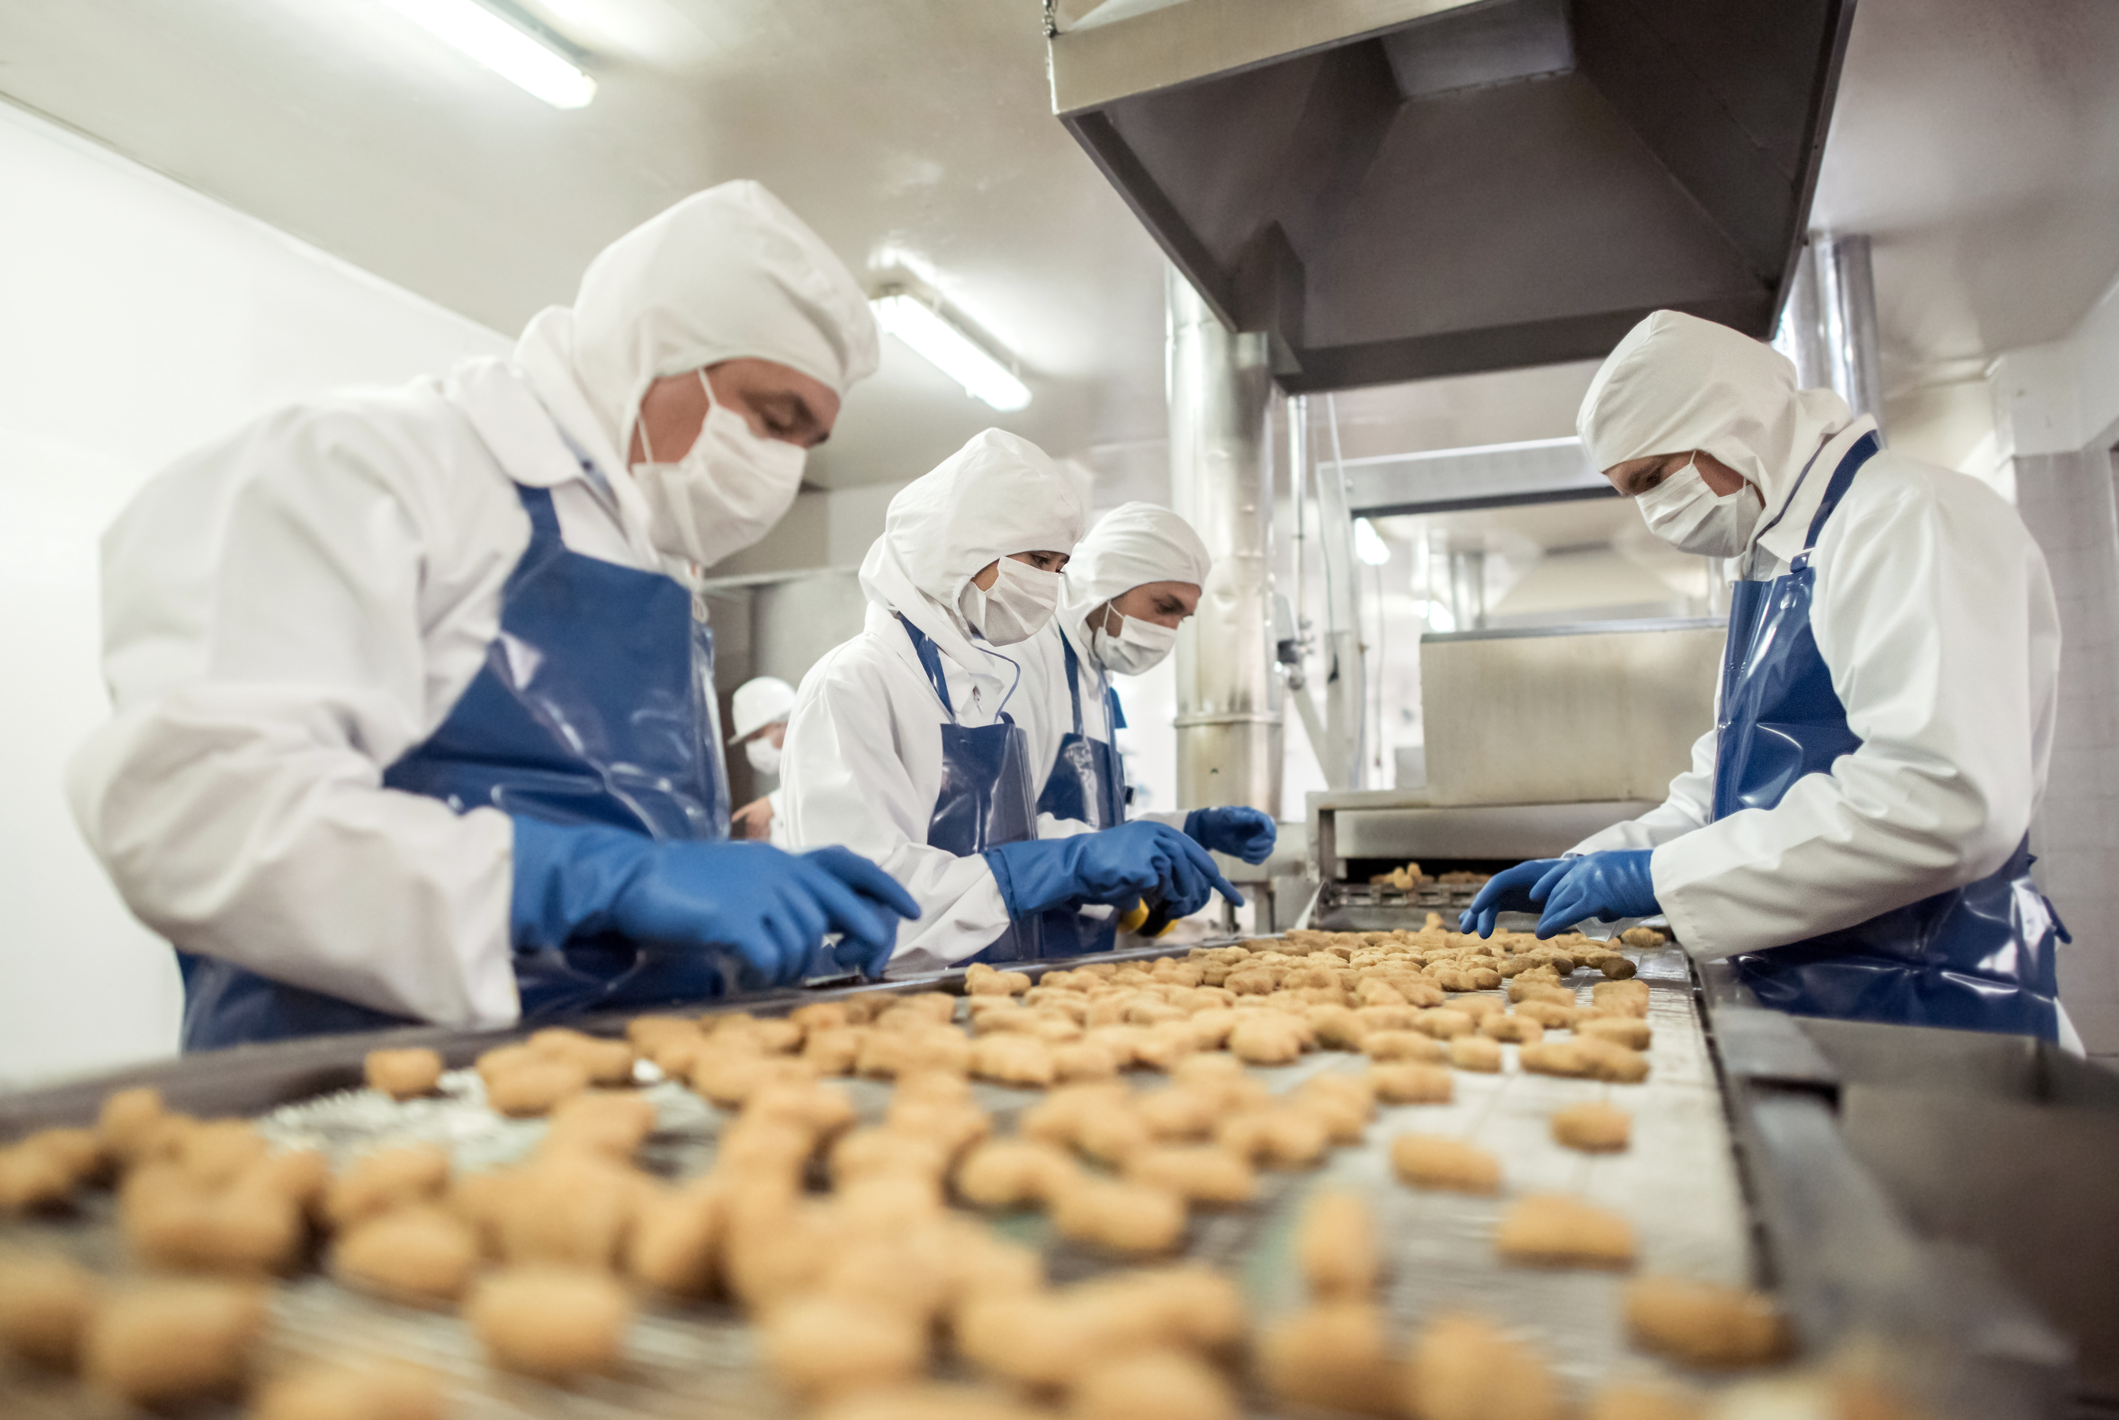
Case study : Cookies Factory
Traditional Inspection steps
Take samples
How often?
How many?
Measure
Dimension
Weight
Appraise
Roundness
Choco. chips spread evenly
Taste
Record observations
Analyze data
Send feedback to a process
Quality Characteristics
Size
weight
Shape
Appearance
Taste
https://www.delish.com/holiday-recipes/christmas/a25440155/andes-chip-cookies-recipe/
http://eapo-tokyo.org/courses/fsm_17-ag-23-ge-dln-a-03/

Slide 5
What if … There is a technique that can
Inspection steps
Take samples
How often?
How many?
Measure
Dimension
Weight
Appraise
Roundness
Choco. chips spread evenly
Taste
Record observations
Analyze data
Send feedback to a process
Perform 100% inspection with low cost
Complete inspection steps in seconds
Report process performance in real-time

Slide 6
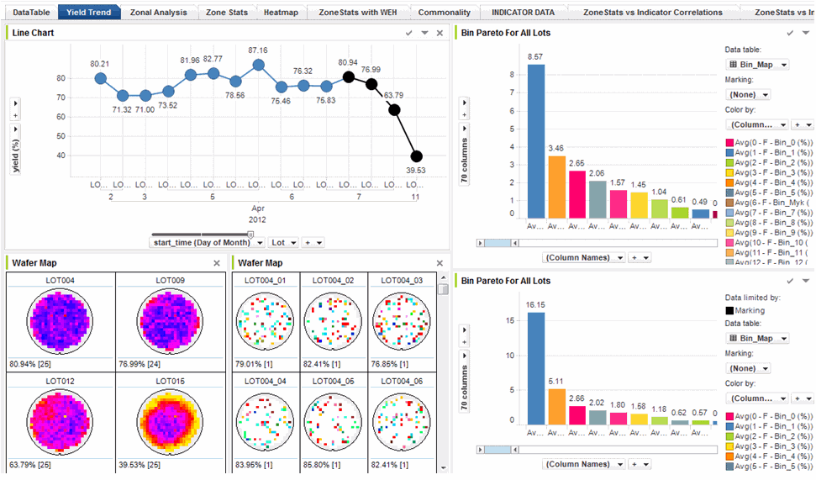
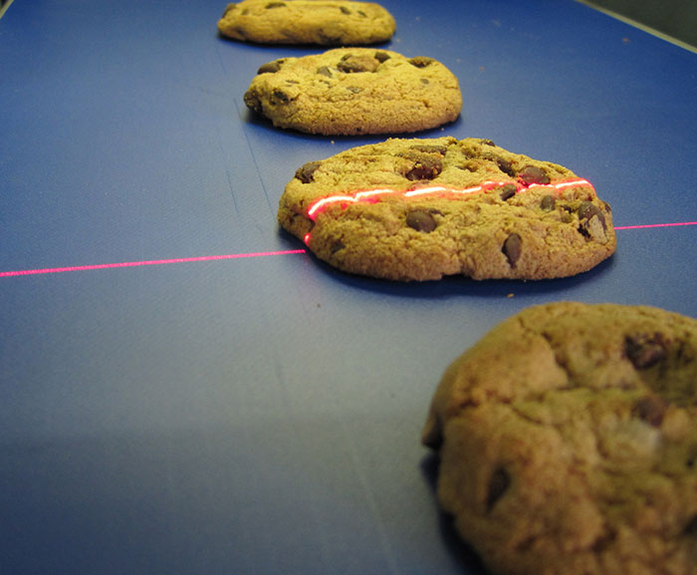
What if … This concept is affordable
http://pdf.com/exensio-old

Slide 7
CIMS and AQIS
Computer integrated manufacturing system (CIMS)
“ A manufacturing system in which all activities relevant to manufacturing are integrated via electronic data collecting and processing frames, Gunn (1998)”
Automated quality inspection system (AQIS) is designed to
Classify conforming and nonconforming units automatically
Collect data of the entire units produced
Assess process performance in real-time
Reduce resources used in quality inspection
Reduce human errors in measurement, appraisal, and forgetfulness

Slide 8
Data Collection System of Automated QIS
Hardware
Transportation system
Conveyor
Diverter
Sensor
Cameras
IR Scanner
Computer
CPU and Monitor
Software
Internet connection
Database / Cloud design
Inspection algorithm
Specification
Reference
Statistical foundation
Camera
Monitor
Diverter

Slide 9
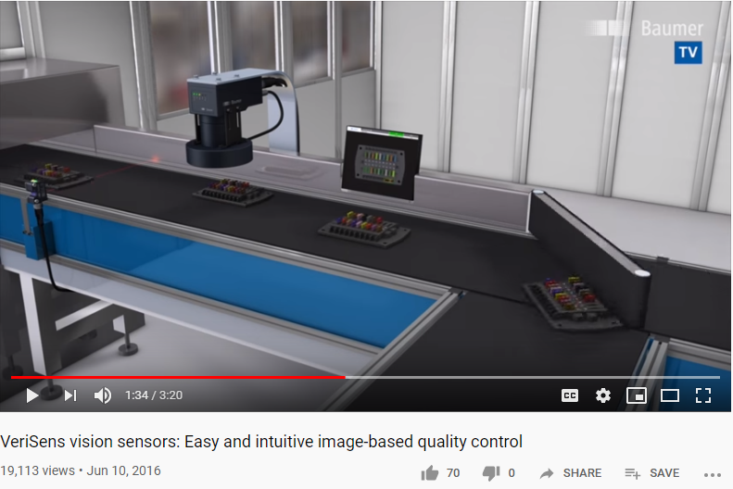
Automated Quality Inspection
https://youtu.be/KXMPk3FKHgA

Slide 10
Image processing in Automated QIS
Image processing is a common term in vision technology
Applications in Automated QIS are
Measurement
Alignment (position/angle)
Location
Shape
Dimension
Color
Alien objects
Defects on fabric/metal

Slide 11
Benefits of Automated QIS
Minimize operators’ errors
Reduce data collection cost
Reduce process analysis time (Real-time feedback)
Faster respond to assignable causes
Stop production line immediately after a predetermined number of defects have been reached
Reduce cost of nonconforming products
Online quality monitoring and assessment

Slide 12
Impact of Automated QIS to Traditional QIS
Automated SPC report obtained from Automated QIS could affect these following partners
Quality Inspector (Operator level)
No longer needed
All data are automatically recorded
Appraisal are, well, let’s say, automatically done
Quality Engineer
Spend less time on running MSA
Human errors during inspection are eliminated
May not need to fully understand the statistical foundation of SPC due to the automatically generated report from a software
Analysis errors are eliminated
Must reskill to fully understand the new set of statistical foundation of Automated SPC, where real-time data is used in stead of samples

Slide 13
Statistical Issues of Automated SPC
Data analysis of a whole population, not just samples
Sample size is equal to one
Data are auto-correlated
The assumption of independently and identically distributed data is not satisfied
Non-normality
The ‘true’ distribution of data is revealed.
These issues require engineers to reskill on how to use
The new set of control charts for monitoring real-time data
The new test rules for interpreting the charts

Slide 14
Conclusions
Automated QIS provides an abundance of data from production process at a lower cost, with faster feedback
Due to the decreasing trend of automation cost and low birth rate, most industry are converting from traditional QIS toward the automated QIS
Under the context of automated QIS, quality engineers should
Understand the impact of automated QIS
Be able to manage changes in the transformation (technology, people, technical skills)
Be able to understand and can interpret SPC report for automated QIS, which is constructed based on a different set of statistical foundation compared to the traditional SPC
Next lecture … The general SPC techniques for monitoring real-time data

Slide 15
References
D. Q. Cai , M. Xie & T. N. Goh (2001) SPC in an automated manufacturing environment, International Journal of Computer Integrated Manufacturing, 14:2, 206-211.
T. G. GUNN, (1989) Computer integrated manufacturing (CIM) . In C. Machover ( ed.), The C4 Handbook CAD, CAM, CAE, CIM (Blue Ridge Summit, PA: Tab Books) , pp. 319 – 332.
Xie, M., Goh, T. N., & Kuralmani, V. (2012). Statistical models and control charts for high-quality processes. Springer Science & Business Media.
Linker, R. (2008, September). Extension of statistical process control (SPC) methodology to dynamic systems controlled via output feedback. In 2008 IEEE Conference on Cybernetics and Intelligent Systems (pp. 482-486). IEEE.

