Slide 1
Organization Performances and Quality System Strategy for I4.0
name

Slide 2
What will you learn from this module?
Vision
How to align strategic goals with the organization's vision and mission?
How to deploy those goals throughout the organization?
How to derive the benefits of strategic deployment ?
Mission
Strategies
Strategic goals
Strategic plan
KPIs

Slide 3
What Is Strategic Deployment?
What values will the company deliverer?
A systematic approach to integrating customer-focused organization-wide improvement efforts with the strategic plan of an organization
A systematic process by which an organization defines its long-term goals with respect to quality and integrates them with financial, human resources, marketing and research and development goals into one cohesive business plan.
How to deliver the values to customers?
Notes:
SD should be used as a tool, a mean to an end, not as the goal itself. It should be an endeavor that involves people throughout the organization.
Must capture exiting activities, not just add to already overflowing plats.
Must help senior managers face difficult decisions, set priorities and not just start new initiatives but eliminate many current activities which add no values

Slide 4
Why Do Strategic Deployment?
Effective utilization of organization’s resources
Consistent top-to-bottom message
Create a planning and implementation system
Eliminates unnecessary and wasteful team activities
Ensure the alignment among goals, vision and plan
Encourage interdepartmental cooperation
Strategic deployment is a necessary part of realizing success!

Slide 5
Failure to adopt Strategic Deployment in Quality
Inability to incorporate quality programs into business plan
Poor designs of new products/service but are carried on
No clear responsibility for reducing cycle times or waste
Strategic planning is assigned to planning departments, not upper managers
Fail to integrate departmental goals with the overall organizational goals
Notes:
0. primary cause: inability to incorporate these quality programs into the business plans of the organization
1. Strategic planning was assigned to planning departments, not to the upper managers themselves.
These planners lacked training in concepts and methods and were not among the decision
makers in the organization. This led to a strategic plan which did not include improvement goals
aimed at customer satisfaction, process improvement, etc.
2. Individual departments had been pursuing their own departmental goals, failing to integrate
them with the overall organizational goals.
3. New products or services continued to be designed with failures from prior designs that were
carried over into new models, year after year. The new designs were not evaluated or improved and
hence were not customer-driven.
4. Multifunctional “re-engineering” projects have suffered delays and waste due to inadequate
participation and to lack of early warnings by upper management, and have ended before positive
business results were achieved.
5. There has been no clear responsibility for reducing cycle times or waste associated with major
business processes. Clear responsibilities were limited to local (intradepartmental) processes.
6. Improvement goals were assumed to apply only to manufactured goods and manufacturing
processes. Customers became irritated not only by receipt of defective goods; they were also irritated
by receiving incorrect invoices and late deliveries. The business processes which produce invoices and
deliveries were not subject to modern quality planning and improvement because there were no such
goals in the annual plan to do so.

Slide 6
Strategic Deployment Process and Elements
Planning
Execution
Review and audit
Establish the vision
Agree on a mission
Communicate company policies
Review process
Develop key strategies
Deploy goal
Business audit
Develop strategic goals
Measure with KPIs
Establish values

Slide 7
Identification of strategic goals
How relevant is the goal to your organization?
Can you measure progress towards that goal?
S M A R T
Is your objective specific?
Is the goal realistically achievable?
What is the time-frame for achieving this goal?

Slide 8
Strategic Deployment Process and Elements
Deploying the vision (Juran Institute, Wiliton, CT)

Slide 9
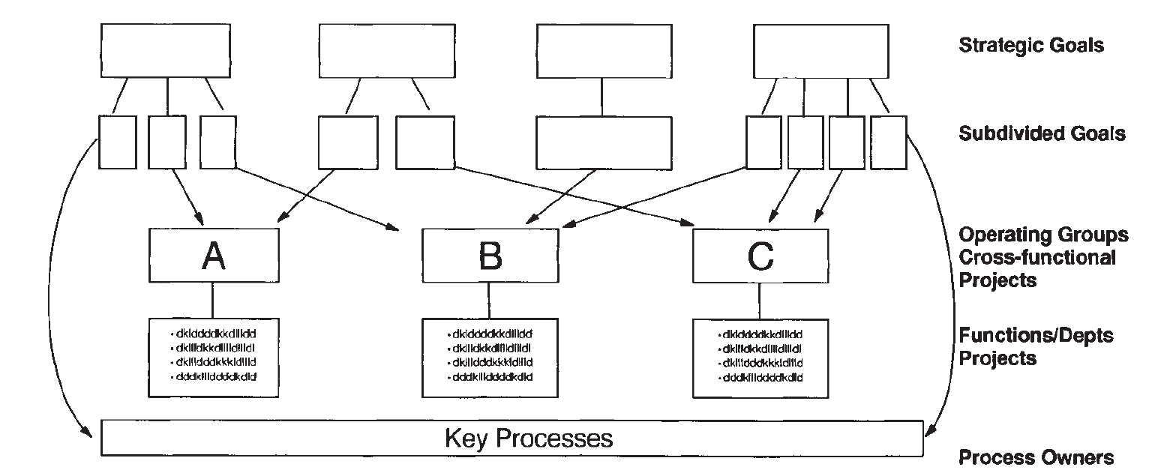
Strategic Deployment Process and Elements
Deploying the strategic goals (Juran Institute, Wiliton, CT)

Slide 10
Key Performance Indicators
A Key Performance Indicator (KPI) is a business metric used to evaluate factors that are crucial to the success of an organization
Properties of KPIs in QM
Link strongly to strategic goals and to the vision and mission of the organization
Include customer concerns; focus on the needs and requirements of internal and external customers
Can be easily obtained on a timely basis for executive decision making
The identification of chronic waste or cost of poor quality
KPI1
Subgoal 1
KPI2
KPI3
Strategic goal
KPI1
Subgoal 1
KPI2
KPI3
Notes:
To achieve this process, Industry 4.0 combines relevant physical and digital technologies, including analytics, additive manufacturing, robotics, high-performance computing, natural language processing, artificial intelligence and cognitive technologies, advanced materials, and augmented reality → The nine technologies for industry 4.0

Slide 11
A Strategist’s Guide to Industry 4.0
5. Transform into a digital enterprise
6. Adopt an ecosystem perspective
4. Become a virtuoso in data analytics
Set clear leadership, commitment and vision
Foster a digital culture, everyone think and act like technologically adept natives
Develop complete product and services solutions for your customers
Use partnerships or align with platforms if you cannot develop a comprehensive offering on your own
3. Define the capabilities
Establish cross-functional analytics capabilities
Develop ways of combining data from different parts of business
Learn to get value out of data through intelligent system design
Using real-time analytics
1. Map out an industry 4.0 strategy up front
2. Start with pilot projects
Map out in detail the capabilities to achieve the goal and acquire them
Develop strategies for recruiting and developing right employees
Evaluate digital maturity vs. what you need
Prioritize the measures that will bring value to business
Align measures with overall strategy
Gain commitment from top management
Establish proof of concept pilot projects will gain buy-in from the organization
Collaborate with digital leaders outside companies
Source: A strategist’s guide to Industry 4.0
(https://www.strategy-business.com/article/A-Strategists-Guide-to-Industry-4.0?gko=a2260)

Slide 12
KPIs in Industry 4.0
TQM Principles | Indicator for improvements | Industry 4.0 indicators | Means of measurement
Customer Focus | Customer satisfaction & loyalty Growth % in customers’ base Improved organization’s reputation | Response time to customers’ orders, product customization, and new product Developments Easy to gather customer feedback through smart product connectivity Real-time in-field performance product monitoring | Internet of Things, Wi-Fi and Big-Data will be utilized as data gathering and analysing tools.
Leadership | Unity of purpose among the organization Aligned strategies, policies, processes and resources Effective communication between all administrative levels | Effective allocation of different Resources (operational effectiveness) Increased revenues due to optimized allocation of | Real-time resources monitoring and automatic regulation and reallocation. System monitoring dashboards, ERP Systems
Engagement of People | Increase motivation of people Increasing innovative ideas Enhanced people satisfaction Self-evaluation and self-improvement culture | Number of innovative ideas or initiatives created or taken by employees Increased value (%) of employees’ Satisfaction Increased revenues due to less human related failures Number of problems solved by Employees | Human Resources smart systems Statistics and data gathered during production
Process approach | Identify key processes and points of improvements Optimized performance and effective process management, Manage processes, and interrelations, as well as dependencies | Number of process re-design activities made because of data analysis and enhancement decisions Production lead time Suppliers’ responsiveness to new supply orders In-process real time quality control Activities (percentage of defects) Decreased percentage of Processing Downtime | ERP system (integrated with customers and suppliers) Sensors and actuators within production process Process related bigdata analysis Internet of things (machines data) Maintenance management system
Source: Suggested Indicators to Measure the Impact of Industry 4.0 on Total Quality Management, International Scientific Conference on Industry 4.0, At 3-16. DECEMBER 2017, BOROVETS, BULGARIA

Slide 13
KPIs in Industry 4.0
TQM Principles | Indicator for improvements | Industry 4.0 indicators | Means of measurement
Improvement | Responsive systems to customer requirements Enhanced ability to react to development of processes, products and market needs Support drivers for innovation | Enhanced percentage of response time (production lead time) The range of customization options that can be fulfilled by the business without affecting the productivity normal rates Number of newly developed products and time needed to introduce it to Markets | ERP system and CRM system Big-data themes Customers feedback
Evidence-based decision making | Clear and agreed decision-making process Data availability and clarity, Effective past decisions, Analyse and evaluate data using suitable methods and tools. | Increased revenues due to recently take decisions Number of reporting and automatic recommendations learned by or from the smart production system Ease of data mining and friendly presentation of results and recommendations | Big-Data analysis ERP system
Relationship management | Stakeholders are identified and suitable communication tools to each are known Stakeholders are satisfied, and their feedback is considered, Suppliers are responding to materials requests on time and at the required quality Supply chain is stable and no downtime due to lack supply | Number of received to processes Communications from stakeholders Rate of satisfaction for stakeholders is improving continuously Improved suppliers 'responsiveness rate Percentage of downtime due to lack of supply is in its minimum value | ERP system (integrated with customers and suppliers) Sensors and actuators within production process Process related big data analysis Internet of things (machines data)
Source: Suggested Indicators to Measure the Impact of Industry 4.0 on Total Quality Management
International Scientific Conference on Industry 4.0, At 3-16. DECEMBER 2017, BOROVETS, BULGARIA

Slide 14
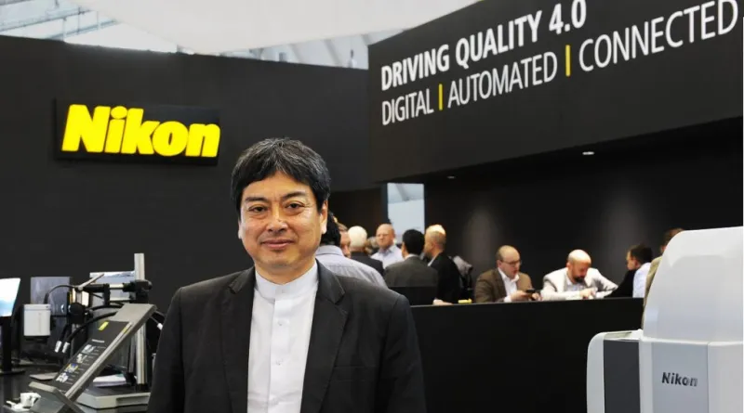
Case study: Nikon Strategic Focus on Quality 4.0
Source: https://metrology.news/nikon-strategic-focus-on-quality-4-0/
Notes:
Discussion

Slide 15
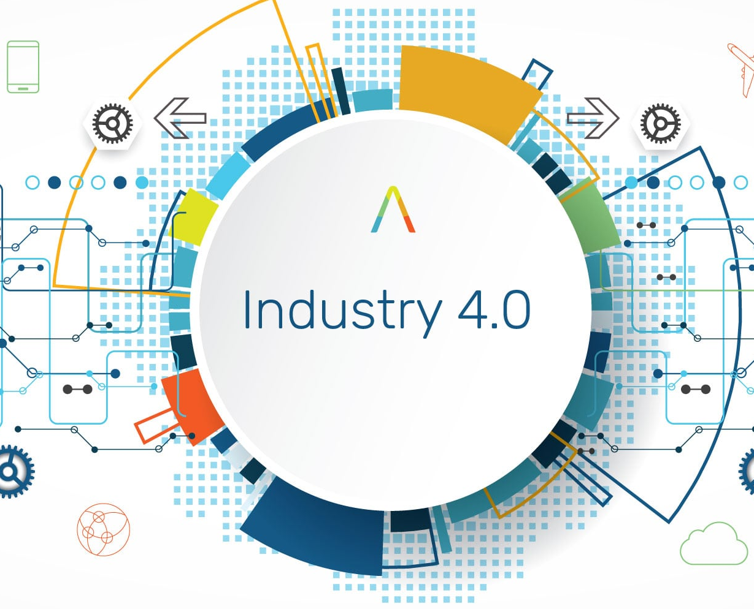
Gallery walk
Strategic Deployment and KPI

Slide 16
Gallery Walk: Strategic Deployment and KPI
Step 1: You will be assigned into a group of four. Each group represents a company in a particular industry. Each company has vision, mission and strategy in response to the arrival of industry 4.0.
Company A
Company B
Company C
Company D
Industry: Food
Type of company: Food manufacturer (B2B)
Product: Fresh and frozen food
Vision: To be the kitchen of the world
Mission: We produce and partner with our global sourcing expertise to provide quality food
Strategy: Transform our existing production to smart factory for the better goods and service
Industry: Healthcare
Type of company: Medical devices R&D and manufacture (B2B)
Product: Medical device
Vision: Be a world-class manufacturer in the medical-device industry
Mission: We provide the highest level of excellence to any hospitals and medical centres
Strategy: Seek for advanced technology to support R&D and operation for more innovative products
Industry: Fashion
Type of company: Design and manufacturer of clothes (B2C)
Product: Clothes
Vision: Fashion and design belong to everyone
Mission: We connect customers around the world through inspiring product design and experiences
Strategy: Adopt digital technology to create the new design for customers and increase manufacturing speed in response to the demand
Industry: Automotive
Type of company: Automobile manufacturer (B2C)
Product: Automobile
Vision: The leader of future mobility society
Mission: We deliver high valued and sustainable cars and create the best experience to our customers
Strategy: Reduce wastes and increase the capacity by transforming to smart factory

Slide 17
Gallery Walk: Strategic Deployment and KPI
Step 2 (30 mins) : Using the predefined KPIs in each industry from the assignment, each group needs to
Define the goal and KPIs of each department in the provided flipchart
Define the technologies (Industry 4.0) to measure each KPI
Ensure that the goal and KPIs are aligned with the vision and mission of the company.
Department | Goal | KPI | Technology
R&D | Goal 1 Goal 2 Goal 3 | KPI 1 KPI 2 KPI 3 | Technology 1 Technology 2 Technology 3
Sales & Marketing
Production
Warehouse and logistics
Quality assurance
Human Resources

Slide 18
Gallery Walk: Strategic Deployment and KPI
Step 3 (20 mins) : Each group spends 5 minutes to visit another group. Each group can add or modify the goal, KPIs and technology in another group’s flipchart with the pen representing the group color. When completely visiting every group, each group comes back to your own group and review the strategic deployment (5 mins).
Group 1
Group 4
Group 2
Group 3

Slide 19
Assignment
Do a self-study on Quality Function Deployment (QFD or House of Quality). Student should understand its concept and be able to create QFD (4 phases)
Do a self-study on a Kano-Based Evaluation. Student should understand how to apply the model to evaluate customers’ needs.
Recommended reading:
1. Developing a Kano-Based Evaluation Model for Innovation Design, Mathematical Problems in Engineering 2015(2):1-8 · October 2015
2. The Complete Guide to the Kano Model: Prioritizing Customer Satisfaction and Delight https://foldingburritos.com/kano-model/

