Slide 1
Module 3: Intellectual Property
Geographical Indications and Appellation of Origin

Slide 2
Content
What is a Geographical Indication?
How Are Geographical Indications Protected?
How Long Does Geographical Indication Protection Last?
Who Can Use A Protection Geographical Indication?
How Are Geographical Indication Rights Enforced?
What Is The Difference Between A Geographical Indication and A Trademark?

Slide 3
What is a Geographical Indication?
A geographical indication (GI) is a sign used on products that have a specific geographical origin and possess qualities or a reputation that are due to that origin.
A sign must identify a product as originating in a given place. The qualities, characteristics, or reputation of the product should be essentially due to the place of origin. Since the qualities depend on the geographical place of production, there is a clear link between the product and its original place of production.
Refer to https://www.wipo.int/geo_indications/en/faq_geographicalindications.html

Slide 4
What Type of Products Can Geographical Identifications Be Used ?
Geographical indications are typically used for agricultural products, foodstuffs, wine and spirit drinks, handicrafts, and industrial products.
There are three main ways to protect a geographical indication:
so-called sui generis systems (i.e. special regimes of protection);
using collective or certification marks; and
methods focusing on business practices, including administrative product approval schemes
How Are Geographical Indications Protected ?
Refer to https://www.wipo.int/geo_indications/en/faq_geographicalindications.html

Slide 5
How Long Does Geographical Indication Protection Last?
In many sui generis legislations, registrations for geographical indications are not subject to a specific period of validity. This means that the protection for a registered geographical indication will remain valid unless the registration is cancelled.
Geographical indications registered as collective and certification marks are generally protected for renewable ten-year periods.
Refer to https://www.wipo.int/geo_indications/en/faq_geographicalindications.html

Slide 6
Who Can Use A Protection Geographical Indication?
The right to use a protected geographical indication belongs to producers in the geographical area defined, who comply with the specific conditions of production for the product.
The rights to geographical indications (GI) are enforced by the application of national legislation, typically in a court of law.
The right to take action could rest with a competent authority, the public prosecutor, or to any interested party, whether a natural person or a legal entity, whether public or private. The sanctions provided for in national legislation could be civil (injunctions restraining or prohibiting unlawful acts, actions for damages, etc.), criminal, or administrative.
How Are Geographical Indication Rights Enforced?

Slide 7
What Is The Difference Between A Geographical Indication and A Trademark?
Geographical indications (GIs) identify a good as originating from a particular place. By contrast, a trademark identifies a good or service as originating from a particular company.
A trademark often consists of a fanciful or arbitrary sign. In contrast, the name used as a geographical indication is usually predetermined by the name of a geographical area.
A trademark can be assigned or licensed to anyone, anywhere in the world because it is linked to a specific company and not to a particular place. In contrast, a GI may be used by any persons in the area of origin, who produces the good according to specified standards, because of its link with the place of origin, a GI cannot be assigned or licensed to someone outside that place or not belonging to the group of authorized producers.

Slide 8
What Is The Difference Between A Geographical Indication and An Appellation of Origin?
Appellations of origin are a special kind of geographical indication (GI). GIs and appellations of origin require a qualitative link between the product to which they refer and its place of origin.
Both inform consumers about a product’s geographical origin and quality or characteristic of the product linked to its place of origin.
The basic difference between the two concepts is that the link with the place of origin must be stronger in the case of an appellation of origin. The quality or characteristics of a product protected as an appellation of origin must result exclusively or essentially from its geographical origin.
Refer to https://www.wipo.int/geo_indications/en/faq_geographicalindications.html

Slide 9
What Is The Difference Between A Geographical Indication and An Appellation of Origin? (Cont.)
This generally means that the raw materials should be sourced in the place of origin and that the processing of the product should also take place there. In the case of GIs, a single criterion attributable to geographical origin is sufficient – be it quality or other characteristic of the product – or even just its reputation.
Refer to https://www.wipo.int/geo_indications/en/faq_geographicalindications.html

Slide 10
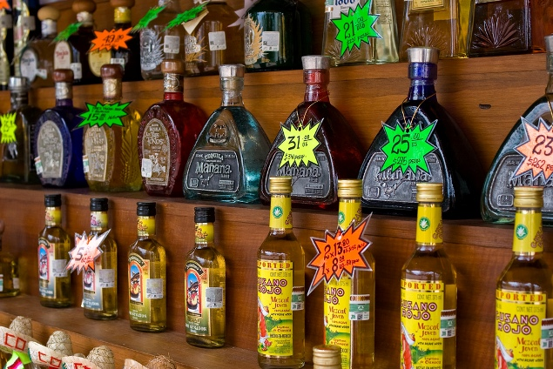
Case Study#1 Liquid Gold from the Agave
Different types of tequila (Photo: Kevin White)
Name: | Tequila
Country / Territory: | Mexico
IP right(s): | Geographical Indications and Appellations of Origin
Date of publication: | September 3, 2010
Last update: | November 27, 2012
Different types of tequila (Photo: Kevin White)
https://www.wipo.int/ipadvantage/en/details.jsp?id=2611

