Slide 1
Module 3: Intellectual Property
Trademark

Slide 2
Content
Purpose and Function of Trademarks
Types of Marks
Protect Trademark
Trademark Registration
Trademark Protection
Trademark Register
Trademark-Related Treaties Administered by WIPO
Case Study

Slide 3
Trademark
A trademark is a sign capable of distinguishing the goods or services of one enterprise from those of other enterprises.
Trademarks perform two critical functions in the marketplace: they provide assurance that goods are of a certain quality and consistency, and they assist consumers in making decisions about the purchase of goods.
Refer to https://www.wipo.int/trademarks/en/มIntellectual Property The Law of Trademarks, Copyrights, Patents, and Trade Secrets

Slide 4
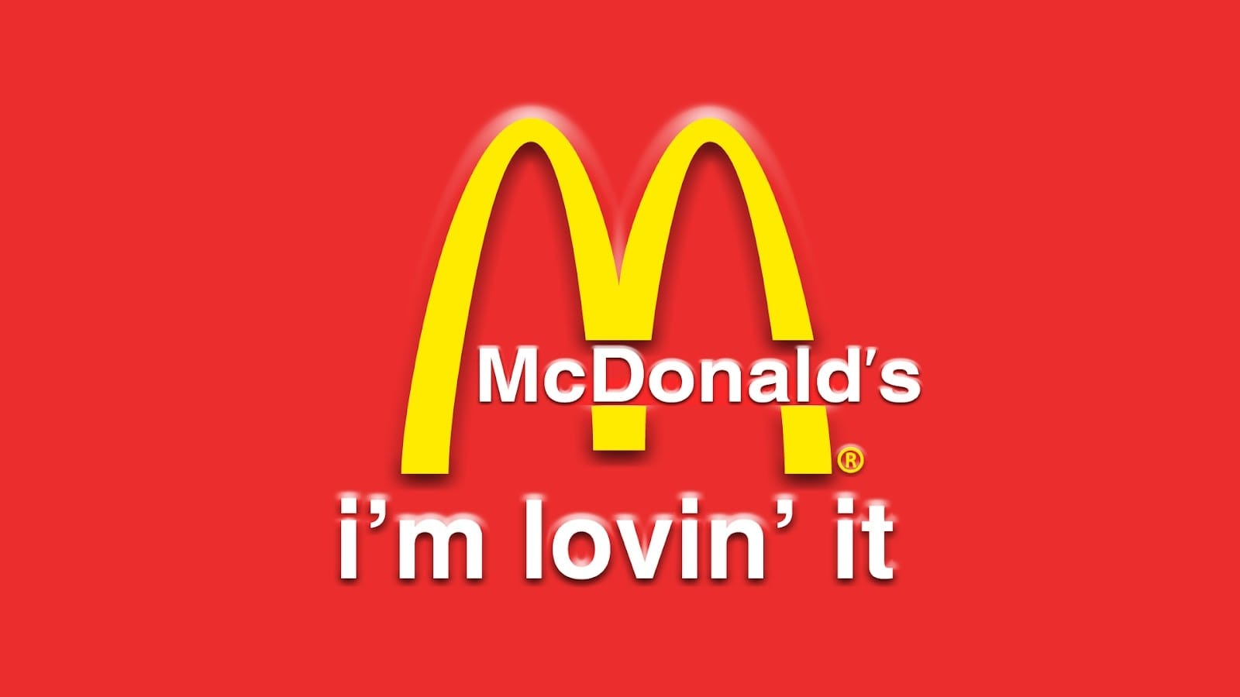
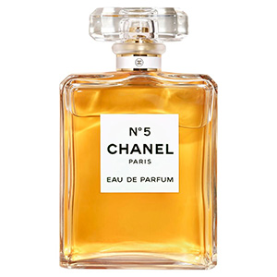
Trademark
A word or a combination of words, letters, and numerals can perfectly constitute a trademark. But trademarks may also consist of drawings, symbols, three-dimensional features such as the shape and packaging of goods, non-visible signs such as sounds or fragrances, or color shades used as distinguishing features – the possibilities are almost limitless.
McDonald’s (Name Symbols and Slogan trademark)
20th Century Fox Fanfare (Sound trademark)
Chanel N°5 (Fragrances trademark)
Refer to https://www.wipo.int/trademarks/en/

Slide 5
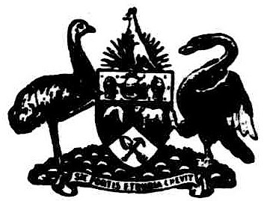
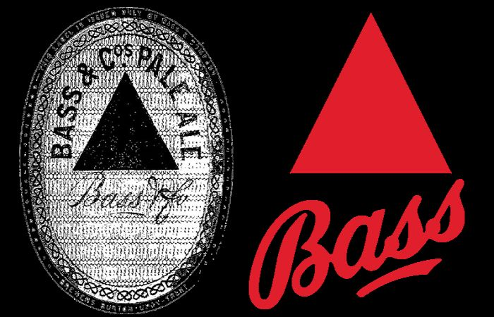
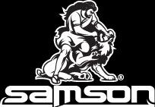
The Oldest Registered Trademark
Australia: 1850 -the Bank of New South Wales had registered its coat of arms.
UK: 1876 – The Bass Brewery's label incorporating its triangle logo for beer was the first trademark to be registered under the Trade Mark Registration Act 1875.
US: 1884 – The oldest U.S. registered trademark still in use is trademark a depiction of the Biblical figure Samson wrestling a lion, by the J.P. Tolman Company(now Samson Rope Technologies, Inc.), a rope-making company.
Picture from https://en.wikipedia.org
Picture from mondaq
Refer to https://en.wikipedia.org
Picture from
Samson Rope Technologies,Inc

Slide 6
Purpose and Function of Trademarks
If a trademark such as NIKE could be counterfeited and used by another on inferior merchandise, there would be no incentive for the owners of the NIKE mark to produce high-quality shoes and to expend money establishing consumer recognition of the products offered under the NIKE marks. Thus, protection of trademarks results in increased competition in the marketplace, with both the producer of goods and services and the consumer as the ultimate beneficiaries.
Refer to Intellectual Property The Law of Trademarks, Copyrights, Patents, and Trade Secrets

Slide 7
Purpose and Function of Trademarks(Cont.)
Businesses benefit because they can reap the rewards of their investment in developing and marketing a product without fearing another business will deceive consumers by using the same or a confusingly similar mark for like goods, and consumers benefit because they can identify and purchase desired goods.
The value inherent in achieving consumer loyalty to a particular product or service through the maintenance of consistent quality of the products or services offered under a mark is called goodwill.
Refer to Intellectual Property The Law of Trademarks, Copyrights, Patents, and Trade Secrets

Slide 8
Purpose and Function of Trademarks (Cont.)
The goodwill associated with a trademark continues to increase over time as additional sales are made of the product offered under a mark and consumers associate the mark with its owner. There is no doubt that the goodwill inherent in a trademark can be among a company’s most valuable assets.
Refer to Intellectual Property The Law of Trademarks, Copyrights, Patents, and Trade Secrets

Slide 9
Purpose and Function of Trademarks (Cont.)
Trademarks thus provide the following functions:
They identify one maker’s goods or services and distinguish them from those offered by others;
They indicate that all goods or services offered under the mark come from a single producer, manufacturer, or “source”;
They indicate that all goods or services offered under the mark are of consistent quality; and
They serve as an advertising device so that consumers link a product or service being offered with a mark (for example, when many consumers see or hear the phrase JUST DO IT, they immediately think of Nike products).
Refer to Intellectual Property The Law of Trademarks, Copyrights, Patents, and Trade Secrets

Slide 10
Types of Marks
Trademark: A trademark includes any word, name, symbol, or device (or combination of such) used to identify and distinguish one’s goods or products from those of another and to indicate the source of such goods or products. Thus, trademarks are used in the advertising and marketing of tangible goods, such as WINDOWS for software.
Service mark. A service mark includes any word, name, symbol, or device (or a combination of such) used to identify the services or intangible activities performed by one person for another, identify and distinguish one’s services from those of another, and indicate the source of such services, such as BURGER KING for restaurant services, UNITED AIRLINES for transportation services, or SPRINT for communication services.

Slide 11
Types of Marks (Cont.)
3. Collective marks: A collective mark is a trademark or service mark used by the members of a cooperative, association, or other collective group or organization, including marks indicating membership in a union or other organization, such as AMERICAN BAR ASSOCIATION, LIONS CLUB, or FRATERNAL ORDER OF POLICE; these marks indicate membership in the organization identified.

Slide 12
Types of Marks (Cont.)
4. Certification marks: A certification mark is a word, name, symbol, or device (or combination of such) used by a person other than its owner to certify quality, accuracy, or some other characteristics of goods or services, such as the famous UL (& Design) mark used by Underwriters’ Laboratories, Inc., to certify that products conform to certain safety standards established by Underwriters’ Laboratories. The UL (& Design) mark is not used by the trademark owner, Underwriters’ Laboratories, but by the manufacturer of an appliance to indicate to consumers that the item meets the safety standards established by Underwriters’ Laboratories.

Slide 13
Trademark Protection
At the national/regional level, trademark protection can be obtained through registration, by filing an application for registration with the national/regional trademark office and paying the required fees.
At the international level, you have two options: either you can file a trademark application with the trademark office of each country in which you are seeking protection, or you can use WIPO’s Madrid System.
The term of trademark registration can vary but is usually ten years. It can be renewed indefinitely on payment of additional fees. Trademark rights are private rights and protection is enforced through court orders.
https://www.wipo.int/trademarks/en/

Slide 14
Trademark Registration
Trademark registration will confer an exclusive right to the use of the registered trademark. This implies that the trademark can be exclusively used by its owner, or licensed to another party for use in return for payment.
Registration provides legal certainty and reinforces the position of the right holder, for example, in case of litigation.
https://www.wipo.int/trademarks/en/

Slide 15
Trademark Register
A word or a combination of words, letters, and numerals can perfectly constitute a trademark. But trademarks may also consist of drawings, symbols, three-dimensional features such as the shape and packaging of goods, non-visible signs such as sounds or fragrances, or color shades used as distinguishing features – the possibilities are almost limitless.
https://www.wipo.int/trademarks/en/

Slide 16
Categories of Marks
A generic mark is a common name of a product such as car, beverage. All of them are not protectable.
A descriptive mark immediately tells something about the product or service (characteristic, quality, ingredient, function, feature, purpose) such as OATNUT for bread made with oats and nuts, QUIK-PRINT for speedy copying service. They are not registrable until the consumer links the mark with a single source(secondary meaning).
Refer to Intellectual Property The Law of Trademarks, Copyrights, Patents, and Trade Secrets

Slide 17
Categories of Marks
A suggestive mark suggests something about the goods or services offered under the mark such as GREYHOUND BUS for transportation service, PLAYBOY for magazine. It is registrable without proof of secondary meaning.
An arbitrary mark is commonly known word that is applied to an unfamiliar product such as BLUE DIAMOND for nuts, APPLE for computer. It is registrable without proof of secondary meaning.
Fanciful marks are those that are invented and have no dictionary meaning such as KODAK, PEPSI, HONDA. They are registrable without proof of secondary meaning.
Refer to Intellectual Property The Law of Trademarks, Copyrights, Patents, and Trade Secrets

Slide 18
Trademark-Related Treaties Administered by WIPO
Paris Convention for the Protection of Industrial Property
The Paris Convention, adopted in 1883, applies to industrial property in the widest sense, including patents, trademarks, industrial designs, utility models, service marks, trade names, geographical indications, and the repression of unfair competition. This international agreement was the first major step taken to help creators ensure that their intellectual works were protected in other countries.
https://www.wipo.int/trademarks/en/

Slide 19
Trademark-Related Treaties Administered by WIPO
Madrid Agreement Concerning the International Registration of Marks
The Madrid System for the International Registration of Marks is governed by the Madrid Agreement, concluded in 1891, and the Protocol Relating to that Agreement concluded in 1989. The system makes it possible to protect a mark in a large number of countries by obtaining an international registration that has effect in each of the designated Contracting Parties.
https://www.wipo.int/treaties/en/registration/madrid/summary_madrid_marks.html

Slide 20
Trademark-Related Treaties Administered by WIPO
Madrid Agreement Concerning the International Registration of Marks (Cont.)
The Madrid system offers several advantages for trademark owners. Instead of filing a separate national application in each country of interest, in several different languages, following different national or regional procedural rules and regulations and paying several different (and often higher) fees, an international registration may be obtained by simply filing one application with the International Bureau (through the office of the home country), in one language (English, French or Spanish) and paying one set of fees.
https://www.wipo.int/treaties/en/registration/madrid/summary_madrid_marks.html

Slide 21
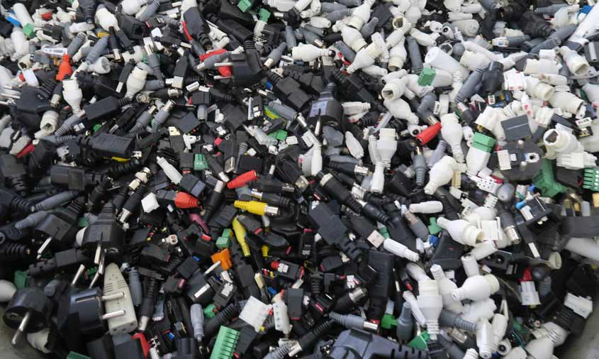
Case Study#1 Making disposal of counterfeits sustainable: the REACT way
https://www.wipo.int/wipo_magazine/en/2018/si/article_0007.html

