Slide 1
Module 3: Intellectual Property
Patent

Slide 2
Content
Right Under Federal Law
U.S. Patent and Trademark Office
Patentability
Exclusion from Patent Protection
Design Patents
Plant Patents
What Condition Must Be Met To Obtain Patent Protection?

Slide 3
Content
Who Grants Patents?
Do I Need A Patent Attorney/Agent to Prepare and File A Patent Application?
How Can Patents Be Obtain Worldwide?
How Can I Find The Patent Laws of Various Countries?
How Are Patents Relevant To My Business?
Case Study

Slide 4
Patent
A patent is an exclusive right granted for an invention, which is a product or a process that provides, in general, a new way of doing something, or offers a new technical solution to a problem.
Patents are territorial rights. In general, the exclusive rights are only applicable in the country or region in which a patent has been filed and granted, following the law of that country or region.
The protection is granted for a limited period, generally 20 years from the filing date of the application.
Refer to https://www.wipo.int/patents/en/

Slide 5
Patent
Some items are excluded from patent protection.
  a mere arrangement of printed matter
  a naturally existing substance
  some methods of doing business and
  a scientific principle
Refer to https://www.wipo.int/patents/en/

Slide 6
Patent
There are three types of patents: utility patents, design patents, and plant patents. The great majority of patents are utility patents, granted for useful objects or processes.
Patent protection is available only for a new and useful process, machine, manufacture, or composition of matter, or any new and useful improvement thereof.
Refer to Intellectual Property The Law of Trademarks, Copyrights, Patents, and Trade Secrets

Slide 7
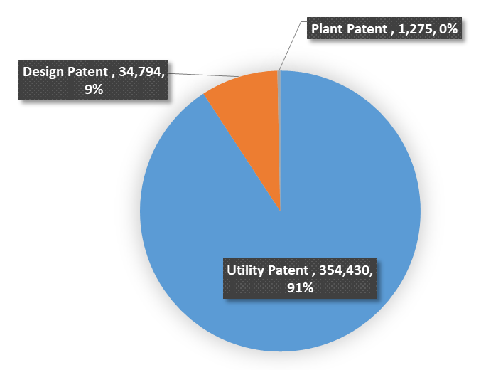
US Patents Granted in 2019 by Type
Refer to uspto.gov

Slide 8
Right Under Federal Law (US)
Four basic conditions that an invention must satisfy to secure patent protection.
  The invention must be a utility, design, or plant patent
  It must be useful (or ornamental in the case of a design patent or distinctive in the case of a plant patent)
  It must be novel in relation to the prior art in the field
  It must not be obvious to a person of ordinary skill in the field
Refer to Intellectual Property The Law of Trademarks, Copyrights, Patents, and Trade Secrets

Slide 9
United States Patent and Trademark Office
Patents exist only to be the authority of government grants. The department of the government responsible for granting patents is the Department of Commerce, acting through the U.S. Patent and Trademark Office (PTO).
The PTO receives application, review them, and issues or grants patents. The PTO also publishes and disseminates patent information, records assignments of patents, maintains files of U.S. and foreign patents, and maintain a search room for public use in examining issued patents and records.
Refer to Intellectual Property The Law of Trademarks, Copyrights, Patents, and Trade Secrets

Slide 10
Patentability
An invention must satisfy four basic requirements to be eligible for patent protection:
  The invention must be one of the types specified by statute as patentable subject matter (namely, a utility, design, or plant patent.)
  The invention must be useful
  The invention must be novel
  The invention must be non-obvious
Refer to Intellectual Property The Law of Trademarks, Copyrights, Patents, and Trade Secrets

Slide 11
Patentability (Cont.)
  Utility patents are the most common and cover a wide variety of inventions discoveries including the typewriter, the automobile, the sewing machine, the geodesic dome, the helicopter, sulfa drugs, gene sequences, and genetically altered mice.
Patentable Subject Matter – Utility Patents
  Process: A patentable method of doing something to produce a given result
  Machine: A device with moving parts that accomplishes a result
  Manufacture: Anything made by humans
  Composition of matter: A combination of two or more substances into a product.
Refer to Intellectual Property The Law of Trademarks, Copyrights, Patents, and Trade Secrets

Slide 12
Patentability (Cont.)
Usefulness
  The constitution itself provides that patent protection is available for “Useful arts”, in defining what is patentable, states that patents are available for useful processes, machines, manufacturers, and composition of matter.
  Mere novelties or inventions that conflict with scientific principles. Such as perpetual motion machine, are not patentable because they are not useful.
  Inventions whose only purpose is detrimental or dangerous or would promote illegal ends cannot be patented in as much as by definition, they are not useful.
Refer to Intellectual Property The Law of Trademarks, Copyrights, Patents, and Trade Secrets

Slide 13
Patentability (Cont.)
Usefulness
  To secure a patent, an invention need not meet the stricter standards of regulatory agencies such as the Food and Drug Administration; it need only be “reasonably safe”.
  To ensure that the invention is useful, the application must disclose or specify the usefulness of the invention. To allow a patent that does not specify its utility would be granted a patent on an entire range of unknown applications, thereby allowing an inventor to obtain a monopoly on an entire field of knowledge.
Refer to Intellectual Property The Law of Trademarks, Copyrights, Patents, and Trade Secrets

Slide 14
Patentability (Cont.)
Novelty
  Inventions known or used by others
  Invention is the subject of a prior application
  Inventions first invented by others
  Invention is in use or on sale
    A patent will not be granted unless an application is filed less than one year from the time the invention is in public use or on sale in the United States.

Slide 15
Patentability (Cont.)
Novelty (Cont.)
  Invention has been abandoned
    A person cannot obtain a patent if he or she has abandoned the invention. Abandonment is shown when inventor expressly or impliedly demonstrates an intent to abandon his or her right to a patent.
  Invention is the subject of a foreign patent
    A patent will be denied to an applicant if the invention was the subject of a patent application in a foreign country filed twelve months before an application in the United States and the patent issued in the foreign country before application was made in the United States.
  Inventor did not invent the invention
    An employee who invents an item while on the job remains the inventor. Although the employer may have a contractual right to own any invention created by employees, a patent application must be filed by the individual inventor.

Slide 16
Patentability (Cont.)
Nonobviousness
  The Graham Factors In Graham v. John Deere Co., the Supreme Court articulated the following factors to consider in determining whether an invention is nonobvious and thus deserving of a patent:
    Pertinent prior art. One must review the scope and content of the prior art in the pertinent field to determine if an invention is nonobvious.
    Differences between the prior and the invention.
    Level of ordinary skill in the prior art. If the invention would be obvious to a person having ordinary skill in the art to which invention pertains, it cannot be patented.

Slide 17
Patentability (Cont.)
Nonobviousness
  The Court suggested that some secondary considerations, all of which are nontechnical and objective, could be considered in determining nonobviousness.
    Commercial success. An invention that is a commercial success may be nonobvious because acceptance by the marketplace tends to show that an invention is significant; moreover, if the invention were obvious, someone would already have attempted to commercialize it for his or her own financial gain.
    Long-felt need. If there has been a long-standing need for a device or process that has gone unresolved despite the efforts of others to solve the problem, and the invention satisfies this need, it tends to show the invention is nonobvious. If invention were obvious, others would have been able to discover it readily.
Refer to Intellectual Property The Law of Trademarks, Copyrights, Patents, and Trade Secrets

Slide 18
Patentability (Cont.)
Nonobviousness
  Secondary Considerations (Cont.)
    Commercial acquiescence. If competitors seek to enter into licenses with the owner so they may use or sell the invention to others, such tends to show nonobviousness because otherwise the third parties would have challenged the patent as invalid based on nonobviousness.
    Copying. Copying or infringement of the patent by another suggests nonobviousness because otherwise the infringer would have been able to independently develop the invention.
  Combination Patents
    The newly combined elements must result in some different function or some result that is different or unexpected such that one possesses ordinary skill in the art would not have predicted the result of the combination of the know elements.
Refer to Intellectual Property The Law of Trademarks, Copyrights, Patents, and Trade Secrets

Slide 19
Exclusion from Patent Protection
Products of Nature
  Naturally occurring substances cannot be protected by patent even if they have previously been unknown to others. For example, a new plant or mineral that is discovered cannot be patented. On the other hand, genetically altered living organisms can be patented as “manufactures” or “compositions of matter.
Law of Nature
  Laws of nature, physical phenomena, scientific truths, and abstract ideas cannot be patented.
  Chemical or mathematical formulas or algorithms cannot be patented as such; however; chemical substances can be patented, systems using formulas can be patented as processes, and item that are produced as the result of formulas can be patented.

Slide 20
การยกเว้นจากการคุ้มครองสิทธิบัตร
Print Matter
  Printed form cannot be patented.
Atomic Weapons
Business Methods and Mental Steps
  Systems for the operation of businesses cannot be patented unless they produce a useful, tangible, and concrete result. A useful and novel business system or idea is not patentable unless there is a product or process to effect it. Similarly, processes consisting solely of mental steps, meaning human thought and deliberation, cannot be patented.
Refer to Intellectual Property The Law of Trademarks, Copyrights, Patents, and Trade Secrets

Slide 21
Design Patents
A design patent can be obtained for articles as diverse as jewelry, furniture, trash receptacles, and clothing.
To be protectable, a design must satisfy the following four requirements:
  It must be an “article of manufacture.”
  It must be new.
  It must be original. The requirement of originality is the equivalent of the requirement of nonobviousness for utility patents
  It must be ornamental.
Refer to Intellectual Property The Law of Trademarks, Copyrights, Patents, and Trade Secrets

Slide 22
Plant Patents
There are four requirements that must be satisfied before a plant can be patented:
1. The new variety must be asexually reproduced. Asexual reproduction involves growing something other than from a seed.
2. The plant must be distinctive. The requirement of distinctiveness imposes only a requirement that the plant be different from, rather than superior to, other varieties.
3. The plant must be novel.
4. The plant must be nonobvious.
Refer to Intellectual Property The Law of Trademarks, Copyrights, Patents, and Trade Secrets

Slide 23
What Condition Must Be Met To Obtain Patent Protection?
The invention must show an element of novelty; that is, some new characteristic which is not known in the body of existing knowledge in its technical field. This body of existing knowledge is called “prior art”.
The invention must involve an “inventive step” or “non-obvious”, which means that it could not be obviously deduced by a person having ordinary skill in the relevant technical field.
The invention must be capable of industrial application, meaning that it must be capable of being used for an industrial or business purpose beyond a mere theoretical phenomenon or be useful.
Refer to https://www.wipo.int/patents/en/faq_patents.html

Slide 24
What Condition Must Be Met To Obtain Patent Protection? (Cont.)
Its subject matter must be accepted as “patentable” under law. In many countries, scientific theories, aesthetic creations, mathematical methods, plant or animal varieties, discoveries of natural substances, commercial methods, methods for medical treatment (as opposed to medical products), or computer programs are generally not patentable.
The invention must be disclosed in an application in a manner sufficiently clear and complete to enable it to be replicated by a person with an ordinary level of skill in the relevant technical field.
Refer to https://www.wipo.int/patents/en/faq_patents.html

Slide 25
Who Grants Patents?
A patent is granted by a national patent office or by a regional office that carries out the task for a number of countries. Currently, the following regional patent offices are in operation:
African Intellectual Property Organization (OAPI)
African Regional Intellectual Property Organization (ARIPO)
Eurasian Patent Organization (EAPO)
European Patent Office (EPO)
Patent Office of the Cooperation Council for the Arab States of the Gulf (GCC Patent Office)
Refer to https://www.wipo.int/patents/en/faq_patents.html

Slide 26
Who Grants Patents? (Cont.)
Under such regional systems, an applicant requests protection for an invention in one or more member states of the regional organization in question. The regional office accepts these patent applications, which have the same effect as national applications, or grants patents if all the criteria for the grant of such a regional patent are met.
There is currently, no universal, international system for the grant of patents.
Refer to https://www.wipo.int/patents/en/faq_patents.html

Slide 27
Do I Need A Patent Attorney/Agent to Prepare and File A Patent Application?
Applicants can prepare their patent applications and file them without assistance from a patent attorney. However, given the complexity of patent documents and the legal skills required, such as claim drafting, it is highly advisable to seek legal assistance from a patent attorney/agent when drafting a patent application.
The legislation of many countries requires that an applicant, whose ordinary residence or principal place of business is outside the country, be represented by an attorney or agent qualified in the country (which usually means an agent or attorney who resides and practices in that country). Information on the qualified attorneys and agents can be obtained directly from national and regional IP offices.
Refer to https://www.wipo.int/patents/en/faq_patents.html

Slide 28
How Can Patents Be Obtain Worldwide?
At present, you cannot obtain a universal “world patent” or “international patent”. Patents are territorial rights.
In general, an application for a patent must be filed, and the patent granted and enforced, in each country in which you seek patent protection for your invention, following the law of that country. Therefore, one way of obtaining patents in many countries is to file a national patent application with each relevant national patent office.
Refer to https://www.wipo.int/patents/en/faq_patents.html

Slide 29
How Can Patents Be Obtain Worldwide? (Cont.)
In some regions, a regional patent office, for example, the European Patent Office (EPO) and the African Regional Intellectual Property Organization (ARIPO), accepts regional patent applications, or grants patents. These have the same effect as applications filed, or patents granted, in the member states of that region. This means that, in certain regions, you can obtain a regional patent from a regional patent office, which is valid in some or all of its member states.
Refer to https://www.wipo.int/patents/en/faq_patents.html

Slide 30
How Can Patents Be Obtain Worldwide? (Cont.)
If you are seeking patent protection in a number of countries worldwide, a good option is to file an international application under the Patent Cooperation Treaty (PCT), administered by WIPO.
Any resident or national of a state party to the PCT (contracting state) can file a single international application which has the effect of a national patent application (and certain regional patent applications) in some or all PCT contracting states.
In some cases, this can be a more straightforward choice than choosing to try to submit individual applications in each and every country in which you require protection. Find out more about the PCT System.
Refer to https://www.wipo.int/patents/en/faq_patents.html

Slide 31
How Can I Find The Patent Laws of Various Countries?
WIPO Lex provides easy access to intellectual property legislation from a wide range of countries and regions as well as to treaties on intellectual property.
Many national or regional patent offices also provide information concerning national or regional legislation on their websites. Consult our list of national and regional intellectual property offices.
Refer to https://www.wipo.int/patents/en/faq_patents.html

Slide 32
How Are Patents Relevant To My Business?
While it is certainly true that not all enterprises develop patentable inventions, it is wrong to believe that patents only apply to complex physical or chemical processes and products or that they are only useful to large corporations. Patents can be obtained for any area of technology from paper clips to computers.
In fact, most patents aren’t granted for groundbreaking scientific breakthroughs, but rather for inventions that make improvements to existing inventions. For example the second or third generation of a product or a process, that works in a more cost-effective or efficient manner.
Refer to https://www.wipo.int/patents/en/faq_patents.html

Slide 33
How Are Patents Relevant To My Business?
Certain countries also have specific legal provisions for protecting incremental innovations. These are called utility models and they tend to have a shorter duration than patents and are generally easier to obtain.
Refer to https://www.wipo.int/patents/en/faq_patents.html

Slide 34
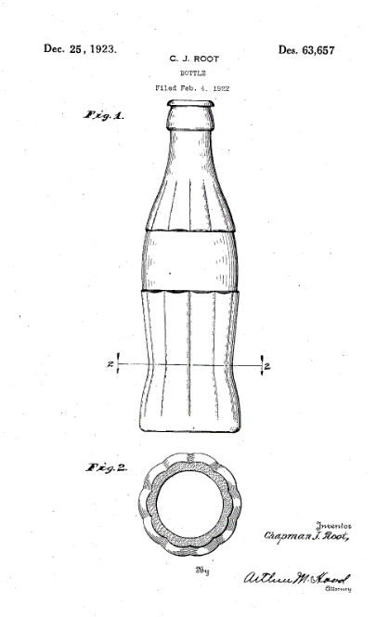
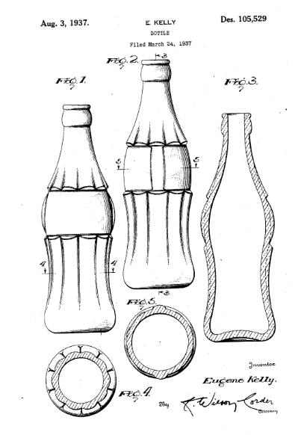
Case Study#1
Coca-Cola: thinking outside the bottle
In 1915, the Root Glass Company won a Coca-Cola Company contest for a bottle design that would be recognizable to everyone, even by touch in the dark.
The first design patent on the “hobble skirt” contour bottle was granted on Dec. 25, 1923, to the bottle manufacturer (known as “the Christmas bottles”).
The second design patent for the contour bottle was granted to the Coca-Cola Company on August 3, 1937, preventing imitation of the bottle for another 14 years.
The bottle shape became so well known that it became synonymous with the Coca-Cola product.
The Coca-Cola Company sought and obtained a federal trademark registration for its contour bottle shape on April 12, 1960, enabling the company to safeguard the bottle design indefinitely.
https://www.wipo.int/edocs/mdocs/.../wipo_smes_ver_09_theme04_2.ppt
https://www.wipo.int/wipo_magazine/en/2015/06/article_0007.html

Slide 35
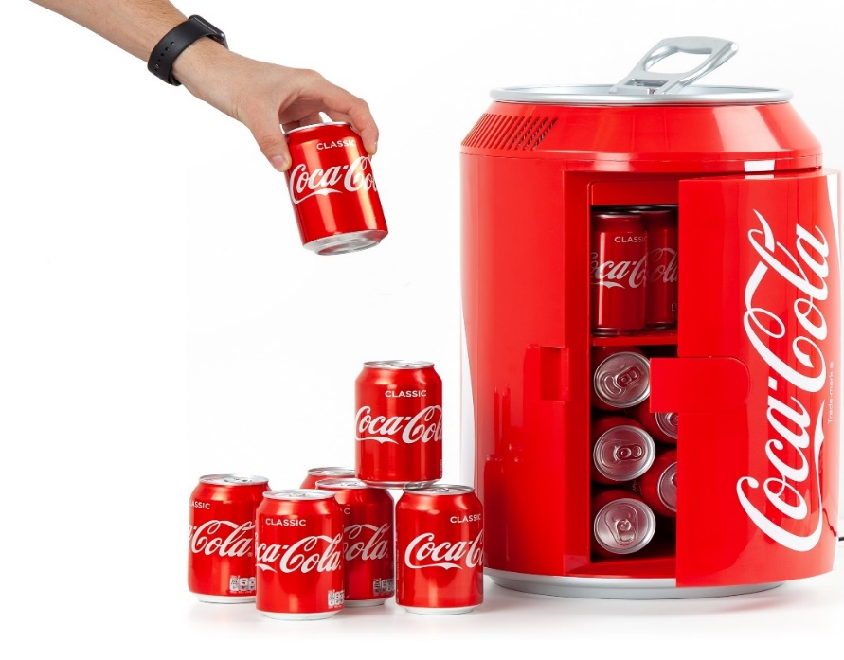
Case Study#1
Coca-Cola: thinking outside the bottle
Patent: Original and second design patent on Shape of bottle
Trademark: COCA-COLA, COKE, shape of bottle
Copyright: Advertising and Promotion
Trade Secret: The formula (SHHH! It’s a secret!)
Right of Publicity: Use of Sports or Other Figures (“persona”)

Slide 36

Case Study#2
Importance of Patenting for Industry 4.0
https://www.wipo.int/edocs/mdocs/mdocs/en/wipo_ipda_ge_19/wipo_ipda_ge_19_t1b.pdf

