Slide 1
Creative thinking and creative problem solving for creating innovative product

Slide 2
Outline
The concept of creative thinking and creative problem solving
Principles and stages of creative problem solving
The benefits of creative thinking
Difficulties blocking creative thinking, counteracting the suppression of creativity
Basic heuristic methods and techniques (mind mapping, brainstorming and its variants, reverse brainstorming, Edward de Bono Methods)

Slide 3
4 P’s of Creativity
Place (Social and cultural context)
Personal characteristics
(openness, self confidence)
Motivation
(risk taking, challenge taking)
Knowledge factors
(information, knowledge)
Process
(tools and techniques)
Product

Slide 4
Degree of Inventiveness
%
of patents
Level
Degree of change
No. of trials
Method
1
It was obvious !
A few
Use general knowledge, common sense, or experience within the field
~ 30%
2
Some modifications were made.
Dozens
Use knowledge and experience within the industry (ME, EE, etc.)
55 %
3
A radical change was made.
Hundreds
Use knowledge outside the product industry
10 %
4
Solution is broadly applicable.
1,000 -10,000
Use knowledge from basic sciences
3 - 4 %
No knowledge in existing science. Need experiment or observation to discover new knowledge.
5
A true discovery,
previously unknown
10,000 -100,000
or more
< 1 %
Notes:
3. - มองหาความขัดแย้งและแก้ปัญหาด้วยหลักการทางกายภาพซึ่งเป็นที่รู้จักกันอยู่แล้ว - มองหาความขัดแย้งและแก้ปัญหาด้วยหลักการทางกายภาพซึ่งเป็นที่รู้จักกันอยู่แล้ว

Slide 5
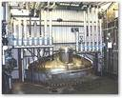
Ex. - Increase the thickness of liquid O₂ piping system
1. Standard

Slide 6
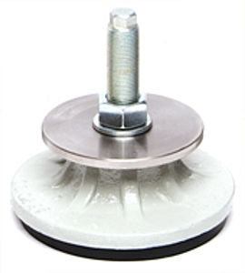
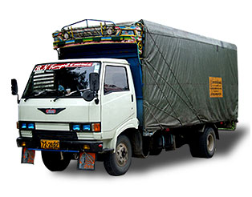
Install rubber pad under the machine to reduce vibration
Increase the truck’s payload to enhance transportation efficiency.

Slide 7
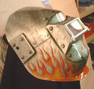
2. Improvement

Slide 8
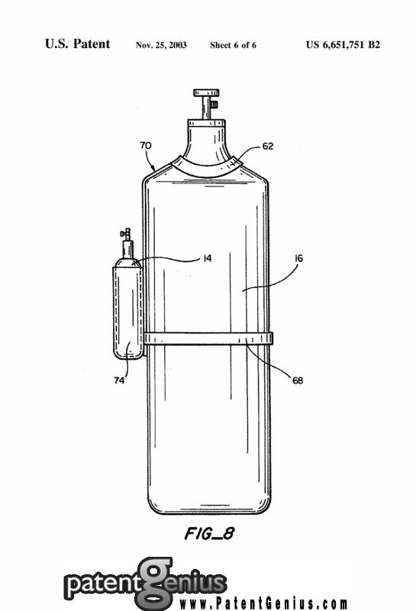
The hollow handle of an ax (less weight and more optimal CG).
A fire extinguisher added to a welding tank.

Slide 9
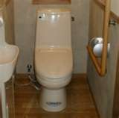
3. Invention inside paradigm
Automatic transmission

Slide 10
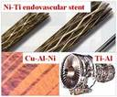
4. Invention outside paradigm
Ex- shape-memory metal

Slide 11
Ex – liquid crystal

Slide 12
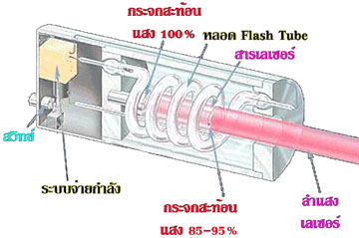
5. Discovery
Ex - Light Amplification by Stimulated Emission Radiation (LASER)

Slide 13
Principle of Psychological Inertia

Slide 14
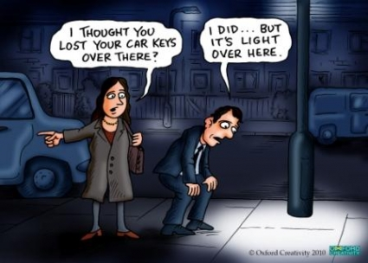
Trap in one’s own experience and expertise

Slide 16
Creative problem solving techniques
Intuitive Approach
Promote creativity from within a person or a group
Logical Approach
Systematic and step-by-step approaches

Slide 17
Richard Fobes’ Techniques (1999)
Techniques for accepting new ideas
Techniques for generating additional ideas
Techniques for organizing ideas

Slide 18
1. Techniques for accepting new ideas
Looking for good things in fresh ideas
Think from new perspectives
Value humor
Keep ideas secret in the beginning

Slide 19
2. Techniques for generating additional ideas
Reinvestigate the objective
Convert negative to positive goal
Consider indirect approach
Break down objective into smaller ones

Slide 20
3. Techniques for organizing ideas
Considering several alternatives
Use diagrams to organize ideas
Use matrix
Combine ideas

Slide 21
Brainstorming
Collect as many creative ideas as possible in a limited time
When this technique is used to generate product concept, it should be used to satisfy functional needs rather than being constrained by product specifications
“Brain ball” is a variant of brainstorming.

Slide 22
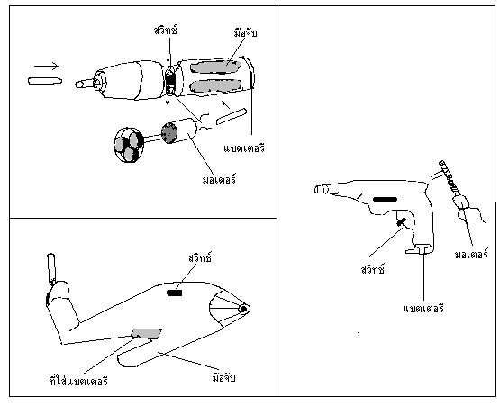
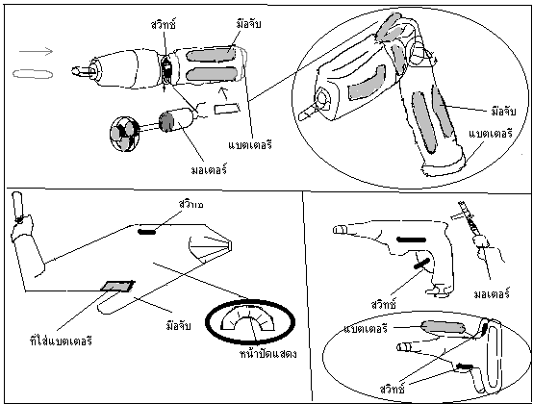
6-3-5 technique
C-sketch, brain writing
6 members/group, 3 ideas, 5 rounds of comment

Slide 23
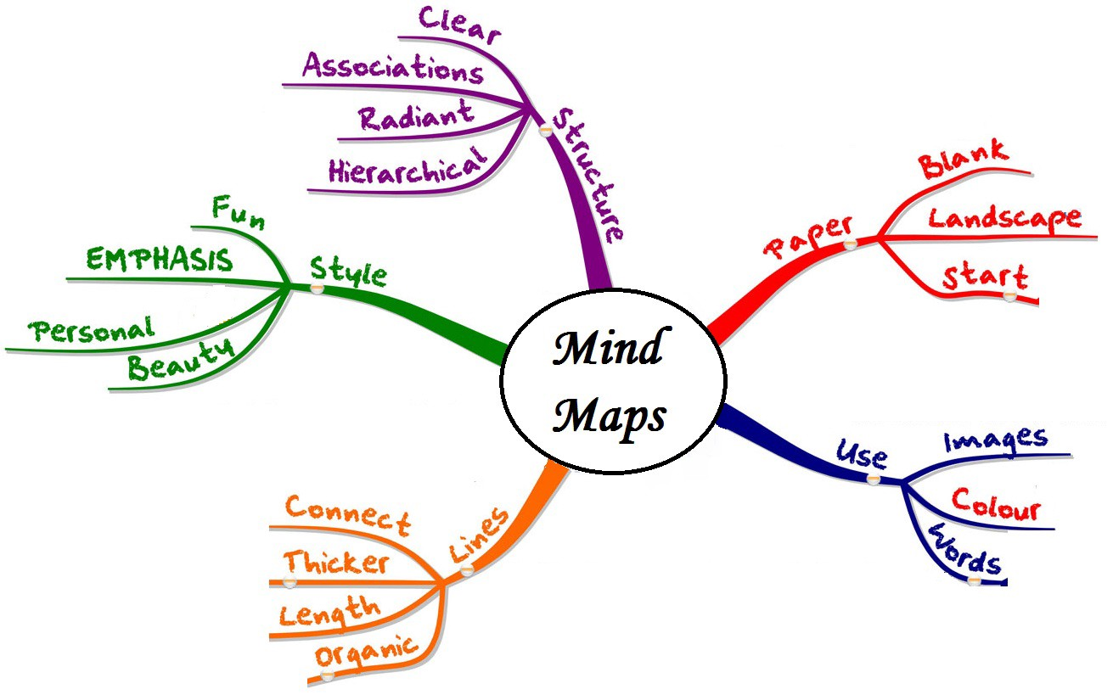
Mind Map

Slide 24
Edward de Bono’s six thinking hats

Slide 25
Creative organization
Understand the organization’s objectives
Allow activities initiated by employees
Unofficial activities
Serendipity
Internal communication

