Slide 1
Course 13: Innovative Product Design
and Development
Montalee Sasananan

Slide 2
Innovation
Creation of new concept, product, service, or method that benefits the creator AND the society.

Slide 3
Development of Innovation
Problem
Creative problem solving
Other people use the results
Innovation
Innovation is used for a long time
Tradition

Slide 4
Path to innovation
Basic research – needs investment in time and capital
Applied research – developed from existing innovation
C&D
Reverse Engineering

Slide 5
c h a l l e n g e s
Constant change
Varied demand
Contradiction
Time constraint
Economic constraint

Slide 6
How to measure success of innovation
Quality
Cost
Development time
Cost of development
Capability of product development

Slide 7
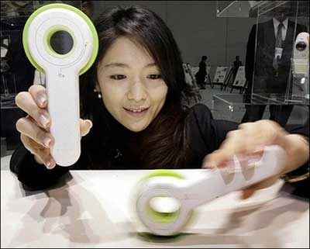
Examples of innovative products
Battery-free camera

Slide 8
Examples of innovative products
Freeplay Ranger radio

Slide 9
Examples of innovative products
Life straw
- drink directly out of rivers and streams

Slide 10
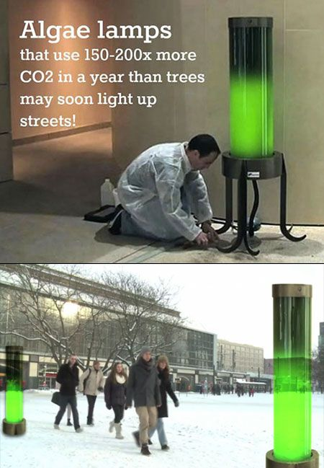
Examples of innovative products

