Slide 1
Applied Data Analytics

Slide 2
Session 3:Hypothesis Testing

Slide 3
Hypothesis Testing for Mean – Single Sample
Hypothesis testing can be used to determine whether a statement about the value of a population parameter should or should not be rejected

Slide 4
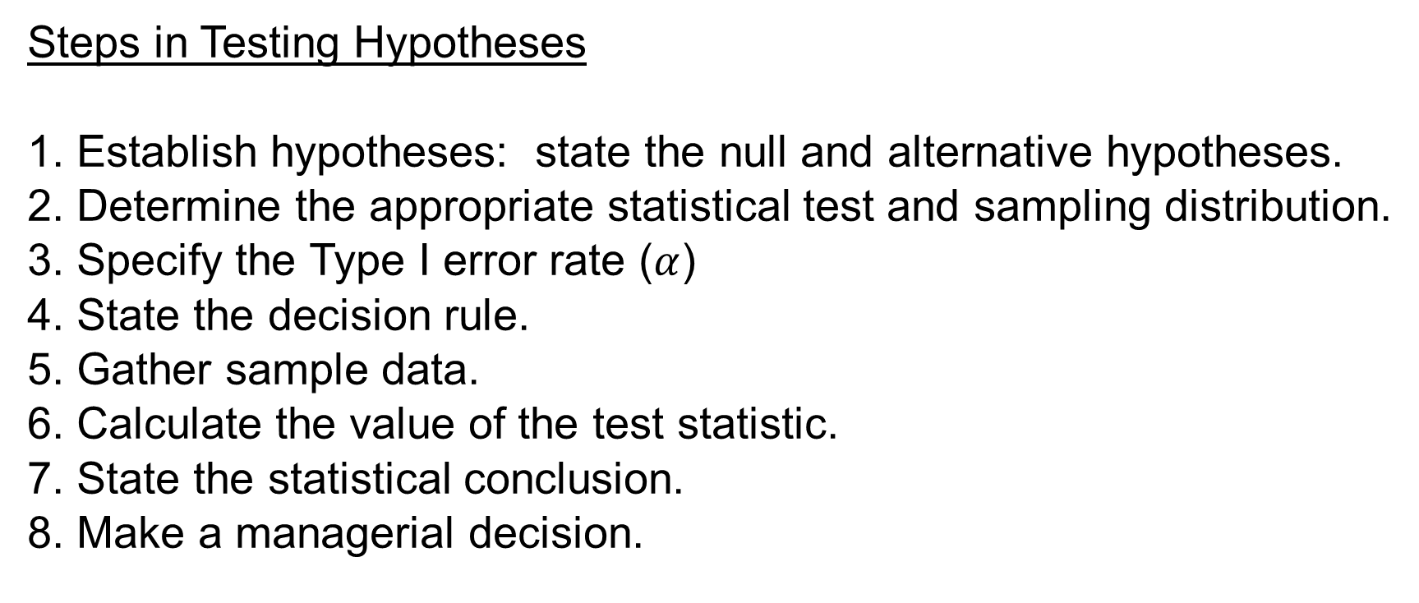
Hypothesis Testing for Mean – Single Sample
Steps in Testing Hypotheses
1. Establish hypotheses: state the null and alternative hypotheses.
2. Determine the appropriate statistical test and sampling distribution.
3. Specify the Type I error rate ($α$)
4. State the decision rule.
5. Gather sample data.
6. Calculate the value of the test statistic.
7. State the statistical conclusion.
8. Make a managerial decision.

Slide 5
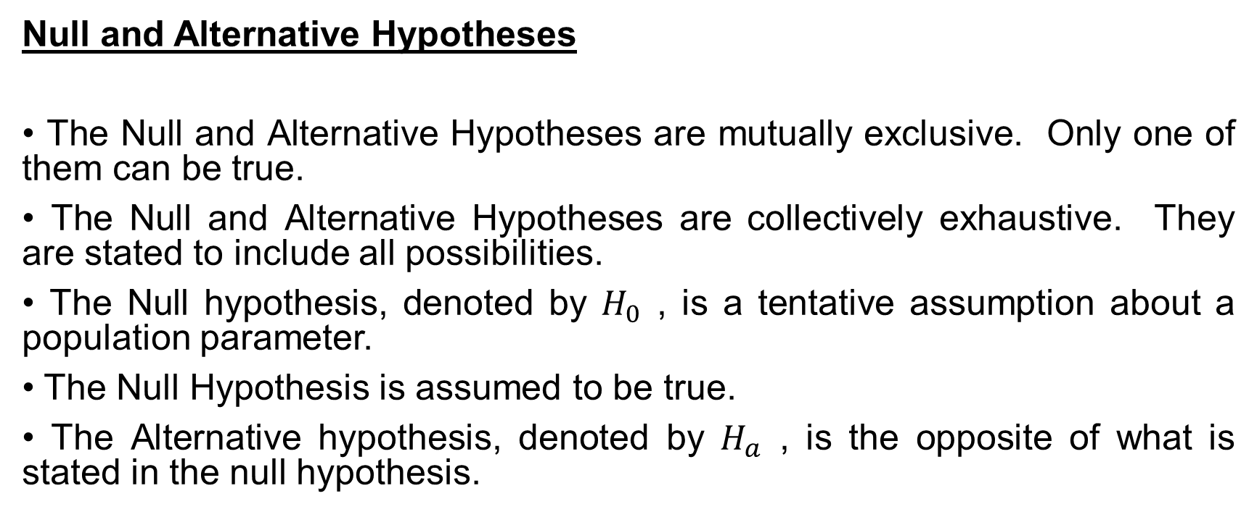
Hypothesis Testing for Mean – Single Sample
Null and Alternative Hypotheses
• The Null and Alternative Hypotheses are mutually exclusive. Only one of them can be true.
• The Null and Alternative Hypotheses are collectively exhaustive. They are stated to include all possibilities.
• The Null hypothesis, denoted by $H_{0}$ , is a tentative assumption about a population parameter.
• The Null Hypothesis is assumed to be true.
• The Alternative hypothesis, denoted by $H_{a}$ , is the opposite of what is stated in the null hypothesis.

Slide 6
Hypothesis Testing for Mean – Single Sample
Example:
A soft drink company is filling 12 oz. cans with cola.
The company hopes that the cans are averaging 12 ounces.

Slide 7
Hypothesis Testing for Mean – Single Sample
The case of large sample
Two-tailed Test

Slide 8
Hypothesis Testing for Mean – Single Sample
The case of large sample
One-tailed Test

Slide 9
Hypothesis Testing for Mean – Single Sample
The case of large sample
Example: Production line of Glow Toothpaste with mean weight = 6 ounces
Periodically, a sample of 30 tubes will be selected to check the filling process. Quality assurance procedures call for the continuation of the filling process if the sample results are consistent with the assumption that the mean filling weight for the population of toothpaste tubes is 6 ounces; otherwise, the filling process will be stopped and adjusted. Assume that a sample of 30 toothpaste tubes provides a sample mean of 6.1 ounces and standard deviation of 0.2 ounces.

Slide 10
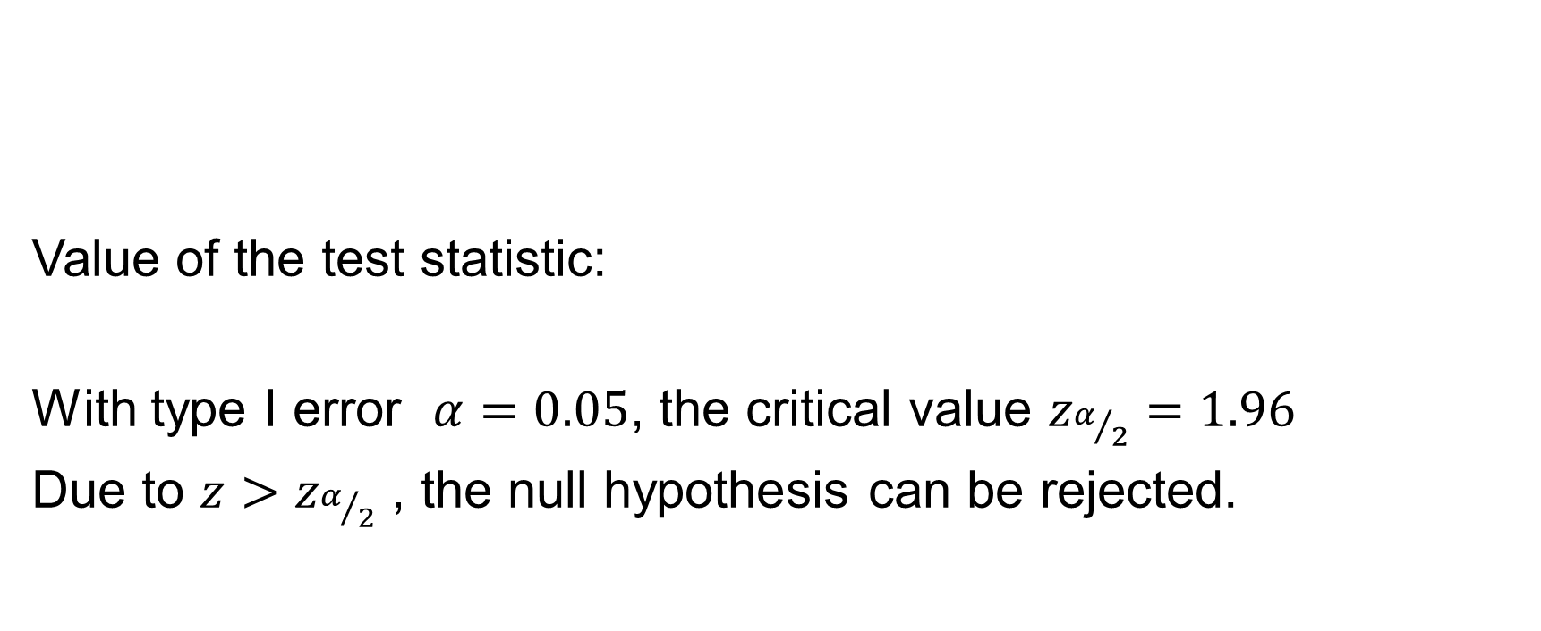
Hypothesis Testing for Mean – Single Sample
The case of large sample
Value of the test statistic:
With type I error $α=0.05$, the critical value $z_{α/2}=1.96$
Due to ${z>z}_{α/2}$ , the null hypothesis can be rejected.

Slide 11
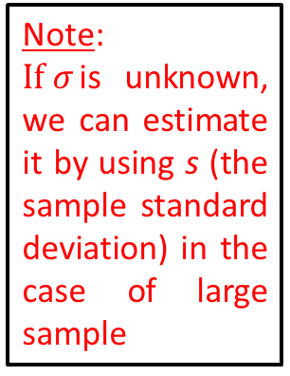
Hypothesis Testing for Mean – Single Sample
The case of large sample
GENERAL RULES
One-tailed Test | Two-tailed Test
Hypotheses: | Hypotheses:
Test Statistic: | Test Statistic:
Rejection Region | Rejection Region
Where: | Where:
Note:
$If σ$is unknown, we can estimate it by using s (the sample standard deviation) in the case of large sample

Slide 12
Hypothesis Testing for Mean – Single Sample
The case of large sample
CRITICAL VALUE METHOD
One-tailed Test | Two-tailed Test
Hypotheses: | Hypotheses:
Critical Value: | Critical Values:
Rejection Region | Rejection Region
Where: | Where:

Slide 13

Hypothesis Testing for Mean – Single Sample
The case of large sample
Example: Glow Toothpaste
Because $\overline{x}=6.1>{\overline{x}}_{c}^{u}$ : we reject the null hypothesis.

Slide 14
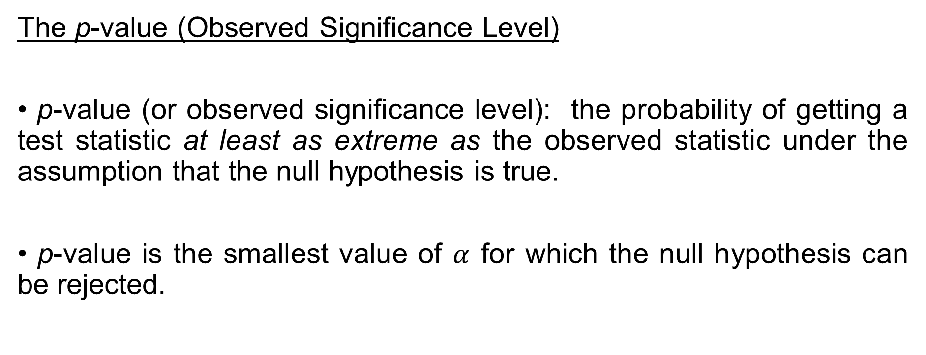
Hypothesis Testing for Mean – Single Sample
The case of large sample
The p-value (Observed Significance Level)
• p-value (or observed significance level): the probability of getting a test statistic at least as extreme as the observed statistic under the assumption that the null hypothesis is true.
• p-value is the smallest value of $α$ for which the null hypothesis can be rejected.

Slide 15
Hypothesis Testing for Mean – Single Sample
The case of large sample
THE p-VALUE METHOD
One-tailed Test | Two-tailed Test
Hypotheses: | Hypotheses:
Test Statistic: | Test Statistic:
p-value: | p-value:
Rejection Region: | Rejection Region:

Slide 16
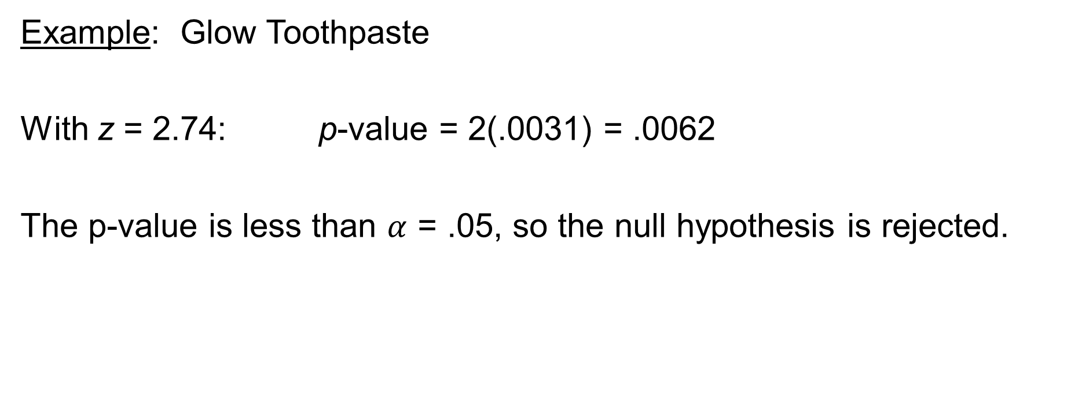
Hypothesis Testing for Mean – Single Sample
The case of large sample
Example: Glow Toothpaste
With z = 2.74: p-value = 2(.0031) = .0062
The p-value is less than $α$ = .05, so the null hypothesis is rejected.

Slide 17
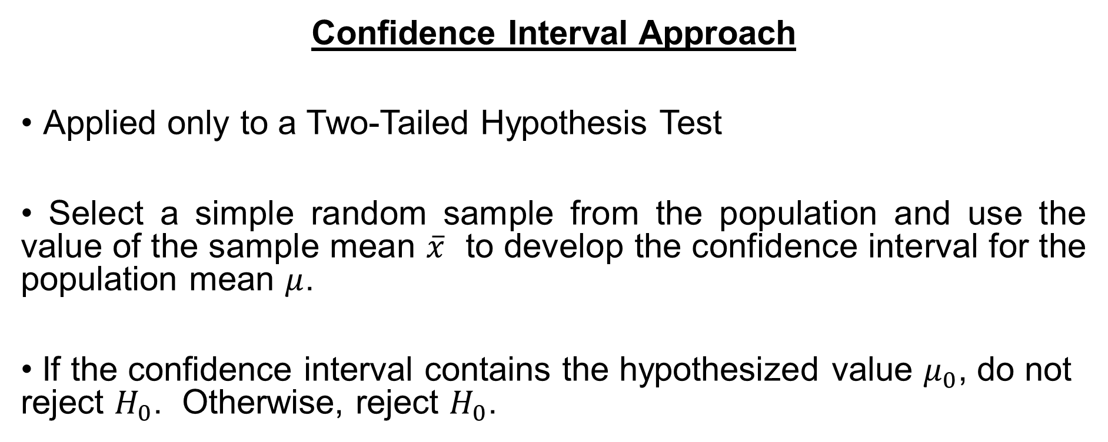
Hypothesis Testing for Mean – Single Sample
The case of large sample
Confidence Interval Approach
Applied only to a Two-Tailed Hypothesis Test
• Select a simple random sample from the population and use the value of the sample mean $\overline{x}$ to develop the confidence interval for the population mean $μ$.
• If the confidence interval contains the hypothesized value $μ_{0}$, do not reject $H_{0}$. Otherwise, reject $H_{0}$.

Slide 18
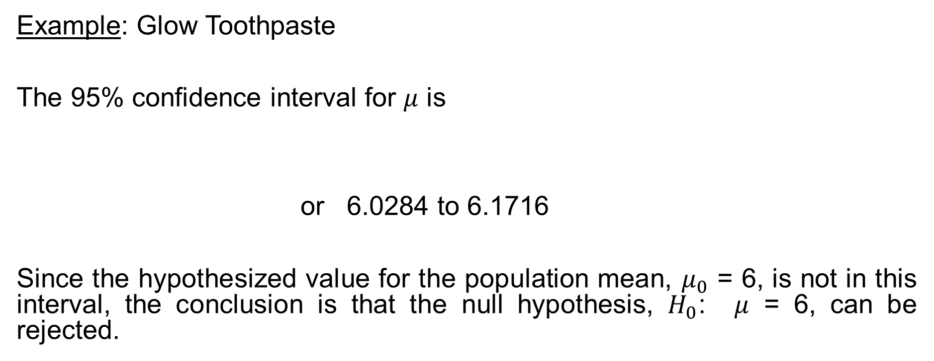
Hypothesis Testing for Mean – Single Sample
The case of large sample
Example: Glow Toothpaste
The 95% confidence interval for $μ$ is
or 6.0284 to 6.1716
Since the hypothesized value for the population mean, $μ_{0}$ = 6, is not in this interval, the conclusion is that the null hypothesis, $H_{0}$: $μ$ = 6, can be rejected.

Slide 19
Hypothesis Testing for Mean – Single Sample
The case of small sample
GENERAL RULES
One-tailed Test | Two-tailed Test
Hypotheses: | Hypotheses:
Test Statistic: | Test Statistic:
Rejection Region | Rejection Region
Where: | Where:

Slide 20
Hypothesis Testing for Mean – Single Sample
The case of small sample
Example: A company builds large harvesters with a 25-pound plate installed on its side. The machine that produce these plate is set to yield plates that average 25 pounds. Suppose that the distribution of plates produced from the machine is normal. The supervisor suspects that the machine is out of adjustment. To test this concern, he selects 20 of the plates produced and weighs them. The results are:
  Weights in Pounds of a Sample of 20 Plates
  22.6 22.2 23.2 27.4 24.5
  27.0 26.6 28.1 26.9 24.9
  26.2 25.3 23.1 24.2 26.1
  25.8 30.4 28.6 23.5 23.6

Slide 21

Hypothesis Testing for Mean – Single Sample
The case of small sample
Hypotheses:
Critical value: (with $α=0.05$ )
Test statistic:
$⇒$ The null hypothesis cannot be rejected.

Slide 22
Hypothesis Testing for Mean – Single Sample
The case of small sample
Note:
The other methods (i.e., critical value method, p-value method, and confidence interval approach) can also be used

Slide 23

Hypothesis Testing for Population Proportion – Single Sample
Condition: $np, nq≥5$
One-tailed Test | Two-tailed Test
Hypotheses: | Hypotheses:
Test Statistic: | Test Statistic:
Rejection Region | Rejection Region
Where: | Where:

Slide 24
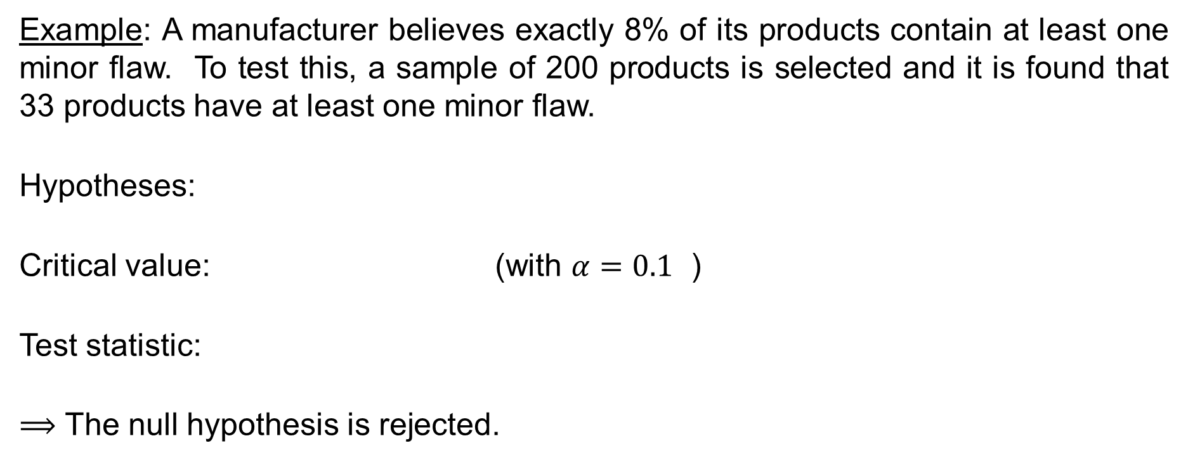
Hypothesis Testing for Population Proportion – Single Sample
Example: A manufacturer believes exactly 8% of its products contain at least one minor flaw. To test this, a sample of 200 products is selected and it is found that 33 products have at least one minor flaw.
Hypotheses:
Critical value: (with $α=0.1$ )
Test statistic:
$⟹$ The null hypothesis is rejected.

Slide 25
Hypothesis Testing for Population Variance – Single Sample
One-tailed Test | Two-tailed Test
Hypotheses: | Hypotheses:
Test Statistic: | Test Statistic:
Rejection Region | Rejection Region
Where: | Where:

Slide 26
Hypothesis Testing for Population Variance – Single Sample
Examples: A small business has 37 employees. Because of uncertain demand, the company usually has to pay overtime on any given week. Assume that there will be around 50 hours of overtime per week and the variance of this figure is about 25. Company officials want to know whether the variance of overtime hours has changed. The following sample of 16 weeks of overtime data (hours/week) is collected:
57 56 52 44
46 53 44 44
48 51 55 48
63 53 51 50
Suppose that hours of overtime are normally distributed. Test the null hypothesis that the variance of overtime data is 25.

Slide 27
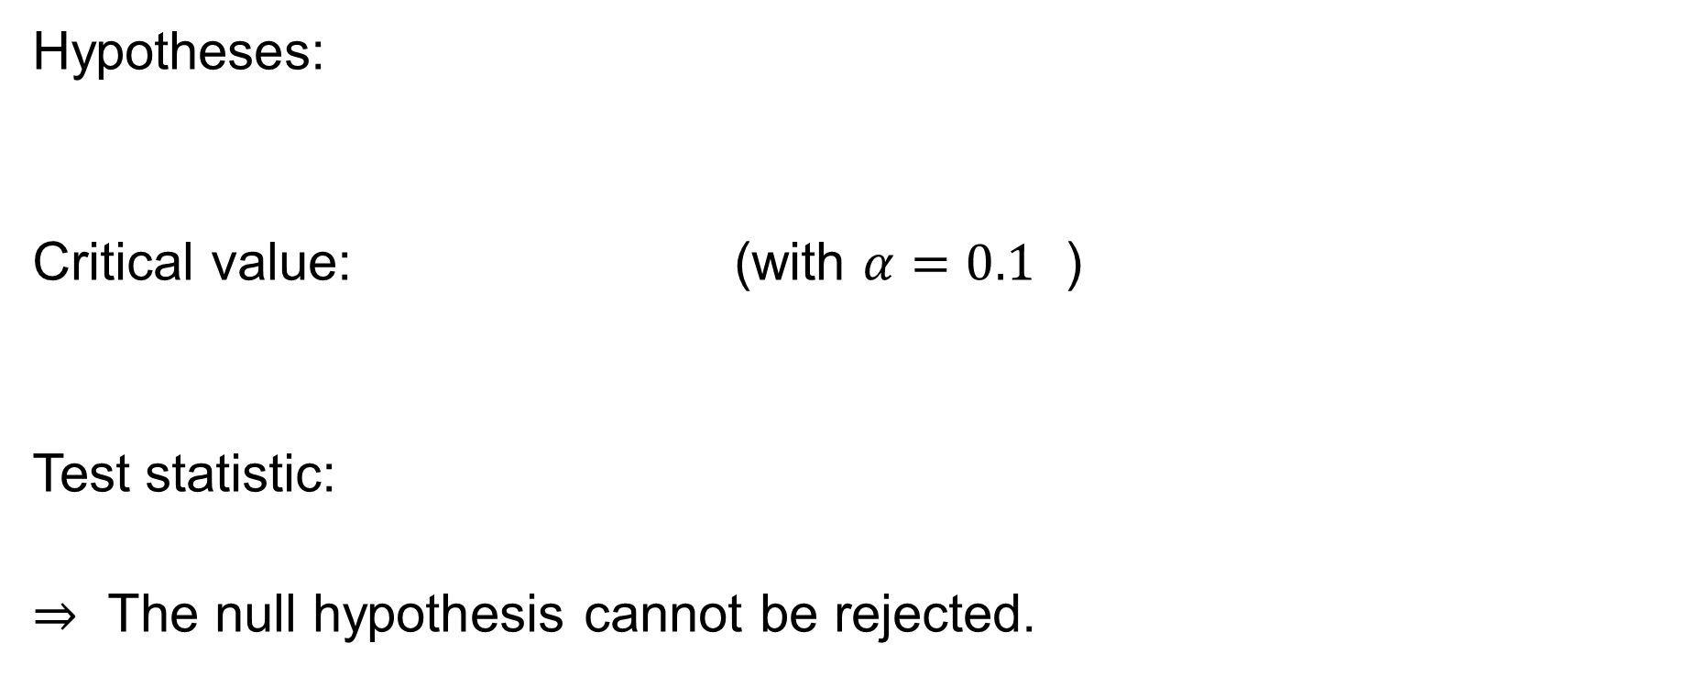
Hypothesis Testing for Population Variance – Single Sample
Hypotheses:
Critical value: (with $α=0.1$ )
Test statistic:
$⇒$ The null hypothesis cannot be rejected.

Slide 28
Hypothesis Testing for Mean – Two Samples
Sampling Distribution of the Difference between Two Sample Means

Slide 29

Hypothesis Testing for Mean – Two Samples
The case of large samples
Z Formula for the Difference in Two Sample Means
• $n_{1}$, $n_{2}≥30$ and Independent Samples

Slide 30
Hypothesis Testing for Mean – Two Samples
The case of large samples
GENERAL RULES
One-tailed Test | Two-tailed Test
Hypotheses: | Hypotheses:
Test Statistic: | Test Statistic:
Rejection Region | Rejection Region
Where: | Where:
Note:
$If σ$is unknown, we can estimate it by using s (the sample standard deviation) in the case of large sample

Slide 31
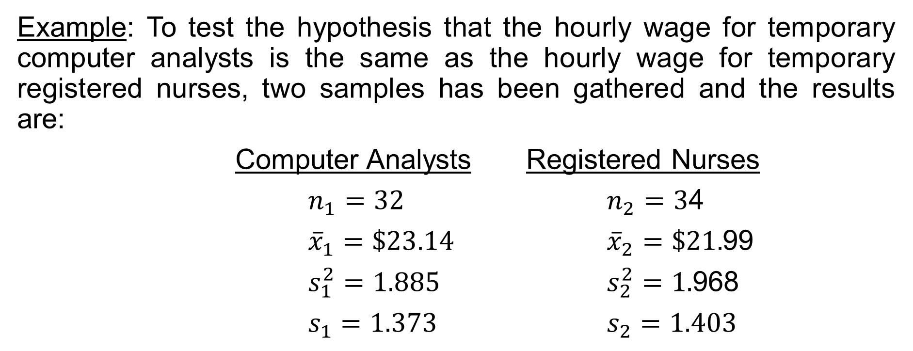
Hypothesis Testing for Mean – Two Samples
The case of large samples
Example: To test the hypothesis that the hourly wage for temporary computer analysts is the same as the hourly wage for temporary registered nurses, two samples has been gathered and the results are:
Computer Analysts Registered Nurses
$n_{1}=32$ $n_{2}=3$4
${\overline{x}}_{1}=\$23.14$ ${\overline{x}}_{2}=\$21.$99
$s_{1}^{2}=1.885$ $s_{2}^{2}=1.$968
$s_{1}=1.373$ $s_{2}=1.403$

Slide 32
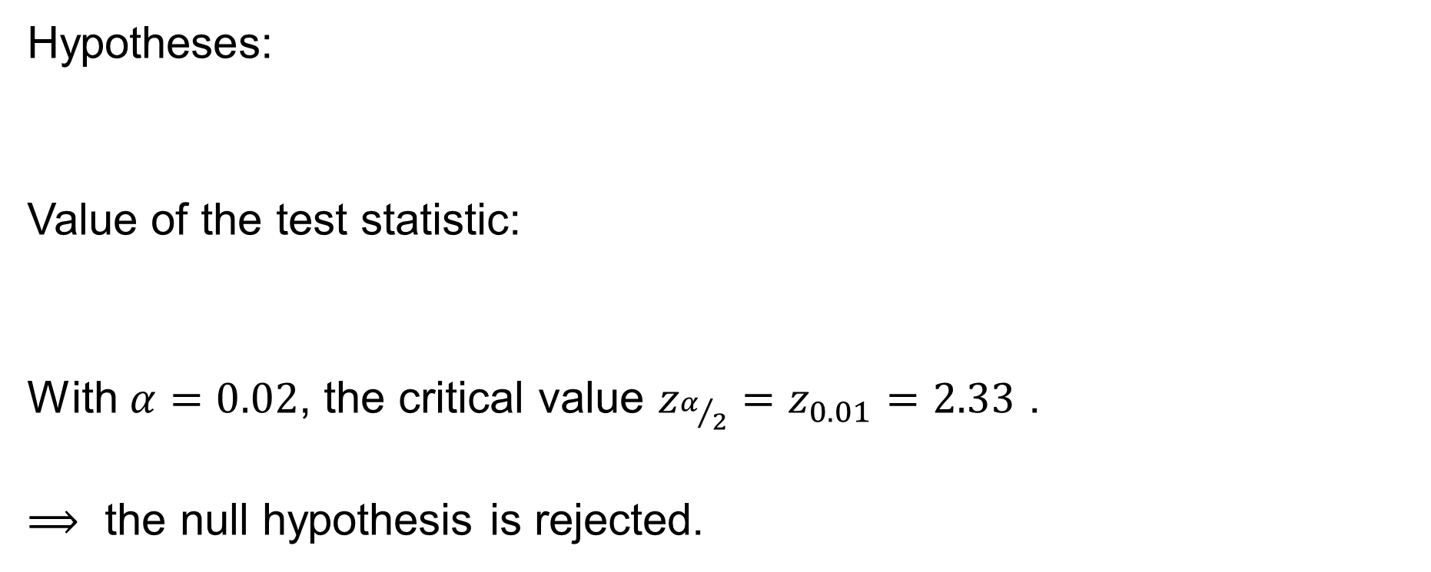
Hypothesis Testing for Mean – Two Samples
The case of large samples
Hypotheses:
Value of the test statistic:
With $α=0.02$, the critical value $z_{α/2}=z_{0.01}=2.33$ .
$⟹$ the null hypothesis is rejected.

Slide 33

Hypothesis Testing for Mean – Two Samples
The case of large samples
Confidence Interval for $μ_{1}−μ_{2}:$
• $σ_{1},σ_{2}$ are known:
• $σ_{1},σ_{2}$are unknown

Slide 34
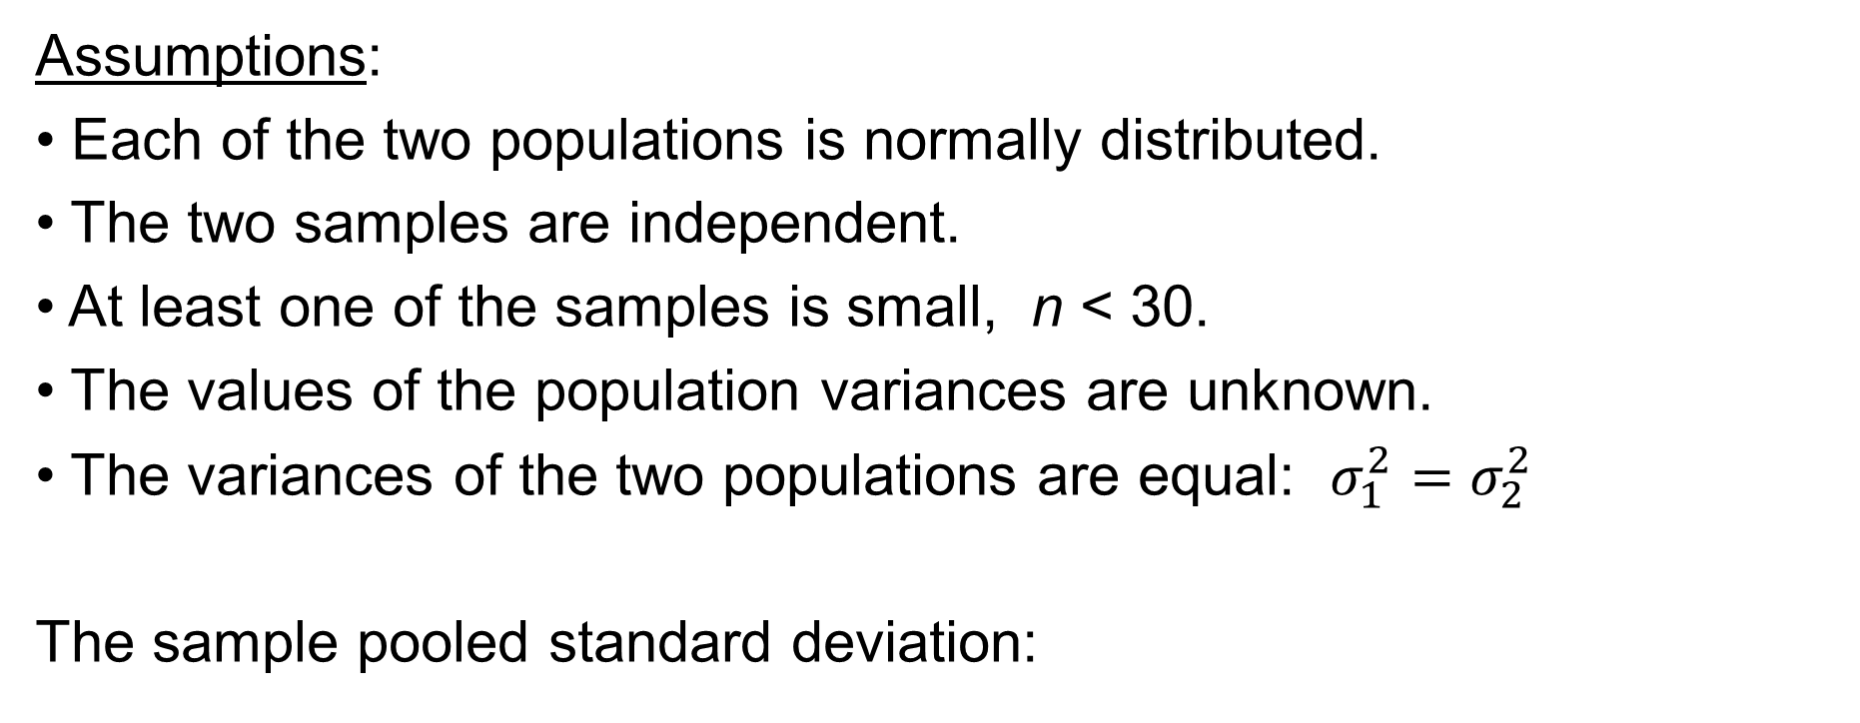
Hypothesis Testing for Mean – Two Samples
The case of small samples
Assumptions:
• Each of the two populations is normally distributed.
• The two samples are independent.
• At least one of the samples is small, n < 30.
• The values of the population variances are unknown.
• The variances of the two populations are equal: $σ_{1}^{2}=σ_{2}^{2}$
The sample pooled standard deviation:

Slide 35
Hypothesis Testing for Mean – Two Samples
The case of small samples
The t-statistic:
If the variances of the two populations are not equal, the t-statistic can also be used by using the Welch–Satterthwaite equation to approximate the degree of freedom

Slide 36
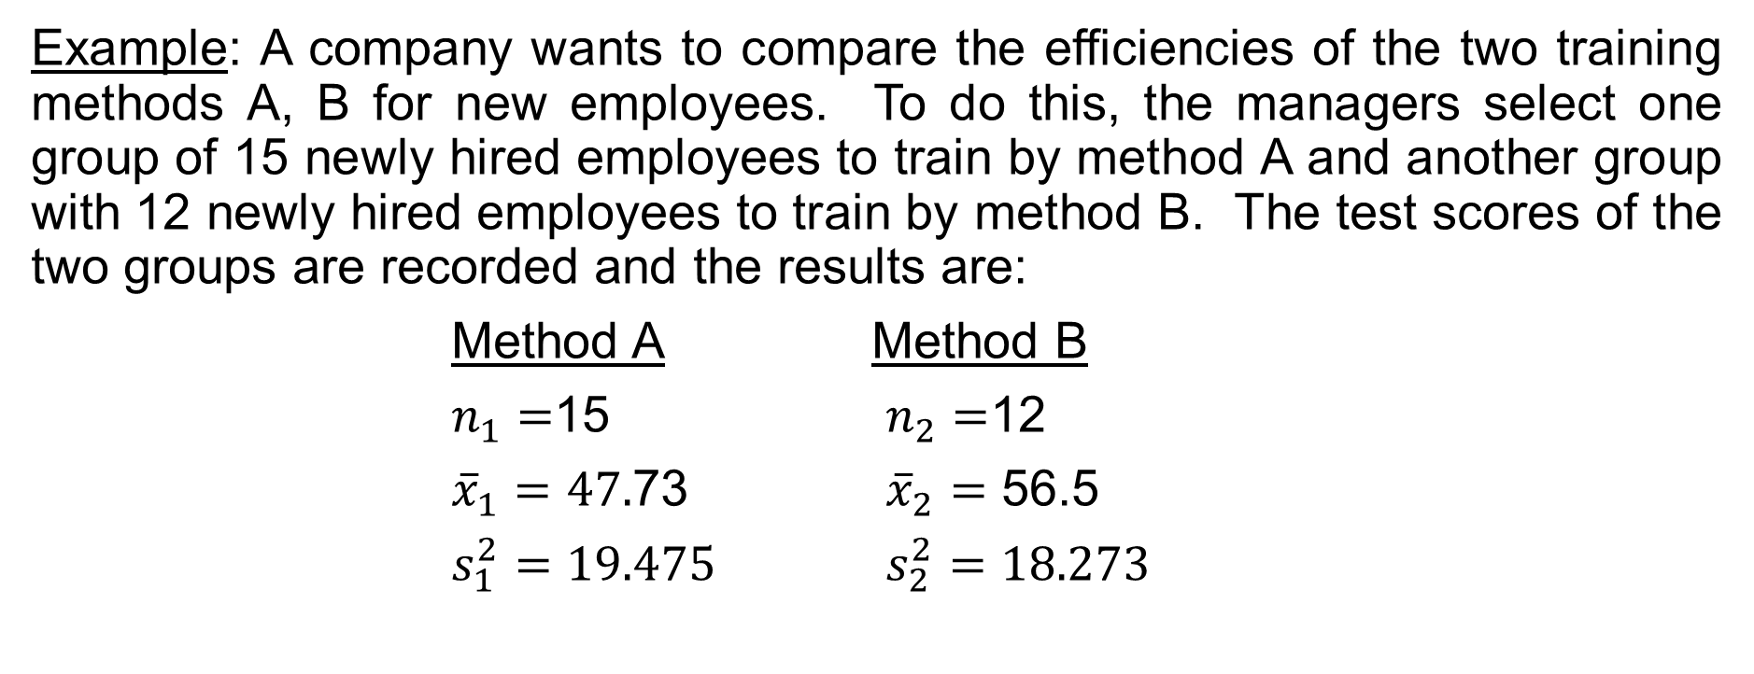
Hypothesis Testing for Mean – Two Samples
The case of small samples
Example: A company wants to compare the efficiencies of the two training methods A, B for new employees. To do this, the managers select one group of 15 newly hired employees to train by method A and another group with 12 newly hired employees to train by method B. The test scores of the two groups are recorded and the results are:
Method A Method B
$n_{1}=$15 $n_{2}=$12
${\overline{x}}_{1}=47.$73 ${\overline{x}}_{2}=$ 56.5
$s_{1}^{2}=19.475$ $s_{2}^{2}=18.273$

Slide 37
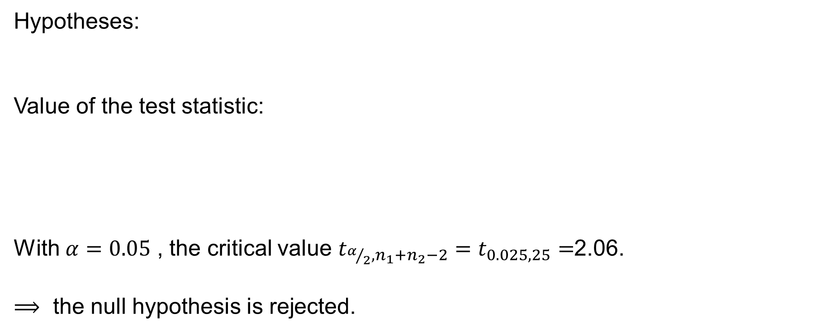
Hypothesis Testing for Mean – Two Samples
The case of small samples
Hypotheses:
Value of the test statistic:
With $α=0.05$ , the critical value $t_{α/2,n_{1}+n_{2}−2}=t_{0.025,25}=$2.06.
$⟹$ the null hypothesis is rejected.

Slide 38

Hypothesis Testing for Mean – Two Samples
The case of small samples
Confidence Interval Formula to Estimate $μ_{1}−μ_{2}$ with Small Samples and $σ_{1}^{2}=σ_{2}^{2}$:

Slide 39
Hypothesis Testing for Mean – Two Samples
The case of two related populations
Dependent samples – Matched samples: paired difference experiments.
Before and After Measurements on the same individual
The matched-sample design can be referred to as blocking.
This design often leads to a smaller sampling error than the independent-sample design because variation between sampled items is eliminated as a source of sampling error.

Slide 40
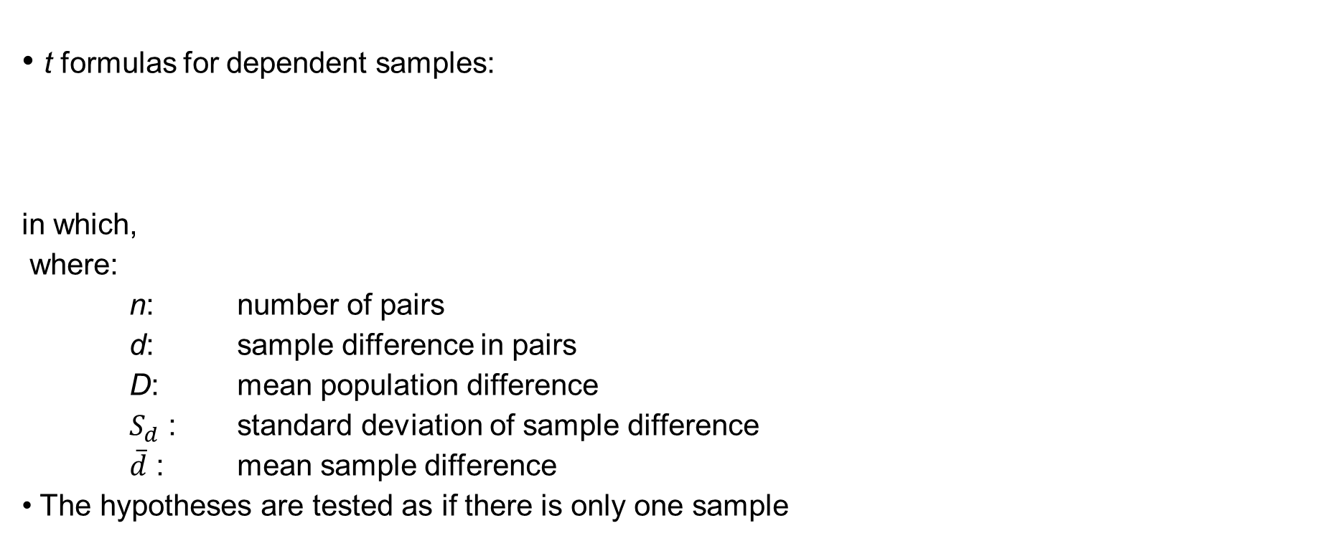
Hypothesis Testing for Mean – Two Samples
The case of two related populations
• t formulas for dependent samples:
in which,
where:
n: number of pairs
d: sample difference in pairs
D: mean population difference
$S_{d}$ : standard deviation of sample difference
$\overline{d}$ : mean sample difference
• The hypotheses are tested as if there is only one sample

Slide 41
Hypothesis Testing for Mean – Two Samples
The case of two related populations
Confidence Interval Formula to Estimate the Difference in Related Population:

Slide 42
Hypothesis Testing for Population Proportion – Two Samples
Applications:
• Comparing the market share of a product for two different markets
• Comparing the proportions of defective products from one period to another.

Slide 43
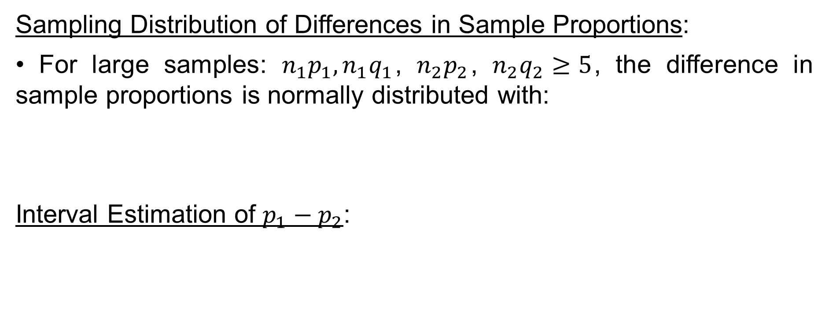
Hypothesis Testing for Population Proportion – Two Samples
Sampling Distribution of Differences in Sample Proportions:
• For large samples: $n_{1}p_{1},n_{1}q_{1}$, $n_{2}p_{2}$, $n_{2}q_{2}≥5$, the difference in sample proportions is normally distributed with:
Interval Estimation of $p_{1}−p_{2}$:

Slide 44

Hypothesis Testing for Population Proportion – Two Samples
Point Estimator of $σ_{{\hat{p}}_{1}−{\hat{p}}_{2}}$ :
Z Formula for the Difference in Two Population Proportions:

Slide 45

Hypothesis Testing for Population Proportion – Two Samples
Hypothesis Testing
• Due to $p_{1},p_{2}$ are unknown, an estimation of Z-statistic (applied only when testing $H_{0}: p_{1}=p_{2})$ is:
where:

Slide 46
Hypothesis Testing for Population Proportion – Two Samples
Example:
A group of researchers attempted to determine whether there was a difference in the proportion of consumers and the proportion of CEOs who believe that fear of getting caught or losing one’s job is a strong influence of ethical behavior. In their study, they found that 57% of consumers and 50% of CEOs said that fear of getting caught or losing one’s job was a strong influence on ethical behavior. These data were determined from a sample of 755 consumers and 616 CEOs.
Is there enough evidence that a significant higher proportion of consumers than of CEOs believe that fear of getting caught or losing one’s job is a strong influence of ethical behavior?

Slide 47
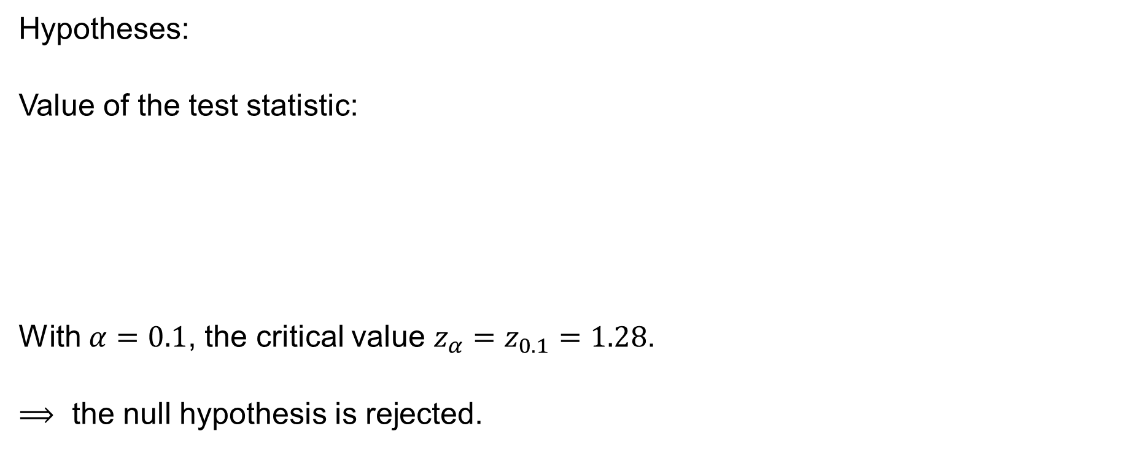
Hypothesis Testing for Population Proportion – Two Samples
Hypotheses:
Value of the test statistic:
With $α=0.1$, the critical value $z_{α}=z_{0.1}=1.28$.
$⟹$ the null hypothesis is rejected.

Slide 48
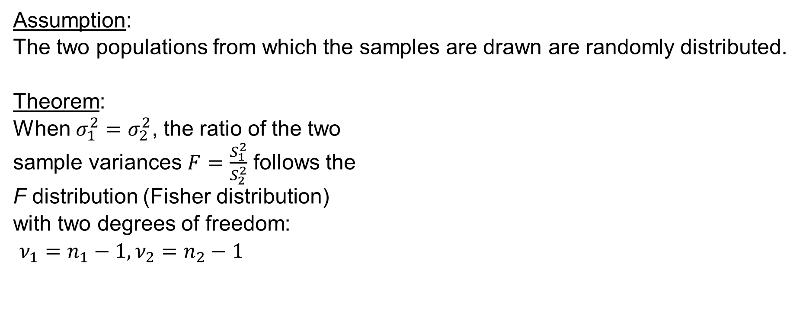
Hypothesis Testing for Two Population Variances
Assumption:
The two populations from which the samples are drawn are randomly distributed.
Theorem:
When $σ_{1}^{2}=σ_{2}^{2}$, the ratio of the two
sample variances $F=\frac{S_{1}^{2}}{S_{2}^{2}}$ follows the
F distribution (Fisher distribution)
with two degrees of freedom:
$ν_{1}=n_{1}−1,ν_{2}=n_{2}−1$

Slide 49
Hypothesis Testing for Two Population Variances
One-tailed Test | Two-tailed Test
Hypotheses: | Hypotheses:
Test Statistic: | Test Statistic:
Rejection Region | Rejection Region
Note that the two-tailed test has been converted to the one-tailed test.

Slide 50

Hypothesis Testing for Two Population Variances
The two-tailed test can be conducted directly noted that:
Rejection region for the test statistic $F=\frac{s_{1}^{2}}{s_{2}^{2}}$ :

Slide 51
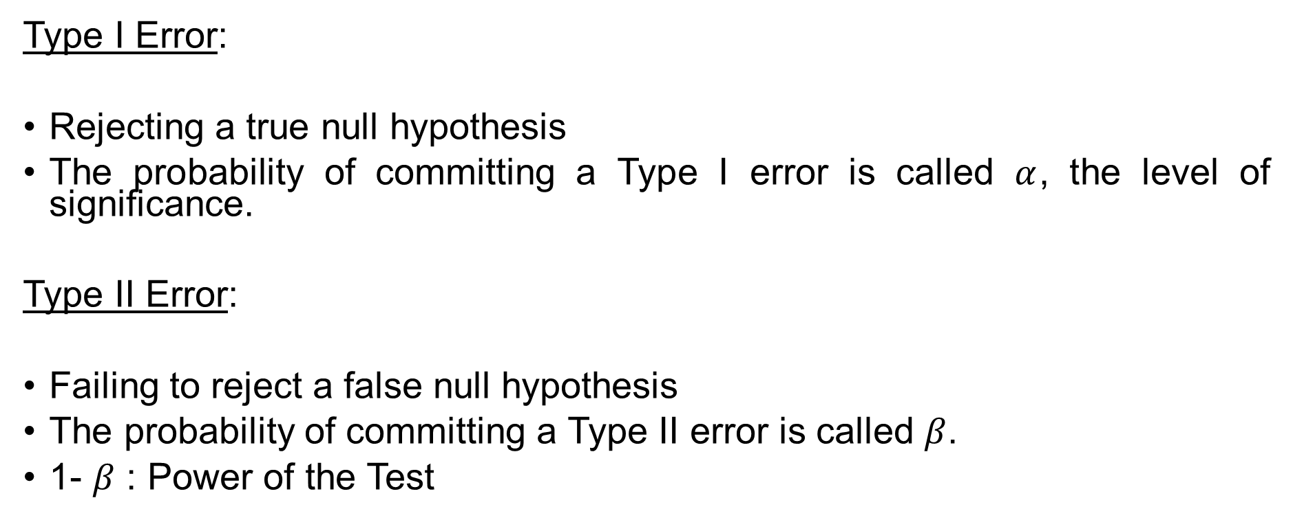
Type I and Type II Errors
Type I Error:
Rejecting a true null hypothesis
The probability of committing a Type I error is called $α$, the level of significance.
Type II Error:
Failing to reject a false null hypothesis
The probability of committing a Type II error is called $β$.
1- $β$ : Power of the Test

Slide 52
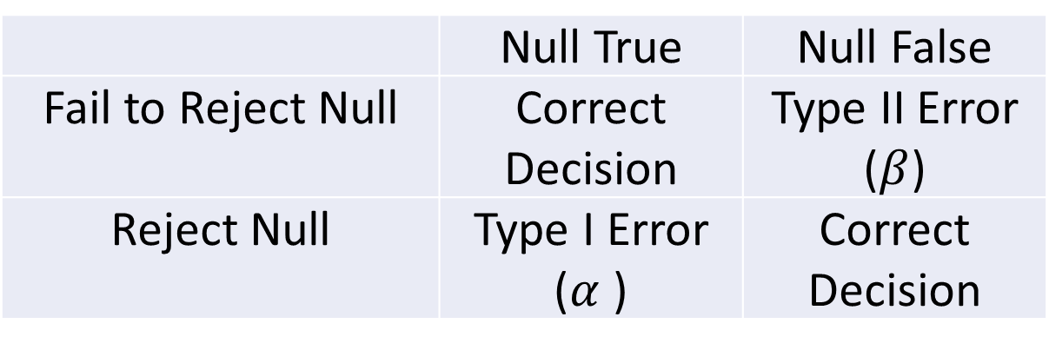
Type I and Type II Errors
Decision Table
for Hypothesis Testing
 | Null True | Null False
Fail to Reject Null | Correct Decision | Type II Error ($β$)
Reject Null | Type I Error ($α$ ) | Correct Decision

Slide 53
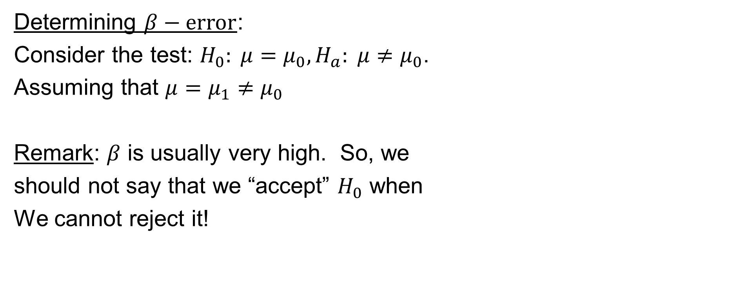
Type I and Type II Errors
Determining $β−error$:
Consider the test: $H_{0}: μ=μ_{0},H_{a}: μ≠μ_{0}$.
Assuming that $μ=μ_{1}≠μ_{0}$
Remark: $β$ is usually very high. So, we
should not say that we “accept” $H_{0}$ when
We cannot reject it!

Slide 54
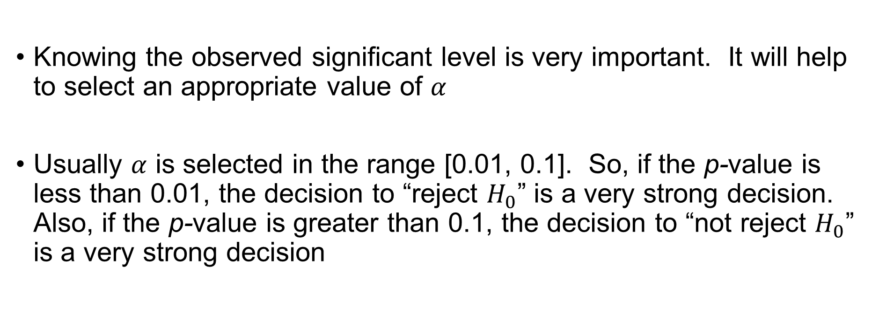
Observed Significant Level
Knowing the observed significant level is very important. It will help to select an appropriate value of $α$
Usually $α$ is selected in the range [0.01, 0.1]. So, if the p-value is less than 0.01, the decision to “reject $H_{0}$” is a very strong decision. Also, if the p-value is greater than 0.1, the decision to “not reject $H_{0}$” is a very strong decision

