Slide 1
Intelligent Decision Support Systems
Knowledge-based Systems for Smart Production

Slide 2
Smart manufacturing systems (SMSs)
Definition 1: From engineering view, smart manufacturing is an intensified application of advanced intelligence systems which enable the rapid manufacturing of new products, dynamic response to product demand, and real-time optimization of manufacturing production and supply chain networks
Definition 2: From interconnection and communication (IoT and CPS) view, Using sensors and communication technologies to capture data at all stages of manufacturing
Definition 3: From the view of predictive analysis and decision making, more accessible and ubiquitous data form big data environment, help manufacturing enterprises better predict, balance production, and improve their efficiency and productivity
Notes:
Qu, Y. J., Ming, X. G., Liu, Z. W., Zhang, X. Y., & Hou, Z. T. (2019). Smart manufacturing systems: state of the art and future trends. The International Journal of Advanced Manufacturing Technology, 103(9-12), 3751-3768.

Slide 3
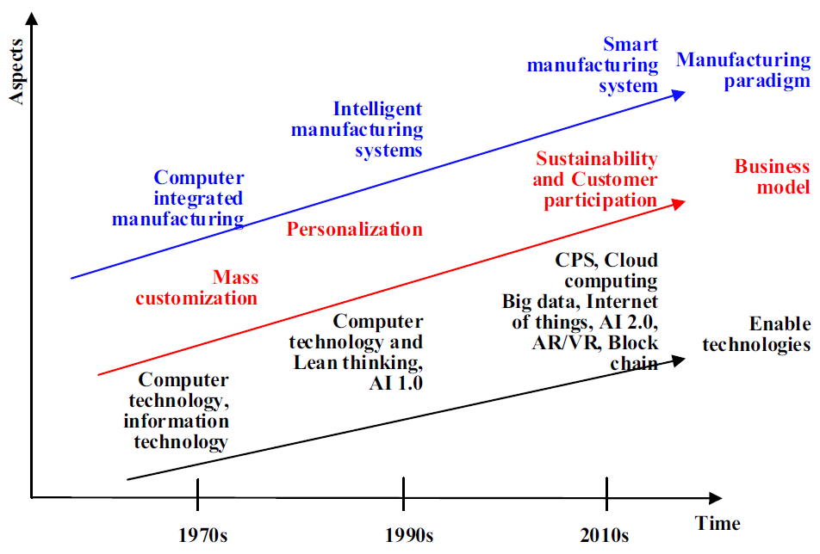
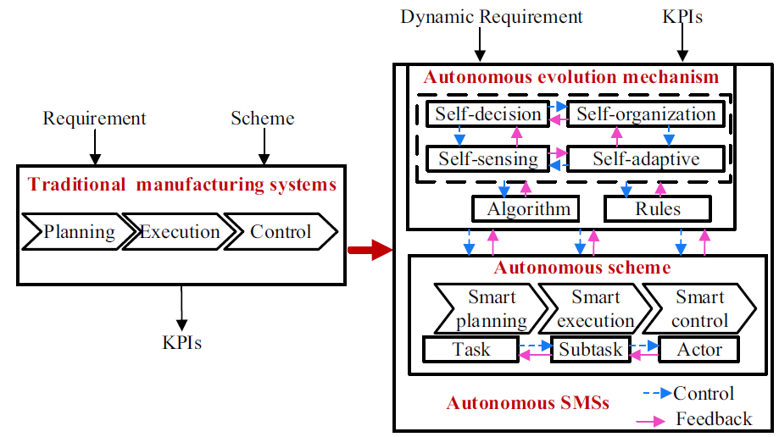
Smart manufacturing systems (SMSs)
Directions of smart manufacturing systems
The evolution of smart manufacturing systems
Notes:
Qu, Y. J., Ming, X. G., Liu, Z. W., Zhang, X. Y., & Hou, Z. T. (2019). Smart manufacturing systems: state of the art and future trends. The International Journal of Advanced Manufacturing Technology, 103(9-12), 3751-3768.

Slide 4
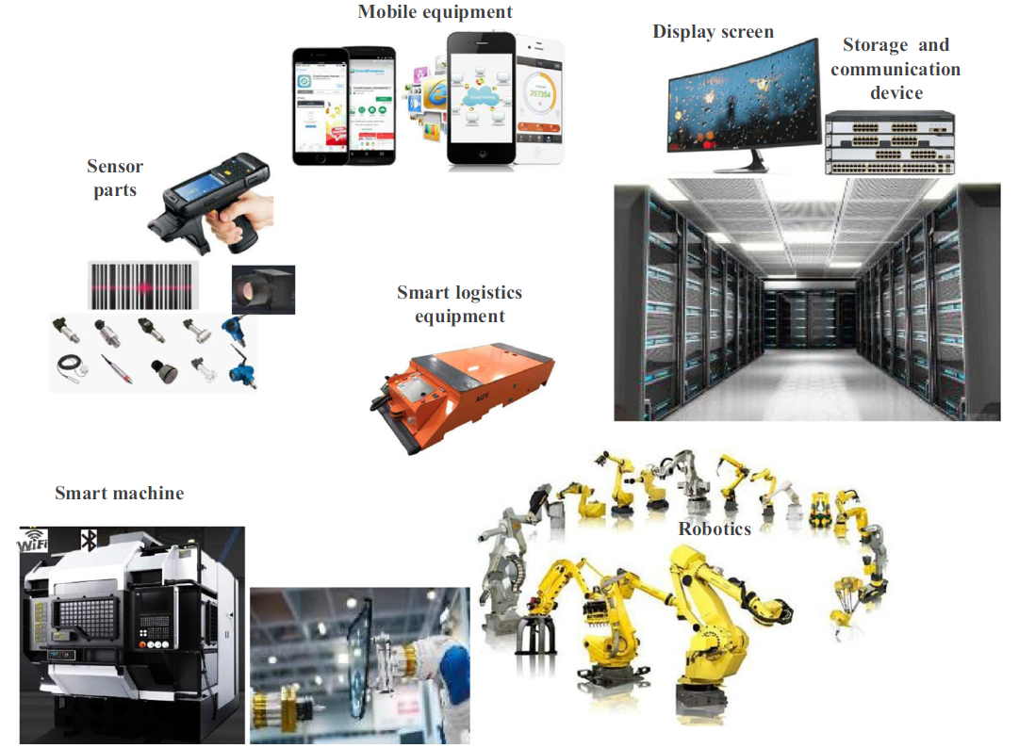
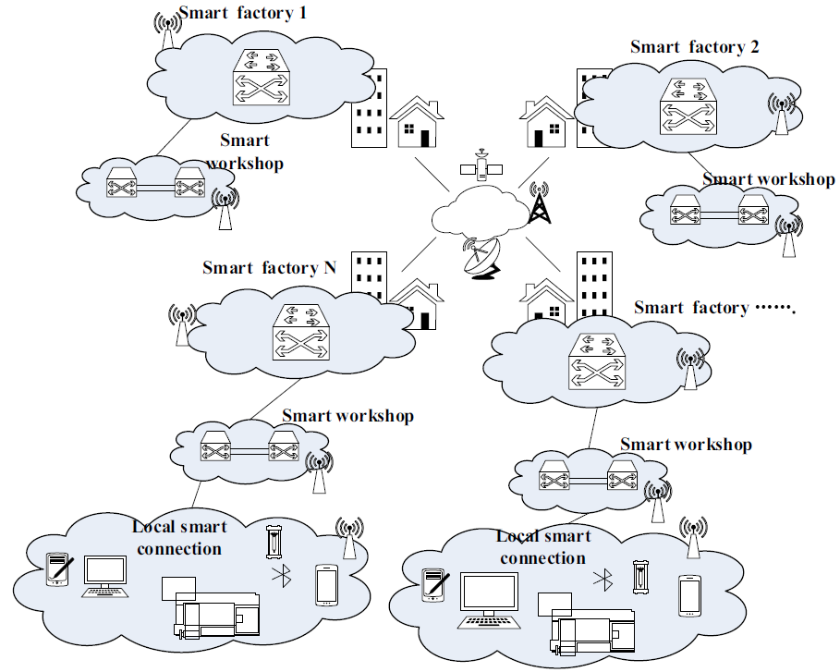
Smart manufacturing systems (SMSs)
Smart interconnection and communication layer of SMSs
Physical layer of SMSs
Notes:
Qu, Y. J., Ming, X. G., Liu, Z. W., Zhang, X. Y., & Hou, Z. T. (2019). Smart manufacturing systems: state of the art and future trends. The International Journal of Advanced Manufacturing Technology, 103(9-12), 3751-3768.

Slide 5
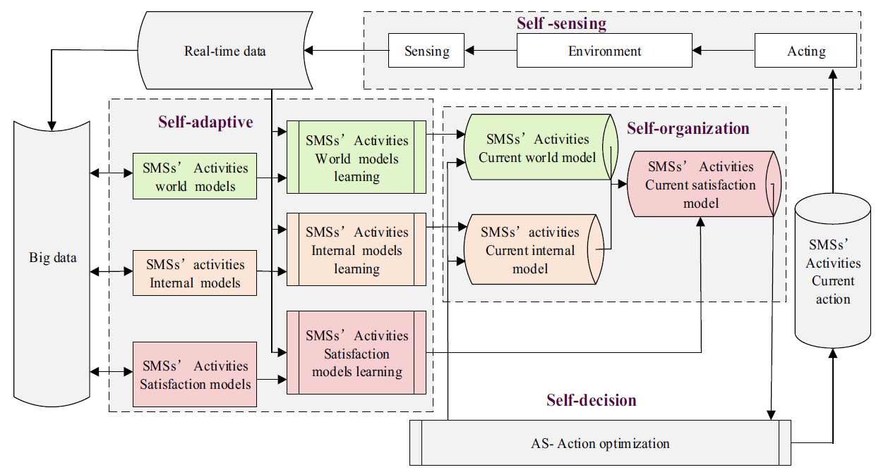
Smart manufacturing systems (SMSs)
Based on multilevel Darwinist brain of SMSs’ autonomous evolution mechanism
Notes:
Qu, Y. J., Ming, X. G., Liu, Z. W., Zhang, X. Y., & Hou, Z. T. (2019). Smart manufacturing systems: state of the art and future trends. The International Journal of Advanced Manufacturing Technology, 103(9-12), 3751-3768.

Slide 6
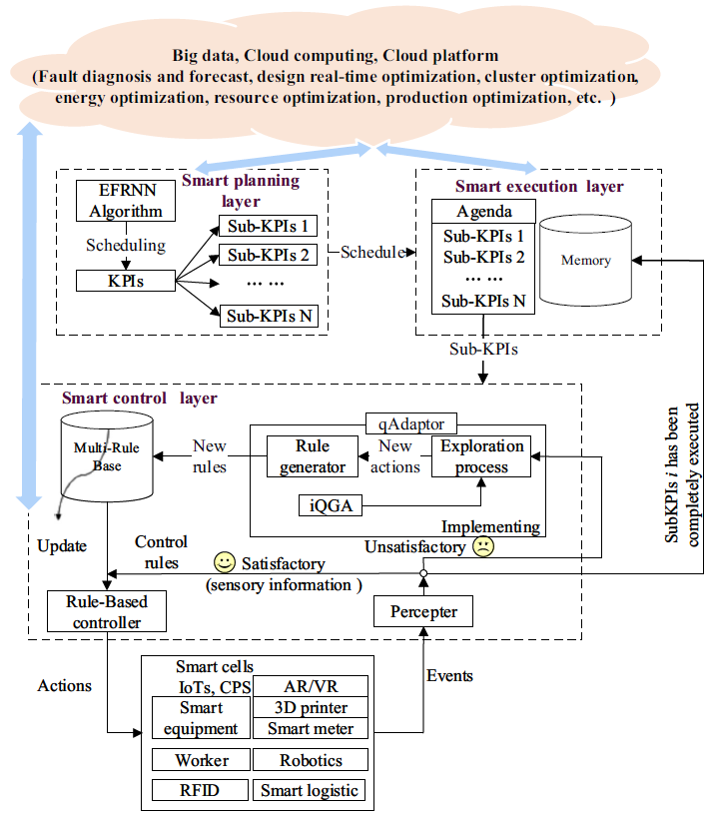
Smart manufacturing systems (SMSs)
Hierarchical architecture of SMSs’ autonomous scheme
Notes:
Qu, Y. J., Ming, X. G., Liu, Z. W., Zhang, X. Y., & Hou, Z. T. (2019). Smart manufacturing systems: state of the art and future trends. The International Journal of Advanced Manufacturing Technology, 103(9-12), 3751-3768.

Slide 7
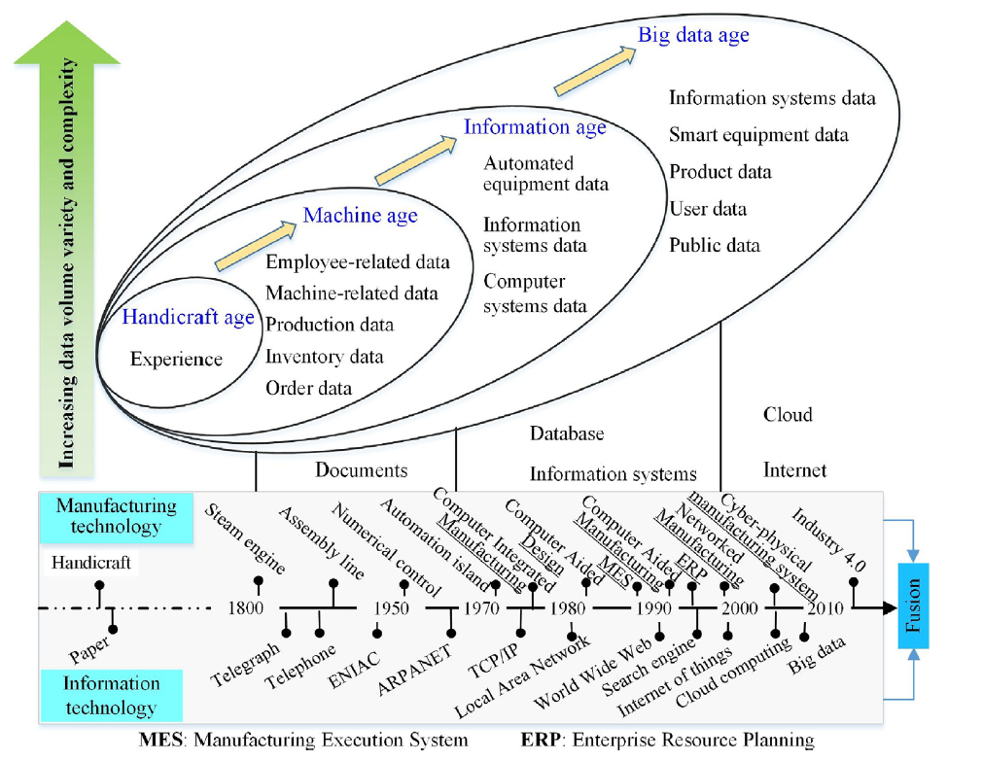
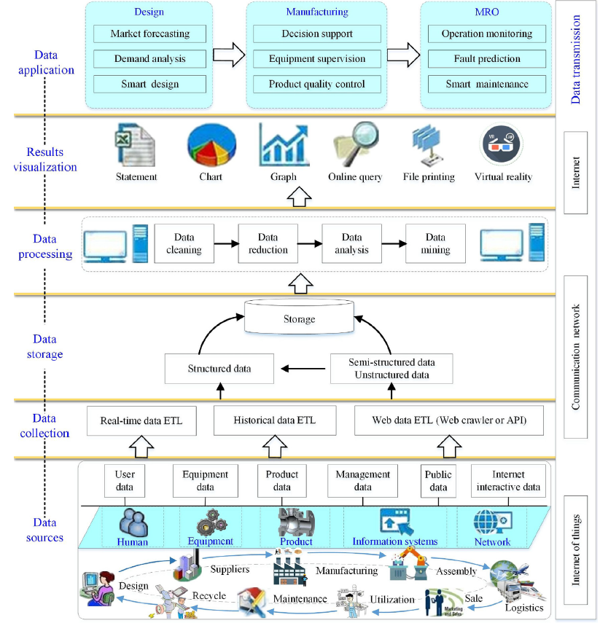
Smart manufacturing systems (SMSs)
Evolution of data in manufacturing
Manufacturing data lifecycle
Notes:
Tao, F., Qi, Q., Liu, A., & Kusiak, A. (2018). Data-driven smart manufacturing. Journal of Manufacturing Systems, 48, 157-169.

Slide 8
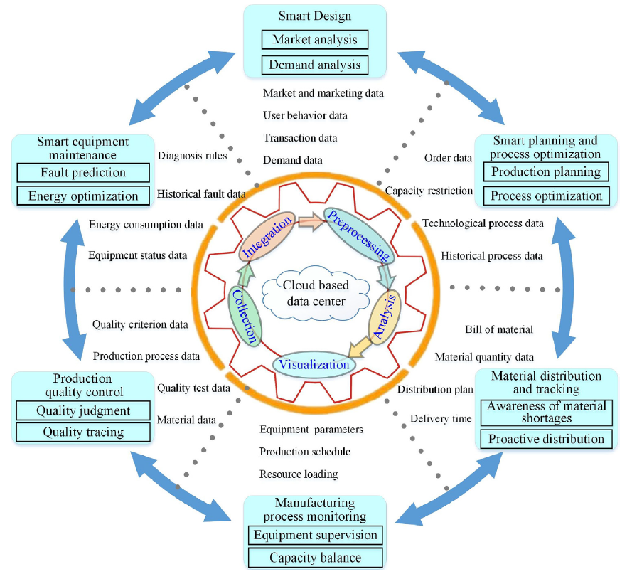
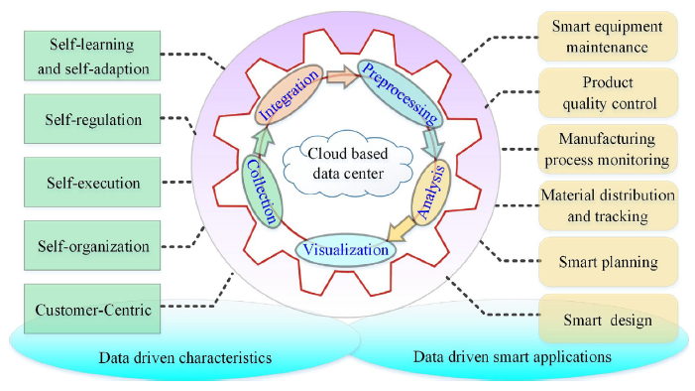
Smart manufacturing systems (SMSs)
Characteristics and applications of data-driven smart manufacturing
Data-driven smart manufacturing application
Notes:
Tao, F., Qi, Q., Liu, A., & Kusiak, A. (2018). Data-driven smart manufacturing. Journal of Manufacturing Systems, 48, 157-169.

Slide 9
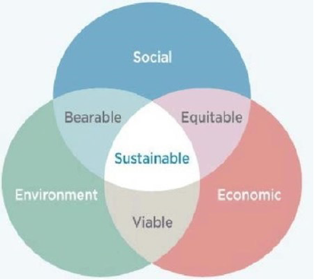
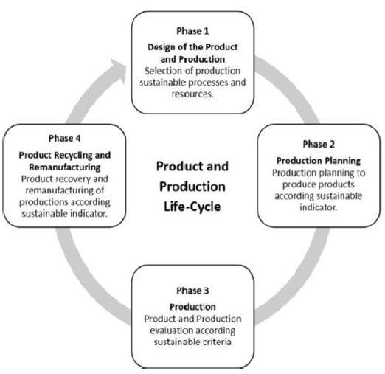
Sustainable smart manufacturing
Notes:
Mahiri, F., Najoua, A., & Souda, S. B. (2020, June). Data-driven sustainable smart manufacturing: A conceptual framework. In 2020 International Conference on Intelligent Systems and Computer Vision (ISCV) (pp. 1-7). IEEE.

Slide 10
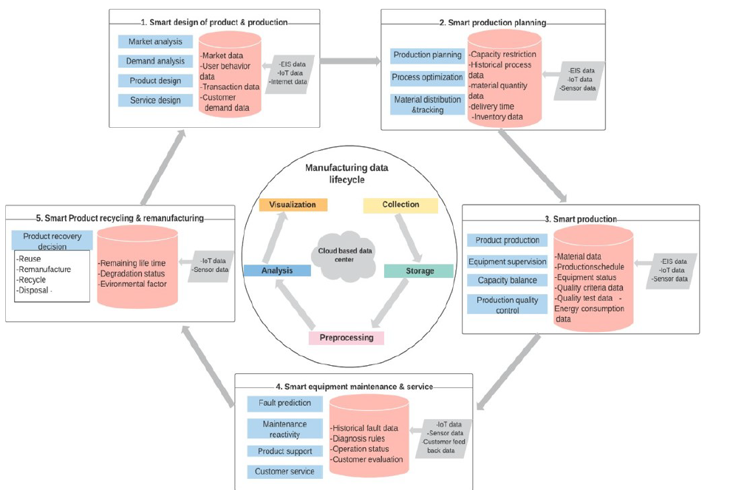
Sustainable smart manufacturing
Conceptual framework of data-driven SSM application
Notes:
Mahiri, F., Najoua, A., & Souda, S. B. (2020, June). Data-driven sustainable smart manufacturing: A conceptual framework. In 2020 International Conference on Intelligent Systems and Computer Vision (ISCV) (pp. 1-7). IEEE.

Slide 11
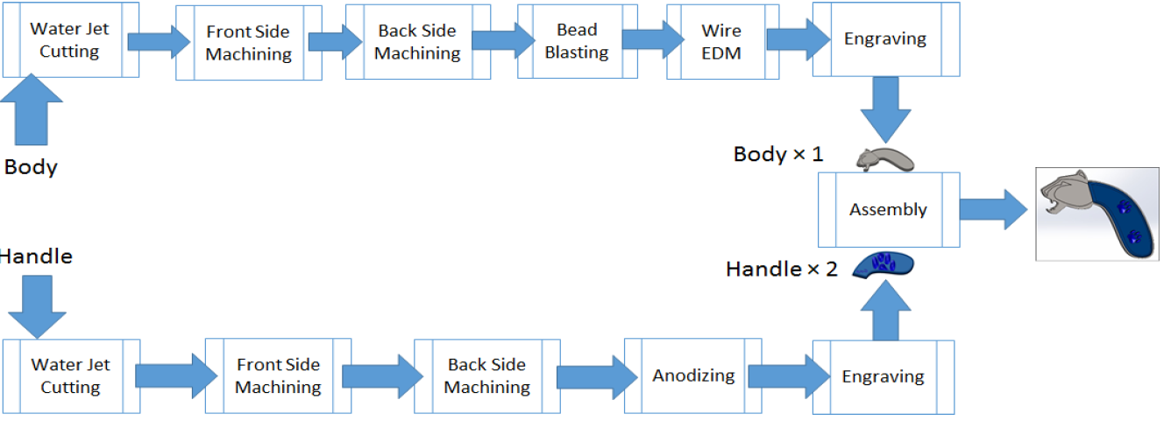
Case Study
The Lion’s Jaw bottle opener
Notes:
Brundage, M. P., Kulvatunyou, B., Ademujimi, T., & Rakshith, B. (2017, June). Smart manufacturing through a framework for a knowledge-based diagnosis system. In International Manufacturing Science and Engineering Conference (Vol. 50749, p. V003T04A012). American Society of Mechanical Engineers.

Slide 12
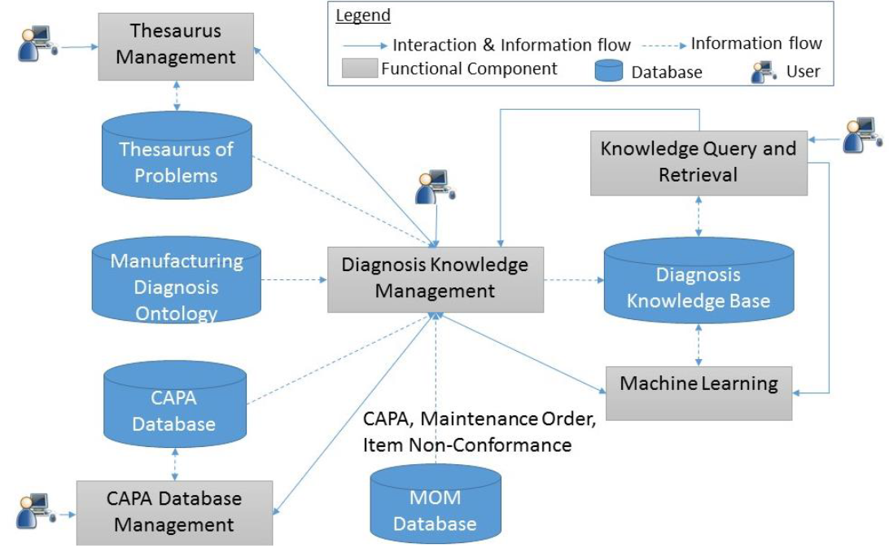
Case Study
Notes:
Brundage, M. P., Kulvatunyou, B., Ademujimi, T., & Rakshith, B. (2017, June). Smart manufacturing through a framework for a knowledge-based diagnosis system. In International Manufacturing Science and Engineering Conference (Vol. 50749, p. V003T04A012). American Society of Mechanical Engineers.

Slide 13
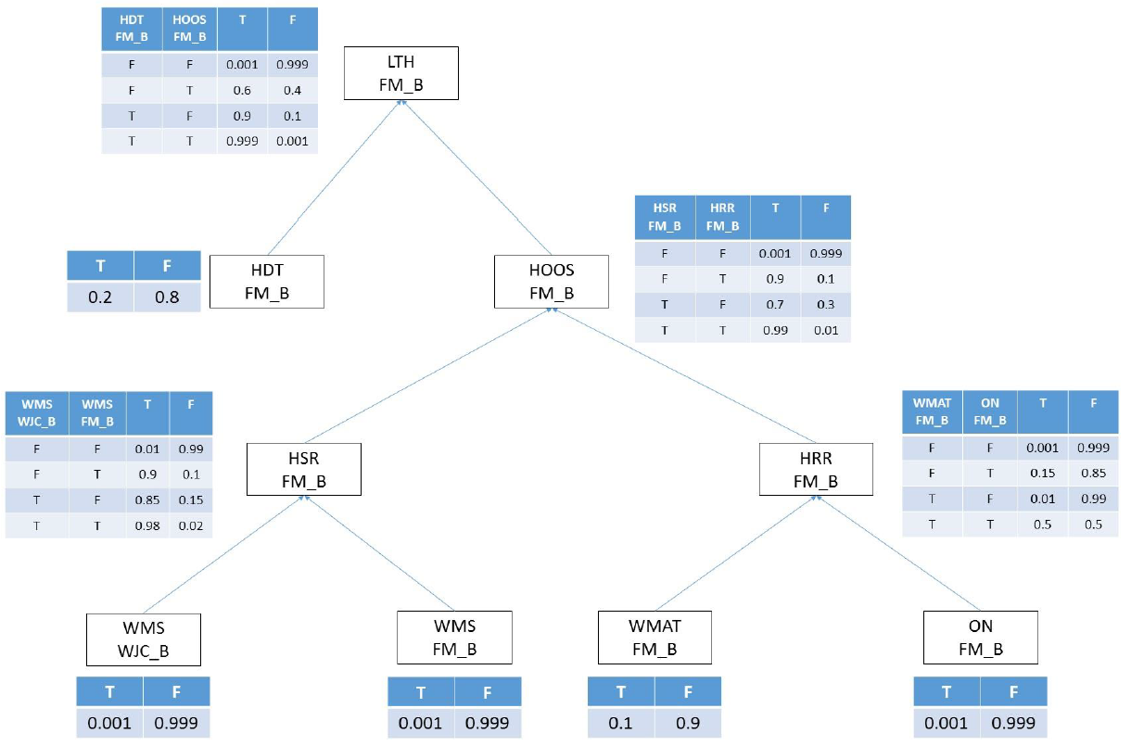
Case Study
Bayesian Network for Lion’s Jaw Bottle Opener Manufacturing
Notes:
Brundage, M. P., Kulvatunyou, B., Ademujimi, T., & Rakshith, B. (2017, June). Smart manufacturing through a framework for a knowledge-based diagnosis system. In International Manufacturing Science and Engineering Conference (Vol. 50749, p. V003T04A012). American Society of Mechanical Engineers.

Slide 14
Case Study
Bayesian Network for Lion’s Jaw Bottle Opener Manufacturing
Notes:
Brundage, M. P., Kulvatunyou, B., Ademujimi, T., & Rakshith, B. (2017, June). Smart manufacturing through a framework for a knowledge-based diagnosis system. In International Manufacturing Science and Engineering Conference (Vol. 50749, p. V003T04A012). American Society of Mechanical Engineers.

Slide 15
Case Study
A silicon wafer production line
Notes:
Tao, F., Qi, Q., Liu, A., & Kusiak, A. (2018). Data-driven smart manufacturing. Journal of Manufacturing Systems, 48, 157-169.

Slide 16
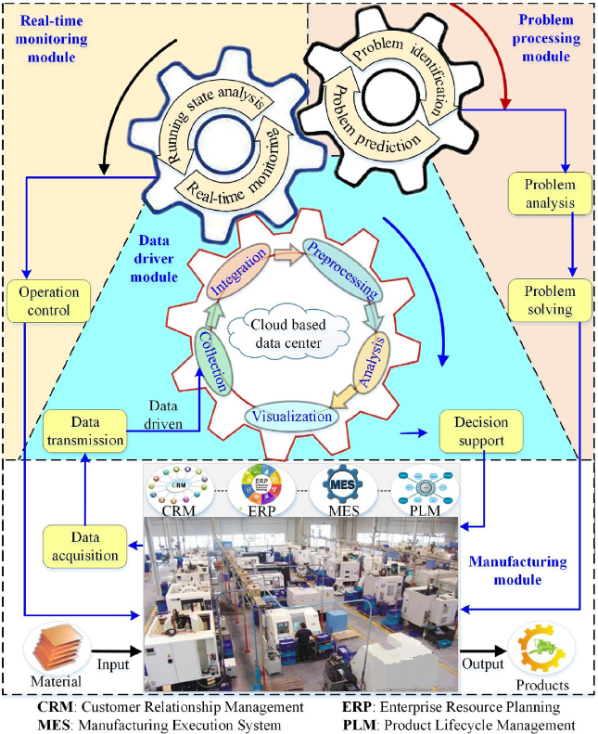
Case Study
A silicon wafer production line
From the input of silicon ingots to the output of silicon wafers, the manufacturing process involves a series of production activities, including loading material, cutting, chamfering and polishing, viscos, slicing, degumming and cleaning, sorting, and packaging
With the support of big data analytics, intelligent algorithms and predictive models analyze this data in order to optimize the manufacturing process.
As a result, big data analytics enables intelligent material assignment, as well as tracking, predictive maintenance, and energy efficiency management.
Notes:
Tao, F., Qi, Q., Liu, A., & Kusiak, A. (2018). Data-driven smart manufacturing. Journal of Manufacturing Systems, 48, 157-169.

Slide 17
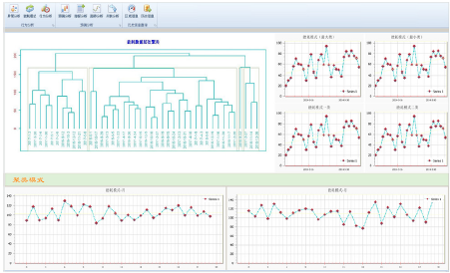
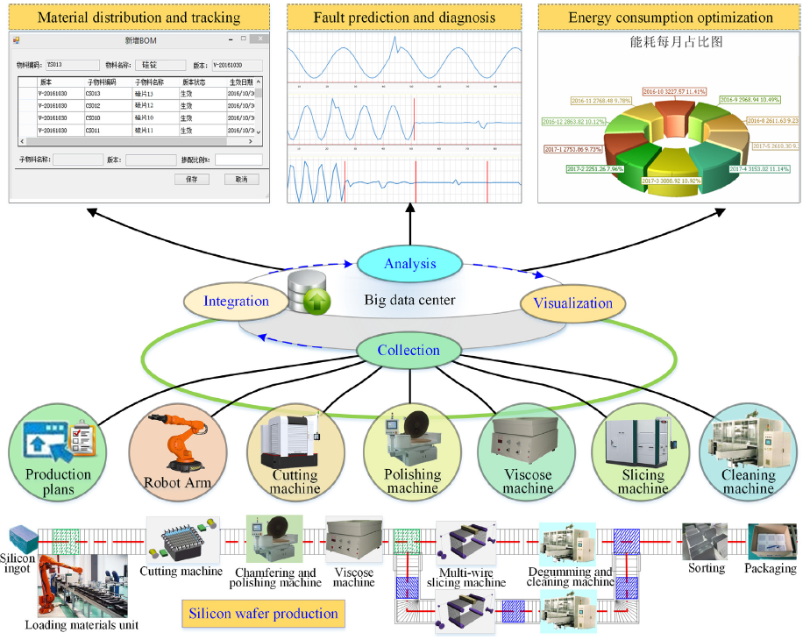
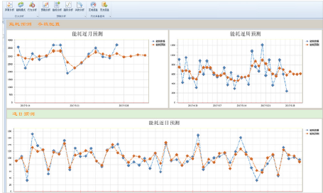
Case Study
Data-driven smart silicon wafer production
Notes:
Tao, F., Qi, Q., Liu, A., & Kusiak, A. (2018). Data-driven smart manufacturing. Journal of Manufacturing Systems, 48, 157-169.

