Slide 1
Intelligent Decision Support Systems
Industrial Applications

Slide 2
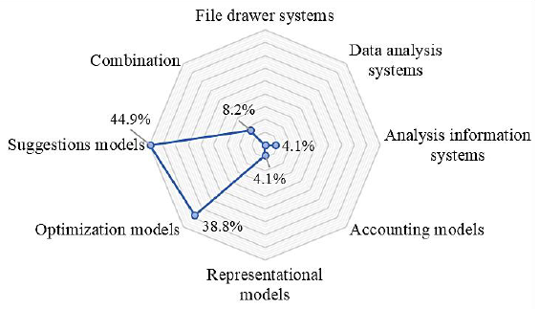
Research Trend
Alter (1980) DSS classification
Notes:
Hasan, M. S., Ebrahim, Z., Mahmood, W. H. W., & Ab Rahman, M. N. (2017). Decision support system classification and its application in manufacturing sector: A review. Jurnal Teknologi, 79(1).

Slide 3
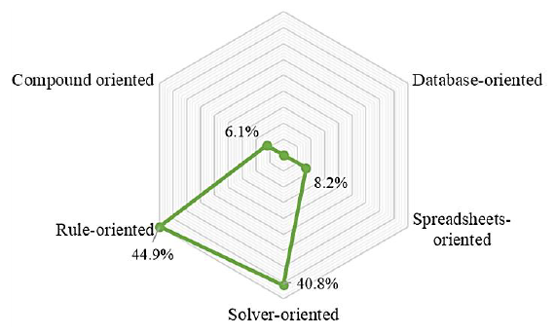
Research Trend
Holsapple & Whinston (1996) DSS classification
Notes:
Hasan, M. S., Ebrahim, Z., Mahmood, W. H. W., & Ab Rahman, M. N. (2017). Decision support system classification and its application in manufacturing sector: A review. Jurnal Teknologi, 79(1).

Slide 4
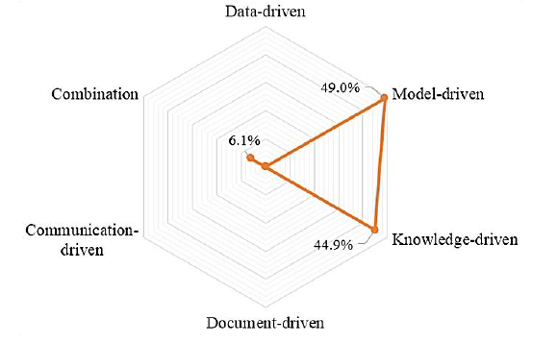
Research Trend
Power (2004) DSS classification
Notes:
Hasan, M. S., Ebrahim, Z., Mahmood, W. H. W., & Ab Rahman, M. N. (2017). Decision support system classification and its application in manufacturing sector: A review. Jurnal Teknologi, 79(1).

Slide 5
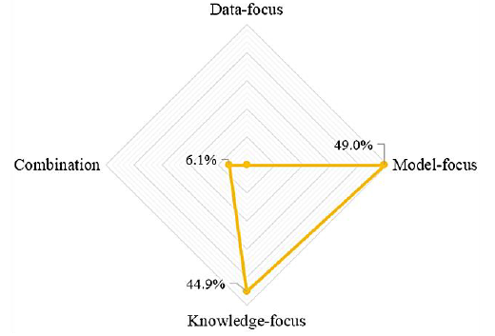
Research Trend
DSS focus-area classification
Notes:
Hasan, M. S., Ebrahim, Z., Mahmood, W. H. W., & Ab Rahman, M. N. (2017). Decision support system classification and its application in manufacturing sector: A review. Jurnal Teknologi, 79(1).

Slide 6
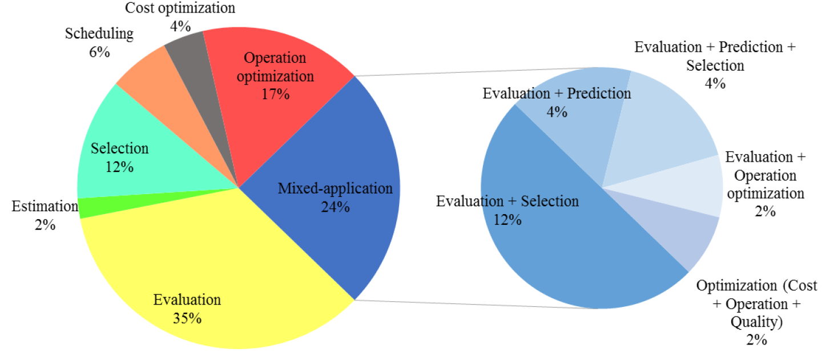
DSS Application in Manufacturing
In manufacturing industry
In mixed application
Notes:
Hasan, M. S., Ebrahim, Z., Mahmood, W. H. W., & Ab Rahman, M. N. (2017). Decision support system classification and its application in manufacturing sector: A review. Jurnal Teknologi, 79(1).

Slide 7
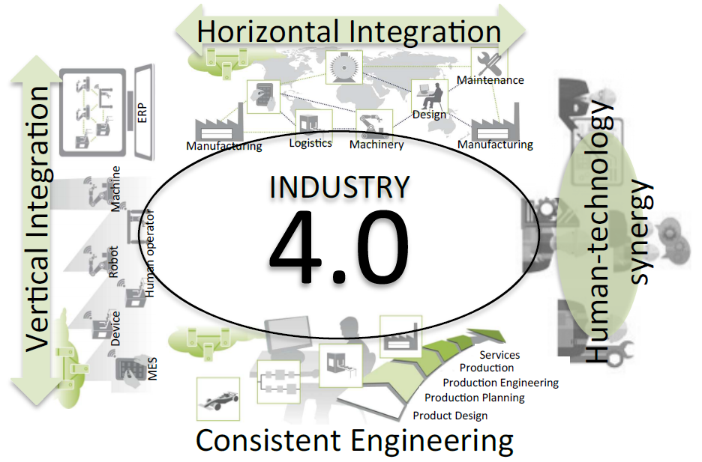
Decision Support for Industry 4.0
Notes:
Marques, M., Agostinho, C., Zacharewicz, G., & Jardim-Gonçalves, R. (2017). Decentralized decision support for intelligent manufacturing in Industry 4.0. Journal of Ambient Intelligence and Smart Environments, 9(3), 299-313.

Slide 8
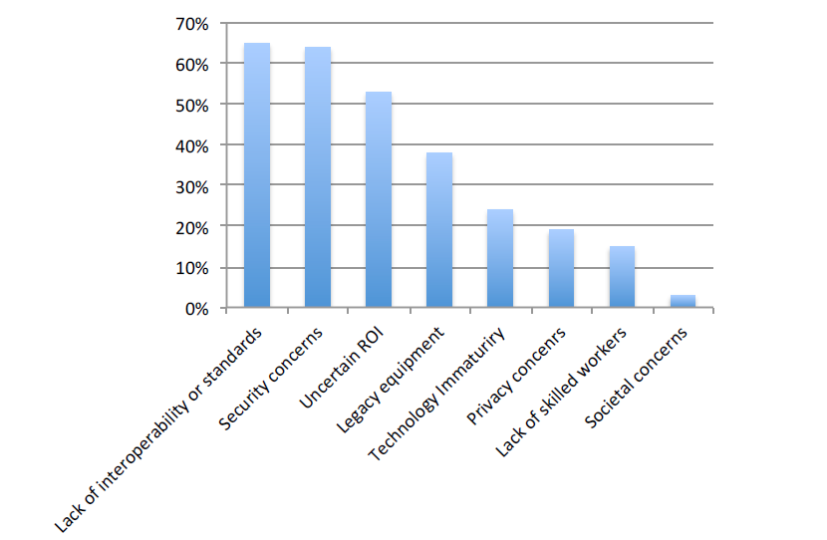
Decision Support for Industry 4.0
Key barriers for industrial digitization
Notes:
Marques, M., Agostinho, C., Zacharewicz, G., & Jardim-Gonçalves, R. (2017). Decentralized decision support for intelligent manufacturing in Industry 4.0. Journal of Ambient Intelligence and Smart Environments, 9(3), 299-313.

Slide 9
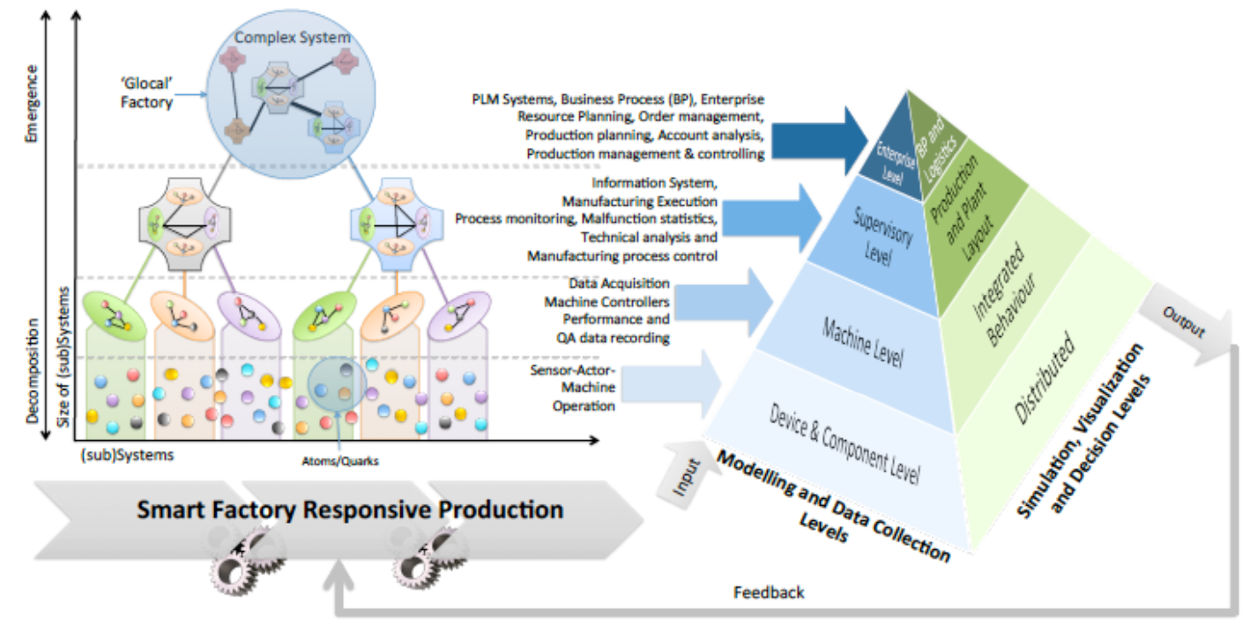
Decision Support for Industry 4.0
Emergent behavior and automation pyramid virtualization: an analogy
Notes:
Marques, M., Agostinho, C., Zacharewicz, G., & Jardim-Gonçalves, R. (2017). Decentralized decision support for intelligent manufacturing in Industry 4.0. Journal of Ambient Intelligence and Smart Environments, 9(3), 299-313.

Slide 10
Decision support for vertical integration
Establishment of efficient policies on predictive, preventive and corrective maintenance in terms of spare parts demand forecast and supply chain stakeholder coordination;
Faster reaction to spare-parts failure due to non-visibility of equipment operation indicators and status;
Decrease of production downtime and lost profits due to spare-parts failure in industrial high-value capital assets.

Slide 11
Decision support for horizontal integration
Detection of the most appropriate business collaboration opportunities (in B2B schema) among common customer projects.;
Reinforce common commitment system for customer projects in collaborative schema;
Development of reactive tools and mechanisms helping to track and estimate the convergence of manufacturing order operations comparing to customer commitments among the collaborative shopfloors

Slide 12
Decision support for horizontal integration
Detection of the most appropriate business collaboration opportunities (in B2B schema) among common customer projects.;
Reinforce common commitment system for customer projects in collaborative schema;
Development of reactive tools and mechanisms helping to track and estimate the convergence of manufacturing order operations comparing to customer commitments among the collaborative shopfloors

Slide 13
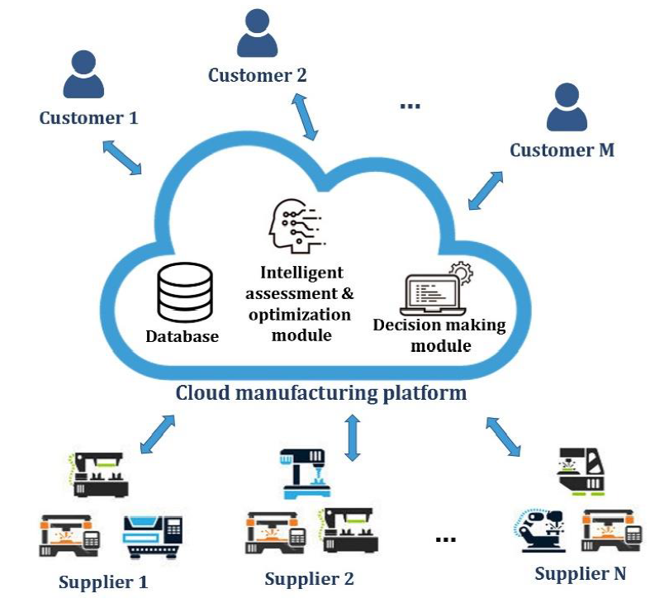
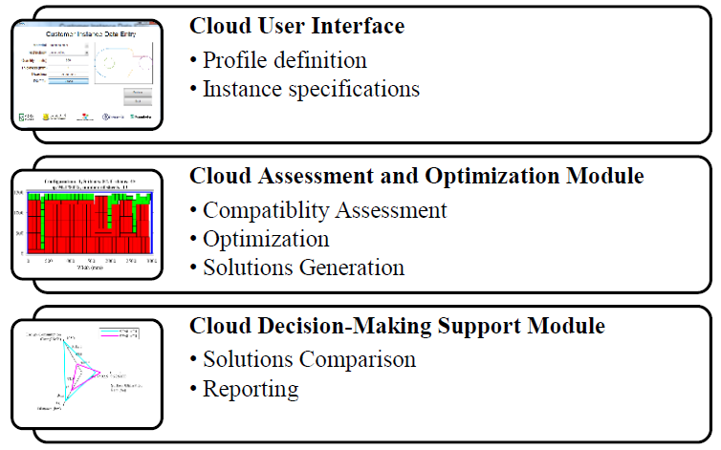
Case Study
Resource sharing in smart manufacturing networks
Cloud platform modules and tasks
Notes:
Simeone, A., Caggiano, A., Boun, L., & Deng, B. (2019). Intelligent cloud manufacturing platform for efficient resource sharing in smart manufacturing networks. Procedia CIRP, 79, 233-238.

Slide 14
Case Study
A prototype system with remote tracking and production scheduling functions
The architecture can be achieved by assisting the production management in tracking the production progress of each customer order and assigning the production for each order to appropriate production units on a real-time basis.
The manufacturing company receives various production orders from different customers. Each group of production orders with the same due date from a same customer is called as an order group. After customer orders of an order group are confirmed, the manufacturer needs to purchase raw materials from material suppliers according to the material requirement of the customer orders.
Notes:
Guo, Z. (2016). An RFID-and Cloud-Based Intelligent Decision Support System Architecture for Production Tracking and Scheduling. In Intelligent Decision-making Models for Production and Retail Operations (pp. 233-260). Springer, Berlin, Heidelberg.

Slide 15
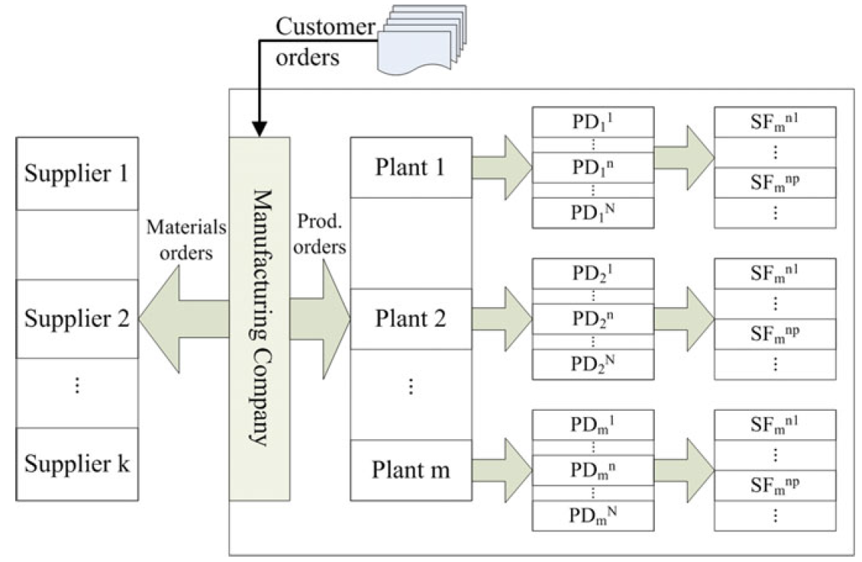
Case Study
Flowchart of production task allocation after receiving customer orders
Notes:
Guo, Z. (2016). An RFID-and Cloud-Based Intelligent Decision Support System Architecture for Production Tracking and Scheduling. In Intelligent Decision-making Models for Production and Retail Operations (pp. 233-260). Springer, Berlin, Heidelberg.

Slide 16
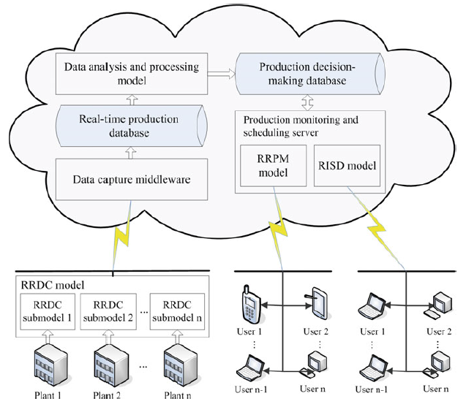
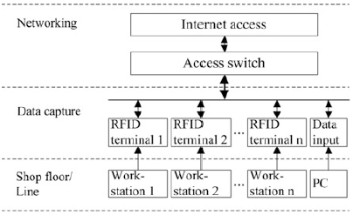
Case Study
RRDC submodel installed in a shop floor or an assembly line
RCIDSS architecture
Notes:
Guo, Z. (2016). An RFID-and Cloud-Based Intelligent Decision Support System Architecture for Production Tracking and Scheduling. In Intelligent Decision-making Models for Production and Retail Operations (pp. 233-260). Springer, Berlin, Heidelberg.

