Slide 1
Intelligent Decision Support Systems
Predictive Models

Slide 2
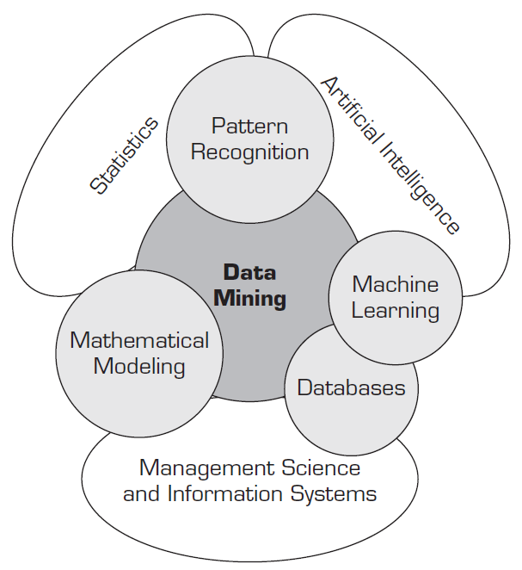
Data Mining
Data mining is a way to develop intelligence (i.e., actionable information or knowledge) from data that an organization collects, organizes, and stores.
Notes:
Ramesh Sharda • Dursun Delen • Efraim Turban, Business Intelligence and Analytics - Systems for Decision Support, Pearson, 2014

Slide 3
Data Mining
The major characteristics and objectives:
Data are often buried deep within very large databases, which sometimes contain data from several years
The data mining environment is usually a client/server architecture or a Web-based information systems architecture
Sophisticated new tools, including advanced visualization tools, help to remove the information ore buried in corporate files or archival public records
It involves massaging and synchronizing the data to get the right results
The miner is often an end user, empowered by data drills and other power query
tools to ask ad hoc questions and obtain answers quickly, with little or no programming skill
Notes:
Ramesh Sharda • Dursun Delen • Efraim Turban, Business Intelligence and Analytics - Systems for Decision Support, Pearson, 2014

Slide 4
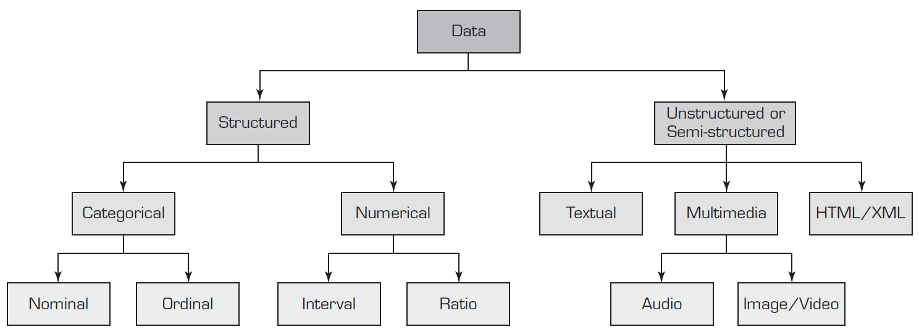
Data Mining
Notes:
Ramesh Sharda • Dursun Delen • Efraim Turban, Business Intelligence and Analytics - Systems for Decision Support, Pearson, 2014

Slide 5
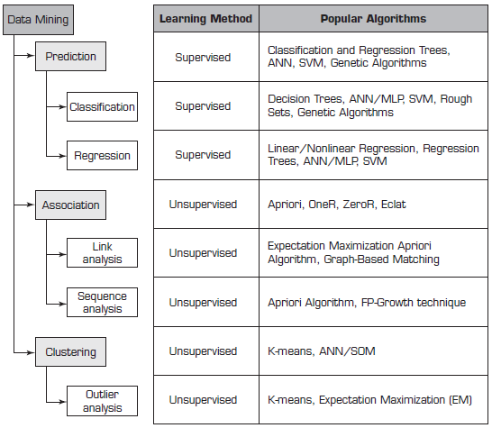
Data Mining
Notes:
Ramesh Sharda • Dursun Delen • Efraim Turban, Business Intelligence and Analytics - Systems for Decision Support, Pearson, 2014

Slide 6
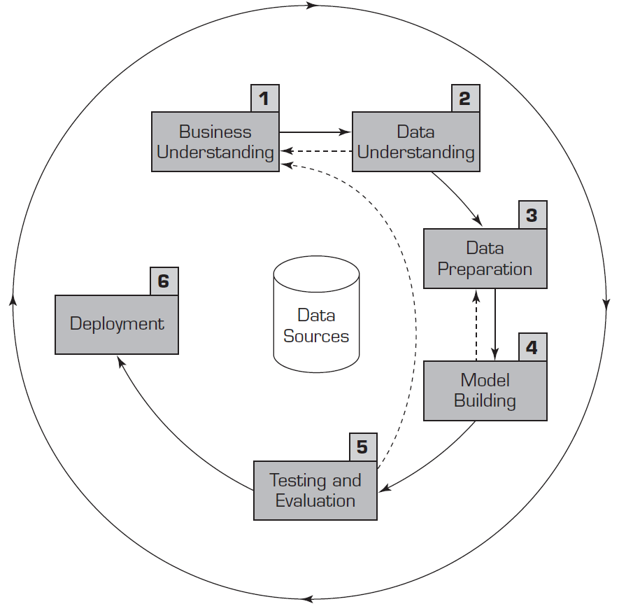
Data Mining Process
Notes:
Ramesh Sharda • Dursun Delen • Efraim Turban, Business Intelligence and Analytics - Systems for Decision Support, Pearson, 2014

Slide 7
Artificial neural network (ANN)
- A pattern-recognition methodology for machine learning.
- Ability to learn from the data and to generalize.
- Mostly used for pattern recognition, forecasting, prediction, and classification
Known as connectionist models, parallel distributed processing models, neuromorphic systems, or simply neural networks
ANN possess some desirable traits similar to those of biological neural networks, such as the abilities to learn, to self-organize, and to support fault tolerance.
Notes:
Ramesh Sharda • Dursun Delen • Efraim Turban, Business Intelligence and Analytics - Systems for Decision Support, Pearson, 2014

Slide 8
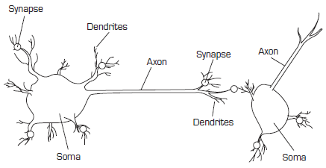
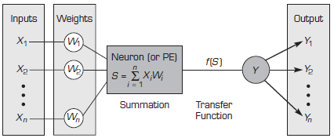
Artificial neural network (ANN)
Notes:
Ramesh Sharda • Dursun Delen • Efraim Turban, Business Intelligence and Analytics - Systems for Decision Support, Pearson, 2014

Slide 9
Elements of ANN
Processing Elements (PE) - Each neuron receives inputs, processes them, and delivers a single output
Network Structure - Each ANN is composed of a collection of neurons that are grouped into layers. Three layers: input, intermediate (called the hidden layer), and output. Parallel processing resembles the way the brain works.
Network Information Processing - Each input corresponds to a single attribute. The output of a network contains the solution to a problem.
Connection weights - express the relative strength (or mathematical value) of the input data or the many connections that transfer data from layer to layer.
Summation Function - compute the weighted sums of all the input elements entering each processing element
Notes:
Ramesh Sharda • Dursun Delen • Efraim Turban, Business Intelligence and Analytics - Systems for Decision Support, Pearson, 2014

Slide 10
Elements of ANN
Transformation (Transfer) Function – combine (i.e., adds up) the inputs coming into a neuron from other neurons/sources and then produces an output based on the transformation function
$$Y_{T}=\frac{1}{\left(1+e^{−Y}\right)}$$
The transformation modifies the output levels to reasonable values (typically between 0 and 1). A threshold value is a hurdle value for the output of a neuron to trigger the next level of neurons
Hidden Layers - Each layer increases the training effort exponentially and also increases the computation required
Notes:
Ramesh Sharda • Dursun Delen • Efraim Turban, Business Intelligence and Analytics - Systems for Decision Support, Pearson, 2014

Slide 11
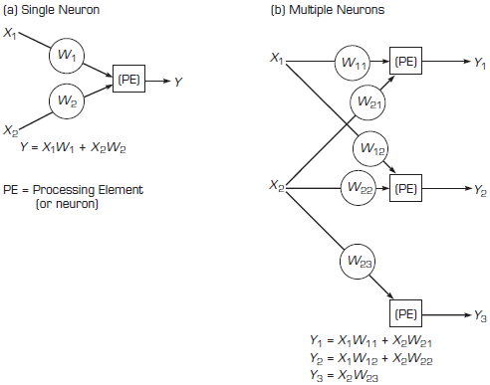
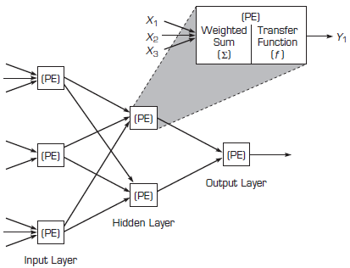
Elements of ANN
Notes:
Ramesh Sharda • Dursun Delen • Efraim Turban, Business Intelligence and Analytics - Systems for Decision Support, Pearson, 2014

Slide 12
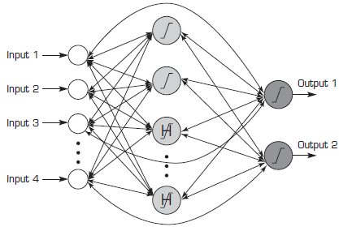
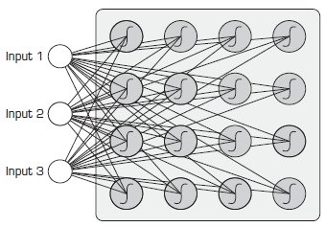
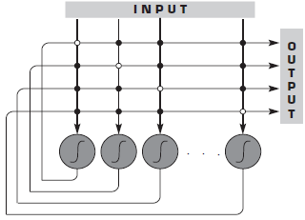
Neural Network Architectures
Recurrent Neural Network
Kohonen Network
Hopfield Network
Notes:
Ramesh Sharda • Dursun Delen • Efraim Turban, Business Intelligence and Analytics - Systems for Decision Support, Pearson, 2014

Slide 13
Developing Neural Network-based Systems
Step 1
Collect, organize, and format the data
Step 2
Separate data into training, validation, and testing sets
Step 3
Decide on a network architecture and structure
Step 4
Select a learning algorithm
Step 5
Set network parameters and initialize their values
Step 6
Initialize weights and start training (and validation)
Step 7
Stop training, freeze the network weights
Step 8
Test the trained network
Step 9
Deploy the network for use on unknown new cases
Get more data; reformat data
Re-separate data into subsets
Change network architecture
Change learning algorithm
Change network parameters
Reset and restart the training
Notes:
Ramesh Sharda • Dursun Delen • Efraim Turban, Business Intelligence and Analytics - Systems for Decision Support, Pearson, 2014

Slide 14
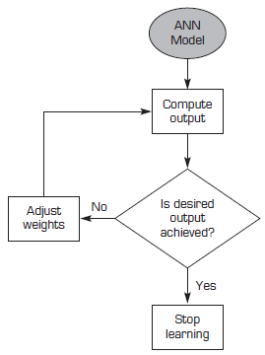
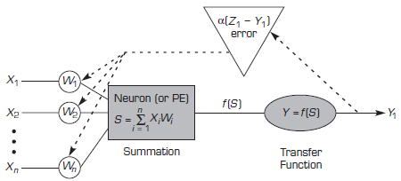
Supervised Learning of ANN
Supervised Learning Process
Backpropagation
Notes:
Ramesh Sharda • Dursun Delen • Efraim Turban, Business Intelligence and Analytics - Systems for Decision Support, Pearson, 2014

Slide 15
Support Vector Machines (SVM)
The supervised learning methods that produce input-output functions from a set of labeled training data
The function between the input and output vectors can be either a classification function (used to assign cases into predefined classes) or a regression function (used to estimate the continuous numerical value of the desired output)
SVMs have also demonstrated highly competitive performance in numerous real-world prediction problems, such as medical diagnosis, bioinformatics, face/voice recognition, demand forecasting, image processing, and text mining
Notes:
Ramesh Sharda • Dursun Delen • Efraim Turban, Business Intelligence and Analytics - Systems for Decision Support, Pearson, 2014

Slide 16
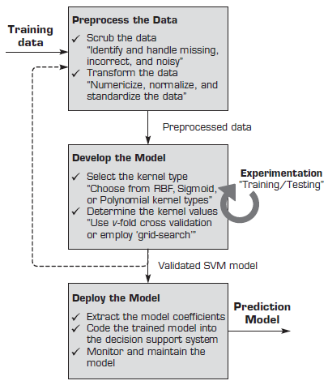
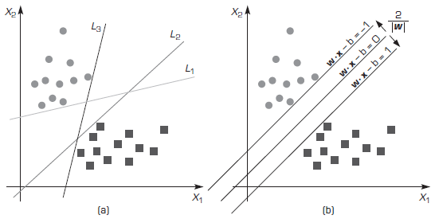
Support Vector Machines (SVM)
Separation of the Two Classes Using Hyperplanes
Developing SVM Models
Notes:
Ramesh Sharda • Dursun Delen • Efraim Turban, Business Intelligence and Analytics - Systems for Decision Support, Pearson, 2014

Slide 17
Nearest Neighbor Method for Prediction
The k-nearest neighbor algorithm (kNN) – a prediction method for classification as well as regression-type prediction problems.
An instance-based learning (or lazy learning) where the function is only approximated locally, and all computations are deferred until the actual prediction
A case is classified by a majority vote of its neighbors, with the object being assigned to the class most common among its k nearest neighbors (where k is a positive integer)
Notes:
Ramesh Sharda • Dursun Delen • Efraim Turban, Business Intelligence and Analytics - Systems for Decision Support, Pearson, 2014

Slide 18
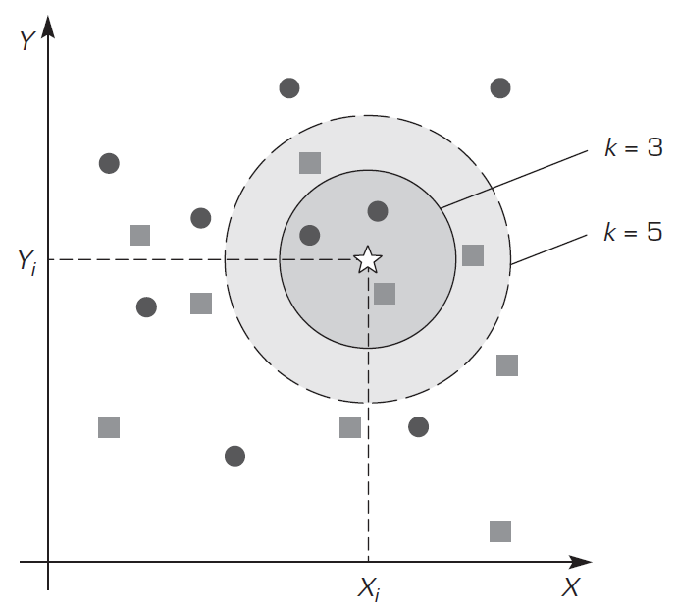
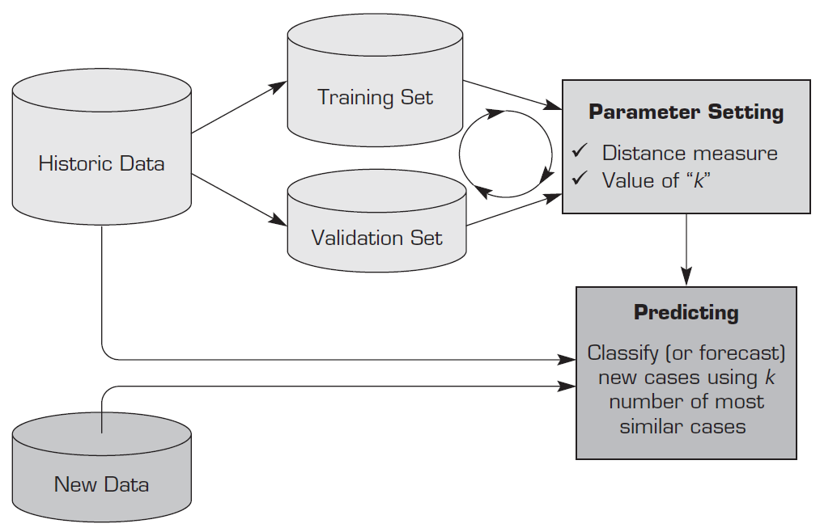
Nearest Neighbor Method for Prediction
The Process of Determining the Optimal Values of Distance Metric and k
The Importance of the Value of k in kNN algorithm
Notes:
Ramesh Sharda • Dursun Delen • Efraim Turban, Business Intelligence and Analytics - Systems for Decision Support, Pearson, 2014

Slide 19
Case Study
Predictive Modeling of Design Innovative Solutions on Tooling Configurations at High-Tech Manufacturing Companies
Objective: Forming a set of configurations for the production operation tooling
Data set: Information forming, generation of new product properties; idea synthesis and analysis; configuration of forming operation tooling; forming of a set of technical, economic, and manufacturing criteria
Result: Optimum innovative solution selection
Notes:
S. Lukina, M. Kosov and I. Tolkacheva, Predictive Modeling of Design Innovative Solutions on Tooling Configurations at High-Tech Manufacturing Companies, Proceedings of the 4th International Conference on Industrial Engineering, Lecture Notes in Mechanical Engineering, ICIE2018

Slide 20
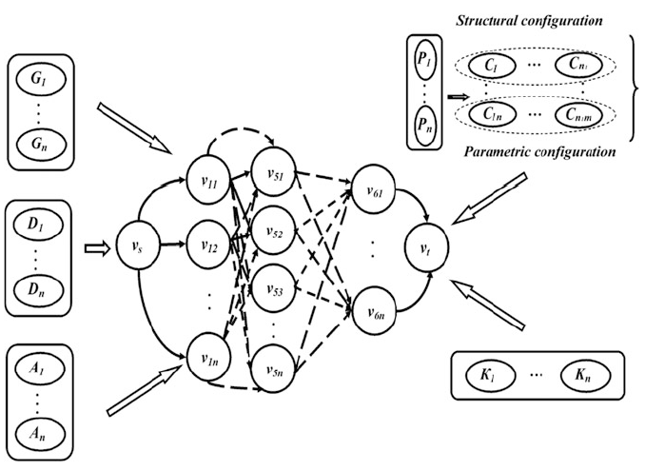
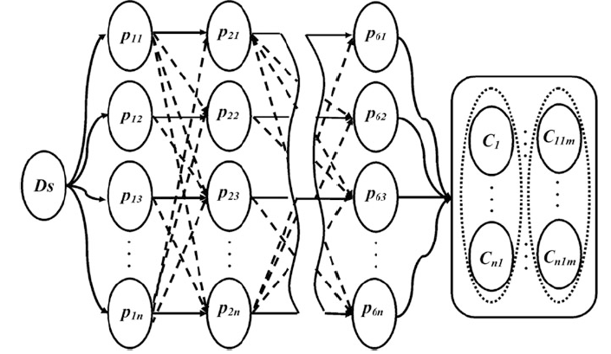
Case Study
The graph model of the tooling configuration of high-tech manufacturing companies
Hyper-graph of the predictive modeling integrated environment
Notes:
S. Lukina, M. Kosov and I. Tolkacheva, Predictive Modeling of Design Innovative Solutions on Tooling Configurations at High-Tech Manufacturing Companies, Proceedings of the 4th International Conference on Industrial Engineering, Lecture Notes in Mechanical Engineering, ICIE2018

Slide 21
Case Study
Decision Support System for Agriculture Industry using Crowd Sourced Predictive Analytics
Objective: To predict the international business of coir in South India with the other parts of the country and outside India
Data set: Density, IHI, VariAging, flexing, compset aged, compset unaged, pH value, chloride content and sulphate content
Algorithm: Fuzzy c4.5, One-of-a-kind choice tree (supervised learning method)
Notes:
Remya S, Dr.R.Sasikala, Decision Support System for Agriculture Industry using Crowd Sourced Predictive Analytics, (IJACSA) International Journal of Advanced Computer Science and Applications, Vol. 9, No. 11, 2018

Slide 22
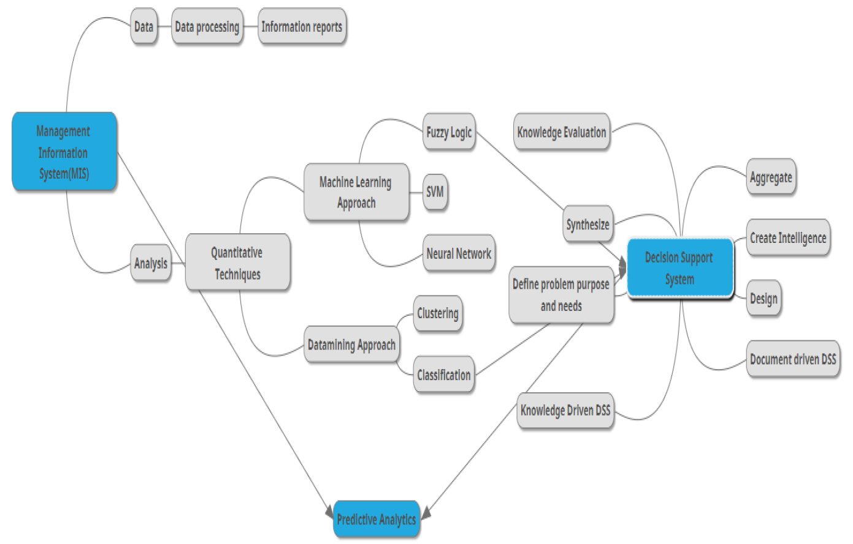
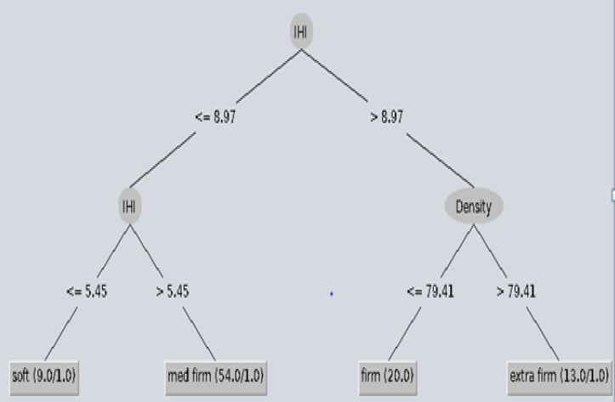
Case Study
Decision Tree Created using Fuzzy C4.5
Workflow of Predictive Analytics
Notes:
Remya S, Dr.R.Sasikala, Decision Support System for Agriculture Industry using Crowd Sourced Predictive Analytics, (IJACSA) International Journal of Advanced Computer Science and Applications, Vol. 9, No. 11, 2018

