Slide 1
Intelligent Decision Support Systems
Artificial Intelligence and DSS

Slide 2
The Development of AI
Approach | Main idea
Classical | Symbol manipulation
Knowledge-based | Knowledge
Case-based | Reminiscence
Connectionist | Distributed computation
Situated | Embodiment and embeddedness
Notes:
Hamid R. Ekbia, Taking Decisions into the Wild: An AI Perspective in the Design of i-DMSS

Slide 3
The Development of AI
The Classical Approach
Classical AI viewed cognition as abstract (physical embodiment is irrelevant), individual (the solitary mind is the essential locus of intelligence), rational (reasoning is paradigmatic of intelligence), and detached (thinking is separated from perception and action)
The failure of the classical approach to tackle these issues and to deliver its promises resulted in a decline of interest in AI research on the part of funding agencies in the early 1980s, leading practitioners to look for practical problems to solve.
The Knowledge-based Approach
As knowledge was conceived to be the key to such practice-oriented endeavor, a
new class of artifacts (“expert systems”) and a new group of practitioners (“knowledge engineers”) appeared on the scene. The knowledge-based approach was concomitant with two other views: case-based reasoning, and planning view.
Notes:
Hamid R. Ekbia, Taking Decisions into the Wild: An AI Perspective in the Design of i-DMSS

Slide 4
The Development of AI
The Connectionist Approach
The main feature of this approach was its opposition to explicit forms of knowledge and its emphasis on brain-like architectures, but it remained committed to most of the principles of classical AI.
The Situated Approach
It considers intelligence to be embodied (physical embodiment is important), embedded (the immediate natural and social environment matters), action-oriented and largely improvisational
Notes:
Hamid R. Ekbia, Taking Decisions into the Wild: An AI Perspective in the Design of i-DMSS

Slide 5
The Development of DSS
Dominant concept of DSS | Technologies
Data modeling and problem solving | Databases, MIS
Collaborative and Group Decision Support (GSS) | Knowledge bases, expert systems, EIS
Organizational learning and Knowledge Management | OLAP, data warehouse, data mining
Web-based and active DSS | Internet, client-server tools, software agents
Notes:
Hamid R. Ekbia, Taking Decisions into the Wild: An AI Perspective in the Design of i-DMSS

Slide 6
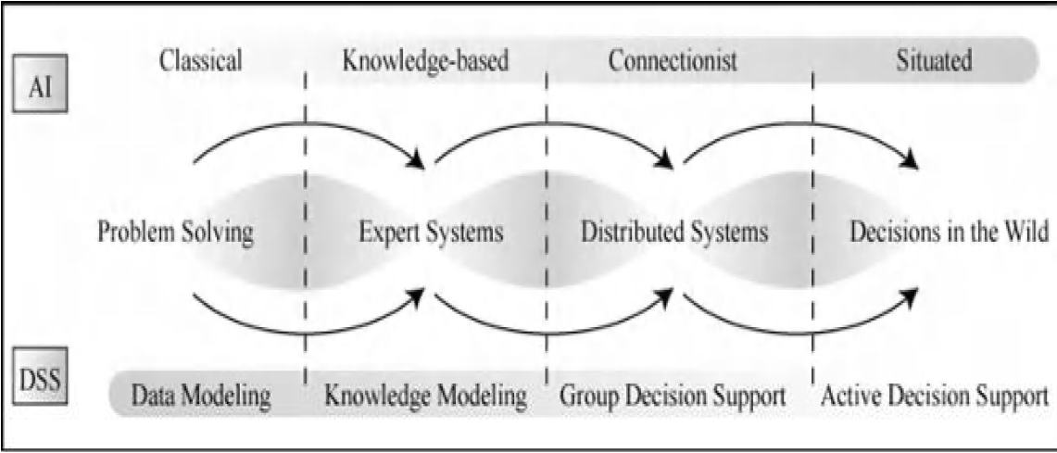
Convergent paths of AI and DSS development
Notes:
Hamid R. Ekbia, Taking Decisions into the Wild: An AI Perspective in the Design of i-DMSS

Slide 7
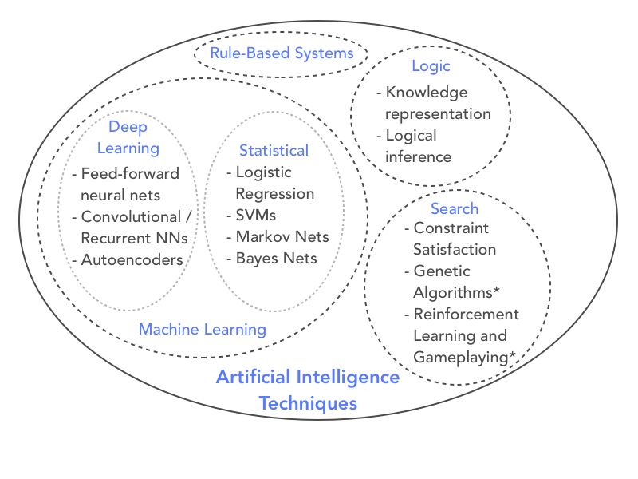
Intelligent Decision Support Systems
IDSS utilize AI techniques to enhance and improve support for the decision maker. AI tools such as fuzzy logic, case-based reasoning, evolutionary computing, artificial neural networks (ANN), and intelligent agents, when combined with DSS, provide powerful aids in solving difficult applied problems that are often real-time, involve large amounts of distributed data, and benefit from complex reasoning.
Notes:
Michael Doumpos and Evangelos Grigoroudis, Multicriteria Decision Aid and Artificial Intelligence Links, Theory and Applications, Wiley

Slide 8
Intelligent Decision Support Systems
IDSS would be DSS that exhibit some abilities indicative of ‘intelligent behavior’ such as:
• learning from experience;
• making sense out of ambiguity or contradiction;
• responding appropriately and timely to a new situation;
• using reasoning to solve problems and inferring in rational ways;
• dealing with perplexing situations;
• applying knowledge to understand or change the environment;
• recognizing the relative importance of various factors in a decision.
Notes:
Michael Doumpos and Evangelos Grigoroudis, Multicriteria Decision Aid and Artificial Intelligence Links, Theory and Applications, Wiley

Slide 9
Artificial neural networks for IDSS
ANN (or neural networks, NN, for short) are composed of a collection of highly interconnected processing units called neurons that work together to solve a problem.
The advantage of NN is their ability to represent any bounded continuous function to any arbitrarily small approximation error.
The basic unit of a NN is the neuron or node. The neuron computes the weighted sum of all inputs to the neuron, i.e., for the j^{th} neuron,
$$Y_{j}=\sum_{i}{x_{i}w_{ij}}$$
where Y_{j} repre.sents the activation level of the neuron
w_{i} are critical to learning in the NN
Notes:
Michael Doumpos and Evangelos Grigoroudis, Multicriteria Decision Aid and Artificial Intelligence Links, Theory and Applications, Wiley

Slide 10
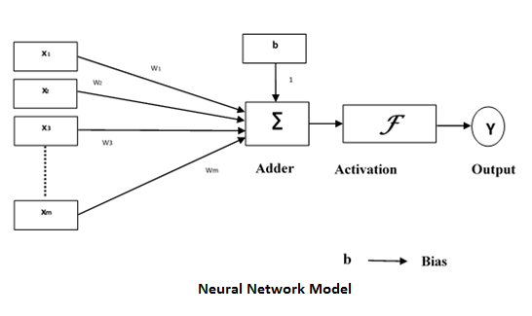
Artificial neural networks for IDSS
Notes:
Michael Doumpos and Evangelos Grigoroudis, Multicriteria Decision Aid and Artificial Intelligence Links, Theory and Applications, Wiley

Slide 11
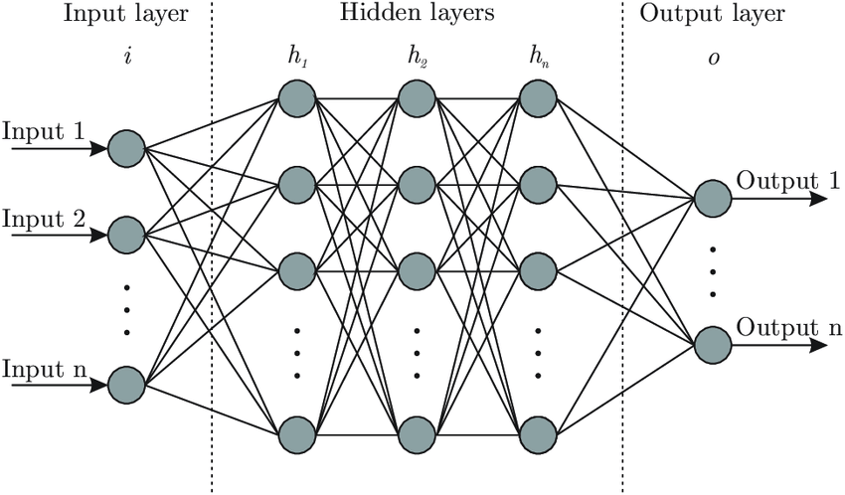
Artificial neural networks for IDSS
The NN can then be used to predict future states with a set of inputs, or ‘learn’ to readjust weights as additional input/output datasets are provided.
Notes:
Michael Doumpos and Evangelos Grigoroudis, Multicriteria Decision Aid and Artificial Intelligence Links, Theory and Applications, Wiley

Slide 12
Artificial neural networks for IDSS
Their fundamental advantage is that they can represent nonlinearity naturally as part of the process of fitting the weights. NN are not suitable for operations such as data processing.
NN ‘learn’ the underlying function described by the data using one of three strategies with ‘training data’: unsupervised, supervised, or reinforcement learning.
Unsupervised learning occurs when the NN are given only inputs and no corresponding outputs.
In supervised learning, the NN are given inputs and corresponding outputs to adjust weights on the various inputs
Reinforcement learning is used to deal with this situation and provide some feedback to the NN to evaluate whether the weights were chosen correctly.
Notes:
Michael Doumpos and Evangelos Grigoroudis, Multicriteria Decision Aid and Artificial Intelligence Links, Theory and Applications, Wiley

Slide 13
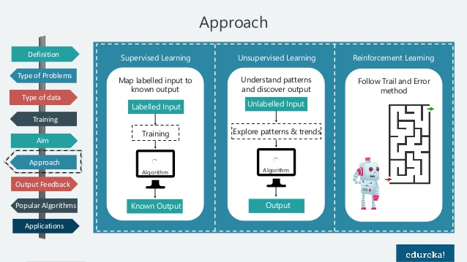
Artificial neural networks for IDSS
Notes:
Michael Doumpos and Evangelos Grigoroudis, Multicriteria Decision Aid and Artificial Intelligence Links, Theory and Applications, Wiley

Slide 14
Fuzzy logic for IDSS
Fuzzy logic features:
Extend decision support by permitting a representation of inputs or variables in the decision problem the way that humans reason about them.
Provide a way to represent rule-based behaviors, such as knowledge from an expert, so that expertise can be captured and provided to the decision maker at the appropriate time
Combined with NN so that the interpretation of decision variables is more apparent.
Fuzzy logic NN are a category of decision models that can provide human understandable meaning to the multilayer feedforward NN
Notes:
Michael Doumpos and Evangelos Grigoroudis, Multicriteria Decision Aid and Artificial Intelligence Links, Theory and Applications, Wiley

Slide 15
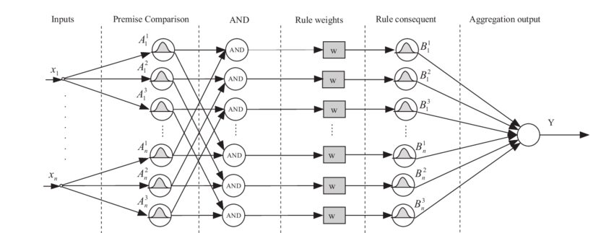
Fuzzy logic for IDSS
Fuzzy logic NN help address some of the shortcomings of NN regarding transparency to
enhance decision making.
Notes:
Michael Doumpos and Evangelos Grigoroudis, Multicriteria Decision Aid and Artificial Intelligence Links, Theory and Applications, Wiley

Slide 16
Expert systems for IDSS
Expert systems for intelligent decision support
Embed the intelligence of one or more identified human experts
A domain expert provides knowledge to the Knowledge Acquisition Module
The user or decision maker enters the system through an interface
To capture, collect and infer knowledge from a domain expert and pass that expertise to a decision maker.
Notes:
Michael Doumpos and Evangelos Grigoroudis, Multicriteria Decision Aid and Artificial Intelligence Links, Theory and Applications, Wiley

Slide 17
Expert systems for IDSS
Knowledge
Base
Knowledge
Acquisition
Module
Inference
Engine
User
Interface
Domain
Expert
Explanation
Module
User
Notes:
Michael Doumpos and Evangelos Grigoroudis, Multicriteria Decision Aid and Artificial Intelligence Links, Theory and Applications, Wiley

Slide 18
Evolutionary computing for IDSS
AI techniques attempt to mimic natural evolution
Adapt to the environment by simulating emergence, survival and refinement of a population of individuals
Genetic algorithms (GA) are among the most utilized for decision problems
Evolutionary computing provides insight into decision strategies for solving multicriteria problems
Notes:
Michael Doumpos and Evangelos Grigoroudis, Multicriteria Decision Aid and Artificial Intelligence Links, Theory and Applications, Wiley

Slide 19
Evolutionary computing for IDSS
Initialize the population
Calculate initial fitness level
Fitness Value or Generation Reached
Output solution
Update population
and fitness
Select elite members
Select parents and apply crossover
Select parents and apply mutation
Notes:
Michael Doumpos and Evangelos Grigoroudis, Multicriteria Decision Aid and Artificial Intelligence Links, Theory and Applications, Wiley

Slide 20
Intelligent agents for IDSS
An agent is an entity within a system that ‘is situated in some environment and that is capable of autonomous action in this environment in order to meet its design objective’. This intrinsic capability of autonomous action is the human-like characteristic of acting (or deciding) on the basis of context rather than the prescriptive logic embedded in if–then computer programs.
Intelligent agent initiate action with a specific directive to meet a goal
Human terms such as knowledge, intention and beliefs are used to describe IA, indicating the complex behaviors that are possible
Notes:
Michael Doumpos and Evangelos Grigoroudis, Multicriteria Decision Aid and Artificial Intelligence Links, Theory and Applications, Wiley

Slide 21
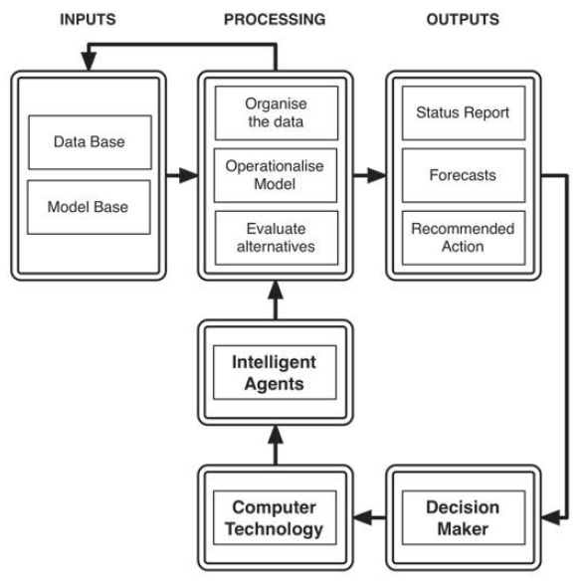
Intelligent agents for IDSS
Intelligent agents can facilitate information processing and user
Interaction.
Agents as global assistants may access distributed information in the enterprise, maintain a current status for the system by updating information in real-time, or use the Internet to bring external information to the decision problem
Notes:
Jeffrey W. Tweedale, Gloria Phillips-Wren and Lakhmi C. Jain, Advances in Intelligent Decision-Making
Technology Support, Intelligent Decision Technology Support in Practice, Springer, 2016

Slide 22
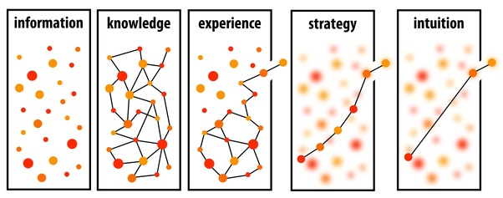
Knowledge
Knowledge is information that is contextual, relevant and actionable
Having knowledge implies that it can be exercised to solve a problem, whereas having information does not carry the same connotation
Notes:
Efraim Turban, Jay E. Aronson, & Ting-Peng-Liang, Decision Support Systems and Intelligent System, Prentic Hall of India

Slide 23
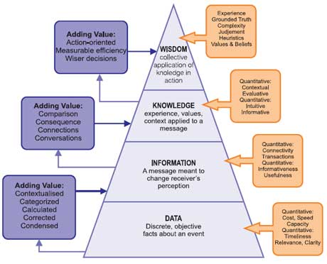
Knowledge
Notes:
http://www.valanglobal.com/data-information-knowledge/

Slide 24
Knowledge-Engineering Process
Knowledge acquisition – the acquisition of knowledge from human experts, books, documents, sensors, or computer files
Knowledge representation – the preparation of a knowledge map and encoding the knowledge in the knowledge base
Knowledge validation – the knowledge is validated and verified until its quality is acceptable
Inferencing – the design of software to enable the computer to make inferences based on the knowledge and specifics of a problem
Explanation and justification – the design and programming of an explanation capability
Notes:
Efraim Turban, Jay E. Aronson, & Ting-Peng-Liang, Decision Support Systems and Intelligent System, Prentic Hall of India

Slide 25
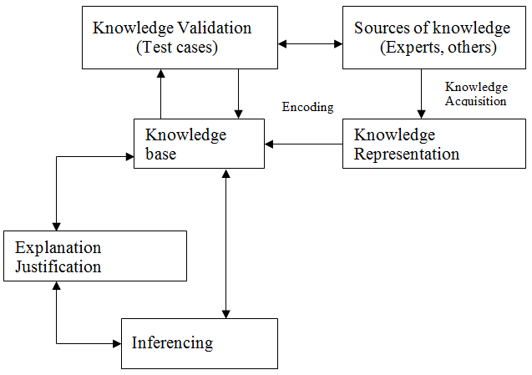
Knowledge-Engineering Process
Notes:
Efraim Turban, Jay E. Aronson, & Ting-Peng-Liang, Decision Support Systems and Intelligent System, Prentic Hall of India

Slide 26
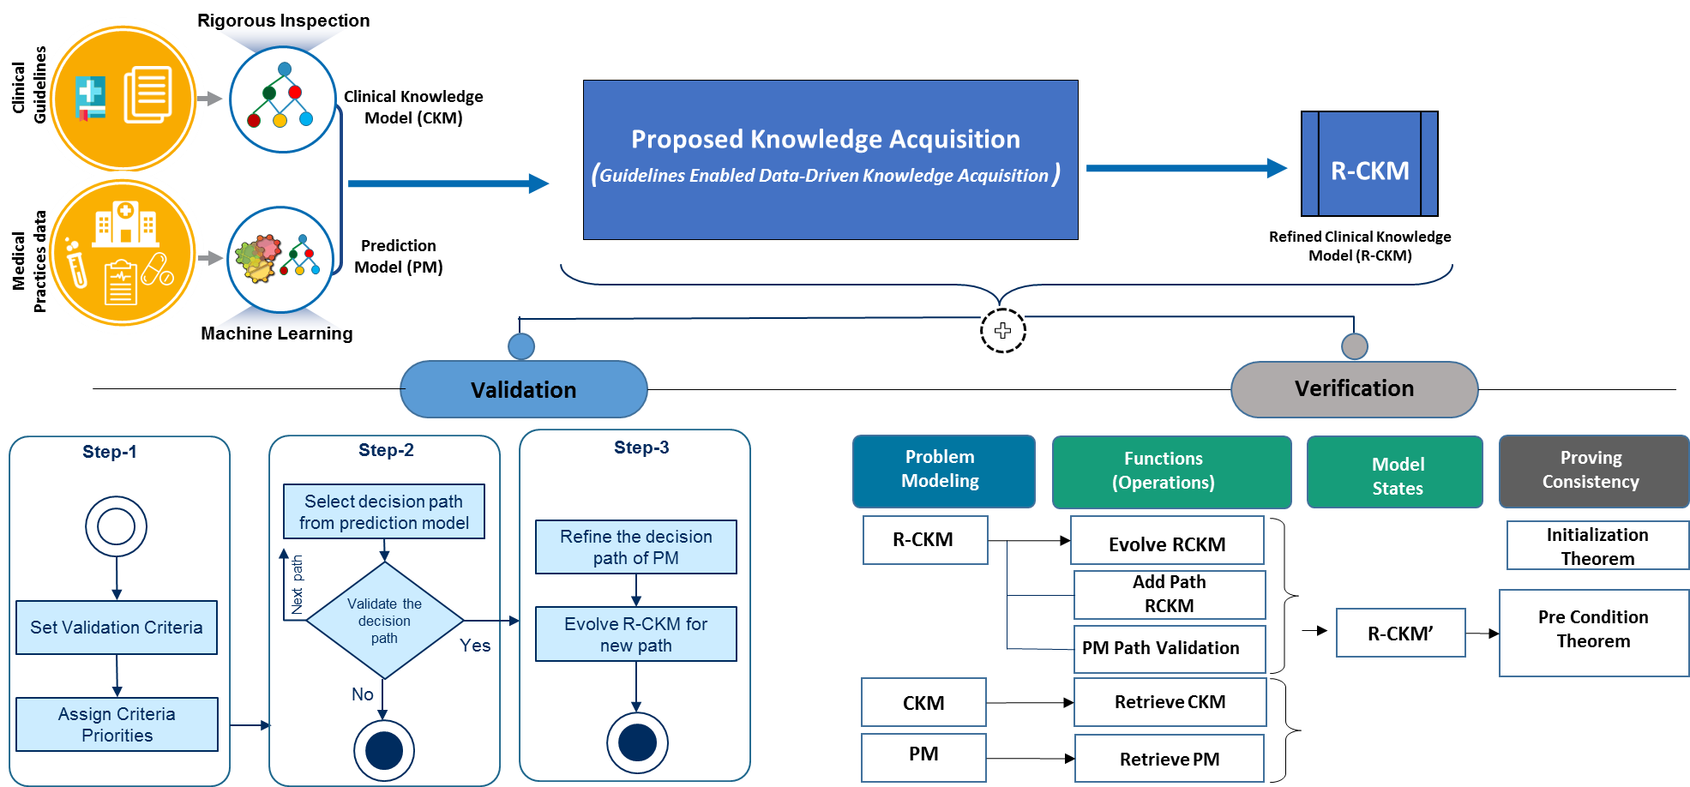
Knowledge Acquisition
Notes:
THREE PHASE KNOWLEDGE ACQUISITION MODEL
http://smartcdss.com/research/knowledge-acquisition/

Slide 27
Knowledge acquisition from experts
Manual methods
Interviews – a direct dialog between the expert and the knowledge engineer. The expert is asked to talk the knowledge engineer through the solution.
Unstructured interviews – one can ask the expert to teach through or read through.
Structured interviews – a systematic goal-oriented process. The structure reduces the interpretation problems inherent in unstructured interviews and allows the knowledge engineer to prevent the distortion caused by the subjectivity of the domain expert.
Process tracking – to track the reasoning process of an expert
Protocol analysis – a protocol is a record or documentation of expert’s step-by-step information processing and decision-making behavior
Notes:
Efraim Turban, Jay E. Aronson, & Ting-Peng-Liang, Decision Support Systems and Intelligent System, Prentic Hall of India

Slide 28
Knowledge acquisition from experts
Semiautomatic methods
Repertory grid analysis – each person is viewed as a personal scientist who seeks to predict and control events by forming theories, testing hypotheses, and analyzing results of experiments
Computer-aided tools – visual modeling are used to construct the initial domain model. EMYCIN – use a natural language interface to help the knowledge engineer test and debug new knowledge
Notes:
Efraim Turban, Jay E. Aronson, & Ting-Peng-Liang, Decision Support Systems and Intelligent System, Prentic Hall of India

Slide 29
Knowledge acquisition from experts
Automatic knowledge-discovery methods
Machine learning/data mining/knowledge discovery
Inductive learning – rules are induced from existing cases with known results
Neural computing – mimic the human brain by building artificial neurons and storing knowledge in the connection of neurons
Genetic algorithms – the principle of natural selection to gradually find the best combination of knowledge from known cases
Notes:
Efraim Turban, Jay E. Aronson, & Ting-Peng-Liang, Decision Support Systems and Intelligent System, Prentic Hall of India

Slide 30
Automated Knowledge acquisition
To increase the productivity of knowledge engineering (reduce the cost)
To reduce the skill level required from the knowledge engineer
To eliminate (or drastically reduce) the need for an expert
To eliminate (or drastically reduce) the need for a knowledge engineer
To increase the quality of the acquired knowledge
Automated rule induction
A rule induction system is given examples of a problem (called a training set) for which the outcome is known. Then it create rules that fit the example case.
Interactive induction
Need an expert supported by computer software
Notes:
Efraim Turban, Jay E. Aronson, & Ting-Peng-Liang, Decision Support Systems and Intelligent System, Prentic Hall of India

Slide 31
Knowledge Representation
KR Techniques
Production Rules
Semantic Networks
Frames
Formal Logic
Object- oriented
Decision Trees
Notes:
https://www.edureka.co/blog/knowledge-representation-in-ai/

Slide 32
Knowledge Representation
Production rules
Knowledge is represented in the form of condition/action pairs: IF this condition (or premise or antecedent) occurs, THEN some action (or result or conclusion or consequence)
Implement an autonomous chunk of expertise that can be developed and modified independently of other rules
Complex knowledge requires thousands of rules, which may create difficulties in using and maintaining the system
Systems with many rules may have a search limitation in the control program
Notes:
Efraim Turban, Jay E. Aronson, & Ting-Peng-Liang, Decision Support Systems and Intelligent System, Prentic Hall of India

Slide 33
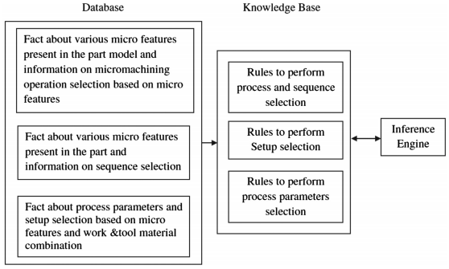
Knowledge Representation
Notes:
S.P. Leo Kumar (2019) Knowledge-based expert system in manufacturing planning: state-of-the-art review, International Journal of Production Research, 57:15-16,

Slide 34
Knowledge Representation
Semantic networks
Graphical depictions of knowledge composed of nodes and links that show hierarchical relationships between objects
Provide visual representation of relationships and can be combined with other representation methods
IS-A is used to show a class relationship
HAS-A links are used to identify characteristics or attributes of object nodes
Notes:
Efraim Turban, Jay E. Aronson, & Ting-Peng-Liang, Decision Support Systems and Intelligent System, Prentic Hall of India

Slide 35
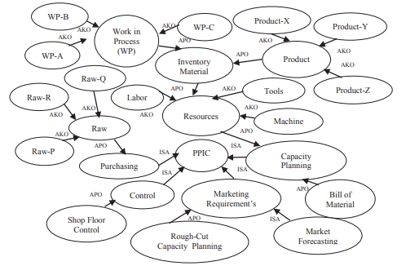
Knowledge Representation
Production Planning’s Semantic Network of Manufacturing
Notes:
Ari Fajar Santoso, Iping Supriana, and Kridanto Surendro, 2017, Designing Knowledge of The PPC with Semantic Network , International Conference on Computing and Applied Informatics 2016, IOP Conf. Series: Journal of Physics: Conf. Series 801

Slide 36
Knowledge Representation
Frame
A data structure that includes all the knowledge about a particular object
Ability to clearly document information about a domain model
Related ability to constrain the allowable values that an attribute can take on
Modularity of information, permitting ease of system expansion and maintenance
Mechanism that allows the scope of facts considered during forward or backward chaining to be restricted
Access to a mechanism that supports the inheritance of information down a class hierarchy
Notes:
Efraim Turban, Jay E. Aronson, & Ting-Peng-Liang, Decision Support Systems and Intelligent System, Prentic Hall of India

Slide 37
Knowledge Representation
Decision Trees
Composed of nodes representing goals and links representing decisions
Knowledge diagramming is often more natural to experts than formal representation methods (e.g., rules, frames)
Machine learning methods are capable of extracting decision trees automatically from textual sources and converting them to rule bases
Notes:
Efraim Turban, Jay E. Aronson, & Ting-Peng-Liang, Decision Support Systems and Intelligent System, Prentic Hall of India

Slide 38
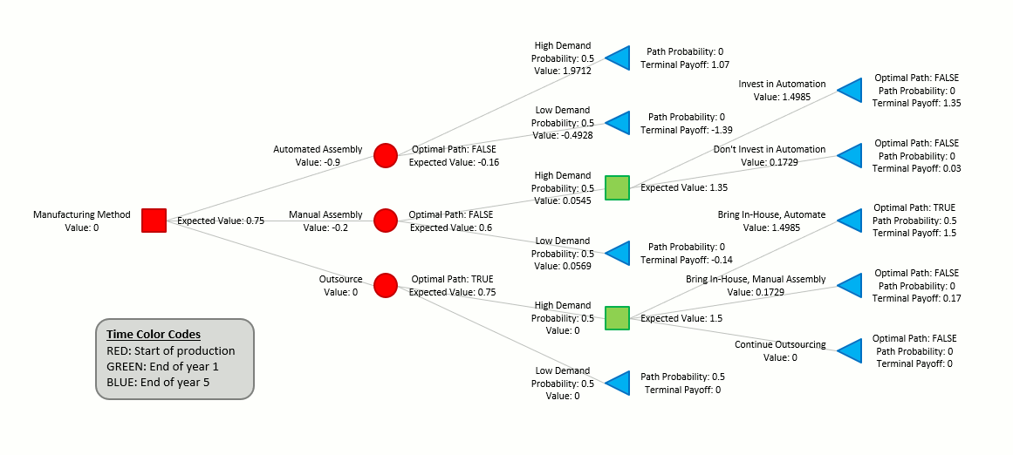
Knowledge Representation
Notes:
Vortarus Technologies LLC, Evaluating a manufacturing decision with a decision tree. https://vortarus.com/manufacturing-decision-decision-tree/

Slide 39
Selection of representation methods
Scheme | Advantages | Disadvantages
Production rules | Simple syntax, easy to understand, simple interpreter, highly modular, flexible | Hard to follow hierarchies, inefficient for large systems, not all knowledge can be expressed as rules, poor at representing structured descriptive knowledge
Semantic networks | Easy to follow hierarchy, easy to trace associations, flexible | Meaning attached to nodes might be ambiguous, exception handling is difficult, difficult to program
Frames | Expressive power, easy to set up slots for new properties and relations, easy to create specialized procedures, and easy detect missing values | Difficult to program, difficult for inference, lack of inexpensive software
Notes:
Efraim Turban, Jay E. Aronson, & Ting-Peng-Liang, Decision Support Systems and Intelligent System, Prentic Hall of India

