Slide 1
Intelligent Decision Support Systems
Deep Learning for Smart Production

Slide 2
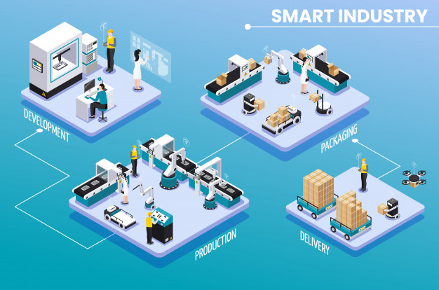
Smart manufacturing
Smart manufacturing refers to using advanced data analytics to complement physical science for improving system performance and decision making.
Manufacturing machines are fully connected through wireless networks, monitored by sensors, and controlled by advanced computational intelligence
Notes:
Jinjiang Wang, Yulin Ma, Laibin Zhang, Robert X. Gao, and Dazhong Wu, 2018, Deep learning for smart manufacturing: Methods and applications, Journal of Manufacturing Systems, 48, pp. 144-156

Slide 3
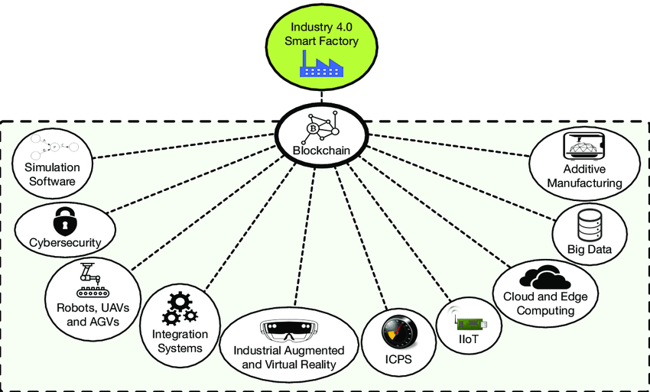
Smart manufacturing
Key supporting technologies to advance modern manufacturing are Internet of Things (IoTs), Cloud Computing, and Cyber-Physical System (CPS)
Data at different stages of product’s life is collected and processed
Notes:
Jinjiang Wang, Yulin Ma, Laibin Zhang, Robert X. Gao, and Dazhong Wu, 2018, Deep learning for smart manufacturing: Methods and applications, Journal of Manufacturing Systems, 48, pp. 144-156

Slide 4
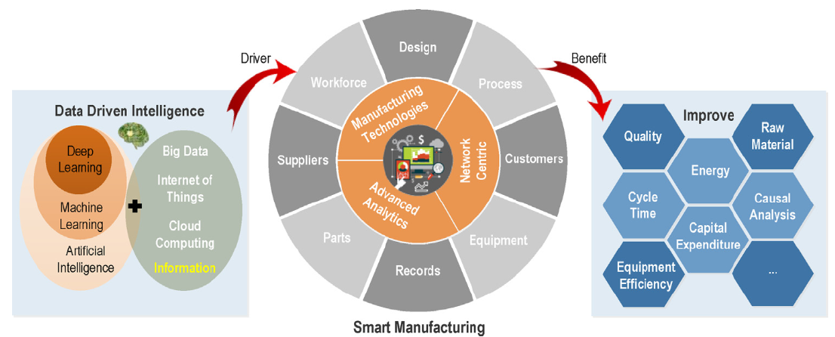
Smart manufacturing
Data driven intelligence models the complex multivariate nonlinear relationships among data, with no in-depth understanding of system physical behaviors required
Notes:
Jinjiang Wang, Yulin Ma, Laibin Zhang, Robert X. Gao, and Dazhong Wu, 2018, Deep learning for smart manufacturing: Methods and applications, Journal of Manufacturing Systems, 48, pp. 144-156

Slide 5
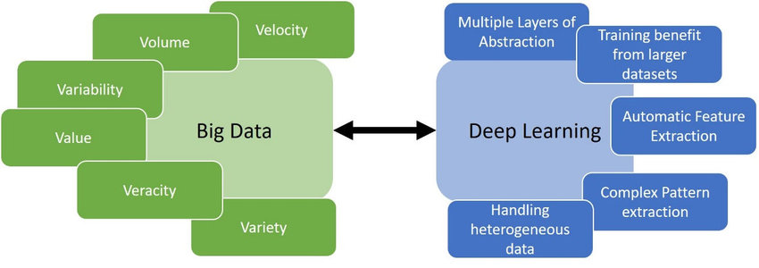
Smart manufacturing
The potential benefit and successful application examples of typical machining learning techniques including Bayesian Networks, Instance-based Learning, Artificial Neural Network, and ensemble methods
Deep Learning provides an advanced analytics tool for smart manufacturing in the Big Data Era
Notes:
Jinjiang Wang, Yulin Ma, Laibin Zhang, Robert X. Gao, and Dazhong Wu, 2018, Deep learning for smart manufacturing: Methods and applications, Journal of Manufacturing Systems, 48, pp. 144-156

Slide 6
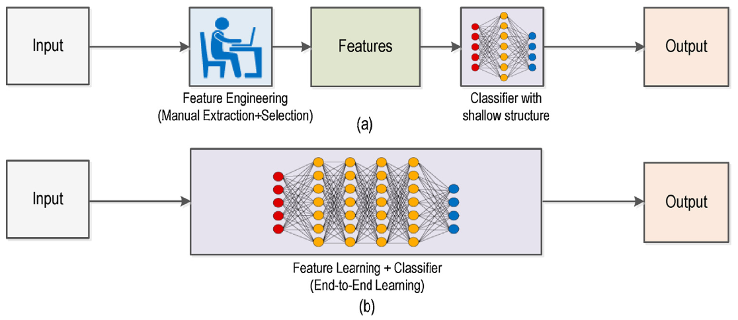
Deep Learning VS Traditional Machine Learning
Traditional machine learning
Deep learning
Notes:
Jinjiang Wang, Yulin Ma, Laibin Zhang, Robert X. Gao, and Dazhong Wu, 2018, Deep learning for smart manufacturing: Methods and applications, Journal of Manufacturing Systems, 48, pp. 144-156

Slide 7
Deep Learning VS Traditional Machine Learning
 | Feature learning | Model construction | Model training
Traditional machine learning | Explicit engineered features extracted with expert domain knowledge | Use extracted features to construct data-driven model, usually with shallow structures | Each module is trained step-by-step
Deep learning | Features are learned by transforming data into abstract representations | An end-to-end high hierarchical model structure with nonlinear combination of mult-layers | Parameters are trained jointly
Notes:
Jinjiang Wang, Yulin Ma, Laibin Zhang, Robert X. Gao, and Dazhong Wu, 2018, Deep learning for smart manufacturing: Methods and applications, Journal of Manufacturing Systems, 48, pp. 144-156

Slide 8
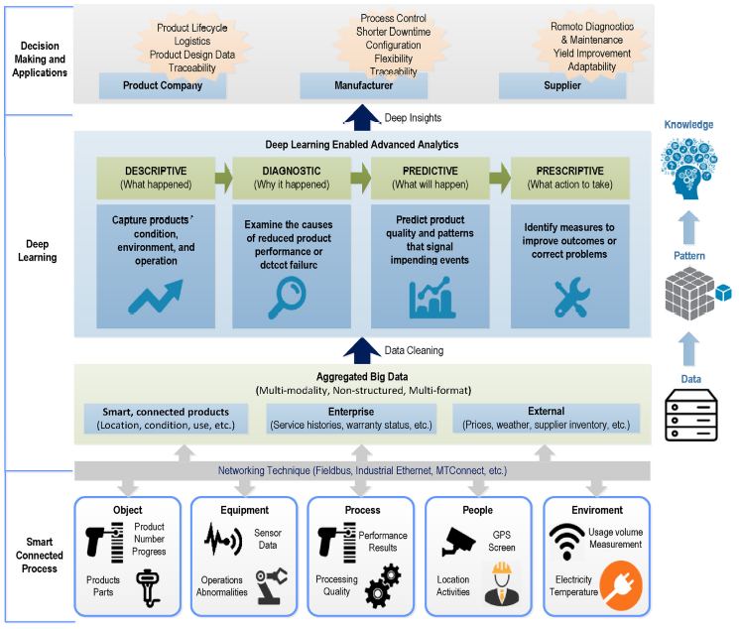
Deep learning enabled advanced analytics for smart manufacturing
Notes:
Jinjiang Wang, Yulin Ma, Laibin Zhang, Robert X. Gao, and Dazhong Wu, 2018, Deep learning for smart manufacturing: Methods and applications, Journal of Manufacturing Systems, 48, pp. 144-156

Slide 9
Deep learning models
Model | Principle | Advantages | Disadvantages
Convolutional Neural Network (CNN) | Abstracted features are learned by stacked convolutional and sampling layers | Reduced parameter number, invariance of shift, scale and distortion | High computational complexity for high hierarchical model training
Restricted Boltzmann Machine (RBM) | Hidden layer describes variable dependencies and connections between input or output layers as representative features | Robust to ambiguous input and training label is not required in pre-training stage | Time-consuming for joint parameter optimization
Notes:
Jinjiang Wang, Yulin Ma, Laibin Zhang, Robert X. Gao, and Dazhong Wu, 2018, Deep learning for smart manufacturing: Methods and applications, Journal of Manufacturing Systems, 48, pp. 144-156

Slide 10
Deep learning models
Model | Principle | Advantages | Disadvantages
Auto Encoder (AE) | Unsupervised feature learning and data dimensionality reduction are achieved through encoding | Irrelevance in the input is eliminated, and meaningful information is preserved | Error propagation layer-by-layer and sparse representations are not guaranteed
Recurrent Neural Network (RNN) | Temporal pattern stored in the recurrent neurons connection and distributed hidden states for time-series data | Short-term information is retained, and temporal correlations are captured in sequence data | Difficult to train the model and save the long-term dependence
Notes:
Jinjiang Wang, Yulin Ma, Laibin Zhang, Robert X. Gao, and Dazhong Wu, 2018, Deep learning for smart manufacturing: Methods and applications, Journal of Manufacturing Systems, 48, pp. 144-156

Slide 11
Applications to Smart Manufacturing
Concept development
Design
Test & Evaluation
Production
Operation
Sustainment
Design & Performance
Materials, Processing &Manufacturing
Operation & Maintenance
Notes:
Jinjiang Wang, Yulin Ma, Laibin Zhang, Robert X. Gao, and Dazhong Wu, 2018, Deep learning for smart manufacturing: Methods and applications, Journal of Manufacturing Systems, 48, pp. 144-156

Slide 12
Descriptive analytics for production quality inspection
Machine vision and image processing techniques is used to detect surface defect
Deep learning has been investigated to learn-level generic features and applied to a wide range of textures or difficult-to-detect defects cases
Applications:
Automated defect identification - CNN
Feature extraction from the pixel representation of steel defect images - CNN
Automatically inspect dirties, scratches, burrs, and wears on surface parts - CNN
Notes:
Jinjiang Wang, Yulin Ma, Laibin Zhang, Robert X. Gao, and Dazhong Wu, 2018, Deep learning for smart manufacturing: Methods and applications, Journal of Manufacturing Systems, 48, pp. 144-156

Slide 13
Diagnostic analytics for fault assessment
To monitor machinery conditions, identify the incipient defects, diagnose the root cause of failures, and incorporate the information into manufacturing production and control
Applications:
Image analysis – CNN
Fault diagnosis of aircraft engine, chemical process, reciprocating compressor, rolling element bearing, high speed train, and wind turbine – DBN
Signal denoising, fused feature extraction, and rolling bearing fault diagnosis - AE
Notes:
Jinjiang Wang, Yulin Ma, Laibin Zhang, Robert X. Gao, and Dazhong Wu, 2018, Deep learning for smart manufacturing: Methods and applications, Journal of Manufacturing Systems, 48, pp. 144-156

Slide 14
Predictive Analytics for Defect Prognosis
Historical data is important for prediction temporal behavior of manufacturing processes, such as maintenance, tools and machine lifetime.
Applications:
Mechanical system or component defect propagation and useful life, Machine health monitoring tasks – RNN
Useful life of an aircraft turbofan engine – LSTM
Material removal rate and chemical mechanical polishing process parameters, RUL prediction of a ceramic bearing, job schedule and balance the computational load - DBN
Notes:
Jinjiang Wang, Yulin Ma, Laibin Zhang, Robert X. Gao, and Dazhong Wu, 2018, Deep learning for smart manufacturing: Methods and applications, Journal of Manufacturing Systems, 48, pp. 144-156

Slide 15
Case Study
A Quality Control Application on a Smart Factory Prototype Using Deep Learning Methods
Features:
A camera placed over the assembly line in a smart factor model to detect object and classification (Visual Quality Control)
Deep learning methods classify “OK” or “NOT OK” product
PLC controls the production line
Notes:
Ridvan Ozdemir, Mehmet Koc, A Quality Control Application on a Smart Factory Prototype Using Deep Learning Methods, CSIT 2019, 17-20 September, 2019, Lviv, Ukraine

Slide 16
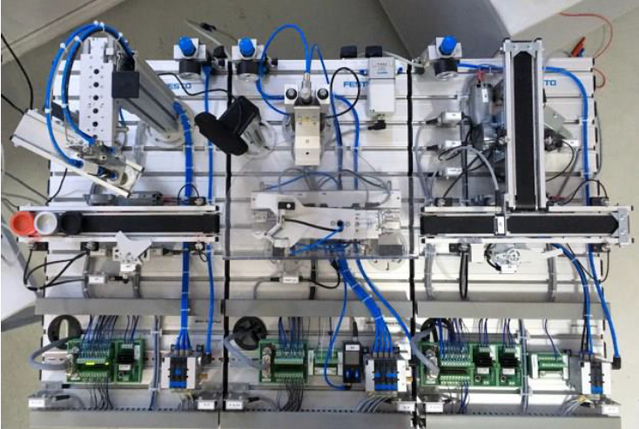
Case Study
A Quality Control Application on a Smart Factory Prototype Using Deep Learning Methods
Smart Factory training prototype assembly line
Festo’s “Pick and Place”, “Muscle Press” and “Separating” modules
CPU 1214C model of Siemens S7-1200 PLC series
Festo’s pneumatic and electropneumatic valves, pistons, vacuum elements, proximity sensors, DC motors
Notes:
Ridvan Ozdemir, Mehmet Koc, A Quality Control Application on a Smart Factory Prototype Using Deep Learning Methods, CSIT 2019, 17-20 September, 2019, Lviv, Ukraine

Slide 17
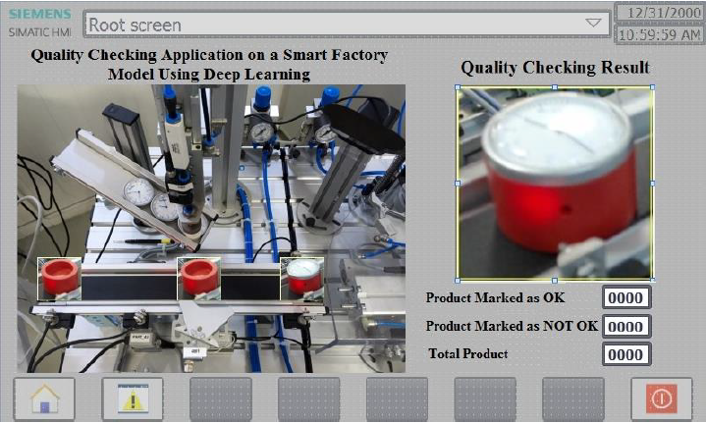
Case Study
A Quality Control Application on a Smart Factory Prototype Using Deep Learning Methods
Programming HMI
TIA Portal V13 software
The position of the product
The quality control result
The number of “OK” and “NOT OK” products
Real time result
Notes:
Ridvan Ozdemir, Mehmet Koc, A Quality Control Application on a Smart Factory Prototype Using Deep Learning Methods, CSIT 2019, 17-20 September, 2019, Lviv, Ukraine

Slide 18
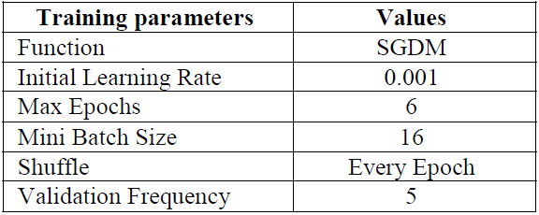
Case Study
A Quality Control Application on a Smart Factory Prototype Using Deep Learning Methods
Object Detection and Recognition
189x2 dimensional list storing 189 images of data set
CNN – AlexNet
Notes:
Ridvan Ozdemir, Mehmet Koc, A Quality Control Application on a Smart Factory Prototype Using Deep Learning Methods, CSIT 2019, 17-20 September, 2019, Lviv, Ukraine

Slide 19
Case Study
A Quality Control Application on a Smart Factory Prototype Using Deep Learning Methods
“OK” and “NOT OK” data set
356 images in 3 colors: red, gray and black
3024x3024 pixels in RGB resized to 227x227 pixels to match CNN’s input image dimensions
ACF object detector algorithm
Notes:
Ridvan Ozdemir, Mehmet Koc, A Quality Control Application on a Smart Factory Prototype Using Deep Learning Methods, CSIT 2019, 17-20 September, 2019, Lviv, Ukraine

Slide 20
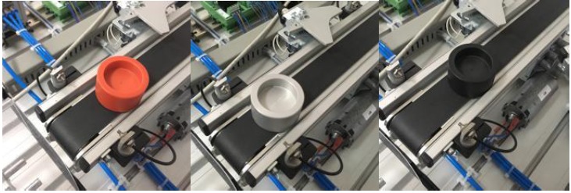
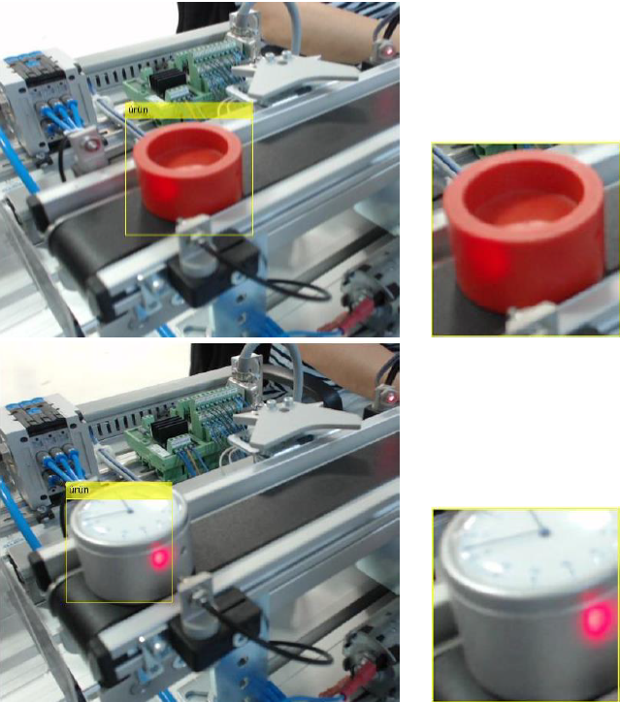
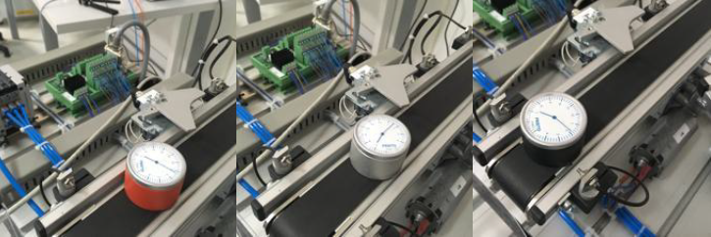
Case Study
“NOT OK”
“OK”
Notes:
Ridvan Ozdemir, Mehmet Koc, A Quality Control Application on a Smart Factory Prototype Using Deep Learning Methods, CSIT 2019, 17-20 September, 2019, Lviv, Ukraine

