Slide 1
Intelligent Decision Support Systems
Agile Approach for Smart Production

Slide 2
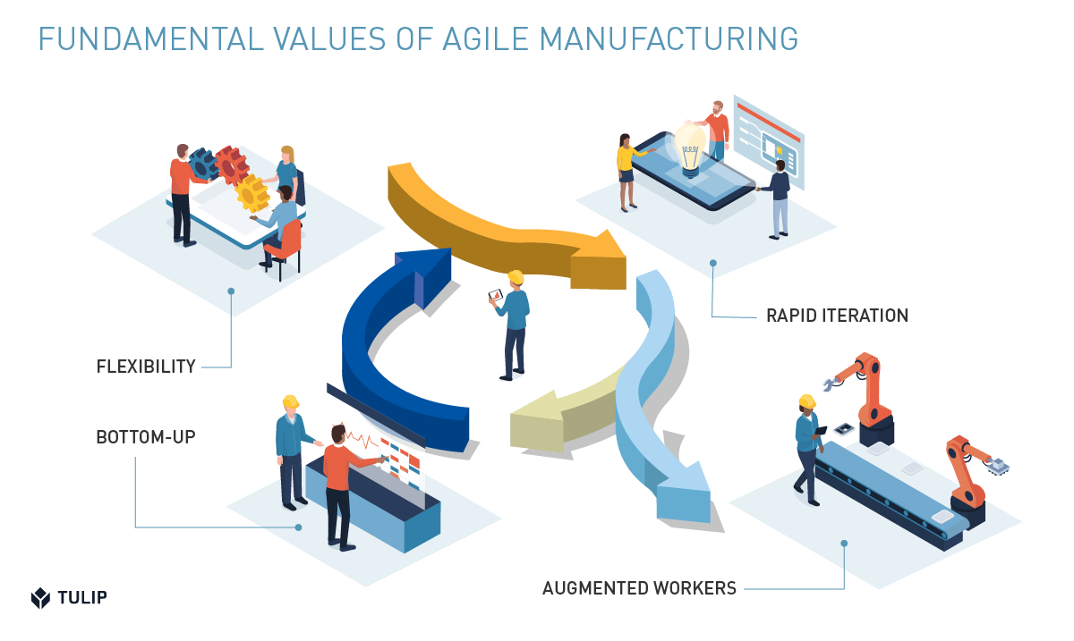
Introduction to Agile Manufacturing
Agile Manufacturing as the 21st Century Strategy for Improving Manufacturing Competitiveness
(Henrique Luiz Correa, 2001)

Slide 3
Introduction to Agile Manufacturing
The need for a strategic management of the manufacturing function:
Manufacturing in general involves the bulk of the company’s assets and human resources
Many decisions regarding manufacturing resources require a long time to take effect therefore requiring a long term outlook of the future to support them
Once made, many of these decisions will normally take a long time and substantial amounts of resources to revert

Slide 4
Introduction to Agile Manufacturing
Manufacturing decisions directly affect the way companies can compete in the marketplace because it is increasingly accepted that there is not such thing as a “best way” to manage manufacturing resources – different configurations of manufacturing resources will result in different levels of manufacturing performance in different aspects (e.g. deliver, flexibility, quality and cost)
Manufacturing decisions have to support and be supported by other functions in order to properly support the business strategy of the company, therefore requiring strategic orientation

Slide 5
The New Manufacturing Environments of the 2000s
Information Technology
- It has remarkably changed the patterns of integration and communication within as well as between companies and between companies and consumers.
- With the integrated systems being connected with the Internet, new virtually endless opportunities are available to the companies who are competent enough to use them for competitive benefit.
- The rate at which technology has evolved requires, more than ever, that manufacturing managers are proactive in anticipating and understanding the newly available technologies and their impact on the company’s competitive performance, both in terms of information, product and process technologies.

Slide 6
The New Manufacturing Environments of the 2000s
2. Customer requirements
- They are increasingly demanding because competition is increasingly global and fierce and, competitors are increasingly competent.
- Required changes in the strategic direction must be quickly mirrored by changes in the pattern of manufacturing decisions.
- Changes in the manufacturing resources, newly developed competencies and newly available technologies should also be able to quickly change the strategic direction of the company changing.

Slide 7
Need for Agile Manufacturing Strategy Processes
Change is rule, not the exception
The internal and external changes affecting the organization will be so frequent and relevant that change should be the main trigger for the strategy reviewing process rather than only time.
Changes may frequently affect so many functional areas that it is impossible that just one or a few of them keep such changes monitores and under control.

Slide 8
Need for Agile Manufacturing Strategy Processes
2. Change is rule, not the exception
The internal and external changes affecting the organization will be so frequent and relevant that change should be the main trigger for the strategy reviewing process rather than only time.
Changes may frequently affect so many functional areas that it is impossible that just one or a few of them keep such changes monitors and under control.

Slide 9
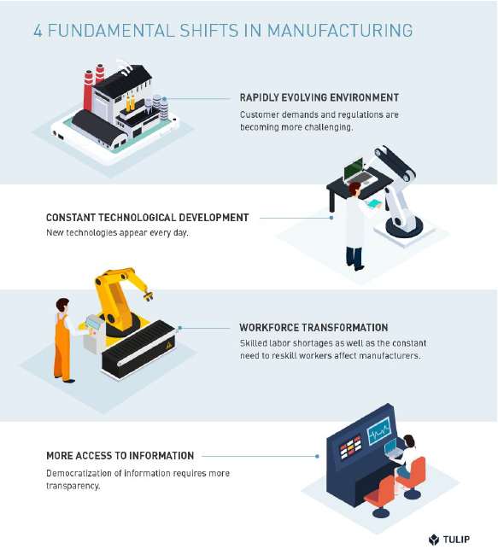
What is Agile Manufacturing?
Agile Manufacturing is an approach to manufacturing that leverages flexibility, bottom-up innovation and augmentation in order to adapt, through an iterative process, to changing conditions.
Notes:
TULIP, Agile Manufacturing – A Complete Guide

Slide 10
What is Agile Manufacturing?
Four major shifts in the manufacturing landscape have made Agile methods necessary
1. Rapidly evolving environment – Technology, Customers and Regulations are driving significant changes.
2. Constant technological development - According to a report published by McKinsey in 2018, manufacturing will experience more disruptions in the next five years than in the past twenty years combined.
3. More access to information - Companies will be able to act on real-time data at every level.
4. Workforce transformation - manufacturers can survive low unemployment rates and an enduring skills gap and remain competitive.
Notes:
TULIP, Agile Manufacturing – A Complete Guide

Slide 11
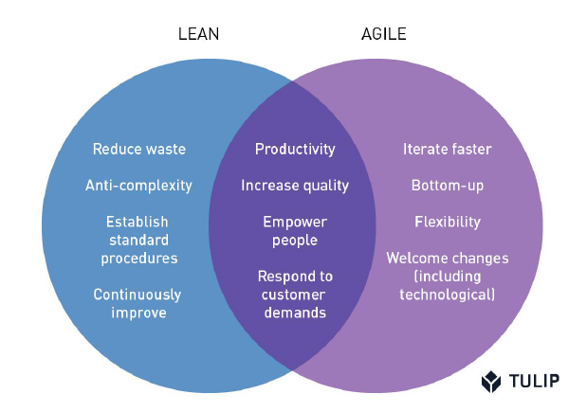
Agile Manufacturing Principles
Lean Manufacturing is focused on increasing efficient by reducing waste.
Agile Manufacturing aims to increase efficiency via flexible, parallel problem solving.
Notes:
TULIP, Agile Manufacturing – A Complete Guide

Slide 12
Key Principles of Agile Manufacturing
1. Iterate Faster
The idea of delivering smaller pieces of value more frequently is central to Agile Manufacturing
To rapidly produce multiple versions
Iterations allow process engineers to test different solutions and gather data on individual variables.
2. Flexibility
In order not to bend under external forces, manufacturing companies need to have flexible systems
Company’s internal structure needs to be dynamic enough to rebound quickly from external disruptions.
Notes:
TULIP, Agile Manufacturing – A Complete Guide

Slide 13
Key Principles of Agile Manufacturing
3. Bottom-Up
Ideas and directives flow seamlessly between all layers of the company
Directors and managers give operators and shop floor workers a voice
The more operators, engineers, managers, and business executives collaborate, the more effective operations will be as a whole.
4. Augmentation
To enhance workers’ capabilities through technology
Humans will perform best if they have tools that enable them to evolve their work
From computer-vision assisted quality checks to error-proofing work instructions, Agile manufacturers use technology to help their people do more work, better
Notes:
TULIP, Agile Manufacturing – A Complete Guide

Slide 14
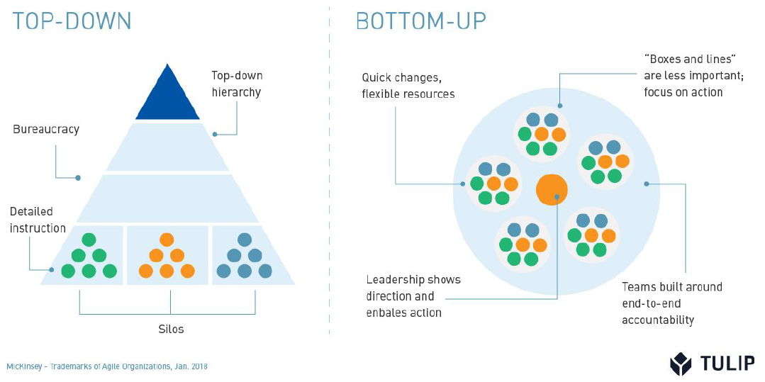
Key Principles of Agile Manufacturing
Notes:
TULIP, Agile Manufacturing – A Complete Guide

Slide 15
Applications of Agile Manufacturing
To iterate faster, Agile manufacturers turn to technologies that help them collect data. To become flexible, tools and software that enable quick turnovers are essential. To follow a bottom-up approach, Agile manufacturers award their workers more trust and power. To augment their workers, they equip them with the proper tools and training.
Notes:
TULIP, Agile Manufacturing – A Complete Guide

Slide 16
Applications of Agile Manufacturing
Using Real-Time Data to Guide Iteration
Contract manufacturer Jabil supports a wide variety of customers and is subject to fast-changing requirements. Moreover, Jabil’s customers need to receive their products as fast as possible. This means Jabil also had to increase its speed.
Thus, non-value-add steps had to be identified and eliminated quickly. The only way to achieve this is to run processes again and again, and collect data on each iteration. Jabil started using IoT connected tools and sensors to collect real-time data on every iteration. This data, collected through the use of a manufacturing app platform, allowed process engineers to incorporate feedback after each process completion.
Notes:
TULIP, Agile Manufacturing – A Complete Guide

Slide 17
Applications of Agile Manufacturing
Using 3D Printing to Prototype Faster
New prototypes no longer need to be designed and manufactured in a process that can take months. Rather, they are simply printed and tried immediately. Products are thus tested early and often, and improvements are made with each version. The result: optimal end products that satisfy customer demands.
Using Computer Vision to Augment Operators
When used to assist operators in line, computer vision systems can help fatigued workers detect defects, and provide error proofing in complex assemblies where workers or prone to miss or mis-execute steps. With computer vision assisting with cognitively taxing tasks, operators have more attention and focus for problem-solving and innovation.
Notes:
TULIP, Agile Manufacturing – A Complete Guide

Slide 18
Applications of Agile Manufacturing
Using Manufacturing Apps to Amplify Training Programs
At Merck, interactive training apps with step-by-step work instructions were a game changer. The photos, videos and live stream sensor data transformed the training experience, making it more interactive and constructive. The new training program augmented workers’ capabilities: rather than using technology to automate workers’ tasks
Using Digital Work Instructions to Error-Proof High-Mix Assemblies
A senior process engineer at Dentsply created an app to simplify the kitting process. The app was connected to IoT devices like pick-to-lights and break beams that would guide workers to the bin with the right part from for each kit. Process engineers were able to improve the process by building the apps themselves. They no longer needed to go through IT or get the change reapproved as part of their Quality Management System. Moreover, production became as flexible as Dentsply’s customized products required it to be.
Notes:
TULIP, Agile Manufacturing – A Complete Guide

Slide 19
Digital Manufacturing or Agile Manufacturing?
Notes:
Discover difference between agile and digital manufacturing, https://www.sculpteo.com/blog/2016/09/28/digital-manufacturing-or-agile-manufacturing/

Slide 20
Digital Manufacturing or Agile Manufacturing?
Agile manufacturing is the capacity to adapt to the market. A whole production line can change from one day to the other to produce a brand-new product. Agile manufacturing is concentrated on efficiency of the production line and the capacity of compiling all the company resources to adaptation. This away, it will rather resist to a moving environment.
In comparison, digital manufacturing is a process, that allows to adapt to the market. It enables quick prototyping and furnishes close-to-reality testing. Production is then more efficient and more focused on the consumers’ needs. Thanks to digital manufacturing, it is possible to plan small productions and therefore work in real-time inventory monitoring. Digital manufacturing is not only about production, it incorporates the whole design and testing process, in low cost and short time.
Notes:
Discover difference between agile and digital manufacturing, https://www.sculpteo.com/blog/2016/09/28/digital-manufacturing-or-agile-manufacturing/

Slide 21
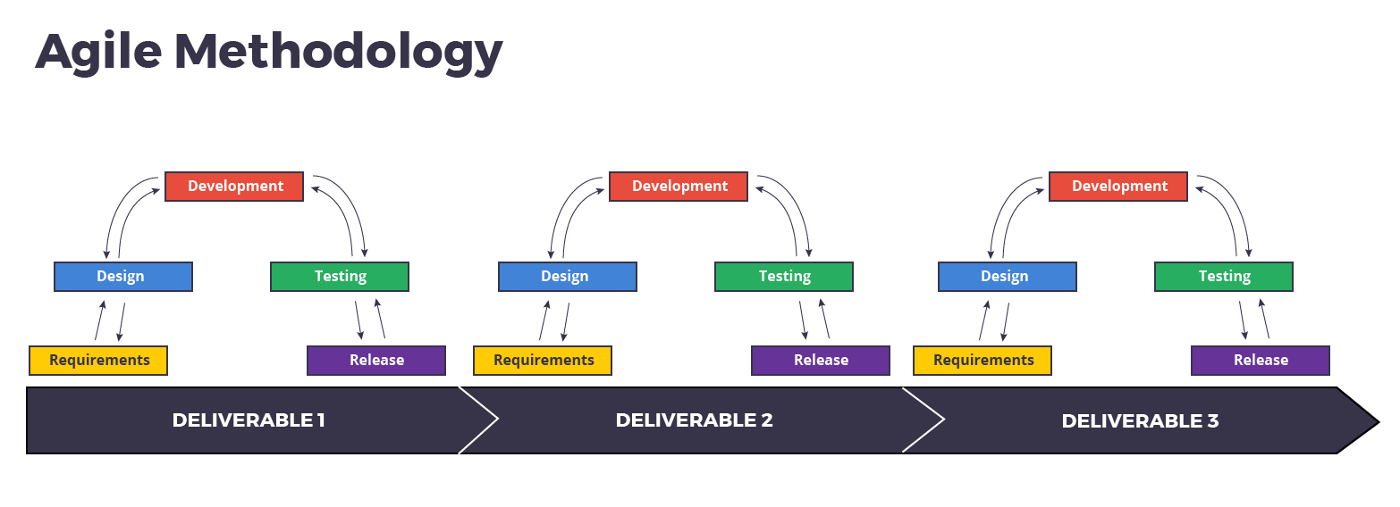
Digital Manufacturing or Agile Manufacturing?
However, digital manufacturing allows to strengthen agile manufacturing
Digital manufacturing can strengthen agile manufacturing. In fact, agile manufacturing is constantly trying to reach efficiency through adaptivity to the market. And digital manufacturing allows the company, through rapid prototyping and more generally quick production mode and small series to adapt to the consumers’ need.
Notes:
Discover difference between agile and digital manufacturing, https://www.sculpteo.com/blog/2016/09/28/digital-manufacturing-or-agile-manufacturing/

