Slide 1
Intelligent Decision Support Systems
The need of Decision Support Tools

Slide 2
Complexity of Real-world Systems/Domains
-They are systems, domains, problems, etc. existing in the daily real life of human beings, and that normally show a strong complexity for their understanding, analysis, management or solving
-They imply several decision-making tasks very complex and difficult, which usually are faced up by human experts
-Some of them, in addition, could have catastrophic consequences either for human beings or for the environment or for the economy of one organization

Slide 3
Complexity of Real-world Systems/Domains
Examples
Industrial Process Management Systems/Domains
Environmental System/Domains
Medical System/Domains
Business Administration & Management Systems/Domains
Marketing
Decisions on products and prices
Decisions on human resources
Decisions on strategies and company policy

Slide 4
Need for Decision Support Tools
Complexity of the decision-making process
Accurate evaluation of multiple alternatives
Need for forecasting capabilities
Uncertainty
Data analysis and exploitation
Need for including experience and expertise (knowledge)

Slide 5
Need for Decision Support Tools
Computational tools
Decision Support Systems
(DSS)
Intelligent Computational tools
Intelligent Decision Support Systems
(IDSS)

Slide 6
Decision Theory
Negotiation-based decisions, based on the notion of negotiation:
Routine decisions
Creative decisions
Negotiated decisions

Slide 7
Decision Theory
Activity-based decisions, attention focused with the most associated activity to the decision:
Entrepreneurial activities
Adaptive activities
Planning activities

Slide 8
Decision Theory
Strategy-based decisions, primary strategy used in making the final choice:
Computational strategies
Judgmental strategies
Compromise strategies
Inspirational strategies

Slide 9
Decision Theory – Types of decision
Structured Decisions
Low uncertainty - Operational
Stable context - Routine
Commonplace, ordinary - Entrepreneurial activity
Recurrent - Computational strategies
Programmable - Near-term
Easily accessible information - Proactive
Decision criterion understood
Focused decision strategy

Slide 10
Decision Theory – Types of decision
2. Semi-structured Decisions
Middle/High uncertainty - Mostly commonplace
Medium-stable context - Semi-programmable
- Tactical/management decision - Short-term
Appear sometimes in a year - Reactive
Compromise – Judgmental strategy - Creative
Partially accessible information
Partially decision criterion understood
Partially focused decision strategy

Slide 11
Decision Theory – Types of decision
3. Unstructured Decisions
Middle/High uncertainty - Mostly commonplace
Medium-stable context - Semi-programmable
- Tactical/management decision - Short-term
Appear sometimes in a year - Reactive
Compromise – Judgmental strategy - Creative
Partially accessible information
Partially decision criterion understood
Partially focused decision strategy

Slide 12
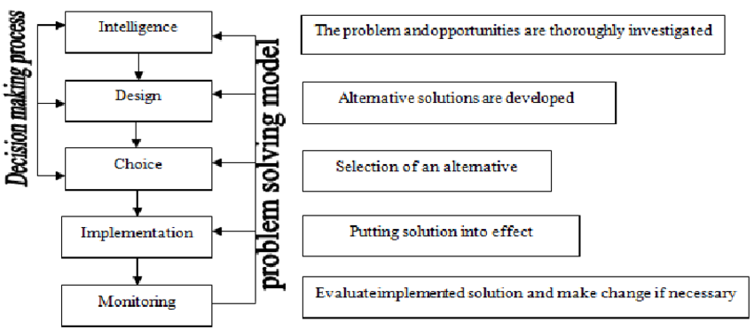
Decision Making
A decision is defined as a process of choosing among alternative courses of action for the purpose of attaining a goal or goals.
Notes:
Ahmad Tariq, Khan Rafi, 2012, Intelligent Decision Support Systems- A Framework, Information and Knowledge Management, Vol 2, No.6

Slide 13
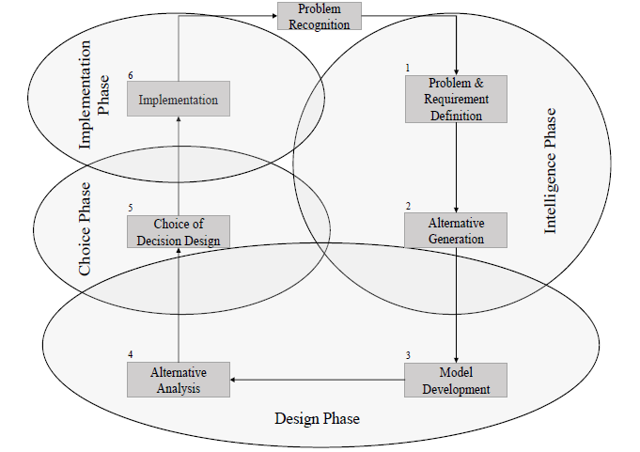
Decision Making
Notes:
Andreas Felsberger, Bernhard Oberegger, Gerald Reiner, A Review of Decision Support Systems for Manufacturing
Systems, SamI40 workshop at i-KNOW ’16 October 18–19, 2016, Graz, Austria

Slide 14
Decision Support System
Decision support system – a specific class of information system that supports business and organizational decision-making activities.
Features:
- Interactive, flexible, and adaptable computer-based systems
- Solve unstructured problems or semi-structured problems
- Supporting ad-hoc data analysis and decision modeling
- Used at irregular, unplanned intervals
Notes:
Ahmad Tariq, Khan Rafi, 2012, Intelligent Decision Support Systems- A Framework, Information and Knowledge Management, Vol 2, No.6

Slide 15
Decision Support System

Slide 16
Decision Support System
Various factors that induce organizations to implement DSS are:
Speed – very quickly and low cost by a computer-based system
Productivity – avoids assembling a group of people at a place
Support – no need of a human expert
Decision quality – providing several alternatives
Competitive advantage – facilitate research, product customization, customer service
Vast processing and storage – limitless in process ability and information storage
Popular computer use – use ICT with less anxiety
Notes:
Ahmad Tariq, Khan Rafi, 2012, Intelligent Decision Support Systems- A Framework, Information and Knowledge Management, Vol 2, No.6

Slide 17
Case Study
A Smart Home Energy Management Systems (HEMS)
Motivation: HEMS should be more flexible in managing and controlling smart home appliances, renewable energy resources, and home energy storage systems. Active control services can be provided to consumers on the basis of HEMS in terms of automatic and adaptive systems.
Concept: Internet of Agent framework in terms of sensing, communicating and collaborating among connected appliances.
Methods: Consensual negotiation mechanism for dynamic scheduling connected appliance
Results: Reduce the electricity demand during peak hours.
Notes:
Khac-Hoai Nam Bui, Jason J. Jung, and David Camacho, 2018, Consensual Negotiation-Based Decision Making for Connected Appliances in Smart Home Management Systems, Sensors 2018, 18

Slide 18
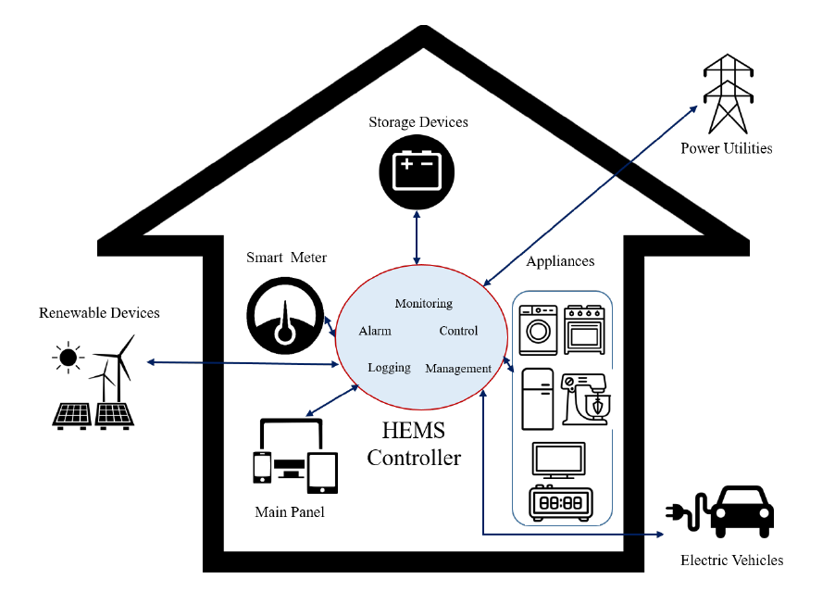
Case Study
Overall architecture of the Home Energy Management System (HEMS)
Notes:
Khac-Hoai Nam Bui, Jason J. Jung, and David Camacho, 2018, Consensual Negotiation-Based Decision Making for Connected Appliances in Smart Home Management Systems, Sensors 2018, 18

Slide 19
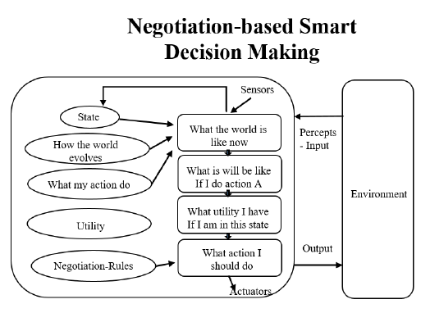
Case Study
The models of negotiation approach:
Theoretical models – describing, specifying, and reasoning about the key feature
Computational models – specifying the key data structures of negotiating agents and the processes operating on these structures.
Notes:
Khac-Hoai Nam Bui, Jason J. Jung, and David Camacho, 2018, Consensual Negotiation-Based Decision Making for Connected Appliances in Smart Home Management Systems, Sensors 2018, 18

Slide 20
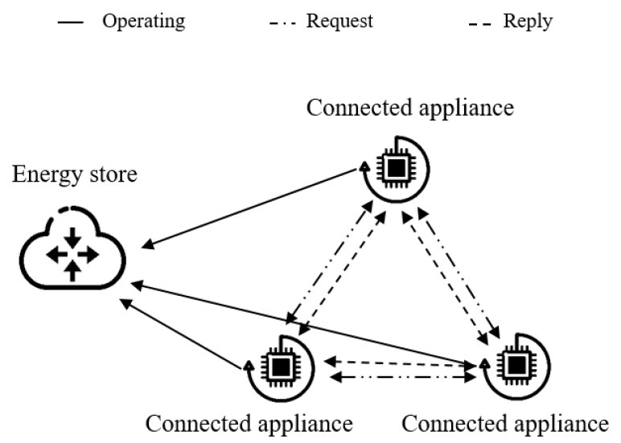
Case Study
The negotiation process among connected appliances use the inter-process communication the includes Request and Reply messages.
Notes:
Khac-Hoai Nam Bui, Jason J. Jung, and David Camacho, 2018, Consensual Negotiation-Based Decision Making for Connected Appliances in Smart Home Management Systems, Sensors 2018, 18

Slide 21
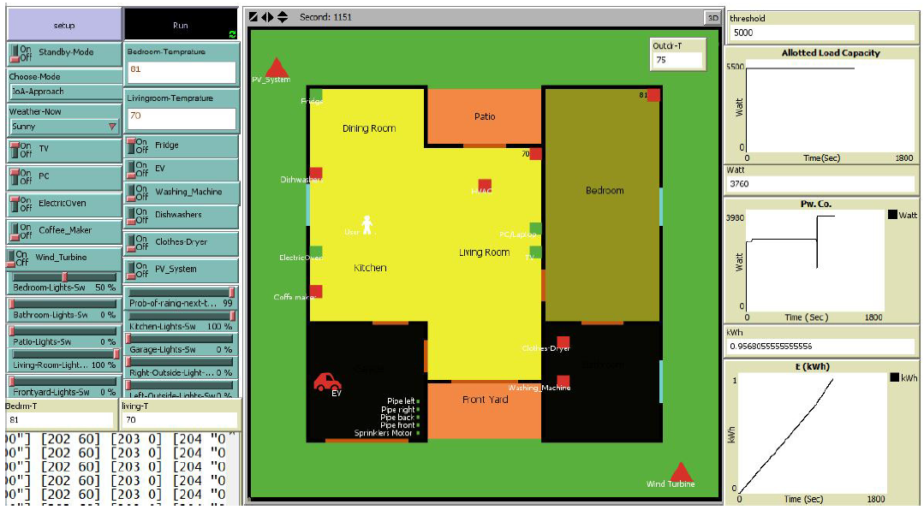
Case Study
Simulated interface of smart HEMS
Notes:
Khac-Hoai Nam Bui, Jason J. Jung, and David Camacho, 2018, Consensual Negotiation-Based Decision Making for Connected Appliances in Smart Home Management Systems, Sensors 2018, 18

