Slide 1
Intelligent Decision Support Systems
IDSS Architecture, Analysis, Design, Requirement, and Validation

Slide 2
IDSS Architecture
Decision process is analogous to that of a group of decision makers, who cooperate with each other in generating a composite solution
Each agent has a knowledge base pertaining to a specific area within the problem-solving domain and the expertise to solve problems from that area
Coordination and cooperation among the agents is effected by a controller that exercises control over these agents
The IDSS is designed to support decision making actively
Notes:
H. Raghav Rao, Ramalingam Sridhar and Sudeep Narain, 1994, An active intelligent decision support system - Architecture and simulation, Decision Support Systems 12 (1994) 79-91

Slide 3
IDSS Architecture
CONTROLLER
Facilitating Element
USER
TASK Allocator
Conflict Resolver
History
Recorder
Decision
Knowledge Processor 1
Knowledge Processor 2
Knowledge Processor 3
Knowledge Processor n
MESSAGE BOARD
Notes:
H. Raghav Rao, Ramalingam Sridhar and Sudeep Narain, 1994, An active intelligent decision support system - Architecture and simulation, Decision Support Systems 12 (1994) 79-91

Slide 4
IDSS Architecture
Controller
In developing a solution to a given problem, the controller uses
The Facilitating Element (FE) to communicate with the user
The model subsystem to select a suitable model for solving the problem
The data subsystem to perform all data related tasks
A knowledge subsystem to generate a single or a set of alternate solutions
Notes:
H. Raghav Rao, Ramalingam Sridhar and Sudeep Narain, 1994, An active intelligent decision support system - Architecture and simulation, Decision Support Systems 12 (1994) 79-91

Slide 5
IDSS Architecture
Controller
Task Allocator - Allocate subproblems to the processors in the knowledge subsystem
Conflict Resolver - The resolution of conflicts of variables within the knowledge subsystem
Notes:
H. Raghav Rao, Ramalingam Sridhar and Sudeep Narain, 1994, An active intelligent decision support system - Architecture and simulation, Decision Support Systems 12 (1994) 79-91

Slide 6
IDSS Architecture
Facilitating element
The facilitating element (FE) incorporates the communication interface between the user and the IDSS.
This interface is implemented as a menu-driven interface in which the IDSS presents its queries to the user in the form of a menu with alternate selections.
The FE has the ability to interpret such a response by parsing through the text
History recorder
Record the various steps taken in the decision process.
Answering various queries of the user.
Notes:
H. Raghav Rao, Ramalingam Sridhar and Sudeep Narain, 1994, An active intelligent decision support system - Architecture and simulation, Decision Support Systems 12 (1994) 79-91

Slide 7
IDSS Architecture
Data subsystem
The data subsystem stores factual information about the problem solving domain in general and the current problem in particular.
Provide data to the computing elements and the user during the problem solving process
Part of the controller subsystem
Model subsystem
Stores typical problem solving techniques for the problem solving domain.
Provide analytical and mathematical models to the computing elements
Notes:
H. Raghav Rao, Ramalingam Sridhar and Sudeep Narain, 1994, An active intelligent decision support system - Architecture and simulation, Decision Support Systems 12 (1994) 79-91

Slide 8
IDSS Architecture
Knowledge subsystem
The knowledge subsystem of the IDSS contains the knowledge of the problem solving domain.
Each of these processors, called a knowledge processor (KP), contains knowledge in a specific domain and functions under the direction of a centralized controller
These knowledge processors implement the knowledge source of the system.
Message board
The means for communication among the KPs.
Memory subsystems that can store data structures to be used by various parts of the knowledge subsystem
Notes:
H. Raghav Rao, Ramalingam Sridhar and Sudeep Narain, 1994, An active intelligent decision support system - Architecture and simulation, Decision Support Systems 12 (1994) 79-91

Slide 9
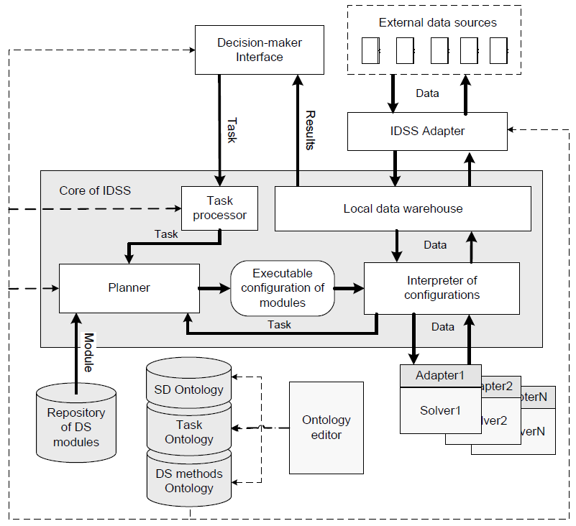
IDSS Architecture
Notes:
Yury Zagorulko, Galina Zagorulko, 2011, Architecture of Extensible Tools for Development of Intelligent Decision Support Systems,

Slide 10
IDSS Architecture – Case Study
Simulation-Based Intelligent Decision Support System
Simulation-based IDSS constitutes the framework of adaptive controller supporting the co-ordination and co-operation relations by coupling a real time simulator, a simulation optimizer and an intelligent DSS for implementing dynamic strategies
The simulation-based IDSS uses a posteriori adaptive real time machining process-monitoring mechanism that also in online control method acting after the event occurs versus such popular reactive control method
The adaptive controller proposed a new bilateral mechanism for simulation optimization based on appropriate control rules that enhance multi performance criteria simulation optimization efficiency
The expected values of multiple performance criteria are controlled by the proposed system at different level of controllable parameters vector
Notes:
I. Mahdavi and B. Shirazi, 2010, A review of simulation-based intelligent decision support system architecture for the adaptive control of flexible manufuctring systems, Journal of Artificial Intelligent 3 (40) 201-219

Slide 11
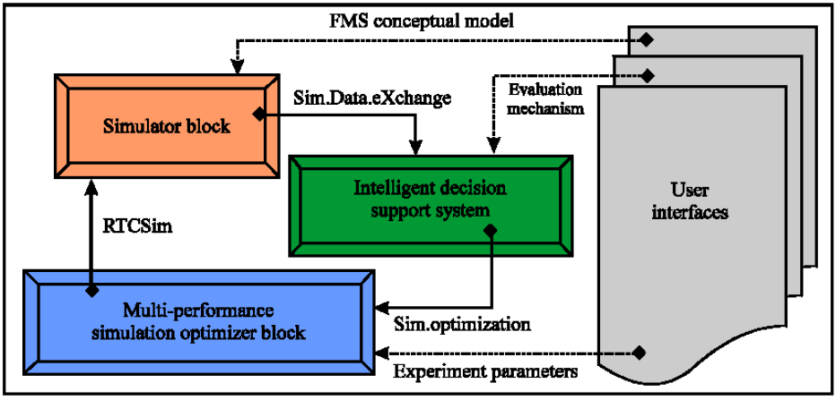
IDSS Architecture – Case Study
Notes:
I. Mahdavi and B. Shirazi, 2010, A review of simulation-based intelligent decision support system architecture for the adaptive control of flexible manufuctring systems, Journal of Artificial Intelligent 3 (40) 201-219

Slide 12
IDSS Architecture – Case Study
Notes:
I. Mahdavi and B. Shirazi, 2010, A review of simulation-based intelligent decision support system architecture for the adaptive control of flexible manufuctring systems, Journal of Artificial Intelligent 3 (40) 201-219

Slide 13
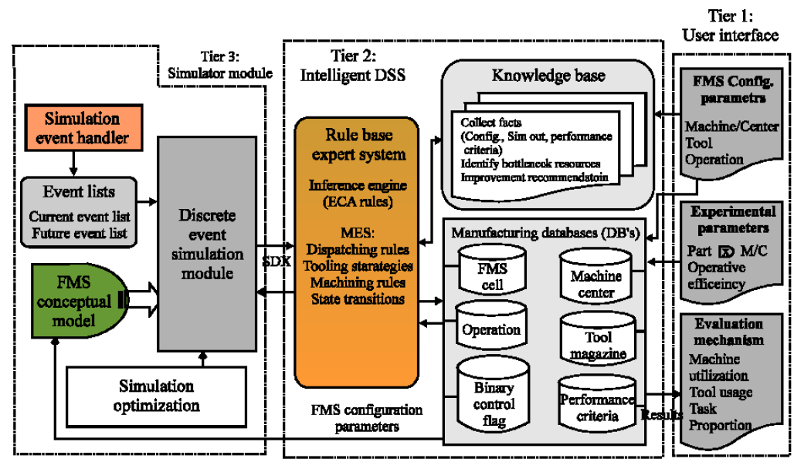
IDSS Architecture – Case Study
Notes:
I. Mahdavi and B. Shirazi, 2010, A review of simulation-based intelligent decision support system architecture for the adaptive control of flexible manufuctring systems, Journal of Artificial Intelligent 3 (40) 201-219

Slide 14
IDSS Architecture – Case Study
An Ambient Intelligence-Based Decision Support System to Enhance Production and Control Planning
To change the actual process, which includes automate parts of the process with information systems, optimize and improve efficiency in the processes, as well as reduce errors
The architecture consists of a Core Server that is composed by four components: Database Handler, Authentication Agent, Standard Worksheet Handler and Standard Worksheet Engine
Notes:
Marco Gomes, F´abio Silva, Filipa Ferraz, Ant´onio Silva, Cesar Analide and Paulo Novais, Developing an Ambient Intelligent-Based Decision Support System for Production and Control Planning, International Conference on Intelligent Systems Design and Applications, ISDA 2016, pp 984-994

Slide 15
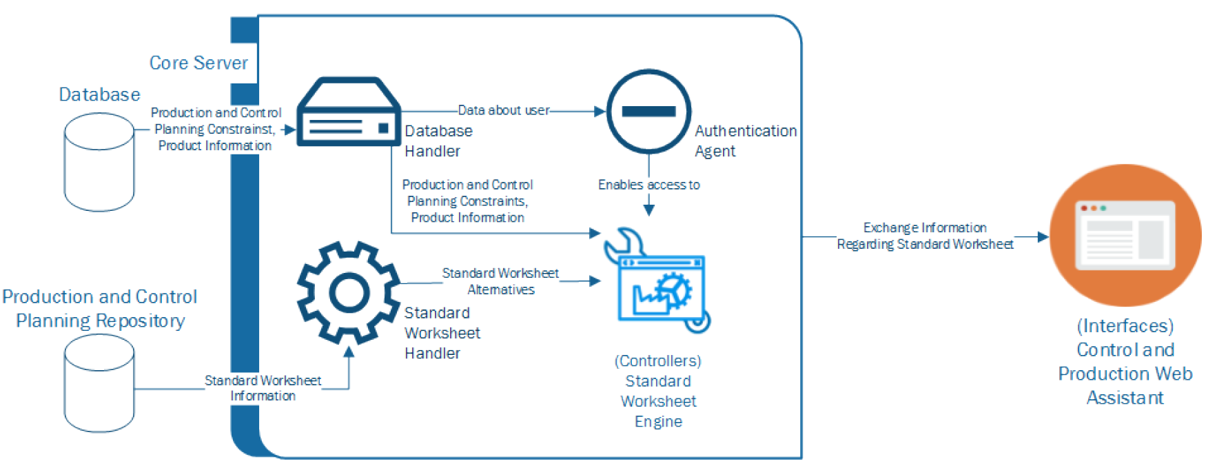
IDSS Architecture – Case Study
Notes:
Marco Gomes, F´abio Silva, Filipa Ferraz, Ant´onio Silva, Cesar Analide and Paulo Novais, Developing an Ambient Intelligent-Based Decision Support System for Production and Control Planning, International Conference on Intelligent Systems Design and Applications, ISDA 2016, pp 984-994

Slide 16
IDSS Architecture – Case Study
Database Handler is responsible to manage the access to the database, containing the constraints of production and control planning, the product information, the work instructions, the table of precedence (which gives the flow between the stations), the tasks to be performed by the operators, etc.
Authentication component is responsible for authenticating the user into the system
Standard Worksheet Handler manages the access to standard worksheets information in Production and Control Planning Repository
Standard Worksheet Engine interprets all the control and planning constraints, product information, the work instructions and provide standard worksheets alternatives
Notes:
Marco Gomes, F´abio Silva, Filipa Ferraz, Ant´onio Silva, Cesar Analide and Paulo Novais, Developing an Ambient Intelligent-Based Decision Support System for Production and Control Planning, International Conference on Intelligent Systems Design and Applications, ISDA 2016, pp 984-994

Slide 17
IDSS Requirements
Type of decision problem (policy, operations, resource allocation, etc.)
Domain and scope of the decision problem
Data and knowledge availability
Organizational and structural boundaries
Decision-making process
Impact on and synergy with the existing systems
Expected consequences of decision execution
Profiles of decision-makers (users of the system)
External constraints and contexts
Objectives of the IDSS

Slide 18
IDSS Validation
IDSS Validation Criteria
System Performance
Efficiency and response time
Data entry
Output format
Hardware
Usage
Man-machine interface
Task performance
Decision-making time, alternatives, analysis, quality and participants
User perceptions of trust, satisfaction and understanding

Slide 19
IDSS Validation
IDSS Validation Criteria
Business Opportunities
Costs of development, operation, and maintenance
Benefits associated with increased income and reduced costs
Value to the organization of better service, competitive advantage, and training
Evolutionary Aspects
Degree of flexibility, ability to change
Overall functionality of the development tool

Slide 20
IDSS Validation – Case Study
Mid Life Upgrade (MLU) project
The project budget is approximately 20 M$, with a time frame of 4 years from start to delivery to customer.
The project includes a process of VVT as well as an evaluation by the customer.
The project combines software design, development of hardware, and an upgrade to the avionics of an existing system and also some additional operational capabilities.
Customer evaluation would include validation of customer requirements and also verifying some engineering requirements that were claimed to be verified by the project manager at the company test sites
Notes:
Jacob Shabi, Yoram Reich and Roee Diamant, 2017, Planning the verification, validation, and testing process: a case study demonstrating a decision support model, JOURNAL OF ENGINEERING DESIGN

Slide 21
IDSS Validation – Case Study
Mid Life Upgrade (MLU) project
VVT methods - verify, validate, and test
The validation of the customer requirements was performed during the System Requirement Review
The following four VVT methods (l = 4) were used for performing the required VVT activities.
(1) VVT by Analysis (A): A product is verified by using analytical data or model simulations in order to exhibit theoretical compliance. Examples include structural analysis to verify compliance to static or dynamic load requirements, Fault Tree Analysis (FTA) to verify compliance to safety requirements, or model simulations.
Notes:
Jacob Shabi, Yoram Reich and Roee Diamant, 2017, Planning the verification, validation, and testing process: a case study demonstrating a decision support model, JOURNAL OF ENGINEERING DESIGN

Slide 22
IDSS Validation – Case Study
Mid Life Upgrade (MLU) project
(2) VVT by Testing (T): This method of VVT, for example, laboratory testing such as random vibration testing, is used to activate or operate the product under specified conditions and observe or record the exhibited behaviour by means of test equipment. We refer to performing tests of components or functions at the subsystem level.
(3) VVT by Simulations (S): The product is verified by performing simulation tests at a flat site with hardware in the loop and at the system level.
(4) VVT by Demonstration (D): The product is verified by operating in a real-life environment, and by performing tests or runs on real systems (hardware and software).
Notes:
Jacob Shabi, Yoram Reich and Roee Diamant, 2017, Planning the verification, validation, and testing process: a case study demonstrating a decision support model, JOURNAL OF ENGINEERING DESIGN

