Slide 1
PM4I4.0 – Project Presentations - Assessment
Rui M. Lima
(School of Engineering of University of Minho)
Notes:
This course is designed to help students to develop competences related to Project Management in context of Industry 4.0.
In order to accomplish this objective, the main assumption is the need to use student-centered learning approaches for competence development. In this course we propose to use a project-based learning approach to solve open problems, which is known as one of the main strategies to give autonomy to the student in the development of competences.
Additionally, we use this project has one of the ways of bringing Industry 4.0 into the content. Students will have to develop their knowledge and skills in this context developing a project related with I4.0 with companies.
Another way to bring I4.0 to the content is through the use of agile approaches and collaborative and multicultural project management content in a new era of digitalization, which are the main requirements in this new era for project management.

Slide 2
Overall Assessment Schema
Assessment Scheme: The final grade will be computed according to the following weight distribution: Individual weekly portfolio entries (10%); overall global portfolio (40%); project presentation and discussion (50%). These will be divided in Oral communication (40%); Written communication (20%); Presentation (10%); Peer Assessment (10%) and Personal Development (20%).
An “A” would be awarded if a student can demonstrate clearly effective project management competences for industry 4.0.
A “B” would be awarded if a student can show good progress on project management competences for industry 4.0.
A “C” would be given if a student can show reasonable progress on project management competences for industry 4.0.
A “D” would be given if a student shows a lack of improvement in project management competences for industry 4.0

Slide 3
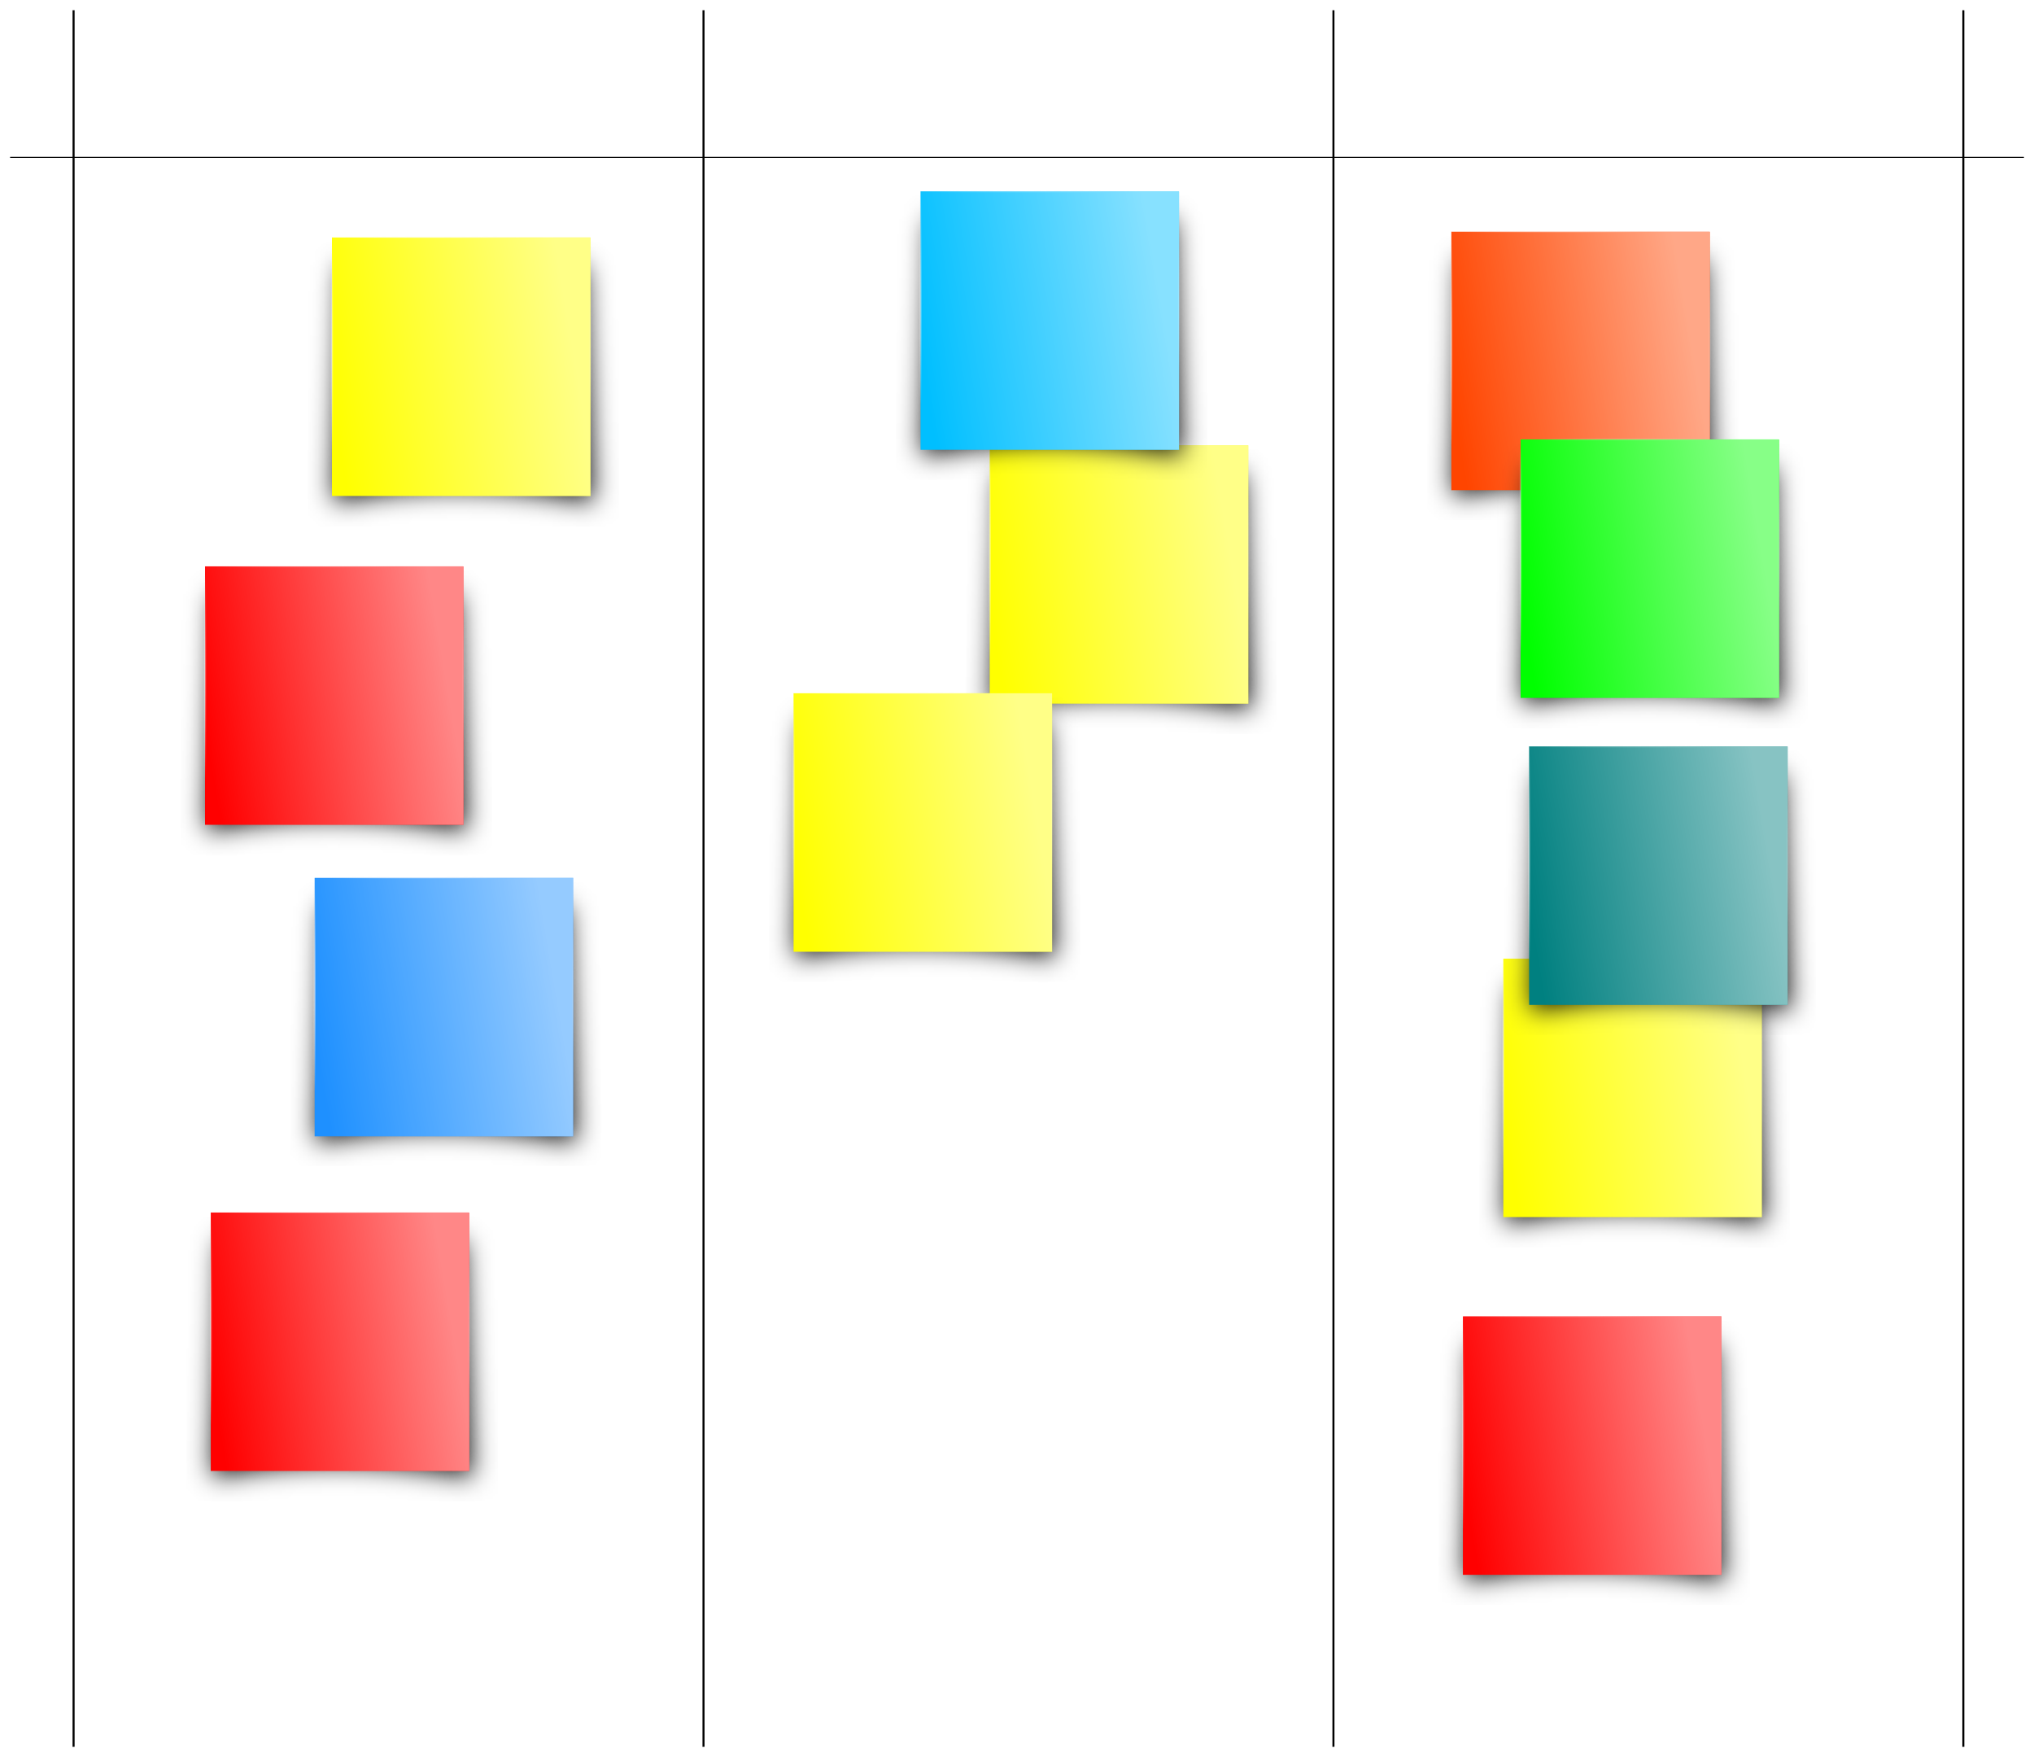
Assessment – Project presentation
Present in poster form in 10 minutes and defend, including discussion and feedback
  Project Plan
  Execution and monitoring process
  Outcome
TODO
DOING
DONE
http://pmcanvas.com.br/download/

