Slide 1
Workshop - Creating and validating the I4.0 maturity self-diagnosis model
Rui M. Lima, Cristiano Jesus
(School of Engineering of University of Minho)

Slide 2
Maturity levels (Acatech)
Computerization - use of information technology;
Connectivity - integration of IT tools;
Visibility - sensors allow processes to be monitored from end to end;
Transparency - digital shadow indicates the current situation;
Predictive capacity - ability to simulate scenarios;
Adaptability - ability to adapt continuously.

Slide 3
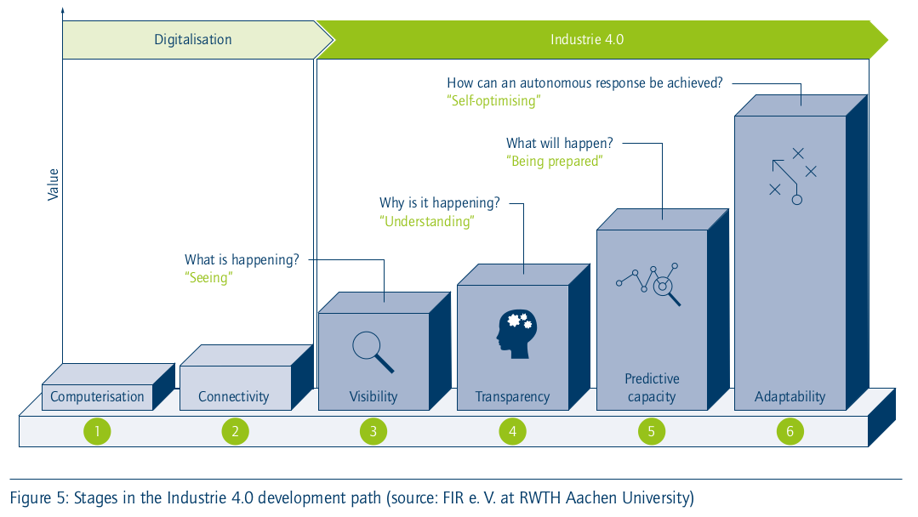
Maturity levels (Acatech)

Slide 4
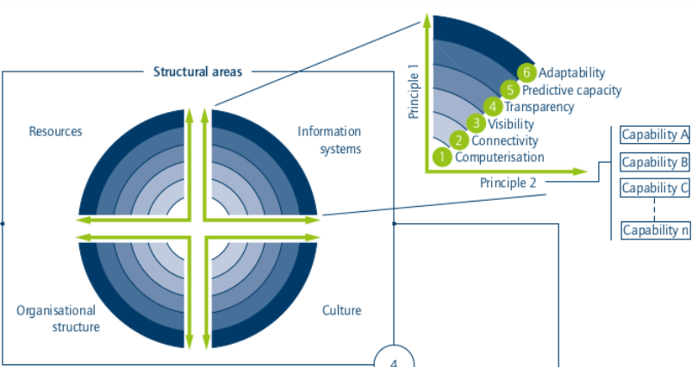
Maturity index (Acatech)

Slide 5
Project + Portfolio
What progress have you identified in your project this week? What did you do for your project this week? What do you plan to do next week? Can you relate project events to Project management skills? Describes examples.
What skills have you reinforced this week with classes? What content and / or activities had the most impact or were the most relevant? What questions or concerns would you like to resolve? Do you have extra comments to add? Give specific examples, relating to project management.

