Slide 1
Project Management monitoring and control – coaching for project management
Diana Mesquita, Rui M. Lima
(University of Minho, Portugal)
Notes:
These are the slides for coaching in project management.
This topic aims to provide knowledge and tools to improve the interpersonal relationship and communication between the team members.
In this sense, it is recommended to include an active learning approach, linking theory and practice during the session.

Slide 2
What is not coaching?
Psychotherapy?
No, because coaching is all about the future.
Mentoring?
No, because coaching is a process to find out the answers.
Socratic method: “I know that I know nothing”
Consulting / Training?
No, because coaching implies an action to change a situation.
Notes:
Before show this slide, the instructor should present an open-ended question to the students: what is your understanding about “coaching”?
Digital tools can be used, for instance, mentimeter (word cloud) or similar. It is important to know what the students know about the topic before starting the discussion.
After that, it is important to clarify the misunderstandings about coaching, taking into account some similarities with other terms: psychotherapy, mentoring, consulting / training. With this in mind, it is possible to identify if the students’ perceptions (based on their previous answers) are aligned or not with some of these terms.

Slide 3
What is coaching?
Coaching is a process aiming at developing, challenging, supporting and enabling people to develop their full potential in professional and personal contexts, using a set of strategies (e.g. questioning).
Notes:
Now, the focus is what the coaching means, highlighting the idea of:
Process – Potential – Questioning.
This suggest the ambience of the session: is going to be a process, in which the students will be challenge to develop some of their potential by making questions and finding their answers. The coach have the questions but only the client have the answers!

Slide 4
Joseph Jastrow (1900)
https://commons.wikimedia.org/wiki/File:Duck-Rabbit_illusion.jpg
Notes:
An interesting way to illustrate what coaching is relevant to develop our potential, is the Duck-Rabbit Illusion.
The instructor should ask to the student what they see in the image. Some of them will answer the “Duck”, some will answer the “Rabbit” and some will answer “both”.
This means that we all see the reality in different perspectives, but we have the potential to see the big picture. We just need to know hoe to get there.
That is why we need a coach [link with the next slide].

Slide 5
Why coaching?
QUESTIONS
AHA MOMENT
MINDSET CHANGE
Notes:
The coach must be able to make key-questions …
This will provide self-awareness about a new perspective about the reality
Enhancing a mindset change which is essential to develop the potential to another level

Slide 6
Speed Coaching
Notes:
Practical exercise – Speed Coaching:
Students must have a partner; they must to define which one is going have the letter “A” and “B”.
In the first round the A is the coach and the B is the client; so, the A will have 2 minutes to make questions about a specific topic selected by the instructor and the B must to answer. The topic must be open in order to give the opportunity for the coach to make the questions about it. Examples of the topics: Future professional practice; Industry 4.0; Experience in working in teams and projects; … the instructor should be creative!
After the 2 minutes, change the roles (B is now the coach and A the client) and changing the topic it is also recommended.
The objective of this exercise is to provide an engaging experience about coaching in practice. Besides, the students have the opportunity to interact to each other in a different environment.

Slide 7
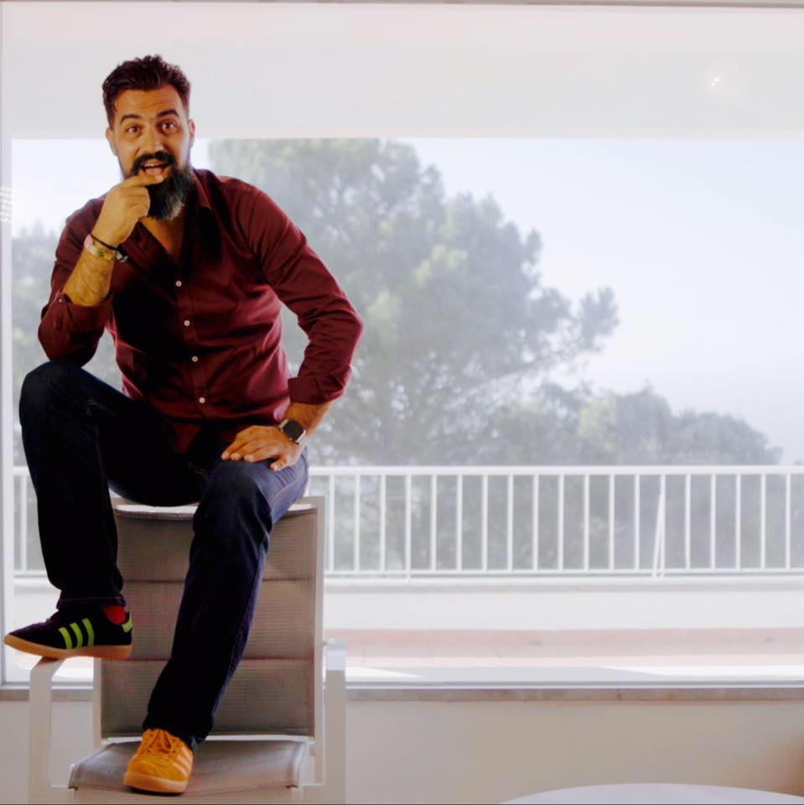
How to do coaching?
ROSA – is a methodology that includes four steps to carry out a coaching session.
Daniel Sá Nogueira
We Create / World Coaching Organization
“Trata a vida por tu”
Photo: https://www.facebook.com/Daniel.sa.nogueira
Notes:
Now, the focus is to learn how to do coaching using a methodology to structure and organize a coaching session.
There are a wide range of different methodologies – R.O.S.A. was develop by Daniel Sá Nogueira and includes four steps to carry out a coaching session.

Slide 8
ROSA
Reality
3.0
2.5
2.0
1.0
Objectives
Solutions
Action
Notes:
The instructor should present what R.O.S.A. and must to emphasize that there are four levels of the R.O.S.A.

Slide 9
ROSA
Reality
3.0
2.5
2.0
1.0
Objectives
Solutions
Action
Notes:
The first level is R.O.S.A. 1.0 – includes the basic tools to put coaching in practice and works in different contexts (personal – with friends, family; professional – team members; etc.). In short, anyone can apply this level of coaching!
The R.O.S.A. 1.0 will be presented in the following slides, with some practical exercices.

Slide 10
(R) - Reality
Reality
What is going on?
Notes:
The key-question in the first step (R) is: what is going on?
The idea is to understand the starting point where the client is.

Slide 11
(R) – Pizza of Life
Notes:
The tool for (R) is the Pizza of Life – it is the original one.
Is an interesting exercise to get an overview about several life areas. Most of all, it is a self-evaluation process, oriented by the coach but created by the client.

Slide 12
SPIRITUAL
MENTAL
Personal Leadership
(me)
Peer Group
Life Purpose
(values)
Hobbies & Social Life
Life Meaning
(world)
Personal Development
10
0
Money
Contribution
(others)
Health
Family & Friends
PRACTICAL
Work & Career
Romance
EMOTIONAL
Based on Nogueira (2014)
Notes:
An overview of the pizza of life is presented to the students, providing how the original one is organized.
In the context of project management the pizza of the next slide it is more suitable and interesting!

Slide 13
(R) – Pizza of Team
Notes:
The Pizza of Life was adapted to the Team environment.

Slide 14
SPIRITUAL
MENTAL
Motivation
Creativitiy
Leadership
Critical Thinking
Myself in the team
(how I feel in the team)
Competences
(role and responsabilities in the project)
10
0
Relationshiop with other stakeholders (university, companies, etc.)
Accomplishment of tasks and objectives
Time Management
Relationship with team members
PRACTICAL
Project Outcomes
Relationship with team members
EMOTIONAL
Diana Mesquita
Notes:
The overview of this pizza is presented by the instructor and students must be encourage to create their own.
To fill the pizza the instructor must consider the following process:
For each slice of pizza the client must ask to themselves: “In this moment, between 0 and 10, how satisfied I am with …” and highlight in the slice.
Example:
Coach - “Between 0 and 10, how satisfied I am with the project outcomes (slice 3)?”
Client – 7 (and must highlight the slice in that mark, filling it – like the image in the slide 10).
Important: it is an individual exercise, there is no right or wrong. It is a self-evaluation and the coach do not provide any opinion or though about the final results. But can make some questions in order to understand the mind of the client!

Slide 15
(O) - Objectives
Objectives
What do you want?
Notes:
The key-question in the second step (O) is: what do you want?
The idea is to understand where the client want to go.

Slide 16
(O) – SMART Objective
Specific
Measurable
Attainable
Relevant
Timebound
SMART (http://en.wikipedia.org/wiki/SMART_criteria)
Specific
(who, why, what, where, when, which)
Measurable
(how much, how many)
Attainable
(how can the goal be accomplished; what do you need; what competences)
Relevant
(worthwhile; now; needs; right person)
Timebound
(when)
Notes:
The tool for (O) is the SMART approach to define objective.
The coach must help the client to define a objective (by using SMART criteria). The objective must be linked to the pizza outcome – What to improve? Why? Etc.

Slide 17
(O) - Reticular Activating System (RAS)
https://paulnicklen.com/pn/wp-content/uploads/2018/11/mm7616-081002-30574_kbg-e1542580549789.jpg
Notes:
Another tool is the Reticular Activating System (RAS) and it is important to keep the focus on the objective.
The idea is to materialize the objective in a symbol, in order to be present in our routines.
Examples: image, password, post it in a wall, quote to repeat every day, etc.

Slide 18
(S) - Solutions
Solutions
How? Well done!
What else?
https://unsplash.com/photos/4Ennrbj1svk
Notes:
The key-question in the second step (S) is: How? Well done! What else?
The idea is to understand open possibilities. Everything is possible!
To understand this idea an exercise is proposed in the next slide.

Slide 19
Draw a watch!
obvious
interesting
creative
innovative
Notes:
Ask the students to draw a watch. Do not give more than 30/40 seconds to do the exercise.
Then ask to the students: “Who drawn a circular watch?” – probably most of them are going to rise the hand.
This means that when we need to take an action, first we have an obvious reaction (based in our references, previous experiences, etc.).
To achieve creative or innovative ideas (and, consequently, do things differently) we need to have many ideas!
The tool for (S) is creativity. Let’s work this muscle by doing some exercise with the students (slide 20 to 22).

Slide 20
Creativity - Exercises
https://unsplash.com/photos/M1ObxvsWVhY
Notes:
Imagine this scenario:
You won a travel for two, 10 days, all included to the …. Maldives.
Why this is not a good news?
The students must give ideas, open possibilities! Does not matter if makes or not sense. The objective is to work the creative process.
Encourage students to think out of the box!

Slide 21
Creativity - Exercises
https://unsplash.com/photos/sc5sTPMrVfk
Notes:
Imagine this scenario:
A recent study shows that 80% of the young people (15 to 20 years) have obesity.
Why this is good a news?
The students must give ideas, open possibilities! Does not matter if makes or not sense. The objective is to work the creative process.
Encourage students to think out of the box!

Slide 22
Creativity - Exercises
1 minute ideas!
https://www.leslielohman.org/project/adam-j-kurtz-then-now
Notes:
This exercise is quite simples but powerful.
The instructor should define an object (e.g. pencil, marker … - anything around you, that the students can see it).
It is an individual task. The students are challenged to write a list of ideas for the use of the object –during 1 minute. Example: what the pencil is it for?
The objective of this exercise is not the quality of the ideas but the number of the ideas – this process will help student to think differently in any project.
In the end the person with more ideas is invited to share the list.

Slide 23
(A) - Action
Action
What is going to be your homework?
Notes:
The key-question in the second step (A) is: What is going to be your homework?
The idea is to compromise the client to something to do related to objective defined. There is no coaching without action = results!

Slide 24
(A) - Action
“Do. Or do not. There is no try.”
Master Yoda –
Star Wars, The Empire Strikes Back
Notes:
This quote is a reference to Star Wars movie – students used to enjoy it!
The objective is to reinforce the importance to put ideas into practice in order to achieve new and high level results.

Slide 25
Let’s practice! Your first coaching session!
Role Play / Simulation:
A – Coach
B – Client
C – Observer
Duration: 10 minutes
Notes:
In the role play it is expected that students have the opportunity to deliver their first session as a coach using the all steps of R.O.S.A 1.0
The students must be organized in three assuming different roles:
A – Coach: must make the questions related to R.O.S.A. 1.0
B – Client: must answer the questions and follow the dynamic from the coach
C – Observer: check the performance of the coach (e.g. if he/she follow the four steps of the R.O.S.A. 1.0)
It is expected to students perform the three roles; so, three rounds (10 minutes each) will be carried out.
It is important to manage the students’ expectations. This role play is just an exercise to explore in practice the tools provided by the coaching methodology.
In this regard, it is natural to struggle with some doubts and difficulties during the exercise (particularly, when performing role A – coach)
Good news: they can learn more about the subject, so the next there are some recommendations for it.

Slide 26
Learning more about Coaching

Slide 27
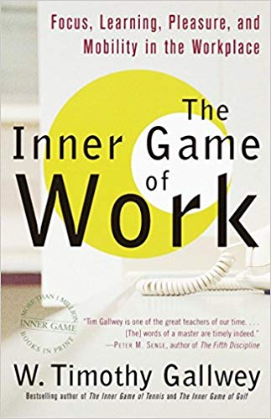
#1 Books
Book Covers from amazon.com
Notes:
Recommendations: readings about coaching, personal development, etc.

Slide 28
#2 Workshop / Training
Note: Photo from the author
Notes:
Recommendations: workshop / training about coaching, personal development, etc.

Slide 29
#3 Seach for more!
https://unsplash.com/photos/mq8QogEBy00
Notes:
Other recommendations: TedTalks; Online Communities; Podcasts; …
Never stop learning about yourself and your teams!

Slide 30
References
Nogueira, D. (2014). Trate a Vida por Tu. Lua de Papel. ISBN: 978-989-23-1051-0

