Slide 1
Project team management in a new era of digitalization
Rui M. Lima
(School of Engineering of University of Minho)
Notes:
This are the slides for the class dedicated to teams in project management. Some slides could be delivered later to students.

Slide 2
LESSON PLAN
Introduction to Teamwork
What is a team?
Team Game
Advantages and Difficulties
Success factors
Project management
Knowledge Area Resources (H) - Processes (PMBOK)
Team Development phases
Belbin Team Roles

Slide 3
What is a Team?
Cooperative process that develops from a common and shared objective.
(Harris & Harris, 1996)
TEAM / GROUP

Slide 4
TEAM VS GROUP
Groups | Teams
- People work together | - People trust each other
- Feelings are not part of the job | - Feelings are openly expressed
- The conflict is settled | - The conflict is debated
- Trust and openness are measured | - People support each other
- Information is given on a “only what is necessary” basis | - Information is freely shared
- The objectives are personal and unclear | - Members have common goals
Miguel, Rocha & Röhrich, 2008 (p. 249)
Notes:
Before showing to students, discuss these concepts.

Slide 5
NASA Exercise - Survival on the Moon
State – Problem:
Individual Response(10min)
Response Group 2-3 elements(15min)
NASA response
Comparison of results (Individual and Group)
Results analysis
0-20 | Excelente
20-30 | Good
30-40 | Medium
40-50 | Weak
> 50 | Insufficient

Slide 6
TEAMWORK
Advantages and Difficulties
Notes:
Discussion. Think-pair share activity.

Slide 7
TEAMWORK
- Greater speed and efficiency in achieving the objectives
- Enrichment of decisions
- Division of tasks
- "We" instead of “Me"- ...
- Occurrences of parasitism: some work others do not
- Internal disputes
- Demanding at the level of communication- ...
Notes:
Before showing to students, discuss these concepts.

Slide 8
Factors for a Successful Team (Tarricone & luca, 2002)
Interdependence - the team members have to ensure conditions to work effectively as a team, with each other and not each in isolation. The contributions generated, when integrated and combined as a whole, allow to reach higher levels of performance.
Interpersonal relationships - interactions should be developed based on trust, respect, and honesty in individual sense (each element) and collective (the team). The creation of group identity and sense of belonging depends, particularly on this factor.
Communication - the nature of the dialogue produced is decisive for the success of the team, as it is essential to know how to listen to the concerns and needs of each element, as well as how to accept the criticisms and suggestions given. Open communication produces positive and constructive feedback and is essential for conflict resolution and decision making.
Leadership and Responsibility - the elements must be individually responsible for the team's performance and the quality of the tasks performed. During the process it is crucial to maintain effective leadership, capable of guaranteeing a position in problem solving and decision making.
Commitment - established towards the team, in order to achieve the goals shared by all its elements.
Group composition - the team must be properly formed so that rules, positions, tasks, and responsibilities are clarified beforehand.

Slide 9
TEAMWORK
Project management

Slide 10
PROJECT
Project
Unrepeatable
Limited time
Limited capital
Limited resources
Multi and interdisciplinary
Complex
Team
Features?

Slide 11
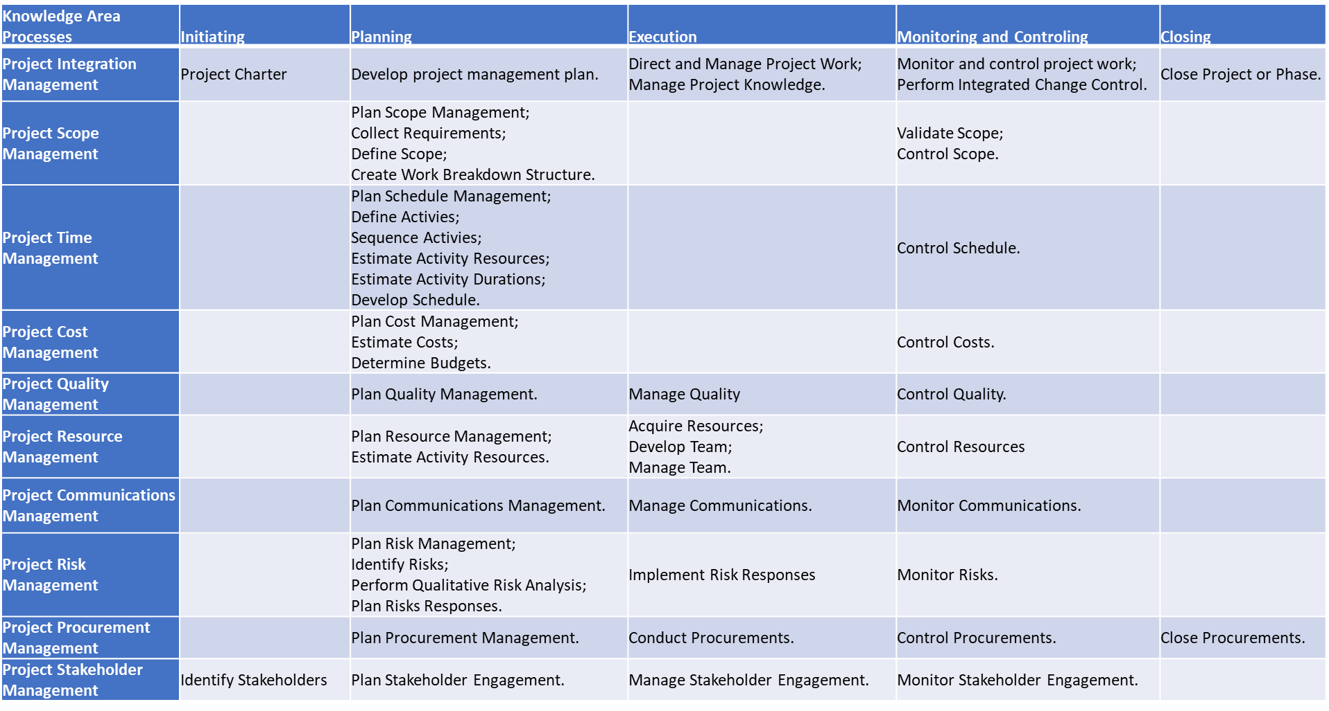
PMBOK – Processes Project Management Process Groups

Slide 12
PMBOK – Processes
Knowledge Area Processes | Planning | Execution | Monitoring and Controling
Project Resource Management | Plan Resource Management; Estimate Activity Resources. | Acquire Resources; Develop Team; Manage Team. | Control Resources

Slide 13
Project Resource Management, including Team Management (project management)
Project resource management includes processes to identify, acquire and manage resources necessary for the successful completion of the project. These processes help to ensure that the right resources will be available to the project manager and his team at the right time and place.
Forming
Storming
Norming
Performing
Resource Planning;
Get the project team;
Develop the project team;
Manage the project team.
Team Development Phases
Bruce W. Tuckman (2001)

Slide 14
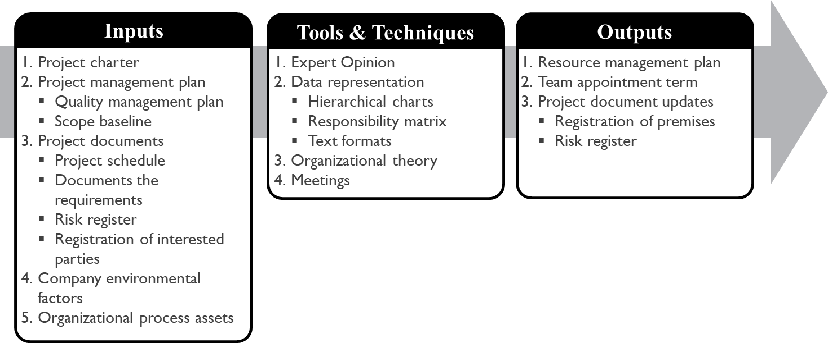
PROCESS: Resource Planning
Planning Resource Management is the process of defining how to estimate, acquire, manage and use physical and team resources. It may include the identification and documentation of the following items in a project:
Skills and competencies required
Roles (functions)
Responsibilities
Hierarchies
PMI-PMBOK (2017)

Slide 15
PROCESS: Obtain the Project Team
Process responsible for:
Confirmation of availability of human resources to carry out the activities related to the project.
Obtaining the necessary team to complete the project activities.
PMI-PMBOK (2017)

Slide 16
Team Development phases
Forming
Storming
Norming
Performing
Team Symptoms
Reduced trust and involvement Socialization of members There will be many issues …
Project Manager Actions
Select team members Explain the team's purposes Present problems clearly Establish objectives and strategies …
Notes:
For teachers: link to the pptx of Avengers team stages - Tuckman

Slide 17
PROCESS: Develop the Project Team
Process responsible for improvement:
skills.
interaction between team members.
of the team's global environment to improve project performance.
PMI-PMBOK (2017)

Slide 18
Team Development phases
Forming
Storming
Norming
Performing
Sintomas na Equipa
“Selected Groups” begin to form Avoid conflict or challenge Externalization of difficulties and problems …
Project Manager Actions
Maintain focus on defined objectives and strategies Clarify each other's roles and responsibilities Train the elements individually Let the conflict unfold …

Slide 19
Belbin Team Roles
http://www.belbin.ie/wp-content/uploads/2014/08/BELBINUK-Self-PerceptionInventory+CompletionGrid.pdf
What is my role in the team?
Notes:
Students should answer to the self perception inventory grid and discover their roles

Slide 20
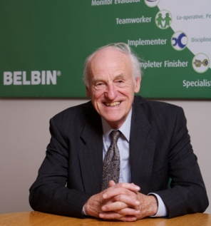
Belbin Team Roles
Raymond Meredith Belbin (1926) – Psychology research
Teamwork – Belbin Associates (1988) - http://www.belbin.com/
Management Teams: Why They Succeed or Fail
Nine roles - team dynamics

Slide 21
Team Roles – BELBIN
Plant
Contribution | Possible Limitations
Creative, imaginative, think outside the box, generate ideas and solve complex problems. | Ignores procedures, weak communication.
http://www.belbin.com/
Notes:
You may deliver this slide later to students.

Slide 22
Team Roles – BELBIN
Resource Investigator
Contribution | Possible Limitations
Enthusiastic, communicative, explores the possibilities and creates a network. | Very optimistic, he loses interest when the initial enthusiasm passes.
Notes:
You may deliver this slide later to students.

Slide 23
Team Roles – BELBIN
Co-ordinator
Contribution | Possible Limitations
Mature, confident, identifies talents, clarifies objectives, delegates efficiently. | It can be manipulative, it tends to reduce its own workload.
Notes:
You may deliver this slide later to students.

Slide 24
Team Roles – BELBIN
Shaper
Contribution | Possible Limitations
Challenging, dynamic, reacts well under pressure, has the courage to lead and overcome obstacles. | It is authoritarian, provocative and hurts people's feelings.
Notes:
You may deliver this slide later to students.

Slide 25
Team Roles – BELBIN
Monitor Evaluator
Contribution | Possible Limitations
Sober, strategist and discernment. Analyze all options and judge accurately. | Problems to lead and inspire people. It can be too critical.
Notes:
You may deliver this slide later to students.

Slide 26
Team Roles – BELBIN
Teamworker
Contribution | Possible Limitations
Cooperative, perceptive and diplomatic. Listens and resolves conflicts. | Undecided in confrontational situations. Avoid direct confrontations.
Notes:
You may deliver this slide later to students.

Slide 27
Team Roles – BELBIN
Implementer
Contribution | Possible Limitations
Efficient, reliable, tactical. It transforms ideas into actions and organizes the work that must be done. | Sometimes it can be inflexible and slow to respond to change.
Notes:
You may deliver this slide later to students.

Slide 28
Team Roles – BELBIN
Completer Finisher
Contribution | Possible Limitations
Careful, anxious, contentious. Search for errors, polished and perfectionist. | You may have difficulty completing the activities.
Notes:
You may deliver this slide later to students.

Slide 29
Team Roles – BELBIN
Specialist
Contribution | Possible Limitations
Resolute, dedicated. Likes the learning process and gathers knowledge and experience, being able to solve problems in key areas (expert). | Tendency to be extremely technical.
Notes:
You may deliver this slide later to students.

Slide 30
Team Development phases
Team Symptoms
Teamwork begins Increases commitment and trust The roles and responsibilities of each are clear and accepted; Behavior based on the participation of members and decision-making already happens by agreement of the group; Coexistence and work norms and rules are built …
Forming
Stormin
Norming
Performing
Project Manager Actions
Recognize individual and collective efforts Give the group learning opportunities …

Slide 31
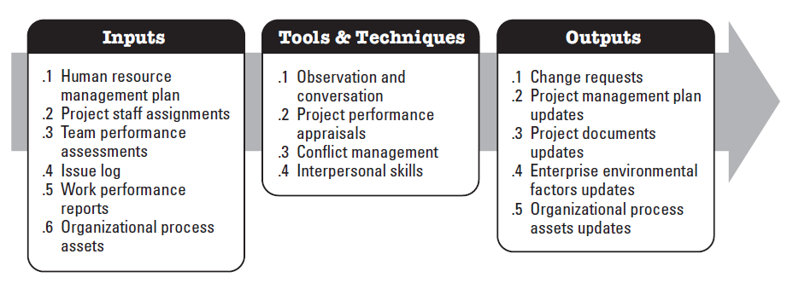
PROCESS: Manage the Project Team
Process responsible for:
Monitor the performance of team members; Provide feedback; Resolve issues; Manage changes to optimize project performance
PMI-PMBOK (2017)

Slide 32
Team Development phases
Forming
Stormin
Norming
Performing
Team Symptoms
Goal / objective orientation Interpersonal relationships between team members Independence, motivation and competence of team members Increases productivity and satisfaction…
Project Manager Actions
To celebrate Minimal team intervention Encourage group decision making Advance to self-managed teams …

Slide 33
SHARING
Peers - sharing a teamwork experience / situation
Profile of team members
Team development phase
Project manager / leader actions

Slide 34
Team Development phases
What about the end of the project?
Adjourning
Project Manager Actions
Gradually separate your team and relocate, where possible, to other projects or teams Monitor the end of the team's work with the necessary evaluation activities…

Slide 35
KEY IDEAS
Team as a fundamental element to consider in project management
Project success also depends on the success of the team
Each team has an identity and each member of the team has a profile
Develop and manage the team: role of the project manager / leader (competencies)
LEADERSHIP
COMMUNICATION

Slide 36
References
PMI-PMBOK. (2017). A guide to the project management body of knowledge (PMBOK guide) (5th ed.). Pennsylvania, USA: Project Management Institute (PMI).
Tuckman, B. W. (2001). Developmental Sequence in Small Groups. Group Facilitation: A Research and Applications Journal, 71-72(3), 66-81.

