Slide 1
Project Management
Rui M. Lima
(School of Engineering of University of Minho)
Notes:
These are the slides for Project Management - time scheduling and management
You may consider to deliver slides with results from examples later to students.

Slide 2
Project Management
Time and resource management
Planning and controlling project activities

Slide 3
Topics
Building networks of project activities and Gantt diagrams.
Project Management Methods:
  CPM
  Planning with limited resources
  PERT
  Time / cost commitment

Slide 4
Term List
AON – Networks “Activity on Node”
AOA – Networks “Activity on Arc”
CPM – Method “Critical Path Method”
PERT - Method “Program Evaluation and Review Technique”
BAG - “Brook’s Algorithm”

Slide 5
Summary - Project Duration?
Project planning
  Activities
  AON and AOA networks
  Gantt diagrams
Time management
  CPM Method
  Time / cost commitment
  PERT method
  Resource allocation
GANTT
Network
REPRESENTATION
Management
PERT
Time / Cost
CPM
Resources

Slide 6
Project Representation
Activities - Precedences
AON Network - AOA Network
Gantt diagram

Slide 7
[Work Breakdown Structure - WBS]
The WBS is a hierarchical structure of all activities and sub-activities necessary for the project to be carried out successfully.
  successively divide complicated activities into several smaller activities
  all levels of the WBS where the total amount of work for a level must match the element of the level immediately above
  find a balance between the definition of elements that can be managed and that have an adequate dimension for realization.
Although there is a wide variety of WBS, one of the most common, according to Kerzner (2009, p. 435), is that of six levels:
  Management Levels: (1) Complete program; (2) Project; (3) Task
  Technical Levels: (4) Subtask; (5) Work package; (6) Effort level
WBS serves as the basis for a set of project management processes:
  Responsibility matrix; Activity network; Costs; Risk analysis; Organizational structure; Control

Slide 8
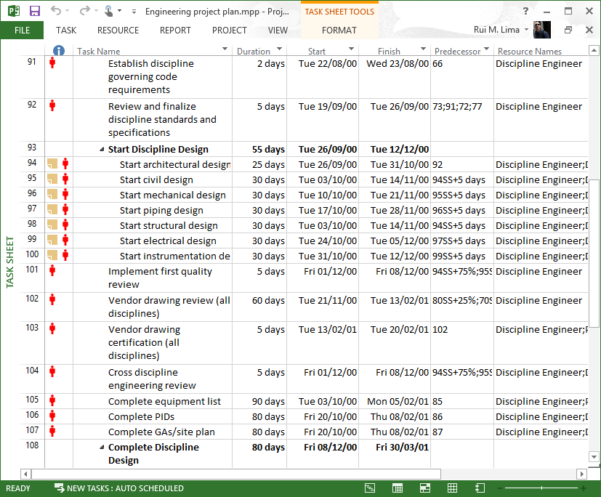
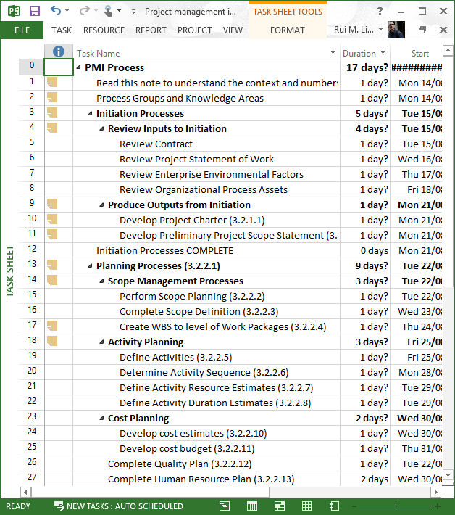
Work Breakdown Structure - Templates

Slide 9
Work Breakdown Structure – Example
Kerzner (p.439)

Slide 10
Project Representation
Activities and Precedences
Activity | Precedences | Duration
A | - | 5
B | - | 4
C | - | 3
D | A | 1
E | C | 2
F | C | 9
G | C | 5
H | B, D, E | 4
I | G | 2

Slide 11
Project Representation
“Activity on Node” Network
A
D
Start
B
H
End
E
C
F
G
I
Notes:
As this is a result of previous example, you may prefer to deliver it later to students.

Slide 12
Project Representation
“Activity on Arc” Network
2
A
D
1
B
4
H
6
C
E
F
I
3
G
5
Notes:
As this is a result of previous example, you may prefer to deliver it later to students.

Slide 13
Project Representation
Gantt Diagram
Notes:
As this is a result of previous example, you may prefer to deliver it later to students.

Slide 14
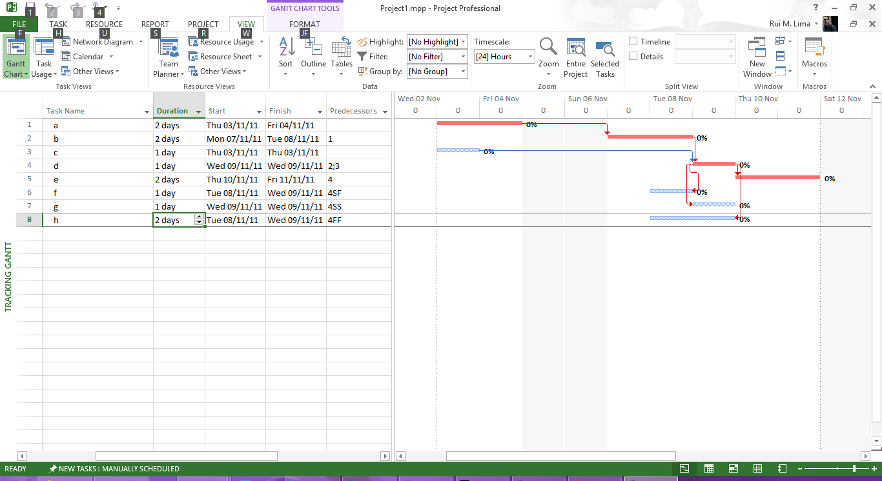
Activities: duration, precedence, restrictions
Duration + Precedence
  FS: Finish to Start
  SF: Start to Finish
  SS: Start to Start
  FF: Finish to Finish
  Lead + Lag Time
Restrictions
  ASAP – As Soon As Possible
  ALAP – As Late As Possible
  SNET – Start No Earlier Than
  SNLT – Start No Later Than
  FNET – Finish No Earlier Than
  FNLT – Finish No Later Than
  MSO – Must Start On
  MFO – Must Finish On
Lag
Lead

Slide 15
CPM Method
Representation Of Activities – Network Construction
Times And Slack Calculation
Critical Path

Slide 16
CPM Method
Representation of Events - Nodes
Node / Events
  ET – “Early Event Time”
  LT – “Late Event Time”
Beginning and / or conclusion of activities.
There is a single start and end event for the project.
They must be numbered from left to right and from top to bottom.

Slide 17
CPM Method
Representation of Activities - Arcs
Arcs / activities
  “Activity” – j: Aj
  “Duration” – : dj
  “Earliest Start” – ESj = ETi
  “Latest Finish” – LFj = LTk
  “Latest Start” – LSj = LTk - dj
  “Earliest Finish” – EFj = ETi + dj
No activity can be represented by more than one arc.
Two activities cannot have the same beginning and end events.
ET_{i}
LT_{i}
ET_{k}
LT_{k}
A_{j}
EF_{j}
i
ES_{j}
k
LS_{j}
d_{j}
LF_{j}

Slide 18
CPM Method - Slacks off
Total Slack
Maximum delay that an activity can have in relation to its earlier start date, without compromising the project's completion time
  FTotal = LTk - ETi - dj
Safety slack
  Similar to the previous one, but in this case, it assumes that the direct precedents of an activity have already been delayed as much as they could
  FSafety = LTk - LTi - dj
Free slack
  Maximum delay that an activity can have in relation to its earlier start date, without preventing the following activities from starting on their earlier dates
  FFree= ETk - ETi - dj
Independent slack
It is the time margin available when the previous activity is completed at a later date and the next activity is considered to have started at the earliest date.
  FIndependent = max{ ETk – LTi - dj, 0 }

Slide 19
CPM Method - Critical Path
Critical Path (CP): consists of the longest sequence of activities that connect the network's initial node to its final node, thus determining the project's execution period.
Critical activities are how they integrate the critical path and directly contribute to the duration of the project. They are activities without slacks off.
Exercise: Solve the exercise presented in the “Activity representation” by the CPM method, determining:
  All times and breaks.
  Critical Path.

Slide 20
CPM Method
Critical Path - Exercise
CP – CF – 12 days
Notes:
As this is a result of previous example, you may prefer to deliver it later to students.

Slide 21
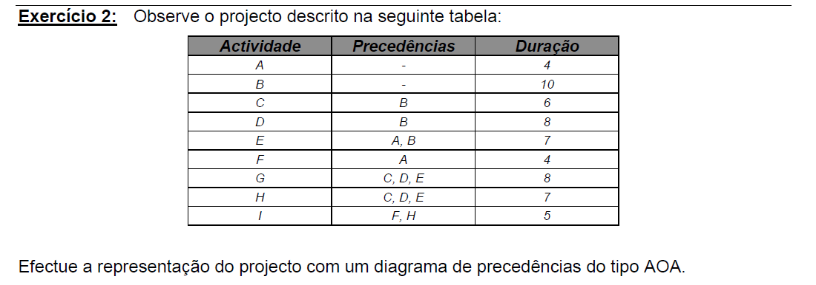
Build the AOA network and determine all activity times and all clearances for an activity.
Activity
Precedence
Duration
Make the representation of the project with the AOA type precedence diagram.

Slide 22
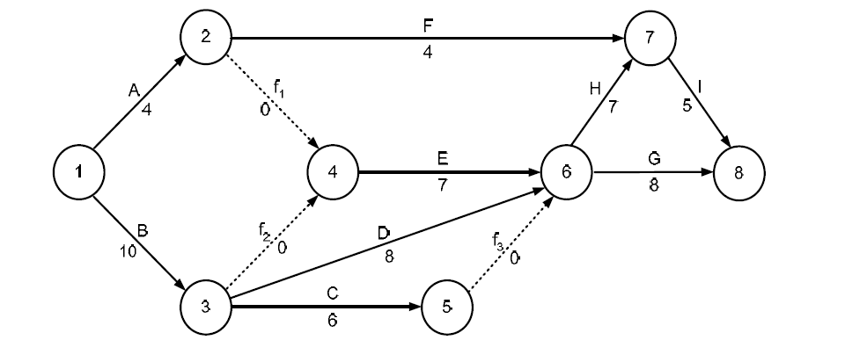
AOA network
Notes:
As this is a result of previous example, you may prefer to deliver it later to students.

Slide 23
Planning with
Resource Restriction
Planning with scarce resources
Lang's heuristic
Brooks algorithm

Slide 24
Resource-Constrained Planning
LANG Heuristic
Sort activities in ascending order from their later start time.
When there is equality, priority is given to:
  activity with less total slack;
  activity with a longer duration;
  activity with the greatest need for resources.

Slide 25
Resource-Constraints Planning
Brooks algorithm (BAG)
Descending ordering of activities according to their ACTIM value.
ACTIM is the maximum time that each activity controls over the network and corresponds to the maximum time of the project, considering this activity as initial.
In case of equality, Lang's heuristic can be used.

Slide 26
Brooks Algorithm (BAG)
Exercise
Considering the activities, precedence, duration and resources required for each activity, indicated in the table, resolve the following questions.
  Build the network, of activities in the branches, of the project, indicating the early and late times of each event, and the early and late start and end of each activity.
  Indicate the critical path and its duration, considering that there are no resource restrictions, and construct the respective Gantt chart.
  Considering that only 24 collaborators are available to carry out the project, build the sequence of activities, allocating resources by the Brooks algorithm. Indicate the duration of the project, and the delay verified by the fact that the resources are not unlimited.
  What is the minimum number of workers to subcontract, and in what period(s) so that the project is not delayed?

Slide 27
Brooks Algorithm (BAG)
Exercise
Activities | Precedences | Duration | Collaborators
A | - | 6 | 6
B | - | 6 | 18
C | - | 2 | 7
D | A | 3 | 10
E | B | 7 | 15
F | B | 3 | 3
G | C | 5 | 8
H | D, E | 7 | 16
I | F | 4 | 9

Slide 28
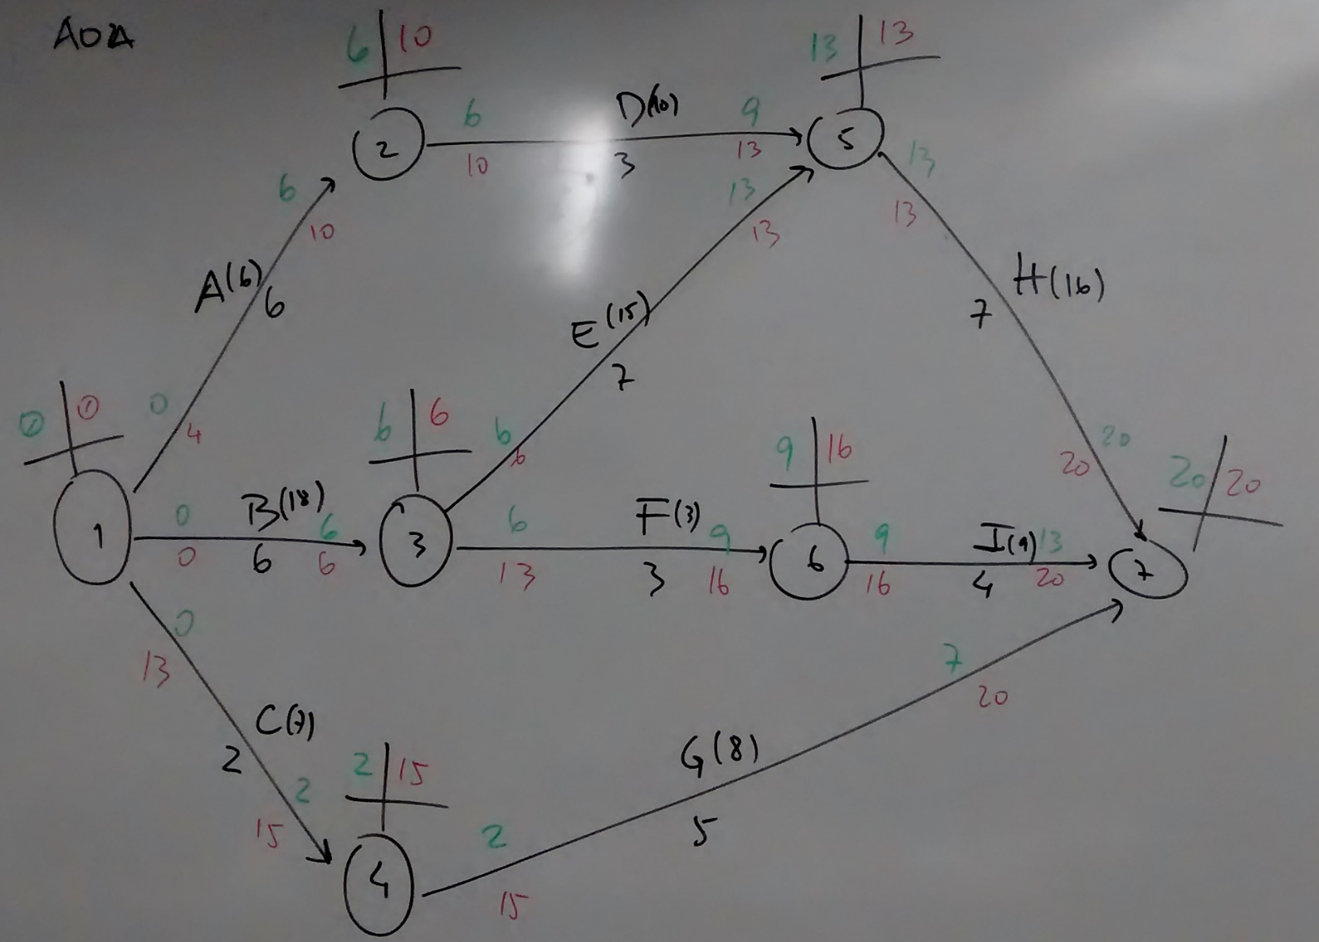
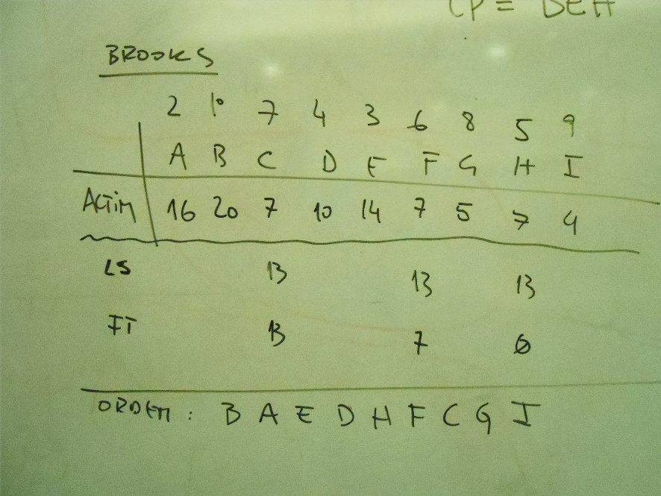
Brooks - Exercise
Network AOA
CP – BEH – 20 days
Notes:
As this is a result of previous example, you may prefer to deliver it later to students.

Slide 29
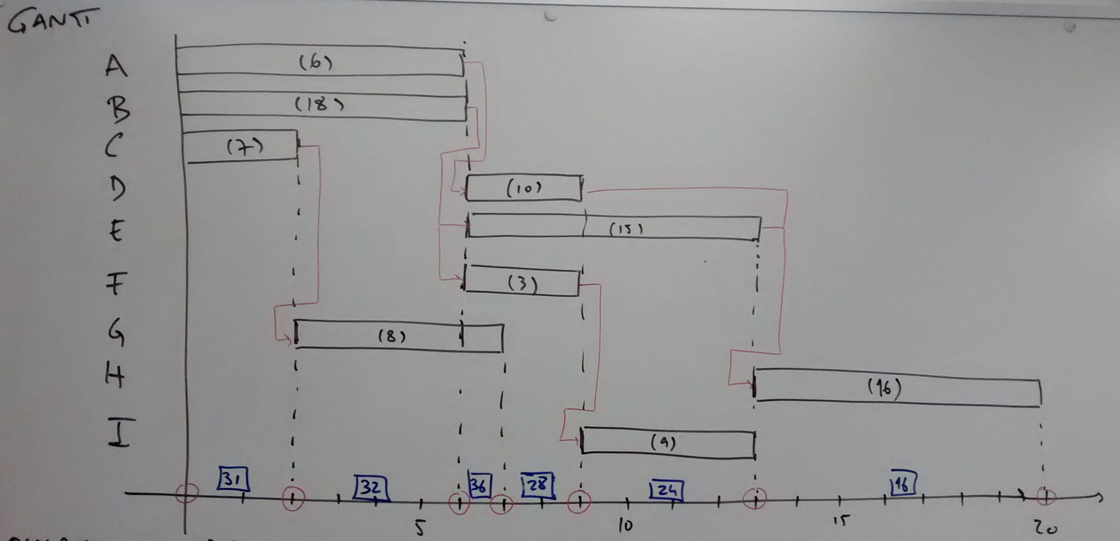
Brooks - Exercise
Activities
Gantt Diagram
Time (days)
Load (Hours)
Notes:
As this is a result of previous example, you may prefer to deliver it later to students.

Slide 30
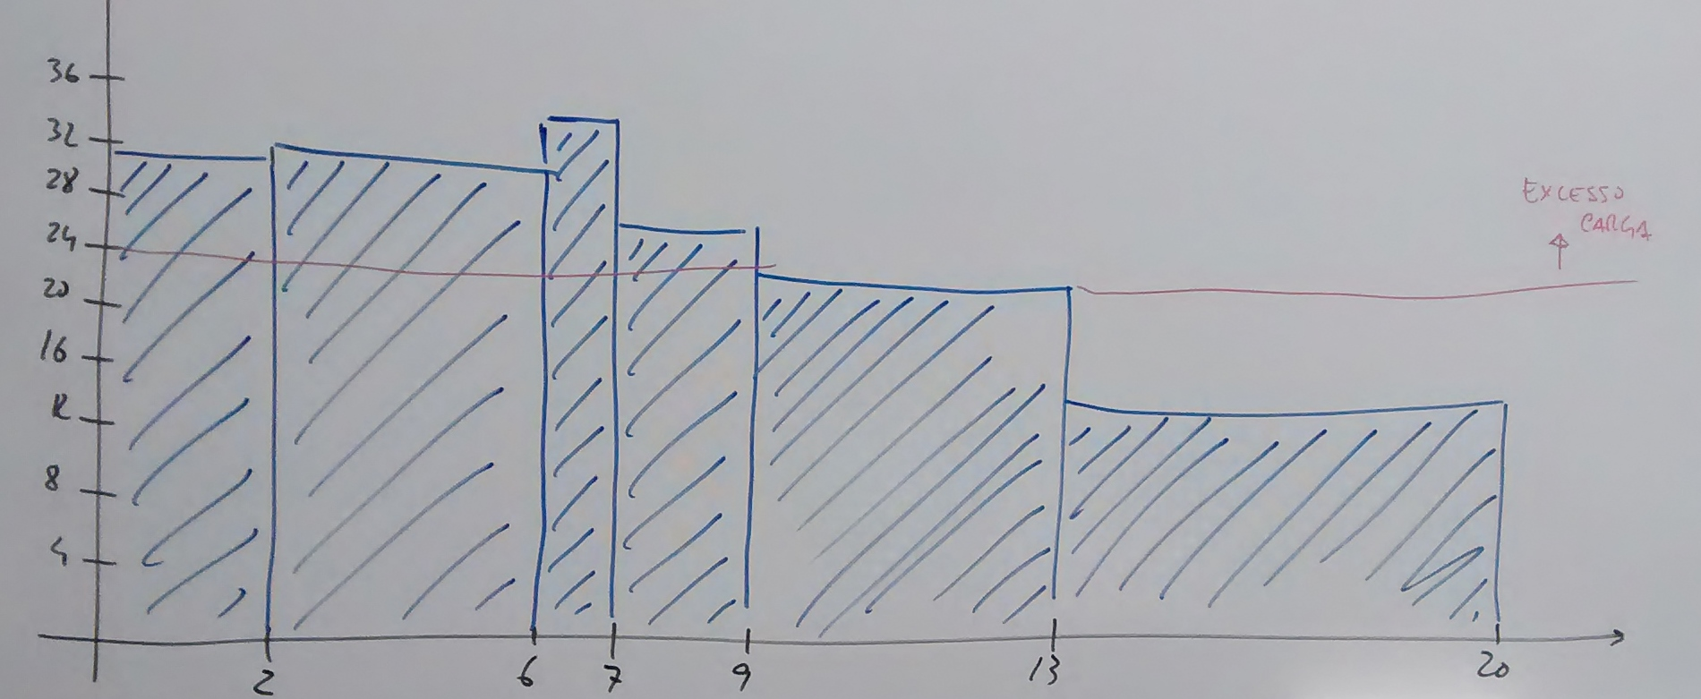
Brooks - Exercise
Load (Hours)
Overload
Time (days)
Notes:
As this is a result of previous example, you may prefer to deliver it later to students.

Slide 31
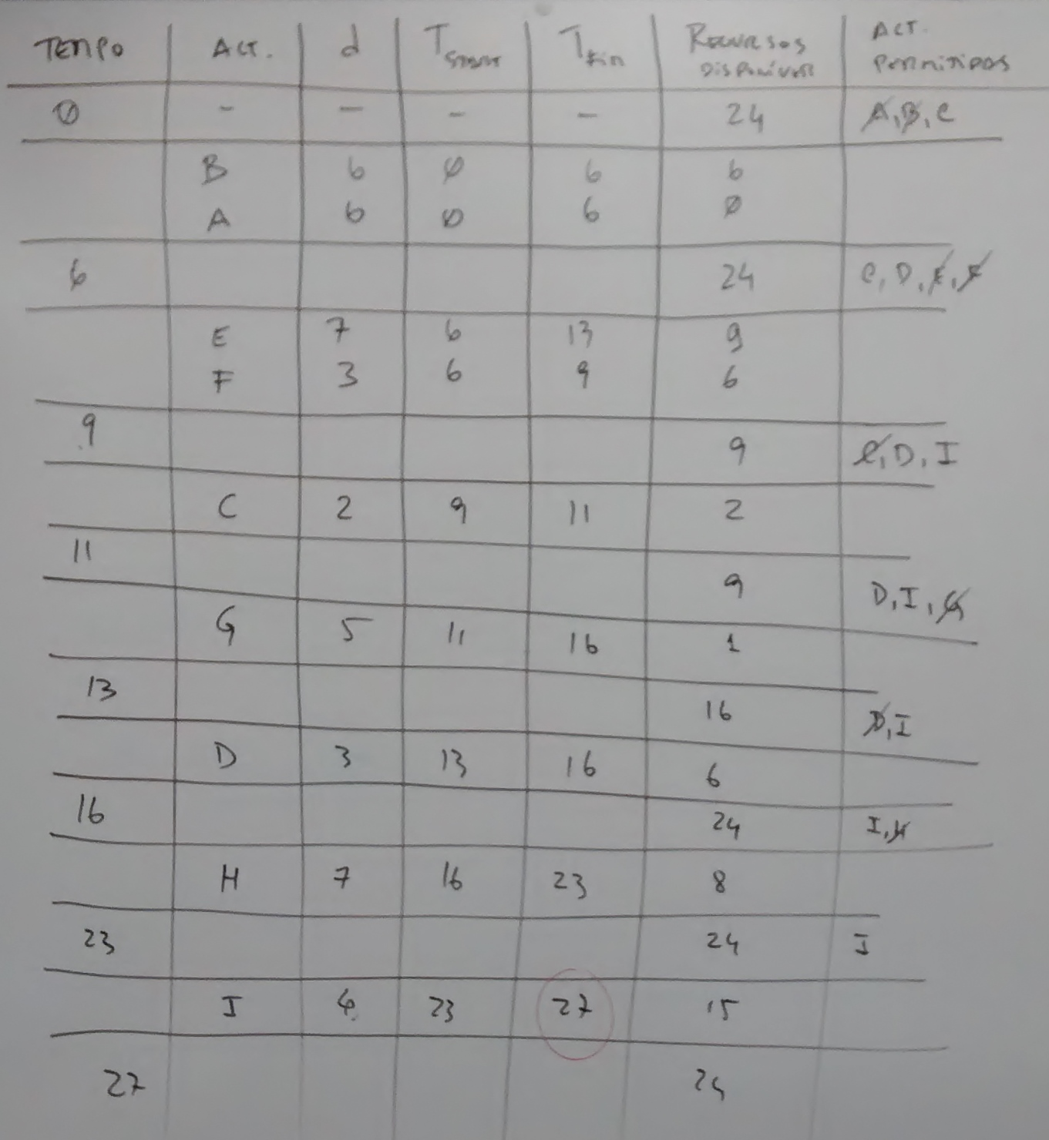
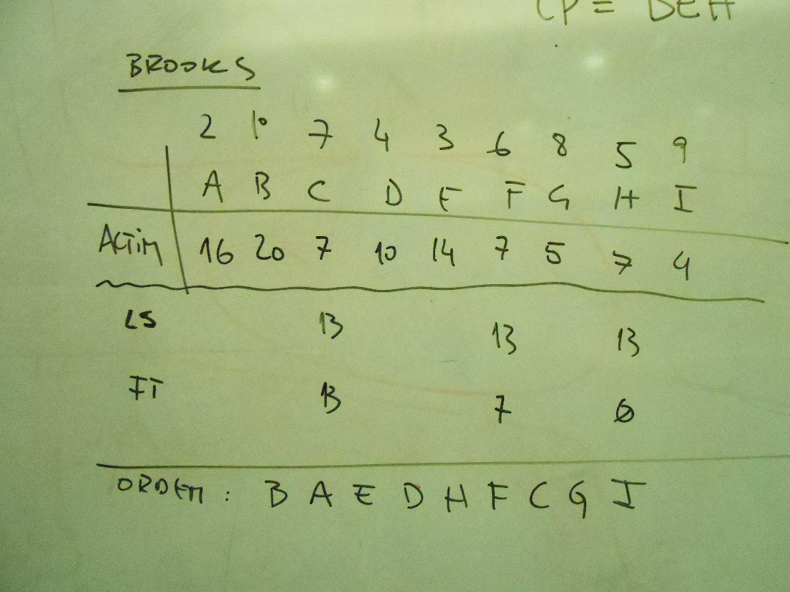
Brooks - Exercise
Notes:
As this is a result of previous example, you may prefer to deliver it later to students.

Slide 32
PERT Method
PERT Method Model - Critical Path
Activity Representation Model
Calculation of Project Duration Times

Slide 33
PERT Method
PERT Method Model
The duration of each activity is no longer considered deterministic to be considered probabilistic:
  dj - activity duration j (random variable)
  mj - average of dj or E [dj]
  σj2 - dj variance
  Method assumptions:
  The activities (respective dj random variables) are probabilistically independent.
  The critical path contains a sufficient number of activities in such a way that the central limit theorem applies.
  Therefore, the distribution of the project duration is close to the Normal Distribution, and its average and variation will be equal to the sum of the averages and variations of the activities.

Slide 34
PERT Method
PERT Method - Critical Path
The critical path is considered the path with the longest expected duration:
That will have variance:
The duration of the project can only be determined probabilistically, using the accumulated normal distribution:

Slide 35
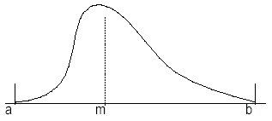
PERT method
Activity duration model
The duration of each activity is represented by a probability distribution ß.
This distribution is defined by 3 activity time estimates:
  a - optimistic estimate of the duration of the activity.
  m - most likely estimate of the duration of the activity.
  b - pessimistic estimate of the duration of the activity.

Slide 36
PERT Method
Calculation of project duration times
Determine the probability of the project ending in 15 days and 19 days.
Determine the probability of the project ending in 19 days, considering the 2nd most critical path
Activity | Precedences | a | m | b | μ | σ2
A | - | 2 | 4 | 12 | 5 | 2,78
B | - | 3 | 6 | 9 | 6 | 1,00
C | A | 1 | 2 | 9 | 3 | 1,78
D | A | 3 | 3 | 9 | 4 | 1,00
E | B | 1 | 2 | 3 | 2 | 0,11
F | B | 2 | 8 | 8 | 7 | 1,00
G | C | 1 | 2 | 9 | 3 | 1,78
H | D, E | 4 | 5 | 12 | 6 | 1,78
I | F | 1 | 3 | 5 | 3 | 0,44

Slide 37
PERT Method
Calculation of project duration times
Notes:
As this is a result of previous example, you may prefer to deliver it later to students.

Slide 38
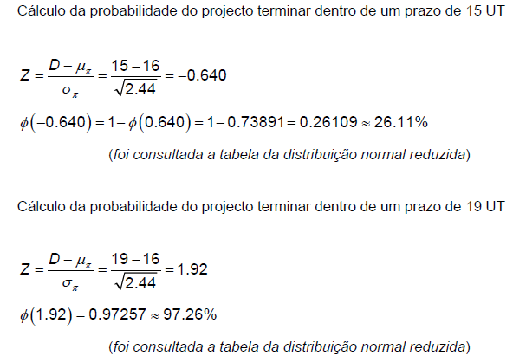
PERT Method
Calculation of project duration times
Calculating the probability of the project ending within 15 UT.
Calculating the probability of the project ending within a period of 19 UT considering the ADH path
The reduced normal distribution table was consulted
Calculating the probability of the project ending within 19 UT.
Cálculo da probabilidade do projeto terminar dentro de um prazo de 19 UT considerando o caminho ADH
The reduced normal distribution table was consulted
Notes:
As this is a result of previous example, you may prefer to deliver it later to students.

Slide 39
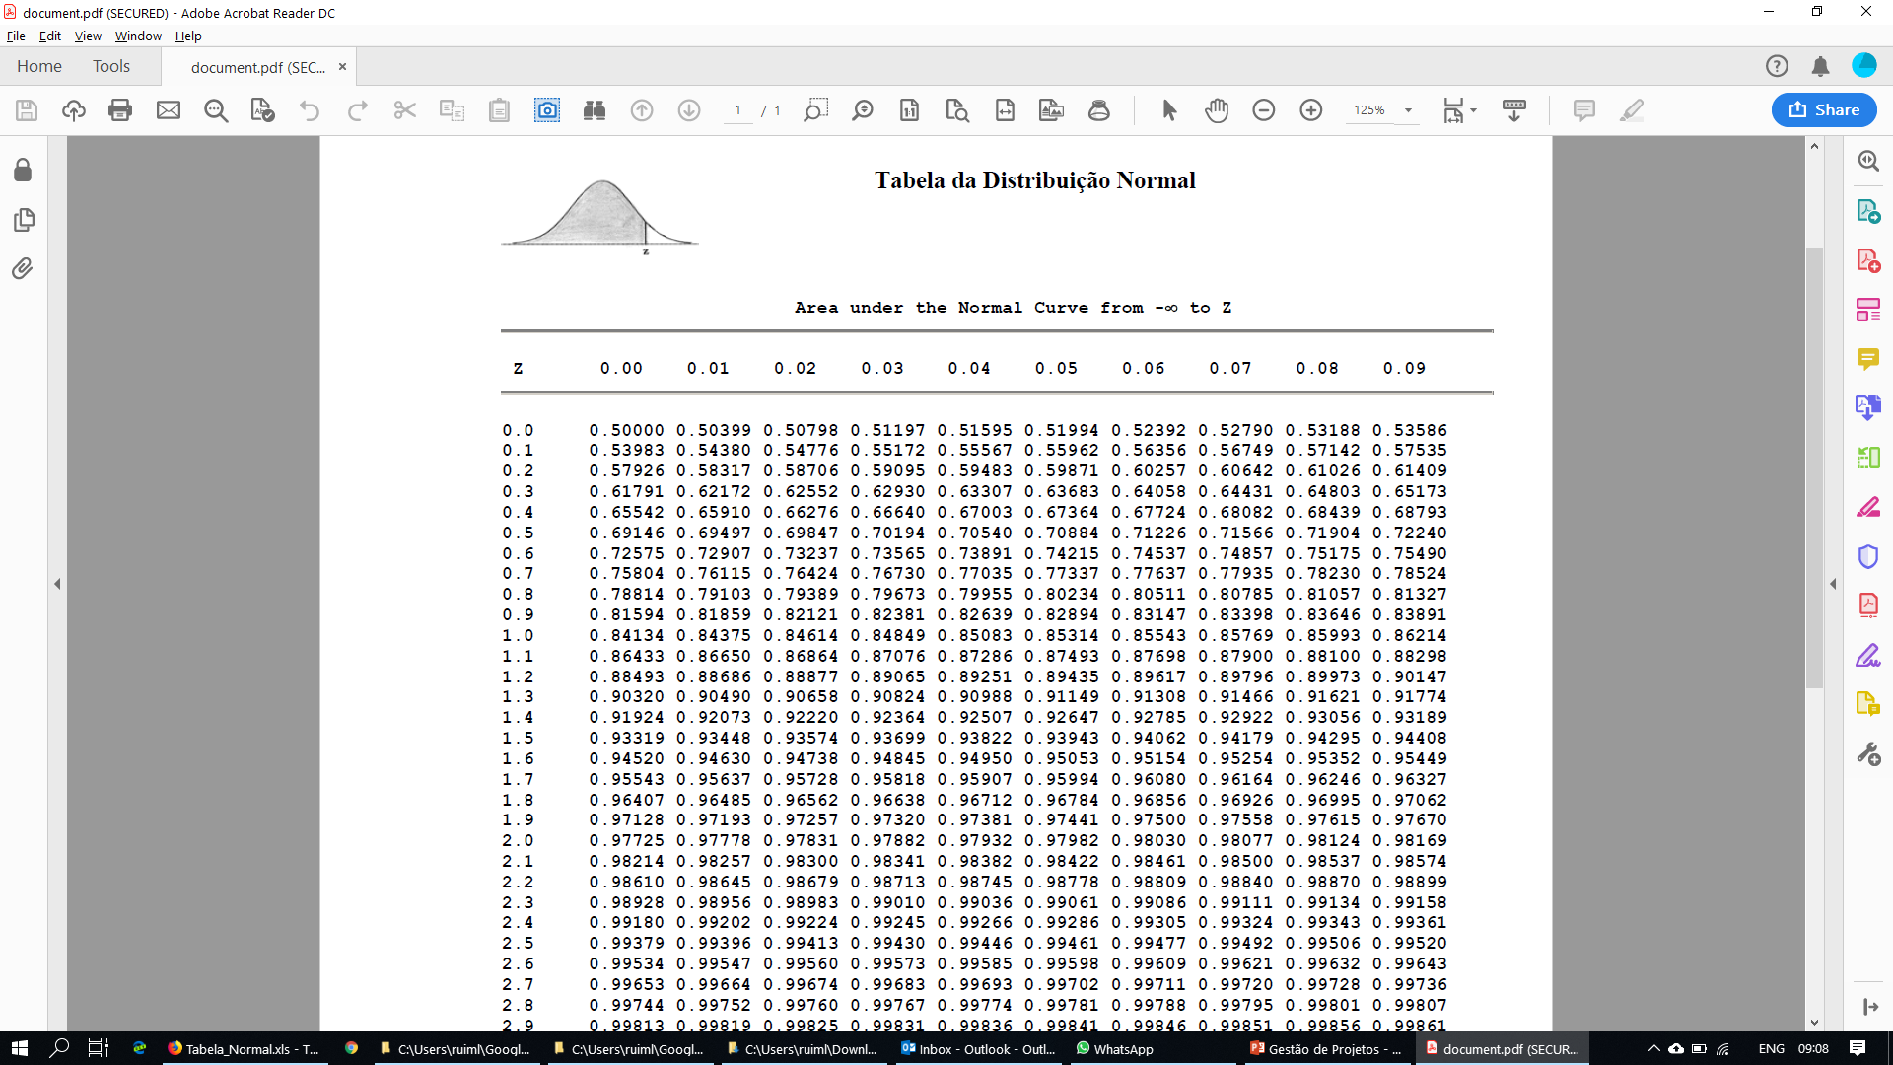
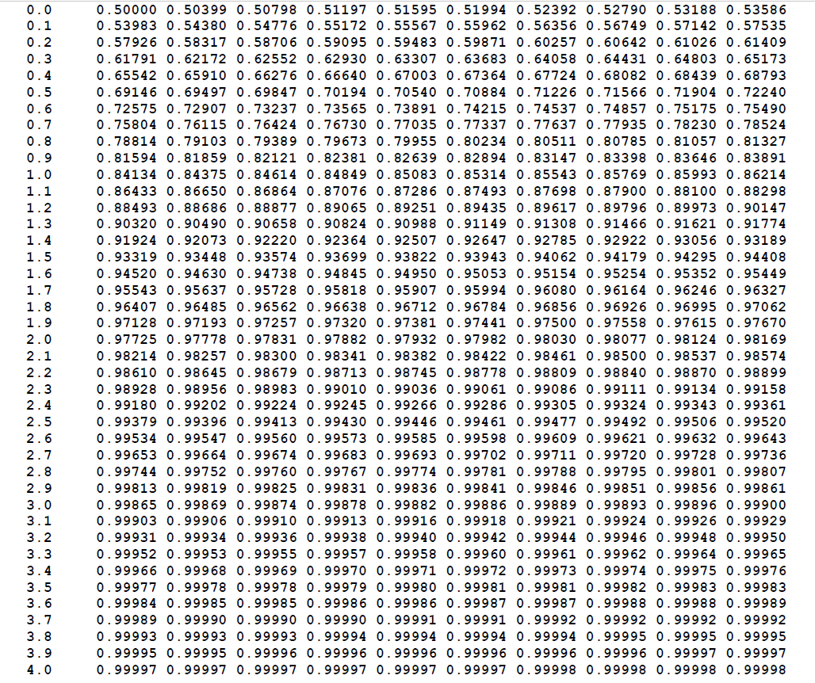
Standard Normal Distribution Table

Slide 40
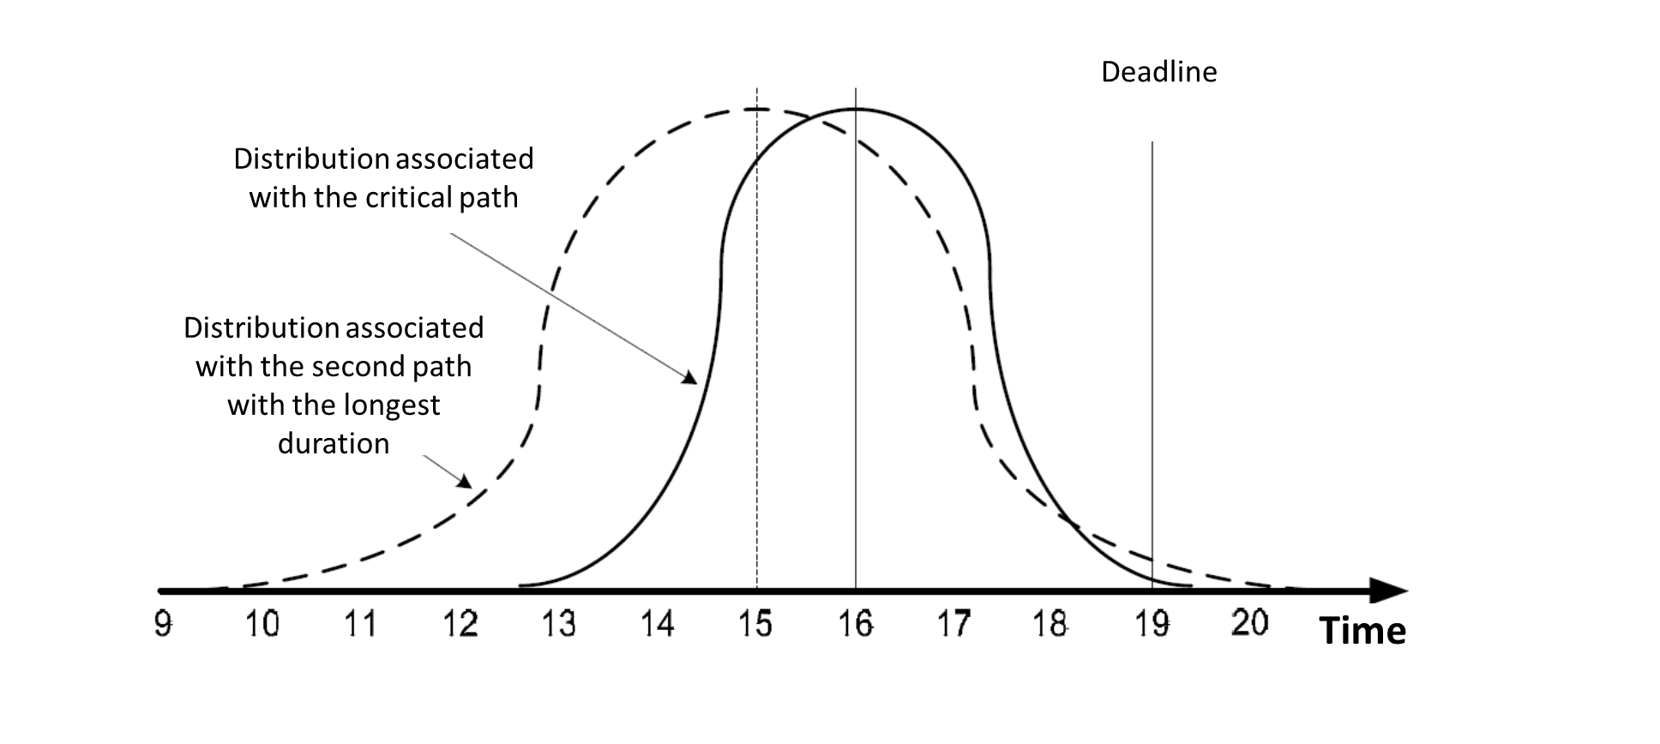
Standard Normal Distribution

Slide 41
Commitment Method Cost / Time
Cost-per-activity model
Calculation of project duration
Relationship of time to cost

Slide 42
Commitment Method Cost / Time
Generic cost model per activity
It is assumed that:
The duration of each activity is a linear function of the costs associated with carrying out the activity.
Each activity has a minimum possible duration (m) and a maximum possible duration (M).
Custo
Cost
c₀
Custo = c₀-c.t
Cost
m
M
t

Slide 43
Method Commitment Cost / Time
Calculation of project duration
Determine the minimum cost of project duration.
Consider a fixed cost of 45 Currency Units (UM) per day for the duration of the project.
Activity | Precedence | M | m | c | c₀ | Cost
A | - | 3 | 1 | 40 | 140 | 140-40t
B | A | 7 | 3 | 10 | 110 | 110-10t
C | A | 4 | 2 | 40 | 180 | 180-40t
D | C | 5 | 2 | 20 | 130 | 130-20t

Slide 44
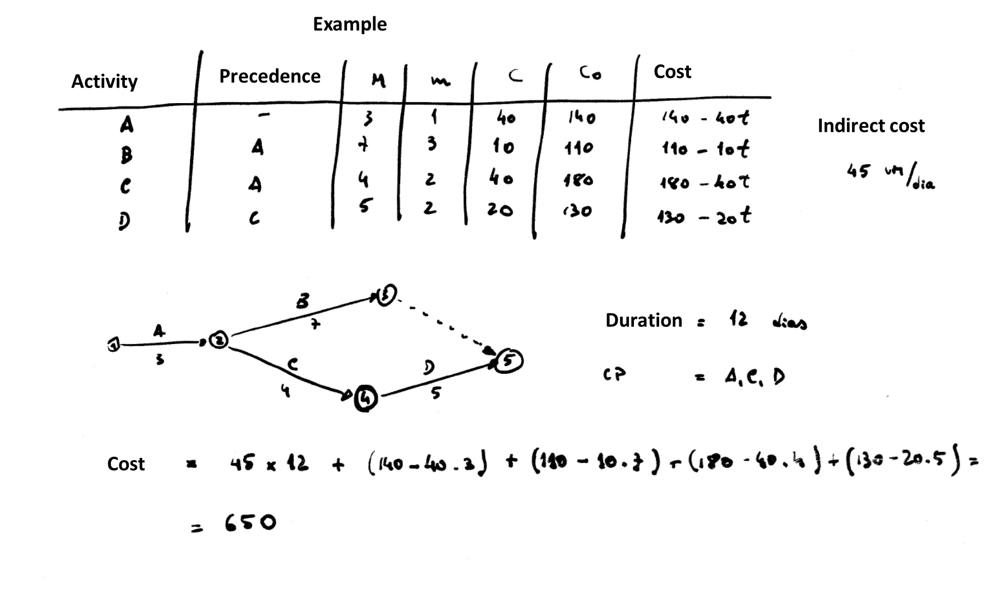
Example
Notes:
As this is a result of previous example, you may prefer to deliver it later to students.

Slide 45
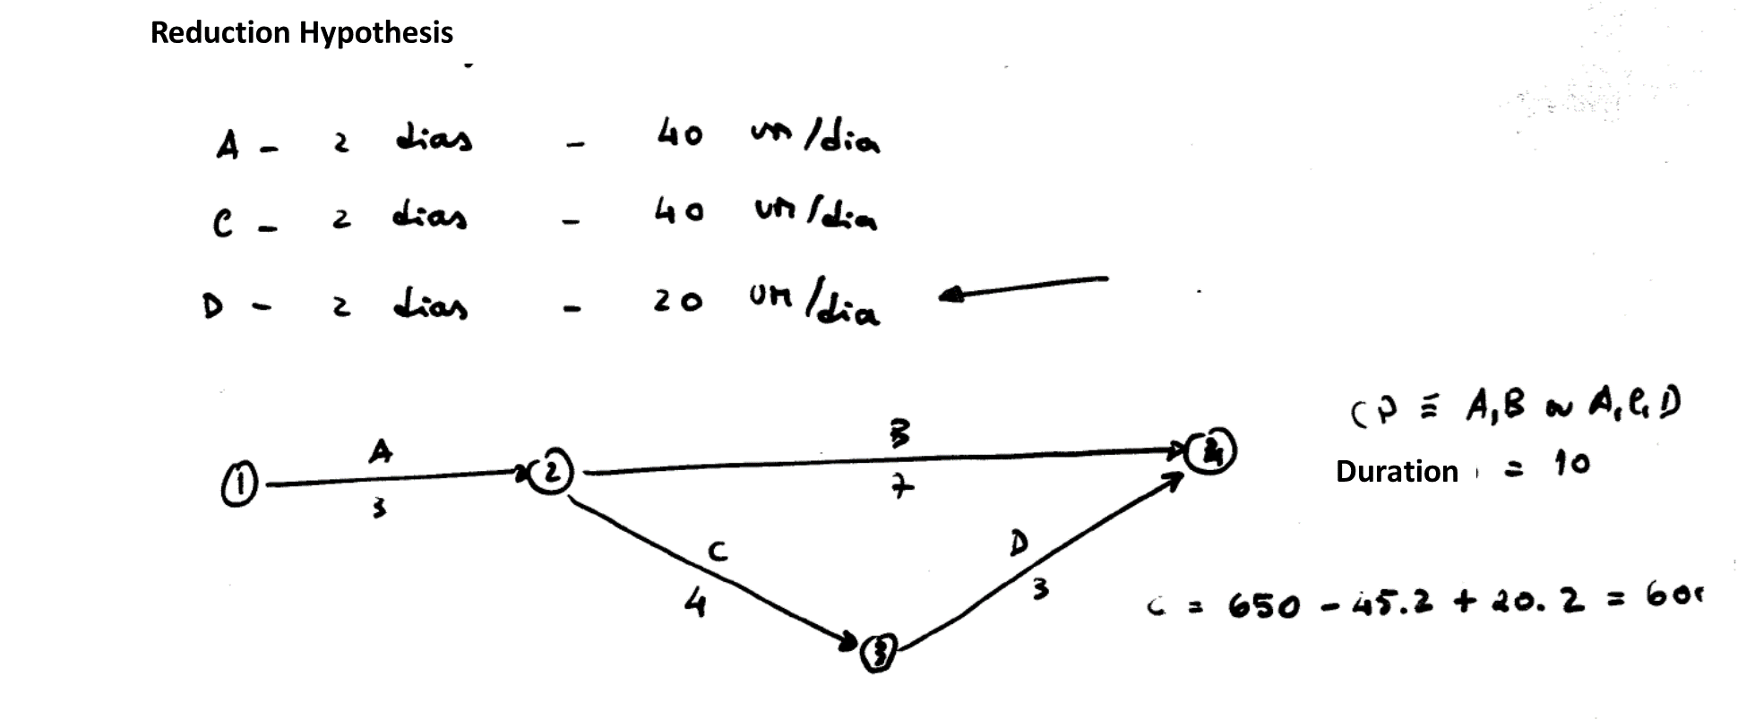
Example
Notes:
As this is a result of previous example, you may prefer to deliver it later to students.

Slide 46
Example
Notes:
As this is a result of previous example, you may prefer to deliver it later to students.

Slide 47
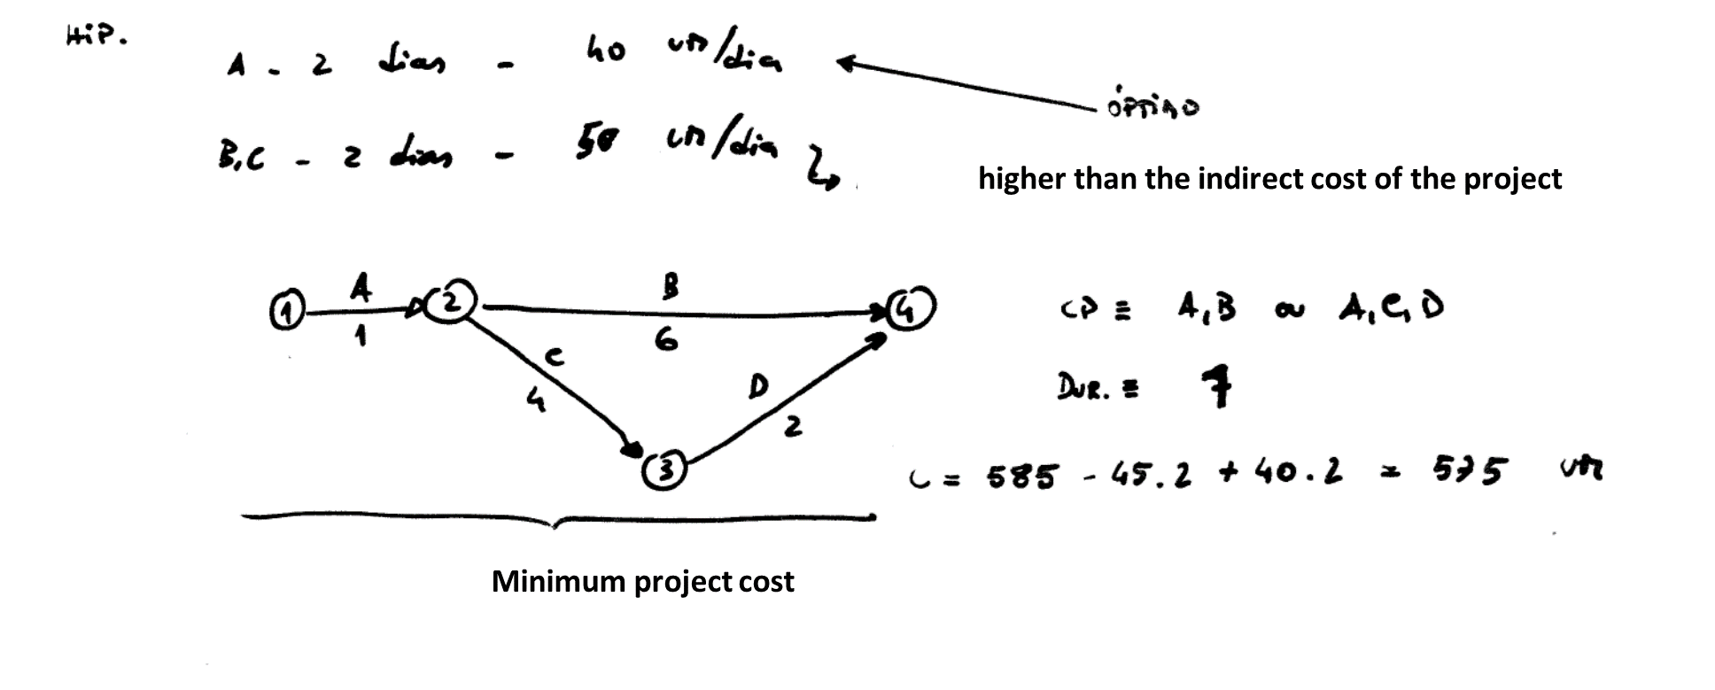
Example

Slide 48
More information
See recommended bibliography
  Kerzner, H. (2009). Project management : a systems approach to planning, scheduling, and controlling. New Jersey, USA: John Wiley & Sons.
  PMI-PMBOK. (2013). A Guide to the Project Management Body of Knowledge (PMBOK® Guide) (5th ed.). Pennsylvania, USA: Project Management Institute (PMI).
WWW ?...
  Project Management Institute
    http://www.pmi.org/
  International Project Management Association
    http://www.ipma.ch/Pages/default.aspx
  Association for Project Management
    http://www.apm.org.uk/
  Project Management Forum
    http://www.pmforum.org/

