Slide 1
Workshop - Scrum management of the project for I4.0 maturity model self-diagnosis

Slide 2
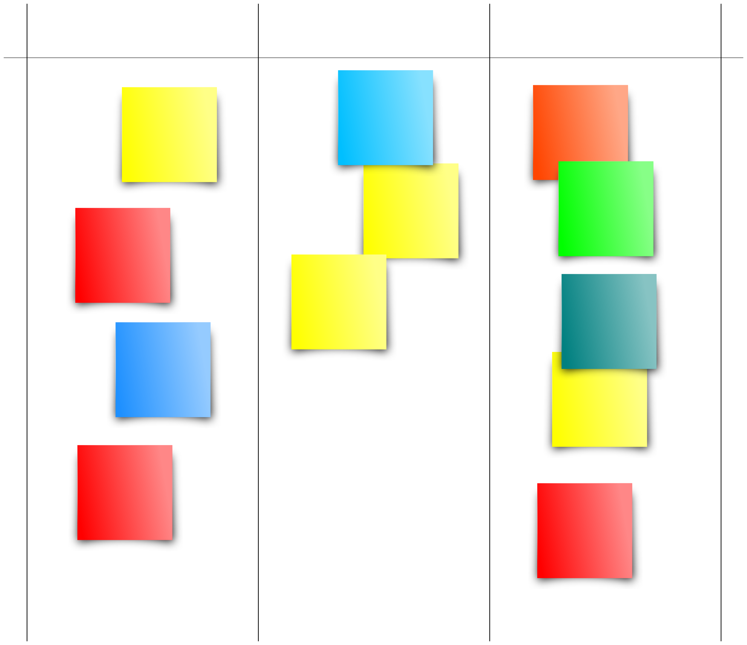
Develop the project plan
Develop the product backlog based on the PM Canvas developed in the previous week
Select the sprint backlog
Develop work
Reflect on the developed work
TODO
DOING
DONE
http://pmcanvas.com.br/download/

Slide 3
Project + Portfolio
What progress have you identified in your project this week? What did you do for your project this week? What do you plan to do next week? Can you relate project events to Project management skills? Describes examples.
What skills have you reinforced this week with classes? What content and / or activities had the most impact or were the most relevant? What questions or concerns would you like to resolve? Do you have extra comments to add? Give specific examples, relating to project management.

