Slide 1
Lean/Agile Project Planning based on the Project Model Canvas
Rui M. Lima
(School of Engineering of University of Minho)

Slide 2
Topics
  Visual project planning concept based on the Project Model Canvas
  Case Study
  Why? Justification, Objectives and Benefits
  What? Product and Requirements
  Who? Stakeholders and the Project Team
  How? Premises, Deliverables and Constraints
  When? Risks, Time Management and Costs
  Project plan integration

Slide 3
Project Model Canvas
Project Plan
  Simplified, Complete, Visual, Cooperative

Slide 4
Project Model Canvas
http://pmcanvas.com.br/download/

Slide 5
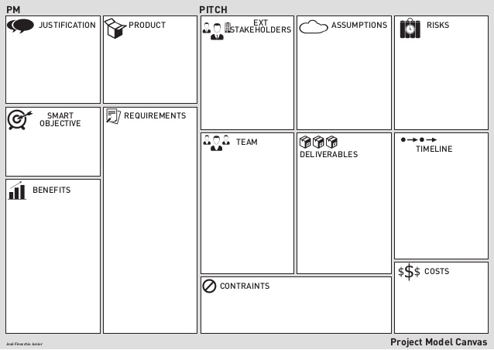
Project Model Canvas
HOW?
WHY?
WHAT?
WHO?
WHEN AND HOW MUCH?

Slide 6
CASE STUDY
Please read the (simplified) case study
We will need it during the session…
Thank you!
Notes:
You may use a case study here or the I4.0 project of each team as the object of work

Slide 7
WHY?
JUSTIFICATIONS | OBJECTIVE | BENEFITS

Slide 8

JUSTIFICATIONS
Problems to be solved
Improvement opportunities
Business needs
Legal demands
No clue why… (0:48 – 1:45): http://www.youtube.com/watch?v=dijVbM9DpxU&feature=player_detailpage#t=48

Slide 9

OBJECTIVE
What the product will achieve
  Purpose
  Direct, concise, persuasive and relevant
SMART (http://en.wikipedia.org/wiki/SMART_criteria)
  Specific
    (who, why, what, where, when, which)
  Measurable
    (how much, how many)
  Attainable
    (how can the goal be accomplished; what do you need; what competences)
  Relevant
    (worthwhile; now; needs; right person)
  Timebound
    (when)
Seinfeld’s friend, George Constanza, got a project but he does not know what the objective is (0:00-0:48):
http://www.youtube.com/watch?v=fzUICBMQBNU

Slide 10
BENEFITS
Characterized by:
  Increased revenue
  Reduction of costs
  Improved image
  More efficient use of assets / resources
  Improving the social and environmental impact
  It should be possible to identify the intensity of the contribution of these benefits to the strategic objectives

Slide 11
BENEFITS
Benefits to the organization running the project
Benefits to the organization that receives the result of the project

Slide 12
WHAT?
Product
Requirements

Slide 13
PRODUCT
Describe exactly what will be delivered
Product
Service
Result
Notes:
These are the slides for a class related to agile project planning using the PM Canvas.

Slide 14
REQUIREMENTS
Requirements are the way the client describe what seems to be necessary or desirable in the product
  COMPLETE but SIMPLIFIED
The major components or subsystems should be listed
General characteristics of requirements
  Complete, consistent, atomic, traceable, current, feasible, unambiguous, priority, verifiable
  http://en.wikipedia.org/wiki/Requirements

Slide 15
WHO?
External STAKEHOLDERS (and external Factors)
Project team

Slide 16
EXTERNAL STAKEHOLDERS
EXTERNAL STAKEHOLDERS
  Are all people or organizations involved or affected by the project
  Stakeholder interest or resistance affect the success of the project, which will depend on the alignment of their interests with the project
EXAMPLES
  Client, sponsor, suppliers, other departments of the organization external to the project, regulators, ...
CLIENT
  Receive product, service or result
SPONSOR
  Provides resources for the project

Slide 17
EXTERNAL FACTORS
Factors to monitor because it can affect the project plan significantly
Examples
  Behavior of the economy
  Climatic factors
  Availability of technology
  Productivity of a technology
  Availability of resources
  Regulations
  Traditional Culture

Slide 18
TEAM
TEAM MEMBERS
  All that produce something in the project
  Identification of the role of each member
MANAGER
  Sphere of control
    authority to set the agenda and priorities
  Sphere of influence
    persons, entities or organizations that may be affected although they can not be controlled
    members of other departments, customer, sponsor, ...

Slide 19
HOW?
PREMISES, DELIVERABLES AND CONSTRAINTS

Slide 20
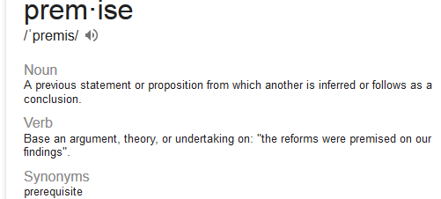
PREMISES
Assumptions taken for granted
  As the plan is constructed under uncertainty it is necessary to assume some premises about a future scenario
  Avoid negative premises
  When a premise becomes false then it is necessary to make new plans
Stakeholders and external factors
  It is necessary to make assumptions ...
Examples
  The Typical rainfall level will have a variation of 10%
  The available technology allows working 100 m² per day

Slide 21
DELIVERABLES
Deliverable vs. Activities
  The activities are constantly changing and increasing the frustration it can bring
  Thinking deliverables gives more autonomy and motivation and sense of belonging
Deliverables are conditioned by the premises and constraints
Yoda … (0:00 – 0:25): http://www.youtube.com/watch?v=BQ4yd2W50No

Slide 22
DELIVERABLES
Focus on relevant deliverables
  Make visible the project result, what is going to produce and also where each deliverable fits in relation to others
  Each hour should contribute to a deliverable
  Integration of components: think of components that when integrated will ensure that the project was completed
  Tangible and measurable
Example from construction
  Foundations, masonry, roof, finishing
  Construction license, contracts, way of delivery

Slide 23
DELIVERABLES
Focus on relevant deliverables
  Make visible the project result, what is going to produce and also where each deliverable fits in relation to others
  Each hour should contribute to a deliverable
  Integration of components: think of components, smaller pieces, when integrated will ensure that the project was completed
  Tangible and measurable
Example from construction
  Foundations, masonry, roof, finishing
  Construction license, contracts, way of delivery
SIMPLIFY
GROUP
ORGANIZE

Slide 24
CONSTRAINTS
Limitations
  A limitation to the project progress
  Limitations to the work, which reduce the freedom of choices.
  Can have internal or external origin
  Can be bottlenecks at different times of the project
Tips
  Specific, quantified, indicates who is limited, indicates who imposes limitations

Slide 25
CONSTRAINTS
Examples of types of constraint
  Restrictions on the allowed work period
  Limitations on the amount of people and equipment that can be allocated
  Restrictions related to logistics and cargo handling
  Restrictions relating to the waste generated by the project
  Pre-established contracts
  Time dependence of some deliverables
  Pre-defined technology standards

Slide 26
WHEN AND HOW MUCH?
RISKS, TIME MANAGEMENT, COSTS

Slide 27
RISKS
Uncertainty
  The level of risk is proportional to the degree of uncertainty associated with the cost and duration
  Consider project risks those uncertainties that really matter, that may influence the project objectives
Risk Management
  Risk Identification
  Risk assessment highlighting the most important
  Developing answers to the most relevant risks
  Implement response actions

Slide 28
TIME MANAGEMENT
Concept
  Simplified approach to the project schedule and budget
  We present orders of magnitude of time duration and cost, just enough so that it is possible to validate the plan
  Time line broken into 4 parts
Deliverables
  Making a commitment of deliverables that can be completed in each quarter of the project

Slide 29
COSTS
Deliverable
  The budget is planned in a simplified way for each deliverable and can be defined by ranges of values
Can be decomposed into
  WORK / MATERIALS / CONTRACTS

Slide 30
INTEGRATION
EIGHT STEPS TO VERIFY AND CONSOLIDATE THE PLAN CONSISTENCY

Slide 31
THE 8 STEPS OF THE INTEGRATION PROTOCOL
3
4
5
Do all REQUIREMENTS “have an owner” and define the product?
Are the right professionals subordinate to the project?
Did we obtain convergence forming valid PREMISES?
1
Are the points mentioned in the JUSTIFICATIONS covered?
7
Do the RISKS cover what we already know about the project and glimpse, at the same time, what we still don't know?
2
Does the OBJECTIVE prove to be sufficient and necessary?
8
Are the schedule and budget driven by deliveries?
6
Are the limitations applicable to work identified in the form of RESTRICTIONS?
Finocchio Junior (2013), pp. 102

Slide 32
REFERENCES
Finocchio Junior, José (2013) Project Model Canvas Gerenciamento de Projetos Sem Burocracia. Elsevier – Campus. ISBN: 978-85-352-7456-1
    http://www.livrariasaraiva.com.br/produto/4967937/project-model-canvas-gerenciamento-de-projetos-sem-burocracia/
Miguel, A. (2006). Gestão Moderna de Projectos (4th ed.): FCA.

