Slide 1
Workshop - Exploring the dimensions of the Industry 4.0 maturity model
Rui M. Lima, Cristiano Jesus
(School of Engineering of University of Minho)
Notes:
These slides will help students to develop instruments to evaluate I4.0 maturity

Slide 2
Industry 4.0 Attributes
Interoperability or the ability to achieve results by different means, to perform the same functions, despite possible exchange of equipment and manufacturers.
Decentralization, which corresponds to the ability to make decisions without dependence on a data processing center or a decision-making body of human resources.
Virtualization, reproduction resource or simulation of the real world in virtual mode.
Modularity, capacity for change, to make processes more comfortable and adherent depending on environmental configurations and the need for variations in product design.
Real-time reaction through analysis of large volumes of data that allow the identification of profiles and even subtle changes in scenarios.
Orientation to services made possible by the integration of processes, since they present themselves as adequate means to mediate the relationship of the consumer market with the companies, as an opportunity for improvements in the final use of the product.

Slide 3
Business Model
Technology
Internet of Things (IoT)
Cloud Computing
Data Science
Big Data Analytics
Artificial Intelligence
Machine learning
Virtualization
Prototype and simulation
Augmented reality
3D Printing
Robotics systems
Process and project based management
Human-computer collaboration
Equipment integration
Collective Intelligence
Sustainability
Economic
Security
Environmental

Slide 4
Reconfiguration plans reviewed
Readiness assessments are evaluation and analysis tools that aim to determine the level of preparedness of an organization in terms of conditions, attitudes and resources.
Frameworks are collections of procedures, methods and tools focused on the design of an organizational architecture or a system.
Roadmaps are "plans that match short-term and long-term goals with specific technology solutions to help to meet those goals".
Maturity models are models that help organizations achieve expected skills in specific dimensions such as culture, processes, resources, etc., through continuous improvement processes.

Slide 5
Scope
Generic Model
They are generic and their application depends on consulting and external evaluations of the processes to identify the level of maturity.
Specific Model
Another way to address the demand for maturity assessment is by choosing to build a model to meet a specific condition. It is common in such cases to use an existing model as a reference. In any case, the identification of success factors that should be considered is a fundamental element.

Slide 6
Maturity levels (Acatech)
Computerization - use of information technology;
Connectivity - integration of IT tools;
Visibility - sensors allow processes to be monitored from end to end;
Transparency - digital shadow indicates the current situation;
Predictive capacity - ability to simulate scenarios;
Adaptability - ability to adapt continuously.

Slide 7
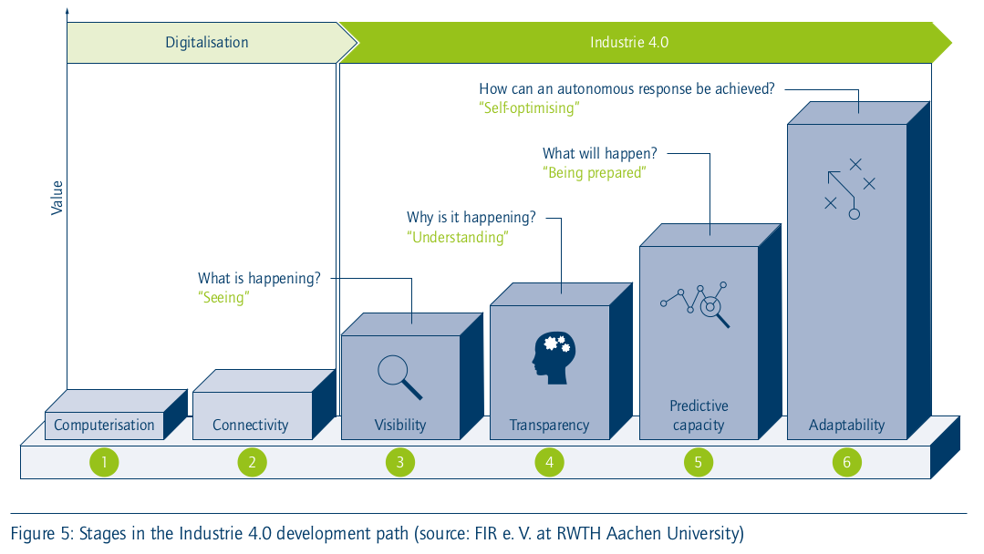
Maturity levels (Acatech)

Slide 8
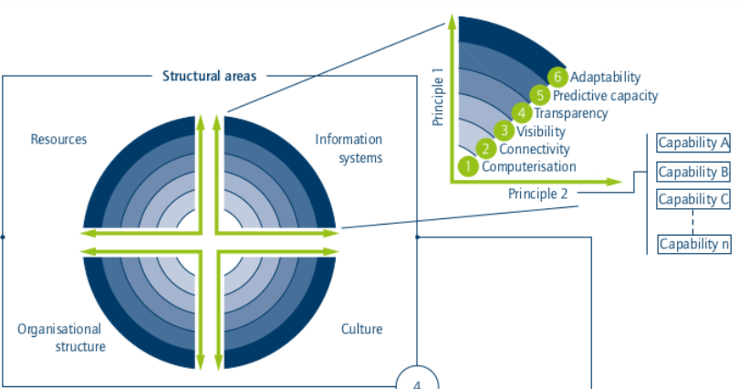
Maturity index (Acatech)

Slide 9
Sustainability
Source: Bakkari, M., & Khatory, A. (2017). Industry 4.0:
Strategy for More Sustainable Industrial Development
in SMEs. Proceedings of the IEOM 7th International
Conference on Industrial Engineering and
Operations Management, (Rabat, Morocco), 11–13.
Social
Bearable
Equitable
Sustainable
Environment
Economic
Viable

