Slide 1
Project Management - Planning
Rui M. Lima and André Luiz Aquere (UnB)
(School of Engineering of University of Minho)
Notes:
This are the slides for a class related to concepts of project management: planning

Slide 2
Plan
Planning Processes
Scope
WBS
Schedule
CPM
Example

Slide 3
Planning the Project
Scope
Schedule
Cost
How to manage
Approved
TAP
Quality
PGP
Resources
Comunication
Risk
Acquisitions
Interested parts
Project Manager + Sponsor
Project Manager + Project Team

Slide 4
What about Customer?
Although the Customer must be committed to project planning, he is not responsible for planning.
The Customer's role is to provide the product requirements (Product Scope) and its Acceptance Criteria (CAC). Scope Management
How to keep the Client engaged and feeling part of the project without interfering is a function of Stakeholder Management and Communication Management.

Slide 5
Plan the Project
 | Project Management Process Groups
Process Knowledge Areas | Iniciation (2) | Planning (24)
Integration (7) | Develop the Term of Opening | Develop Management Plan
Scope (6) |  | Scope management planning; Collect requirements; Scope definition; Create WBS
Schedule(6) |  | Schedule management planning; Define activities; Sequencing activities; Estimate resources of activities; Estimate duration of activities; Develop schedule
Cost (4) |  | Cost Management Planning; Estimate Costs; Determine budget
Quality (3) |  | Quality Management Planning
Resources (6) |  | Resource Planning Estimate Activity Resources
Comunication (3) |  | Comunication Management Planning
Risk (7) |  | Risk Management Planning; Identify the risks; Perform qualitative risk analysis; Risk response plan.
Acquisitions (3) |  | Procurement Management Planning
Stakekholders (4) | Identify Stakeholders | Stakeholder Engagement Planning

Slide 6
Scope Management
Plan Scope Management
Collecting Requirements
Define the Scope
Create the WBS
Always keep in mind the difference between:
Project Scope and Product Scope

Slide 7
Project Analytical Structure (WBS)
Divide project deliverables and work into smaller, more manageable elements.
OUTPUT
Scope baseline
Specifying the scope of the project
EAP
EAP Dictionary
Update on project documents

Slide 8
Work Breakdown Structure(WBS)
It can be represented oriented towards the life cycle phases, deliveries or subcomponents developed by external organizations.
It must include all deliveries related to the project.
Each level is a decomposition.
The lowest level is called a “work package”.

Slide 9
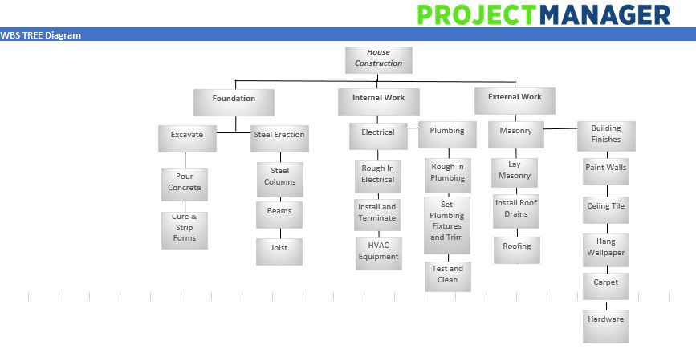
Work Breakdown Structure(WBS)
https://www.projectmanager.com/training/what-is-a-work-breakdown-structure
Video: https://www.youtube.com/watch?v=wEWhnodF6ig&feature=youtu.be

Slide 10
Schedule Management
Processes
Schedule management planning;
Define activities;
Activity sequencing;
Estimate activity resources;
Estimate the duration of activities;
Schedule Development.

Slide 11
Define Activities
OUTPUTS
Activities list
Activity attributes
(predecessors, successors, logical relationships, waits and anticipations, resource requirements, imposed dates, restrictions and assumptions)
List of milestones
Decomposition
Subdivide work packages into smaller and more easily manageable components called schedule activities.

Slide 12
Sequence Activities
Tools and techniques
Precedence diagram method (PDM)
Dependency determination
Anticipations and waits

Slide 13
Sequence Activities
End to start. The initiation of the successor activity depends on the completion of the predecessor activity. |  | Concreting takes place after the hardware is in place.
End to end. The completion of the successor activity depends on the completion of the predecessor activity. |  | The work is completed together with the INSS payments to obtain the CND.
Start to start. The initiation of the successor activity depends on the initiation of the predecessor activity. |  | Construction of the walls and hydraulic installation.
Start to finish. The completion of the predecessor activity depends on the initiation of the successor activity. |  | Finalization of payment occurs only after handing over the keys.
Predecessor
Successor
Predecessor
Mandatory dependency
Arbitrary dependence
External dependency
Successor
Predecessor
Successor
Successor
Predecessor

Slide 14
Sequence Activities
Purchase of land
Cleaning
Executive project
Construction
Start
preliminary design
Engagement
Marriage
Change
End

Slide 15
Estimate Activity Resources
Estimation of the types and quantities of material, people, equipment and supplies that will be needed to carry out each activity.
Always consider:
Resource calendars

Slide 16
Estimate Activity Duration
It is the process of calculating the duration of the project activities with the estimated resources.
Estimates and Levels of Accuracy
By Analogy
Parametric Deterministic
Bottom – Up
Three points Probabilistic (Risks)
Accuracy
Information

Slide 17
Schedule Development
Consolidates the previous processes, evaluating the sequencing, the estimated resources and the calculated durations, applying anticipations, waits, parallels and compressions to the project activities, in order to obtain a schedule that meets the project needs.

Slide 18
Develop the Schedule
Tools and techniques
Schedule network analysis
Critical path method
Critical current method
Resource optimization techniques
Model creation techniques
Anticipations and Waits
Schedule compression
Timeline tool

Slide 19
Critical Path Method (CPM)
Includes determining the longest path on the network (critical path) and the earlier and later time that an activity can begin and be completed.
Deterministic model.
Emphasis on cost control and schedule flexibility.
It is concerned with the time-cost ratio.
Projects with previous experience.

Slide 20
Program Evaluation and Review Technique (PERT)
Uses a sequential network and a weighted average duration estimate to calculate activity durations.
Differs fundamentally from CPM because it uses distribution of averages instead of the most likely estimate.
Probabilistic model.
Emphasis on the schedule with flexibility in costs.
Research and development projects.
Can be used to estimate time and cost.

Slide 21
Critical Path Method (CPM)
Critical Path - Concept
The critical path is the path formed by activities that, if delayed, delay the duration of the project. These activities, therefore, have zero slack.

Slide 22
Critical Path Method (CPM)
Actvity Duration
Forward Pass
Early beginning
IMC
TMC
IMT
TMT
Backward Pass
Early conclusion
Late beginning
Late conclusion

Slide 23
Critical Path Method (CPM)
D 10
A 6
E 3
H 5
Start
B 2
F 2
J 8
K 4
End
C 3
G 4
L 6
M 2

Slide 24
Critical Path Method (CPM)
1 - Walk the paths from the beginning to the end to determine the earliest dates
D 10
6
16
A 6
E 3
H 5
0
6
6
9
9
14
start
B 2
F 2
J 8
K 4
end
0
2
3
5
7
15
15
19
C 3
G 4
L 6
M 2
0
3
3
7
7
13
13
15

Slide 25
Critical Path Method (CPM)
1 - Walk the paths from the beginning to the end to determine the earliest dates
D 10
6
16
9
19
A 6
E 3
H 5
0
6
6
9
9
14
3
9
11
14
14
19
start
B 2
F 2
J 8
K 4
end
0
2
3
5
7
15
15
19
3
5
5
7
7
15
15
19
C 3
G 4
L 6
M 2
0
3
3
7
7
13
13
15
1
3
3
7
11
17
17
19

Slide 26
Critical Path Method (CPM)
D 10
FL=19-16=3
6
16
9
19
A 6
E 3
H 5
0
6
6
9
9
14
3
9
11
14
14
19
FL=9-6=3
FL=14-9=5
FL=19-14=5
start
B 2
F 2
J 8
K 4
end
0
2
3
5
7
15
15
19
3
5
5
7
7
15
15
19
FL=5-2=3
FL=7-5=2
FL=15-15=0
FL=19-19=0
C 3
G 4
L 6
M 2
0
3
3
7
7
13
13
15
1
3
3
7
11
17
17
19
FL=3-3=0
FL=7-7=0
FL=17-13=4
FL=19-15=4

Slide 27
Critical Path Method (CPM)
Exercise
You are the manager of a new project and must implement the following dependencies:
Task A starts immediately and has an estimated duration of 3 weeks;
Task B starts after Task A and has an estimated duration of 3 weeks;
Task C starts after Task A and has an estimated duration of 6 weeks;
Task D starts after Task B and has an estimated duration of 8 weeks;
Task E starts after Task D and Task C and has an estimated duration of 4 weeks.

Slide 28
Critical Path Method (CPM)
How long is the critical path?
What is the slack for task C?
What is the slack for task B?
What is the slack of path with the greatest slack?
Consider that Task C's feature is replaced by a less experienced one. Task C now takes 10 weeks. How it will affect the project?
Considering the original situation of the issue, after discussions between interested parties, a new Task F is added to the project. It will last for 11 weeks, being carried out after Task C and before Task E. The client is concerned because he thinks that adding this task will delay the project's completion by 11 weeks. But the sponsor argues that the additional time will be less than 11 weeks. Who is correct? How long will the project last?

Slide 29
Critical Path Method (CPM)
Answer
A 3
B 3
D 8
Stard
0
3
3
6
6
14
18 weeks
5 weeks
None
5 weeks
No effect
The sponsor; 6 weeks
0
3
3
6
6
14
C 6
E 4
14
3
9
18
14
8
18
14
end
Notes:
Do not give this slide in advance to students.

Slide 30
Recommended bibliography
Harold Kerzner (2009) Project Management: A Systems Approach to Planning, Scheduling, and Controlling; John Wiley & Sons; ISBN: 0470278706.
PMI-PMBOK (2017) “A Guide to the Project Management Body of Knowledge (PMBOK Guide 6th ed.)”. Pennsylvania, USA: Project Management Institute (PMI).
Miguel, A. (2006). Modern Project Management(4th ed.): FCA.
Martin, P; Tate, K (2001) “Getting Started in Project Management”, ; John Wiley & Sons; ISBN: 0-471-13503-8.

